Slide 1
TYPES AND COSTS OF FINANCIAL CAPITAL

Slide 2
Types & Costs of Financial Capital
Implicit Versus Explicit Financial Capital Costs
  Formal historical accounting procedures include explicit records of debt (interest and principal) and dividend capital costs
  However, no provision is made to record the less tangible expenses of equity capital (i.e., required capital gains to complement the dividends)

Slide 3
Financial Markets
Public Financial Markets:
markets for the creation, sale and trade of liquid securities having standardized features
Private Financial Markets:
markets for the creation, sale and trade of illiquid securities having less standardized negotiated features

Slide 4
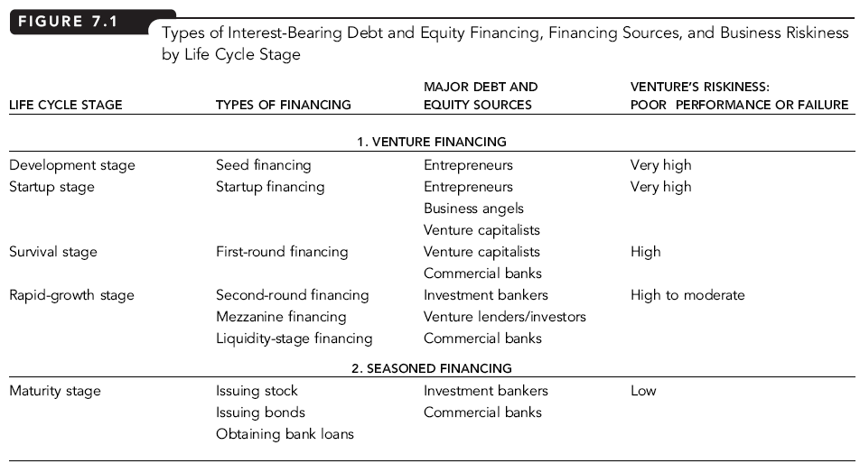

Slide 5
Determining Cost Of Debt Capital
Interest Rate:
price paid to borrow funds
Riskier debt costs more
Default Risk:
risk that a borrower will not pay the interest and/or principal on a loan
Lenders expected to be compensated for such risk
Risk varies across riskiness of ventures, state of economy – boom or recession

Slide 6
Determining Cost Of Debt Capital
Nominal Interest Rate (r_{d}):
observed or stated interest rate
In addition to default risk, other factors – inflation expectations, marketability and the life span of the debt instrument – pay important roles in determining interest rates
Real Interest Rate (RR):
interest one would face in the absence of inflation, risk, illiquidity, and any other factors determining the appropriate interest
Risk-free Interest Rate (r_{f}):
interest rate on debt that is virtually free of default risk
Inflation:
rising prices not offset by increasing quality of the goods or services being purchased

Slide 7
Determining Cost Of Debt Capital
Inflation premium (IP):
average expected inflation rate over the life of a risk-free loan
Default Risk Premium (DRP):
additional interest rate premium required to compensate the lender for the probability that a borrower will default on a loan
Liquidity Premium (LP):
charged when a debt instrument cannot be converted to cash quickly at its existing value
Maturity Premium (MP):
premium to reflect increased uncertainty associated with long-term debt

Slide 8
Determining Cost Of Debt Capital
Prime Rate:
interest rate charged by banks to their highest quality (lowest default risk) business customers
Bond Rating:
reflects the default risk of a firm’s bonds as judged by a bond rating agency
Senior Debt:
debt secured by a venture’s assets
Subordinated Debt:
debt with an inferior claim (relative to senior debt) to venture assets

Slide 9
Determining Cost Of Debt Capital
Term Structure of Interest Rates:
relationship between nominal interest rates and time to maturity when default risk is held constant

Slide 10
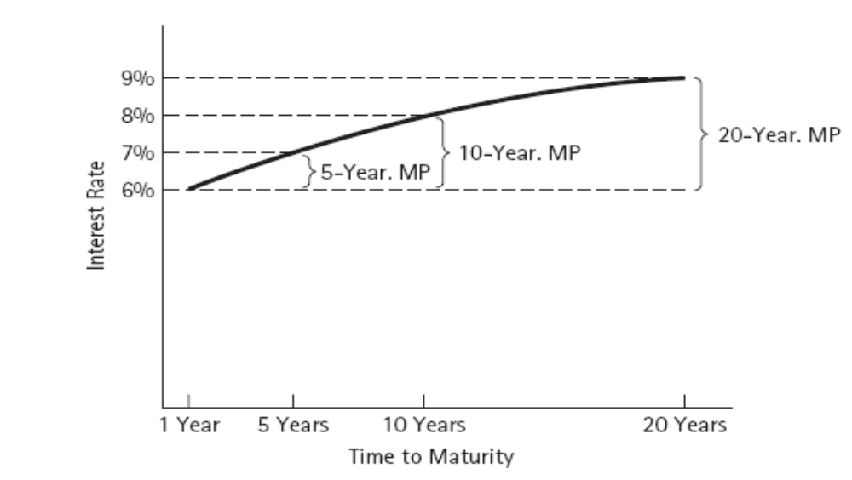
Determining Cost Of Debt Capital
Yield Curve: graph of the term structure of interest rates

Slide 11
Interest Rate Relationships
r_{f} = RR + IP
for debt by effectively default-free borrowers (e.g. Government)
r_{d} = RR + IP + DRP +LP +MP
more generally, for more complicated risky debt securities at various maturities and liquidities
Can think of r_{d} = r_{f} + DRP + LP + MP

Slide 12
Determining Market Interest Rates
r_{d} = RR + IP + DRP +LP +MP
Suppose:
  Real interest rate = 3%
  Inflation expectation = 3%
  Default risk = 5%
  Liquidity premium = 3%
  Maturity premium = 2%
Then:
  rd = 3% + 3% + 5% + 3% + 2% = 16%

Slide 13
What Is Investment Risk?
Investment Risk:
chance or probability of financial loss from a venture investment
  Debt, equity, and founding investors all assume investment risk
  A widely accepted measure of risk is the dispersion of possible outcomes around the expected return of an investment – the standard deviation of possible investment returns

Slide 14
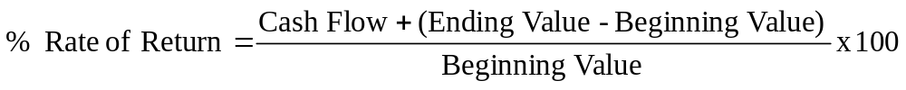
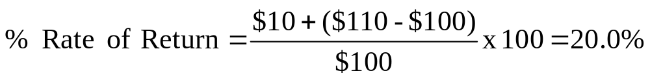
Calculating a Possible Return
Suppose
  Buy stock at $100
  Receive $10 dividend
  Ending stock value = $110
Then:

Slide 15
Calculating an Expected Return
Expected Rate of Return:
probability-weighted average of all possible rate of return outcomes
  Economic Probability of Rate of Weighted
  Climate Occurrence X Return = Return
  Rapid Growth .30 X 60% = 18.0%
  Normal .40 X 20% = 8.0%
  Recession .30 X -20% = -6.0%
  1.00 Expected Return = 20.0%

Slide 16
Measuring Risk as a Dispersion Around an Average
Weighted
Outcome Minus Difference Probability Squared
Expected Return Squared x of Outcome = Deviations
60% - 20% = 40% 1,600 x .3 = 480.0
20% - 20% = 0 0 x .4 = 0.0
-20% - 20% = -40% 1,600 x .3 = 480.0 Variance = 960.0
Standard Deviation = 31.0%

Slide 17
Measuring Risk as a Dispersion Around an Average
Calculating Standard Deviation:
  Calculate the expected rate of return on an investment based on estimates of possible returns and probabilities associated with those returns
  Subtract the expected value from each outcome to determine deviations from the expected value
  Square each difference or deviation
  Multiply each squared deviation by the probability of the outcome and sum the weighted squared deviation to get the variance
  Calculate the square root of the variance to get standard deviation

Slide 18
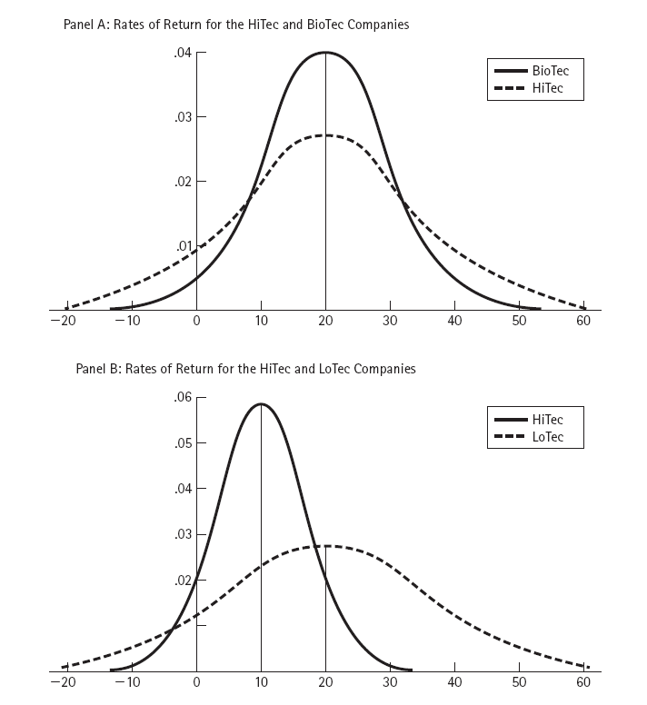
Graphical View Of Dispersion: Continuous Probability Distributions of Rates of Return

Slide 19
Measuring Risk as a Dispersion Around an Average
Coefficient of Variation:
  Standard Deviation / Expected Return
  Coefficient of Variation: shows the dispersion risk per unit of expected rate of return – a ratio of risk to reward

Slide 20
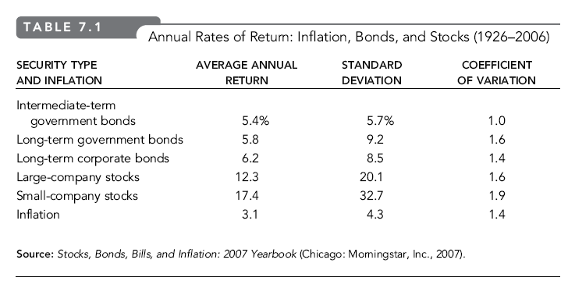

Slide 21
Estimating the Cost of Equity Capital
Private Equity Investors
owners of proprietorships, partners in partnerships, and owners in closely held corporations
Closely Held Corporations
corporations whose stock is not publicly traded
Publicly Traded Stock Investors
equity investors of firms whose stocks trade in public markets such as an organized securities exchange

Slide 22
Estimating the Cost of Equity Capital
Organized Securities Exchange:
a formally organized exchange typically having a physical location with a trading floor where trades take place under rules set by the exchange
Market Capitalization (market cap):
determined by multiplying a firm’s current stock price by the number of shares that are outstanding
Diversifiable and Non-diversifiable risk

Slide 23
Cost of Equity Capital for Public Corporations
r_{e} = r_{f} + IRP = RR + IP + IRP
where:
  r_{e} = cost of common equity
  r_{f} = risk-free interest rate
  RR = real rate of interest
  IP = inflation premium
  IRP = equity investment risk premium
IRP:
additional return expected by investors in a risky publicly traded common stock

Slide 24
Cost of Equity Capital for Public Corporations
Expected Return on Venture’s Equity (r_{e}) using the Security Market Line (SML):
r_{e} = r_{f} + [r_{m} – r_{f}] β
where
  r_{f} = risk-free interest rate
  r_{m} = expected annual rate of return on stock market
  β (beta) = systematic risk of firm to the overall stock market

Slide 25
Cost of Equity Capital for Public Corporations
Expected Return on Venture’s Equity (r_{e}) using the Security Market Line (SML):
r_{e} = r_{f} + [MRP] β
MRP:
market risk premium = excess average annual return of common stocks over long-term government bonds

Slide 26
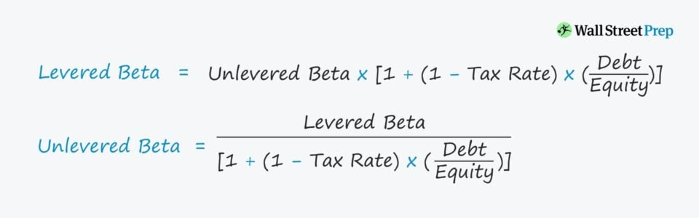
Levered and unlevered beta

Slide 27
Cost of Equity Capital for Private Ventures
Venture Hubris:
- optimism expressed in business plan projections that ignore the possibility of failure or underperformance
- margins will be reasonably projected but sales, time to market and competition will be subjected to relatively large biases
What do we do with such projections? Use
r_{v} = r_{e} + AP + LP + HPP
where:
        r_{v} = rate of return for venture investors
        r_{e} = cost of common equity
        AP = advisory premium
        LP = liquidity risk
        HPP = hubris projections premium

Slide 28
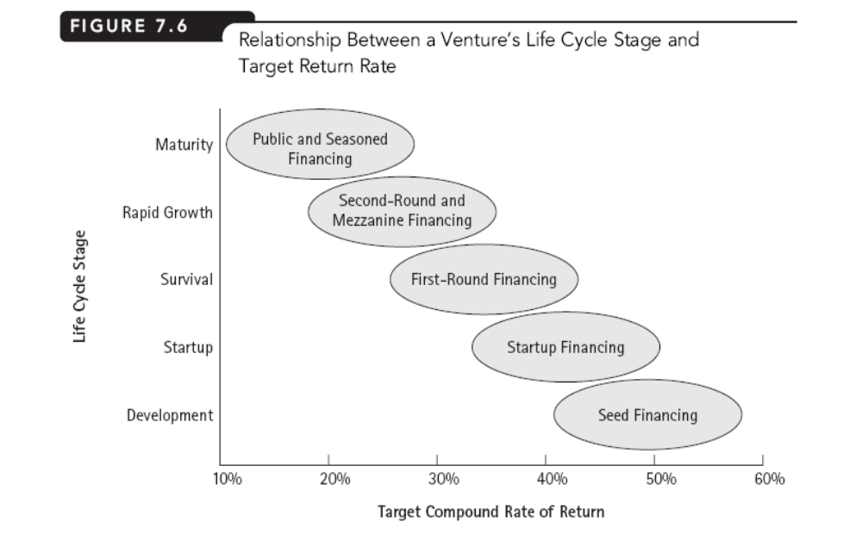

Slide 29
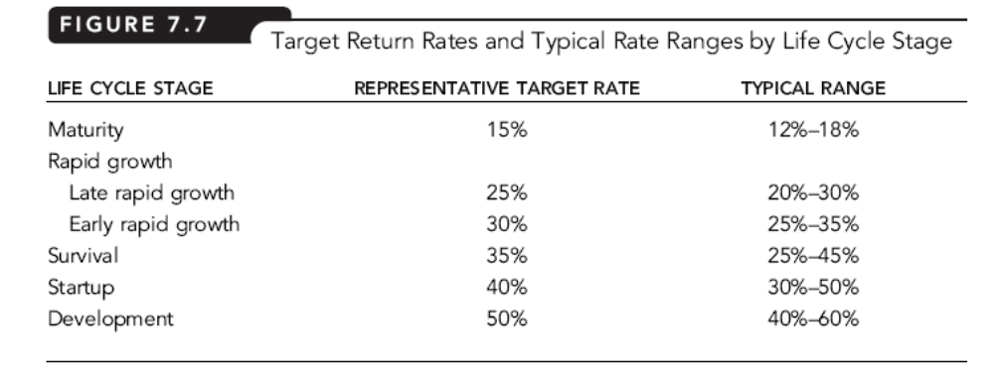

Slide 30
Weighted Average Cost of Capital (WACC)
WACC:
weighted average cost of the individual components of interest-bearing debt and common equity capital
After-tax WACC:
= (1 – tax rate) x (debt rate) x (debt–to– value) +
equity rate x (1 – debt–to–value)
= (1- t) X Cost of debt X D/(D+E) + Cost of equity X (E/D+E)

Slide 31
Weighted Average Cost of Capital (WACC)
WACC Example for $1 Venture with:
  $.50 of debt
  $.50 of equity
  debt interest rate = 10%
  tax rate = 30%
  required return to equity holders = 20%
After-tax WACC
= (1 – tax rate) x (debt rate) x (debt–to–value) +
equity rate x (1 – debt–to–value)
= (.70 x .10 x .5) + (.20 x .5)
= .135 or 13.5%

Slide 32
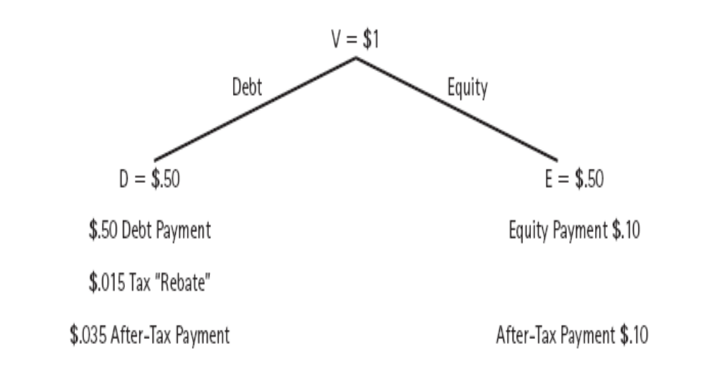
Graphically,

Slide 33
Using WACC to Complete Calibration of EVA
EVA:
Net Operating Profit After Taxes (NOPAT) – After-tax Dollar Cost of Financial Capital Used
  NOPAT = EBIT(1- Effective Tax Rate)
  After-Tax Dollar Cost of Financial Capital Used = amount of financial capital x WACC

