Slide 1
FINANCIAL PLANNING: SHORT TERM AND LONG TERM

Slide 2
SHORT-TERM CASH PLANNING TOOLS
Sales Schedule
Purchase Schedule
Wages and Commission Schedule
Cash Budget

Slide 3
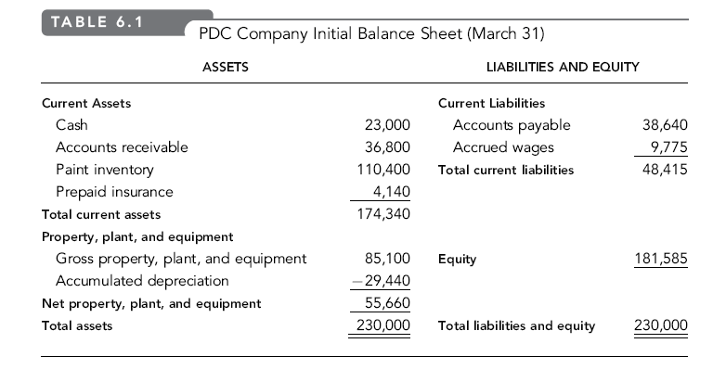

Slide 5
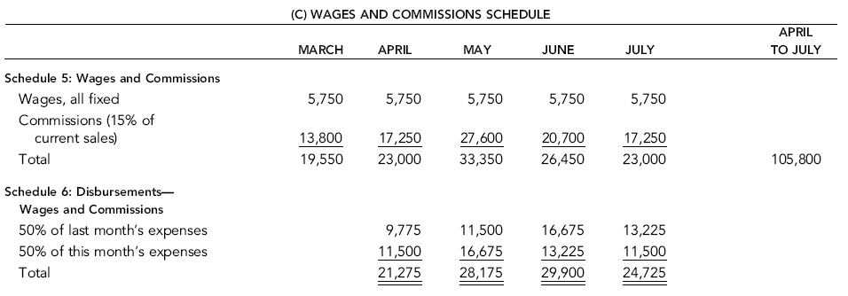

Slide 7
Cash budget helps to know
Is there a cash need for the coming year?
If so, when will that need arrive and what is the maximum amount required?
Can a cash need (if any) be repaid within the year?

