Slide 1
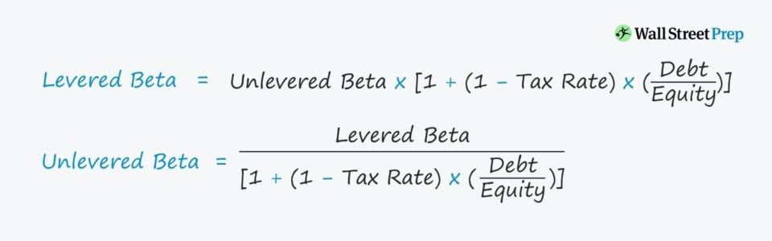
(COC Contd….) Levered and unlevered beta

Slide 2
Problem:
Safecorp, which owns and operates grocery stores currently has Rs. 50 million in debt and Rs. 100 million in equity outstanding. Its stock has a beta of 1.2. It is planning a leveraged buy out (LBO), where it will increase its debt-equity ratio to 8. If the tax rate is 40%, what will the beta of the equity in the firm be after the LBO?

Slide 3
VALUING NEW VENTURES

Slide 4
Value at venture’s different life cycle stage
Early stage: No operating history, subjective process
Measurable increase in value at each stage
Late stage: important to quantify the value created; less subjective, more accurate

Slide 5
“Investors pay for the future; entrepreneurs pay for the past.”
Irrelevant Past efforts = Entrepreneur’s sunk cost
Past efforts resulted in a product or brand which is a basis for future profits to repay the investors
Jim should consider
Future customer base, consumption, sales behaviour
Growth plan for additional brewpubs
Scope for expansion – local, regional, national, international
Distribution and quality issues in growing outside the locality
Margins on various follow-on products sharing same brand
How much stake to sell to justify initial investment?

Slide 6
What is a Venture Theoretically Worth?
Present value (PV): value today of all future cash flows discounted to the present at the investor’s required rate of return
“Investors pay for the future; entrepreneurs pay for the past.”
“If you’re not using estimates, you’re not doing a valuation.”
Notes:
Find a price that allows an investor to make the same as she would make in other comparable investment opportuinities.

Slide 7
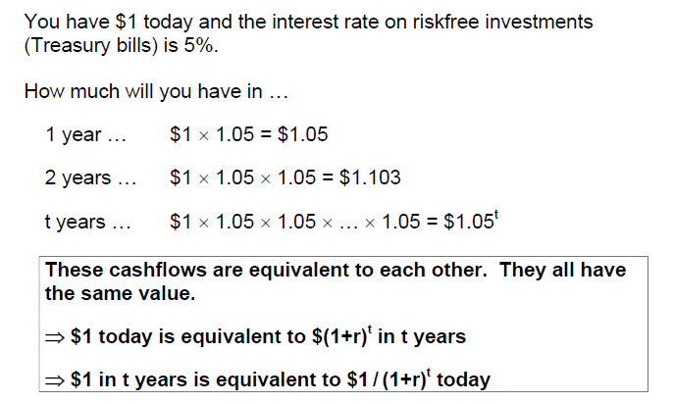
Time value of money
Basic principle of Finance: A rupee today is worth more than a rupee tomorrow, because the rupee today can be invested to start earning interest immediately.

Slide 8
Valuing an Office Building
Step 1: Forecast cash flows
Cost of building = C₀ = 350
Sale price in Year 1 = C₁ = 400
Step 2: Estimate opportunity cost of capital
If equally risky investments in the capital market
offer a return of 7%, then
Cost of capital = r = 7%

Slide 9
Valuing an Office Building
Step 3: Discount future cash flows

Slide 10
Risk and Present Value
Higher risk projects require a higher rate of return.
Higher required rates of return cause lower PVs.

Slide 11
Risk and Present Value

Slide 12
Essence of Valuation
Find a price that allows investor to make the same as she would make in other comparable investment opportunities
Valuation treats the opportunity cost imposed by the comparable investment opportunities as hurdle to be cleared.
“Vision in the numerator and reality in the denominator”

Slide 13
Basic Mechanics Of Valuation: Mixing Vision and Reality
Explain how the time pattern of cash flows relates to venture value
Describe how valuation incorporates projections of near- and long-term success by dividing the venture’s future into an explicitly forecasted period and a subsequent growth period
Extract the necessary valuation data from projected financial statements

Slide 14
Basic Mechanics Of Valuation
Discounted cash flow (DCF):
valuation approach involving discounting future cash flows for risk and delay
Explicit forecast period:
two- to ten-year period in which the venture’s financial statements are explicitly forecast
Terminal (or horizon) value:
value of the venture at the end of the explicit forecast period
Stepping stone year:
first year after the explicit forecast period

Slide 15
C1/(1+r) + C2/(1+r)2 + C3/(1+r)3+….
+ T.V./(1+r)t

Slide 16
Discounted Cashflow Valuation: Basis for Approach
where,
n = Life of the asset
CF_{t} = Cashflow in period t
r = Discount rate reflecting the riskiness of the estimated cashflows

Slide 17
Divide and Conquer: Terminal

Slide 18
Equity Valuation
The value of equity is obtained by discounting expected cash flows to equity, i.e., the residual cash flows after meeting all expenses, tax obligations and interest and principal payments, at the cost of equity, i.e., the rate of return required by equity investors in the firm.
where,
CF to Equity_{t} = Expected Cashflow to Equity in period t
k_{e} = Cost of Equity

Slide 19
Cash Flows and Discount Rates
Assume that you are analyzing a company with the following cashflows for the next five years.
Year CF to Equity
1 $ 50
2 $ 60
3 $ 68
4 $ 76.2
5 $ 83.49
Terminal Value $ 1603.008
Assume also that the cost of equity is 13.625% and the firm can borrow long term at 10%. (The tax rate for the firm is 50%.)
The current market value of equity is $1,073 and the value of debt outstanding is $800.

Slide 20
Equity Valuation
Method : Discount CF to Equity at Cost of Equity to get value of equity
Cost of Equity = 13.625%
PV of Equity = 50/1.13625 + 60/1.13625² + 68/1.13625³ + 76.2/1.13625⁴ + (83.49+1603)/1.13625⁵ = $1073

Slide 21
Discounted Cash Flow Valuation: The Steps
Estimate the discount rate or rates to use in the valuation
Estimate the current earnings and cash flows to the claimholders (CF to Firm)
Estimate the future earnings and cash flows on the asset being valued, generally by estimating an expected growth rate in earnings.
Estimate when the firm will reach “stable growth” and what characteristics (risk & cash flow) it will have when it does.
Choose the right DCF model for this asset and value it.

Slide 22
Steps in Cash Flow Estimation
Estimate the current earnings of the firm
Cash flows to the firm: look at operating earnings after taxes
Consider how much the firm invested to create future growth
If the investment is not expensed, it will be categorized as capital expenditures. To the extent that depreciation provides a cash flow, it will cover some of these expenditures.
Increasing working capital needs are also investments for future growth

Slide 23
Equity Valuation Cash Flows
Equity Valuation Cash Flow (FCFE) =
Net Income
+ Depreciation and Amortization Expense
- Change in Net Working Capital
- Capital Expenditures
+ Net Debt Issues

Slide 24
Growth Pattern: Stable Growth and Terminal Value
When a firm’s cash flows grow at a “constant” rate forever, the present value of those cash flows can be written as:
Value = Expected Cash Flow Next Period / (r - g)
where,
r = Discount rate (Cost of Equity or Cost of Capital)
g = Expected growth rate
This “constant” growth rate is called a stable growth rate
When they do approach stable growth, the valuation formula above can be used to estimate the “terminal value” of all cash flows beyond.

Slide 25
Summarizing the Inputs
In summary, at this stage in the process, we should have an estimate of
the current cash flows to the firm
the current cost of capital
the expected growth rate in earnings, based upon historical growth, analysts forecasts and/or fundamentals.

Slide 26
Sources of Information
Current financial Statements
Past history
Competitors or Peers
Firms without much past history
Team
Network
USP
Customer acquired
Time to market

Slide 27
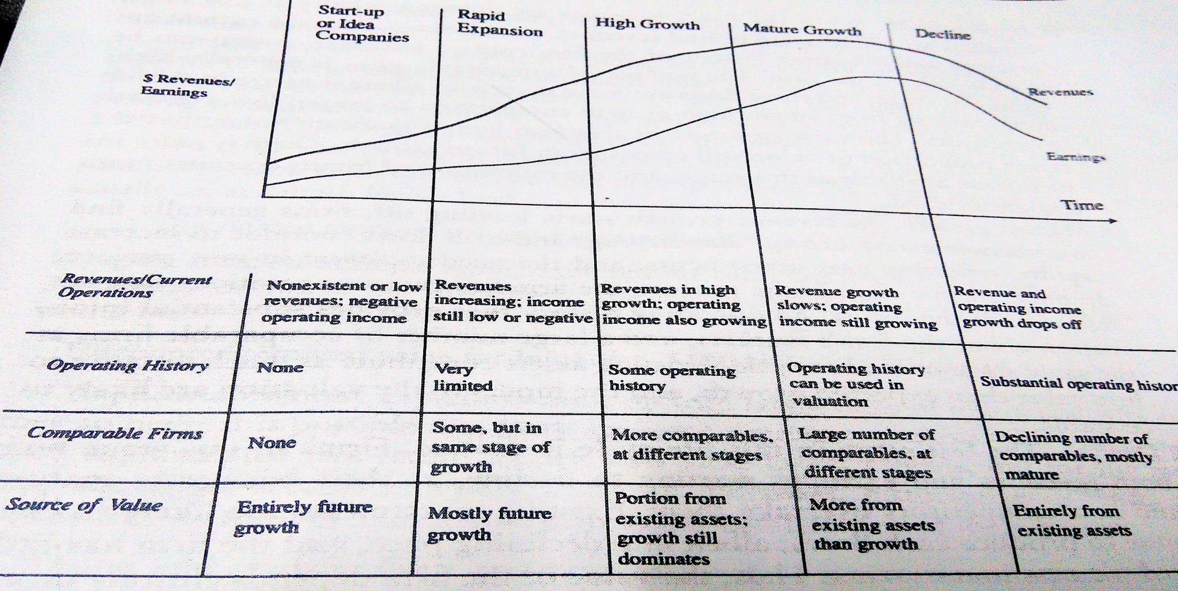
Valuation Issues across the Life Cycle

Slide 28
Value Driver
Value of Firm
= Value of assets in place
+
Value of growth potential

Slide 29
3 constraints of young start ups
Negative earnings
Limited history
Few comparable firms

Slide 30
Steps in Valuation
Assess the Firm’s Current Standing
Estimate Revenue Growth
Past growth rate in revenues at the firm itself
Growth rate in the overall market that the firm serves
Barriers to entry and competitive advantage possessed by the firm
Estimate a Sustainable Operating Margin In Stable Growth
Looking at the underlying business that this firm is in
Deconstruct the firm’s current income statement to get a truer measure of its operating margin

Slide 31
Steps in Valuation
4. Estimate Reinvestment to Generate Growth
5. Estimate Risk Parameters and Discount Rates
6. Estimate the Value of the Firm (see next slide)
7. Estimate the Value of Equity and Per-Share Value

Slide 32
Value of the Firm
Value of Firm
= Probability of surviving as a going concern X Discounted cash flow value of firm
+
(1 – Probability of surviving as a going concern) X Distress or liquidation sale value

