Slide 1

Notes:
Chapter 11 – Statement of Cash Flows

Slide 2
Profit Without Cash
Sweet Dreamers Bakery is a new cookies-and-cakes manufacturer that supplies specialty grocery stores. The founder has lined up orders based on her unique home-style recipes and she’s ready to launch on January 1. We’ll assume she has Rs. 10,000 cash in the bank and we’ll also assume that in the first 3 months her sales are Rs.20,000, 30,000 & 45,000. COGs are 60% of sales and her monthly operating expenses are Rs.10,000. The bakery has an agreement with its vendors to pay for the ingredients it buys in 30 days. However, the grocery stores the company sells to take 60 days to pay their bills.

Slide 3
Cash Without Profit
Fine Cigar Shops is another start-up. It sells very expensive cigars and it’s located in a part of town frequented by business people and well-to-do tourists. Its sales for first 3 months are Rs. 50,000, 75000 and 95000 – a healthy growing trend. Its COGs is 70% of sales and its monthly operating expenses are Rs. 30,000(high rent!) It too begins with Rs. 10,000 cash. As a retailer, of course, it collects the money on each sale immediately. It also was able to negotiate good terms with its vendors paying them in 60 days.

Slide 4
The Statement of Cash Flows
The statement of cash flows reports the impact of a firm’s operating, investing, and financing activities on cash flows during the accounting period.
In fact, users of financial statements have made the statement of cash flows one of the most important of the four required financial statements.
Notes:
The statement of cash flows reports the impact of a firm’s operating, investing, and financing activities on cash flows during the accounting period.
In fact, some would say that users of financial statements have made the statement of cash flows one of the most important of the four required financial statements.

Slide 5
Statement of Cash Flows
Since neither the balance sheet nor the income statement displays the firm’s sources and uses of cash, the statement of cash flows:
explains the reasons for a change in cash.
classifies the reasons for the change as an operating, investing or financing activity.
reconciles net income with cash flow from operations.
Notes:
One of the most important resources of any company is cash. If a company cannot generate sufficient cash, its ability to continue operations is significantly limited. The statement of cash flows is a financial statement that summarizes a company’s inflows and outflows of cash over a period of time. Its purpose is to inform users on how and why a company’s cash changed during the period. So that it is as informative as possible, the statement groups and reports cash flows in three major categories: operating, investing, and financing. This net change reconciles the difference between the beginning and ending cash and cash equivalents balances from the balance sheet.

Slide 6
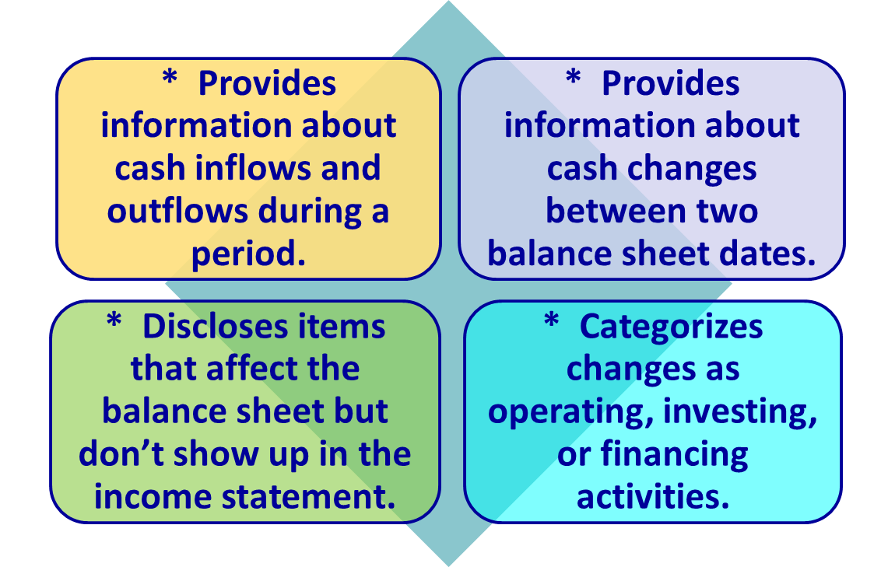
The Purpose of the
Statement of Cash Flows
Notes:
The purpose of the Statement of Cash Flows includes:
Providing information about cash inflows and cash outflows during a period;
Providing information about cash changes between two balance sheet date;
Disclosing items that affect the balance sheet but don’t show up in the income statement; and
Categorizing changes as operating, investing or financing activities.

Slide 7
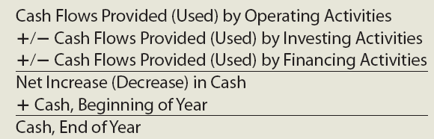
The Basic Structure of the Statement
Notes:
Three groupings of cash flows are presented in the basic structure of the statement.
(1) Cash flows provided (used) by operating activities are those cash inflows and outflows arising from the company’s operations. These inflows and outflows are
sometimes called operating cash flows and would include the following:
• Cash inflows from sales or services
• Cash outflows for operating items such as inventory purchases, salaries, insurance, and supplies
(2) Cash flows provided (used) by investing activities are those cash inflows and outflows arising from the acquisition and disposal of non-current assets. They are
often called investing cash flows and would include the following:
• Cash inflows from the sale of property, facilities, equipment, or investments
• Cash outflows for the purchase of property, facilities, equipment, or investments
(3) Cash flows provided (used) by financing activities are those cash inflows and outflows associated with the generation and return of capital. These are often called financing cash flows and would include the following:
• Cash inflows from borrowings or stock issuances
• Cash outflows to satisfy debt obligations or to repurchase treasury stock
• Cash outflows for dividends to stockholders

Slide 8
Three Classifications of Cash Flows
Operations –
  cash flows related to selling goods and services; that is, the principle business of the firm.
Investing –
  cash flows related to the acquisition or sale of noncurrent assets.
Financing –
  long term and short term cash flows related to liabilities and owners’ equity; dividends are a financing cash outflow.
Notes:
As noted earlier, when preparing the statement of cash flows, all companies report cash flows from operating, investing and financing activities.

Slide 9
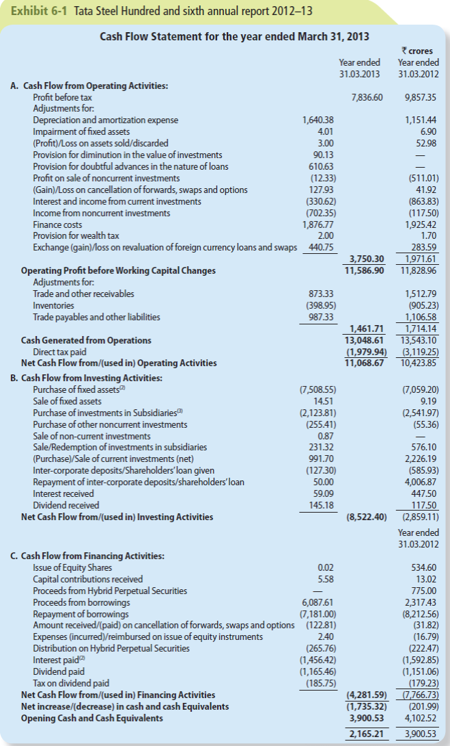
Cash Flow Statement for Tata Steels for 2012-13

Slide 10
Preparing the Statement of Cash Flows
Information for the statement of cash flows is collected from a variety of sources
Preparing the statement of cash flows requires an
examination of the changes in all non-cash accounts
Therefore, in order to explain a company’s change in cash, you must explain the changes in the company’s noncash accounts. And to do that, you need the following three items:
• A comparative balance sheet
• An income statement
• Additional information on changes in account balances
Notes:
Recall that the income statement, the statement of retained earnings, and the balance sheet are prepared with numbers from an adjusted trial balance. However, the statement of cash flows is different. It is prepared with information collected from a variety of sources, including the examination of the changes in all non-cash accounts. Therefore, in order to explain a company’s change in cash, you must explain the changes in the company’s noncash accounts. And to do that, you need the following three items:
• A comparative balance sheet
• An income statement
• Additional information on changes in account balances

Slide 11
Direct and Indirect Method
Direct method -
calculates cash flow from operations by subtracting cash disbursements to supplies, employees, and others from cash receipts from customers.
Indirect method -
calculates cash flow from operations by adjusting net income for noncash revenues and expenses.
U.S. GAAP and permits
either the direct or the indirect method;
a firm that presents the direct method must
also show a reconciliation
Most firms use this method.
Notes:
The manner in which cash flows from investing and financing activities are reported is the same for all companies. However, companies can report their cash flows from operating activities using one of two methods:
• Direct Method
• Indirect Method
Under the direct method, a company calculates and reports its cash inflows from operations followed by its cash outflows or disbursements for operations.
Under the indirect method, a company reports its cash flows from operating activities by adjusting its net income from an accrual basis to a cash basis.
Both the indirect and direct methods will yield the same net cash flows from operating activities. U.S. GAAP permits either the direct or the indirect method. However, most publicly traded companies use the indirect method. As a result, firms that use the direct method must also show a reconciliation with the indirect method.

Slide 12
Regardless of whether you use the Direct or Indirect method, both the investing and financing activities sections are calculated the same way. Only the Operating Section differs.
ABC, Inc.
Statement of Cash Flows for Fiscal Year Ended 12/31/10
 | 
Cash flow from operating activities | Rs496,624
 | 
Cash flow from investing activities | Rs(120,671)
 | 
Cash flow from financing activities | Rs(158,641)
Change in cash | 217,266
Cash, January 1, 2010 | 725,002
Cash, December 31, 2010 | Rs942,268
Supplemental Information:
Interest paid | Rs33,265
Income taxes paid | 32,962
Notes:
Regardless of whether you use the Direct or Indirect method to prepare the statement of cash flows, the investing and financial activities sections are calculated the same way for both methods. Only the Operating Section differs in its approach to determining cash flow. However, it is important to remember that both methods will agree on the total change in cash.

Slide 13
Reporting Cash Flows from Operating Activities—
Indirect Method (Working capital Adjustment)
 | Net Income
+ | Increases in current liabilities
+ | Decreases in current assets
- | Increases in current assets
- | Decreases in current liabilities
= | Cash flow from operating activities
Notes:
When reporting operating cash flows under the indirect method, companies calculate and report net cash flows from operating activities by adjusting net income from an accrual basis to a cash basis. This requires many adjustments, but they can be grouped into three main types:
• Non-cash effects on net income
• Gains and losses from investing and/or financing activities
• Changes in current assets and liabilities
Notice that this slide presents the adjustments to net income in the operating activities to achieve
cash basis. Depreciation is typically the largest decrease in related noncash assets that must be added back to net income to obtain cash-based income.

Slide 14
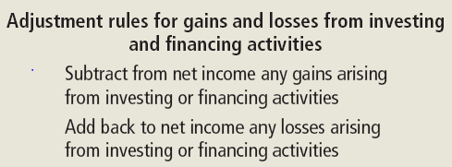
Adjustments for Gains and Losses from Investing and Financing Activities
Notes:
Sometimes, a company’s net income will include a gain or loss arising from an investing or financing activity. For example, a company might generate a gain from the sale of equipment or a loss from the sale of an intangible asset. Another company might generate a gain from the early retirement of debt or a loss from a bond redemption. When such activity occurs, the entire cash inflow associated with the transaction will be reported as either an investing or financing cash flow. As a result, the effect of the gain or loss must be removed from net income so that operating cash flows are not affected by the transaction. Gains must be subtracted from income, and losses must be added back to income.

Slide 15
Computing Cash Flows from
Investing Activities
To calculate cash flows from investing activities, all changes in non-current assets must be examined. In general, an increase in a non-current asset suggests a purchase and therefore a cash outflow. A decrease suggests a sale and therefore a cash inflow.
Notes:
To calculate cash flows from investing activities, all changes in non-current assets must be examined. In general, an increase in a non-current asset suggests a purchase and therefore a cash outflow. A decrease suggests a sale and therefore a cash inflow.

Slide 16
Types of Investing Inflows of Cash
Investing Cash Inflows Into Company
Sale of property, plant, and equipment,
The sale of securities (stocks and bonds) of other companies, and
The receipt of loan payments.
Company
Notes:
Cash flows from investing activities include cash inflows from the sale of property, plant, and equipment; the sale of securities (stocks and bonds) of other companies; and the receipt of loan payments.

Slide 17
Types of Investing Outflows of Cash
Investing Cash Outflows from Company
Purchases of property, plant, and equipment,
Purchase of securities, and
Making loans as investments.
Company
Notes:
Cash outflows include the purchase of property, plant, and equipment; the purchase of securities; and making loans as investments. Loans directly related to the sale of products or services are likely classified as operating activities. The interest on loans included as an investing activity is also classified as a cash flow from operating activities.

Slide 18
Cash Inflow from Investing
Assume Hardin discloses that the Rs1 gain on the sale of equipment arose from selling equipment with a cost of Rs10 and accumulated depreciation of Rs5 for Rs6.
Activities from Investing
Rs6 total cash inflow
Activities from Operations
Rs1 gain
Notes:
Cash outflows include the purchase of property, plant, and equipment; the purchase of securities; and making loans as investments. Loans directly related to the sale of products or services are likely classified as operating activities. The interest on loans included as an investing activity is also classified as a cash flow from operating activities.

Slide 19
Computing Cash Flows from
Financing Activities
To calculate cash flows from financing activities, the balances for long-term liabilities, equity accounts, and dividends must be examined. In general, an increase in a liability or an equity account such as common stock suggests a cash inflow from either borrowing or selling stock. A decrease in a liability or an increase in treasury stock or dividends suggests a cash outflow from payments to creditors or investors.
Notes:
To calculate cash flows from financing activities, the balances for long-term liabilities, equity accounts, and dividends must be examined. In general, an increase in a liability or an equity account such as common stock suggests a cash inflow from either borrowing or selling stock. A decrease in a liability or an increase in treasury stock or dividends suggests a cash outflow from payments to creditors or investors.

Slide 20
Types of Financing Inflows of Cash
Financing Inflows Into Company
Selling Stock,
Issuing Bonds,
Contributions from owners, and
Borrowing from banks on a long-term basis.
Company
Notes:
Cash flows from financing activities include cash inflows from selling stock or from issuing bonds. Cash inflows from financing activities also include contributions from owners and borrowing from banks on a long-term basis.

Slide 21
Types of Financing Outflows of Cash
Financing Cash Outflows from Company
Repayment of notes and bonds,
Cash payments to repurchase stock (treasury stock),
Payment of dividends.
Company
Notes:
Cash outflows from financing activities include repayment of notes and bonds, cash payments to repurchase stock (Treasury stock), and the payment of dividends. Once again, all interest payments are included in cash flows from operating activities.

Slide 22
A Statement of Cash Flows (indirect method shown) concludes by adding the Change in Cash to the Beginning Cash balance to derive the Ending Cash balance.
Hardin Company
Statement of Cash Flows for Period Ending 12/31/09
Net Income (amounts in thousands of Rs) | 331
Depreciation and amortization expense | 59
 | 
Cash flow from operating activities | 575
 | 
Cash flow from investing activities | (292)
 | 
Cash flow from financing activities | Rs(77)
Change in cash | 206
Cash, January 1, 2009 | 121
Cash, December 31, 2009 | Rs327
The Company receives Rs100 Cash from a customer
Notes:
Here is a model of a statement of cash flows using the indirect method. Notice that after the three cash flow activity sections, the statement concludes by adding the Change in Cash to the Beginning Cash balance to derive the Ending Cash balance.

Slide 23
Analyzing a Company’s
Statement of Cash Flows
The Statement of Cash Flows can be used to answer many questions about a company’s cash. Two of the broader questions that can be addressed are as follows:
  1. Is the company able to generate enough cash to grow?
  2. Is the company able to generate enough cash to satisfy its obligations?
Notes:
The Statement of Cash Flows can be used to answer many questions about a company’s cash. Two of the broader questions that can be addressed are as follows:
1. Is the company able to generate enough cash to grow?
2. Is the company able to generate enough cash to satisfy its obligations?

