Slide 1
Measuring Financial Performance

Slide 2
Basic Accounting Concepts
Generally Accepted Accounting Principles (GAAP):
guidelines that set out the manner & form for presenting accounting information
Codified in accounting standards issued by ICAI
Ensures comparability and consistency
Accrual Accounting:
the practice of recording economic activity when recognized rather than waiting until realized

Slide 3
Accounting Principles
Principles | Definition | Ramification
Revenue recognition | Revenues are recorded when they are earned | The receipt of cash is not required to record a revenue
Matching | Expenses are recorded in the time period when they are incurred to operate revenues | For many assets, the cost of the asset must be spread over the periods that it is used
Cost | Assets are recorded and maintained at their historical costs | Except in a few cases, market values are not used for reporting assets values

Slide 4
Accounting Assumptions
Assumption | Definition | Ramification
Economic entity | The financial activities of a business can be accounted for separately from the business’s owners | We do not have to worry that the financial information of the owners is mixed with the financial information of the business
Monetary unit | The rupee, unadjusted for inflation, is the best means of communicating accounting information in India | All transaction in foreign currencies are converted to rupees
Time period | Accounting information can be communicated effectively over short periods of time | Most business prepare quarterly and annual financial statements
Going concern | The company for which we are accounting will continue its operations indefinitely | If an entity is not selling its assets, then the cost principle is appropriate

Slide 5
Basic Accounting Concepts (continued)
Depreciation:
reduction in value of a fixed asset over its expected life intended to reflect the usage of wearing out of the asset
Accumulated Depreciation:
sum of all previous depreciation amounts charged to fixed assets

Slide 6
Basic Balance Sheet Terms & Concepts
Balance Sheet:
financial statement that provides a snapshot of a venture’s financial position as of a specific date
Balance Sheet Equation:
Total Assets = Total Liabilities + Owners’ Equity

Slide 7
Basic Balance Sheet Terms & Concepts (continued)
Assets:
financial, physical and intangible items owned or controlled by the business
assets are listed in declining order of liquidity, or how quickly the asset can be converted into cash
Owners’ Equity:
equity capital contributed by the owners and Other Equity
Liabilities:
short-term liabilities are listed first followed by long-term debts owed by the venture

Slide 8
Types of Balance Sheet Assets
Current Assets:
cash & other assets that are expected to be converted into cash in less than one year
Fixed Assets (or Non Current Assets):
assets with expected lives of greater than one year

Slide 9
Types of Current Assets
Cash and Bank balance:
Receivables:
credit sales made to customers
Inventories:
raw materials, work-in-process, & finished products which the venture hopes to sell

Slide 10
Types of Current Liabilities
Payables:
short-term liabilities owed to suppliers for purchases made on credit
Accrued Wages:
liabilities owned to employees for previously completed work
Bank Loan:
interest-bearing loan of one year or less from a commercial bank

Slide 11
Types of Long-Term Liabilities
Long-Term Debts:
loans that have maturities of longer than one year

Slide 13
 |  | Balance Sheet as at 31-03-12
Owner's Equity |  |  |  | Assets
Share capital |  | 30 |  | Fixed Assets
 |  |  |  | Furniture |  | 5
Reserves & Surplus |  | 6.8
Long Term Liabilities |  |  |  | Current Assets
 |  |  |  | Inventory | 15
Loan from Bank |  | 20 |  | Debtors | 23
 |  |  |  | Rent Advance | 5
Current Liabilities |  |  |  | Cash | 50 | 93
Creditors |  | 36
Expenses payable |  | 5.2
 |  | 98 |  |  |  | 98

Slide 14
Basic Income Statement Terms & Concepts
Income Statement:
financial statement that reports the revenues generated & expenses incurred over an accounting period
Sales or Revenues:
funds earned from selling a product or providing a service
Gross Earnings:
net sales (after deducting returns & allowances) minus the cost of production

Slide 15
Basic Income Statement Terms & Concepts (continued)
Operating Income or Earnings Before Interest & Taxes (EBIT):
indicates a firm’s profit after operating expenses, excluding financing costs, have been deducted from net sales
Net Income (or Profit):
bottom line measure after all operating expenses, financing costs, & taxes have been deducted from net sales

Slide 16
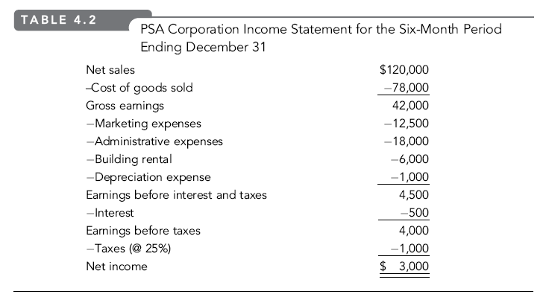

Slide 17
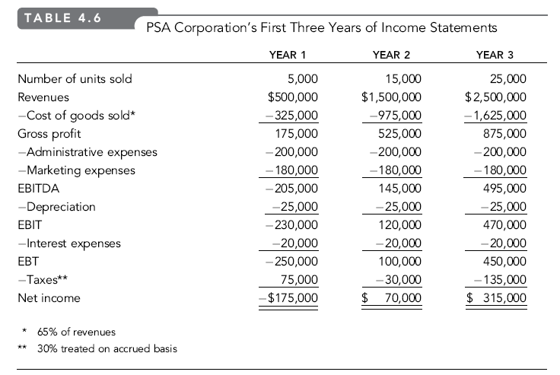

Slide 18
Class Work
A = L+E
E = Contributed Capital + Retained Earnings
Types of Accounts
Asset (Recorded in Balance Sheet)
Liability (Recorded in Balance Sheet)
Revenue (Recorded in Income Statement)
Expense (Recorded in Income Statement)
Revenue – Expenses = Profit = Retained Earnings = Equity

