Slide 1
Measuring Financial Performance
© 2009 South-Western Cengage Learning

Slide 2
Statement of Cash Flows: Definition and Use
Statement of Cash Flows:
shows how cash, reflected in accrual accounting, flowed into & out of a firm during a specific period of operation
Can be used to determine if a venture has been building or burning cash
“Net Cash Burn” occurs when the sum of cash flows from “operations” and “investing” is negative

Slide 3
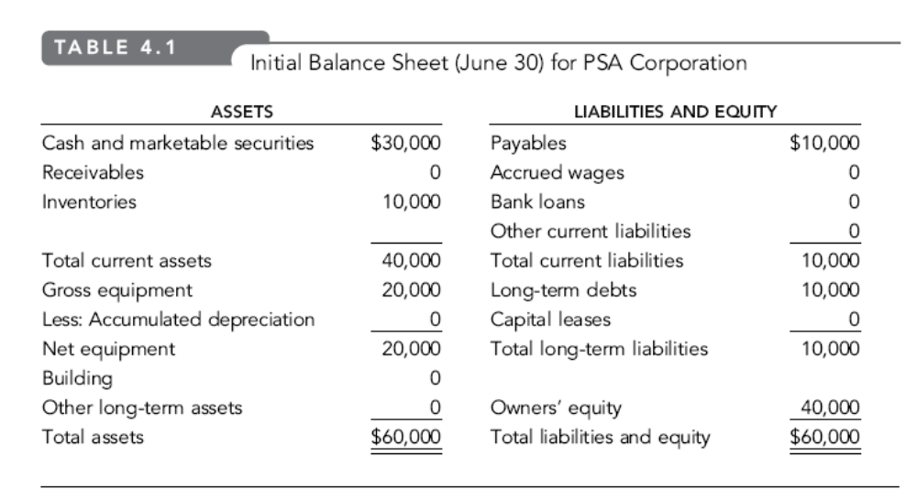

Slide 4
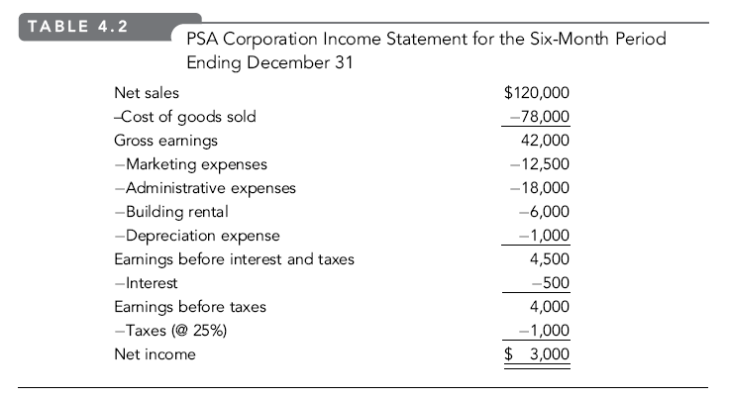

Slide 5
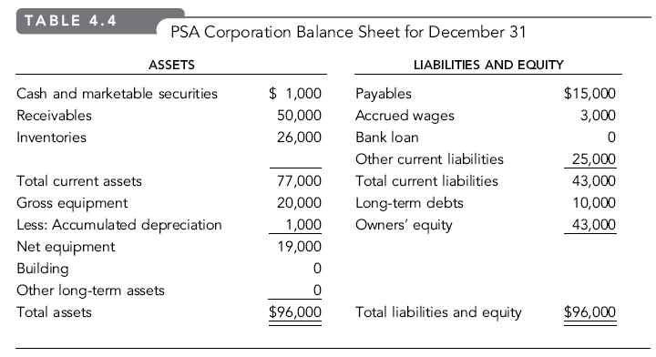

Slide 6
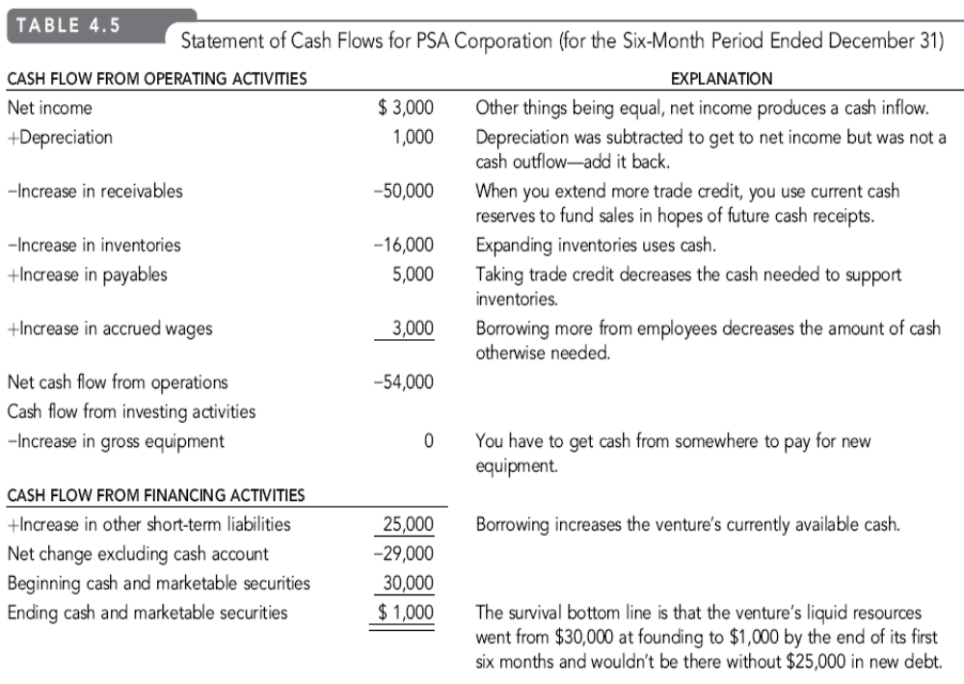

Slide 7
Reporting Cash Flows from Operating Activities—
Indirect Method
 | Net Income
+ | Depreciation and Amortisation
+ | Increases in current liabilities
+ | Decreases in current assets
- | Increases in current assets
- | Decreases in current liabilities
+ | Finance Cost (i.e., Interest)
= | Cash flow from operating activities
Notes:
When reporting operating cash flows under the indirect method, companies calculate and report net cash flows from operating activities by adjusting net income from an accrual basis to a cash basis. This requires many adjustments, but they can be grouped into three main types:
• Non-cash effects on net income
• Gains and losses from investing and/or financing activities
• Changes in current assets and liabilities
Notice that this slide presents the adjustments to net income in the operating activities to achieve
cash basis. Depreciation is typically the largest decrease in related noncash assets that must be added back to net income to obtain cash-based income.

Slide 8
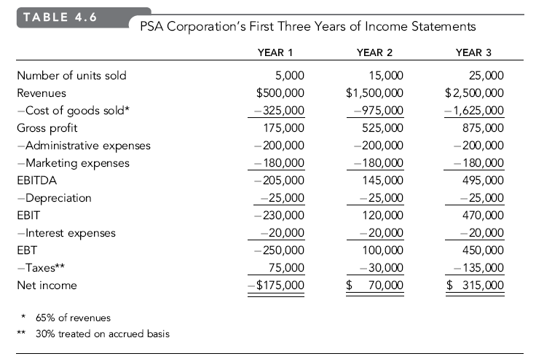

Slide 9
Operating Breakeven Analysis: Basic Terms
Variable Expenses:
costs or expenses that vary directly with revenues
Fixed Expenses:
costs that are expected to remain constant over a range of revenues for a specific time period
EBITDA:
earnings before interest, taxes, & depreciation & amortization

Slide 10
Operating Breakeven Analysis: Basic Terms (continued)
EBDAT:
earnings before depreciation, amortization, & taxes
EBDAT Breakeven:
amount of revenues (survival) needed to cover cash operating expenses
Cash Flow Breakeven:
cash flow at zero for a specific period (EBDAT = 0)

Slide 11
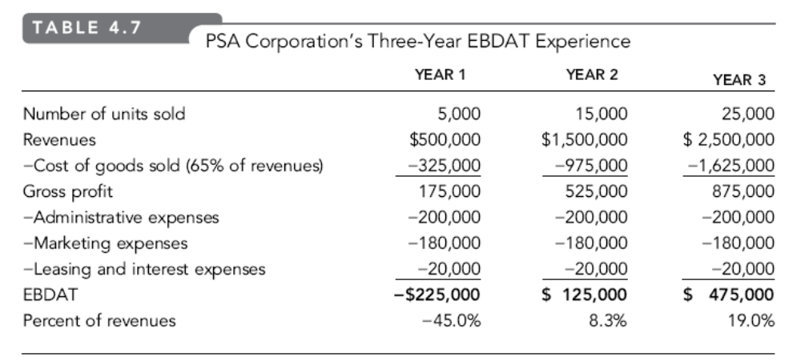

Slide 12
Survival Breakeven Analysis: Some Basics
Basic Equation:
EBDAT = Revenues (R) - Variable Costs (VC) – Cash Fixed Costs (CFC)
Where:
CFC includes both fixed operating (e.g., general & administrative, & possibly marketing expenses) & fixed financing (interest) costs
When EBDAT is Zero:
R = VC + CFC

Slide 13
Solving for the Breakeven Level of Survival Revenues
Starting Point:
Ratio of variable costs (VC) to revenues (R) is a constant (VC/R) & is called the Variable Cost Revenue Ratio (VCRR)
Survival Revenues (SR) = VC + CFC
Rewriting, CFC = SR – VC
By substitution, CFC = SR[1 – (VCRR)]
Solving for SR, SR = [CFC/(1 – VCRR)]

Slide 14
Survival Revenues Breakeven: An Example
If the PSA venture were expecting:
Revenues = $1,000,000
Cost of Goods Sold = $650,000
Administrative Expenses = $200,000
Marketing Expenses = $180,000
Depreciation Expenses = $100,000
Interest Expenses = $20,000
Tax Rate = 33%

Slide 15
Survival Revenues Breakeven: An Example (continued)
Note: only Cost of Goods Sold is expected
to vary directly with Sales
VCRR = $650,000/$1,000,000 = .65
CFC = $200,000 + $180,000 + $20,000 = $400,000
SR = $400,000/(1 - .65) = $1,143,000 rounded

Slide 16
Survival Revenues Breakeven: An Example (continued)
Check:
Survival Revenues $1,143,000
Cost of Goods Sold (65%) -743,000
Gross Profit 400,000
Administrative Expenses -200,000 Marketing Expenses -180,000 Interest Expenses -20,000
EBDAT $0

Slide 17
Identifying Breakeven Drivers in Revenue Projections
1. Contribution Profit Margin = 1 – VCRR
higher contribution profit margins mean lower levels of survival revenues are needed to break even (EBDAT = 0)
Example:
Assume cash fixed costs are $400,000 & the VCRR declines from 65% to 60%
[A]: SR = $400,000/(1 - .65) = $1,143,000
[B]: SR = $400,000/(1 - .60) = $1,000,000

Slide 18
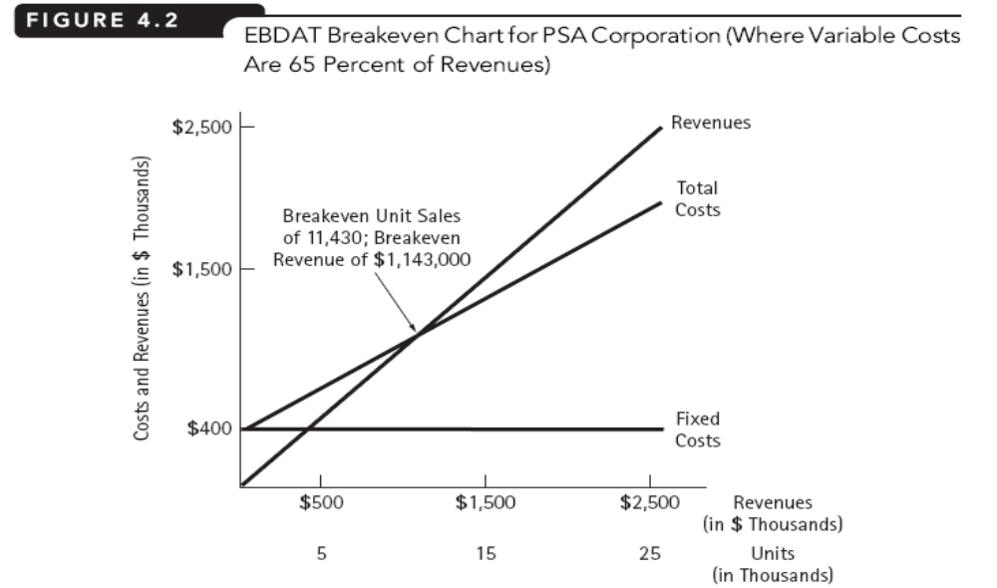
Graphically

Slide 19
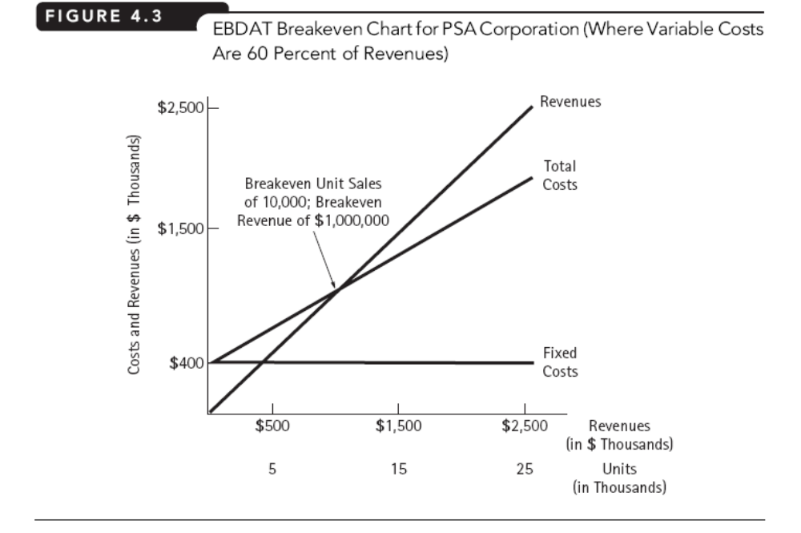

Slide 20
Identifying Breakeven Drivers in Revenue Projections (continued)
2. Amount of Cash Fixed Costs
lower cash fixed costs result in lower levels of survival revenues needed to breakeven (EBDAT = 0)
Example:
Assume cash fixed costs decline from $400,000 to $350,000 & the VCRR is 65%
[A]: SR = $400,000/(1 - .65) = $1,143,000
[B]: SR = $350,000/(1 - .65) = $1,000,000

