Slide 1
EVALUATING FINANCIAL PERFORMANCE

Slide 2
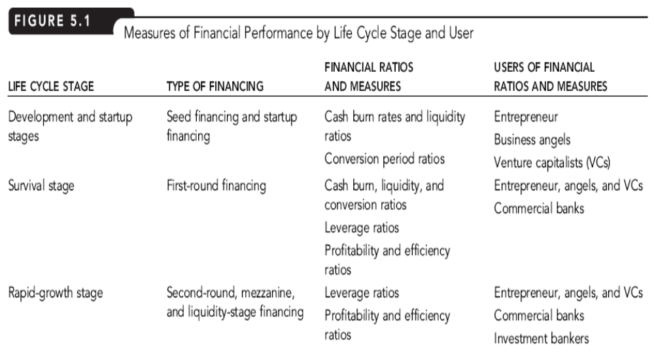
Financial Measure by Life Cycle

Slide 3
FINANCIAL RATIO & ANALYSIS
Financial Ratios:
show the relationship between two or more financial variables
Trend Analysis:
used to examine a venture’s performance over time
Cross-sectional Analysis:
used to compare a venture’s performance against another firm at the same point in time
Industry Comparables Analysis:
used to compare a venture’s performance against the average performance in the same industry

Slide 4
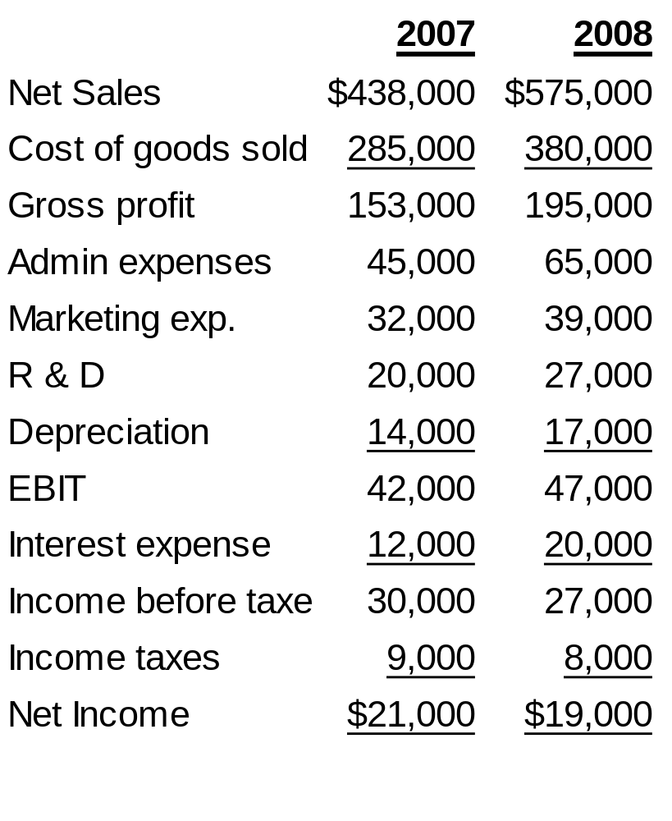
MPC INCOME STATEMENT

Slide 5
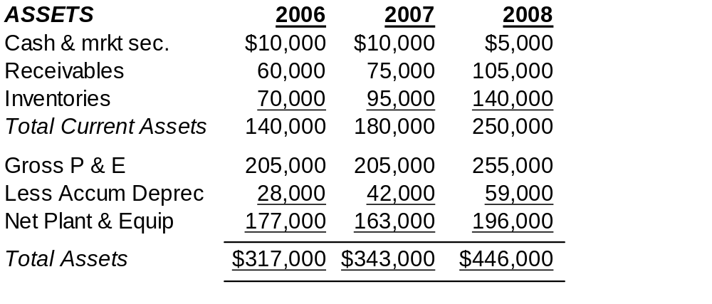
MPC BALANCE SHEET

Slide 6
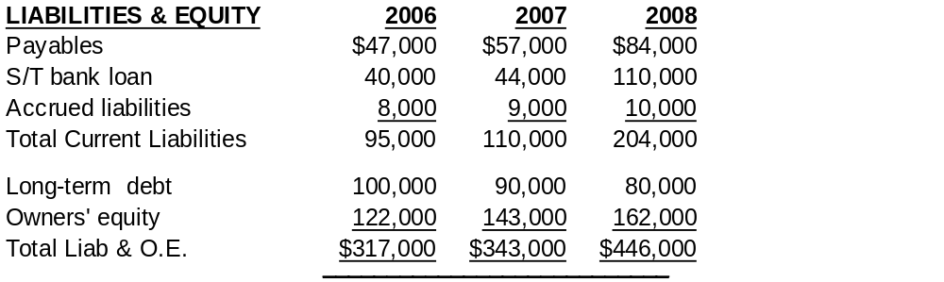
MPC BALANCE SHEET (cont.)

Slide 7
LIQUIDITY RATIOS
Indicate the ability to pay short-term liabilities when they come due
Current Ratio:
  = Average current assets/Average current liabilities
  = (250,000+180,000)/2
  (204,000+110,000)/2
  = 1.37

Slide 8
LIQUIDITY RATIOS
Liquid assets: sum of a venture’s cash and marketable securities plus its receivables
Quick Ratio =
Average current assets – Average inventories
Average current liabilities
= (250,000 +180,000)/2 – (140,000+95,000)/2
(204,000 + 110,000)/2
= .62

Slide 9
MPC BURN RATES & LIQUIDITY RATIOS
    RATIO 2007 2008 % Change
    Current ratio 1.56 1.37 -12.2%
    Quick ratio .76 .62 -18.4%

Slide 10
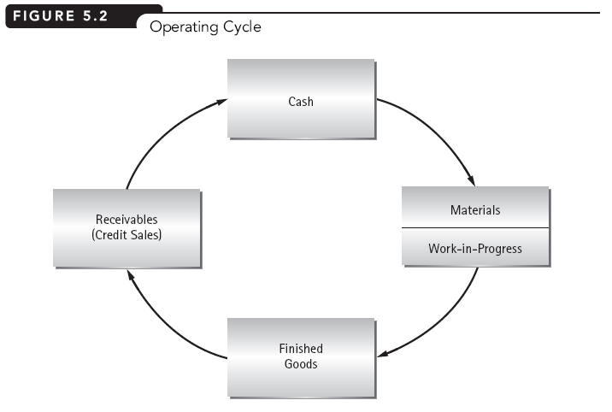

Slide 11
CONVERSION PERIOD RATIOS
Conversion Period Ratio:
indicates the average time it takes in days to convert certain current assets and current liability accounts into cash
Operating Cycle:
time it takes to purchase, produce, and sell the venture’s products plus the time needed to collect receivables if the sales are on credit
Cash Conversion Cycle:
sum of the inventory-to-sale conversion period and the sales-to-cash conversion period less the purchase-to-payment conversion period

Slide 12
MEASURING CONVERSION TIMES
Inventory-to-Sale Conversion Period or DII (Days in Inventory)
= Ave. Inventories
(CGS / 365)
= (140,000 + 95,000)/2 = 117,500
380,000/365 1041
= 112.9 days

Slide 13

Inventory Turnover Ratio
Or, Inventory Turnover Ratio = 360
DII

Slide 14
MEASURING CONVERSION TIMES
Sale-to-Cash Conversion Period or DSO (days sales Outstanding) or Receivables Collection period in days:
= Ave Receivables
(Net Sales/365)
= (105,000 + 75,000)/2
575,000/365
= 57.1 days

Slide 15
MEASURING CONVERSION TIMES
Purchase-to-Payment Conversion Period or (Days Payable Outstanding) or Payables period in days:
= Ave Payables + Ave Accrued Liabilities
(COGS / 365)
= (84,000+57,000)/2 + (10,000+9,000)/2
380,000/365
= 76.8 days
Notes:
MPC had almost 77 days of the costs of production financed by trade credit and accrued wages and liabilities.

Slide 16
MEASURING CONVERSION TIMES
Cash Conversion Cycle
= Inventory-to-Sale Conversion Period (DII)
+ Sale-to-Cash Conversion Period (DSO)
– Purchase-to-Payment Conversion (DPO)
= 112.9 days + 57.1 days – 76.8 days
= 93.2 days
Notes:
CCC is the number of days of operation that must be externally financed. Zero CCC indicates that production is fully internally financed.

Slide 17
MPC CONVERSION PERIOD PERFORMANCE
    Conversion Ratio Impact on
    2007 2008 Conv. Cycle
    Inventory-to-sale 105.7 days 112.9 days +7.2 days
    Sale-to cash 56.3 days 57.1 days +0.8 days
    Purchase-to-payment 77.5 days 76.8 days +0.7 days
    Cash conversion cycle 84.5 days 93.2 days +8.7 days

Slide 18
MEASURING CONVERSION TIMES
Given New I-to-S, Can Solve for New Average Inventories
= Inventory-to-Sale Conversion Period
x (COGS/365)
= 105.7 X $1,041
= $110,000 (rounded)

