Slide 1
EVALUATING FINANCIAL PERFORMANCE

Slide 2
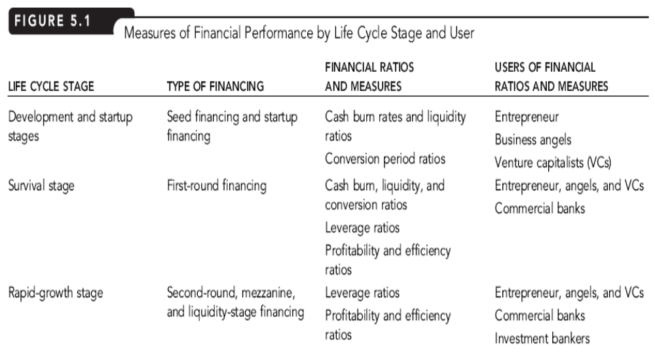
Financial Measure by Life Cycle

Slide 3
FINANCIAL RATIO & ANALYSIS
Financial Ratios:
show the relationship between two or more financial variables
Trend Analysis:
used to examine a venture’s performance over time
Cross-sectional Analysis:
used to compare a venture’s performance against another firm at the same point in time
Industry Comparables Analysis:
used to compare a venture’s performance against the average performance in the same industry

Slide 4
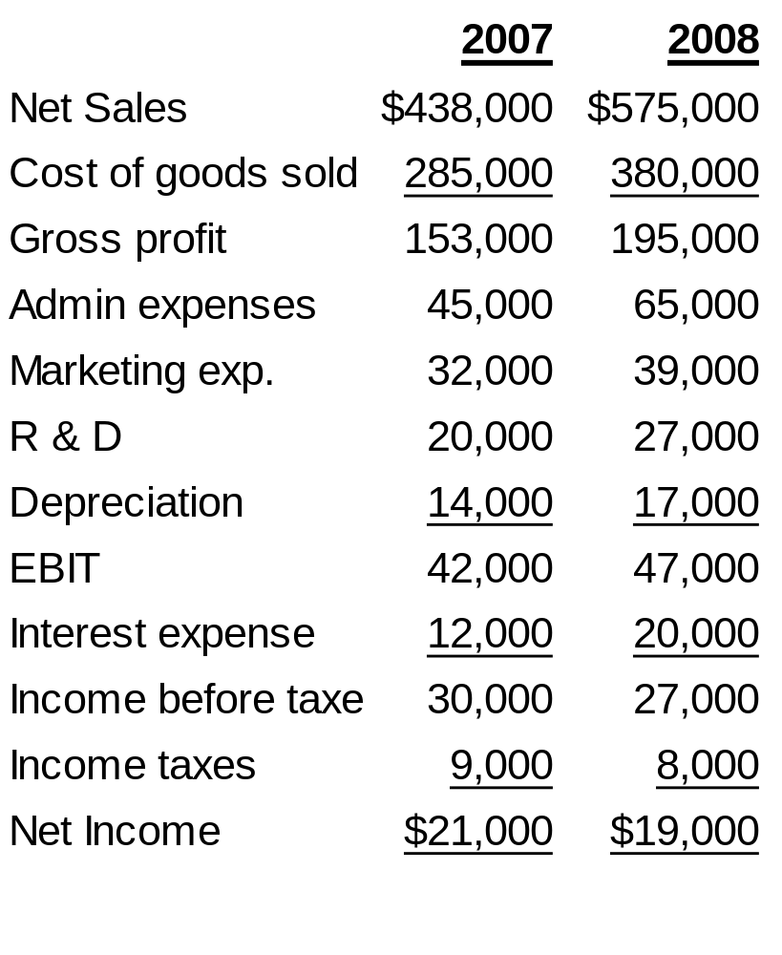
MPC INCOME STATEMENT

Slide 5
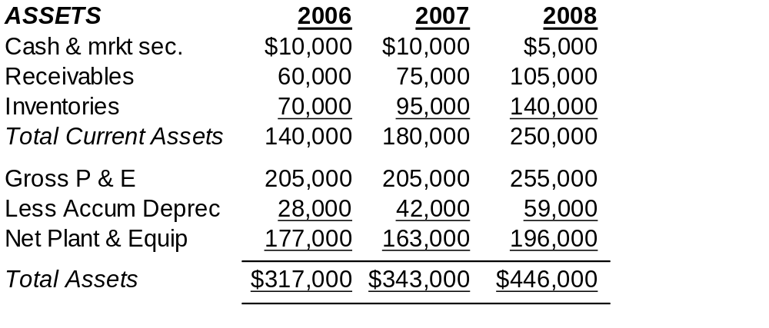
MPC BALANCE SHEET

Slide 6
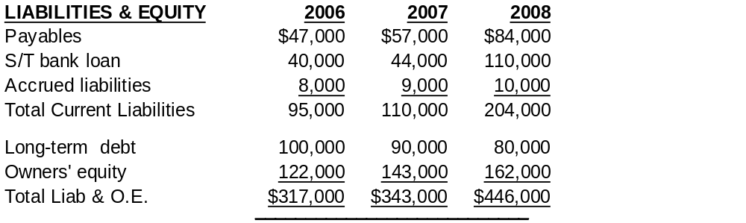
MPC BALANCE SHEET (cont.)

Slide 7
LEVERAGE RATIOS
Leverage Ratio:
indicates the extent to which the venture is in debt and its ability to repay its debt obligations
Loan Principal Amount:
dollar amount borrowed from a lender
Interest:
dollar amount paid on the loan to a lender as compensation for making the loan
Operating Gearing
Company that faces high fixed costs will be more sensitive to changes in sales volumes (i.e. more highly geared ) than a company with low fixed costs

Slide 8
MEASURING FINANCIAL LEVERAGE
Total-Debt-to-Total-Asset Ratio:
= Ave total debt / Ave total assets
= (204,000 +110,000)/2 + (80,000 +90,000)/2
(446,000 + 343,000)/2
= .6134 or 61.34%

Slide 9
MEASURING FINANCIAL LEVERAGE
Equity Multiplier:
= Ave total assets / Ave owners’ equity
= (446,000 + 343,000)/2
(162,000 + 143,000)/2
= 2.587 times

Slide 10
MEASURING FINANCIAL LEVERAGE
Current-Liabilities-to-Total-Debt Ratio:
= Ave. current liabilities / Ave. total debt
= (204,000 + 110,000)/2
(284,000 + 200,000)/2
= .6488 or 64.88%

Slide 11
MEASURING FINANCIAL LEVERAGE
Interest Coverage Ratio:
= EBITDA / Interest
= 47,000 + 17,000/2
20,000
= 3.20 times

Slide 12
MPC LEVERAGE RATIO PERFORMANCE
    Leverage Ratio Impact on
    2007 2008 Leverage risk
    Total debt/total assets 59.8% 61.3% Increase
    Equity multiplier 2.491 2.587 Increase
    Current liab / total debt 52.9% 64.9% Increase
    Interest coverage 4.6 3.2 Increase

Slide 13
PROFITABILITY & EFFICIENCY RATIOS
Profitability Ratios:
indicate how efficiently a venture controls its expenses
Efficiency Ratios:
indicate how efficiently a venture uses its assets in producing sales

Slide 14
MEASURING PROFITABILITY & EFFICIENCY
Gross Profit Margin:
= Net Sales – COGS
Net Sales
= 195,000/575,000
= .3391 or 33.91%

Slide 15
MEASURING PROFITABILITY & EFFICIENCY
Operating Profit Margin:
= EBIT .
Net Sales
= 47,000/575,000
= .0817 or 8.17%

Slide 16
MEASURING PROFITABILITY & EFFICIENCY
Net Profit Margin:
= Net Profit
Net Sales
= 19,000/575,000
= .0330 or 3.30%

Slide 17
MEASURING PROFITABILITY & EFFICIENCY
Sales-to-Total-Assets Ratio (Or, Asset Turnover Ratio):
= Net Sales .
Ave total assets
= 575,000 .
(446,000 + 343,000)/2
= 1.458 times

Slide 18
MEASURING PROFITABILITY & EFFICIENCY
Return on Total Assets (ROA):
= Net profit .
Ave total assets
= 19,000 _
(446,000 + 343,000)/2
= .048 or 4.8%

Slide 19
MEASURING PROFITABILITY & EFFICIENCY
ROA Model:
the decomposition of ROA into the product of the net profit margin and the sales-to-total-assets ratio
ROA
= (Net profit / sales) x (Net sales / Ave. total assets)
= (19,000/575,000) x (575,000/ (446,000 + 343,000)/2)
=.0330 x 1.458 = .048 or 4.8%

Slide 20
MEASURING PROFITABILITY & EFFICIENCY
Return on Equity (ROE):
= Net Income .
Ave owners’ equity
= 19,000 .
(162,000 + 143,000)/2
= .1246 or 12.46% (or 12.5% rounded)

Slide 21
MEASURING PROFITABILITY & EFFICIENCY
ROE Model:
the decomposition of ROE into the product of the net profit margin, sales-to-total-assets ratio, and equity multiplier
ROE
= (Net profit / sales) x (Net sales / Ave. total assets) x (Ave. total assets / Ave. equity)
= ROA x Equity Multiplier
= Operating Performance x Financial Policy
= 3.3% x 1.46% x 2.59% = 12.5%

Slide 22
MPC PROFITABILITY & EFFICIENCY PERFORMANCE
    Impact on
    Profitability
    Ratio 2007 2008 or Efficiency
    Gross profit margin 34.93% 33.91% lower
    Operating profit margin 9.59% 8.17% lower
    Net profit margin 4.79% 3.30% lower
    Sales to total assets 1.327 1.458 higher
    ROA 6.36% 4.82% lower
    ROE 15.85% 12.46% lower

Slide 23
MPC INDUSTRY COMPARABLES ANALYSIS
    2008 Comparison
    Leverage Ratios 2008 Industry Ave. with industry
    Tot. debt-to-tot. assets 61.3% 60.0% higher
    Interest coverage 3.20 4.00 lower
    Profitability/Efficiency Ratios
    Gross profit margin 33.91% 35.0% lower
    Operating profit margin 8.17% 10.0% lower
    Net profit margin 3.30% 4.5% lower
    Sales-to-total assets 1.458 1.5 lower
    Return on total assets 4.82% 6.3% lower
    Return on equity 12.46% 15.00% lower

