Slide 1


Slide 2
For plotting a grapgh using GNUPLOT we require two files:
data.txt (you can rename the name of this txt file)
This is the file where you can store inputs and their respective complexities.
2. dataplot.p (you can rename the name of this txt file)
This is the script file for plotting graph. It is editable file

Slide 3
Structure of data.txt file:
#TitleText: Accuracy Compararion
5 93.3 52.4 79.3
10 95.6 78.8 82.11
15 98.9 100 99.2720
20 91.5 95.5 92.36

Slide 4
-------
---------
------
------
-----
Plot “data.txt” using 1:2 title ‘Best Case’ with linepoints, \
“data.txt” using 1:3 title ‘Average Case’ with linepoints, \
“data.txt” using 1:4 title ‘Worst Case’ with linepoints

Slide 5
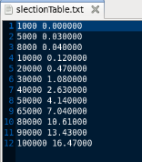
Structure of data.txt file:

Slide 6
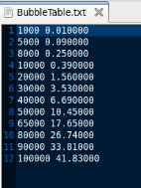
Structure of data.txt file:

Slide 7
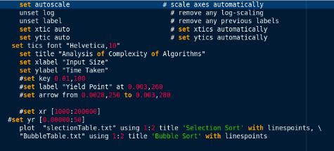
Structure of dataplot.p file:

Slide 8
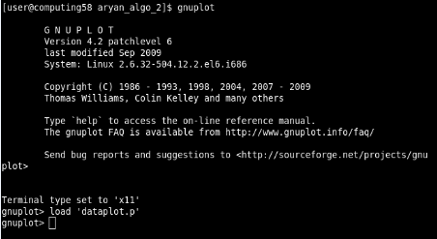
Command for plotting the graph using gnuplot

Slide 9
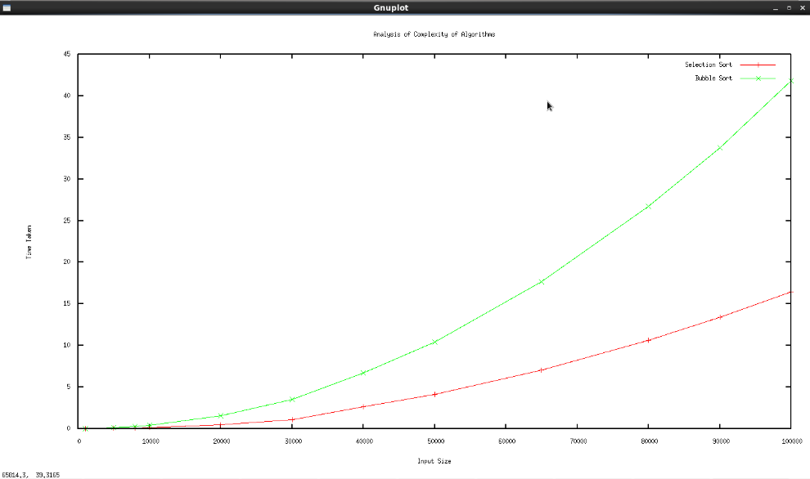

Slide 10
Structure of dataplot.p file:

