Slide 1
Indian Statistical Institute
REGRESSION SPLINES

Slide 2
Indian Statistical Institute
REGRESSION SPLINES
Spline
A continuous function formed by connecting linear segments
A function constructed piecewise from polynomial functions
Knots
The points where the segments are connected
Spline of degree D
A function formed by connecting polynomial segments of degree D so that
Function is continuous
Function has D – 1 continuous derivatives
Usage
Develop models when relationship between y and x’s is piecewise polynomial

Slide 3
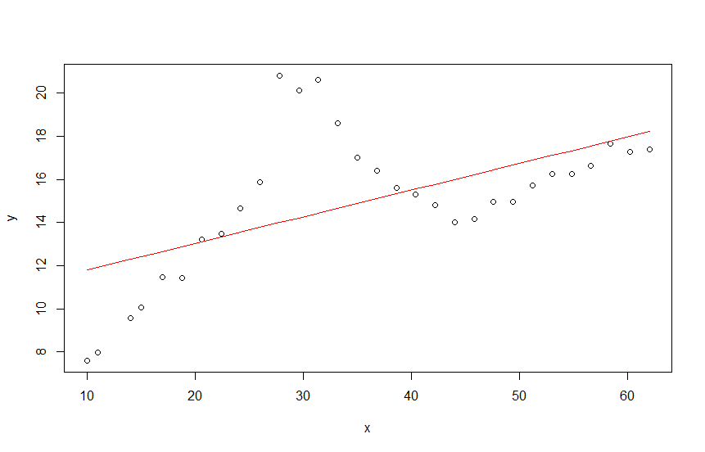
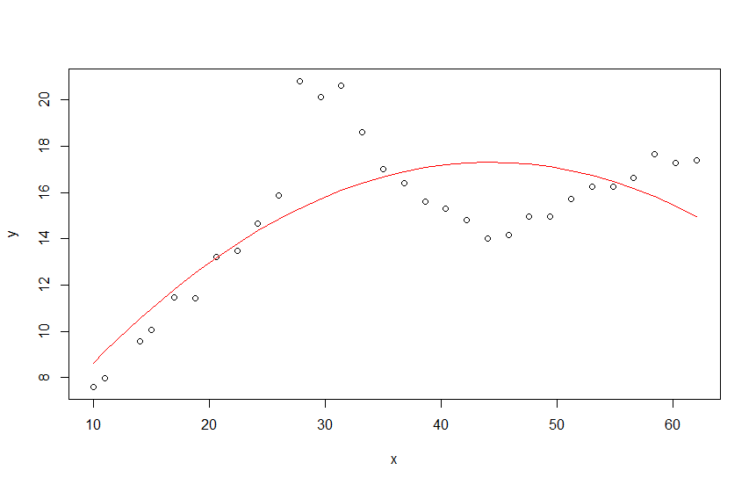
Indian Statistical Institute
REGRESSION SPLINES
y vs x (linear)
y vs x (Polynomial)

Slide 4
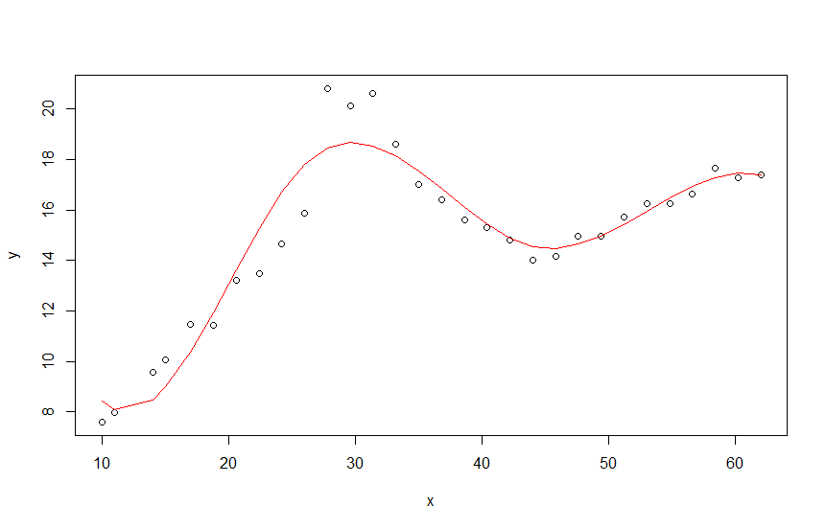
Indian Statistical Institute
REGRESSION SPLINES
y vs x (Piecewise polynomial - Spline)

Slide 5
Indian Statistical Institute
REGRESSION SPLINES
Example 1: The data on defect finding rate (design phase) and the corresponding defect finding rate (coding phase) of 20 similar projects is given in Reg_Spline_DFR.csv. Fit a suitable model to predict defect finding rate in coding phase in terms of defect finding rate in design phase?
Reading data
> design = mydata$Design
> coding = mydata$Coding
> plot(design, coding)

Slide 6
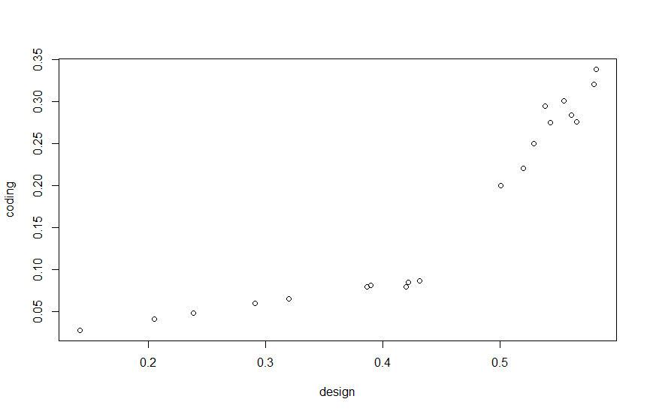
Indian Statistical Institute
REGRESSION SPLINES
Example 1:
Exploring the relationship
> plot(design, coding)

Slide 7
Indian Statistical Institute
REGRESSION SPLINES
Example 1:
Fitting a linear model
> mymodel = lm(coding ~ design)
> summary(mymodel)
Statistics | Value
R² | 0.8179
R² adjusted | 0.8078
F Statistics | 80.84
P value | 0.000

Slide 8
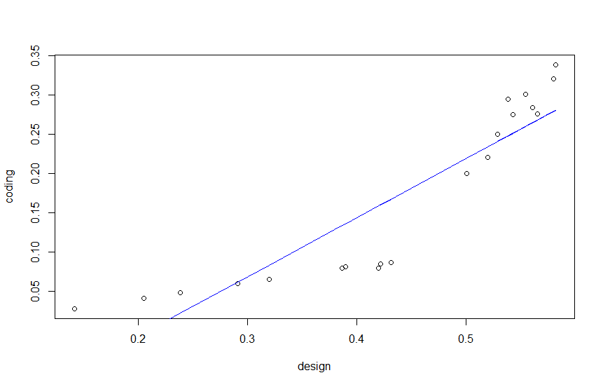
Indian Statistical Institute
REGRESSION SPLINES
Example 1:
Plotting the model
> pred = predict(mymodel)
> plot(design, coding)
> lines( design, pred, col = “blue)

Slide 9
Indian Statistical Institute
REGRESSION SPLINES
Example 1:
Introducing knot at design = 0.44
> design44 = design – 0.44
> design44[design44 < 0] = 0
Fitting linear spline model
> mymodel = lm(coding ~ design + design44)
> summary(mymodel)
Statistics | Value
R² | 0.9882
R² adjusted | 0.9868
F Statistics | 709.3
P value | 0.000

Slide 10
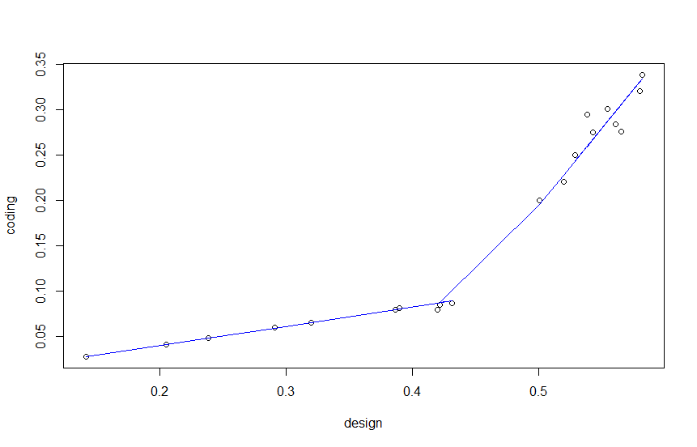
Indian Statistical Institute
REGRESSION SPLINES
Example 1:
Plotting the linear spline model
> pred = predict(mymodel)
> plot(design, coding)
> lines( design, pred, col = “blue)
Note: Model is good but not a continuous function

Slide 11
Indian Statistical Institute
REGRESSION SPLINES
Example 1:
Fitting cubic spline model
> designsq = design^2
> designcb = design^3
> design44cb = design44^3
> mymodel = lm(coding ~ poly(design, 3, raw = TRUE) + design44cb)
> summary(mymodel)
Statistics | Value
R² | 0.9857
R² adjusted | 0.9819
F Statistics | 258.4
P value | 0.000

Slide 12
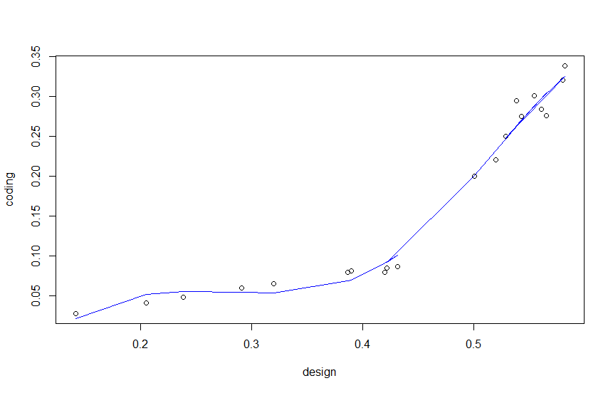
Indian Statistical Institute
REGRESSION SPLINES
Example 1:
Plotting the linear spline model
> pred = predict(mymodel)
> plot(design, coding)
> lines( design, pred, col = “blue)

Slide 13
Indian Statistical Institute
REGRESSION SPLINES
Example 2: The data on advertisement cost and the corresponding sales revenueis given in Reg_Spline_Adv.csv. Fit a suitable model to predict the sales revenue in terms of advertisement cost?
Example 3: The data on x and y is given in Reg_Spline_Ex3.csv. Fit a suitable model to predict the y in terms of x?

