Slide 1
Indian Statistical Institute
ARTIFICIAL NEURAL
NETWORKS

Slide 2
Indian Statistical Institute
ARTIFICAL NEURAL NETWORKS
Introduction
One of the most fascinating machine learning modeling technique
Generally uses back propagation algorithm
Relatively complex (due to deep learning with many hidden layers)
Structure is inspired by brain functioning
Generally computationally expensive

Slide 3
Indian Statistical Institute
ARTIFICAL NEURAL NETWORKS
Instructions
Normalize the data – Use Min – Max transformation
Normalized data = Data – Minimum / (Maximum – Minimum)
2. Number of hidden layers required = 1 for vast number of application
3. Number of neurons required = 2/3 of the number of predictor variables or input layers
Remark: The optimum number of layers and neurons are the ones which would minimize mean square error or misclassification error which can be obtained by testing again and again

Slide 4
Indian Statistical Institute
ARTIFICAL NEURAL NETWORKS
Example
Develop a model for predicting the conversion in a chemical process in terms of Temperature, Time and Kappa Number using artificial neural networks. The data is given in Mult_Reg_Conversion.csv . Predict the conversion for the data given in the file Conversion_Std_Output.csv?

Slide 5
Indian Statistical Institute
ARTIFICAL NEURAL NETWORKS
Example
Reading the data
> mydata <- read_csv("E:/Infosys/DataSets/Mult_Reg_Conversion.csv")
> mydata = mydata[,2:5]
Standardize the data
> maxs = apply(mydata, 2, max)
> mins = apply(mydata, 2, min)
> myzdata = scale(mydata, center = mins, scale = maxs - mins)
> apply(myzdata, 2, max)
> apply(myzdata, 2, min)

Slide 6
Indian Statistical Institute
ARTIFICAL NEURAL NETWORKS
Example
Format data as data frame
> myzdata = as.data.frame(myzdata)
> attach(myzdata)
Develop the model
> library(MASS)
> library(neuralnet)
> mymodel = neuralnet(Conversion ~ Temperature + Time + Kappa_Number, hidden = c(2), data = myzdata)

Slide 7
Indian Statistical Institute
ARTIFICAL NEURAL NETWORKS
Example: Interpretation
> mymodel = neuralnet(Conversion ~ Temperature + Time + Kappa_Number, hidden = c(2), data = myzdata, linear.output = TRUE)
hidden : a vector representing hidden layers and hidden neurons in each layer
hidden :c(k, l) – two hidden layers with k and l hidden neurons respectively
linear.output: TRUE for regression (when response is numeric) and FALSE for classification (when response is categorical). Default is TRUE

Slide 8
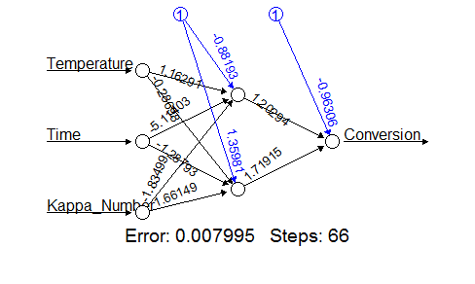
Indian Statistical Institute
ARTIFICAL NEURAL NETWORKS
Output
> plot(mymodel)
Black lines: Shows the connection between each layer and the weights (coefficients) on each connection
Blue lines: The intercept or bias term added in each step

Slide 9
Indian Statistical Institute
ARTIFICAL NEURAL NETWORKS
Output
> mymodel$result.matrix
Statistics | Values
Error | 0.00799
Reached threshold | 0.00445
Steps | 66
Intercept to hidden layer 1 neuron 1 | -0.8819
Temperature weight to neuron 1 | 1.16291
Time weight to neuron 1 | -5.114
Kappa_Number weight to neuron 1 | -1.835
Intercept hidden layer 1 neuron 2 | 1.35981
Temperature weight to neuron 2 | -0.287
Time weight to neuron 2 | -1.2879
Kappa_Number weight to neuron 2 | 1.66149
Intercept to Conversion | -0.9631
hidden layer 1 neuron 1 weight to Conversion | 1.20294
hidden layer 1 neuron 2 weight to Conversion | 1.71915

Slide 10
Indian Statistical Institute
ARTIFICAL NEURAL NETWORKS
Output
> pred = mymodel$net.result[[1]]
> res = Conversion - pred
> cbind(myzdata, pred, res)

Slide 11
Indian Statistical Institute
ARTIFICAL NEURAL NETWORKS
Output
SL No | Temperature | Time | Kappa_Number | Conversion | Predicted | Residuals
1 | 1 | 0.00578 | 0.12429 | 0.95775 | 0.98821 | -0.03046
2 | 1 | 0.00578 | 0.20904 | 0.99155 | 0.98125 | 0.01030
3 | 1 | 0.00000 | 0.32203 | 1.00000 | 0.97820 | 0.02180
4 | 1 | 0.01734 | 0.46328 | 0.94366 | 0.92692 | 0.01675
5 | 1 | 0.02312 | 0.66102 | 0.91549 | 0.88712 | 0.02838
6 | 1 | 0.00578 | 1.00000 | 0.83099 | 0.85538 | -0.02439
7 | 0.5 | 0.32948 | 0.00000 | 0.36620 | 0.36540 | 0.00080
8 | 0.5 | 0.30636 | 0.12429 | 0.46479 | 0.43503 | 0.02976
9 | 0.5 | 0.23699 | 0.32203 | 0.54930 | 0.55927 | -0.00998
10 | 0.5 | 0.16763 | 0.46328 | 0.56338 | 0.64832 | -0.08494
11 | 0.5 | 0.26012 | 0.66102 | 0.64789 | 0.61363 | 0.03426
12 | 0.5 | 0.34104 | 1.00000 | 0.66197 | 0.64244 | 0.01954
13 | 0 | 0.83815 | 0.00000 | 0.00000 | 0.02303 | -0.02303
14 | 0 | 1.00000 | 0.12429 | 0.05634 | 0.01778 | 0.03856
15 | 0 | 0.93064 | 0.32203 | 0.15493 | 0.18660 | -0.03167
16 | 0 | 0.86127 | 0.66102 | 0.40845 | 0.40365 | 0.00480

Slide 12
Indian Statistical Institute
ARTIFICAL NEURAL NETWORKS
Output
> mse = mean(res^2)
> rmse = sqrt(mse)
> residual_ss = sum(res^2)
> total_ss = var(myzdata$Conversion)*15
> r_sq = 1 – residual_ss / total_ss
Statistics | Value
Mean Square Error | 0.0009994
Root Mean Square Error | 0.0316128
R Square | 0.9905

Slide 13
Indian Statistical Institute
ARTIFICAL NEURAL NETWORKS
Prediction for new data set
> test <- read_csv("E:/Infosys/output.csv“)
> output = compute(mymodel, test)
> output$net.result
Temperature | Time | Kappa_Number | Conversion | Predicted Conversion
1 | 0.0058 | 0.1243 | 0.9577 | 0.9882
1 | 0.0058 | 0.2090 | 0.9915 | 0.9813
1 | 0.0000 | 0.3220 | 1.0000 | 0.9782
1 | 0.0173 | 0.4633 | 0.9437 | 0.9269
1 | 0.0231 | 0.6610 | 0.9155 | 0.8871

Slide 14
Indian Statistical Institute
ARTIFICAL NEURAL NETWORKS
Exercise 1
Develop a model for Sprint Productivity using Artificial neural network algorithm. The data is given in ANN_Exercise.csv file. Use 80% of the data to develop the model and validate the model using the remaining 20% of the data

Slide 15
Indian Statistical Institute
ARTIFICAL NEURAL NETWORKS
Exercise 1
R Code – Import the data
> mydata <- read_csv("E:/L&T_Infotech/Dataset_VII/ANN_Exercise.csv")
Standardize the data
> maxs = apply(mydata, 2, max)
> mins = apply(mydata, 2, min)
> myzdata = scale(mydata, center = mins, scale = maxs - mins)
> apply(myzdata, 2, min)
> apply(myzdata, 2, max)

Slide 16
Indian Statistical Institute
ARTIFICAL NEURAL NETWORKS
Exercise 1
Random Sampling from the data
> sampleid = sample(2, 111, replace = TRUE, prob = c(0.8, 0.2))
> training = myzdata[sampleid == 1,]
> test = myzdata[sampleid == 2,]
> training = as.data.frame(training)
Develop the model
> library(neuralnet)
> mymodel = neuralnet(Sprint_Productivity ~ Team_Size + Module_Size + Est_effort + Domain_Skill + Agile_Skill, data = training, hidden = c(3))
> plot(mymodel)
> mymodel$result.matrix

Slide 17
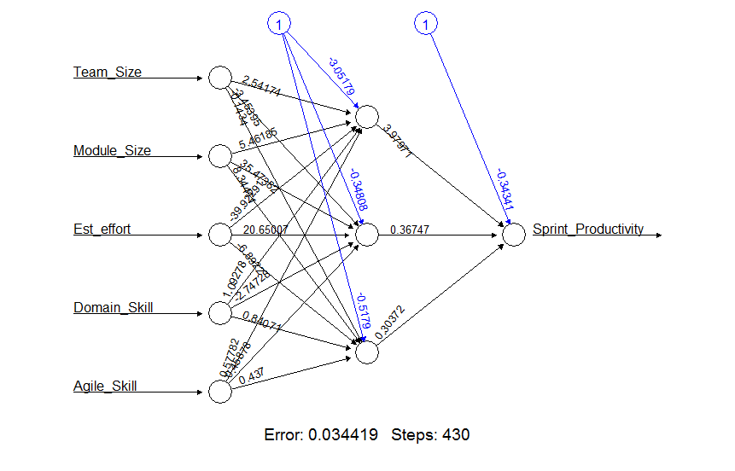
Indian Statistical Institute
ARTIFICAL NEURAL NETWORKS
Exercise 1: Output

Slide 18
Indian Statistical Institute
ARTIFICAL NEURAL NETWORKS
Exercise 1:
Computation of model diagnostic measures
> pred = mymodel$net.result[[1]]
> res = training$Sprint_Productivity - pred
> mse = mean(res^2)
> rmse = sqrt(mse)
> res_ss = sum(res^2)
> total_ss = var(training$Sprint_Productivity)*84
> rsq = 1 - res_ss/total_ss

Slide 19
Indian Statistical Institute
ARTIFICAL NEURAL NETWORKS
Exercise 1:
Model Validation
> testx = tes[,1:5]
> testx = as.data.frame(testx)
> predtest = compute(mymodel, testx)
> predtest = predtest$net.result[,1]
> test = as.data.frame(test)
> res = test$Sprint_Productivity - predtest
> mse = mean(res^2)
> rmse = sqrt(res^2)

Slide 20
Indian Statistical Institute
ARTIFICAL NEURAL NETWORKS
Exercise 1:
Model Validation
> res_ss = sum(res^2)
> total_ss = var(test$Sprint_Productivity)*25
> rsq = 1 - res_ss/total_ss
 | MSE | RMSE | R²
Training | 0.00081 | 0.0285 | 0.966
Test | 0.0021 | 0.0463 | 0.827

