Slide 1
DevSecOps Application Deployment with AWS AI Integration
Developed by Kathleen Hill
*Using VSCode Claude Code Integration

Slide 2

Application Overview
LEVERAGING AWS SERVICES
Sentiment Analysis: AWS Comprehend
Conversational Assistant: AWS Lex
DEPLOYMENT DETAILS
Model Development required provisioning based on maximizing RAM utility through the use of only 2 workers, and implementing a Provisioned Concurrance.
CONTINUOUS DEPLOYMENT
Leverages Gunicorn on Ec2 for ....
APPLICATION PURPOSE
An integrated solution to review open-source information to track performance of Cyber-Security Related Companies
KEY APPLICATION COMPONENTS
Document Scraping (SEC Filings, Earnings Transcripts), Profit Reporting and Forecasting, Sentiment Analysis, and AI Assistant

Slide 3
AWS AI INTEGRATION
AMAZON COMPREHEND
AMAZON LEX
Utilizing Amazon Comprehend to perform sentiment analysis on SEC Filings (i.e., 10-K, 10-Q) and Earnings Calls (Sourced from Alpha Vantage). This incorporates:
Commonly Used Word Visualization,
Top level document evaluations are leveraged to compare document types,
NER for targeted sentiment analysis providing granular understanding of the sentiments associated with specific entities (i.e., brands or products).
Incorporating Amazon Lex to build a conversational interface allowing a user to interface with the chatbot to answer questions such as:
What companies are being tracked?
What information is available about Crowdstrike?
View forecast predictions for Crowdstrike.
Explain dashboard features.
Start tracking Microsoft. (Adds company to Company Table in the Back-end Database)
Stop tracking Crowdstrike (Removes company from Company Table in the Back-end Database)

Slide 4
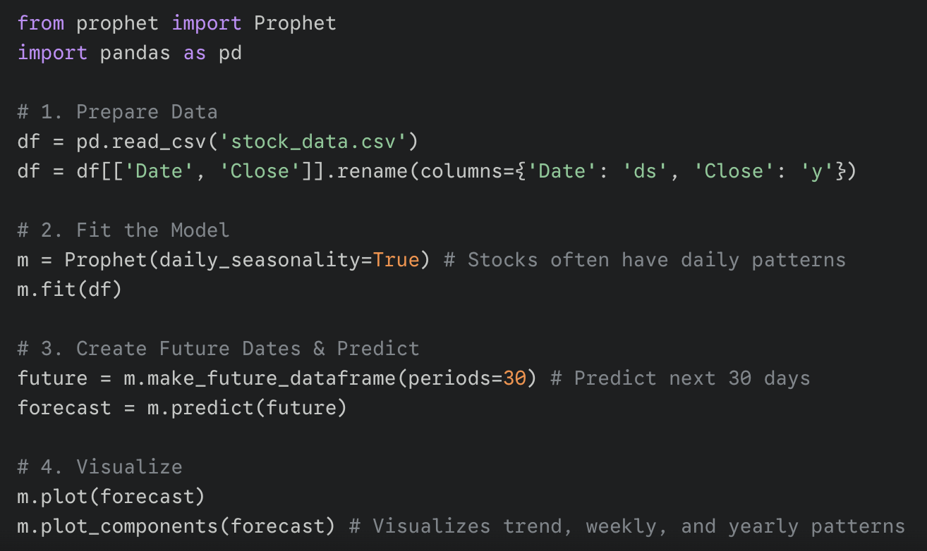
Capability Development
y = trend + seasonality + holidays
Price Forecasting
Utilizing Amazon Comprehend to perform sentiment analysis on SEC Filings (i.e., 10-K, 10-Q) and Earnings Calls (Sourced from Alpha Vantage). This incorporates:
Commonly Used Word Visualization,
Top level document evaluations are leveraged to compare document types,
NER for targeted sentiment analysis providing granular understanding of the sentiments associated with specific entities (i.e., brands or products).

Slide 5
Capability Development
Amazon Lex
Intent Lambda Handler | Data Source
WelcomeIntent | Static (intentional)
ListCompaniesIntent | Database
CompanyInfoIntent | Database
SentimentAnalysisIntent | API /api/sentiment/{ticker}
ForecastIntent | API /api/forecast + /api/evaluate
GrowthMetricsIntent | API /api/company-growth/{ticker}
DocumentInventoryIntent | Database
DashboardFeaturesIntent | Static (intentional)
FallbackIntent | Static (intentional)
AddCompanyIntent | Database
RemoveCompanyIntent | Database
Troubleshooting:
API Responses for model-based information resulted in a timeout from Lex for the Lambda to respond
Solution was twofold:
Provisioned Concurrency to avoid cold startups; will destroy instance when not using due to increased cost
Having the Lambda call the EC2's public IP instead of the private IP (30 seconds vs .3 seconds)
Conversations with confirmation (such as remove company from tracking required adjustment from ElicitIntent to ConfirmIntent

Slide 6




















AWS Cloud
Region: us-west-2
AWS AI Services
Amazon Lex
Amazon Comprehend
External Data Sourced from Internet
Artifacts Storage
Virtual private cloud (VPC)
10.0.0.0/16
Internet gateway
via
SEC Edgar
(10-K, 10-Q)
Public subnet
10.0.0.0/24
Amazon S3
SEC Filings, Transcripts
EC2 instance
10.0.0.114
Yahoo Finance
(Stock Data)
CloudFront
Explorium
(Company Growth)
HTTPS
2 Workers
Time Series
Forecaster
NAT
gateway
dnes10oz5czsk.cloudfront.net
Se: YouTube (KWIIPKbdxD0)
Alpha Vantage
(Transcripts)
User
via
HTTPS
Availability Zone 1 (us-west-2b)
Private subnet
10.0.10.0/24
Frontend Hosting
Private subnet
10.0.11.0/24
Security Group (rds-sg)
RDS Multi-AZ Ready
Amazon RDS PostgreSQL
instance
Amazon S3
React Build
Security Group (lambda-sg)
Lambda function
(Lex Fulfillment)
Tables:
Companies (Tickers, Aliases)
Sentiment Cache
Forecast Cache
Growth Cache
Public subnet
10.0.1.0/24
Assorted Icons
Notes:
NAT Gateway is for private subnet egress and acknowledge it's the biggest cost driver (~$32/month), not currently used as the Lambda directly accesses the EC2 within the VPC.
Lambda → EC2 (for API calls like /api/forecast)
arrow from Lambda → RDS (for direct database queries)
Set up to allow load balancer or an auto scaling group with additional public subnet, but not needed for this presentation.

Slide 7
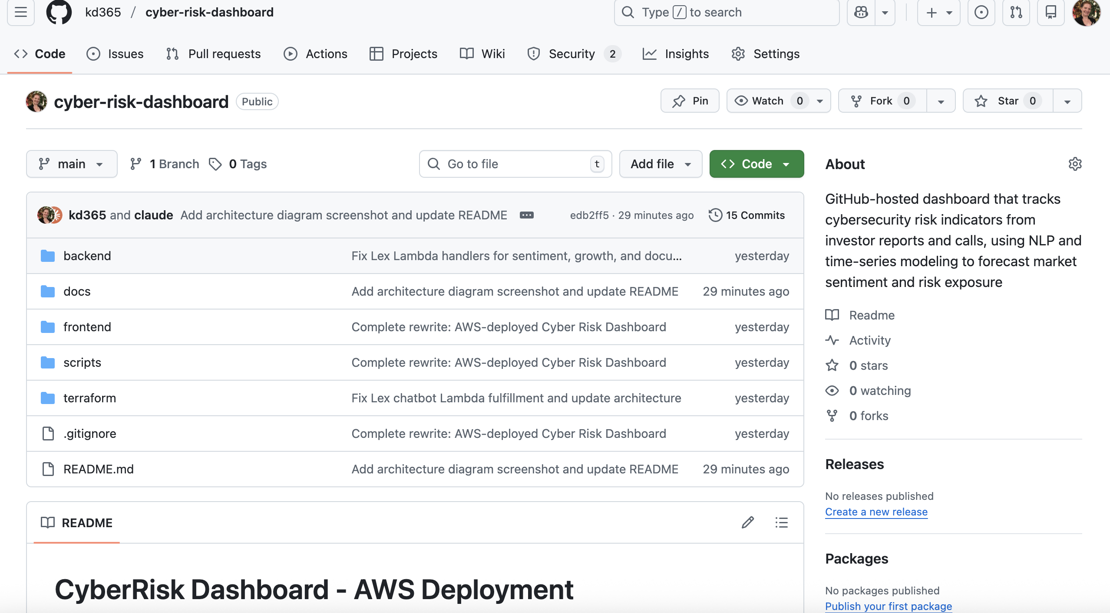
GitHub Deployment
https://github.com/kd365/cyber-risk-dashboard/tree/main
Local Development
Build and Test
Local App Version Developed in VSCode with Claude Code
Application is built and tested
Conversion to Cloud Hosted Version
Git Documentation
Develop deployment using Terraform
Successful build documented on GitHub

Slide 8

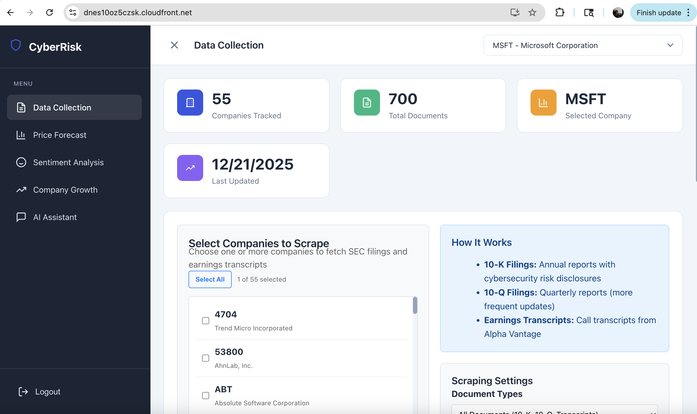
Demo

