Slide 1
Distribution of Regulatory Weights in Six Database-Derived GRNs
Brandon Klein
Last Updated: 02/27/17

Slide 2
Updates
Fixed bin interval=20.
Cumulative percentage line graphs generated.
Problem: could not find a simple way to plot a smooth curve.

Slide 3
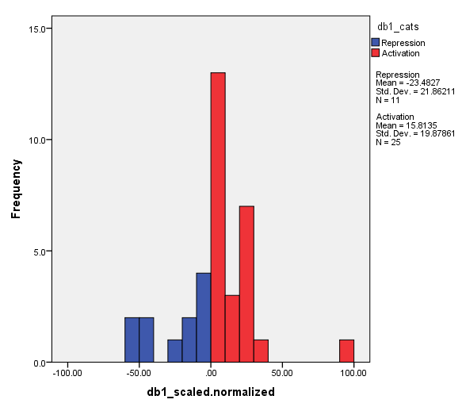
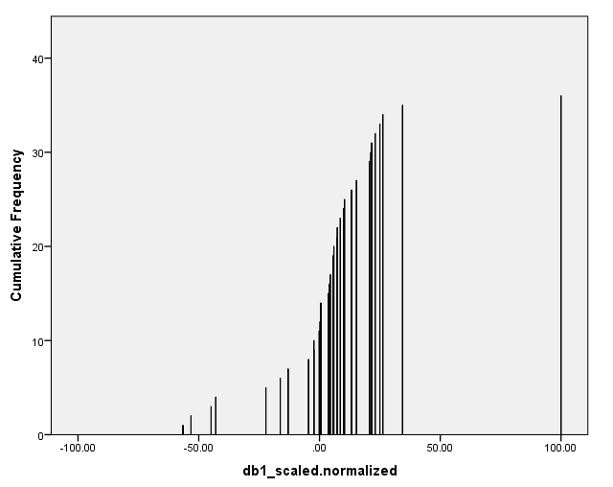
Distribution of db1 Regulatory Weights Network: 16 Genes, 36 Edges

Slide 4
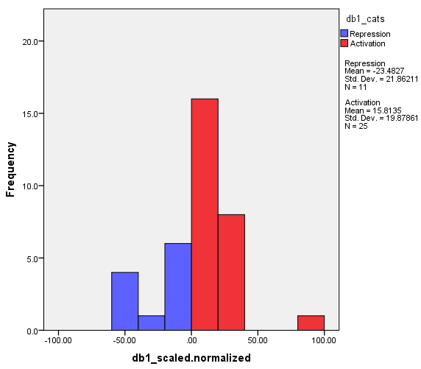
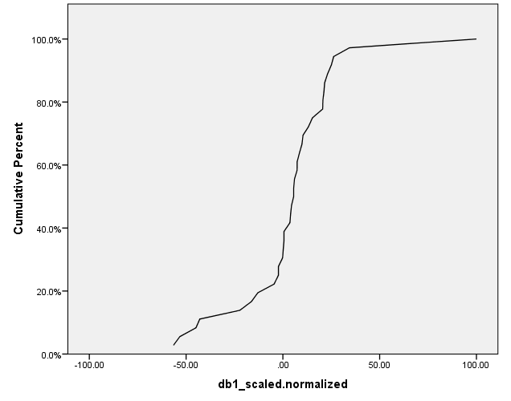
Distribution of db1 Regulatory Weights Network: 16 Genes, 36 Edges

Slide 5
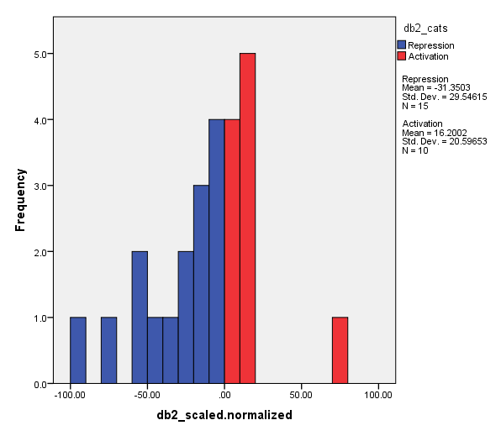
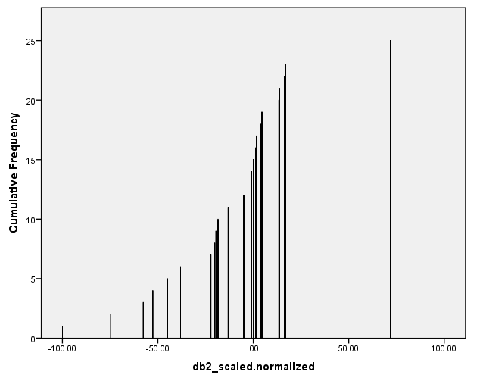
Distribution of db2 Regulatory Weights Network: 14 Genes, 25 Edges

Slide 6
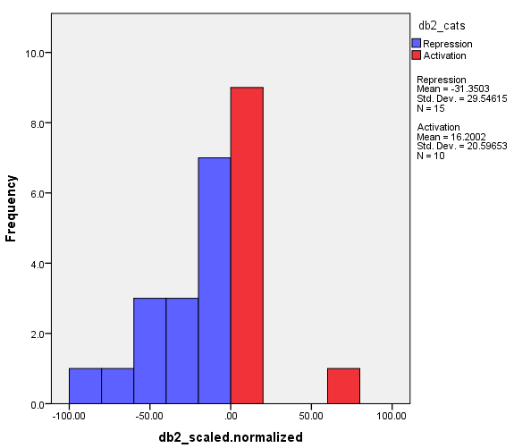
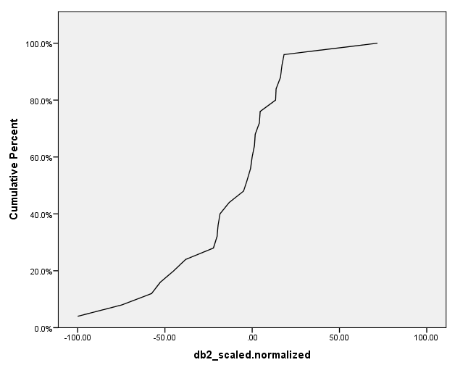
Distribution of db2 Regulatory Weights Network: 14 Genes, 25 Edges

Slide 7
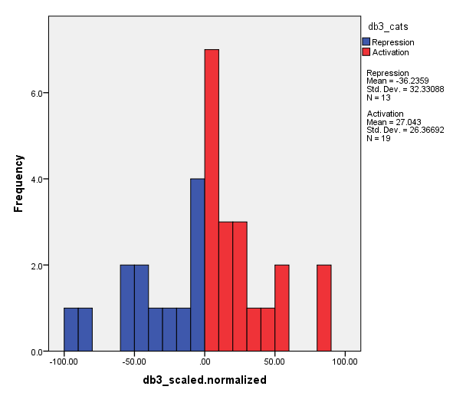
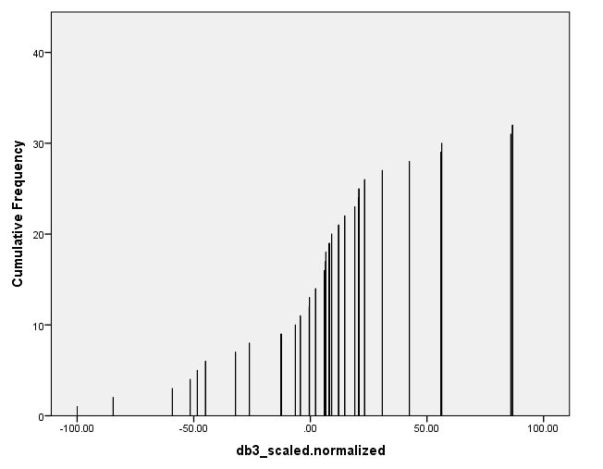
Distribution of db3 Regulatory Weights Network: 17 Genes, 32 Edges

Slide 8
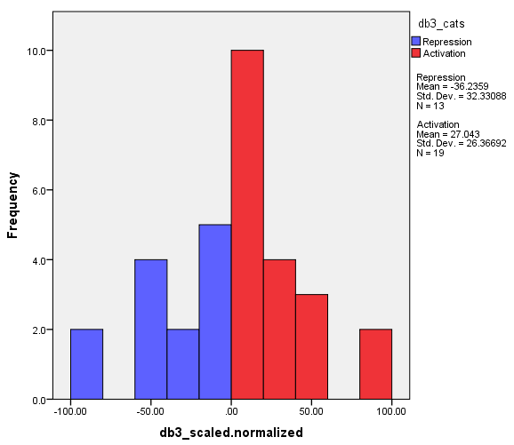
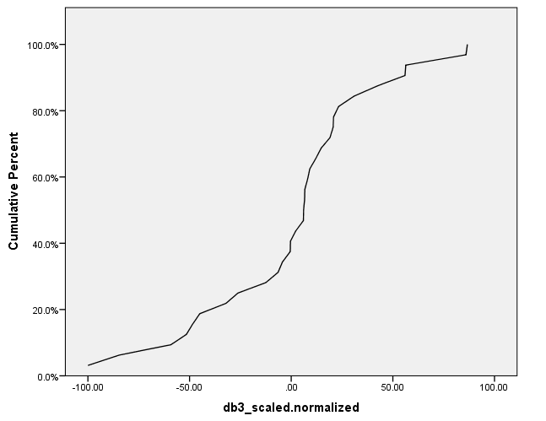
Distribution of db3 Regulatory Weights Network: 17 Genes, 32 Edges

Slide 9
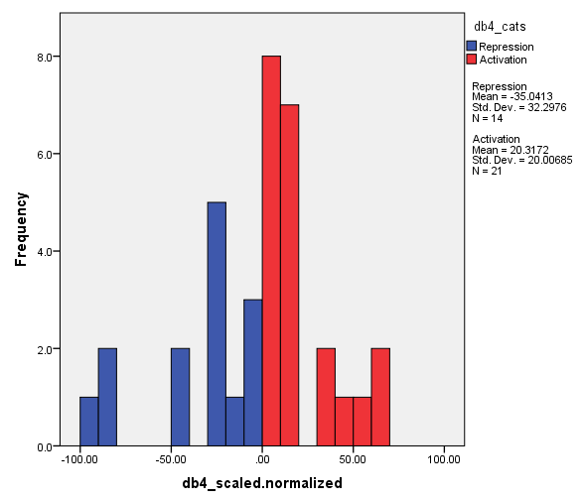
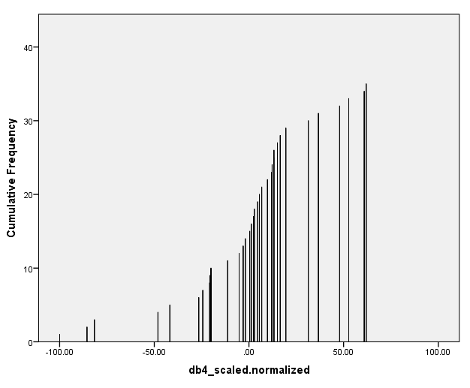
Distribution of db4 Regulatory Weights Network: 14 Genes, 35 Edges

Slide 10
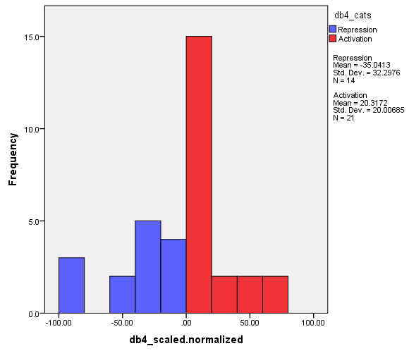

Distribution of db4 Regulatory Weights Network: 14 Genes, 35 Edges

Slide 11
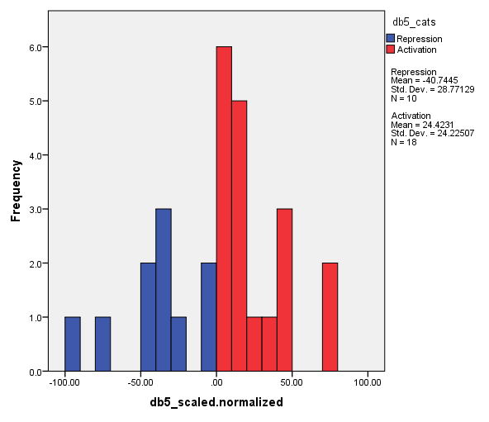
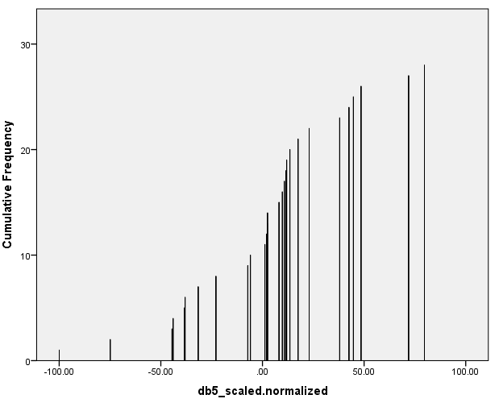
Distribution of db5 Regulatory Weights Network: 15 Genes, 28 Edges

Slide 12
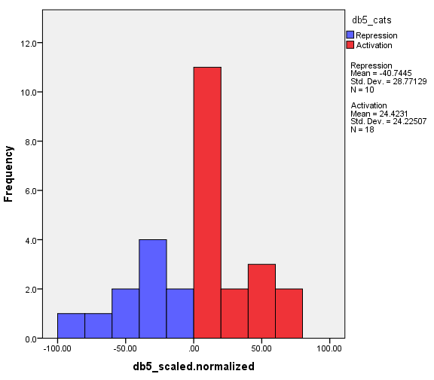
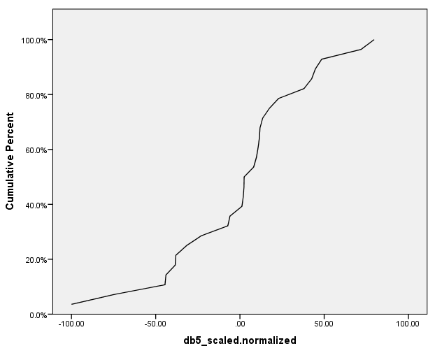
Distribution of db5 Regulatory Weights Network: 15 Genes, 28 Edges

Slide 13
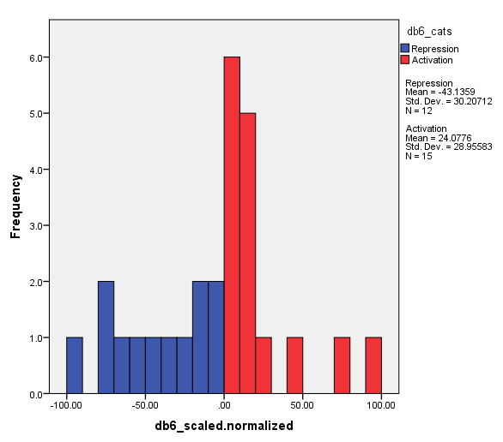
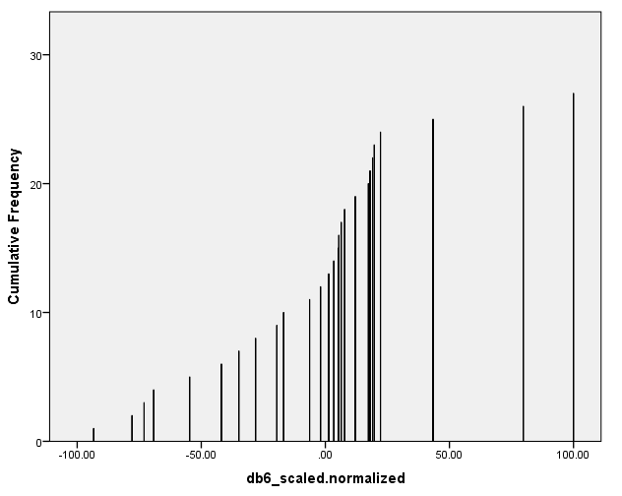
Distribution of db6 Regulatory Weights Network: 16 Genes, 27 Edges

Slide 14
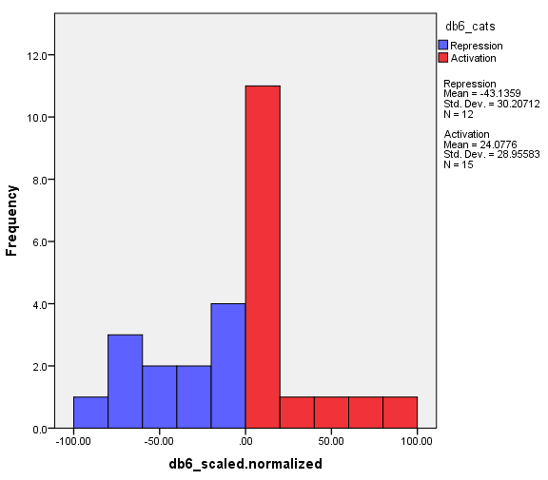
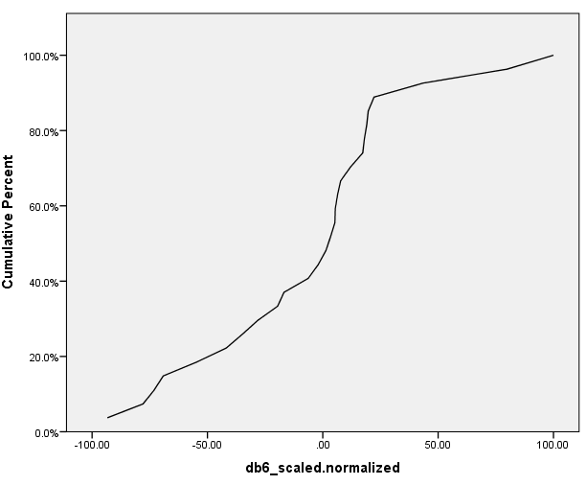
Distribution of db6 Regulatory Weights Network: 16 Genes, 27 Edges

