Slide 1

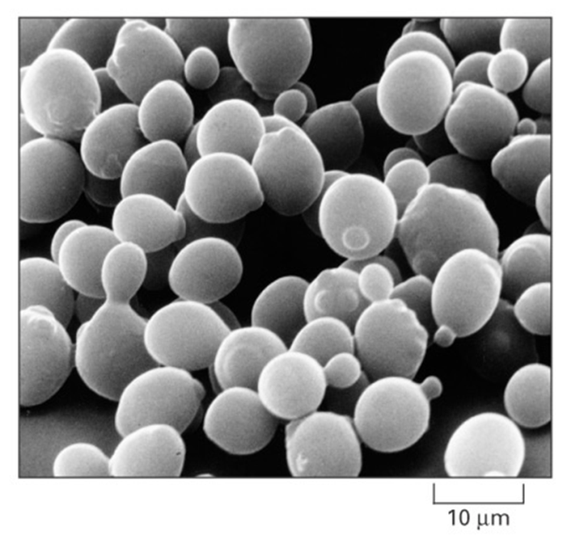
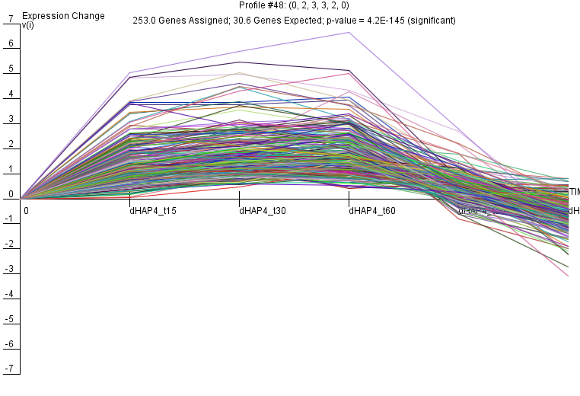
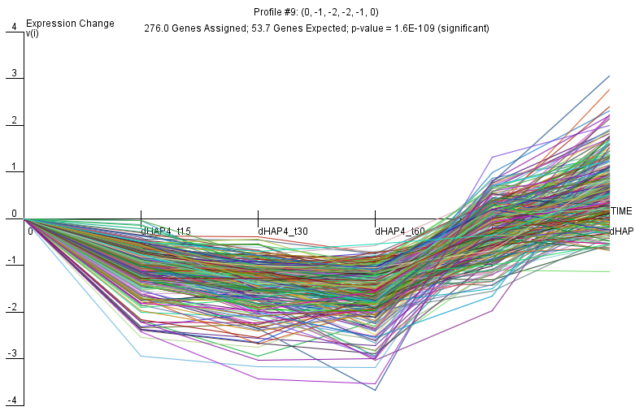
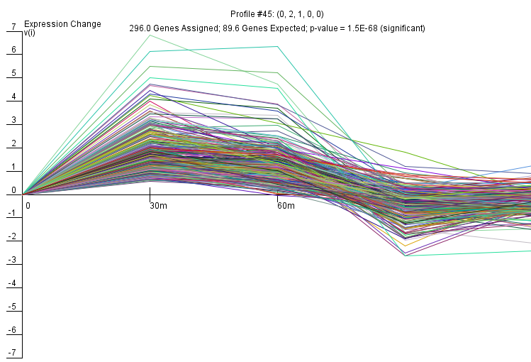
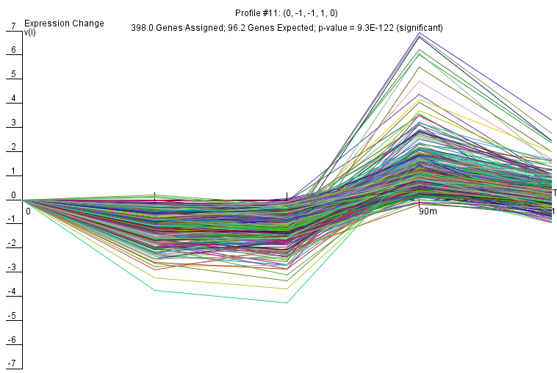
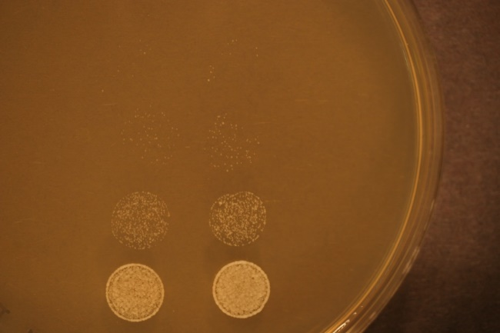
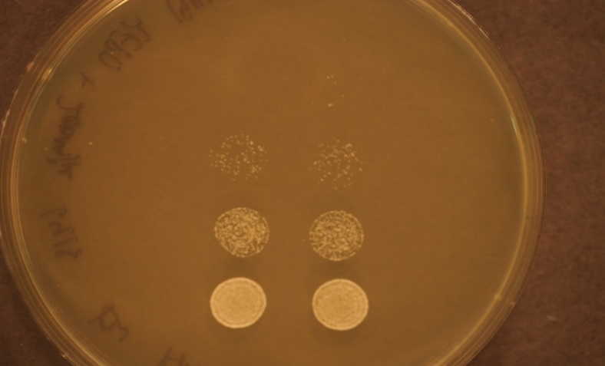
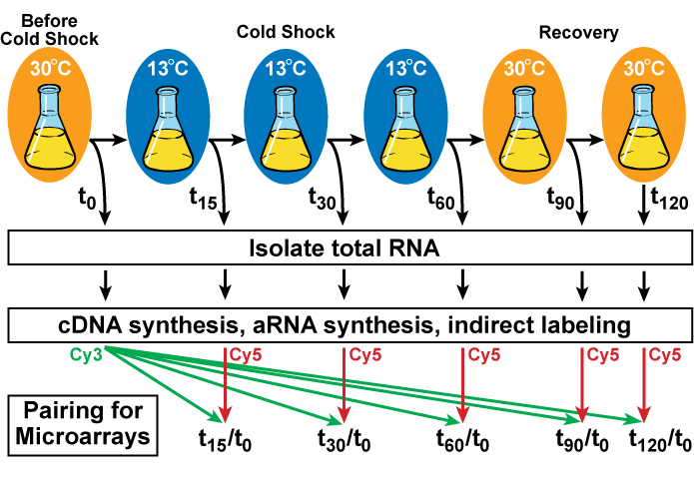
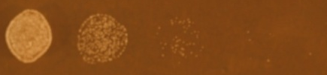
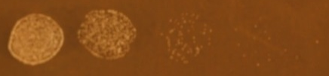
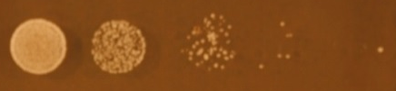
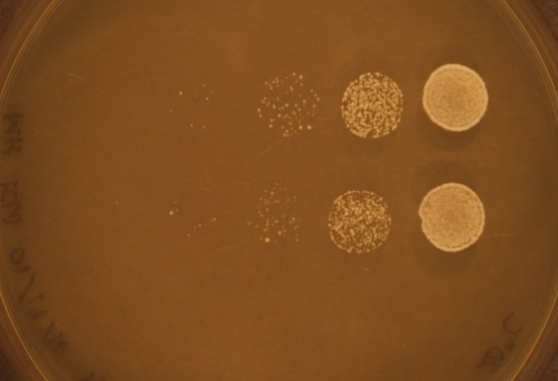
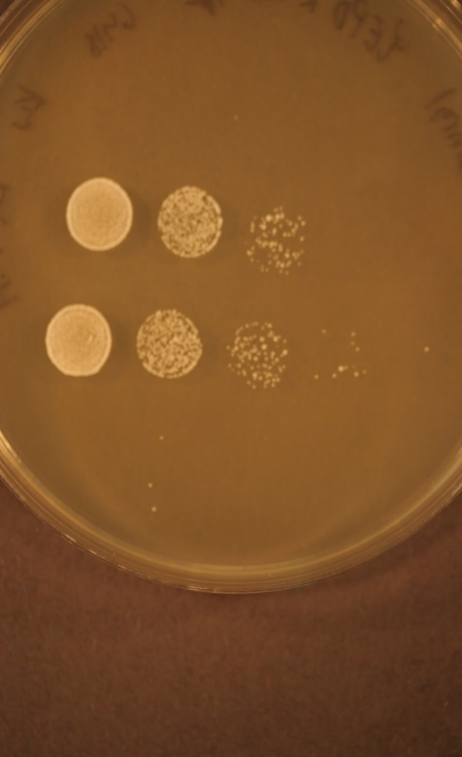

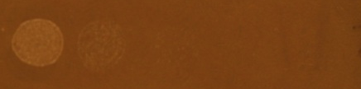
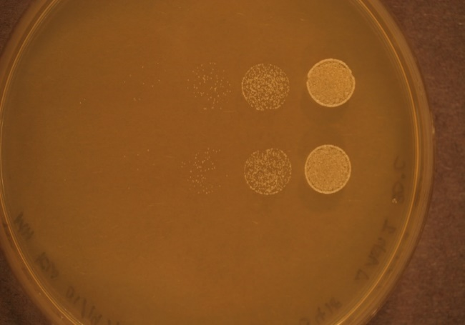
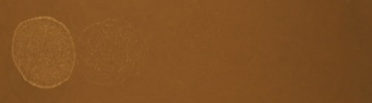


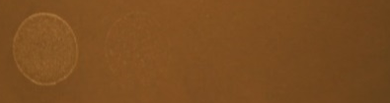
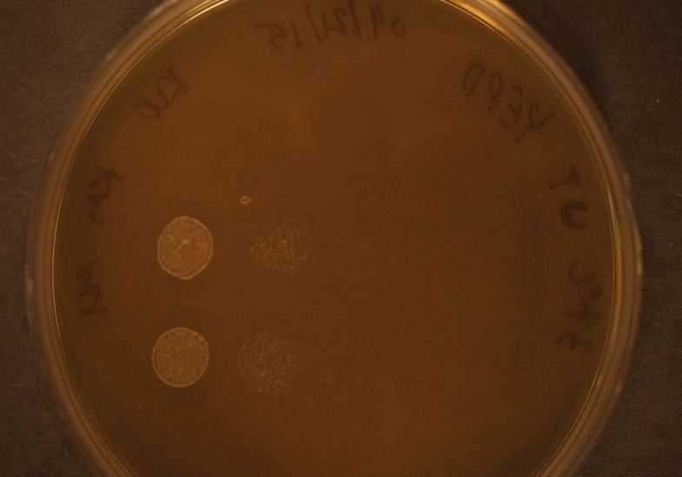
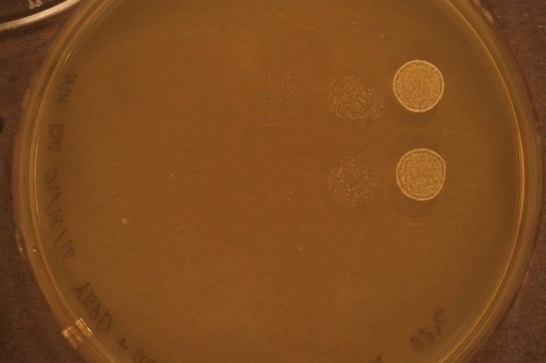
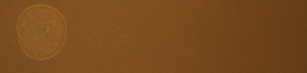
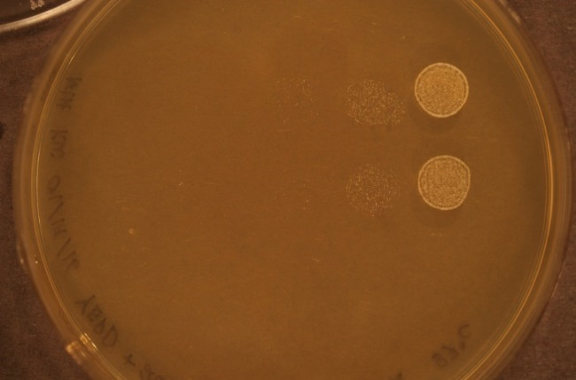
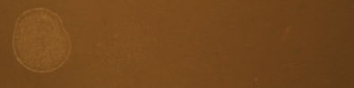
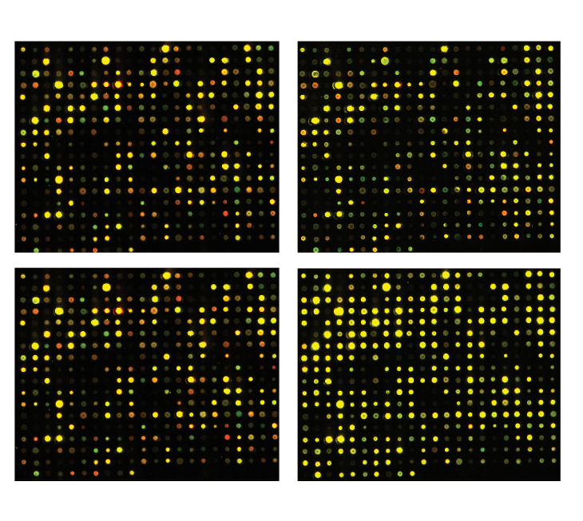
The transcription factors Hap4 and Swi4 contribute to the regulation of the transcriptional response to cold shock in Saccharomyces cerevisiae
Monica V. Hong*, Kevin W. Wyllie**, Kevin P. McGee*, Kam D. Dahlquist*
*Department of Biology, **Department of Chemistry & Biochemistry, Loyola Marymount University, 1 LMU Drive, Los Angeles, CA 90045
Budding Yeast, Saccharomyces cerevisiae, is
an Ideal Model Organism for Systems Biology
An ANOVA and a Modified T Test Were Used to Determine Which Genes Had Significant Changes in Expression in the Wild Type, Δhap4, and Δswi4 Strains
Short Time Series Expression Miner (STEM)
Software Clusters Genes with Similar Profiles
Budding yeast has a small genome of approximately 6000 genes.
Extensive genome-wide datasets are publicly accessible in databases.
Deletion strain collections and other molecular genetic tools are readily available.
ANOVA | WT | Δswi4 | Δhap4
p < 0.05 | 2200 (36%) | 2606 (42%) | 2382 (38%)
B-H p < 0.05 | 1346 (22%) | 1869 (30%) | 1620 (26%)
Bonferroni p < 0.05 | 119 (1.9%) | 178 (2.9%) | 56 (0.9%)
Genes that met the Benjamini and Hochberg corrected p < 0.05 criterion in the ANOVA test for each deletion strain were clustered using the STEM software (Ernst and Bar-Joseph 2006).
Genes that exhibited similar patterns of expression over the course of the cold shock and recovery experiment were grouped into profiles.
The figures below are profiles which showed patterns of expression of up-regulation during cold shock followed by down-regulation during recovery or vice versa.
The stem software determined which Gene Ontology categories were enriched among genes in the profiles, examples of which are shown below each figure.
Alberts et al. (2004)
The ANOVA test determined whether a particular gene was differentially expressed (log₂ fold change > or < 0) at any timepoint.
This table shows the number and percentage of genes that had a significant change in expression at an unadjusted
p < 0.05, a Benjamini and Hochberg (B-H) corrected p < 0.05, or a Bonferroni corrected p < 0.05.
The Benjamini and Hochberg and Bonferroni adjustments were applied to the unadjusted p values to correct for the multiple testing problem. When performing 6189 hypothesis tests, as was done here, we would expect 5% of the genes (303) to have a p < 0.05 due just due to chance. The Bonferroni correction is more stringent than the Benjamini and Hochberg correction.
Cold Shock Is an Environmental Stress that Is Not Well-Studied
Increases in temperature (heat shock)
response very well-characterized
proteins denature due to heat
induction of heat shock proteins (chaperonins), that assist in protein folding
conserved in all organisms (prokaryotes, eukaryotes)
Decreases in temperature (cold shock)
response less well-characterized
decrease fluidity of membranes
stabilize DNA and RNA secondary structures
impair ribosome function and protein synthesis
decrease enzymatic activities
no equivalent set of cold shock proteins that are conserved in all organisms
Wild Type | Cold Shock |  | Recovery
Modified T test | t₃₀ | t₆₀ | t₉₀ | t₁₂₀
Increased LogFC > 0.25 and p < 0.05 | 807 (13%) | 895 (14%) | 382 (6.2%) | 227 (3.7%)
Decreased LogFC < -0.25 and p < 0.05 | 774 (13%) | 902 (14%) | 377 (6.1%) | 279 (4.5%)
Total p < 0.05 | 1589 (26%) | 1809 (29%) | 761 (12%) | 510 (8.2%)
B-H p < 0.05 | 102 (1.6%) | 14 (0.2%) | 0 (0%) | 1 (0.016%)
Bonferroni p < 0.05 | 0 (0%) | 0 (0%) | 1 (0.02%) | 0 (0%)
Δhap4
Expression (log₂ fold change)
Δswi4 | Cold Shock |  | Recovery
Modified T test | t₃₀ | t₆₀ | t₉₀ | T₁₂₀
Increased LogFC > 0.25 and p < 0.05 | 767 (12%) | 796 (12%) | 510 (8.2%) | 325 (5.0%)
Decreased LogFC < -0.25 and p < 0.05 | 726 (11%) | 953 (15%) | 579 (9.4%) | 375 (6.0%)
Total p < 0.05 | 1501 (24%) | 1761 (28%) | 1093 (18%) | 701 (11%)
B-H p < 0.05 | 3 (0.48%) | 7 (0.11%) | 1 (0.016%) | 0 (0%)
Bonferroni p < 0.05 | 0 (0%) | 0 (0%) | 1 (0.016%) | 0 (0%)
Example Gene Ontology categories:
Time (minutes)
mRNA metabolic process
Ribosome biogenesis
Chromatin modification
Microtubule cytoskeleton organization
Condensed nuclear chromosome
Endoplasmic reticulum
Yeast Respond to Cold Shock by Changing Gene Expression
Δhap4 | Cold Shock |  |  | Recovery
Modified T test | t15 | t30 | t60 | t90 | t120
Increased LogFC > 0.25 and p < 0.05 | 699 (11%) | 927 (15%) | 1038 (17% | 153 (2.5%) | 289 (4.7%)
Decreased LogFC < -0.25 and p < 0.05 | 527 (8.5%) | 839 (14%) | 951 (15%) | 86 (1.4%) | 228 (3.7%)
Total p < 0.05 | 1256 (20%) | 1840 (30%) | 2024 (33%) | 258 (4.2%) | 540 (8.7%)
B-H p < 0.05 | 801 (13%) | 1205 (19%) | 1431 (23%) | 131 (2.1%) | 260 (4.2%)
Bonferroni p < 0.05 | 4 (.065%) | 4 (.065%) | 1 (.016%) | 0 (0%) | 0
Cold shock temperature range for yeast is 10-18°C
Previous studies indicate that the cold shock response can be divided into:
Late response genes – 12 to 60 hours (Schade et al. 2004)
General environmental stress response genes (ESR) are induced
Regulated by the Msn2/Msn4 transcription factors
Early response genes – 15 minutes to 2 hours
Genes unique to cold shock are induced, such as genes involved in ribosome biogenesis and membrane fluidity
Which transcription factors regulate this response is unknown
Previously in the lab, it was shown that the Δswi4 and Δhap4 strains of budding yeast, which are deleted for the Swi4 and Hap4 transcription factors, respectively, are impaired for growth at cold temperatures. Thus we chose to further study those strains.
Expression (log₂ fold change)
Δswi4
This table shows the number and percentage of genes that had a significant change in expression for each time point at an unadjusted p < 0.05, a Benjamini and Hochberg (B-H) corrected p < 0.05, or a Bonferroni corrected p < 0.05. The number of genes that were increased and decreased in expression at an unadjusted p < 0.05 are also shown.
Example Gene Ontology categories:
Time (minutes)
Positive regulation of protein polymerization
Actin cytoskeleton organization
Glycogen metabolic process
Phosphorus metabolic process
Four Independent Cultures Were Subjected
to the Cold Shock and Recovery Experiment
Additional Transcription Factor Deletion Strains Were Tested
for Growth Impairment at Four Different Temperatures
Ribosome biogenesis
Nitrogen compound metabolic processes
Protein serine/threonine phosphatase complex
Cells were grown to early log phase and five timepoints were collected: before cold shock (t₀), after 30 and 60 minutes of cold shock at 13°C (t₃₀, t₆₀), and after 60 minutes of cold shock followed by 30 and 60 minutes of recovery at 30°C (t₉₀, t1₂₀). An additional cold shock timepoint was collected for the Δhap4 strain after 15 minutes (t₁₅).
Total RNA was prepared using the Ambion RiboPure Yeast Kit.
aRNA was prepared from 1 μg of total RNA and labeled with the Cy3 and Cy5 dyes using the Ambion Amino Allyl Message Amp II Kit before hybridizing to DNA microarrays.
Dye orientation was swapped for two sets of replicates.
Microarrays were scanned using the Axon GenePix 4000B scanner.
Wild-Type
Δash1
Δnrg1
Summary and Future Directions
15ºC
day 5
Cells of S. cerevisiae deletion strains Δswi4 and Δhap4 were subjected to a cold shock and recovery experiment.
The genes which show different patterns of expression between the wild type and either deletion strain are the ones that are potentially involved in the cold shock response.
Gene Ontology categories were assigned to expression profiles.
The two major patterns of expression were up regulation during cold shock, followed by down regulation during recovery, and vice versa.
Gene Ontology categories that followed these patterns in the Δswi4 strain include ribosome biogenesis, nitrogen compound metabolic processes, protein serine/threonine phosphates complex, and, positive regulation of protein polymerization, actin cytoskeleton organization, glycogen metabolic processes, phosphorus metabolic processes, respectively.
Gene Ontology categories that followed these patterns in the Δhap4 strain include mRNA metabolic process, ribosome biogenesis, chromatin modification, and, microtubule cytoskeleton organization, condensed nuclear chromosome, endoplasmic reticulum.
Based on new growth experiments, we are further investigating the Δash1 strain.
20ºC
day 4
30ºC
day 1
37ºC
Gene Expression Changes Due to Cold Shock
Return to Pre-shock Levels During Recovery
day 1
Acknowledgments
t₃₀/t₀ cold shock
t₆₀/t₀ cold shock
Representative images of DNA microarrays for wild type S. cerevisiae are shown.
Each spot contains DNA from one gene, which hybridizes to the aRNA prepared in the experiment.
Red spots indicate an increase in gene expression relative to the control (t₀).
Green spots indicate a decrease in gene expression relative to the control (t₀).
Yellow spots indicate no change in expression.
Wild-Type Growth
Δash1 Growth
Δnrg1 Growth
The figures above show growth of the wild type, Δash1, and Δnrg1 strains at four different temperatures.
The table to the left interprets the results, showing relative growth between the three strains.
Cultures of equal cell density (OD600 = 0.5) were serially diluted and were then plated on YEPD agar (plus 200 μg/mL G418 antibiotic for deletion strains).
Growth of each strain was documented each day for seven days, at 15, 20, 30 and 37ºC.
Nine deletion strains were tested, and results from the growth experiments were used to determine which strains should be further investigated via DNA microarray analysis.
We are further investigating the Δash1 strain.
15ºC
+++
+
++++
We would like to thank Heather King, Matt Mejia, Wesley Citti, Olivia Sakhon, and Elizabeth Liu for collecting the wild type DNA microarray data, the Biology 478: Molecular Biology of the Genome classes from Spring 2013 and Spring 2014 for their contributions to collecting the Δswi4 microarray data, and the Biology 478 Spring 2015 class for their contributions to collecting the Δhap4 data. Partial funding for this project was provided by NSF-RUI 0921038 (K.D.D.), a Kadner-Pitts Research Grant (K.D.D., M.V.H.), the LMU Summer Undergraduate Research Program (K.W.W., K.P.M.), and the LMU Honors Program Summer Research Fellowship (M.V.H.).
day 5
+++
++
++++
20ºC
day 4
+++
++++
++
References
30ºC
day 1
Alberts, B., Bray, D., Hopkin, K., Johnson, A., Lewis, J., Raff, M., ... & Walter, P. (204). Essential cell biology, 2nd ed., Garland Science.
Ernst, J., and Brr-Joseph, Z. (2006) STEM: a tool for the analysis of short time series gene expression data. BMC Bioinformatics, 7:191. Schade, B., Jansen, G., Whiteway, M., Entian, K.D., and Thomas, D.Y. (2004) Cold Adaptation in Budding Yeast. Molecular Biology of the Cell 15: 5492–5502.
37ºC
+++
++++
++
t₉₀/t₀ recovery
t₁₂₀/t₀ recovery
day 1

