Slide 1
Db5-Derived Random Networks Multiple Regression Analysis
Brandon Klein
1/30/18

Slide 2
Design
Goal: to identify determinants of node MSE:minMSE ratio in random networks, and to compare these findings to those from db1-db6
The db5-derived random networks with the 3 lowest (15, 16, 24) and 3 highest (7, 12, 31) LSE:minLSE ratios were selected for multiple regression analysis
Dependent Variable: node MSE:minMSE ratio
Independent Variables: GRNmap inputs (deg. rate, average expression), GRNmap outputs (optimized p & b), experimental outcomes (ANOVA B&H p-value), and Gephi graph statistics (centrality measures, weighted degree, etc.)

Slide 3
Narrowing of Independent Variables
Closeness Centrality vs. Harmonic Closeness Centrality
Highly collinear
Harmonic closeness centrality was excluded
In Degree + Out Degree vs. Degree
Highly collinear
Incorporating in degree and out degree separately was more informative than only incorporating degree into regression models
Often, only in degree was correlated to MSE:minMSE ratio, providing a more specific predictor
Degree was excluded
Weighted Degree Metrics vs. Unweighted Degree Metrics
Weighted degree metrics are more informative, correlating far more significantly with MSE:minMSE ratio
Unweighted degree metrics were excluded
Other Collinear Graph Statistics (e.g. closeness vs. eccentricity)
Varied in significance and predictive power in different models
All were input as DVs, although collinear statistics were not incorporated together into final models
See next slide for more details

Slide 4
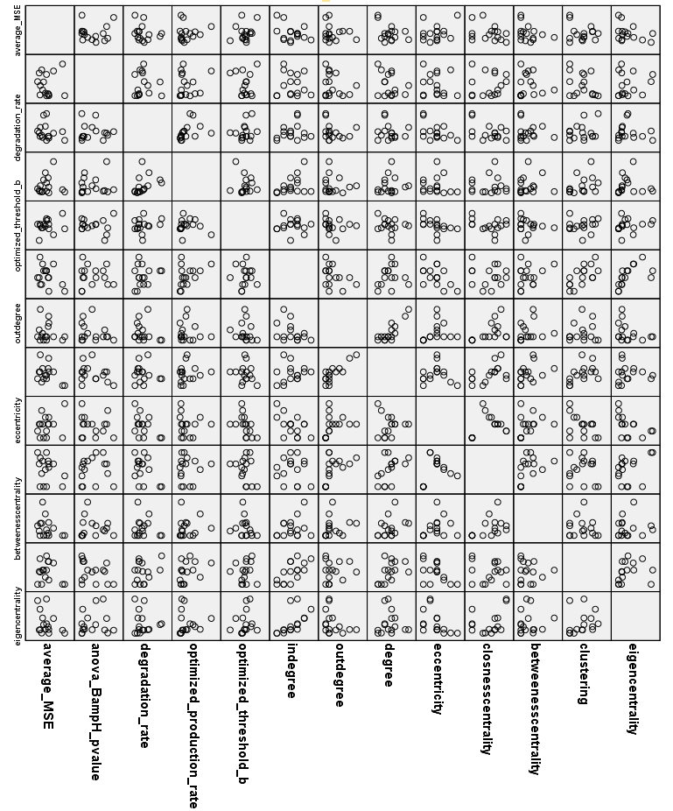
Further Notes on Collinearity
Eccentricity
Clustering
Eigencentrality
Notes:
From previous db1 analysis.

Slide 5
Models for the 3 Best Performing db5-Derived Random Networks

Slide 6
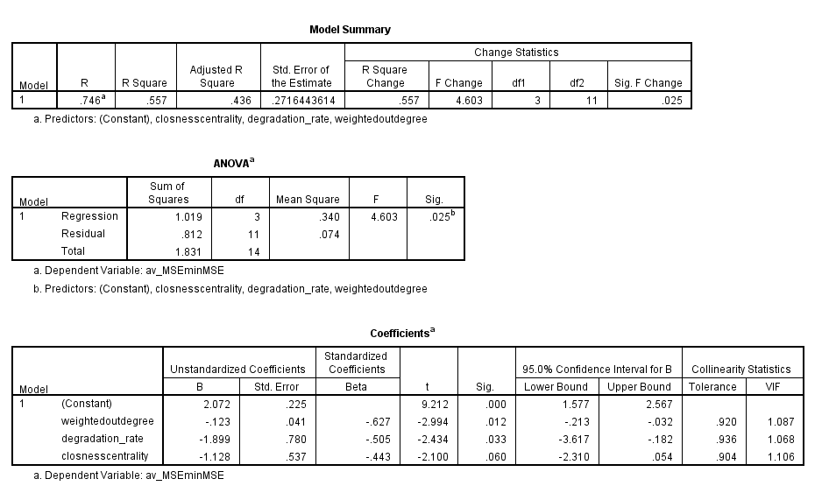
Regression Model: rand15

Slide 7
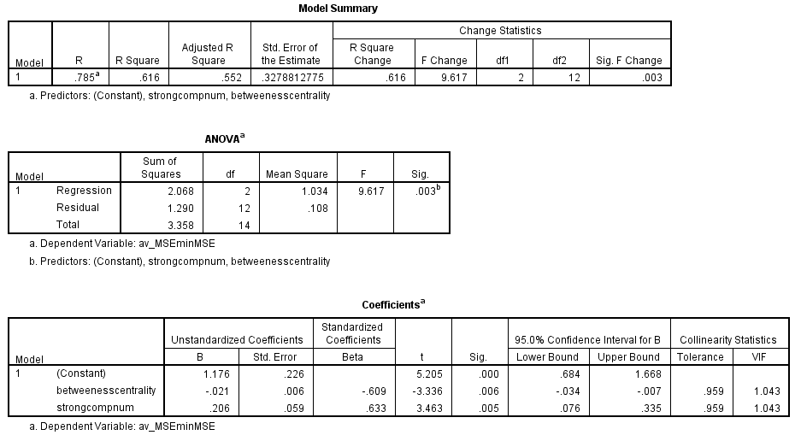
Regression Model: rand16

Slide 8
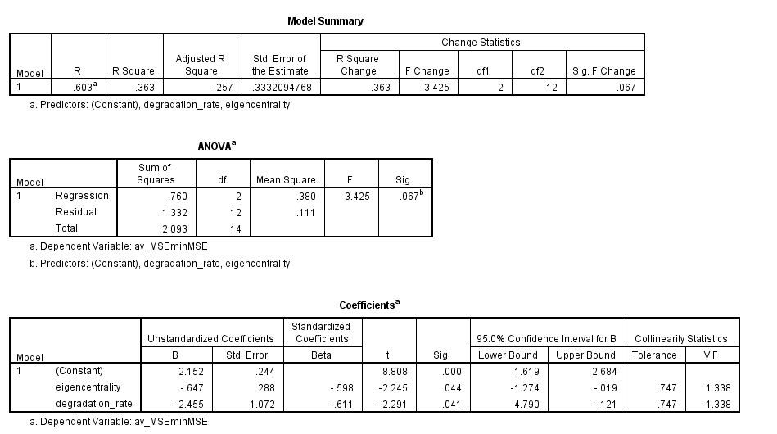
Regression Model: rand24

Slide 9
Models for the 3 Worst Performing db5-Derived Random Networks

Slide 10
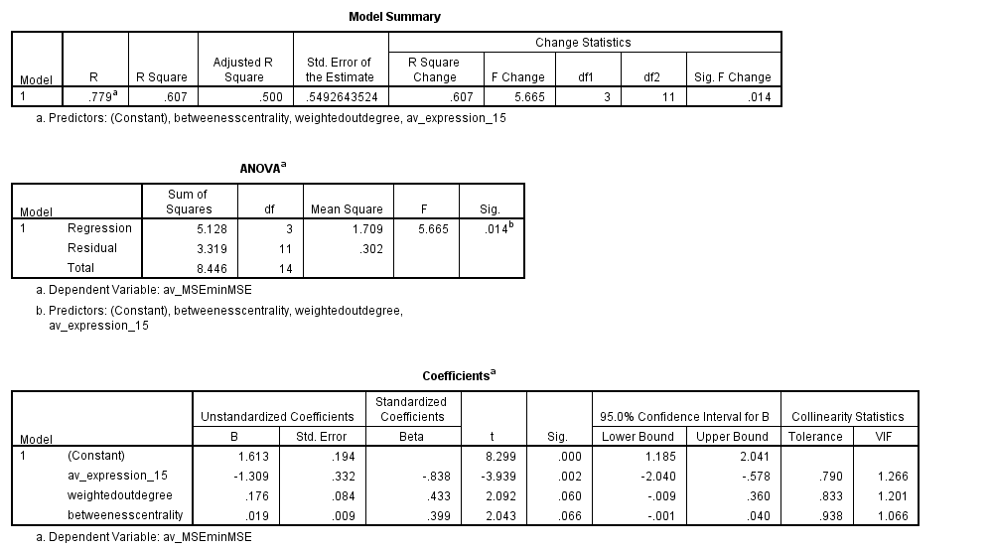
Regression Model: rand7 (1)

Slide 11
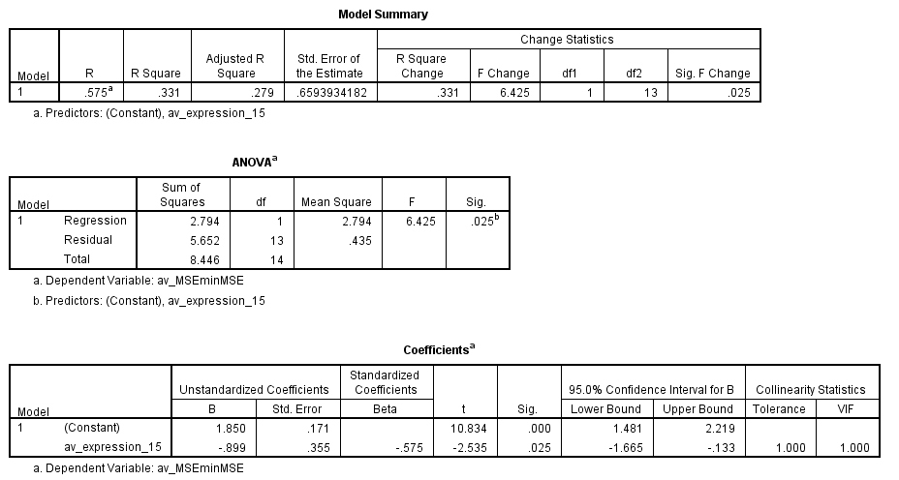
Regression Model: rand7 (2)

Slide 12
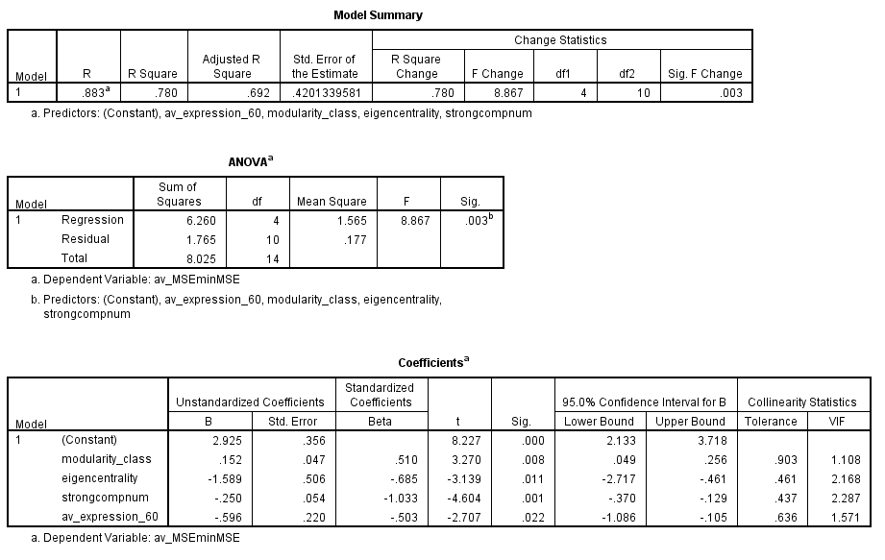
Regression Model: rand12

Slide 13
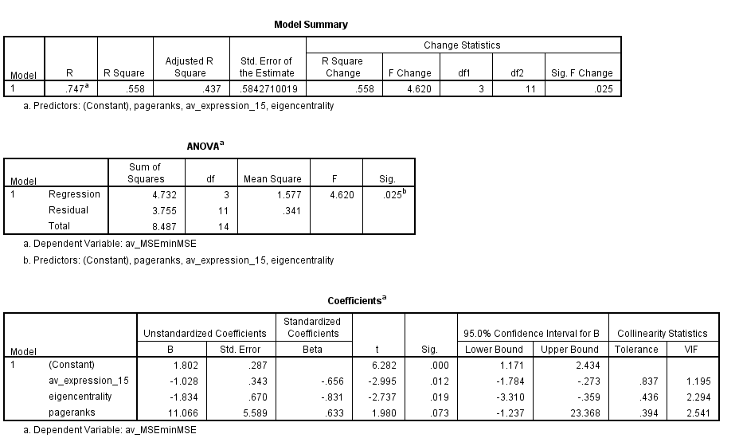
Regression Model: rand31 (1)

Slide 14
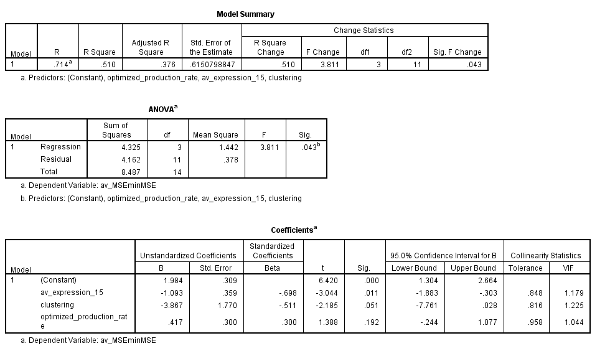
Regression Model: rand31 (2)

Slide 15
Random Networks: Summary of Model Coefficients
 | rand15 | rand16 | rand24 | rand7 | rand12 | rand31 (1) | rand31 (2)
ANOVA B&H p-value
Average Expression at 15min. |  |  |  | -0.838 |  | -0.656 | -0.698
Average Expression at 30min.
Average Expression at 60min. |  |  |  |  | -0.503
Average Expression
Degradation Rate | -0.505 |  | -0.611
Optimized Production Rate |  |  |  |  |  |  | (0.300)
Optimized Threshold b
Weighted In-degree
Weighted Out-degree | -0.627 |  |  | (0.433)
Eccentricity
Closeness Centrality | (-0.443)
Betweenness Centrality |  | -0.609 |  | (0.399)
Clustering |  |  |  |  |  |  | (-0.511)
Eigen Centrality |  |  | -0.598 |  | -0.685 | -0.831
Modularity Class |  |  |  |  | 0.510
Page Ranks |  |  |  |  |  | (0.633)
Strong Component Number |  | 0.633 |  |  | -1.033
Adjusted R Squared | 0.436 | 0.552 | 0.257 | 0.500 | 0.692 | 0.437 | 0.376
Dependent Variable: average MSE:minMSE ratio
Blue = inversely proportional to MSE → higher values yield better fit
Red = directly proportional to MSE → lower values yield better fit
Notes:
From previous db1-db6 analysis: https://github.com/kdahlquist/DahlquistLab/blob/master/data/Spring2017/15-gene_networks_analysis/multiple_regression_analysis/db1-db6_Multiple-Regression_BK20170329.pptx

Slide 16
db1-db6: Summary of Model Coefficients
 | db1 | db2 | db3 | db4 | db5 | db6-1 | db6-2
ANOVA B&H p-value
Average Expression at 15min. | (-0.507) | -0.624 | -0.479 | (-0.552) | -0.528 | (-0.626)
Average Expression at 30min.
Average Expression at 60min.
Average Expression
Degradation Rate |  |  |  |  |  |  | (-0.483)
Optimized Production Rate | (0.578) |  |  | (0.777) |  | (0.437)
Optimized Threshold b |  |  |  | (0.883)
Weighted In-degree |  |  |  |  |  | (0.617)
Weighted Out-degree
Eccentricity
Closeness Centrality
Betweenness Centrality
Clustering |  | 0.522 | 0.473 |  | 0.501
Eigen Centrality | (-0.384) |  |  | (-0.533) |  | (-0.328)
Adjusted R Squared | (0.290) | 0.525 | 0.360 | (0.441) | 0.350 | (0.196) | (0.178)
Dependent Variable: average MSE:minMSE ratio
Blue = inversely proportional to MSE → higher values yield better fit
Red = directly proportional to MSE → lower values yield better fit
Notes:
From previous db1-db6 analysis: https://github.com/kdahlquist/DahlquistLab/blob/master/data/Spring2017/15-gene_networks_analysis/multiple_regression_analysis/db1-db6_Multiple-Regression_BK20170329.pptx

Slide 17
Synthesis of Multiple Regression Analyses
 | Database-Derived Networks |  |  |  |  |  |  |  | 3 Best Random Networks |  |  |  | 3 Worst Random Networks
 | db1 | db2 | db3 | db4 | db5 | db6 (1) | db6 (2) |  | rand15 | rand16 | rand24 |  | rand7 | rand12 | rand31 (1) | rand31 (2)
ANOVA B&H p-value
Average Expression at 15min. | (-0.507) | -0.624 | -0.479 | (-0.552) | -0.528 | (-0.626) |  |  |  |  |  |  | -0.838 |  | -0.656 | -0.698
Average Expression at 30min.
Average Expression at 60min. |  |  |  |  |  |  |  |  |  |  |  |  |  | -0.503
Degradation Rate |  |  |  |  |  |  | (-0.483) |  | -0.505 |  | -0.611
Optimized Production Rate | (0.578) |  |  | (0.777) |  | (0.437) |  |  |  |  |  |  |  |  |  | (0.300)
Optimized Threshold b |  |  |  | (0.883)
Weighted In-degree |  |  |  |  |  | (0.617)
Weighted Out-degree |  |  |  |  |  |  |  |  | -0.627 |  |  |  | (0.433)
Eccentricity
Closeness Centrality |  |  |  |  |  |  |  |  | (-0.443)
Betweenness Centrality |  |  |  |  |  |  |  |  |  | -0.609 |  |  | (0.399)
Clustering |  | 0.522 | 0.473 |  | 0.501 |  |  |  |  |  |  |  |  |  |  | (-0.511)
Eigen Centrality | (-0.384) |  |  | (-0.533) |  | (-0.328) |  |  |  |  | -0.598 |  |  | -0.685 | -0.831
Modularity Class | — | — | — | — | — | — | — |  |  |  |  |  |  | 0.510
Page Ranks (derived from eigen) | — | — | — | — | — | — | — |  |  |  |  |  |  |  | (0.633)
Strong Component Number | — | — | — | — | — | — | — |  |  | 0.633 |  |  |  | -1.033
Adjusted R Squared | 0.290 | 0.525 | 0.360 | 0.441 | 0.350 | 0.196 | 0.178 |  | 0.436 | 0.552 | 0.257 |  | 0.500 | 0.692 | 0.437 | 0.376
Independent Variables that were not significant predictors in ANY models: ANOVA B&H p-value, average expression at 30 minutes, eccentricity
Independent Variables that were consistently significant predictors across ALL models: Eigen centrality
Further note predictors that were significant in some subgroups but not others (average expression at 15 in 3 worst but not 3 best; clustering in db1-db6 but not random networks; degradation rate in 3 best but not 3 worst)

