Slide 1
Distribution of Regulatory Weights in Six Random GRNs Derived from db5
Brandon Klein
Last Updated: 04/05/17

Slide 2
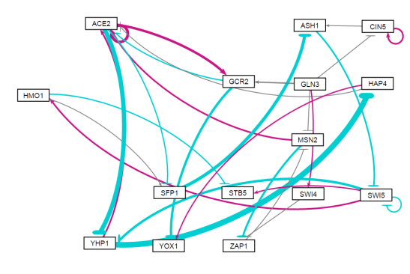
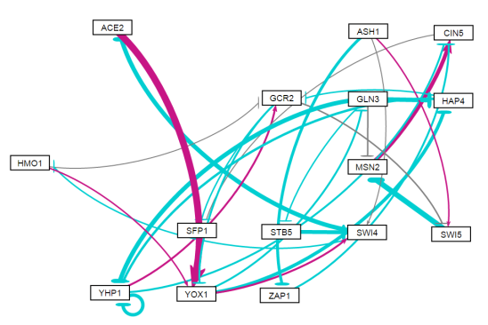
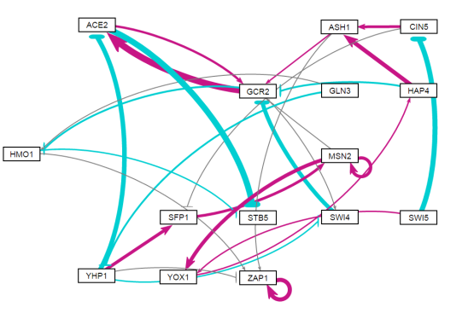
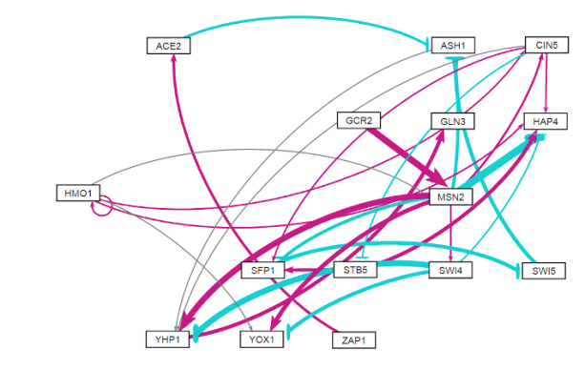
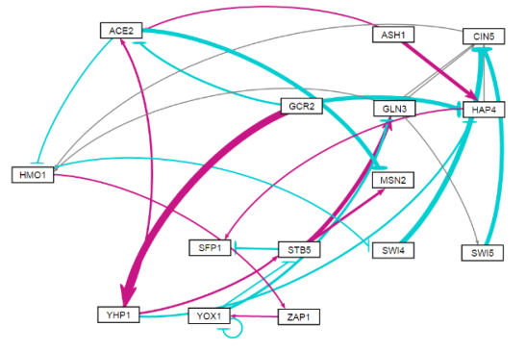
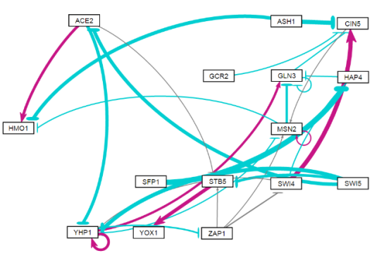
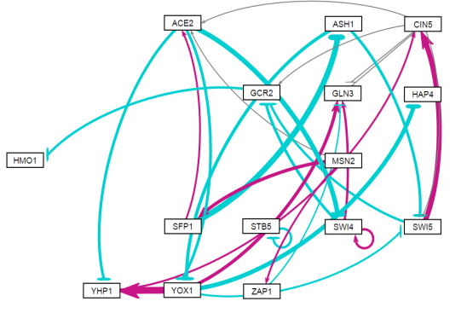
The Three Best and Three Worst Random Networks Derived from db5 were Assessed
Better networks are
on top (green)
Random Network 15
Random Network 16
Random Network 24
DB5 Network
Random Network 7
Random Network 12
Random Network 31
Worse networks are on bottom (purple)

Slide 3

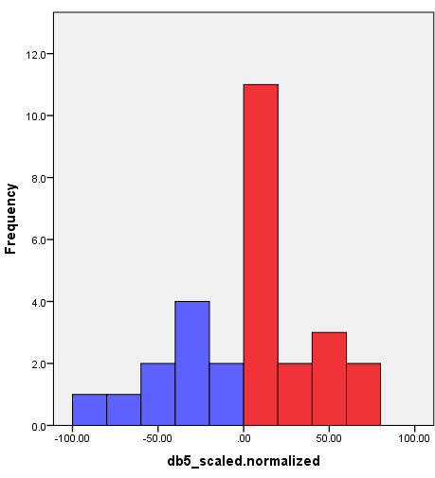
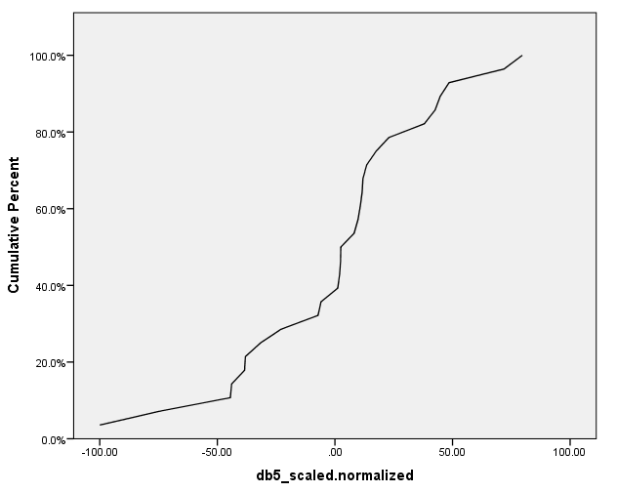
Distribution of db5 Regulatory Weights
db5 Network

Slide 4

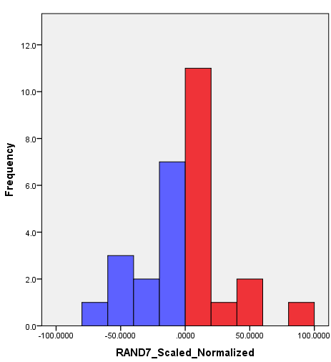
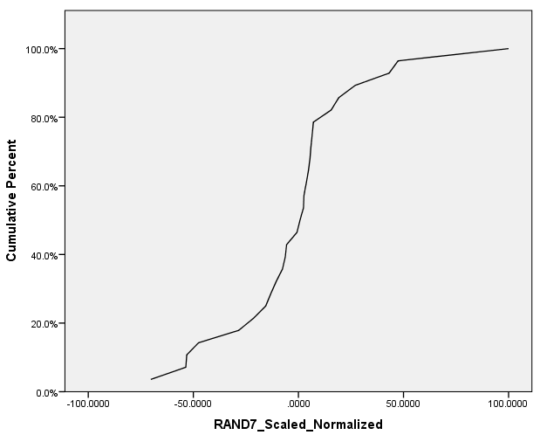
Distribution of RAND7 Regulatory Weights
Random Network 7

Slide 5

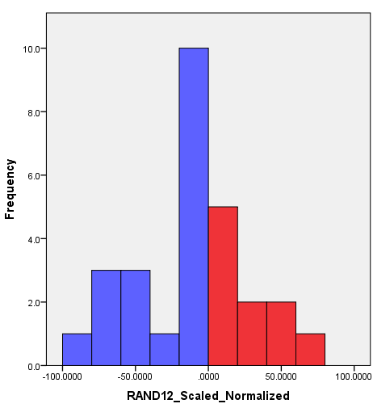
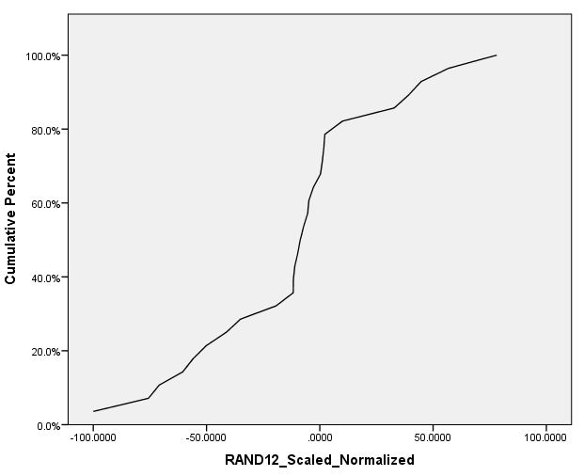
Distribution of RAND12 Regulatory Weights
Random Network 12

Slide 6

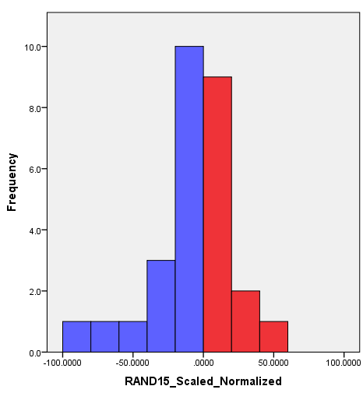
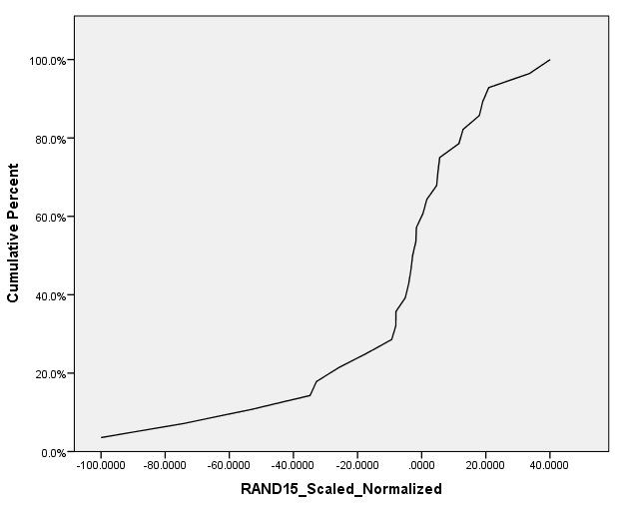
Distribution of RAND15 Regulatory Weights
Random Network 15

Slide 7

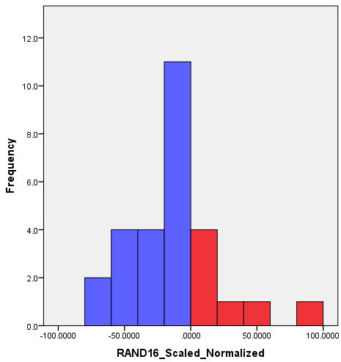
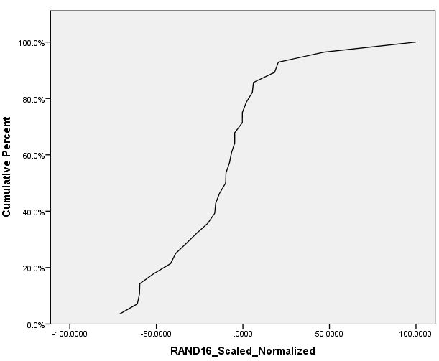
Distribution of RAND16 Regulatory Weights
Random Network 16

Slide 8

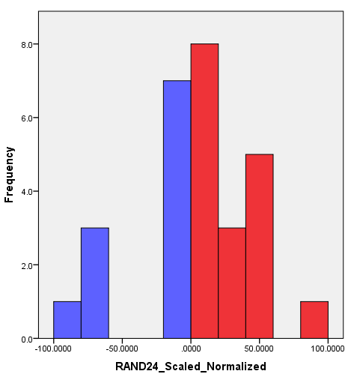
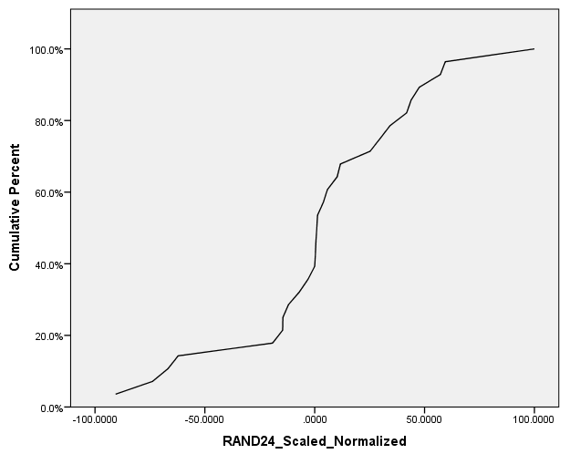
Distribution of RAND24 Regulatory Weights
Random Network 24

Slide 9

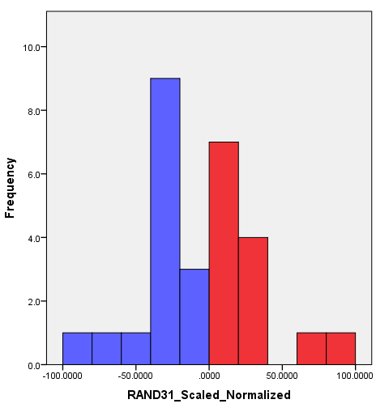
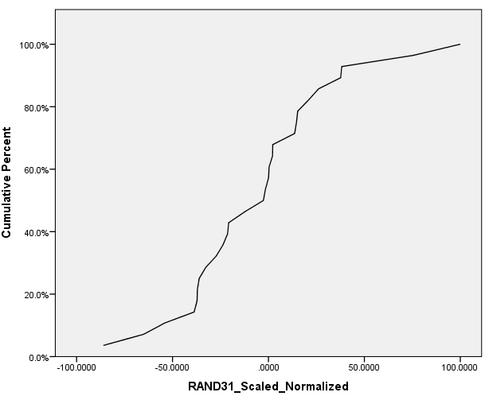
Distribution of RAND31 Regulatory Weights
Random Network 31

Slide 10
Random Network 15
Random Network 16
Random Network 24
db5 Network
Random Network 7
Random Network 12
Random Network 31

Slide 11

Random Network 15
Random Network 16*
Random Network 24
db5 Network
Random Network 7*
Random Network 12
Random Network 31
Similarities are visible between the weight distributions of the best and worst performing random networks.
Sharing weighted edges with db5 appears to a better predictor of random network performance than having a similar weight distribution.
Notes:
Similarities between RAND16 & RAND7 cumulative percent plots.
Suggests that having edges in common with db5 is more important that sharing similar weight distributions.
Does normalization detract from ability to compare?

