Slide 1
“Insignificant” Regulatory Weights in Six Database-Derived GRNs
Brandon Klein
Last Updated: 02/13/17

Slide 2
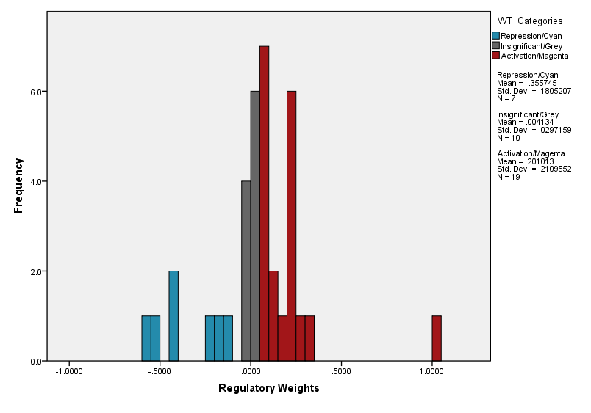
Distribution of Wild-Type Derived Network Regulatory Weights Network: 16 Genes, 36 Edges

Slide 3
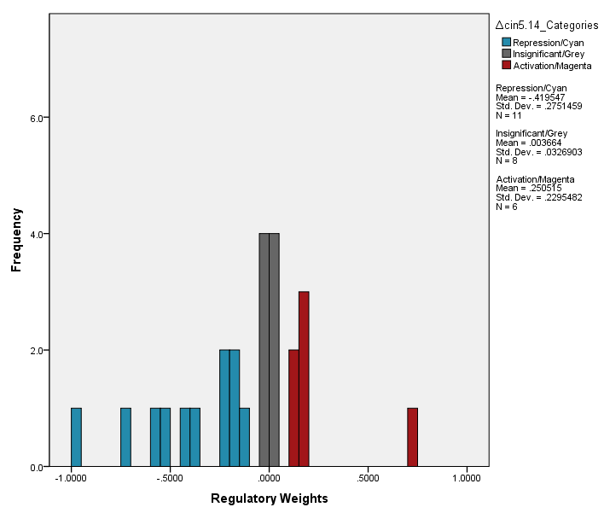
Distribution of ∆cin5 Derived Network Regulatory Weights Network: 14 Genes, 25 Edges

Slide 4
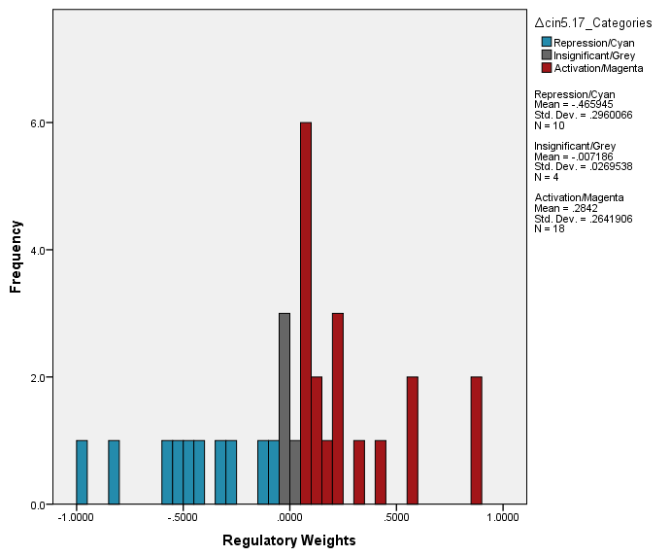
Distribution of ∆cin5 Derived Network Regulatory Weights Network: 17 Genes, 32 Edges

Slide 5
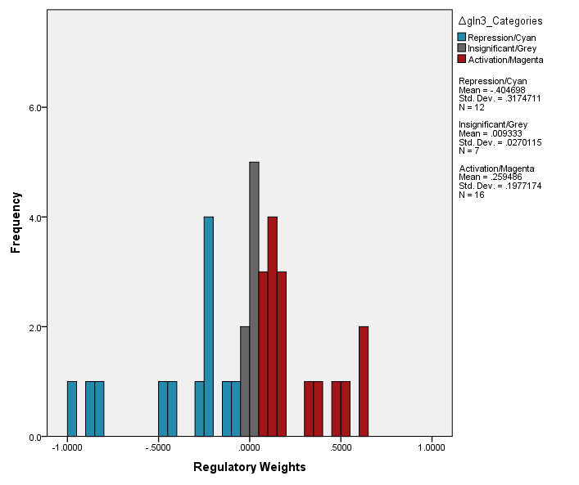
Distribution of ∆gln3 Derived Network Regulatory Weights Network: 14 Genes, 35 Edges

Slide 6
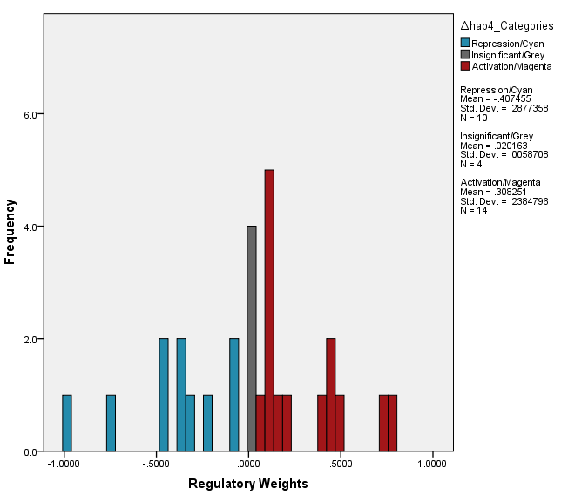
Distribution of ∆hap4 Derived Network Regulatory Weights Network: 15 Genes, 28 Edges

Slide 7
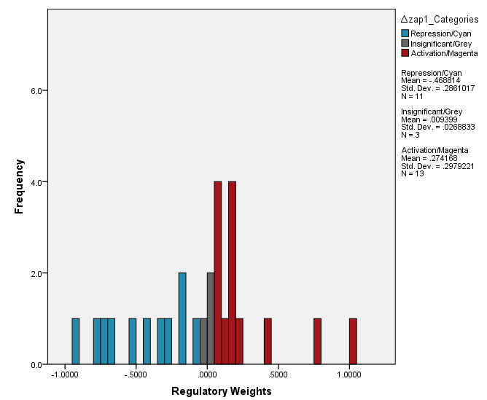
Distribution of ∆zap1 Derived Network Regulatory Weights Network: 16 Genes, 27 Edges

