Slide 1
db1-db6 Weighted Networks with Nodes Colored by ANOVA Results
Brandon Klein
Last Modified: 12/05/17

Slide 2
ANOVA B&H p-values Were Compiled for All 27 Genes Appearing in db1-db6 and for All Six Strains
Genes | wt | dcin5 | dgln3 | dhap4 | dhmo1 | dzap1 | # significant
HMO1 | 0.039736165 | 0.002237531 | 0.002475972 | 0.424420381 | 0.575837998 | 0.00112383 | 4
HSF1 | 0.134546663 | 0.029491106 | 0.048848554 | 0.014953146 | 0.528133234 | 0.015874144 | 4
ABF1 | 0.005511013 | 0.014806196 | 0.109489748 | 0.000354887 | 0.599330474 | 0.089506884 | 3
AFT2 | 0.936135106 | 0.70044301 | 0.034299278 | 0.004545231 | 0.992985644 | 0.015870961 | 3
CIN5 | 0.066225125 | 0.61881514 | 0.01634799 | 0.011178235 | 0.411285519 | 0.025966862 | 3
TEC1 | 0.004612119 | 0.007767711 | 0.019659044 | 0.065379185 | 0.287579189 | 0.262666296 | 3
CST6 | 0.000469096 | 0.557090227 | 0.319052683 | 0.386268083 | 0.400863563 | 0.037601248 | 2
MSN4 | 0.188669283 | 0.124329466 | 0.239801992 | 0.008106867 | 0.621392002 | 0.002161182 | 2
SFP1 | 0.409677471 | 0.049361534 | 0.075060611 | 0.053349459 | 0.83537027 | 0.002075105 | 2
YHP1 | 0.174295602 | 0.868445831 | 0.04326839 | 0.008352158 | 0.815246173 | 0.065292475 | 2
YOX1 | 0.004042497 | 0.057965914 | 0.218104992 | 0.011738841 | 0.219743869 | 0.265846072 | 2
ACE2 | 0.76238449 | 0.446249756 | 0.785519961 | 0.291600725 | 0.825773867 | 0.045710095 | 1
ASF1 | 0.029788439 | 0.419327134 | 0.416513909 | 0.230498882 | 0.84466937 | 0.166852682 | 1
ASH1 | 0.082901279 | 0.009078221 | 0.520247387 | 0.072269283 | 0.763882697 | 0.45347931 | 1
HAP4 | 0.730744752 | 0.482119509 | 0.07729933 | 0.416487633 | 0.926181661 | 0.015741523 | 1
MSN2 | 0.305558969 | 0.220796801 | 0.342732664 | 0.016849469 | 0.802076734 | 0.083557084 | 1
ZAP1 | 0.008895736 | 0.316034374 | 0.250267715 | 1.013437775 | 0.882435983 | 0.456170915 | 1
CYC8 | 0.804280108 | 0.093043166 | 0.530502564 | 0.097511793 | 0.935279439 | 0.960389448 | 0
GCN4 | 0.62968209 | 0.276123454 | 0.275067466 | 0.505797519 | 0.911766831 | 0.520711154 | 0
GCR2 | 0.330613246 | 0.587610631 | 0.876273722 | 0.12610119 | 0.84451617 | 0.347872213 | 0
GLN3 | 0.418863879 | 0.546835191 | 0.609367959 | 0.518884552 | 0.92811382 | 0.117144835 | 0
MCM1 | 0.935440616 | 0.093041647 | 0.867650832 | 0.103131156 | 0.931070282 | 0.941485924 | 0
MGA2 | 0.099636081 | 0.30028122 | 0.441547953 | 0.38224545 | 0.467855983 | 0.511296855 | 0
RDS3 | 0.295221468 | 0.61490992 | 0.59667395 | 0.846905197 | 1.005680397 | 0.80272494 | 0
STB5 | 0.312866168 | 0.369198822 | 0.320447792 | 1.019268775 | 0.417305946 | 0.329647735 | 0
SWI4 | 0.673063018 | 0.48391675 | 0.379674389 | 0.615519862 | 0.965182239 | 0.779894544 | 0
SWI5 | 0.095712796 | 0.446342377 | 0.312556654 | 0.986789769 | 0.517815471 | 0.297478017 | 0

Slide 3
The Frequency of Significant B&H p-values for Each Gene in db1-db6 Was Determined
The number of individual strains incorporated when modeling db1—db6 was taken into consideration when determining frequencies.
The frequencies of significant B&H p-values for individual genes were broken up into three categories:
≥2 significant B&H p-values
1 significant B&H p-value
No significant B&H p-values
Nodes were color coded (as shown above) to indicate ANOVA results within the weighted networks for db1-db6.

Slide 4
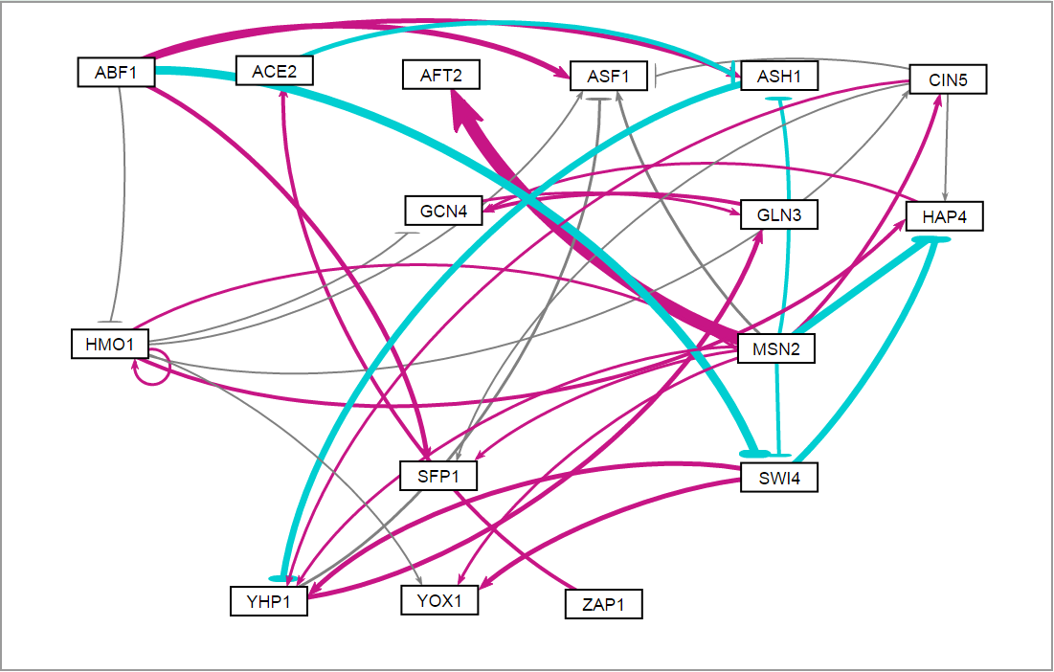
db1: Network Derived from wt Data
16 Genes, 26 Edges
Notes:
Source: https://github.com/kdahlquist/DahlquistLab/blob/master/documents/NEW_BK_GRNmap_Testing_network_presentation-all-strains_20161030.pptx

Slide 5
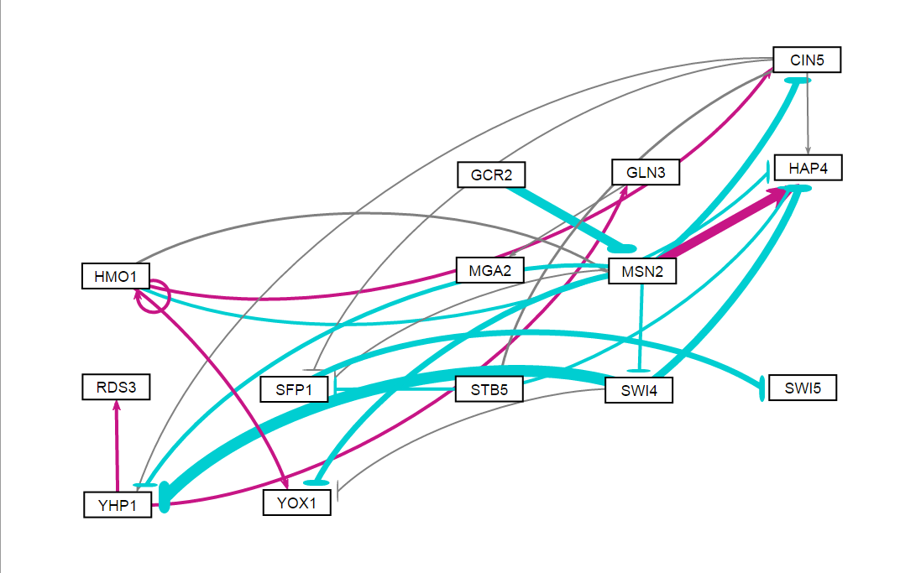
db2: Network Derived from ∆cin5 Data
14 Genes, 25 Edges
Notes:
Source: https://github.com/kdahlquist/DahlquistLab/blob/master/documents/NEW_BK_GRNmap_Testing_network_presentation-all-strains_20161030.pptx

Slide 6
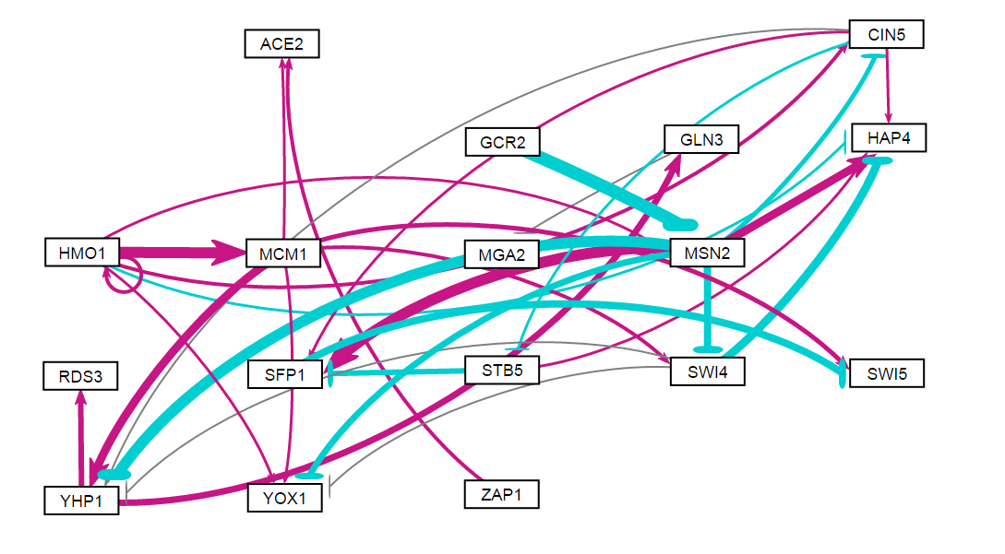
db3: Network Derived from ∆cin5 Data
17 Genes, 32 Edges
Notes:
Source: https://github.com/kdahlquist/DahlquistLab/blob/master/documents/NEW_BK_GRNmap_Testing_network_presentation-all-strains_20161030.pptx

Slide 7
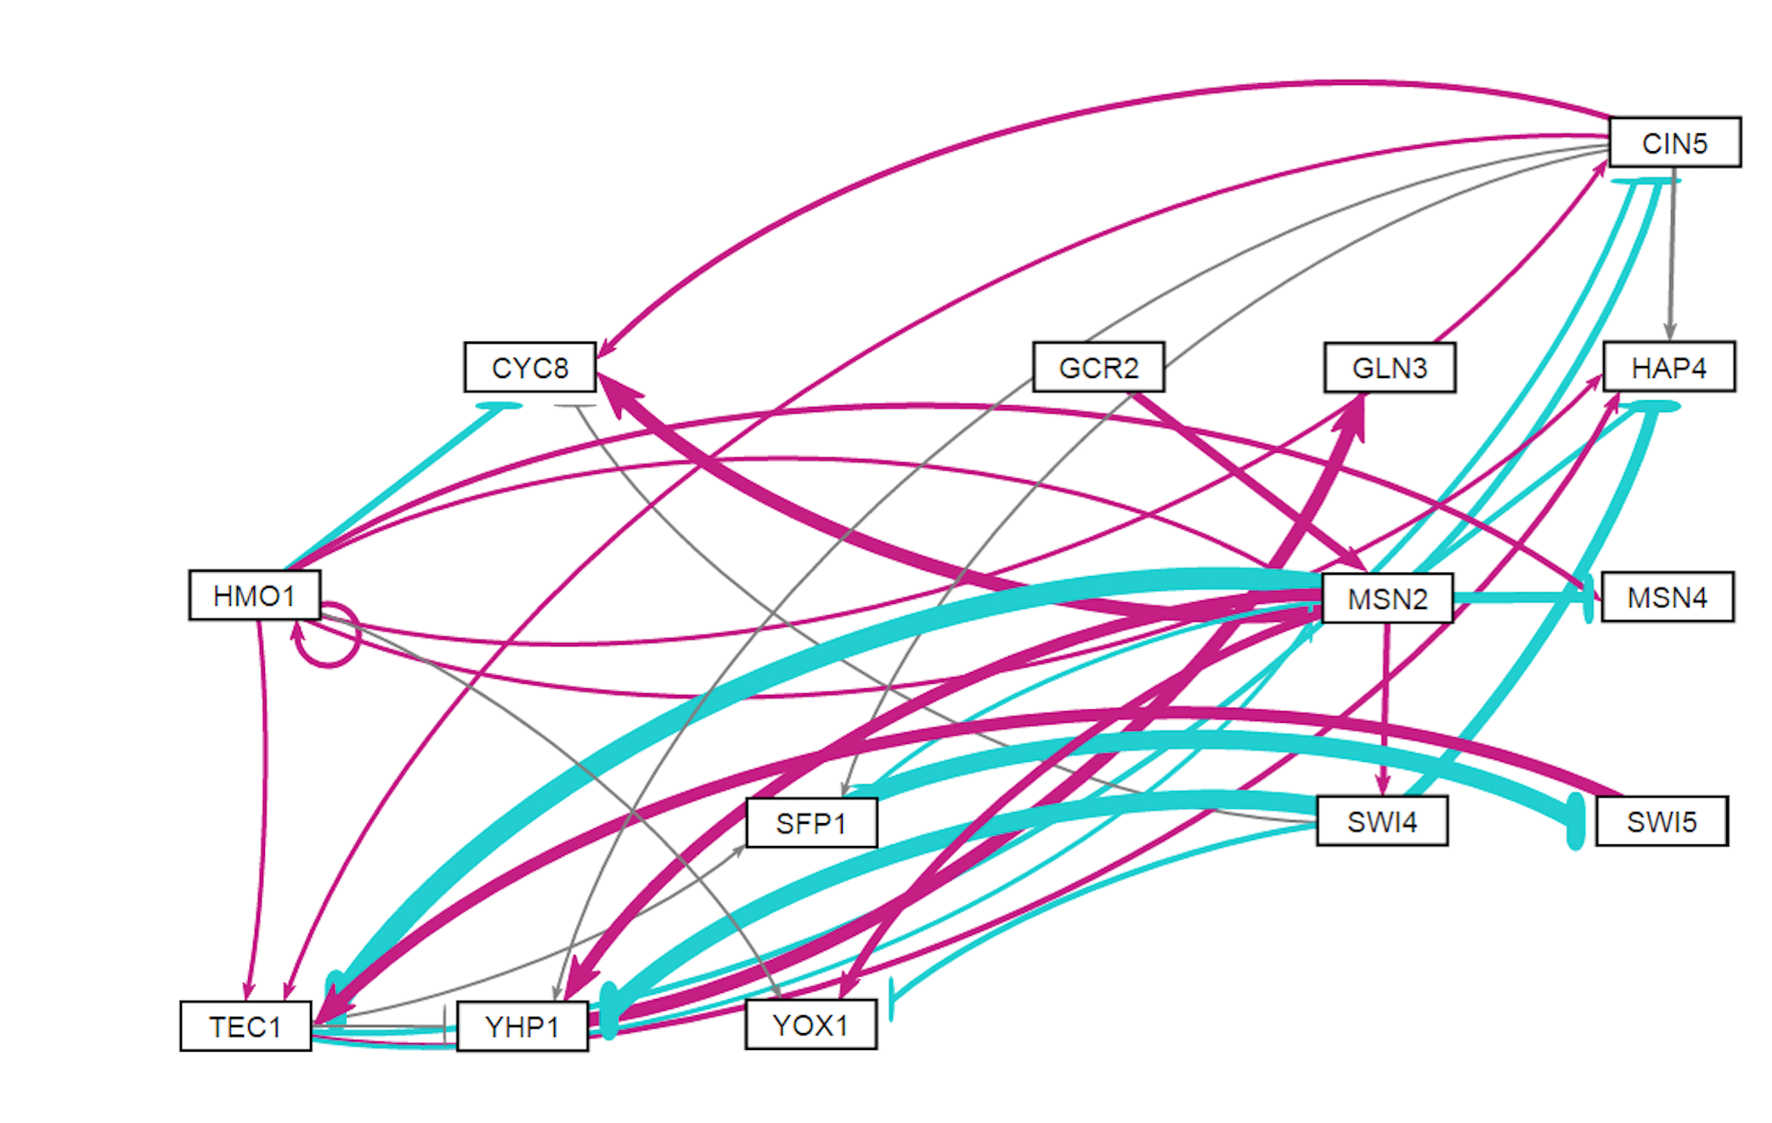
db4: Network Derived from ∆gln3 Data
14 Genes, 35 Edges
Notes:
Source: https://github.com/kdahlquist/DahlquistLab/blob/master/documents/NEW_BK_GRNmap_Testing_network_presentation-all-strains_20161030.pptx

Slide 8
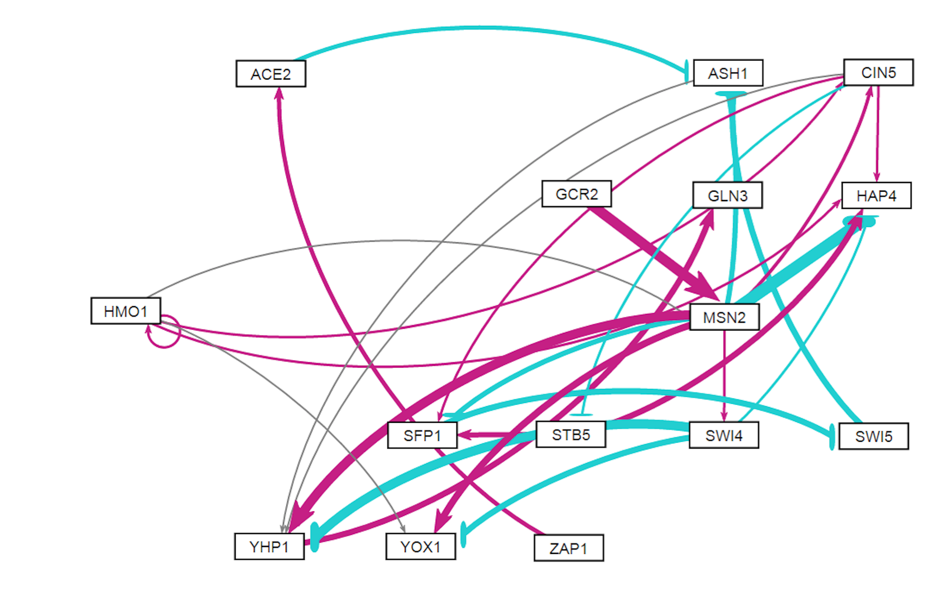
db5: Network Derived from ∆hap4 Data
15 Genes, 28 Edges
Notes:
Source: https://github.com/kdahlquist/DahlquistLab/blob/master/documents/NEW_BK_GRNmap_Testing_network_presentation-all-strains_20161030.pptx
*HMO1, CIN5, YHP1 involved in important regulatory relationships and significantly changing expression.
*It’s surprising that MSN2 only has 1 significant B&H p-value.
*STB5 consistently modeled with repression relationship… likely modeling noise.

Slide 9
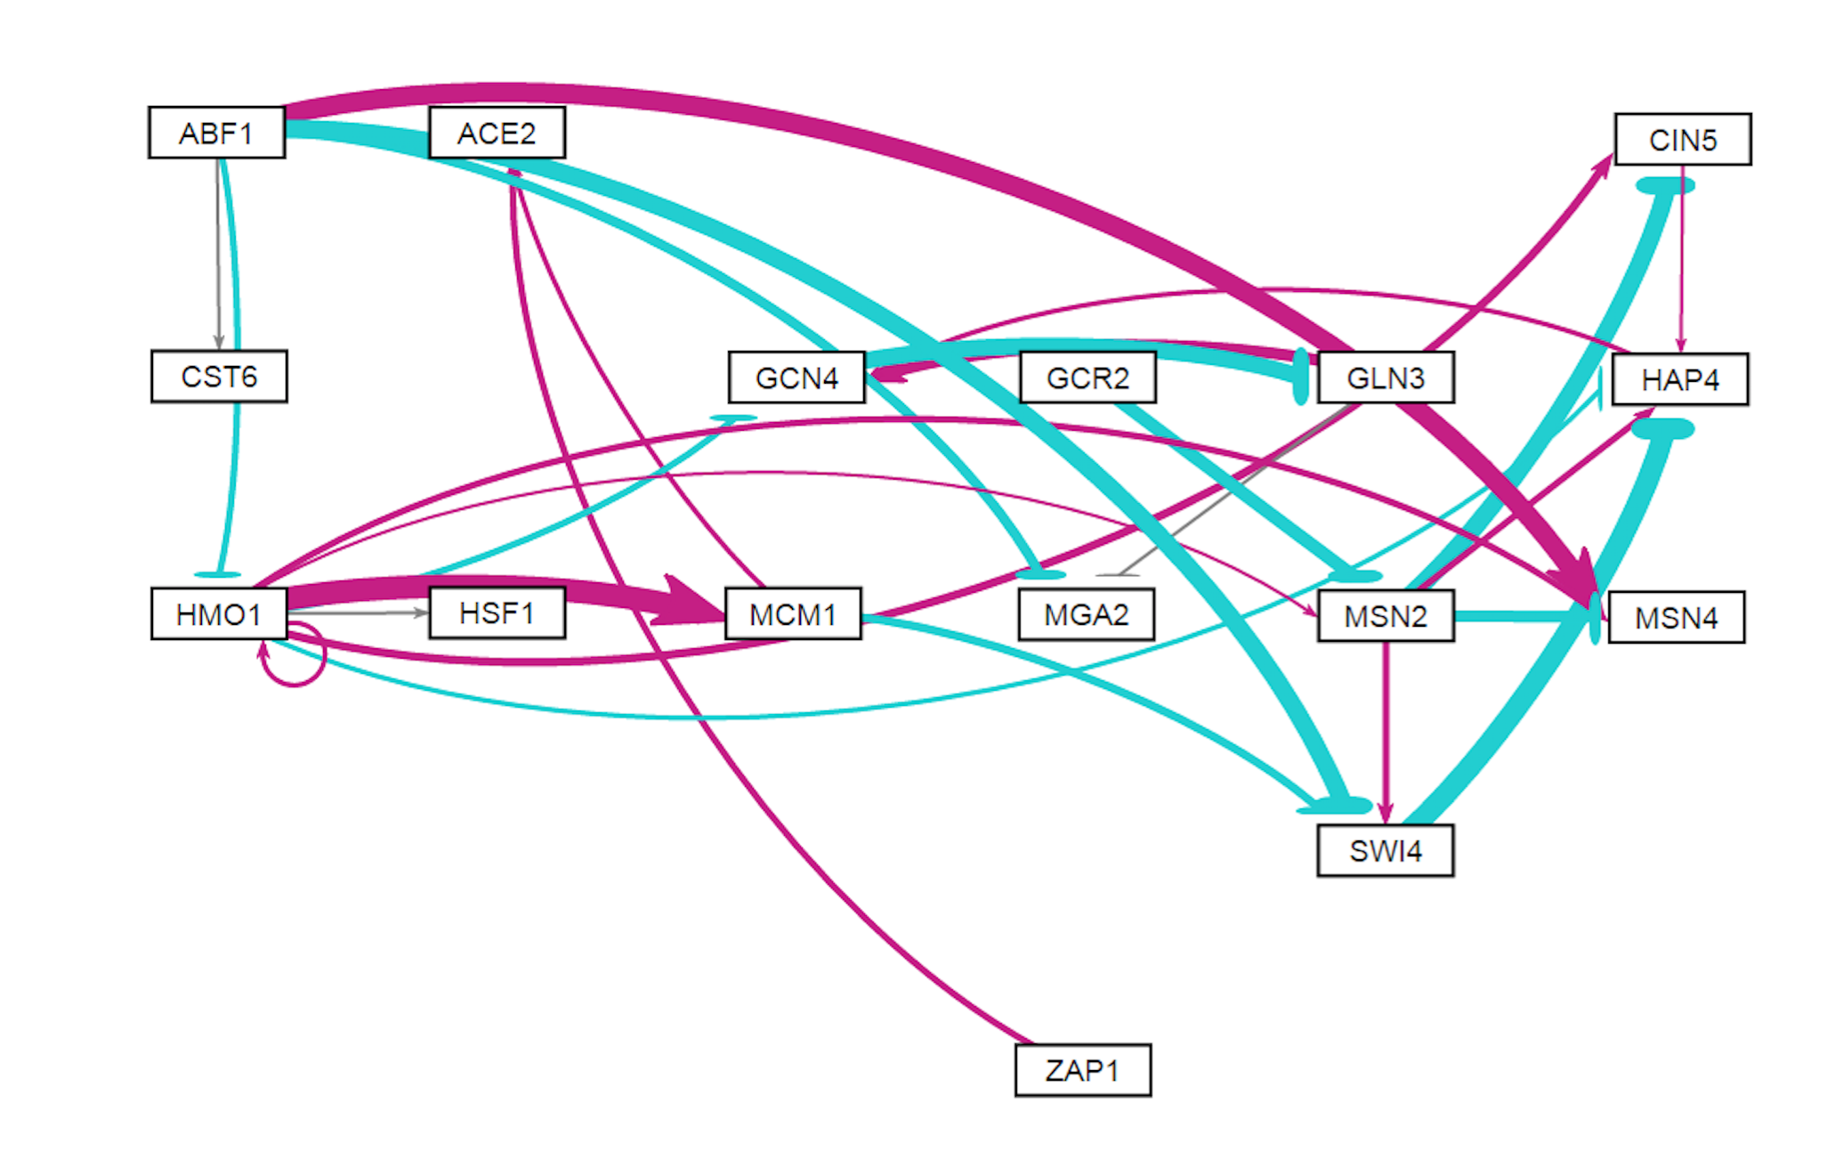
db6: Network Derived from ∆zap1 Data
16 Genes, 27 Edges
Notes:
Source: https://github.com/kdahlquist/DahlquistLab/blob/master/documents/NEW_BK_GRNmap_Testing_network_presentation-all-strains_20161030.pptx

