Slide 1
All Strains STEM Profiles Summary

Slide 2
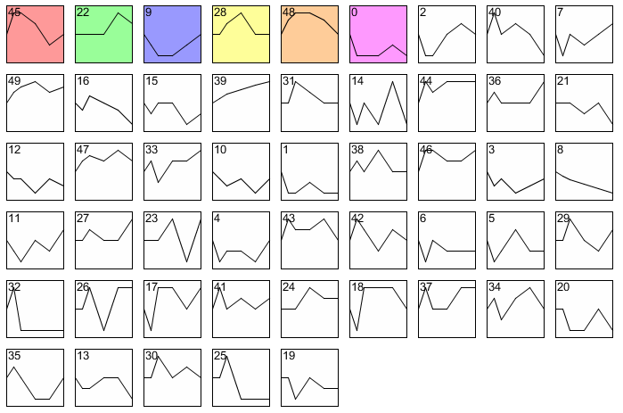
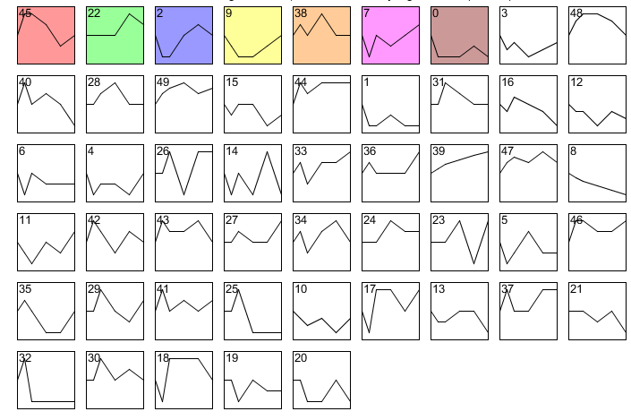
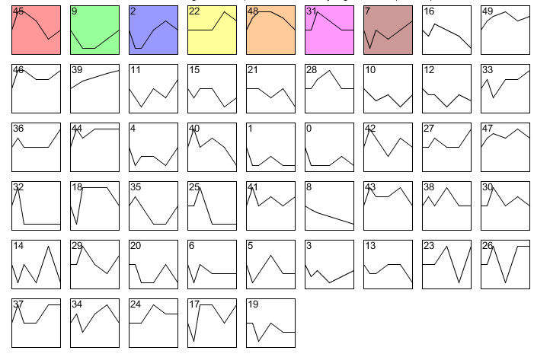
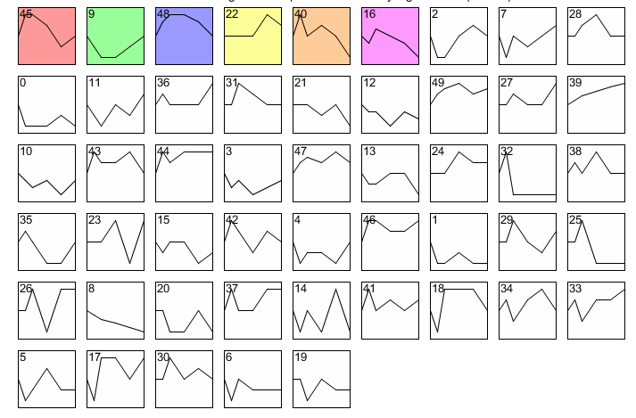
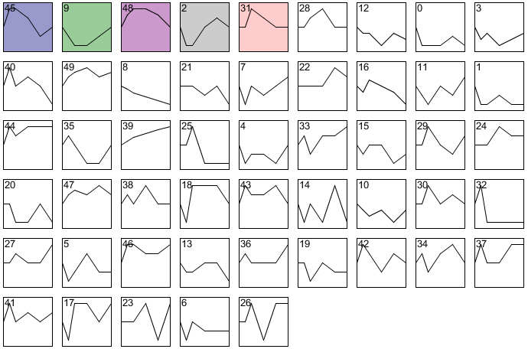
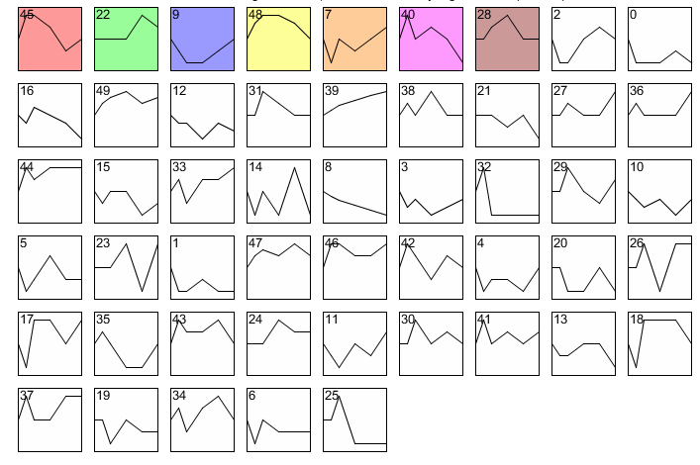
Wild type
dCIN5
dGLN3
dHAP4
dHMO1
dZAP1
* Original profile layout from STEM for each strain

Slide 3
Wild type
dCIN5
dGLN3
dHAP4
dHMO1
dZAP1

Slide 4
 | 45 | 9 | 22 | 48 | 2 | 7 | 40 | 0 | 31 | 28 | 38 | 16
Wild type
dCIN5
dGLN3
dHAP4
dHMO1
dZAP1

Slide 5
 | 45 | 9 | 48 | 22 | 2 | 7 | 40 | 31 | 0 | 28 | 38 | 16
WT
dCIN5
dGLN3
dHAP4
dHMO1
dZAP1
Total | 6 | 6 | 5 | 5 | 3 | 3 | 2 | 2 | 2 | 2 | 1 | 1

