Slide 1
Identifying Determinants of MSE in the db1 Network
Brandon Klein
Last Updated: 02/20/2017

Slide 2
Design
Stepwise regression performed via backward elimination
Dependent Variable: Average MSE for each TF
Independent Variables Included: B&H p-value (ANOVA), d, optimized p, optimized b, in degree, out degree, total degree, eccentricity, closeness centrality, betweenness centrality, clustering, eigen centrality
Notable Exclusions: weight values**, other graph statistics from Gephi
Red: a priori thoughts

Slide 3
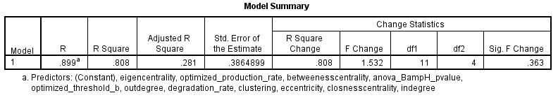
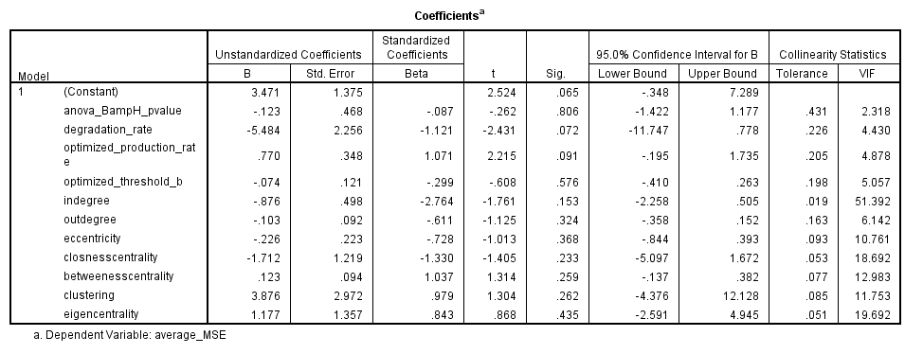
Round 1—Collinearity Assessed

Slide 4
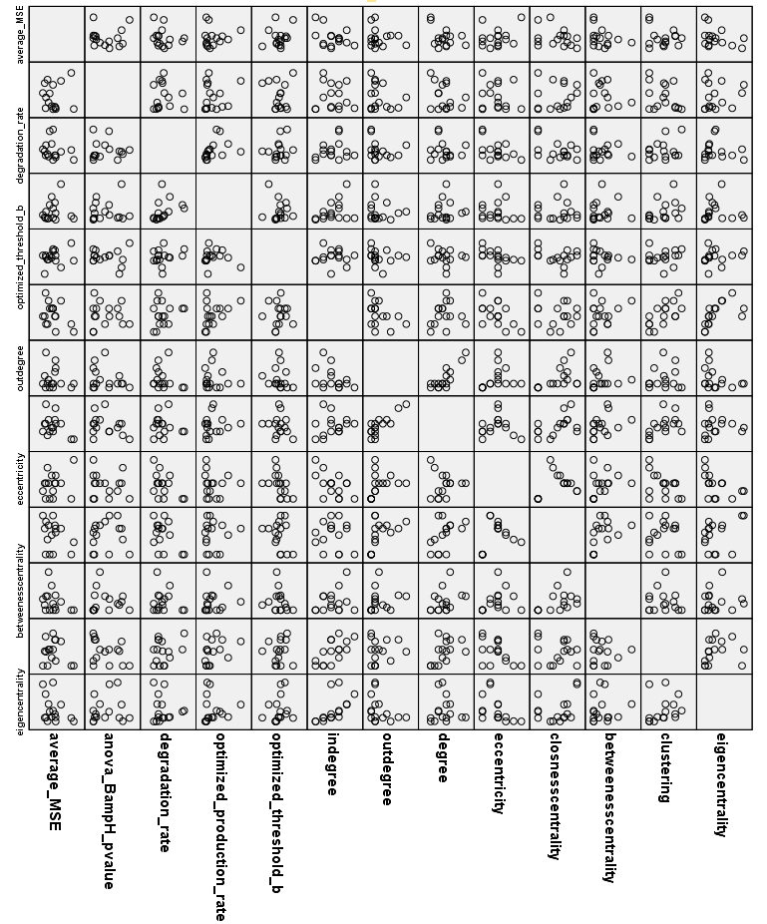
Eccentricity
Clustering
Eigencentrality

Slide 5
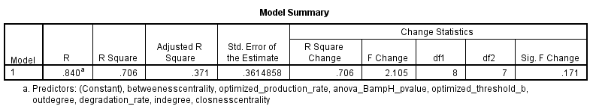
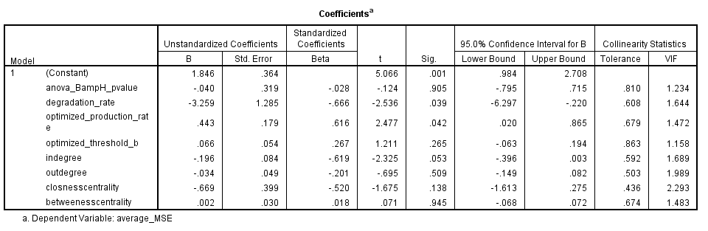
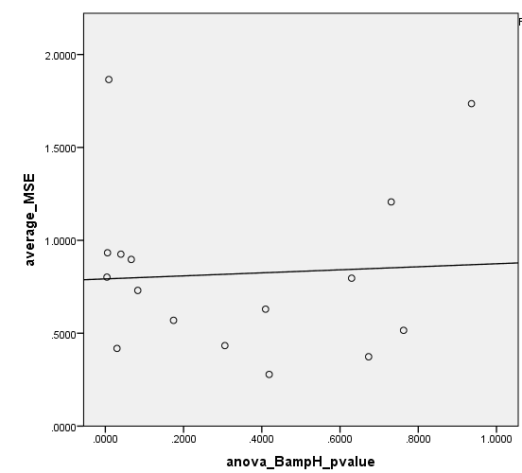
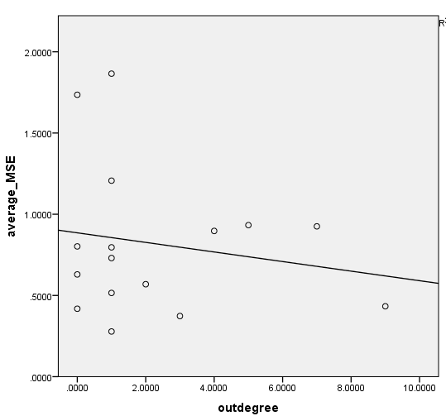
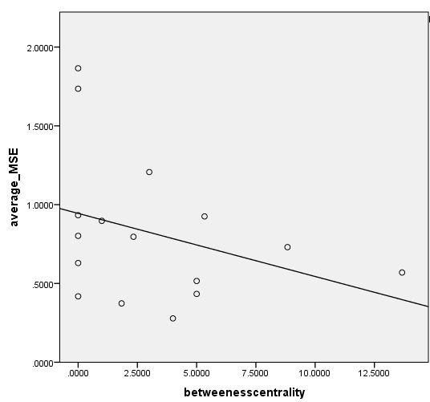
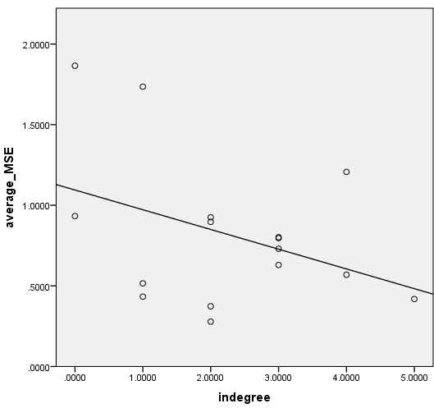
Round 2—Coefficients Assessed
R^2: 0.003
R^2: 0.030
R^2: 0.114
R^2: 0.149

Slide 6
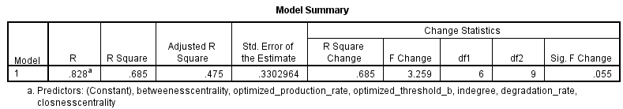
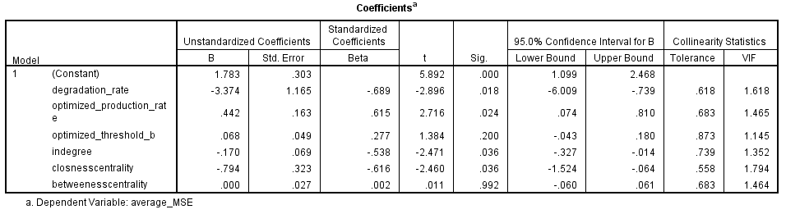
Round #3—Coefficients Further Assessed

Slide 7
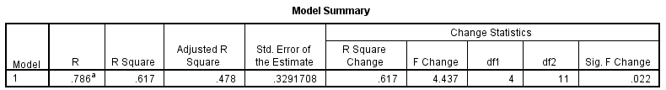
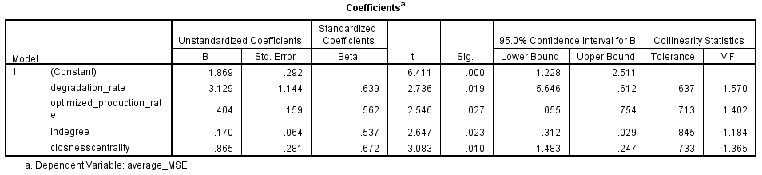
Round #4—Final Model
Preliminary Conclusions:
~50% of the variance in how well the model fit expression data for each TF (MSE) could be explained via d, optimized p, in degree, & closeness centrality
Better fit achieved when:
In degree is high
Closeness centrality is high
Degradation rate is high
Optimized production rate is low
Cooperative Effect (?)—Reg. by several indep. motifs
Both favor low [Transcription Factor]. Why?

