Slide 1
Preliminary Analysis of Motifs in db1-db6
Brandon Klein
02/08/2018

Slide 2
Systematic Analysis of Common Edges was Performed

Slide 3
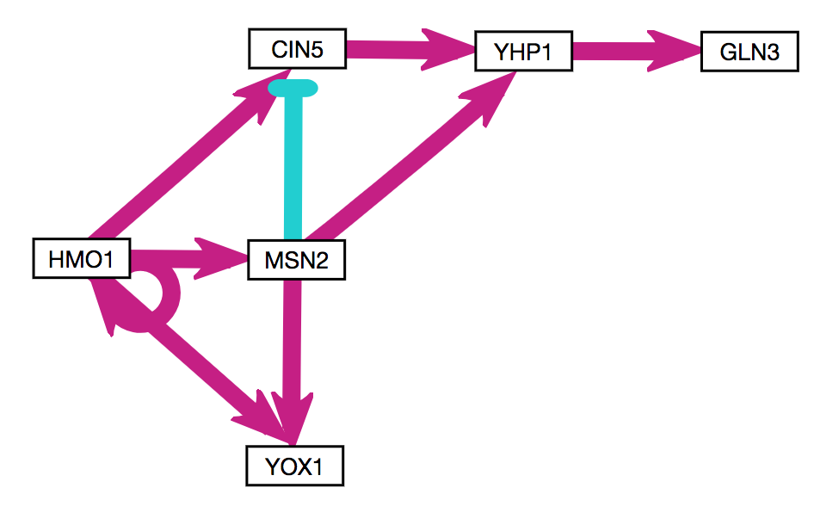
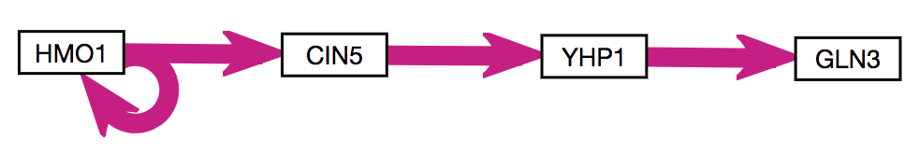
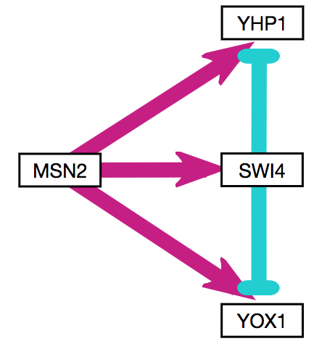
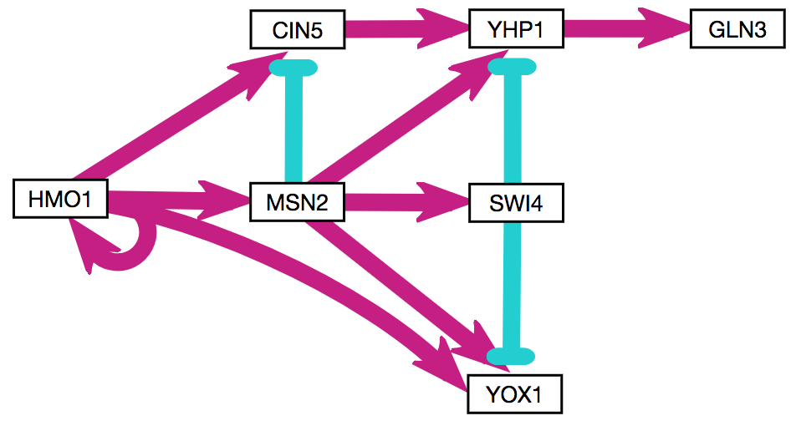
Common Motifs Were Identified
A
B
C
D
Notes:
C1 FFL → YOX1 (common)
I1 FFL → CIN5 (common)
I4 FFL → YHP1 (rare)

Slide 4
Types of Feed-Forward Loops

Slide 5
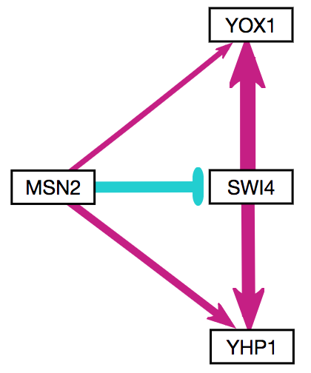
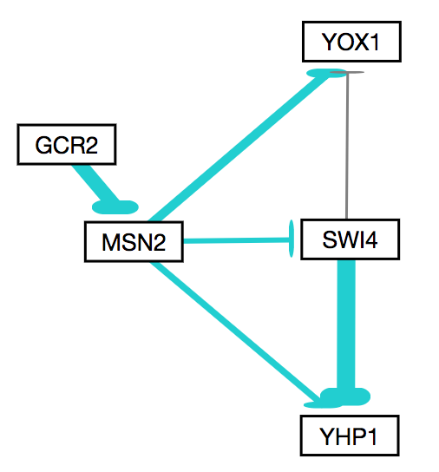
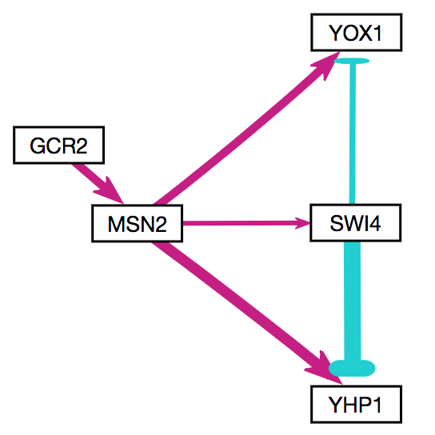
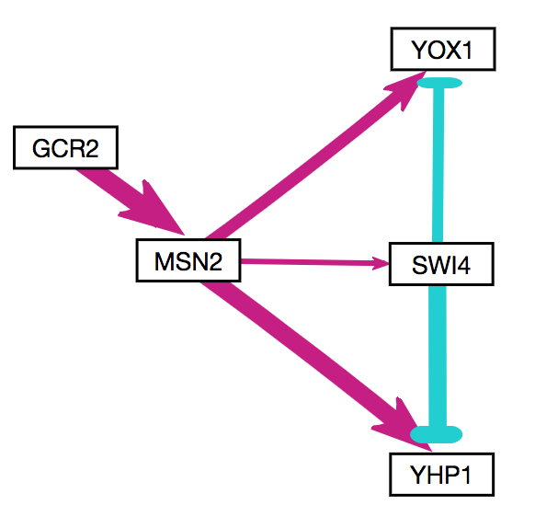
GCR2 May Influence Paralog Signaling in Deletion Strains
db1
I4-FFLs
YOX1 & YHP1
db2
I2-FFLs
YOX1 > YHP1
db4
I1-FFLs
YOX1 > YHP1
db5
I1-FFLs
YOX1 & YHP1
Notes:
Coherent type 1 (all +) and Incoherent type 1 are most common FFLs in biological systems.
Incoherent type 1 for fold detection response: https://www.ncbi.nlm.nih.gov/pmc/articles/PMC2896310/
Q: Does GCR2 (significant TF in deletion strains; perhaps indicating role in backup system through paralog) induce shift in paralog signaling? Above results would suggest no, as in WT both paralogs are being induced.

Slide 6
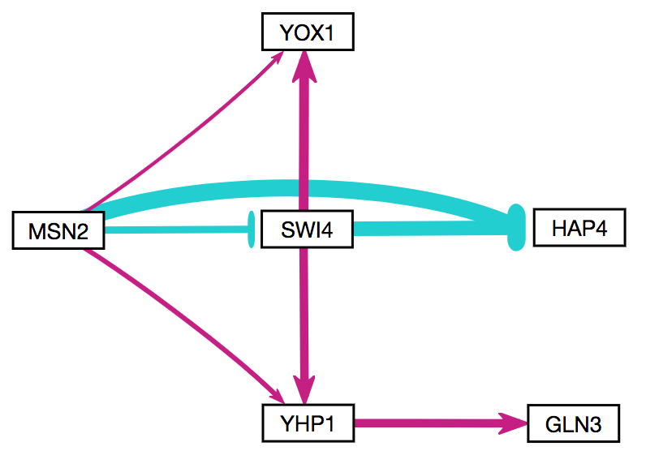
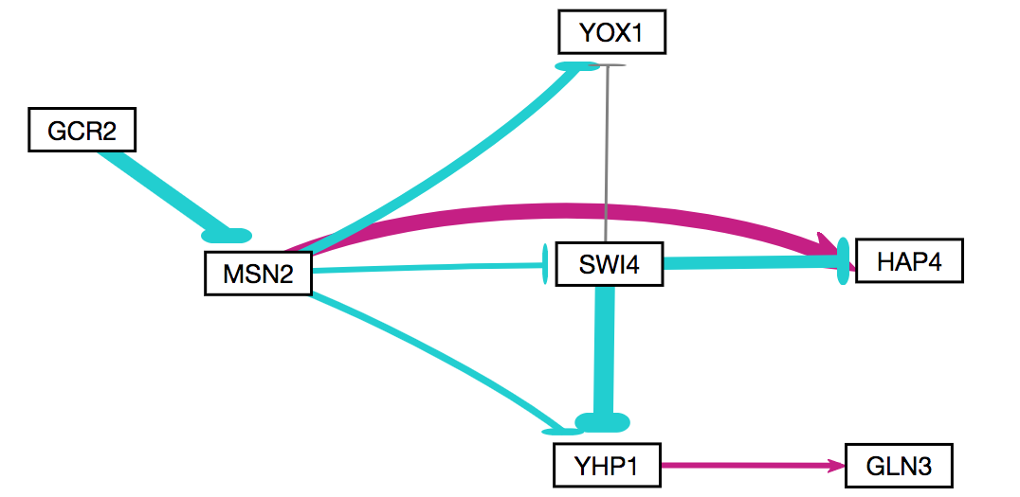
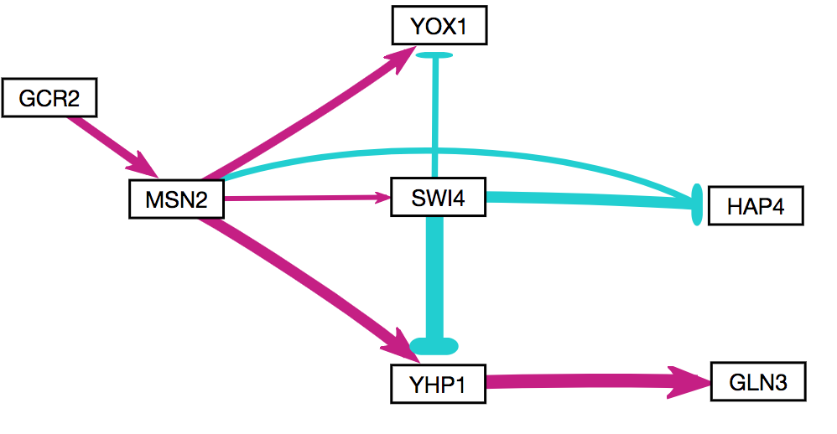
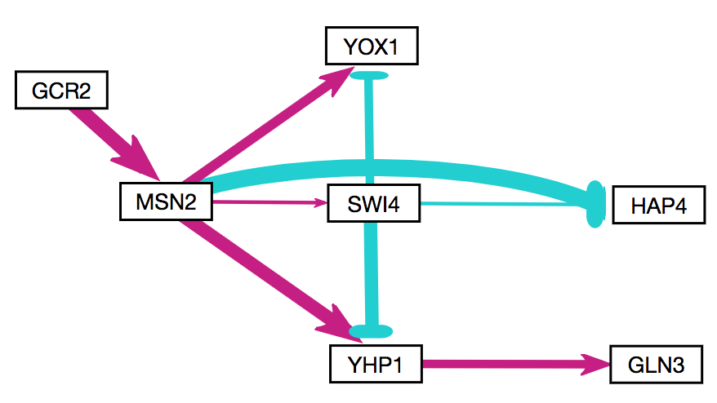
Expanded View of Symmetrical Incoherent FFLs
db1
db2
db4
db5
Notes:
How about we just consider the conserved motif… MSN2→ swi4 → FF YOX1 & YHP1 (paralogs).
Could mention GCR2 effects this… could this be a mode of switching polarity?
Top Left: incoherent type 4 x2
Top Right: incoherent type 2 x2
Bottom two: incoherent type 1, supported by GCR2.
Incoherent type 1 for fold detection response https://www.ncbi.nlm.nih.gov/pmc/articles/PMC2896310/
(coherent type 1 (all +) and incoherent type 1 are most common in biological systems.

Slide 7
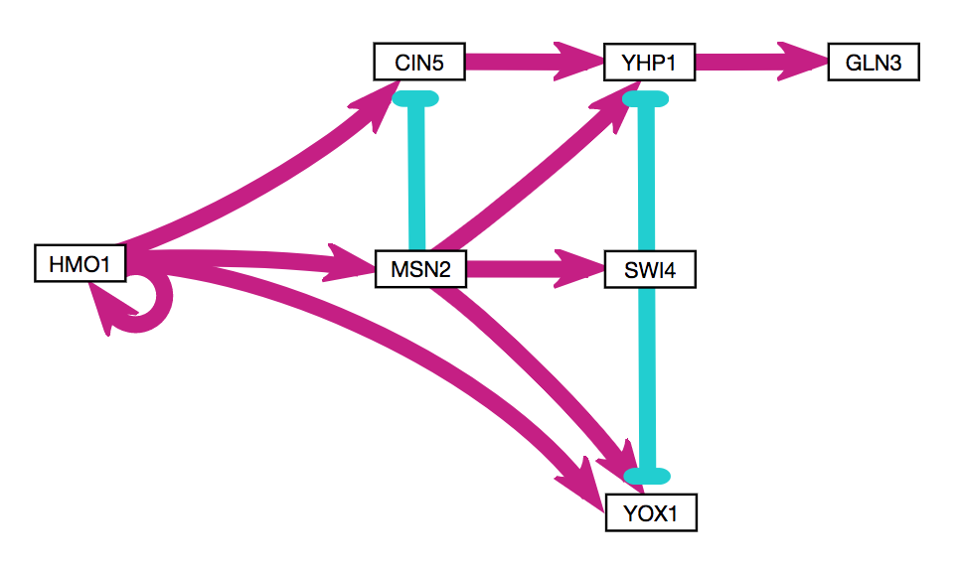
Cumulative View of Identified Motifs
?
?
?
?
?
?
Notes:
OTHER TFs appearing in 5+ networks:
SFP1—target of MSN2 & CIN5 FF loop of unknown type (like yhp1)
HAP4—target of HMO1, MSN2, CIN5, & SWI4, FF unknown type (SWI4→HAP4 always repression)

Slide 8
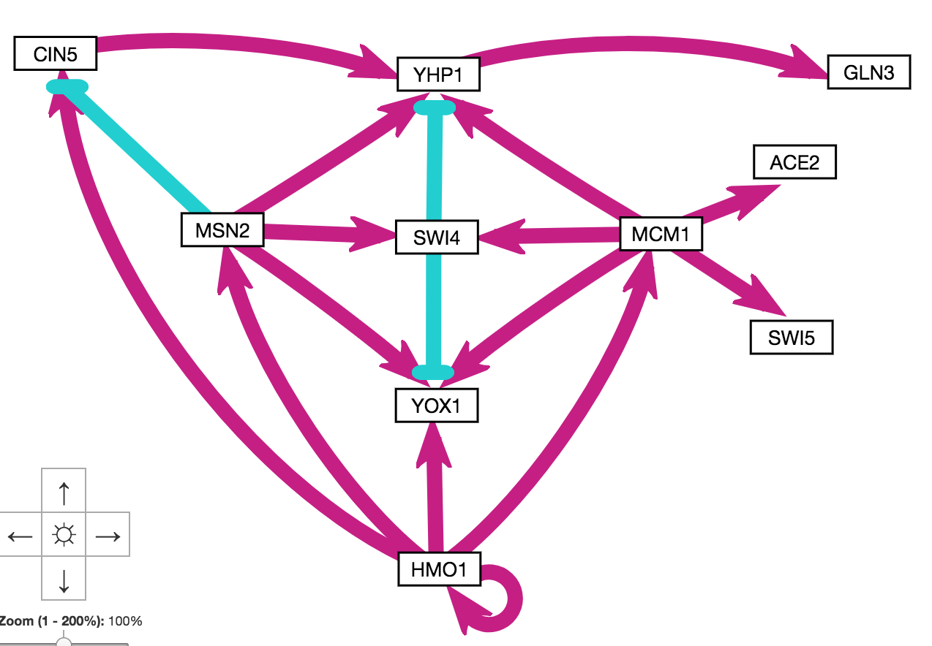

Slide 9
Notes:
Might want to reorder to match previous figure.

Slide 10
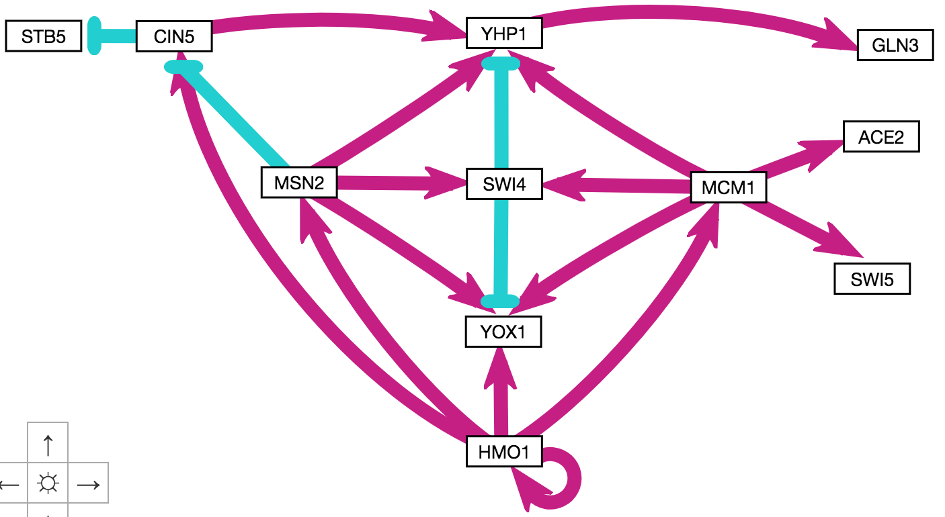
Notes:
STB5 has documented cold-sensitive phenotype.

Slide 11
Notes:
STB5 has documented cold-sensitive phenotype.

Slide 12
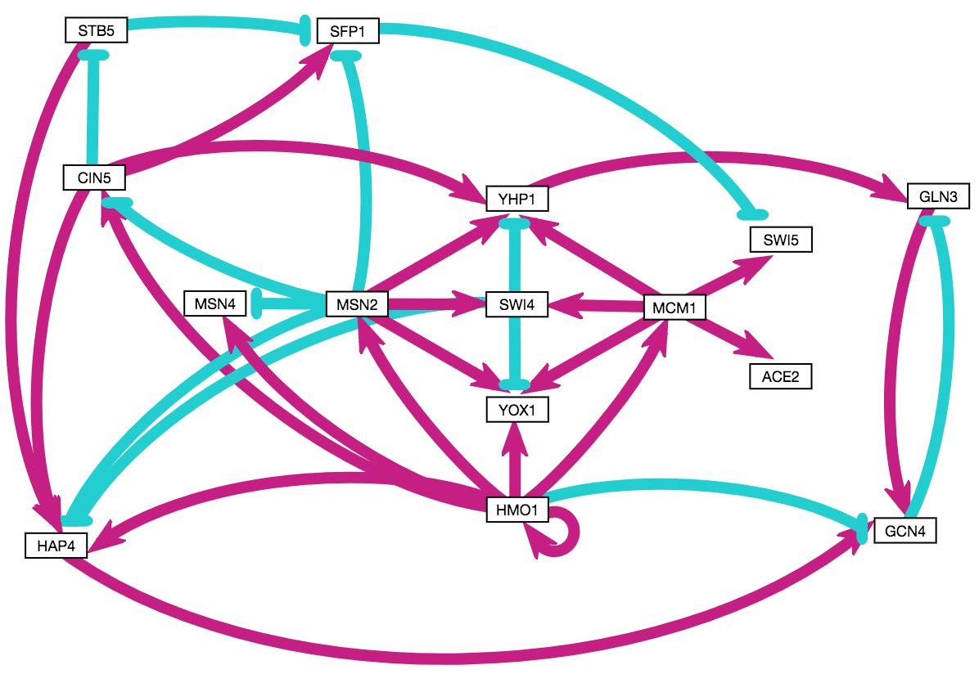

Slide 13
Notes:
Sample of built out hypothesis network.
15 genes, 34 edges (highly connected; most similar to db4 in this respect, which had lowest LSE:minLSE ratio but also included TEC1).
Colored pairs = paralogs.
Orange borders = known cold-sensitive phenotypes on SGD.
Green borders = tested by Dahlquist lab.
Light grey shading = appears distinct from ESR (not MSN2/4 mediated).
SFP1 in 5/6 networks + high eigen + consistent repression of SWI5.
GCN4 has eigen of 1 in both networks where it appears… connects disparate “modules” and created negative feedback loop.
Nodes that did not make it: TEC1 (highly connected, but 1 network), GCR2 (5/6, but negligible experimental expression ∆), CST6 (known cold phenotype, but only connected to ABF1, which is not in this GRN).

