Slide 1
Proposals for use of Graph Statistics Moving Forward
Presented at the Data Analysis Research Meeting
November 1, 2017

Slide 2
Statistics Measures Currently Documented
Betweenness Centrality
Closeness Centrality
Eccentricity
Eigenvector Centrality

Slide 3
Statistics Measures Currently Documented
Betweenness Centrality
Closeness Centrality
Eccentricity
Eigenvector Centrality

Slide 4
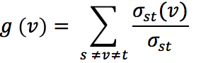
Betweeness Centrality
Where v is the node of interest, and sigma is the number of paths from nodes s->t, and sigma(v) is the number of paths from s->t that pass through node v.
High betweeness = used many times as a hub, betweeness of 0 means not on any shortest paths

Slide 5
Betweenness Centrality
Should only be used to determine which nodes are being used as hubs
To determine information about each node in a network, and the structure of the network, needs to be used in conjunction with in and out degrees
In = 0, BC =0, node is at the start of a network, start of pathway
Out = 0, BC =0, node is at the end of regulatory pathway
Lots of nodes, lots of BC =0, then network is made of mostly direct edges between nodes
Lots of nodes, lots of BC>0, then the network is not very direct

Slide 6
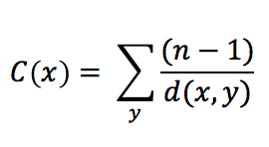
Closeness Centrality
Where n = the number of shortest paths going through the node; y = the node in question, x = the node passing through node y
High closeness = highly connected to other nodes in graph
Low closeness = no shortest paths go through the node

Slide 7
Closeness Centrality
Only statistic that seems to make sense to stand alone
In and out degrees could be used to approximate closeness value
Still trying to figure out other statistics that can be combined with closeness centrality to determine more information about the graphs

Slide 8
Eccentricity
Calculated using an algorithm identifying the max{dist(i,j)} where i is the node of interest, and j is any other node in the network
Eccentricity shows how accessible a node is from other nodes, or the distance from the starting node to the farthest node from it in a network
High eccentricity = high impact on graph
Low eccentricity = no out degrees

Slide 9
Eccentricity
Should be used to compare to a weighted network to determine what types of regulatory relationships have farthest reach
Ex: Activating edges with high impact, then graph is mostly activated
If a graph has many nodes with the same eccentricity value, then those nodes in the graph all have a similar impact on the network

Slide 10
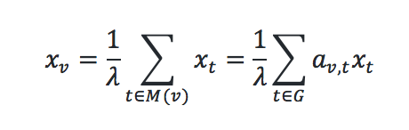
Eigenvector Centrality
Acts similarly to a limit, higher number of iterations corresponds to approaching a value (ex. 0.85)
High eigenvector = high level of influence

Slide 11
Eigenvector Centrality
Low eigenvector centrality seems to correspond to those “most central to the network”
High eigenvector centrality has few out degrees, deemed “important” because of nodes regulating them
Might indicate where regulatory pathways in networks end, as the highest measures are those with no out degrees
The eigenvector centrality measure does not seem to be particularly informative to investigating our networks.

