Slide 1
GRNmap Testing
Natalie Williams
Brandon Klein

Slide 2
GRNmap Testing with 5 Networks
After making the 5 input sheets for the various strains,

Slide 3
Wt GRNMap testing
Network composed of the following genes:
ABF1
ACE2
AFT2
ASF1
ASH1
CIN5
GCN4
GLN3
HAP4
HMO1
MSN2
SFP1
SWI4
YHP1
YOX1
ZAP1
As of: 2016 Oct. 30

Slide 4
Parameter Outputs - WT
Penalty Term: 0.819447
Least Squares Error (LSE): 2.592287
Minimum LSE: 0.576818
Iteration Count: 109,718

Slide 5
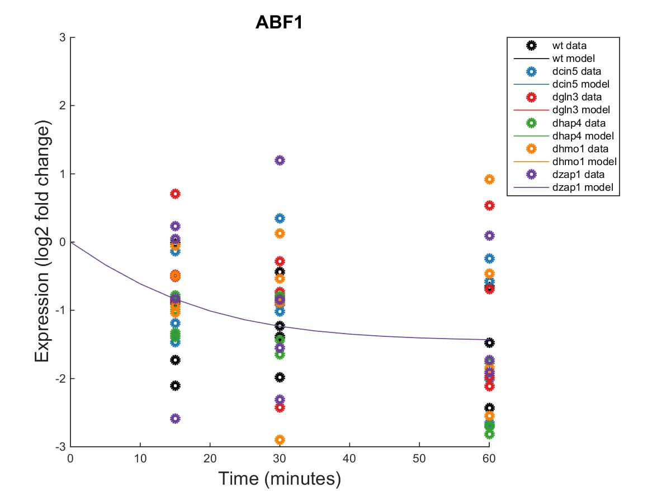
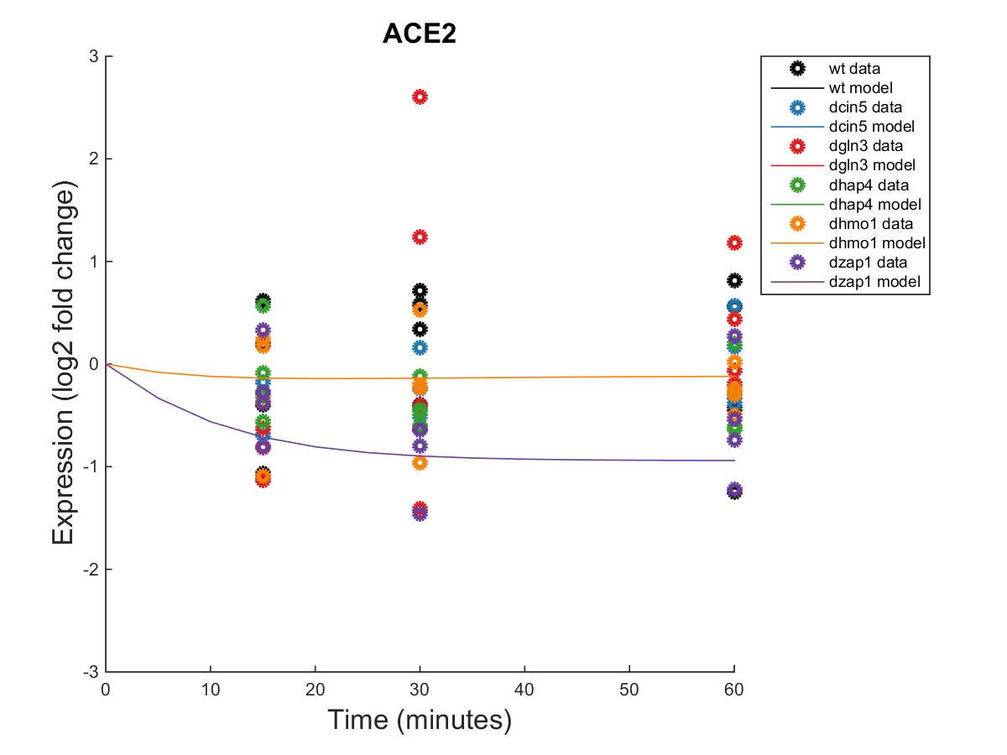
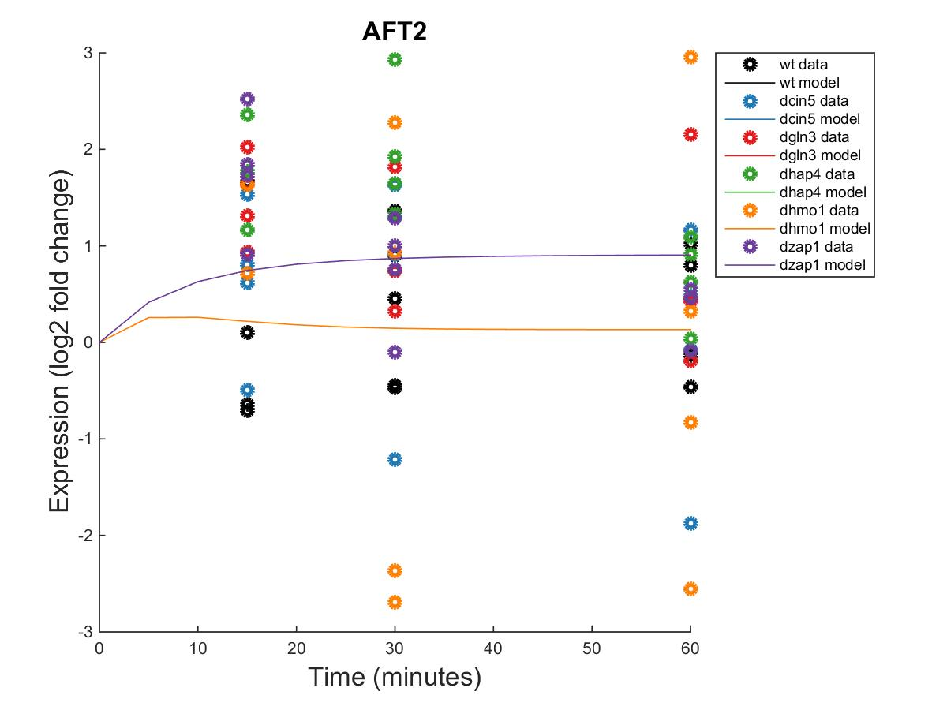
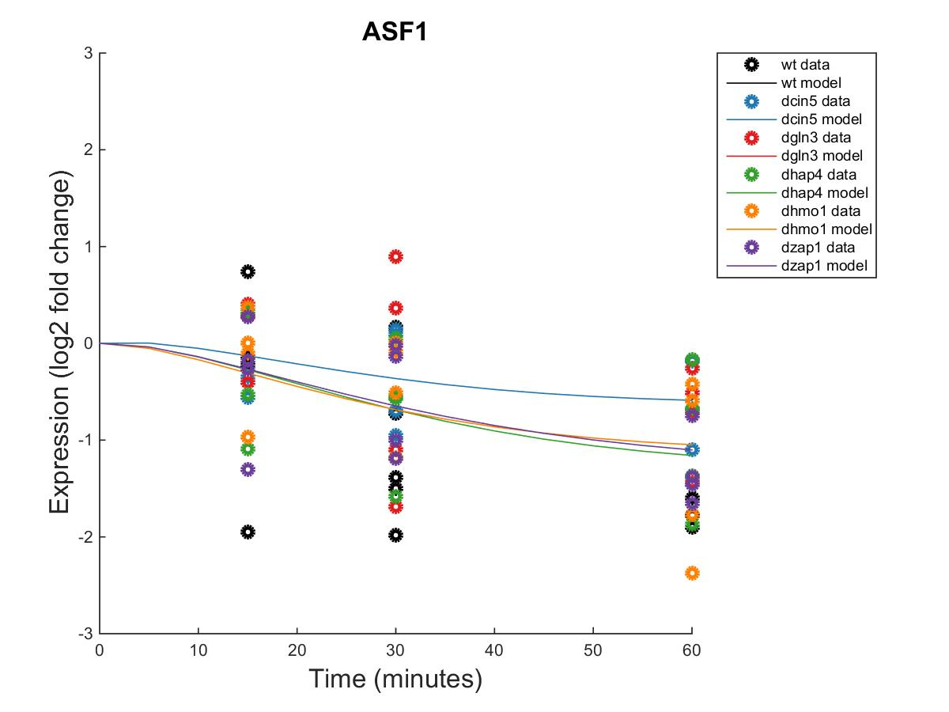
GRNmap Output Estimation of ABF1, ACE2, AFT2, AND ASF1

Slide 6
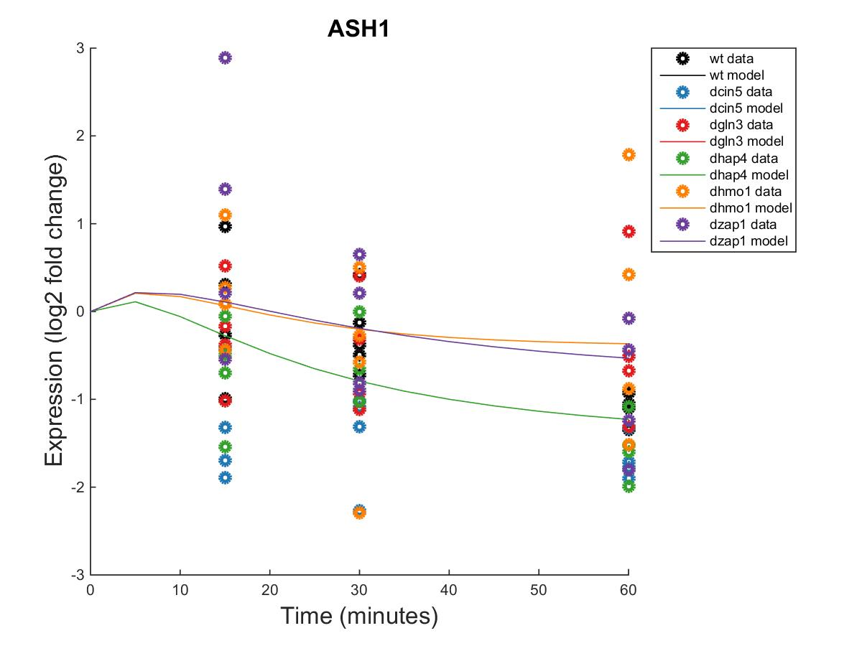
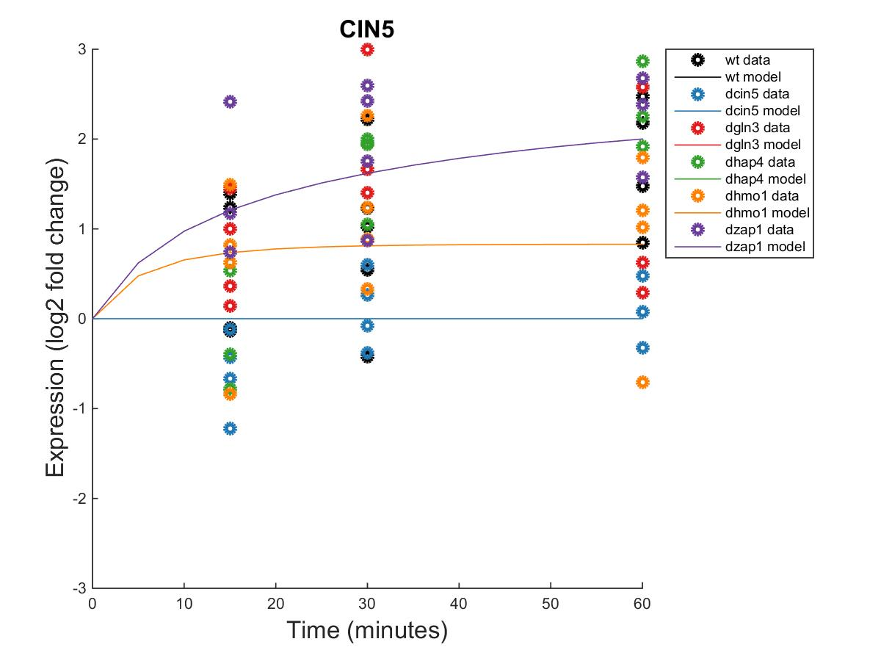
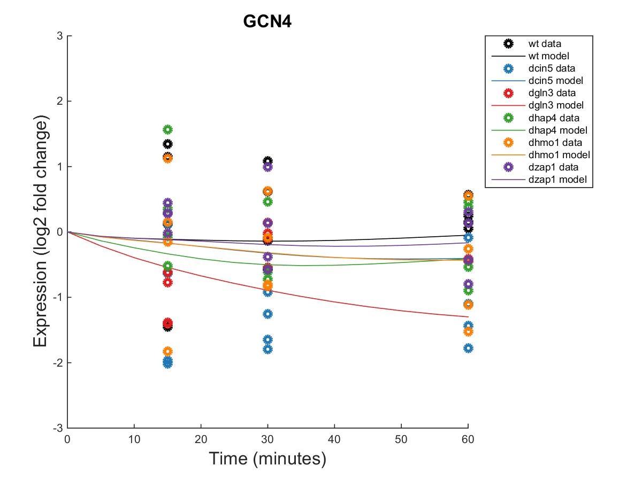
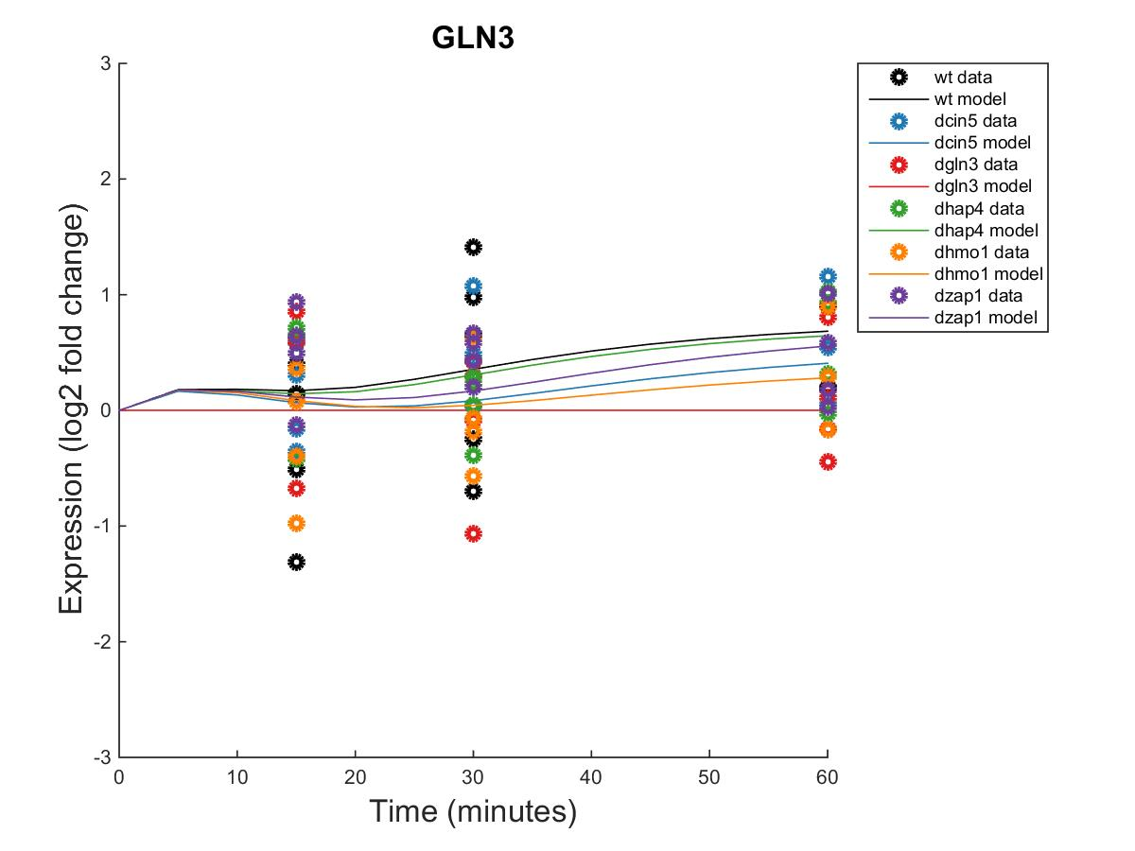
GRNmap Output Estimation of ASH1, CIN5, GCN4, AND GLN3

Slide 7
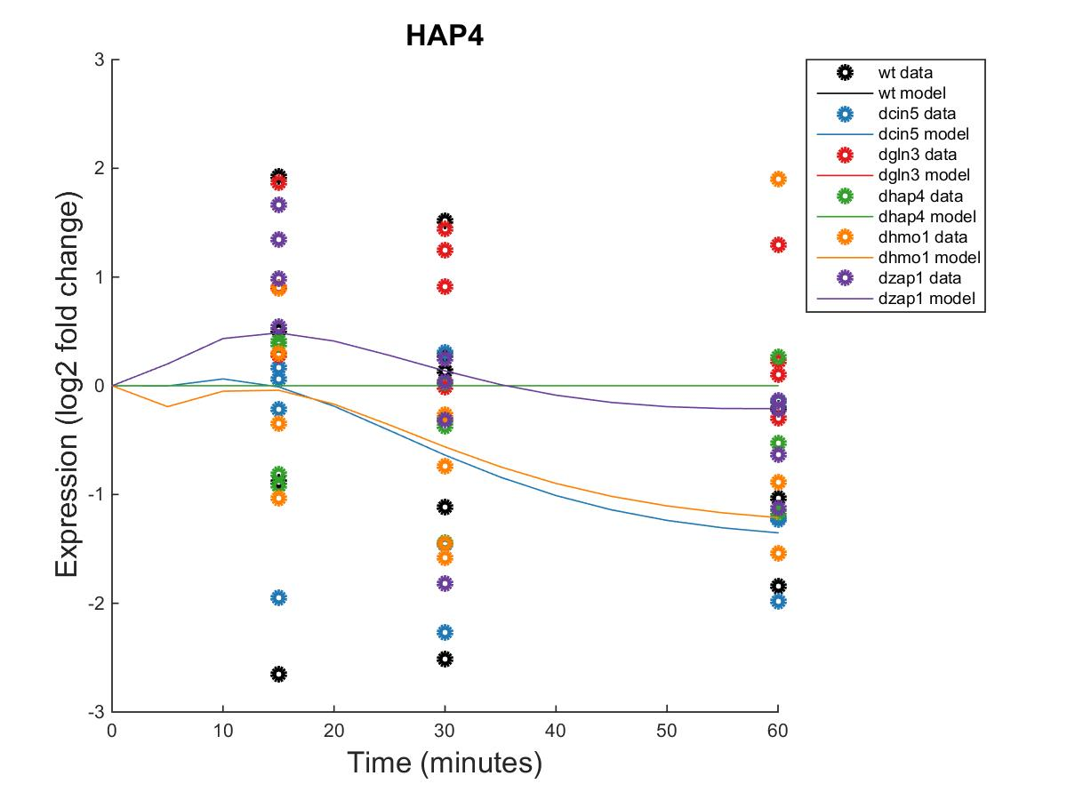
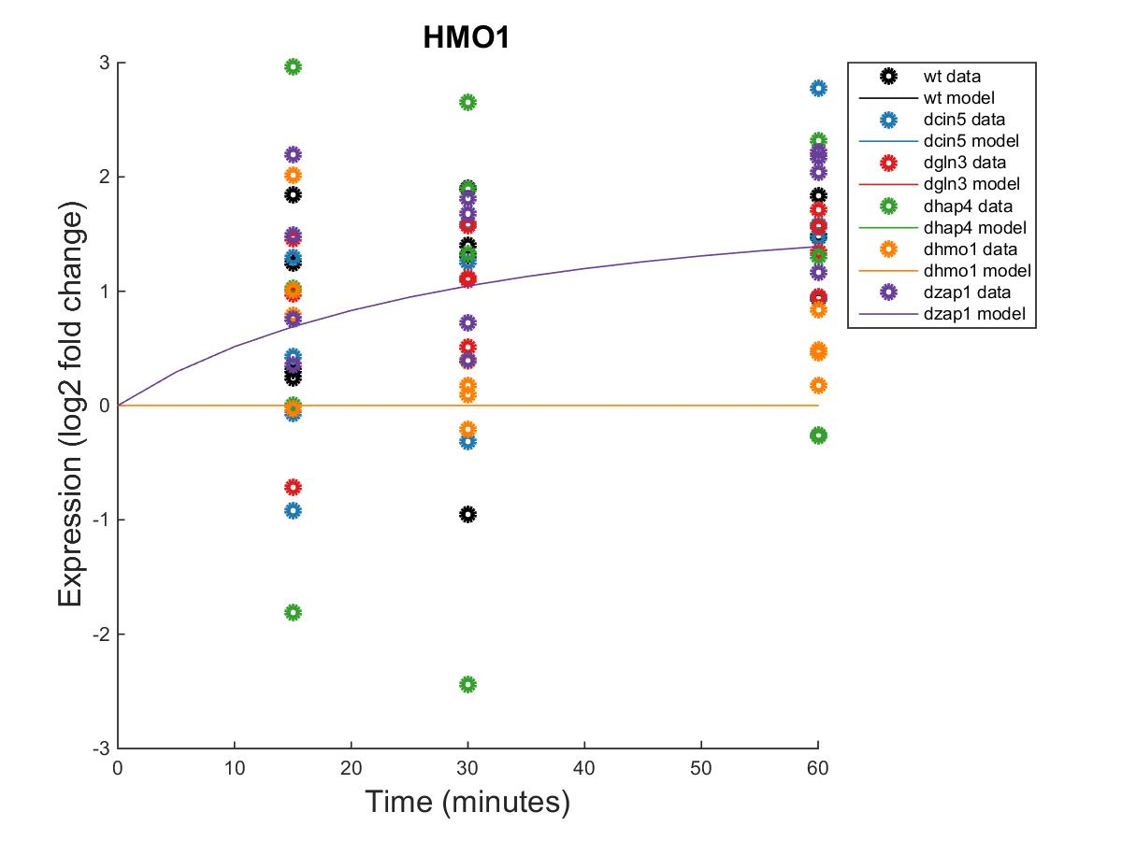
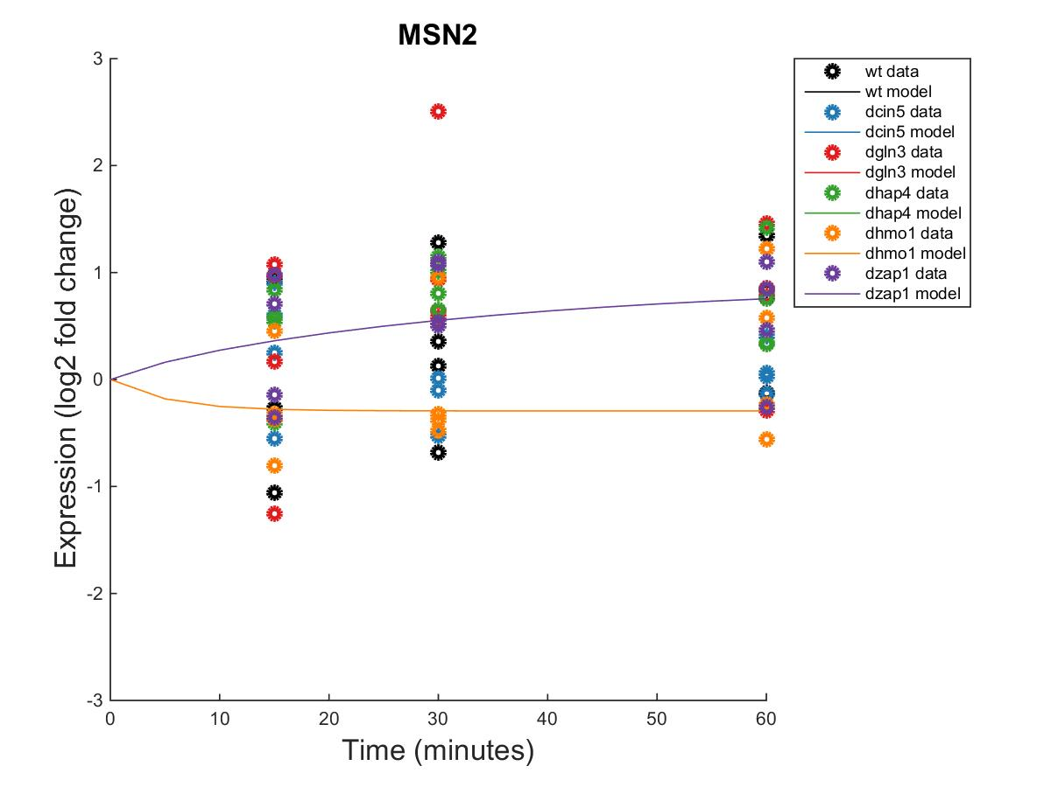
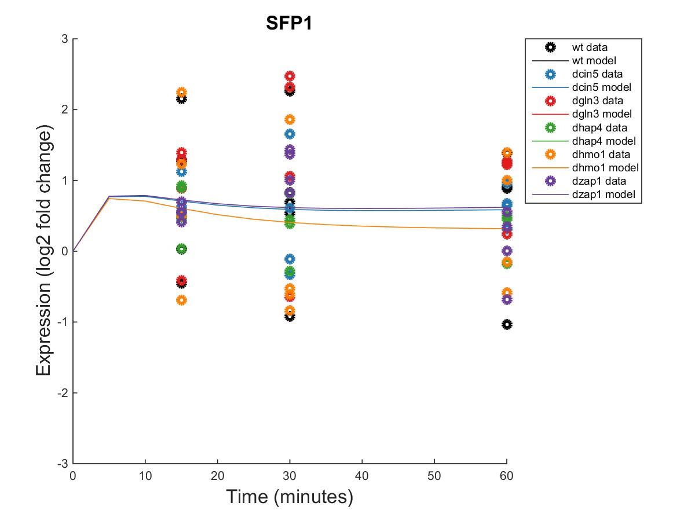
GRNmap Output Estimation of HAP4, HMO1, MSN2, AND SFP1

Slide 8
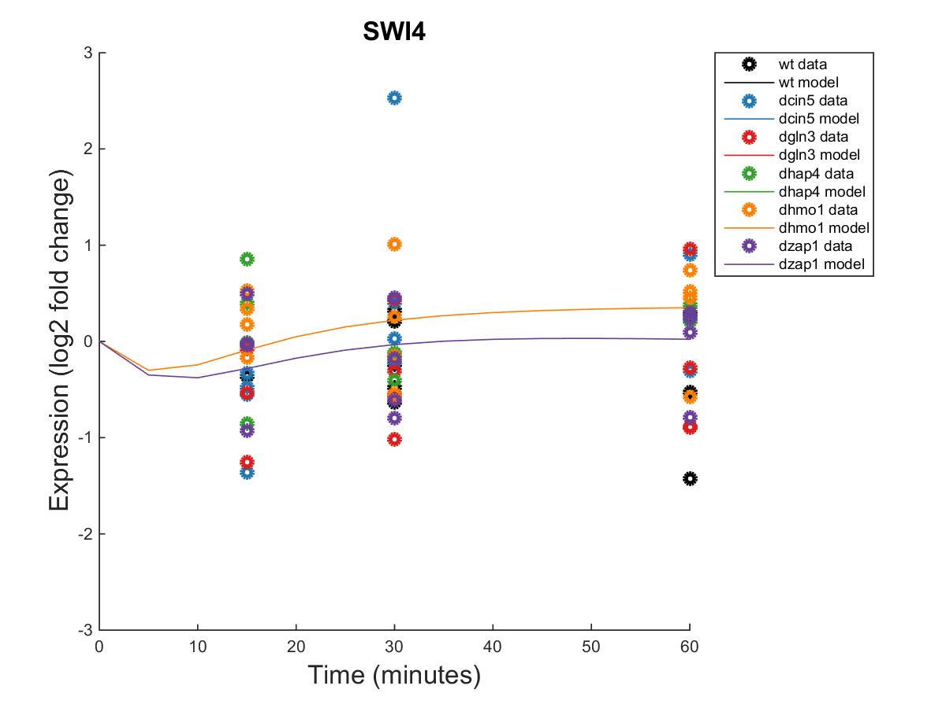
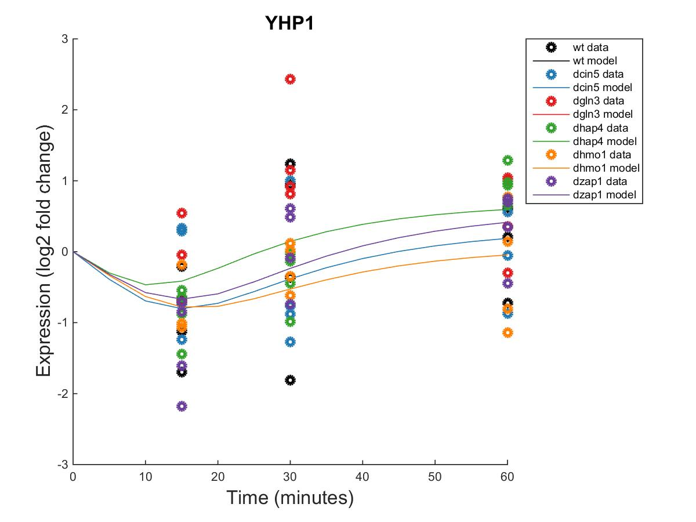
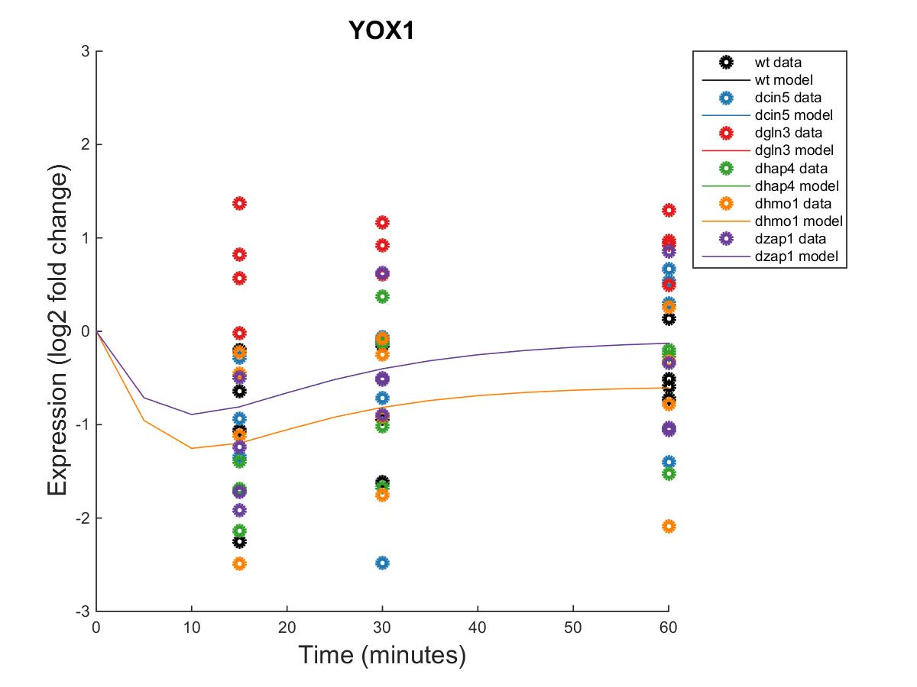
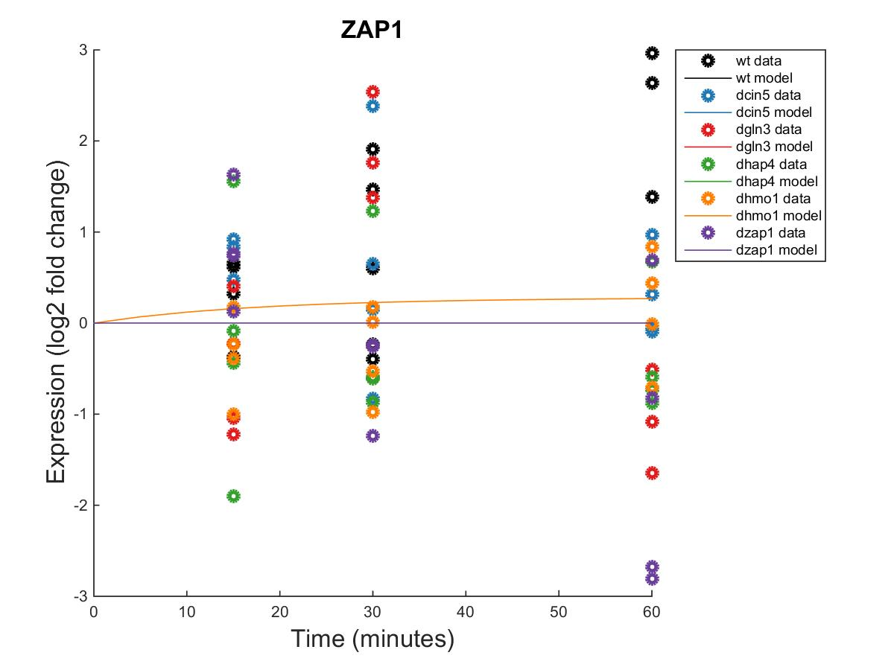
GRNmap Output Estimation of SWI4, YHP1, YOX1, AND ZAP1

Slide 9
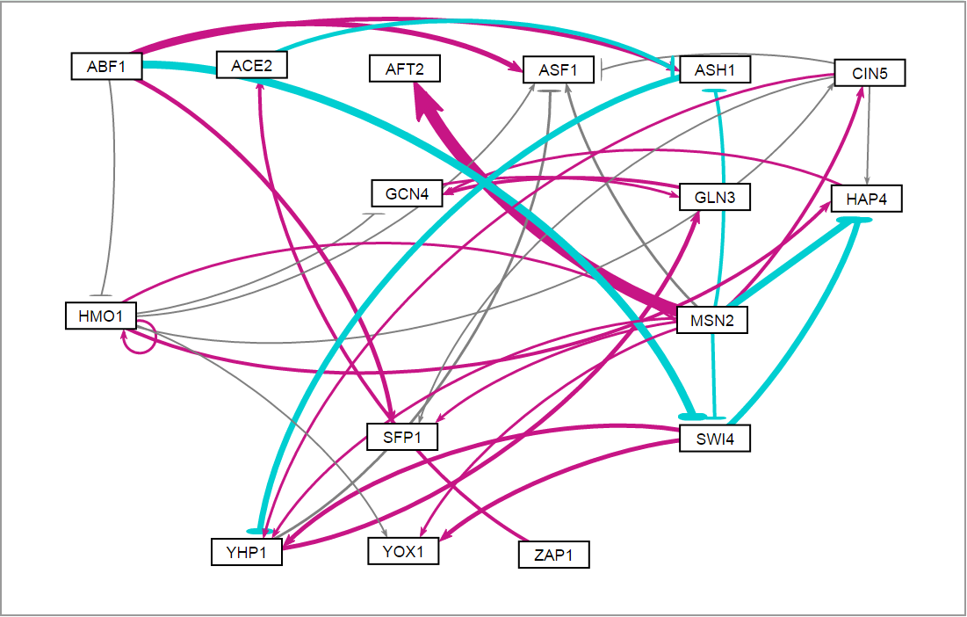
Weighted wt Network appears to have more activation than repression of genes within the network.

Slide 11
Optimized Threshold B for wt
id | threshold_b
ABF1 | 0.057591
ACE2 | 0.262124
AFT2 | 4.516856
ASF1 | 1.358124
ASH1 | 0.764114
CIN5 | 2.697564
GCN4 | 2.422825
GLN3 | 1.344126
HAP4 | -1.74514
HMO1 | 1.312883
MSN2 | 0.89613
SFP1 | 1.243381
SWI4 | -3.39406
YHP1 | 0.312824
YOX1 | 2.981617
ZAP1 | 0.126533

Slide 12
dCIN5 Grnmap Testing
Network Composed of the following genes:
ACE2
CIN5
GCR2
GLN3
HAP4
MGA2
MSN2
PDR1
RDS3
SFP1
STB5
SWI5
YHP1
YOX1
ZAP1
As of: 2016 Oct. 26

Slide 13
Parameter Outputs – dCIN5
Penalty Term: 0.72001
Least Squares Error (LSE): 1.939594
Minimum LSE: 0.488311
Iteration Count: 32,595

Slide 14
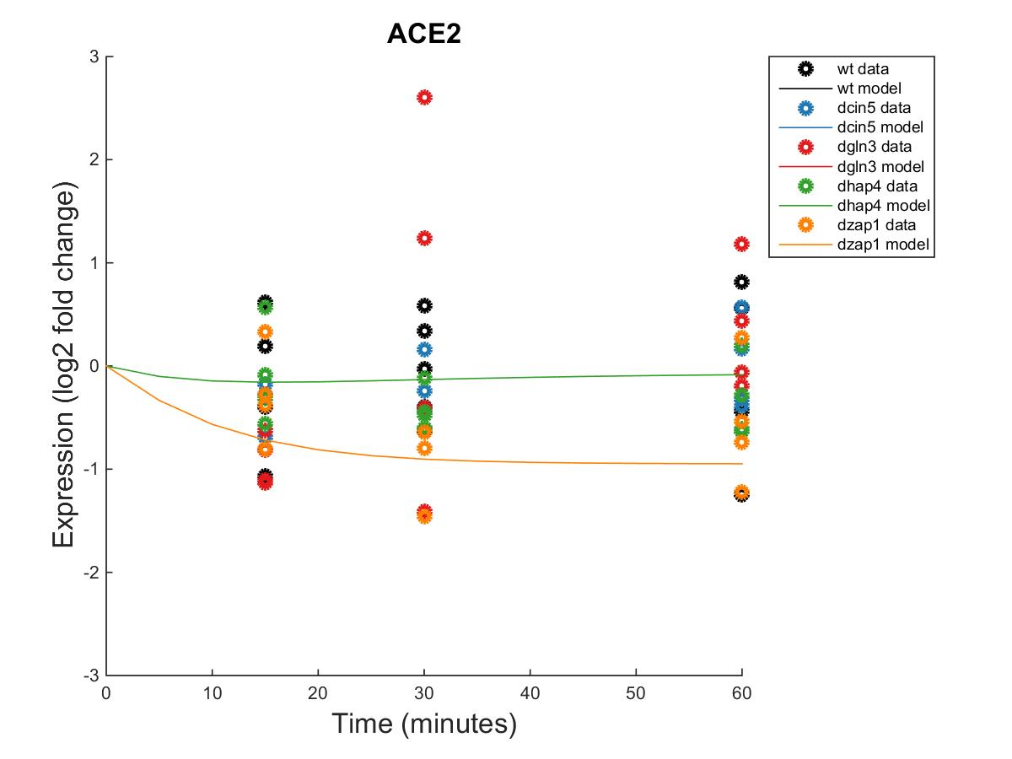
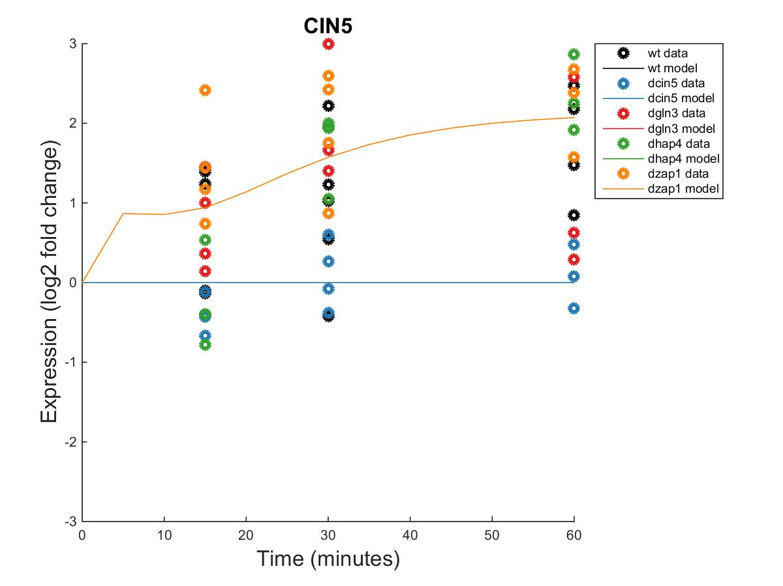
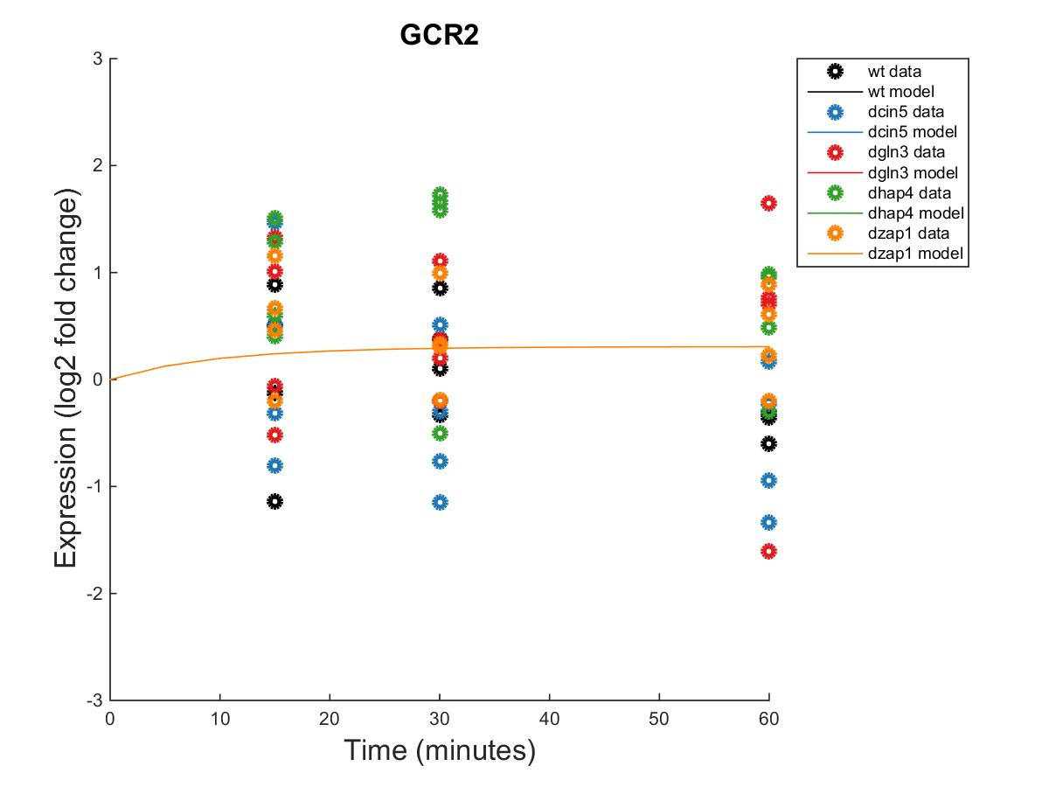
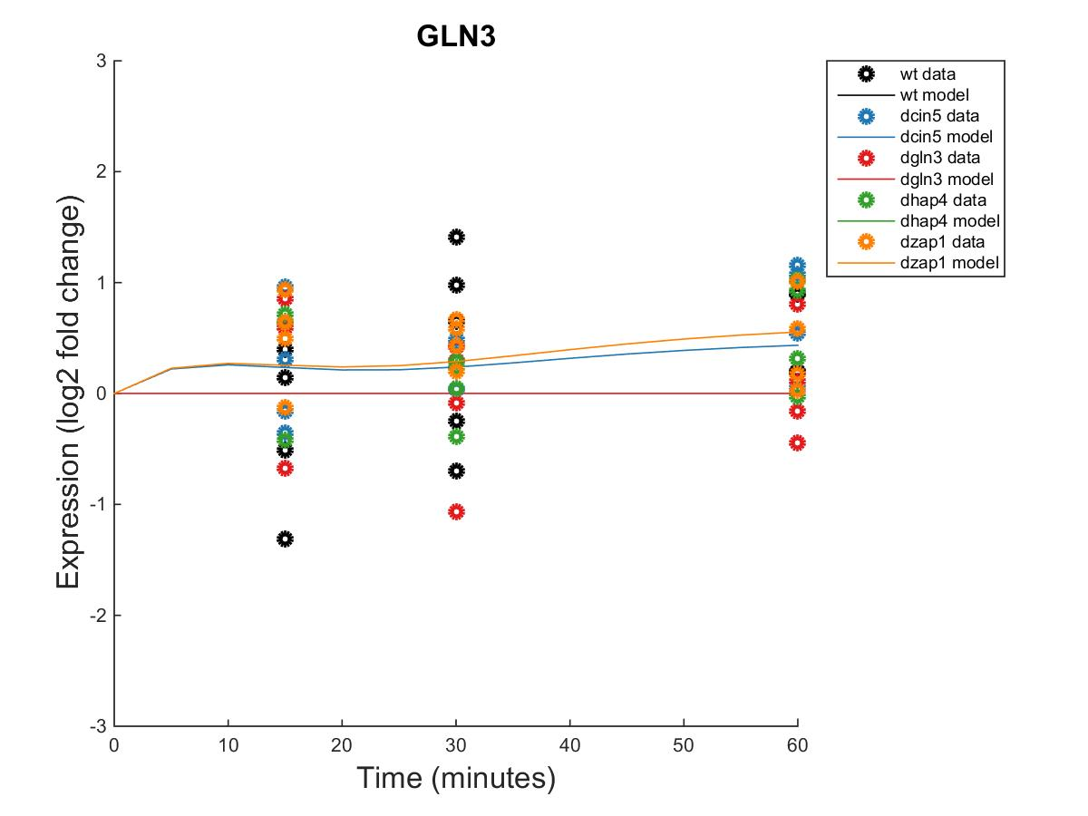
GRNmap Output Estimation of ACE2, CIN5, GCR2 AND GLN3

Slide 15
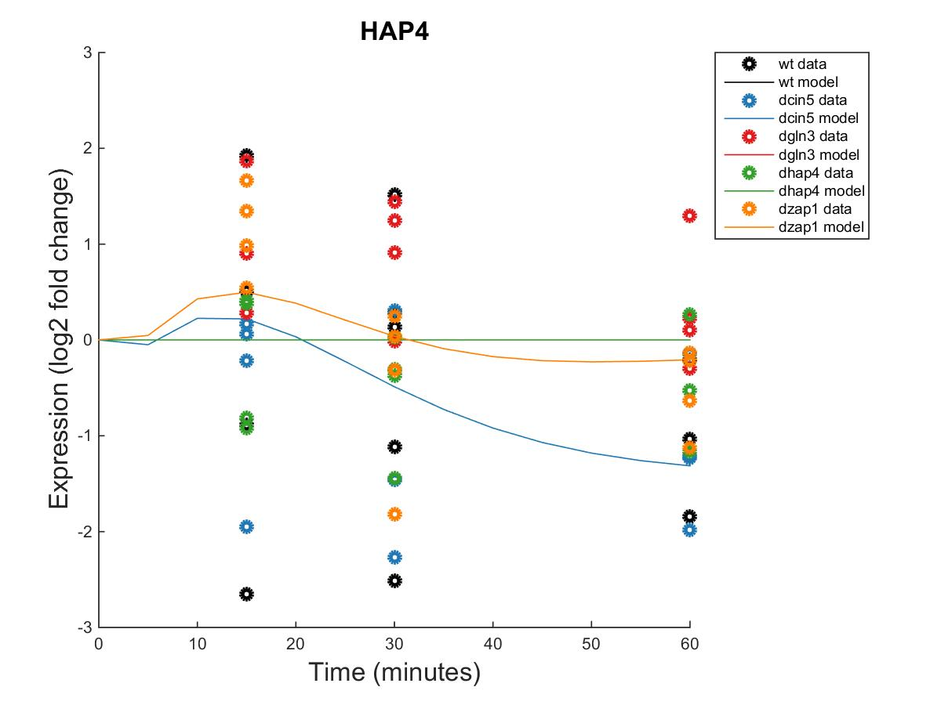
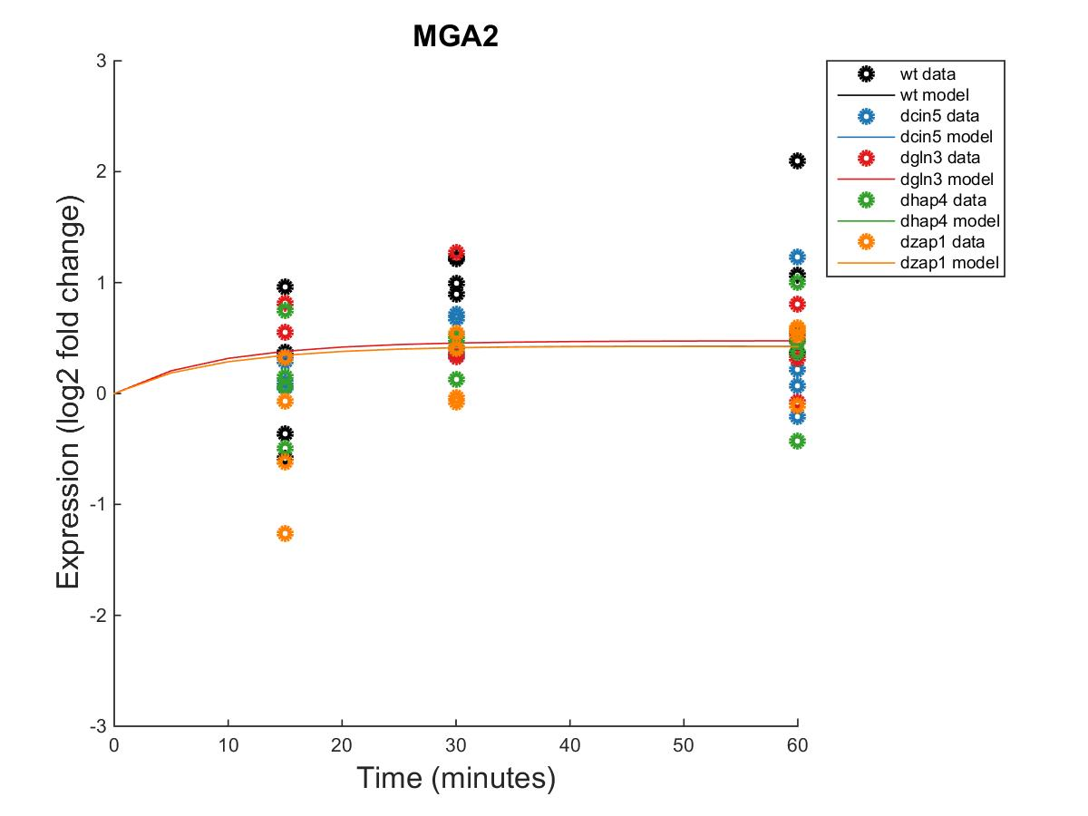
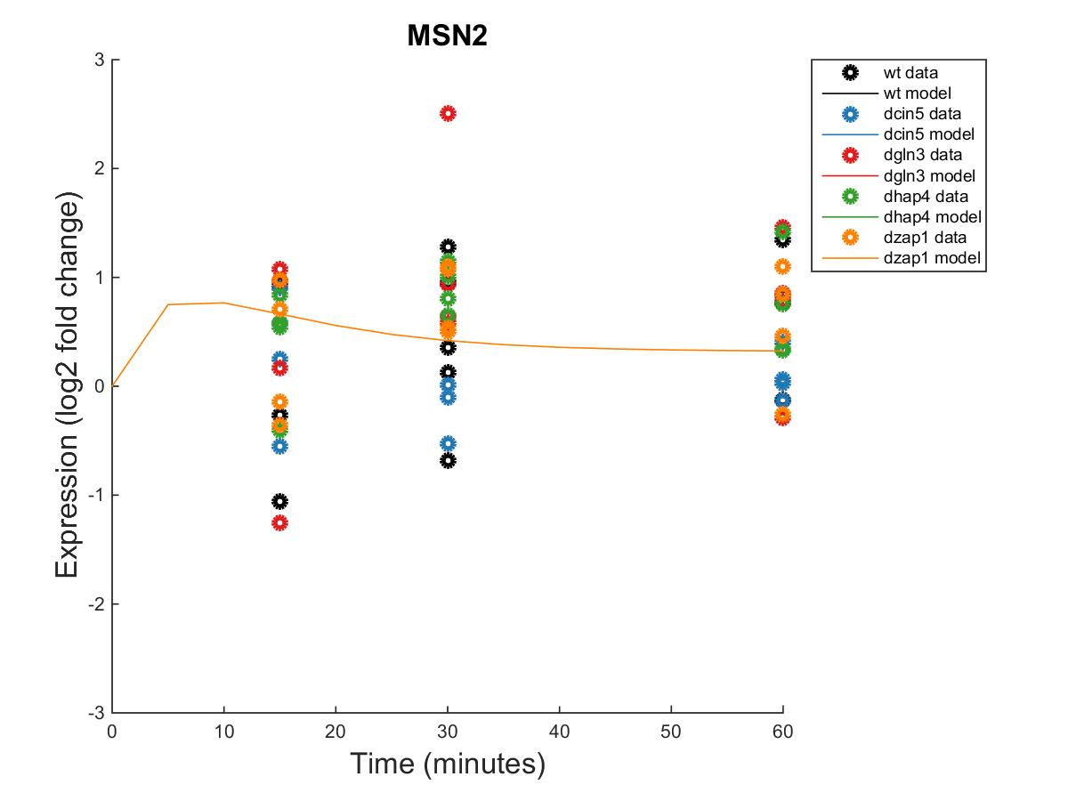
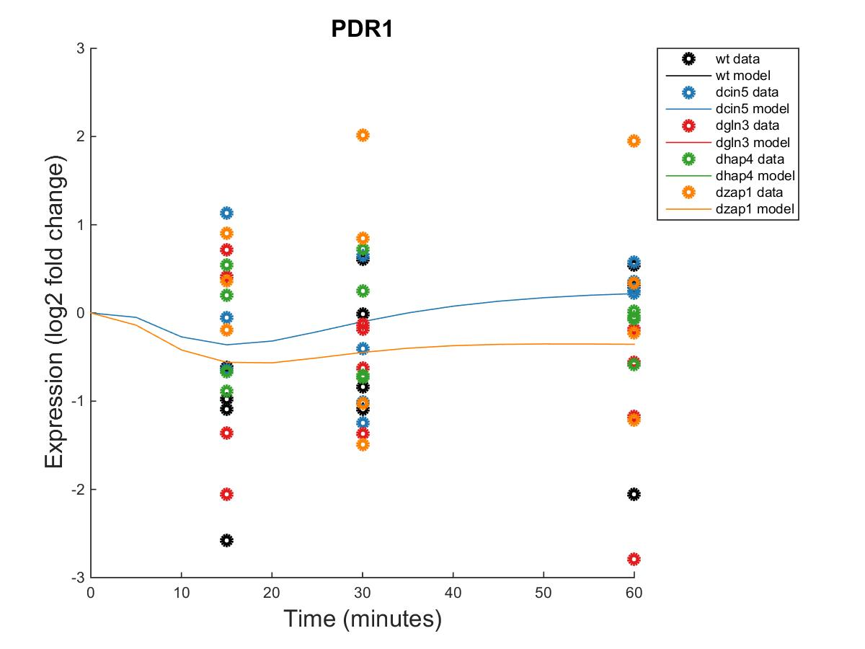
GRNmap Output Estimation of HAP4, MGA2, MSN2, AND PDR1

Slide 16
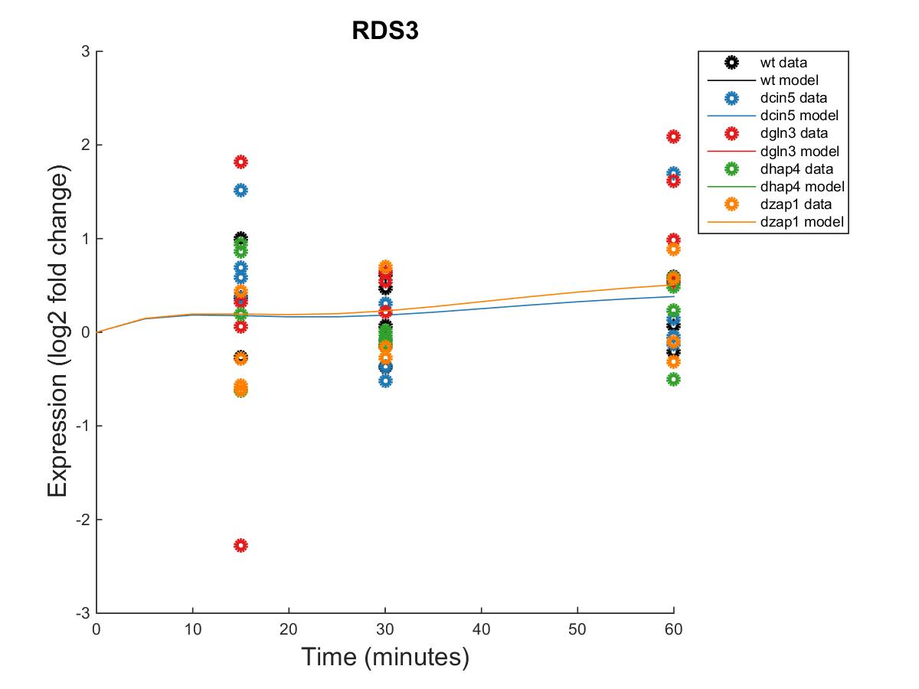
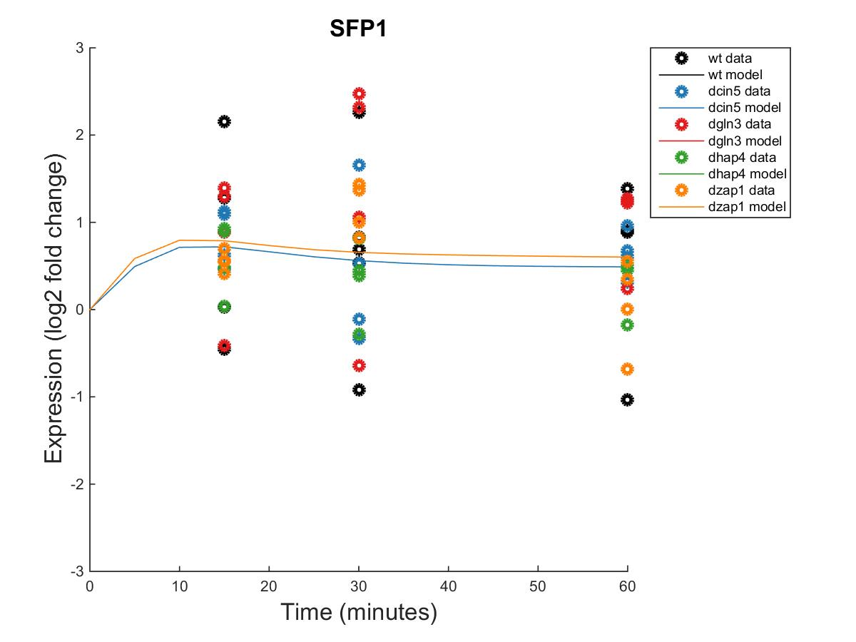
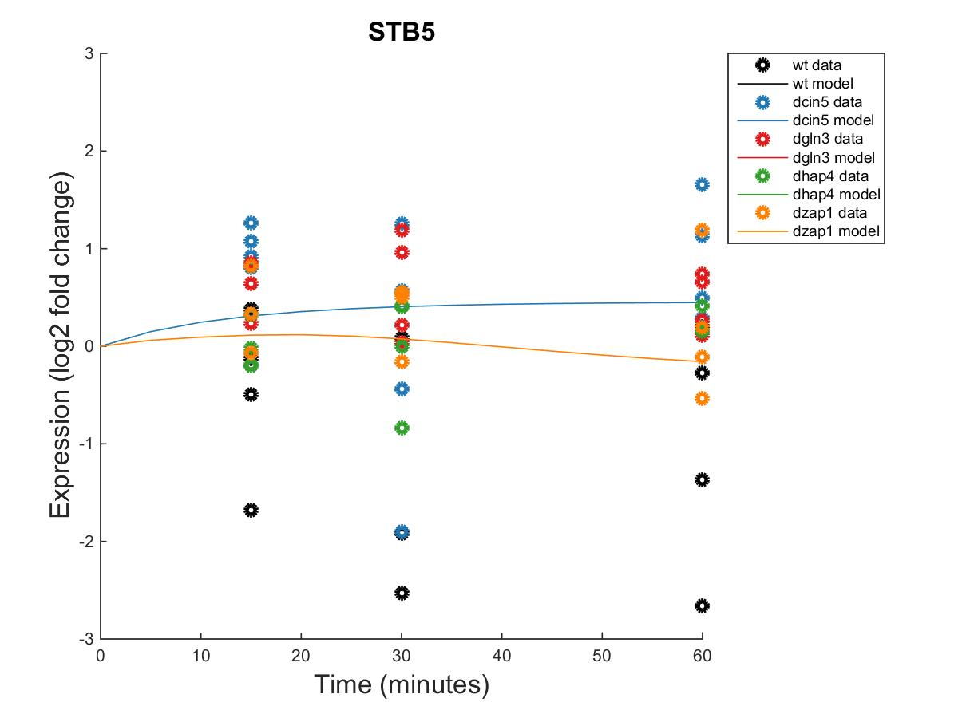
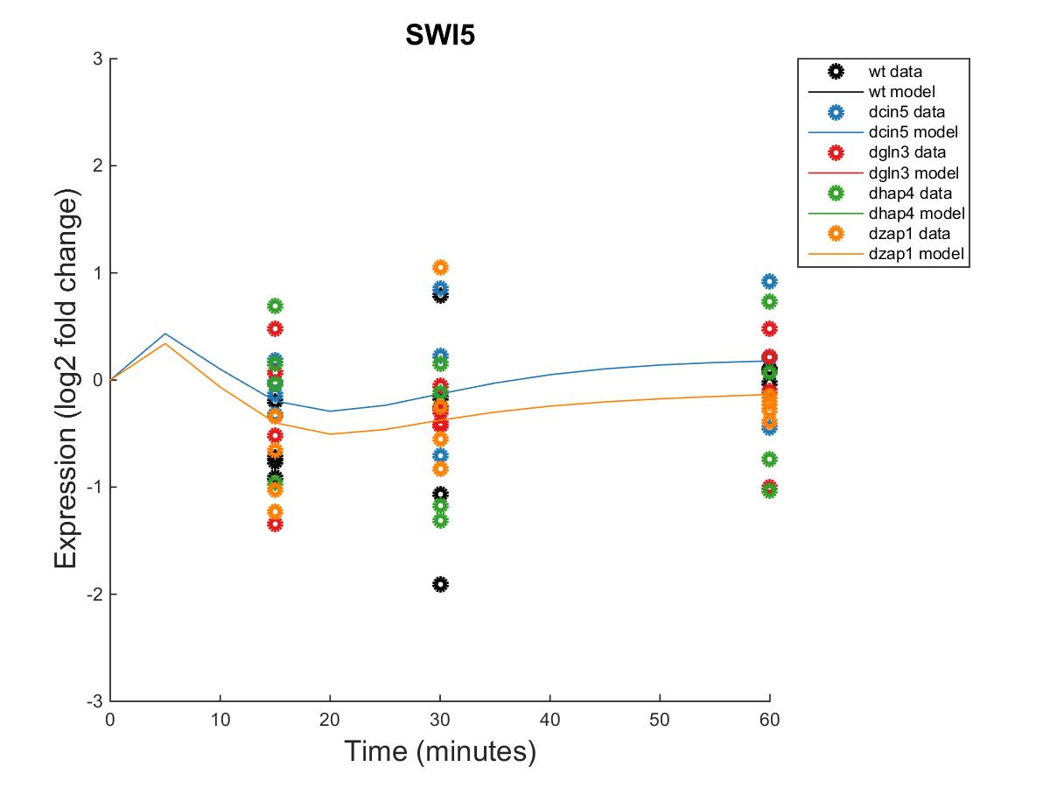
GRNmap Output Estimation of RDS3, SFP1, STB5, AND SWI5

Slide 17
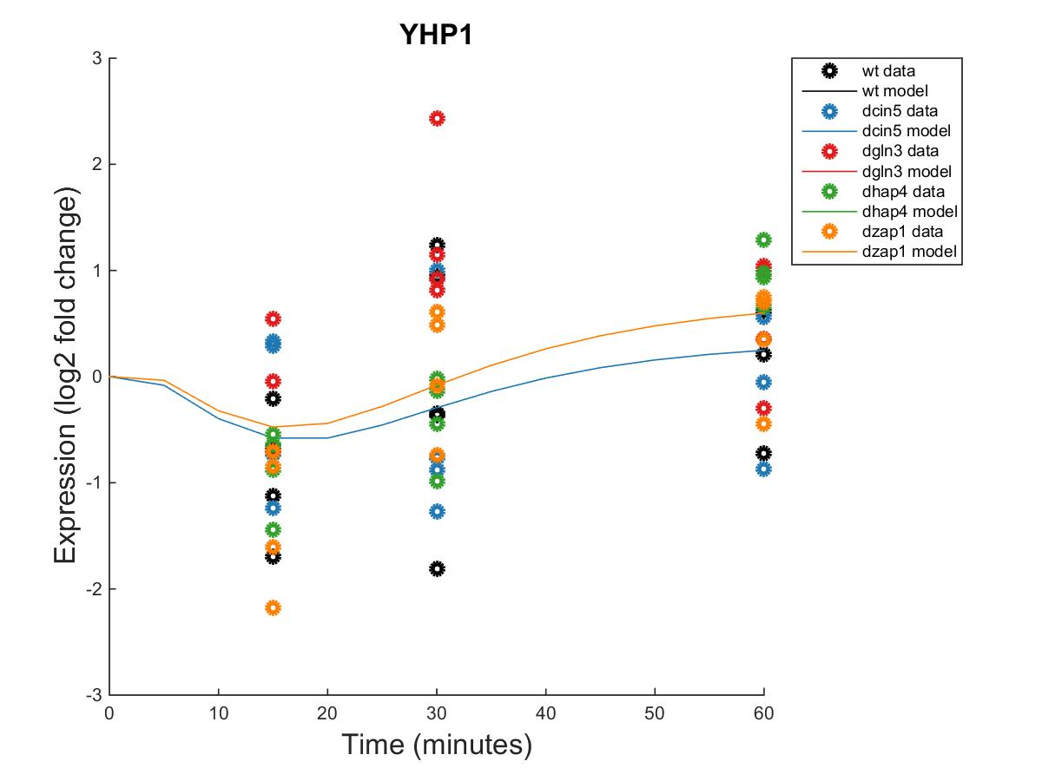
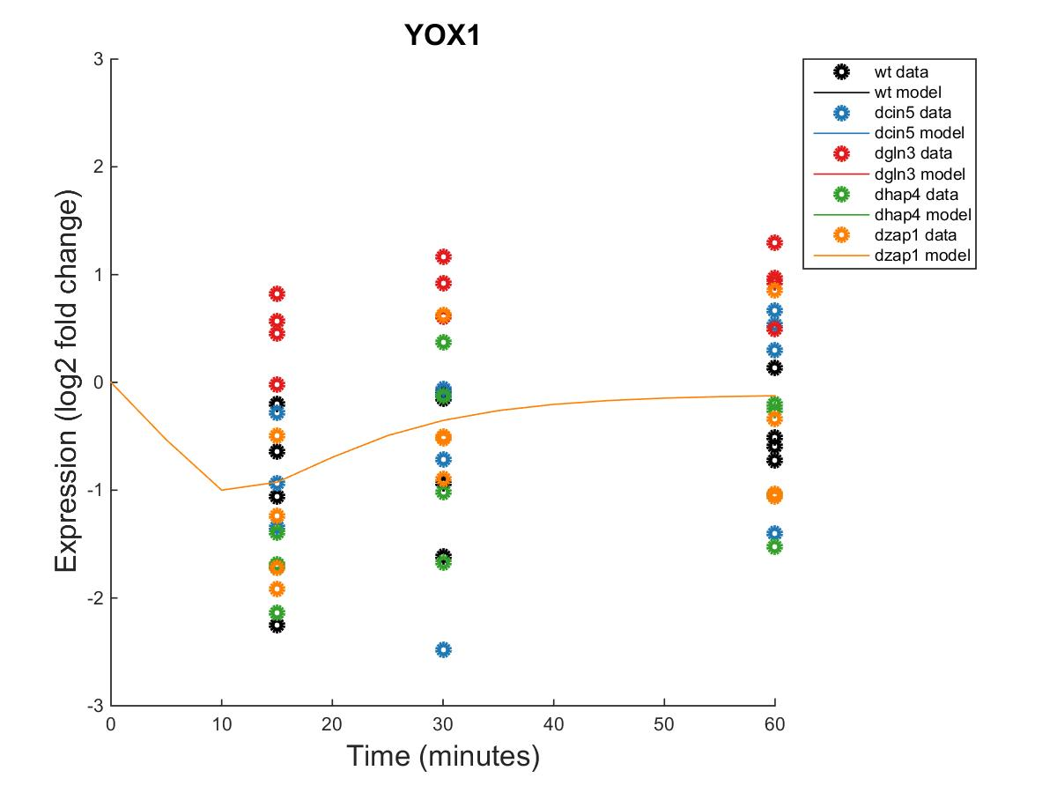
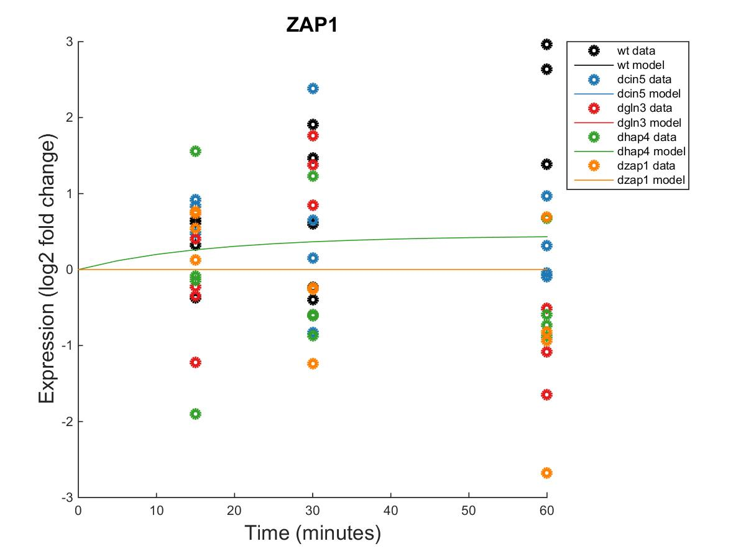
GRNmap Output Estimation of YHP1, YOX1 AND ZAP1

Slide 18
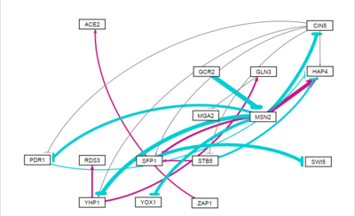
Weighted dCIN5 Network from GRNSight appears to have an equal distribution of high activation and repression.

Slide 20
Optimized Threshold B for dCIN5
id | threshold_b
ACE2 | 1.140363
CIN5 | -1.59358
GCR2 | 0.238369
GLN3 | 0.373651
HAP4 | 3.900532
MGA2 | -0.02688
MSN2 | -1.78041
PDR1 | -0.42142
RDS3 | 0.567369
SFP1 | 2.315616
STB5 | 0.857352
SWI5 | -1.10279
YHP1 | -1.26956
YOX1 | -0.97951
ZAP1 | 0.142221

