Slide 1
Identifying Determinants of Node MSE in db1-db6
Brandon Klein
Last Updated: 3/30/17

Slide 2
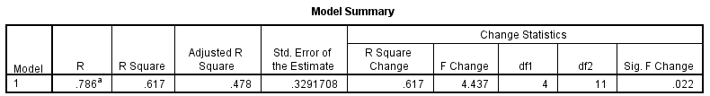
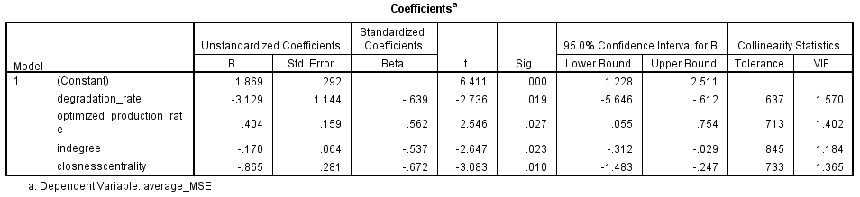
Final Model: db1
Preliminary Conclusions:
~50% of the variance in how well the model fit expression data for each TF (MSE) could be explained via d, optimized p, in degree, & closeness centrality
Better fit achieved when:
In degree is high
Closeness centrality is high
Degradation rate is high
Optimized production rate is low
Cooperative effect
Both favor low [transcription factor]

Slide 3
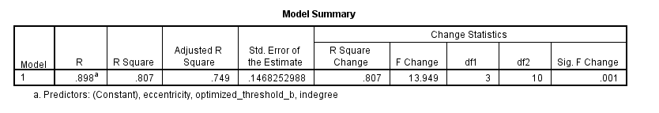
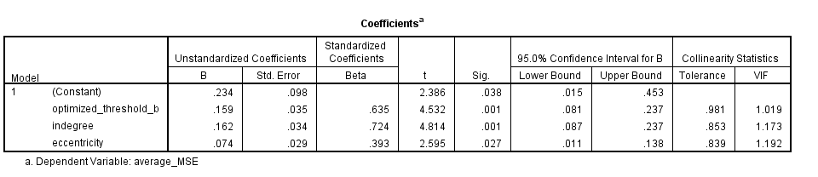
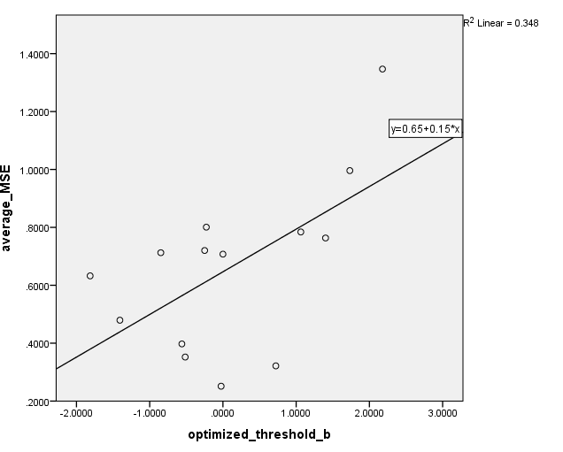
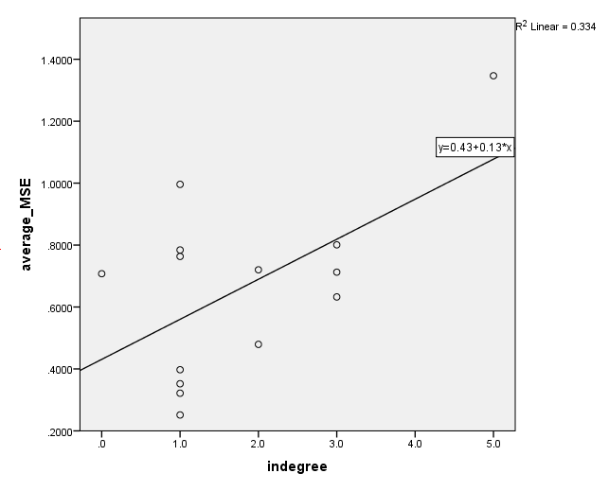
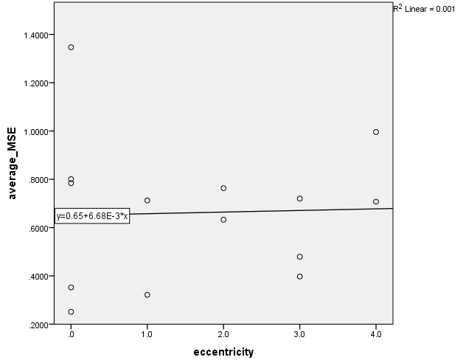
Final Model: db2

Slide 4
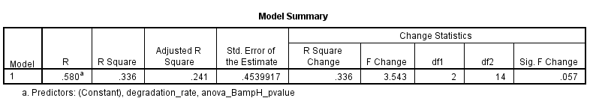
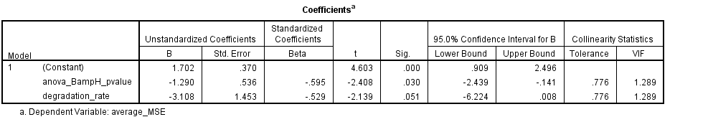
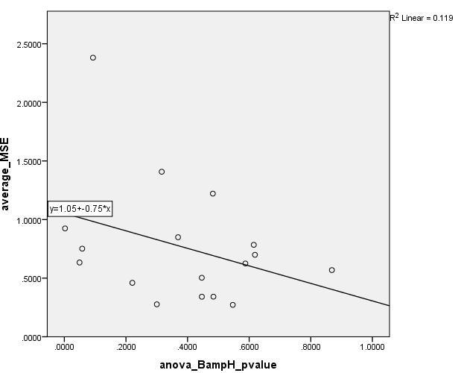
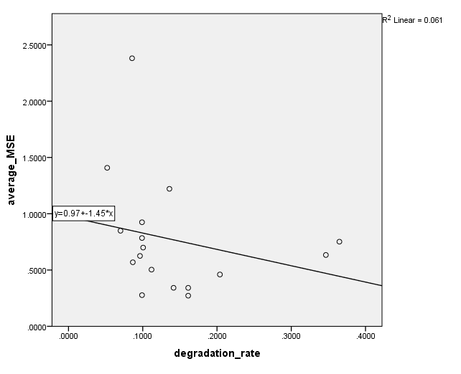
Final Model: db3

Slide 5
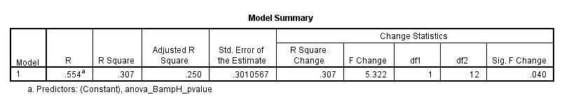
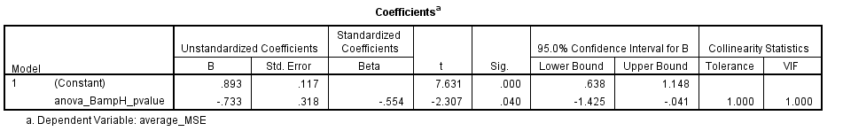
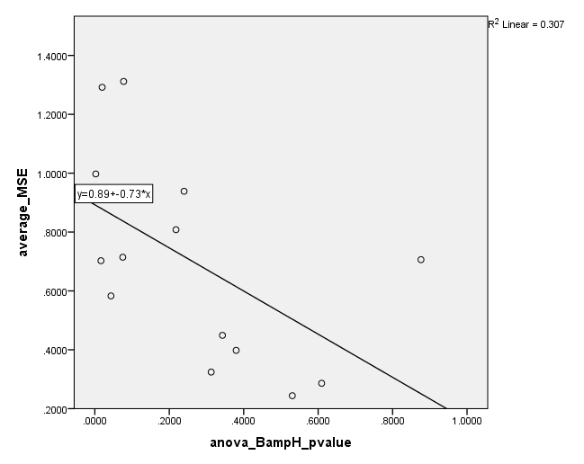
Final Model: db4

Slide 6
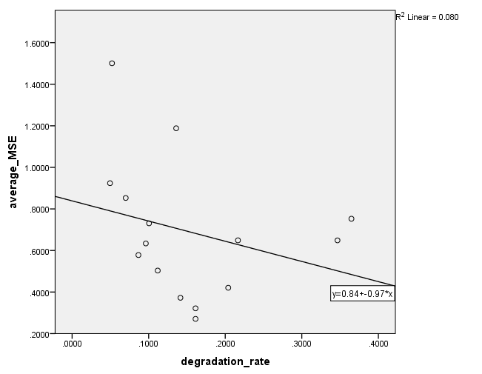
Final Model: db5
No significant predictors of MSE.
Best correlation:

Slide 7
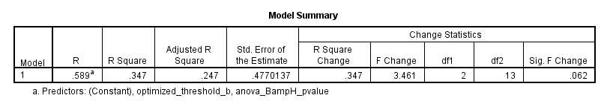
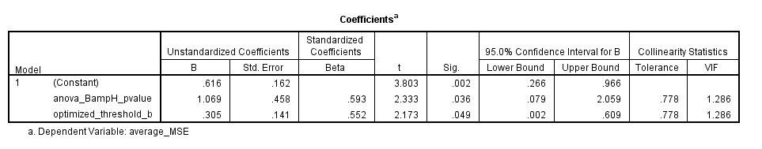
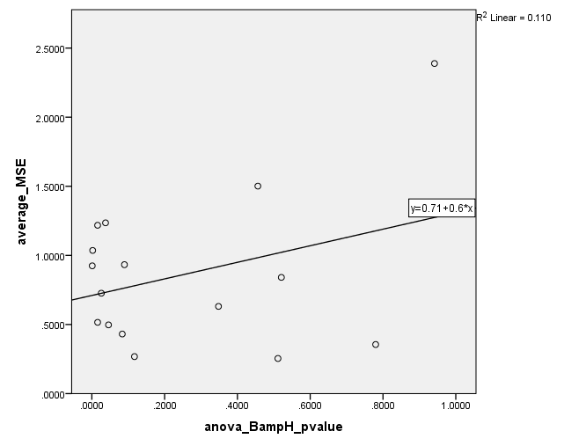
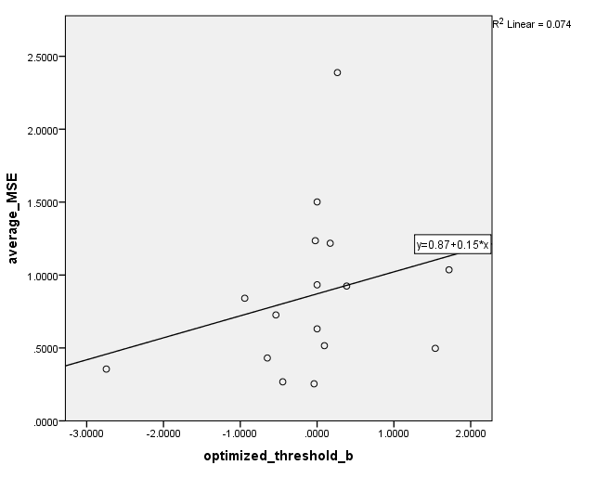
Final Model: db6

Slide 8
Summary of Model Coefficients
 | db1 | db2 | db3 | db4 | db5 | db6
ANOVA B&H p-value |  |  | -1.290 | -0.733 |  | 1.069
Degradation Rate | -3.129 |  | -3.108 |  | (-0.97)
Optimized Production Rate | 0.404
Optimized Threshold b |  | 0.159 |  |  |  | 0.305
Indegree | -0.170 | 1.620
Outdegree
Eccentricity |  | 0.740
Closeness Centrality | -0.865
Betweenness Centrality
Clustering
Eigen Centrality
Adjusted R Squared | 0.478 | 0.749 | 0.241 | 0.250 | N/A | 0.247
*
*
*
DV: Average MSE
Blue = negative = inversely proportional to MSE → higher values yield better fit
Red = positive = directly proportional to MSE → lower values yield better fit

