Slide 1
db1 Weighted Network with Nodes Colored by Average Expression at 15 and 60 Minutes
Brandon Klein
Last Modified: 12/05/17

Slide 3
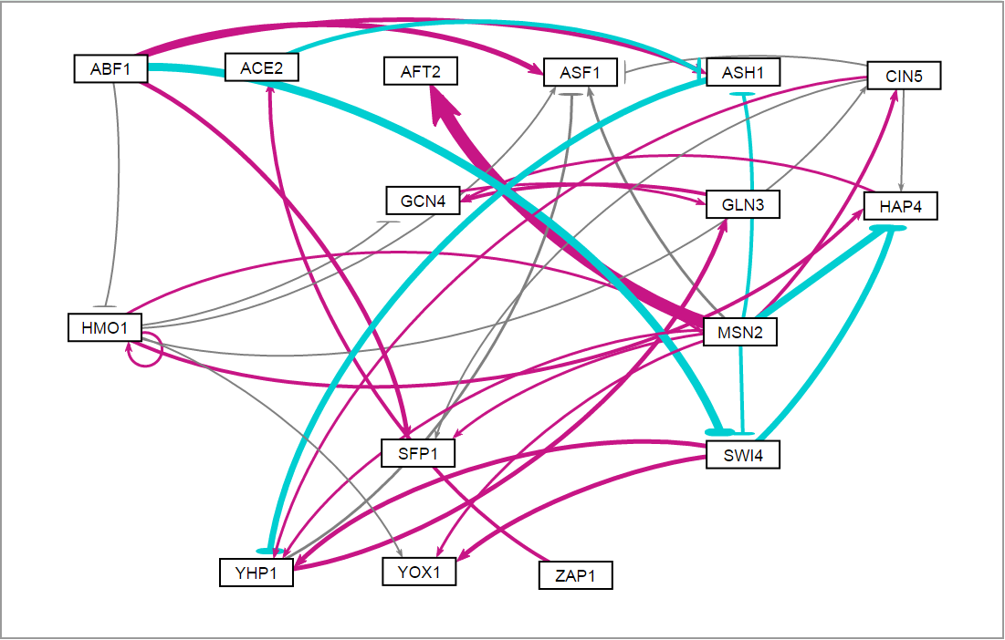
db1: Network Derived from wt Data
16 Genes, 26 Edges
Notes:
Source: https://github.com/kdahlquist/DahlquistLab/blob/master/documents/NEW_BK_GRNmap_Testing_network_presentation-all-strains_20161030.pptx

Slide 4
P-value Color Coding for Comparison.
db1: Network Derived from wt Data
16 Genes, 26 Edges
Notes:
Source: https://github.com/kdahlquist/DahlquistLab/blob/master/documents/NEW_BK_GRNmap_Testing_network_presentation-all-strains_20161030.pptx

