Slide 1
Db5-Derived Random Networks Edge Analysis
Brandon Klein
Last Updated: 10/24/17

Slide 2
Counts of Common Edges Between 30 Random Networks and db5
Network | LSE:minLSE | Shared; Activation | Shared; Repression | Shared; Opposite Weights | Total Shared Activation / Repression | Total Common Edges
rand24 | 1.388008562 | 1 | 0 | 1 | 1 | 2
rand15 | 1.406274908 | 0 | 0 | 0 | 0 | 0
rand16 | 1.416466167 | 2 | 0 | 1 | 2 | 3
rand26 | 1.420561799 | 3 | 4 | 0 | 7 | 7
rand9 | 1.424704767 | 1 | 0 | 0 | 1 | 1
db5 | 1.426289945
rand2 | 1.427750444 | 0 | 0 | 4 | 0 | 4
rand3 | 1.430205179 | 0 | 0 | 1 | 0 | 1
rand19 | 1.430550447 | 2 | 1 | 2 | 3 | 5
rand6 | 1.431296312 | 2 | 1 | 0 | 3 | 3
rand18 | 1.431848149 | 1 | 2 | 0 | 3 | 3
rand28 | 1.431848522 | 2 | 3 | 0 | 5 | 5
rand23 | 1.433218457 | 3 | 3 | 1 | 6 | 7
rand13 | 1.437326433 | 2 | 0 | 2 | 2 | 4
rand25 | 1.443309199 | 3 | 2 | 1 | 5 | 6
rand29 | 1.443442645 | 3 | 0 | 0 | 3 | 3
rand27 | 1.451985022 | 2 | 1 | 2 | 3 | 5
rand21 | 1.452774561 | 3 | 2 | 1 | 5 | 6
rand1 | 1.45297725 | 0 | 2 | 1 | 2 | 3
rand14 | 1.458560319 | 2 | 0 | 2 | 2 | 4
rand11 | 1.47413037 | 3 | 1 | 2 | 4 | 6
rand30 | 1.476084423 | 4 | 1 | 0 | 5 | 5
rand8 | 1.477279395 | 2 | 1 | 1 | 3 | 4
rand20 | 1.48174589 | 0 | 1 | 1 | 1 | 2
rand22 | 1.483940029 | 0 | 0 | 2 | 0 | 2
rand10 | 1.492072317 | 1 | 0 | 0 | 1 | 1
rand17 | 1.492966168 | 1 | 0 | 0 | 1 | 1
rand4 | 1.493268684 | 0 | 3 | 1 | 3 | 4
rand31 | 1.50094837 | 0 | 0 | 1 | 0 | 1
rand12 | 1.5080249 | 1 | 0 | 1 | 1 | 2
rand7 | 1.520212753 | 0 | 0 | 1 | 0 | 1

Slide 3
LSE:minLSE Ratio of Random Networks vs. # of Regulatory Relationships Shared with db5
Median # of regulatory relationships shared with db5 = 2 (vertical line).
LSE:minLSE ratio of db5 = 1.4263 (horizontal line).
Notes:
Q4 is conspicuously empty (except for point where x=7), whereas Q3 contains several points. However, in Q1 & Q2, points appear to slope downwards.
Suggests that for networks that performed worse than db5, having common edges tended to boost performance. However, to exceed db5, rewiring of the network was required.
Key: Q4 empty indicates that the best performing networks are NOT more likely to have common edges with db5.

Slide 4
All But One of the Regulatory Relationships Seen in db5 Appeared in the Random Networks
 | rand1 | rand2 | rand3 | rand4 | rand6 | rand7 | rand8 | rand9 | rand10 | rand11 | rand12 | rand13 | rand14 | rand15 | rand16 | rand17 | rand18 | rand19 | rand20 | rand21 | rand22 | rand23 | rand24 | rand25 | rand26 | rand27 | rand28 | rand29 | rand30 | rand31
ACE2->ASH1 |  |  |  |  |  |  |  |  |  | 4 |  | 4 |  |  |  |  |  | 2
ASH1->YHP1 |  | 4 | 4 |  |  |  |  |  |  |  |  | 4
CIN5->HAP4 |  |  |  |  |  |  |  |  |  | 6 |  |  |  |  |  |  |  |  |  |  |  |  |  |  |  |  |  | 6
CIN5->SFP1 |  |  |  |  |  |  |  |  |  |  |  |  |  |  | 4 |  |  |  |  |  |  |  | 4
CIN5->STB5 |  | 4 |  | 2 | 2 |  |  |  |  |  |  |  |  |  |  |  | 2 |  | 2 |  |  | 2 |  |  | 2 |  | 2 |  | 2
CIN5->YHP1 |  |  |  |  |  |  |  |  |  |  |  |  |  |  |  |  | 6 |  |  |  |  | 6 |  |  |  |  |  | 6
GCR2->MSN2 |  | 4 |  |  | 6 |  |  |  |  |  |  |  |  |  |  |  |  | 6 | 4 |  |  | 4
HMO1->CIN5 |  |  |  |  |  |  | 6 |  |  |  |  |  |  |  |  |  |  |  |  |  |  | 6 |  |  |  | 6 |  |  | 6
HMO1->HAP4 |  |  |  |  |  |  |  |  |  | 6 |  |  |  |  |  |  |  |  |  | 6 |  |  |  |  | 6 |  |  | 6 | 6
HMO1->HMO1 |  |  |  |  | 6 |  |  |  |  | 6 |  |  | 6 |  |  |  |  |  |  |  |  | 6
HMO1->MSN2 |  |  |  |  |  |  |  |  |  |  |  |  |  |  |  |  |  | 4 |  | 6 |  |  |  |  |  |  | 6 |  | 6
HMO1->YOX1 |  |  |  |  |  |  |  |  |  |  |  |  |  |  | 6 |  |  | 6 |  |  |  |  |  |  |  |  | 6
MSN2->ASH1 |  |  |  | 2 |  |  |  |  |  |  |  |  |  |  |  |  |  |  |  | 2 |  |  |  |  |  | 2
MSN2->CIN5 |  |  |  |  |  |  |  | 6 |  |  |  | 6 |  |  | 6
MSN2->HAP4 |  |  |  |  |  |  |  |  |  |  |  |  |  |  |  |  |  |  |  | 2 |  | 2 |  | 2 | 2 |  | 2
MSN2->SFP1 |  |  |  |  |  |  |  |  |  | 2 |  |  |  |  |  |  |  |  |  |  |  |  |  | 2 |  |  |  |  |  | 4
MSN2->SWI4 |  |  |  |  |  |  |  |  | 6 |  |  |  | 4 |  |  | 6 |  |  |  |  | 4
MSN2->YHP1 | 4 |  |  | 4 |  |  |  |  |  |  |  |  |  |  |  |  |  |  |  |  |  |  |  |  | 6
MSN2->YOX1 |  |  |  |  |  |  |  |  |  | 4 |  |  | 6 |  |  |  |  |  |  |  |  |  | 6 | 4
SFP1->SWI5 |  |  |  |  |  |  |  |  |  |  |  |  |  |  |  |  |  |  |  | 4 |  |  |  |  | 2 |  | 2
STB5->HAP4
STB5->SFP1 |  |  |  |  |  | 4 | 6 |  |  |  |  |  | 4 |  |  |  |  |  |  |  | 4 |  |  | 6 |  |  |  |  | 6
SWI4->HAP4 | 2 |  |  |  |  |  |  |  |  |  |  |  |  |  |  |  |  | 4
SWI4->YHP1 |  |  |  |  |  |  | 2 |  |  |  | 4 |  |  |  |  |  |  |  |  |  |  |  |  |  |  | 4
SWI4->YOX1 |  | 4 |  | 2 |  |  | 4 |  |  |  |  |  |  |  |  |  |  |  |  |  |  |  |  |  | 2
SWI5->ASH1 | 2 |  |  |  |  |  |  |  |  |  |  |  |  |  |  |  | 2 |  |  |  |  | 2 |  |  |  | 4
YHP1->GLN3 |  |  |  |  |  |  |  |  |  |  | 6 | 6 |  |  |  |  |  |  |  |  |  |  |  | 6
ZAP1->ACE2 |  |  |  |  |  |  |  |  |  |  |  |  |  |  |  |  |  |  |  | 6 |  |  |  | 6 | 6 | 6
6 = shared activation; 4 = mixed regulation; 2 = shared repression.
The regulatory relationship highlighted in yellow did not appear in any of the random networks.
The random networks highlighted in blue outperformed db5 (i.e. lower LSE:minLSE ratio).

Slide 5
Counts of Common Edges Between 30 Random Networks and db5
Notes:
All but one edge in db5 (28 total) represented.
ASH1->YHP1 - weak activation in db5. Strong repression in 3 randoms. CIN5->SFP1 - weak activation in db5. Weak repression in both randoms.

Slide 6
All the Shared Regulatory Relationships Appearing in Random Networks that Outperformed db5 Were Used to Build the Foundation of a GRN
 | rand1 | rand2 | rand3 | rand4 | rand6 | rand7 | rand8 | rand9 | rand10 | rand11 | rand12 | rand13 | rand14 | rand15 | rand16 | rand17 | rand18 | rand19 | rand20 | rand21 | rand22 | rand23 | rand24 | rand25 | rand26 | rand27 | rand28 | rand29 | rand30 | rand31
ACE2->ASH1 |  |  |  |  |  |  |  |  |  | 4 |  | 4 |  |  |  |  |  | 2
ASH1->YHP1 |  | 4 | 4 |  |  |  |  |  |  |  |  | 4
CIN5->HAP4 |  |  |  |  |  |  |  |  |  | 6 |  |  |  |  |  |  |  |  |  |  |  |  |  |  |  |  |  | 6
CIN5->SFP1 |  |  |  |  |  |  |  |  |  |  |  |  |  |  | 4 |  |  |  |  |  |  |  | 4
CIN5->STB5 |  | 4 |  | 2 | 2 |  |  |  |  |  |  |  |  |  |  |  | 2 |  | 2 |  |  | 2 |  |  | 2 |  | 2 |  | 2
CIN5->YHP1 |  |  |  |  |  |  |  |  |  |  |  |  |  |  |  |  | 6 |  |  |  |  | 6 |  |  |  |  |  | 6
GCR2->MSN2 |  | 4 |  |  | 6 |  |  |  |  |  |  |  |  |  |  |  |  | 6 | 4 |  |  | 4
HMO1->CIN5 |  |  |  |  |  |  | 6 |  |  |  |  |  |  |  |  |  |  |  |  |  |  | 6 |  |  |  | 6 |  |  | 6
HMO1->HAP4 |  |  |  |  |  |  |  |  |  | 6 |  |  |  |  |  |  |  |  |  | 6 |  |  |  |  | 6 |  |  | 6 | 6
HMO1->HMO1 |  |  |  |  | 6 |  |  |  |  | 6 |  |  | 6 |  |  |  |  |  |  |  |  | 6
HMO1->MSN2 |  |  |  |  |  |  |  |  |  |  |  |  |  |  |  |  |  | 4 |  | 6 |  |  |  |  |  |  | 6 |  | 6
HMO1->YOX1 |  |  |  |  |  |  |  |  |  |  |  |  |  |  | 6 |  |  | 6 |  |  |  |  |  |  |  |  | 6
MSN2->ASH1 |  |  |  | 2 |  |  |  |  |  |  |  |  |  |  |  |  |  |  |  | 2 |  |  |  |  |  | 2
MSN2->CIN5 |  |  |  |  |  |  |  | 6 |  |  |  | 6 |  |  | 6
MSN2->HAP4 |  |  |  |  |  |  |  |  |  |  |  |  |  |  |  |  |  |  |  | 2 |  | 2 |  | 2 | 2 |  | 2
MSN2->SFP1 |  |  |  |  |  |  |  |  |  | 2 |  |  |  |  |  |  |  |  |  |  |  |  |  | 2 |  |  |  |  |  | 4
MSN2->SWI4 |  |  |  |  |  |  |  |  | 6 |  |  |  | 4 |  |  | 6 |  |  |  |  | 4
MSN2->YHP1 | 4 |  |  | 4 |  |  |  |  |  |  |  |  |  |  |  |  |  |  |  |  |  |  |  |  | 6
MSN2->YOX1 |  |  |  |  |  |  |  |  |  | 4 |  |  | 6 |  |  |  |  |  |  |  |  |  | 6 | 4
SFP1->SWI5 |  |  |  |  |  |  |  |  |  |  |  |  |  |  |  |  |  |  |  | 4 |  |  |  |  | 2 |  | 2
STB5->HAP4
STB5->SFP1 |  |  |  |  |  | 4 | 6 |  |  |  |  |  | 4 |  |  |  |  |  |  |  | 4 |  |  | 6 |  |  |  |  | 6
SWI4->HAP4 | 2 |  |  |  |  |  |  |  |  |  |  |  |  |  |  |  |  | 4
SWI4->YHP1 |  |  |  |  |  |  | 2 |  |  |  | 4 |  |  |  |  |  |  |  |  |  |  |  |  |  |  | 4
SWI4->YOX1 |  | 4 |  | 2 |  |  | 4 |  |  |  |  |  |  |  |  |  |  |  |  |  |  |  |  |  | 2
SWI5->ASH1 | 2 |  |  |  |  |  |  |  |  |  |  |  |  |  |  |  | 2 |  |  |  |  | 2 |  |  |  | 4
YHP1->GLN3 |  |  |  |  |  |  |  |  |  |  | 6 | 6 |  |  |  |  |  |  |  |  |  |  |  | 6
ZAP1->ACE2 |  |  |  |  |  |  |  |  |  |  |  |  |  |  |  |  |  |  |  | 6 |  |  |  | 6 | 6 | 6
Weights were taken into consideration.
All common edges shared exhibited the same type of regulation as in db5, with the exception of CIN5->SFP1 (changed to repression relationship).
Weak activation in db5.
Weak repression in rand16 & rand24.

Slide 7
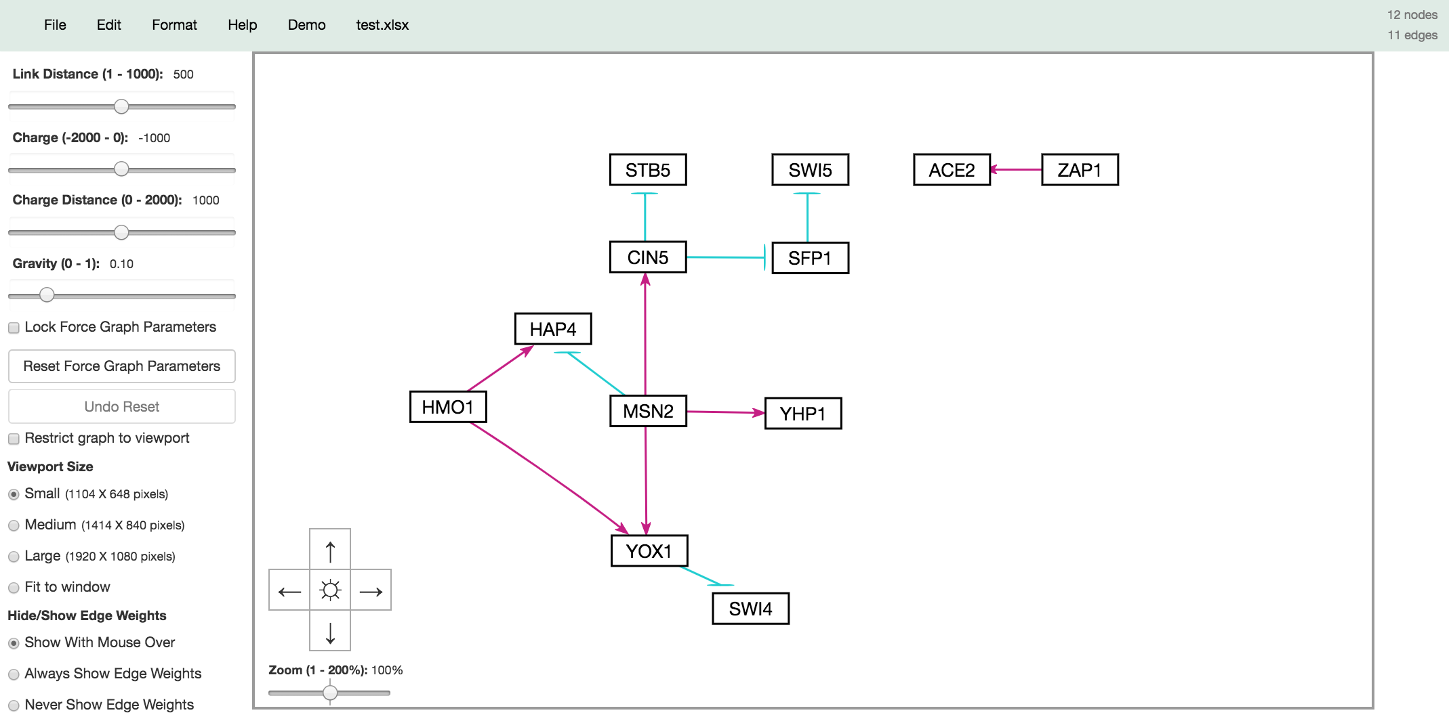
All the Shared Regulatory Relationships Appearing in Random Networks that Outperformed db5 Were Used to Build the Foundation of a GRN

Slide 8
Edges in Which ≥75% of Networks Shared the Same Regulation Type were Added to the GRN (if not already present)
Added 10 edges & 2 nodes (ASH1, GLN3).
ASH1->YHP1 changed to repression relationship (strong repression in all random networks).
ACE2 & ZAP1 still disconnected from GRN*.
Notes:
All but one edge in db5 (28 total) represented.
ASH1->YHP1 - weak activation in db5. Strong repression in 3 randoms. CIN5->SFP1 - weak activation in db5. Weak repression in both randoms.

Slide 9
Edges in Which Only One Regulation Type was Present in the 2+ Best Performing Networks Containing that Edge were Added to the GRN
Added 2 edges.
ACE2->ASH1 & SWI4->YOX1 retained as a repression relationships (same as in db5).
ACE2 & ZAP1 now connected to network.
Notes:
All but one edge in db5 (28 total) represented.
ASH1->YHP1 - weak activation in db5. Strong repression in 3 randoms. CIN5->SFP1 - weak activation in db5. Weak repression in both randoms.

Slide 10
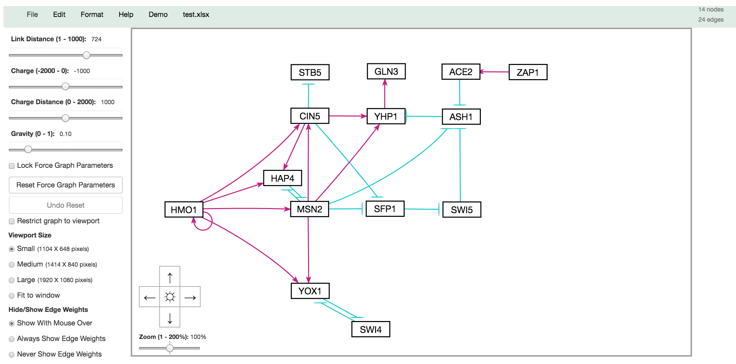
Final GRN — 14 Nodes, 23 Edges
Comparison to db5:
CIN5->SFP1 & ASH1->YHP1 changed to repression relationships.
1 Node Excluded: GCR2
5 Edges Excluded: GCR2->MSN2, MSN2->SWI4, STB5->SFP1, SWI4->HAP4, SWI4->YHP1.
Next step would be to add remaining edges with same regulation type as in db5.
Notes:
Note: triple repression of ASH1 (direct through MSN2; direct through ACE2; indirect through SFP1, which increases SWI5, a repressor of ASH1).
Note: triple activation of YHP1 &, in turn, GLN3 (ASH1, a repressor of YHP1, is repressed; direct through CIN5, direct through MSN2).

