Slide 1
Running dCIN5 Network on GRNmap
Natalie Williams
November 21, 2016

Slide 2
Dr. Dahlquist generated a new database-network from the dCIN5 data.
Two networks were generated:
17 genes and 32 edges, includes ZAP1
14 genes and 25 edges, excludes ZAP1

Slide 3
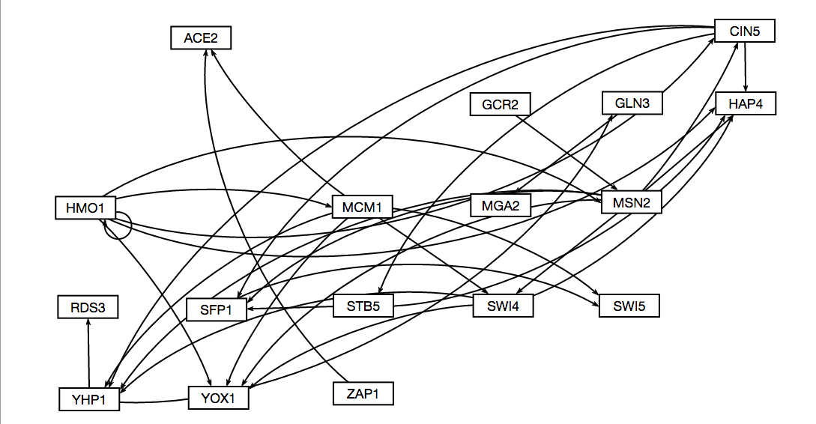
17 nodes, 32 edges dCIN5 network

Slide 4
Parameter Output
Parameter | Value
Penalty Term | 1.7570
LSE | 0.7864
minLSE | 0.5449
LSE:minLSE ratio | 1.4100
Iteration Count | 118,921

Slide 5
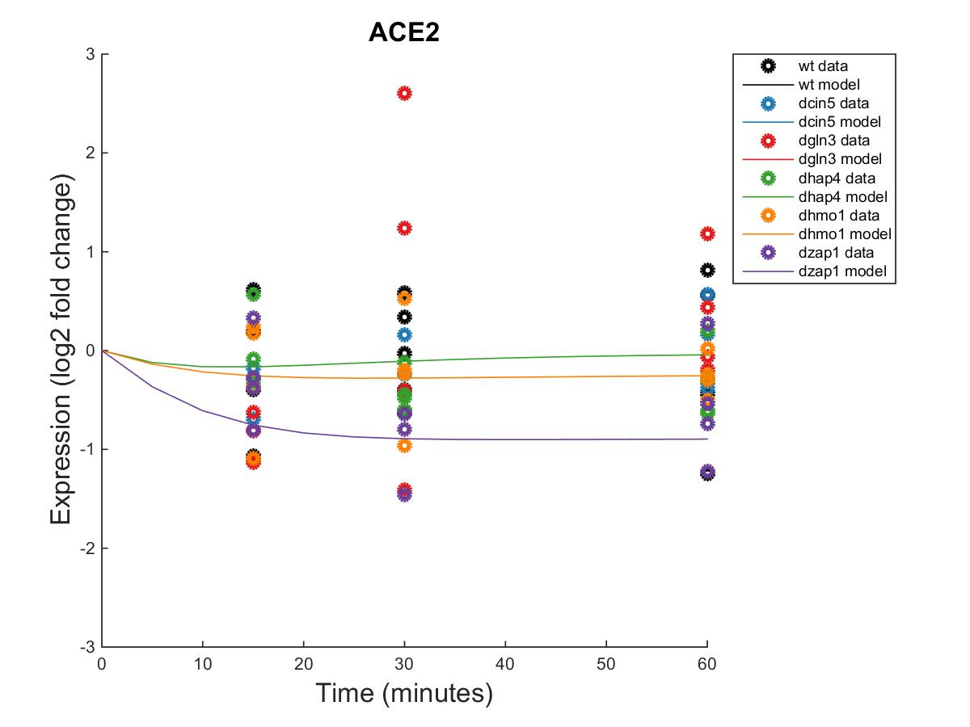
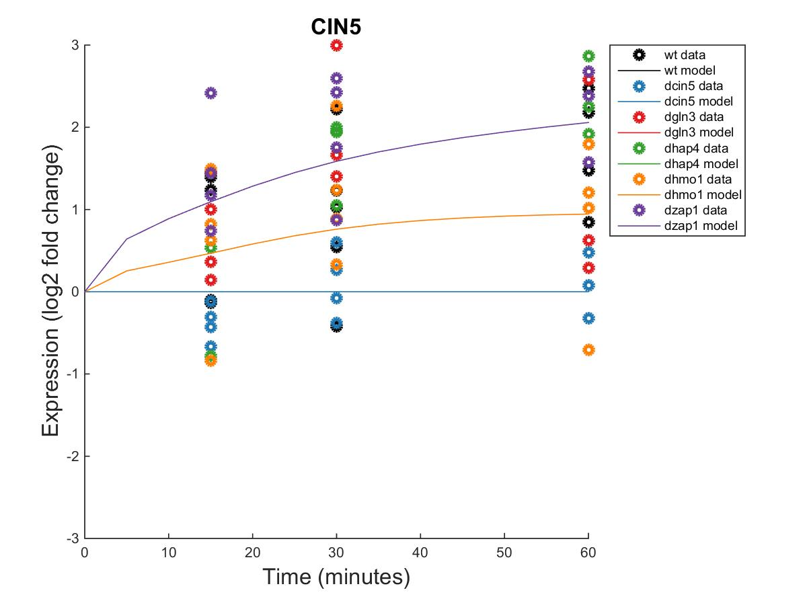
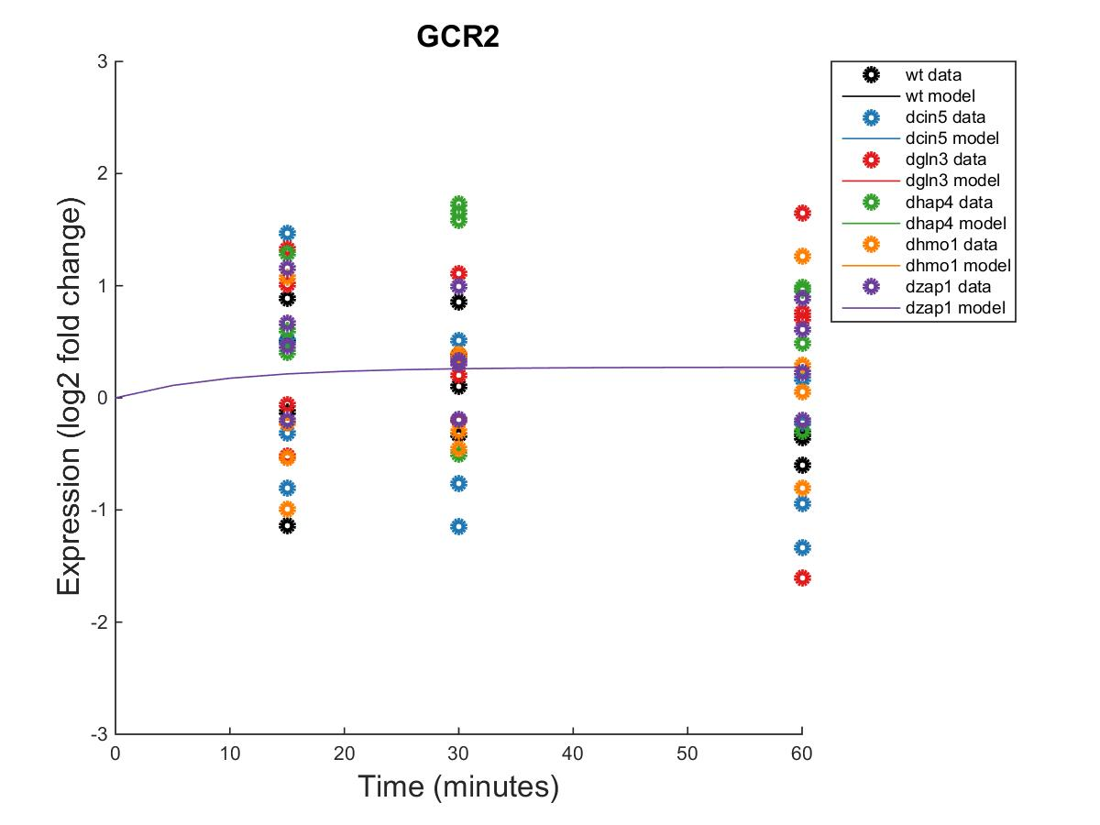
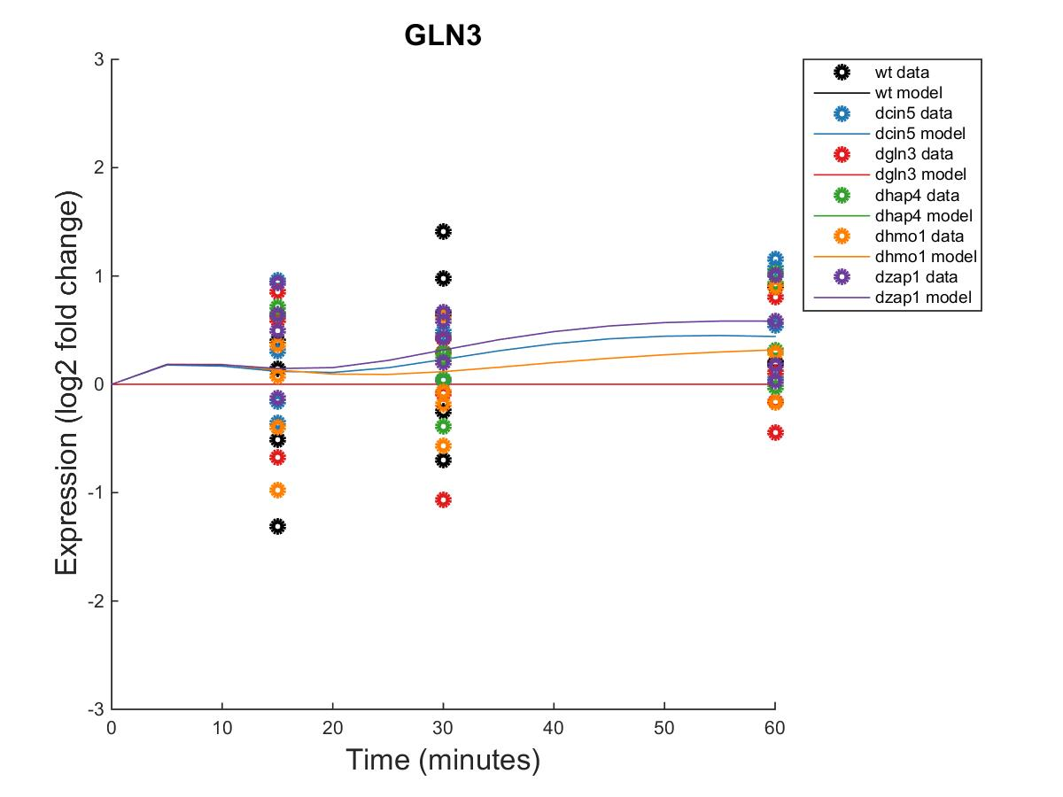
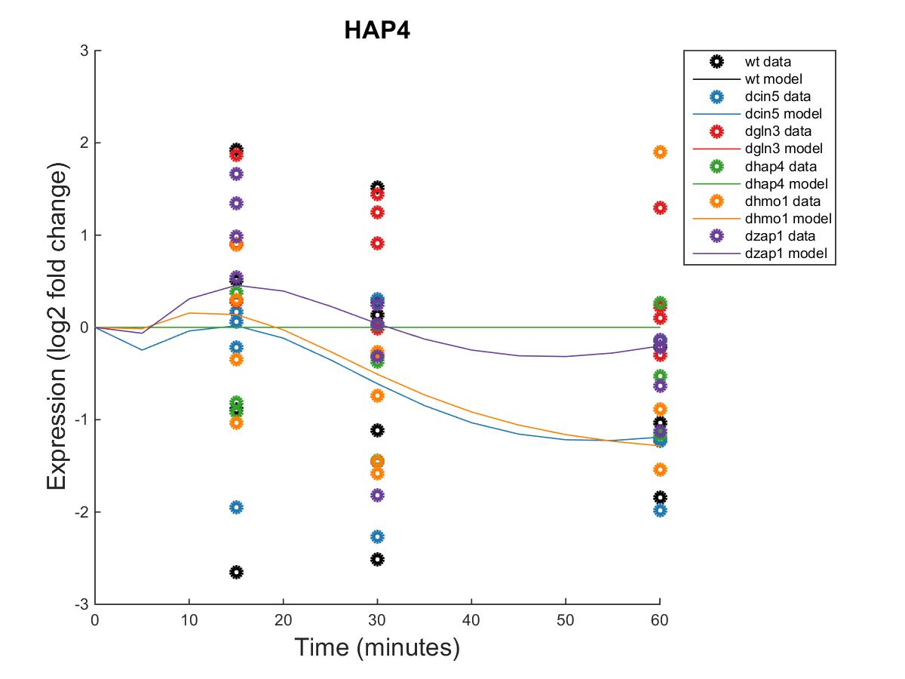
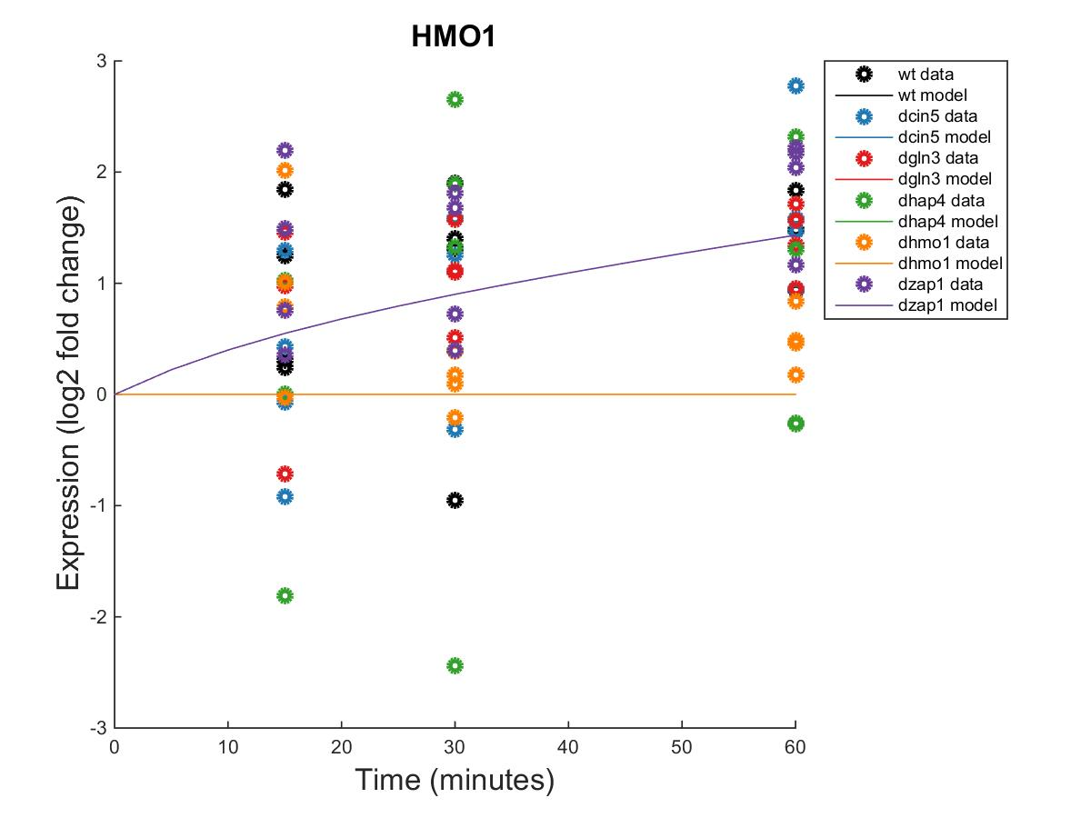
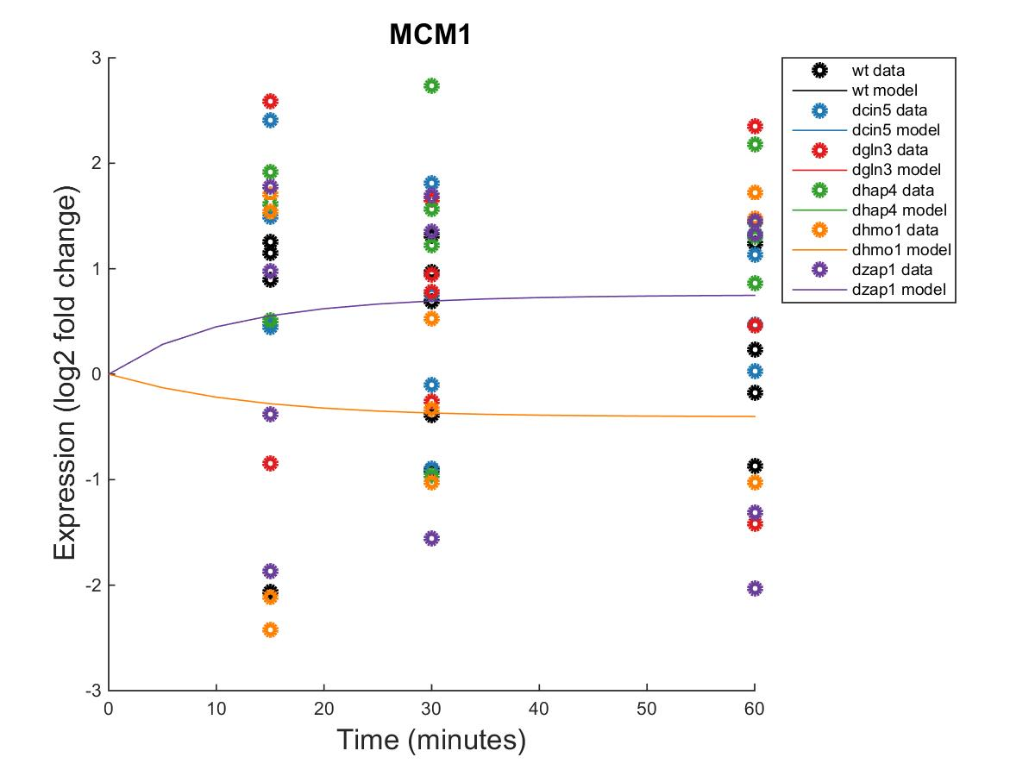
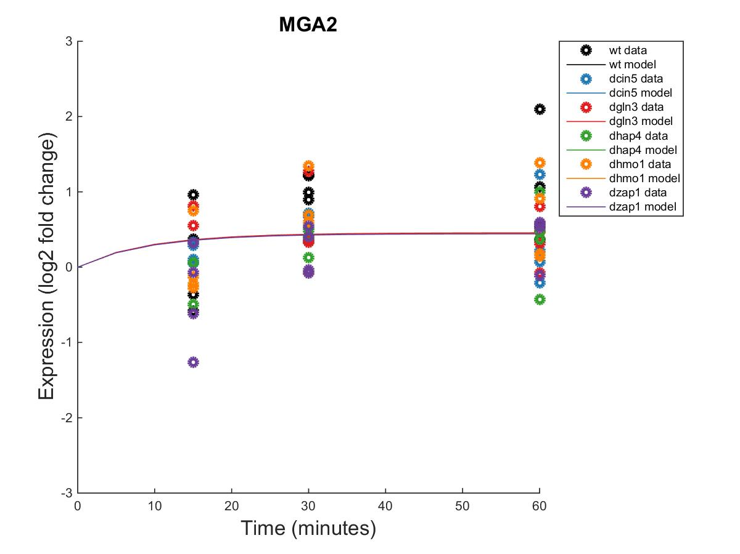
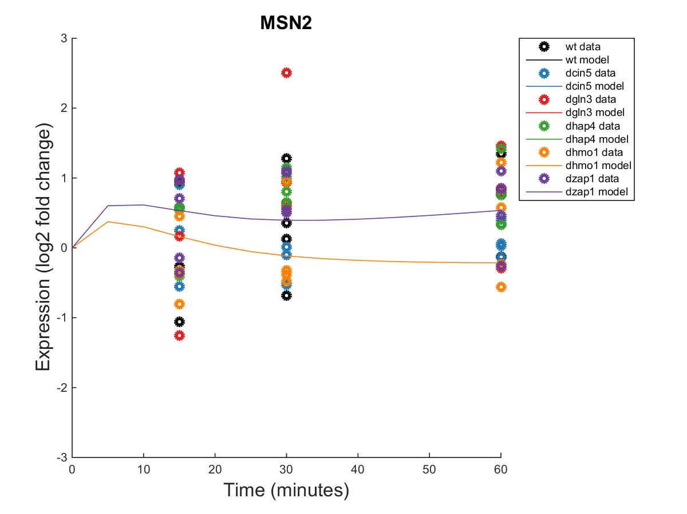
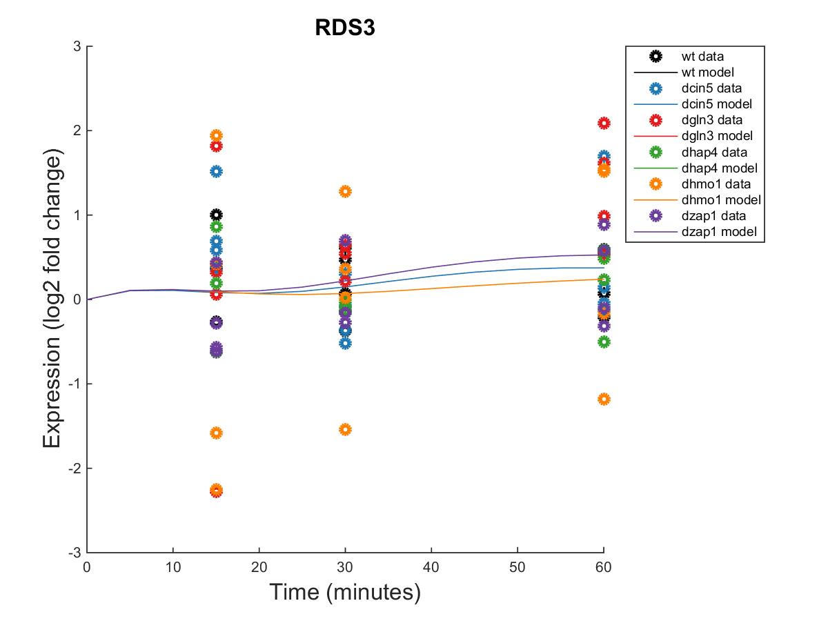
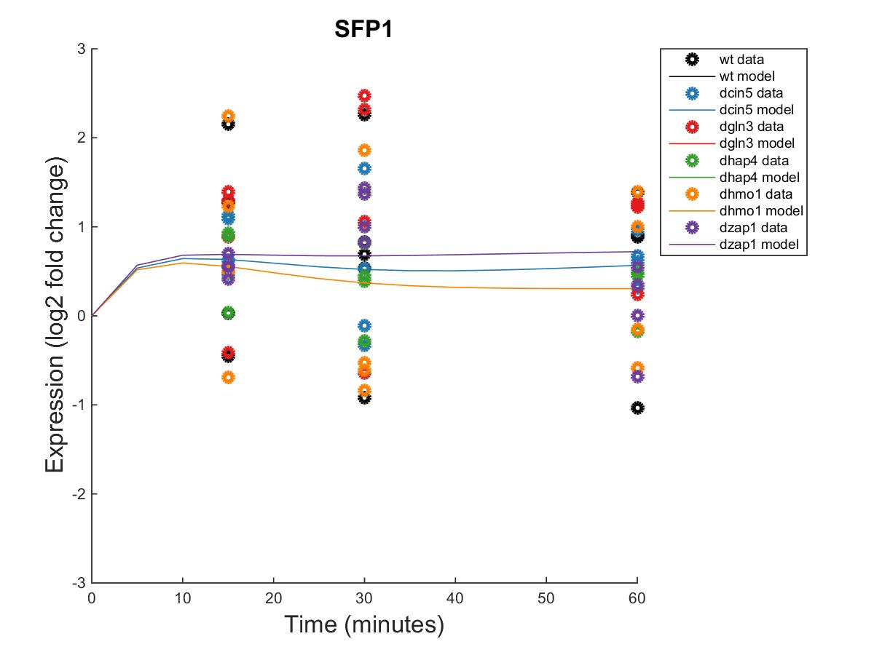
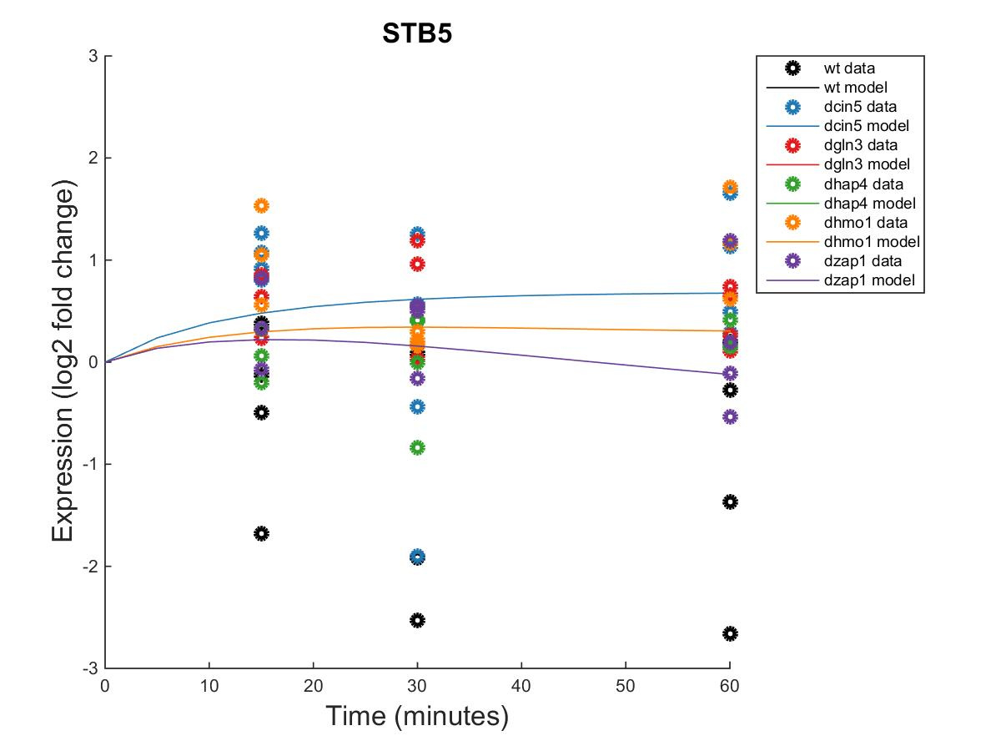
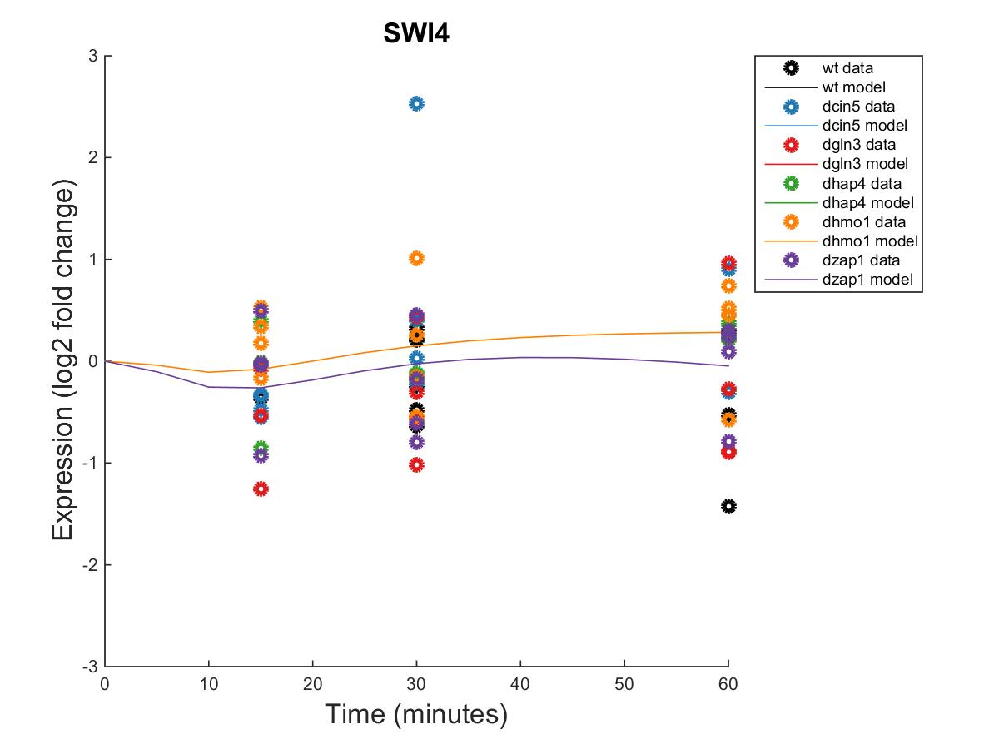
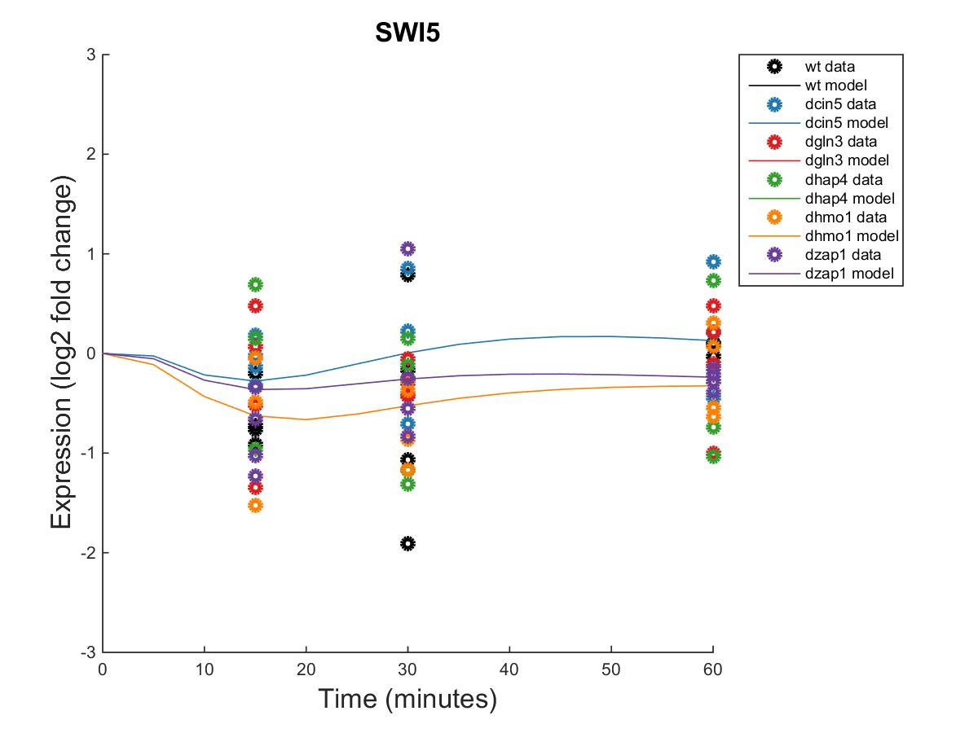
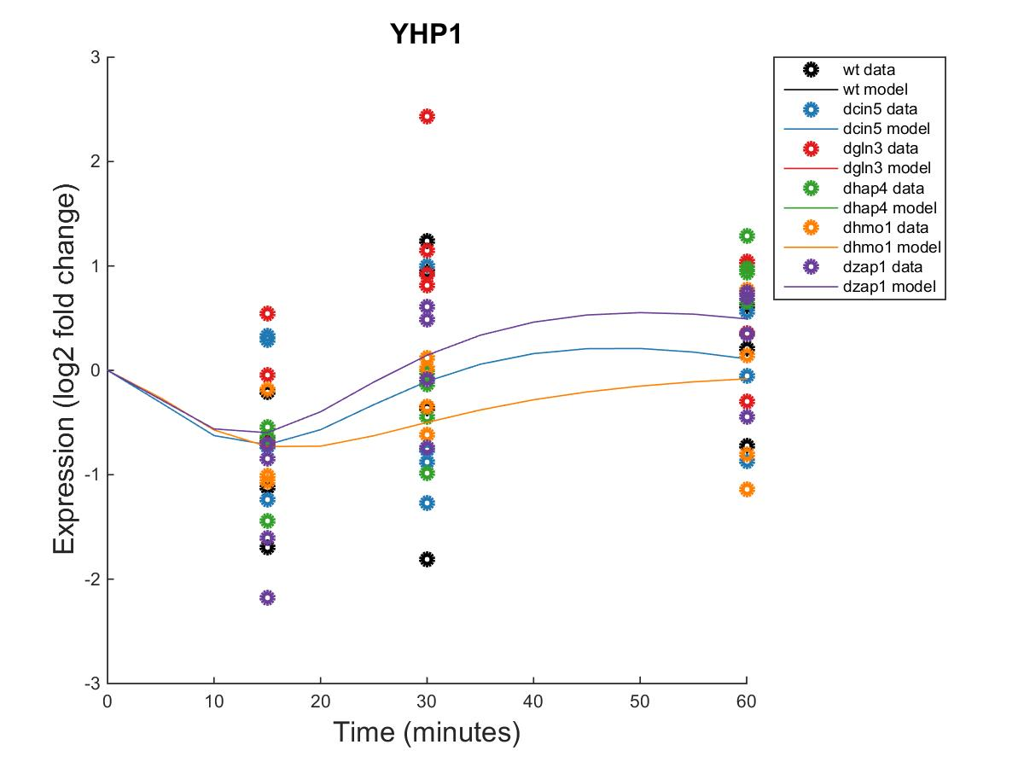
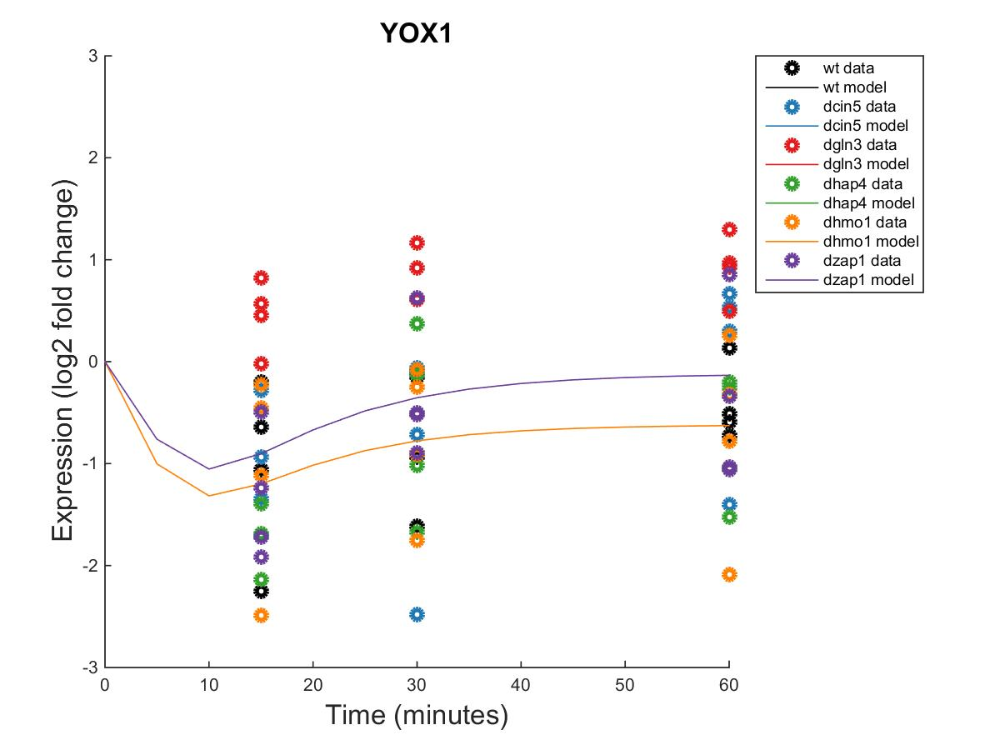

Slide 6
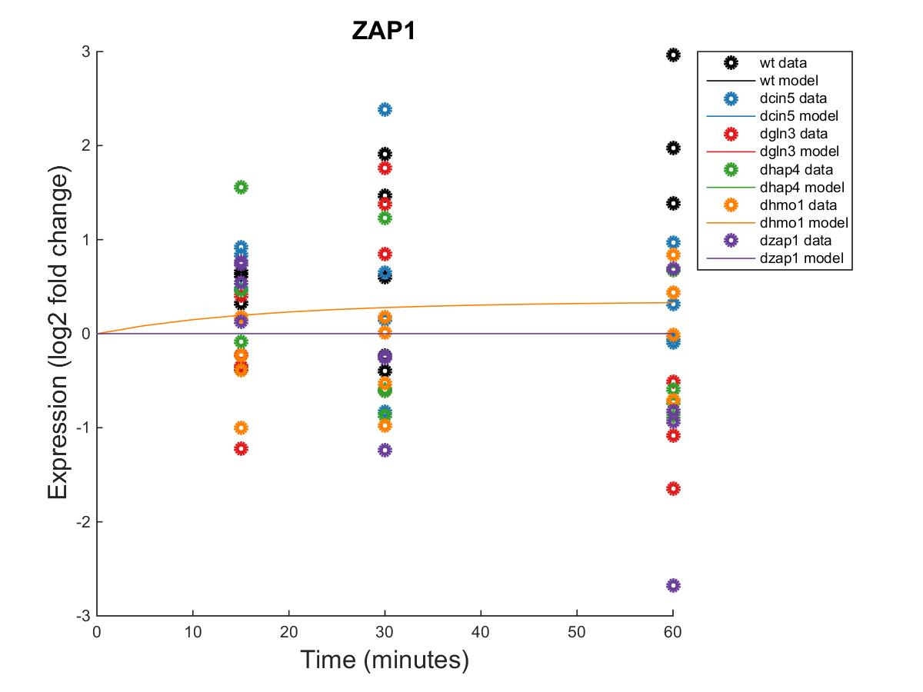

Slide 7
id | threshold_b | production_rate
ACE2 | 1.4950 | 0.2233
CIN5 | 0.3752 | 0.8464
GCR2 | 0.2328 | 0.2328
GLN3 | 0.5978 | 0.2889
HAP4 | 3.1300 | 1.2711
HMO1 | 1.8877 | 0.5459
MCM1 | 0.2061 | 0.1443
MGA2 | -0.0327 | 0.2674
MSN2 | -1.8024 | 2.6109
RDS3 | 0.6593 | 0.1996
SFP1 | 0.7107 | 0.5865
STB5 | 0.1796 | 0.2471
SWI4 | -1.7389 | 0.2758
SWI5 | 0.1242 | 0.8183
YHP1 | 0.9109 | 0.7462
YOX1 | 0.0539 | 1.1141
ZAP1 | 0.1322 | 0.1322

Slide 8
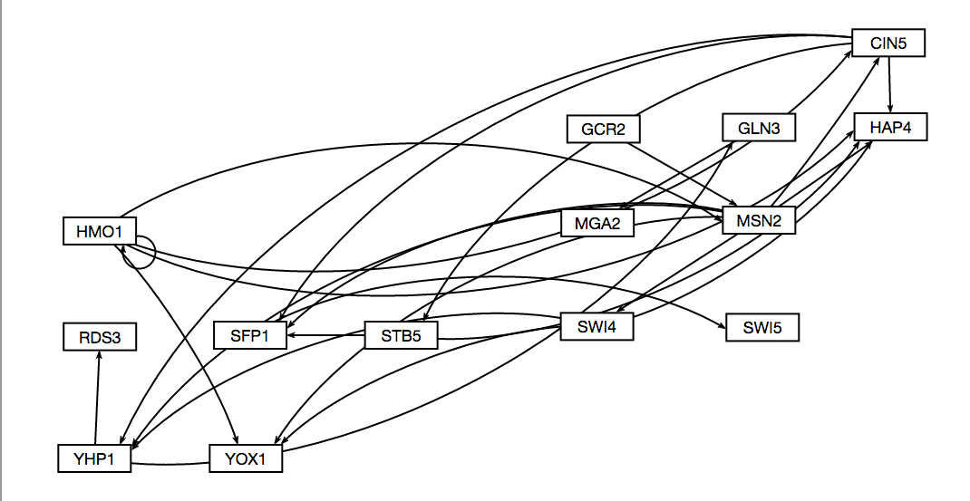
14 nodes, 25 edges dCIN5 network

Slide 9
Parameter Output
Parameter | Value
Penalty Term | 1.8830
LSE | 0.6634
minLSE | 0.4885
LSE:minLSE ratio | 1.3580
Iteration Count | 53,862

Slide 10
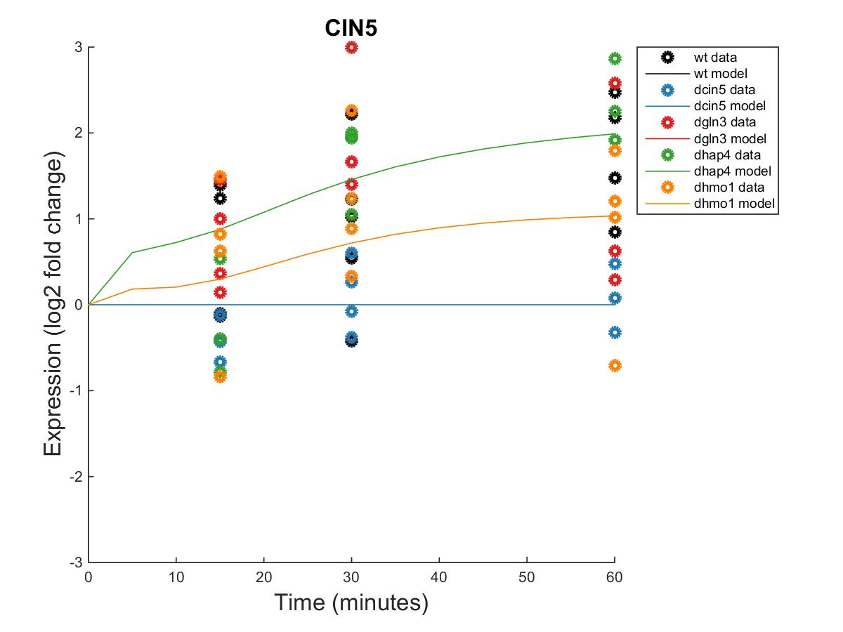
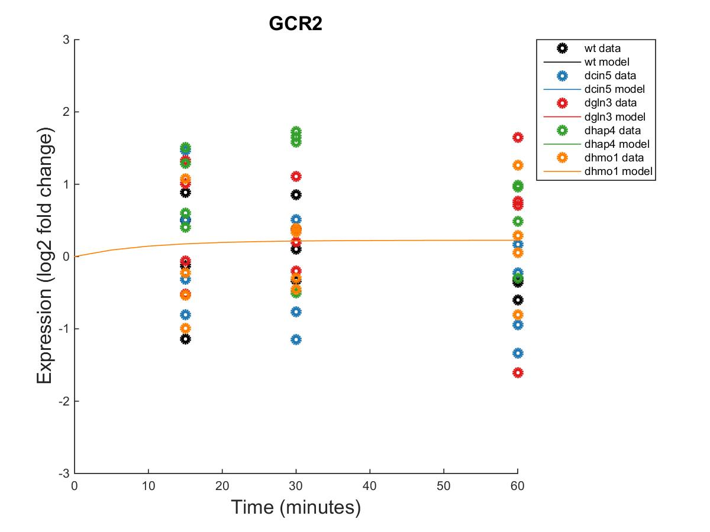
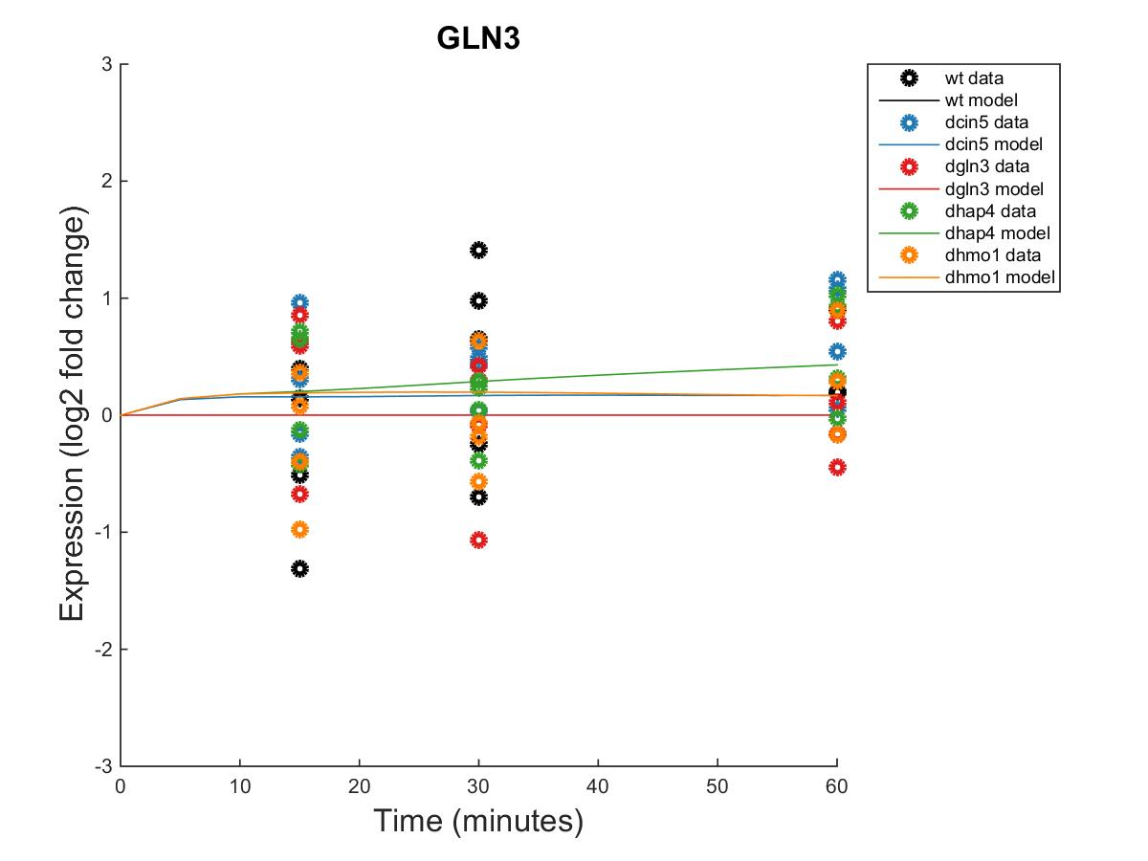
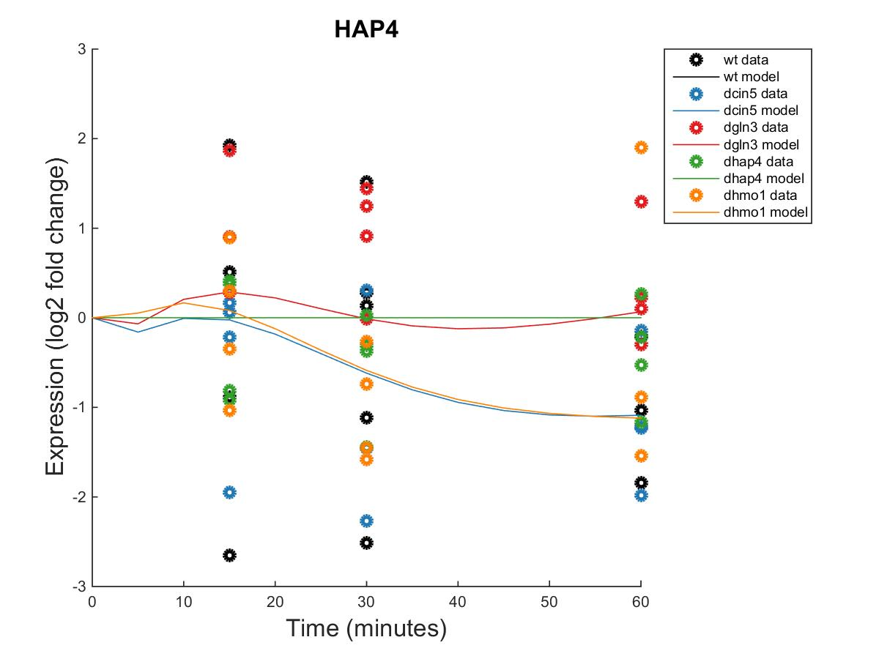
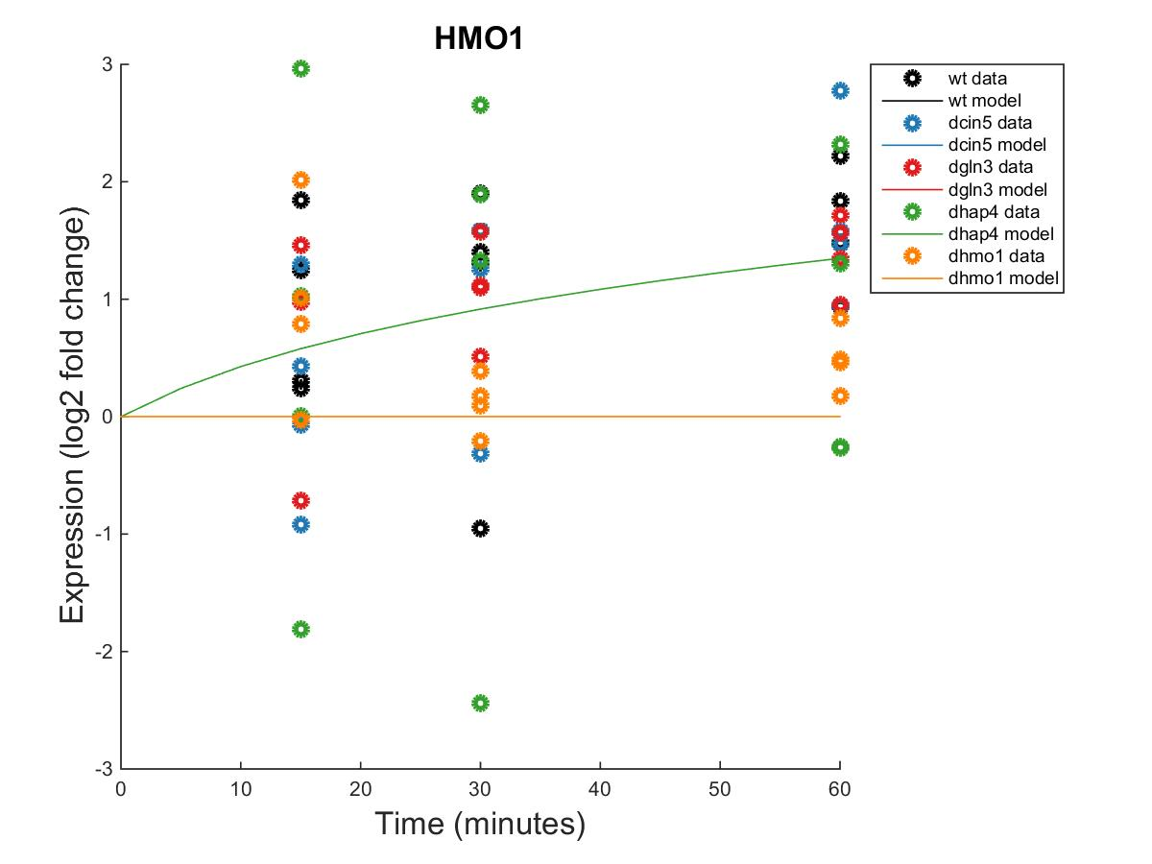
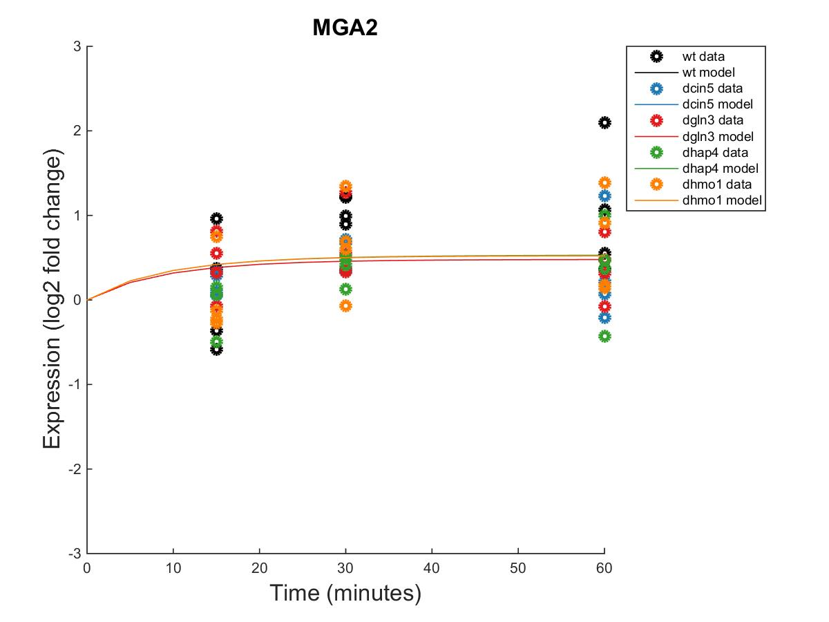
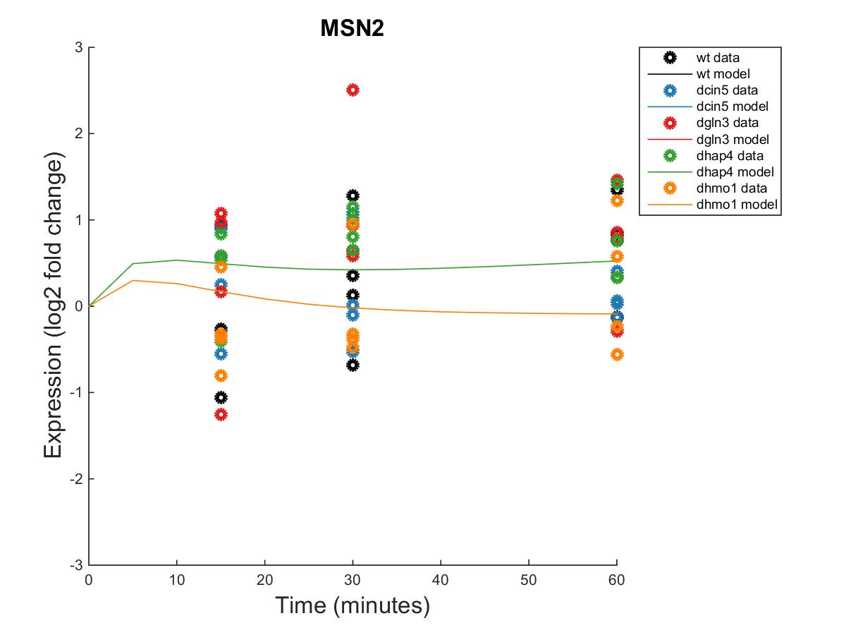
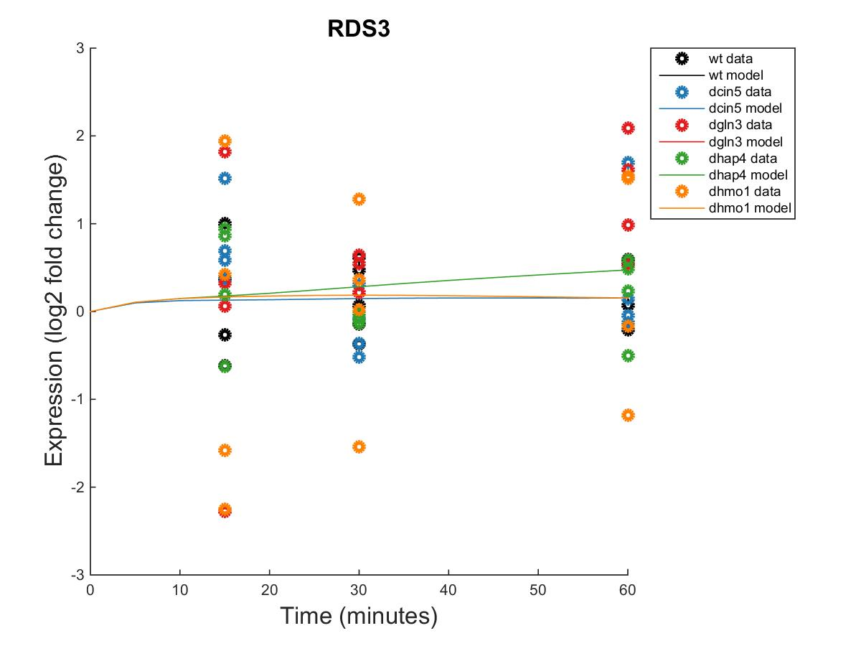
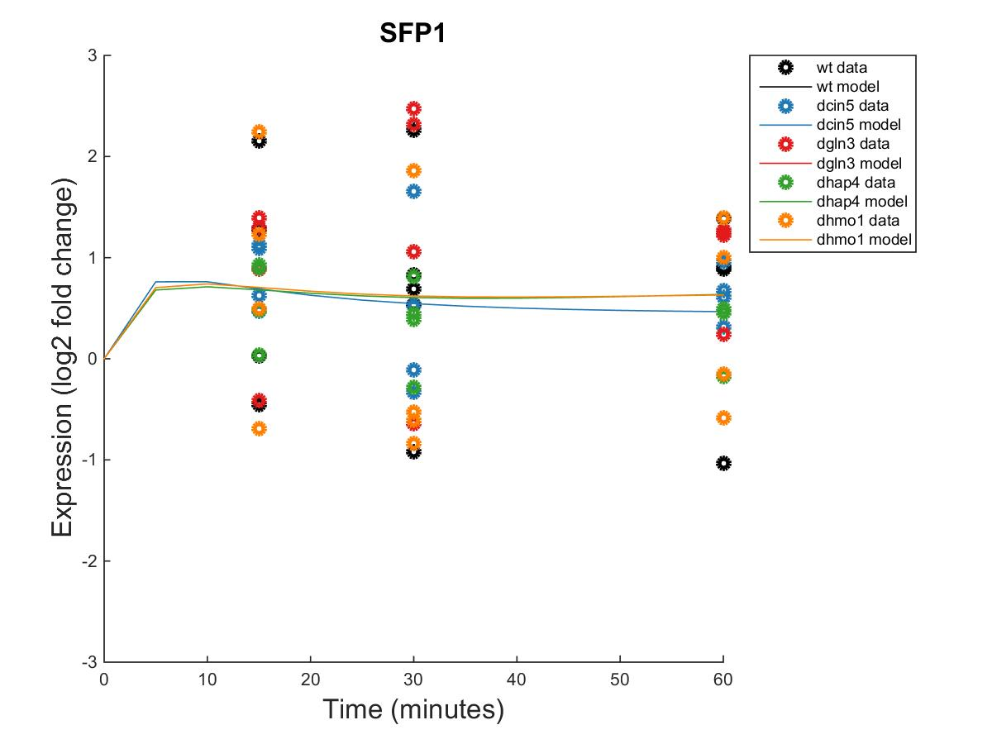
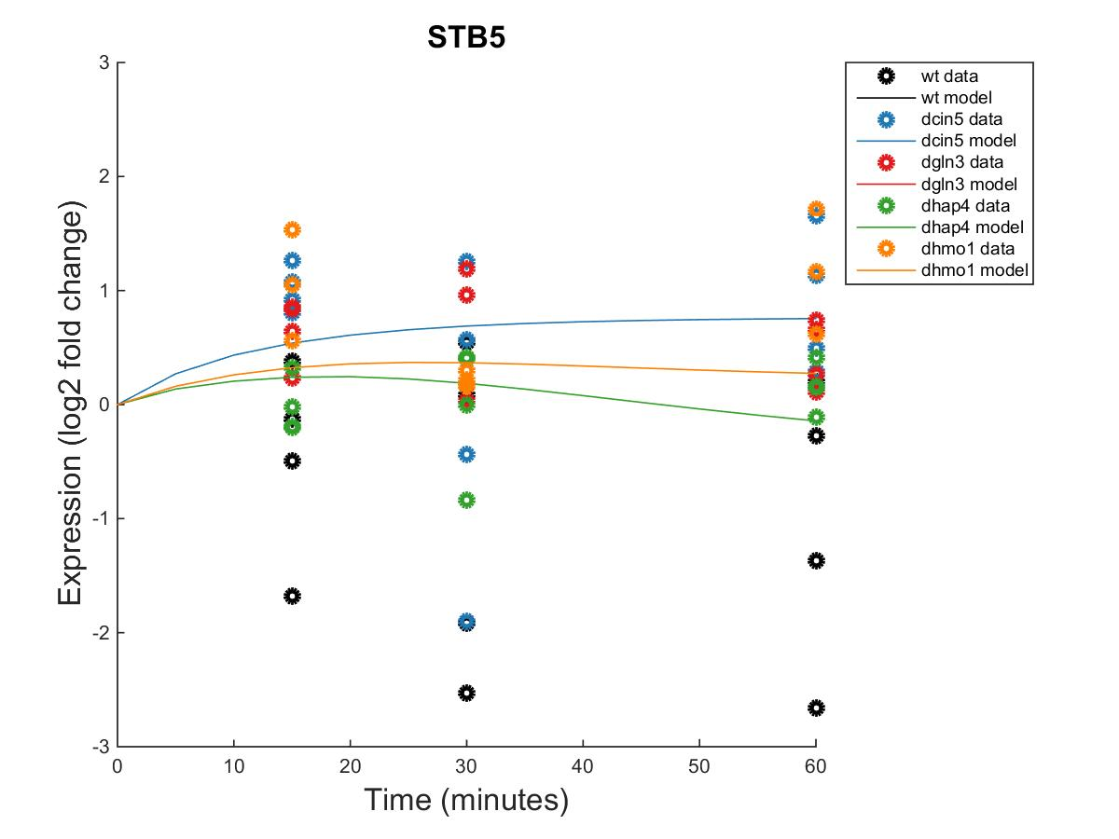
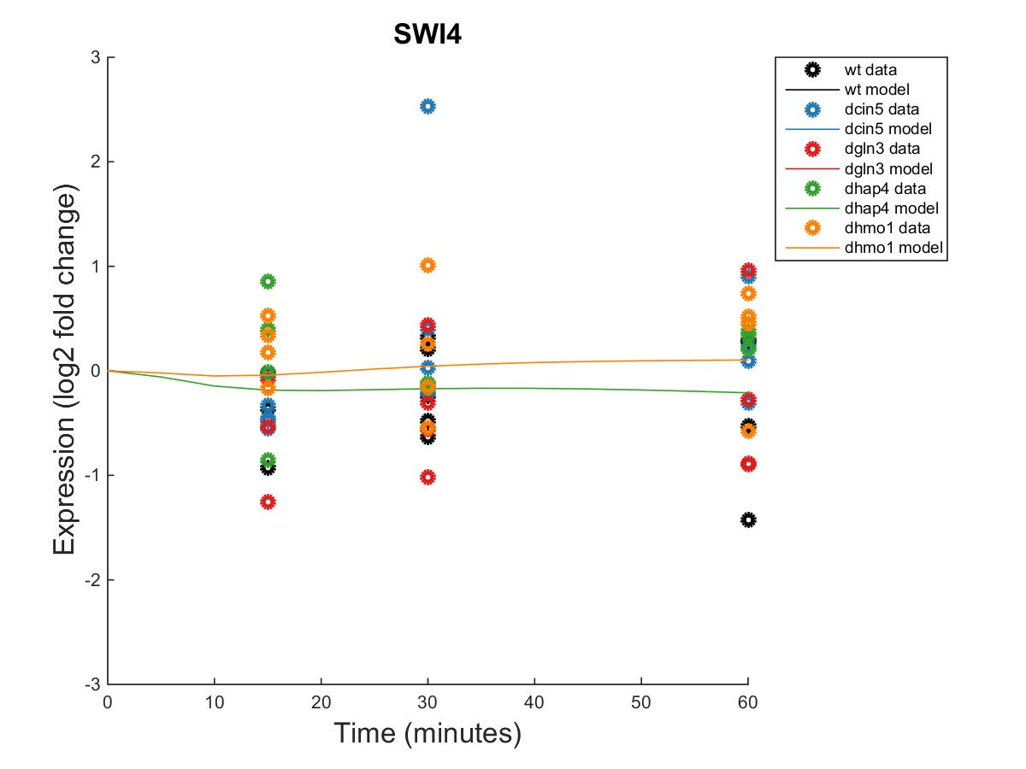
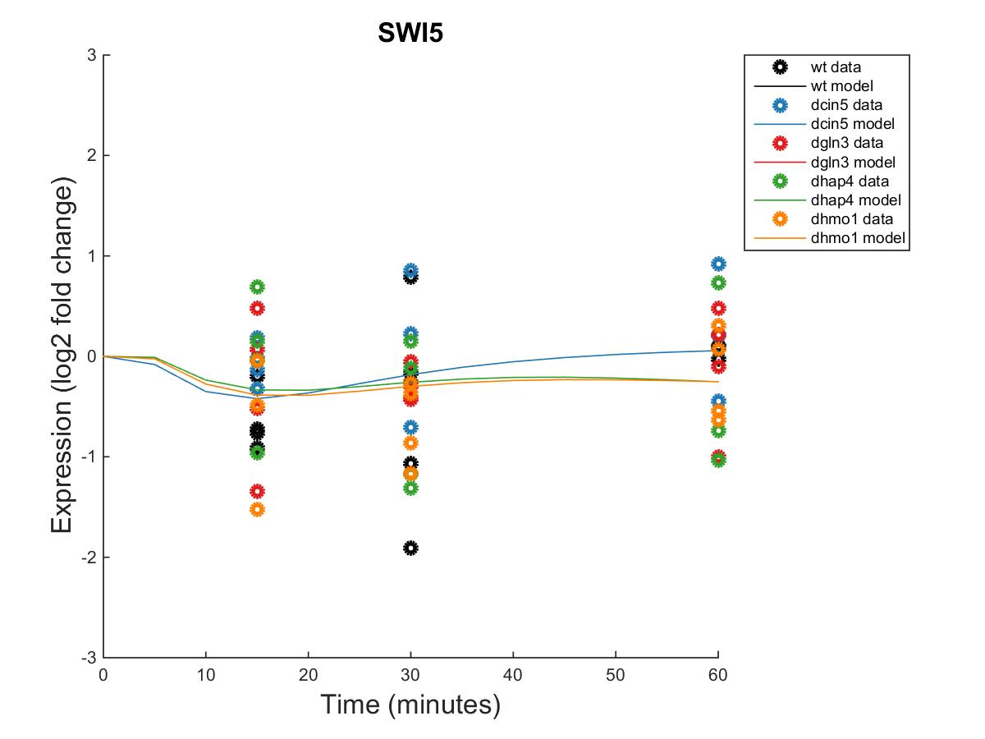
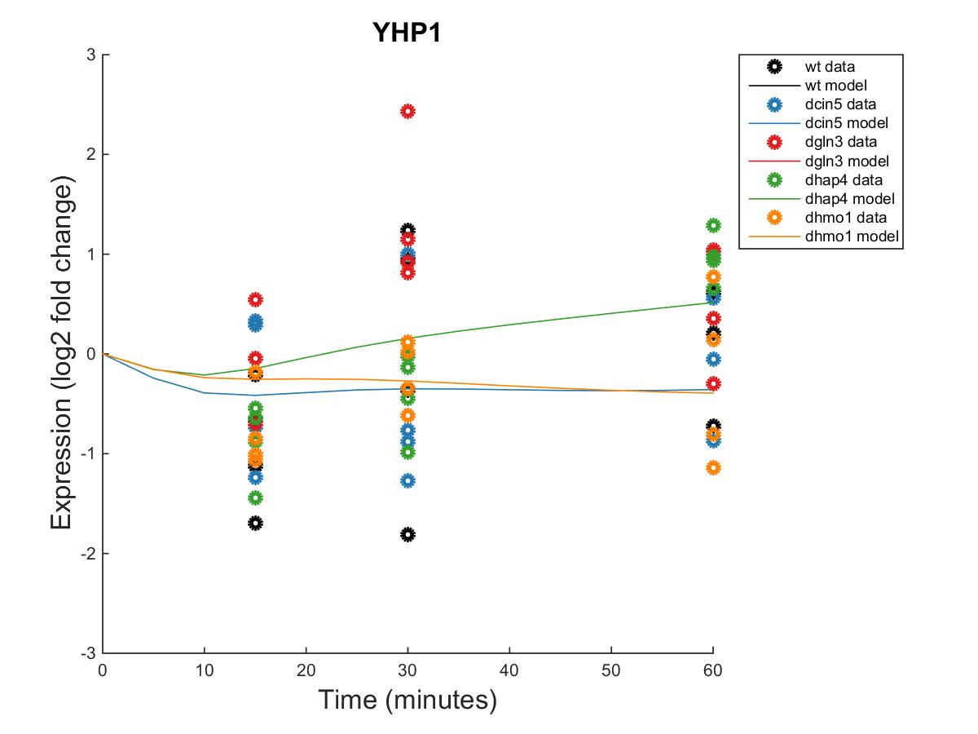
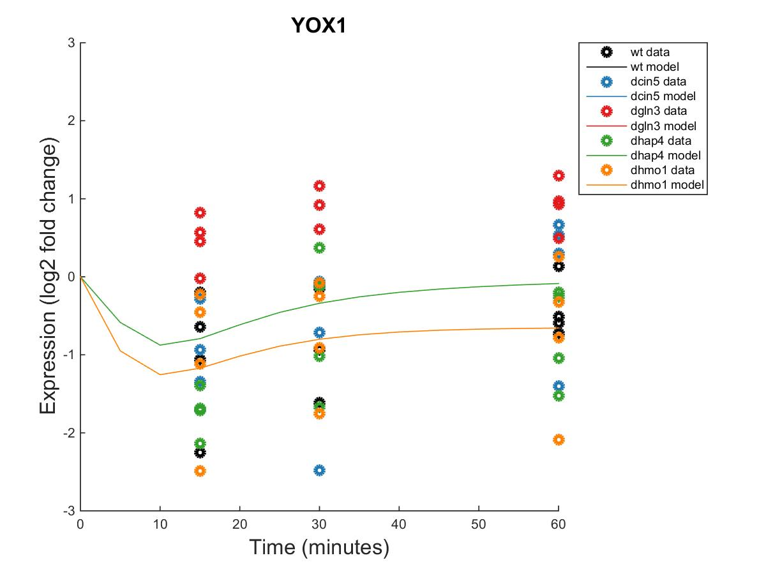

Slide 11
id | threshold_b | production_rate
CIN5 | -0.2500 | 1.5792
GCR2 | 0.2253 | 0.2253
GLN3 | 0.7220 | 0.4174
HAP4 | 2.1782 | 1.0796
HMO1 | 1.7324 | 0.5122
MGA2 | -0.0252 | 0.2725
MSN2 | -1.4075 | 2.1830
RDS3 | 1.0634 | 0.2958
SFP1 | -0.8488 | 1.4101
STB5 | 1.4014 | 0.6012
SWI4 | -0.5609 | 0.3355
SWI5 | -0.5153 | 1.1400
YHP1 | -1.8135 | 1.8826
YOX1 | -0.2274 | 1.3668

