Slide 1
dCIN5 STEM Results

Slide 2
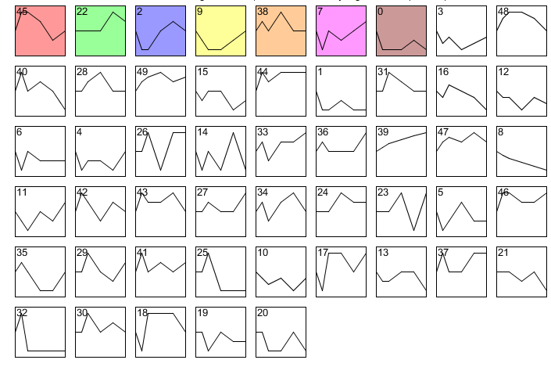
dCIN5 all STEM profiles

Slide 3
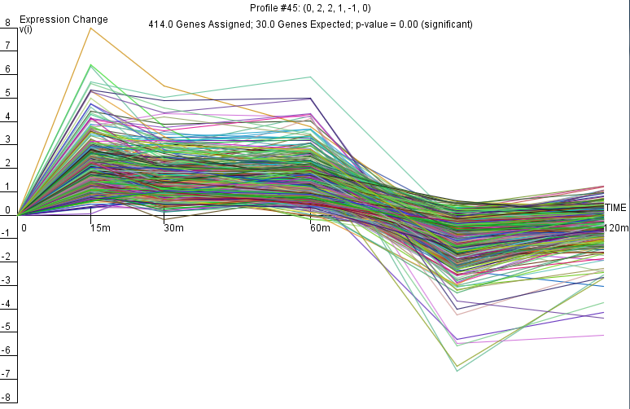
dCIN5 Profile 45

Slide 4
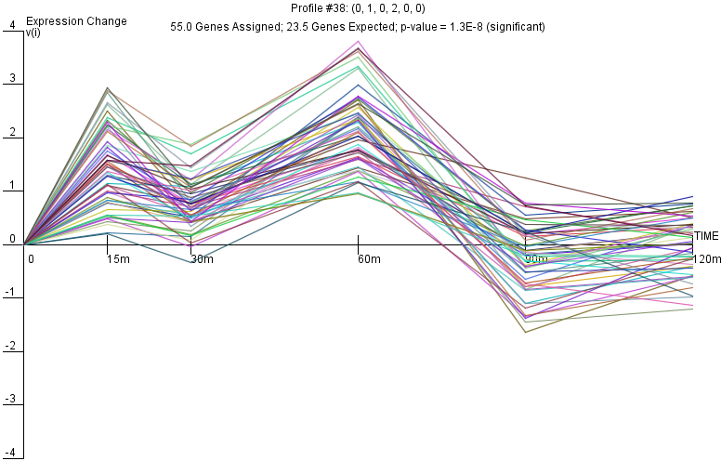
dCIN5 Profile 38

Slide 5
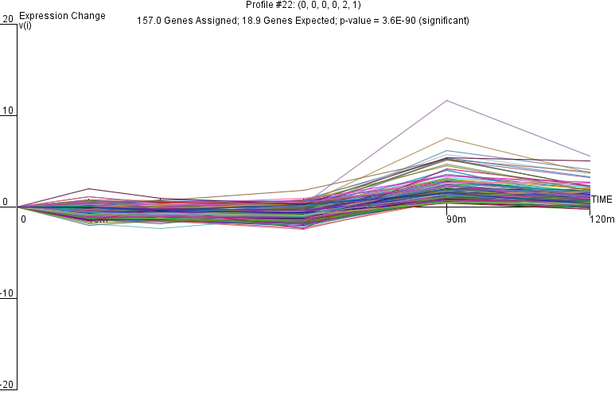
dCIN5 Profile 22

Slide 6
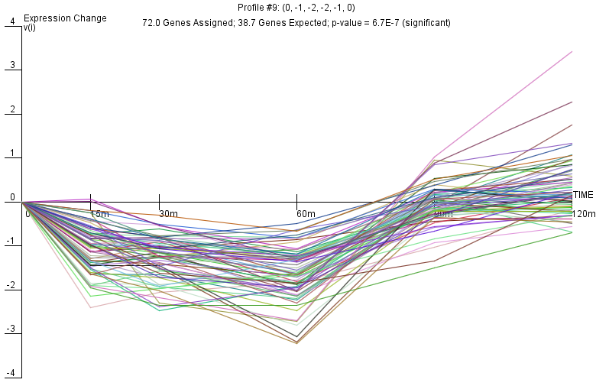
dCIN5 Profile 9

Slide 7
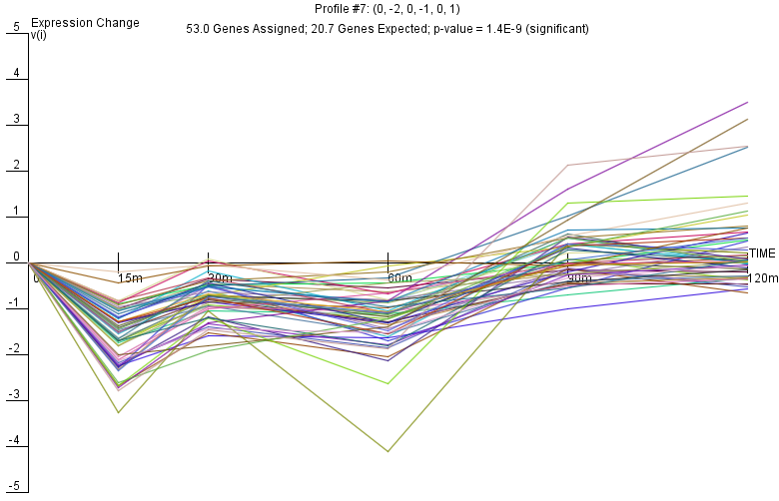
dCIN5 Profile 7

Slide 8
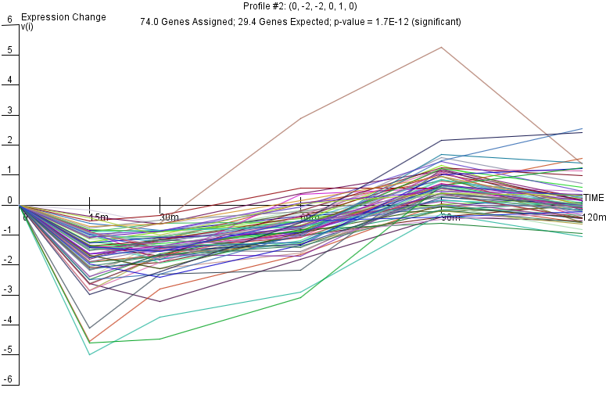
dCIN5 Profile 2

Slide 9
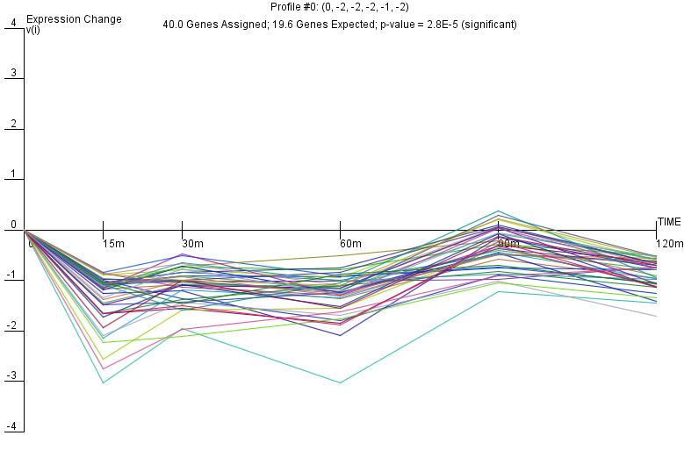
dCIN5 Profile 0

