Slide 1




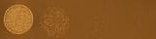
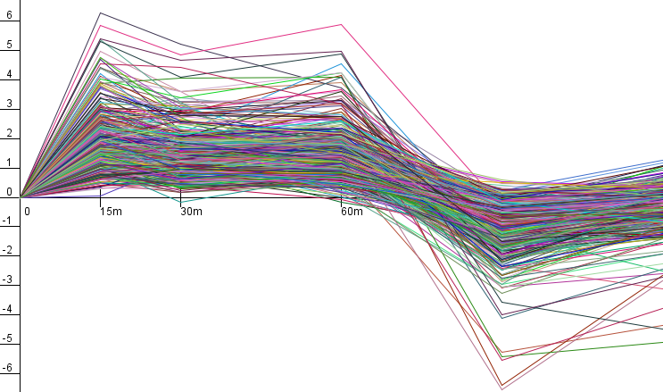
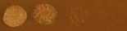
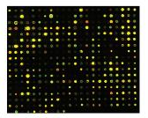
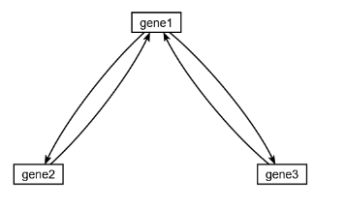
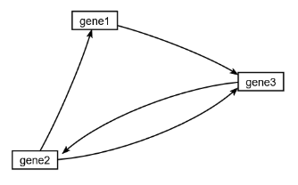
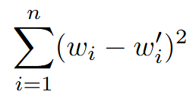
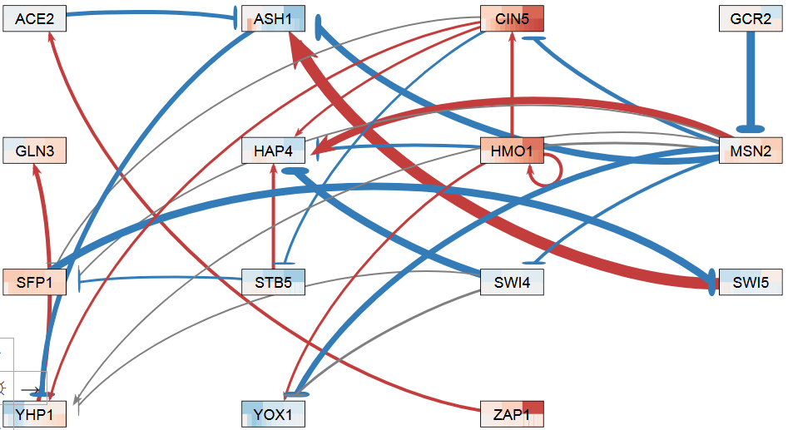
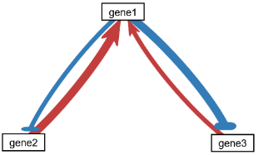
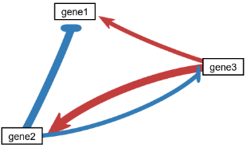
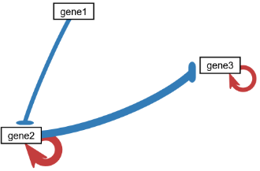
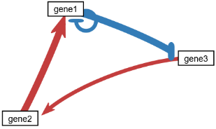
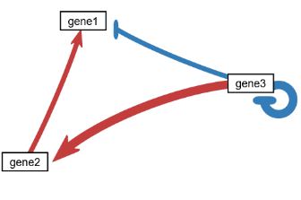
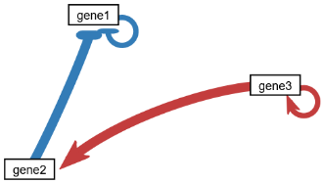
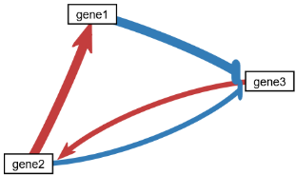
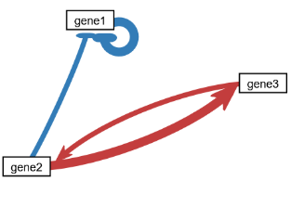
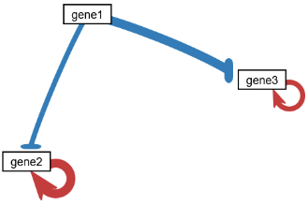
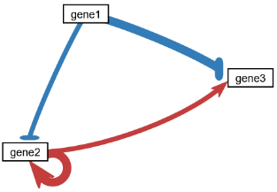
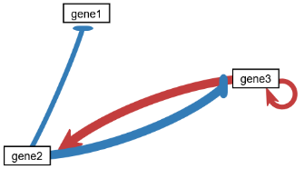
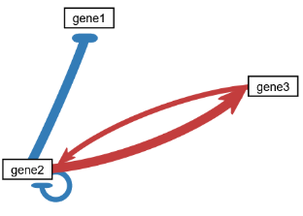
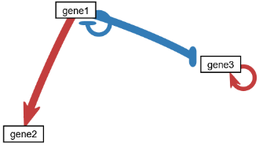
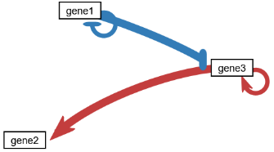
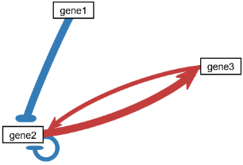
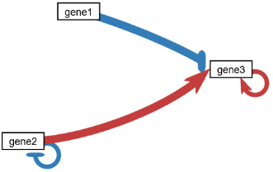
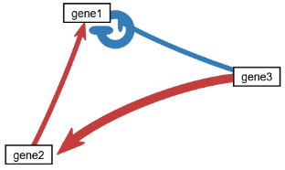
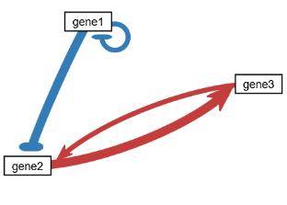
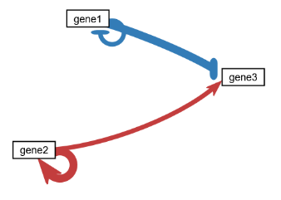
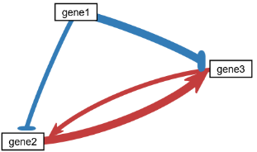
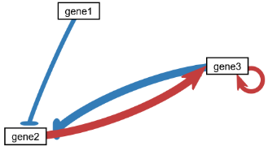
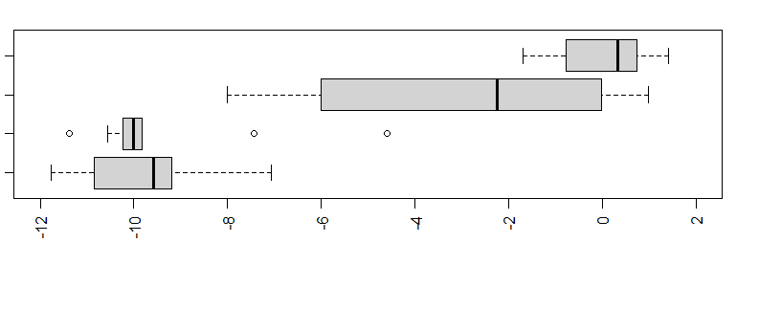
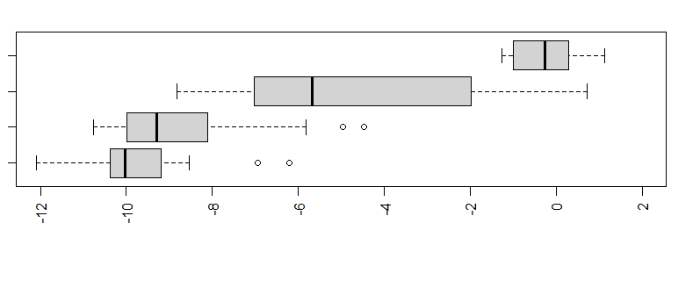
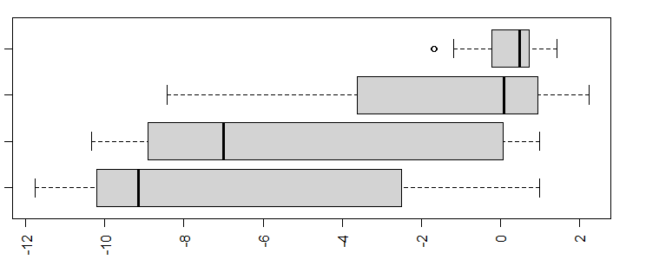
Accuracy of parameter estimation for a simple gene regulatory network model is sensitive to the number of parameters estimated and the magnitude and direction of regulatory relationships
Nikki C. Chun^{1,2}, Kam D. Dahlquist¹, Ben G. Fitzpatrick²
Departments of ¹Biology and ²Mathematics, Statistics, and Data Science, Loyola Marymount University, 1 LMU Drive, Los Angeles, CA 90045 USA
http://kdahlquist.github.io/GRNmap/ and http://dondi.github.io/GRNsight/
We have previously used a systems biology approach to understand the regulation of the cold shock response in yeast
Weight estimation precision is dependent on weight values
Model sensitivity was tested using all possible small-scale 3-gene, 4-edge “toy” networks. Simulated data was generated based on known parameters. Then the simulated data was used to estimate parameters to see if the model returned the known values.
Since weights were chosen arbitrarily (either 1, -1, 2, or -2), we also investigated if the rankings were solely based on network structure, or if they were also impacted by the choices of weights.
All 24 permutations of the weight assignments to edges were modeled for the networks originally ranked 1st and 7th to determine the impact of the weights.
The LSE of the weights were calculated for each trial as before.
wt
15°C
Cold shock microarray data from wt and TF deletion strains
Dash1
†
††
Interpretation,
new questions, new experiments
Normalization, statistical analysis, clustering
Least squares error, LSE, was used to rank the performance of the networks relative to one another.
The error between the known known weights and the estimated weights was computed as follows:
LSE= where w_{i} are the actual weights and w’_{i} are the estimated weights.
All 21 possible 3-gene, 4-edge networks are shown below and ranked from best to worst based on the sum of the LSE across the types of estimations.
Network Originally Ranked 1st
Network Originally Ranked 7th
Weight 1
Weight 2
Weight 1
Weight 3
Weight 3
Weight 4
Weight 4
Visualization of modeling results using GRNsight
Derivation of gene regulatory networks from databases
Weight 2
*Best | Actual W | W estimates with P and b held constant | W estimates when P and b also estimated
Weight 1 | -2 | -2.0000 | -1.9172
Weight 2 | -1 | -1.0000 | -0.9030
Weight 3 | 1 | 1.0000 | 0.9764
Weight 4 | 2 | 2.0000 | 1.9388
**Best | Actual W | W estimates with P and b held constant | W estimates when P and b also estimated
Weight 1 | -2 | -2.0000 | -2.0121
Weight 2 | 2 | 1.9999 | 2.3139
Weight 3 | 1 | 1.0000 | 1.1456
Weight 4 | -1 | -1.0000 | -0.9312
Dynamical systems modeling using GRNmap
1
2
3
4
5
6
7
A “medium-scale” gene regulatory network that regulates the cold shock response
bi-mutual
regulating
mutual
cascade
2 autoregulation
feedback loop
1 autoregulation
feedforward loop
1 autoregulation
cascade
2 autoregulation
mutual cascade
#Worst | Actual W | W estimates with P and b held constant | W estimates when P and b also estimated
Weight 1 | 1 | 1.0000 | 0.4924
Weight 2 | -1 | -1.0000 | -0.7337
Weight 3 | -2 | -1.9999 | -2.8069
Weight 4 | 2 | 1.9997 | 0.1271
##Worst | Actual W | W estimates with P and b held constant | W estimates when P and b also estimated
Weight 1 | 1 | 1.0000 | 0.6198
Weight 2 | 2 | 1.9993 | 1.5623
Weight 3 | -2 | -1.9996 | -1.5411
Weight 4 | -1 | -1.0000 | -0.7627
15-gene, 28-edge network.
Each node represents one gene
encoding a transcription factor.
Each edge represents a
regulatory relationship, either
activation or repression,
depending on the sign of
the weight.
This network was modeled with
GRNmap using Dahlquist et al. (2018) expression data, and the results
were visualized with GRNsight. P, b, and w were all estimated.
wt yeast were subjected to 15, 30, and 60 minutes of cold shock at 13°C.
The top set of stripes in each node is actual log₂ fold change expression data for each timepoint, bottom is model-simulated data.
There is generally a good concordance between the experimental and model-simulated data.
8
9
10
11
12
13
14
Color shading reflected the magnitude of the difference between actual w and estimated w with darker color reflecting the greatest magnitude difference.
mutual out
1 autoregulation
fan out
2 autoregulation
feedforward loop
1 autoregulation
mutual out
1 autoregulation
mutual out
1 autoregulation
fan out
2 autoregulation
cascade
2 autoregulation
Log₁₀ LSE of Weight Permutations for Network Ranked 1st
w estimated only (dark); P, b, & w all estimated (light)
Log₁₀ LSE of Weight Permutations for Network Ranked 7th
w estimated only (dark); P, b, & w all estimated (light)
15
16
17
18
19
20
21
*
†
#
**
††
##
mutual in
1 autoregulation
fan in
2 autoregulation
feedforward loop
1 autoregulation
mutual in
1 autoregulation
fan in
2 autoregulation
regulated
mutual
mutual in
1 autoregulation
Rank | Estimate P, b, w | Estimate P and w b held constant | Estimate b and w P held constant | Estimate w P and b held constant | Sum
1 | 0.0209 | 1.02E-07 | 3.60E-08 | 1.69E-12 | 0.0209
7 | 2.2486 | 1.9650 | 8.12E-10 | 3.92E-11 | 4.2136
14 | 6.8500 | 3.75E-09 | 4.4999 | 4.5001 | 15.8499
21 | 4.9845 | 172.8924 | 2.59E-09 | 7.94E-10 | 177.8768
Weight 1
Weight 1
Weight 2
Weight 2
GRNmap: Gene Regulatory Network modeling and parameter estimation
Weight 3
Weight 3
Weight 4
Weight 4
Model is coded in MATLAB.
GRNmap takes the input mRNA expression and degradation rate data and estimates parameters using a penalized least squares approach.
Estimate P, b, w
Estimate P, b, w
Estimate b and w
P constant
Estimate b and w
P constant
Estimate b and w
b constant
Estimate b and w
b constant
Weight estimation precision increases when production rates are held constant
Estimate w
P and b constant
Estimate w
P and b constant
log₁₀ of the weight LSE
log₁₀ of the weight LSE
The distribution of the LSE of all 21 networks with different numbers of parameters being estimated are shown.
The median value of the LSE for when w only was estimated and when P, b, and w are estimated is a little better for the network originally ranked 7th.
If all the permutations were taken into consideration, the network ranked 7th would be higher-ranked than the one that was ranked first.
This supports the conclusion that the ranking of the plots in the middle panel depended on the arbitrary assignment of the weight parameters, not the network structure.
Estimate P, b, w
Dahlquist et al. (2015)
Estimate b and w
P constant
Conclusion
              Degradation rates for each gene were taken from mRNA half life data from Neymotin et al. (2014).
              We use a sigmoidal production function where:
                P_{i} is mRNA production rate for gene i
                d_{i} is the mRNA degradation rate for gene i
                w is the weight term, determining the level of activation or repression
                of j on i
                b is the threshold of expression for each gene.
              When P, b, and w are all estimated, the total number of parameters being estimated is twice the number of genes in the model plus the number of edges.
              In the medium-scale model above, there are 58 parameters being estimated, which is a lot given the amount of input data.
              GRNmap can also hold P and b constant and only estimate w; hold P constant and estimate b and w; or hold b constant and estimate P and w.
Estimate b and w
b constant
Estimating production rates from limited gene expression data is difficult for GRNmap to do.
Investigation of 3-gene, 4-edge “toy” networks shows that the performance of the GRNmap model is influenced by a combination of network structure and edge weights.
Estimate w
P and b constant
log₁₀ of the weight LSE
Future Directions
Model estimations for weight value permutations will be run for additional models to see if further patterns can be determined.
To determine biological significance, a we will run model estimations for three to five documented gene regulatory networks derived from the Saccharomyces Gene Database.
Future wet lab research will focus on collecting production rate data to be used in future models because we have determined the importance of the production rates for accurate modeling.
  When P and b were held constant, only the 4 weight parameters were estimated, compared to the 10 estimated when P, b, and w were all estimated.
  The performance of the model when P and b were held constant and when only P was held constant were relatively similar, suggesting that the issue is estimating the production rate, not necessarily the number of parameters estimated.
The ranking of network motifs is heavily dependent on the choice of the weight values which were assigned arbitrarily, so conclusions about the relationship of specific network structure on model accuracy were unable to be drawn.
        However, both types of “fan in with two autoregulation” and all three types of “mutual in with one autoregulation” were in the lowest tercile of the ranks, suggesting further investigation of these regulatory motifs is warranted.
Acknowledgments
We would like to thank the previous developers on the GRNmap and GRNsight projects. This work was partially funded by LMU Rains Research Assistantship (N.C.C.). Thank you to the ABRCMS Travel Grant for the opportunity to come and present my work.
  To better understand parameter sensitivity, we simplified the network into a small-scale “toy” network of 3 genes and 4 edges and explored holding the P and b parameters constant to understand the effect on the accuracy of the estimation.
References
Dahlquist, K.D., Fitzpatrick, B.G., Camacho, E.T., Entzminger, S.D., & Wanner, N.C. (2015) Parameter Estimation for Gene Regulatory Networks from Microarray Data: Cold Shock Response in Saccharomyces cerevisiae. Bulletin of Mathematical Biology, 77(8), 1457-1492. doi: 10.1007/s11538-015-0092-6
Dahlquist, K.D., Dionisio, J.D.N., Fitzpatrick, B.G., Anguiano, N.A., Varshneya, A., Southwick, B.J., & Samdarshi, M. (2016) GRNsight: a web application and service for visualizing models of small- to medium-scale gene regulatory networks. PeerJ Computer Science, 2, e85. doi: 10.7717/peerj-cs.85
Dahlquist, K.D., Abdulla, H., Arnell, A.J., Arsan, C., Baker, J.M., Carson, R.M., … & Zapata, B.B. (2018). Global transcriptional response of wild type and transcription factor deletion strains of Saccharomyces cerevisiae to the environmental stress of cold shock and subsequent recovery. GEO Dataset GSE83656. https://www.ncbi.nlm.nih.gov/geo/query/acc.cgi?acc=GSE83656
Neymotin, B., Athanasiadou, R., & Gresham, D. (2014). Determination of in vivo RNA kinetics using RATE-seq. Rna, 20(10), 1645-1652. doi: 10.1261/rna.045104.114
Notes:
I replaced the db5 networks so that experimental data is on top and simulated data is on the bottom. I forgot that GRNsight doesn’t have the simulated data.
I reorganized the bullet points in the left panel.
I fixed the label in the table so it correctly read “Estimate P and w, b held constant”
I edited the bullet points below the box and whiskers plot in the central panel.
I added the weight labels to the networks on the right side
I reworded the future directions
I fixed the references so that they are all in APA format and include a citation for the Dahlquist et al. (2018) data
I aligned all the text

