Slide 1
Modeling of Gene Regulatory Network Dynamics Predicts which Regulatory Relationships are Important for Controlling the Cold Shock Response in Saccharomyces cerevisiae
Lauren M. Kelly
March 22nd, 2019
LMU Undergraduate Research Symposium

Slide 2
Outline
Gene regulatory networks (GRNs) are a set of transcription factors that regulate the level of expression of a set of target genes.
GRNs can be used to model the cold shock response in yeast.
A candidate GRN was modeled using differential equations.
Systematic edge deletions were performed in order to assess the importance of each edge in the network.
MSN2, CIN5, and HMO1 are important for regulating the response to cold shock in yeast.

Slide 3
Outline
Gene regulatory networks (GRNs) are a set of transcription factors that regulate the level of expression of a set of target genes.
GRNs can be used to model the cold shock response in yeast.
A candidate GRN was modeled using differential equations.
Systematic edge deletions were performed in order to assess the importance of each edge in the network.
MSN2, CIN5, and HMO1 are important for regulating the response to cold shock in yeast.

Slide 4
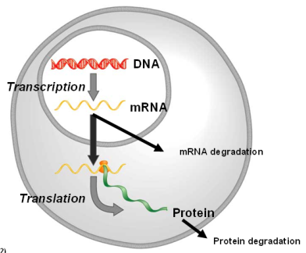
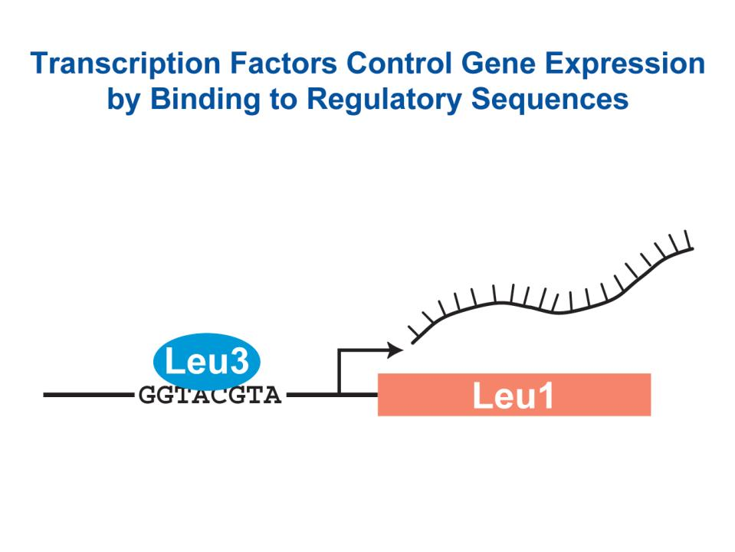
Transcription factors control gene expression by binding to regulatory DNA sequences upstream of genes
Activators increase gene expression.
Repressors decrease gene expression.
Transcription factors are themselves proteins that are encoded by genes.
(Freeman, 2002)

Slide 5
Outline
Gene regulatory networks (GRNs) are a set of transcription factors that regulate the level of expression of a set of target genes.
GRNs can be used to model the cold shock response in yeast.
A candidate GRN was modeled using differential equations.
Systematic edge deletions were performed in order to assess the importance of each edge in the network.
MSN2, CIN5, and HMO1 are important for regulating the response to cold shock in yeast.

Slide 6
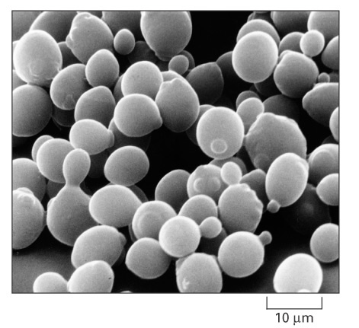
Budding yeast, Saccharomyces cerevisiae, is a good model organism to study the regulation of gene expression
In the Dahlquist Lab, we are studying changes in gene expression due to cold shock.
We have two questions:
Which transcription factors control the response?
What are the indirect effects of the transcription factors in the gene regulatory network?
Notes:
Little is known about which transcription factors regulate the cold shock response
Heat shock induces the expression of various heat shock proteins (HSPs)
Cold shock causes physical and biochemical changes in the cell, but little is known about the mechanisms responsible
The Dahlquist Lab studies the global transcriptional response to cold shock using DNA microarrays, which measure the level of mRNA expression for all 6000 yeast genes

Slide 7
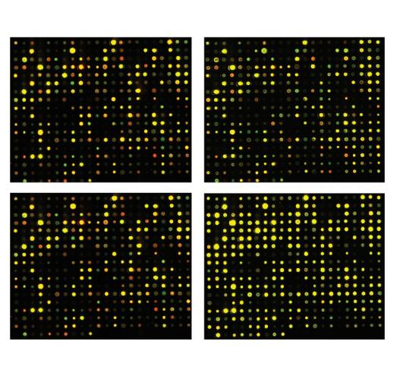
Microarrays measure changes in gene expression due to cold shock over time
Data collected 15, 30, 60 min after cold shock at 13℃
Wt and 5 deletion strains (𝞓cin5, 𝞓gln3, 𝞓hmo1, 𝞓zap1, 𝞓hap4)
Multiple replicates
Over 100 data points for the 6189 genes of yeast
t₃₀/t₀ cold shock
t₆₀/t₀ cold shock
t₉₀/t₀ recovery
t₁₂₀/t₀ recovery
Notes:
Expression data was previously collected from the wild type strain and five transcription factor deletion strains (𝞓cin5, 𝞓gln3, 𝞓hmo1, 𝞓zap1, 𝞓hap4) before cold shock at 30°C and after 15, 30, and 60 minutes of cold shock at 13 °C
Mathematical modeling is used to determine the relative influence of each transcription factor in the GRN that controls the cold shock response

Slide 8
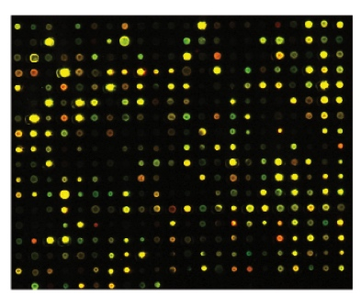
Microarray data used to derive a candidate GRN from the YEASTRACT database
15 Transcription Factors that Potentially Regulate Response
ACE2 HAP4 SWI4
ASH1 HMO1 SWI5
CIN5 MSN2 YHP1
GCR2 SFP1 YOX1
GLN3 STB5 ZAP1
YEASTRACT Database

Slide 9
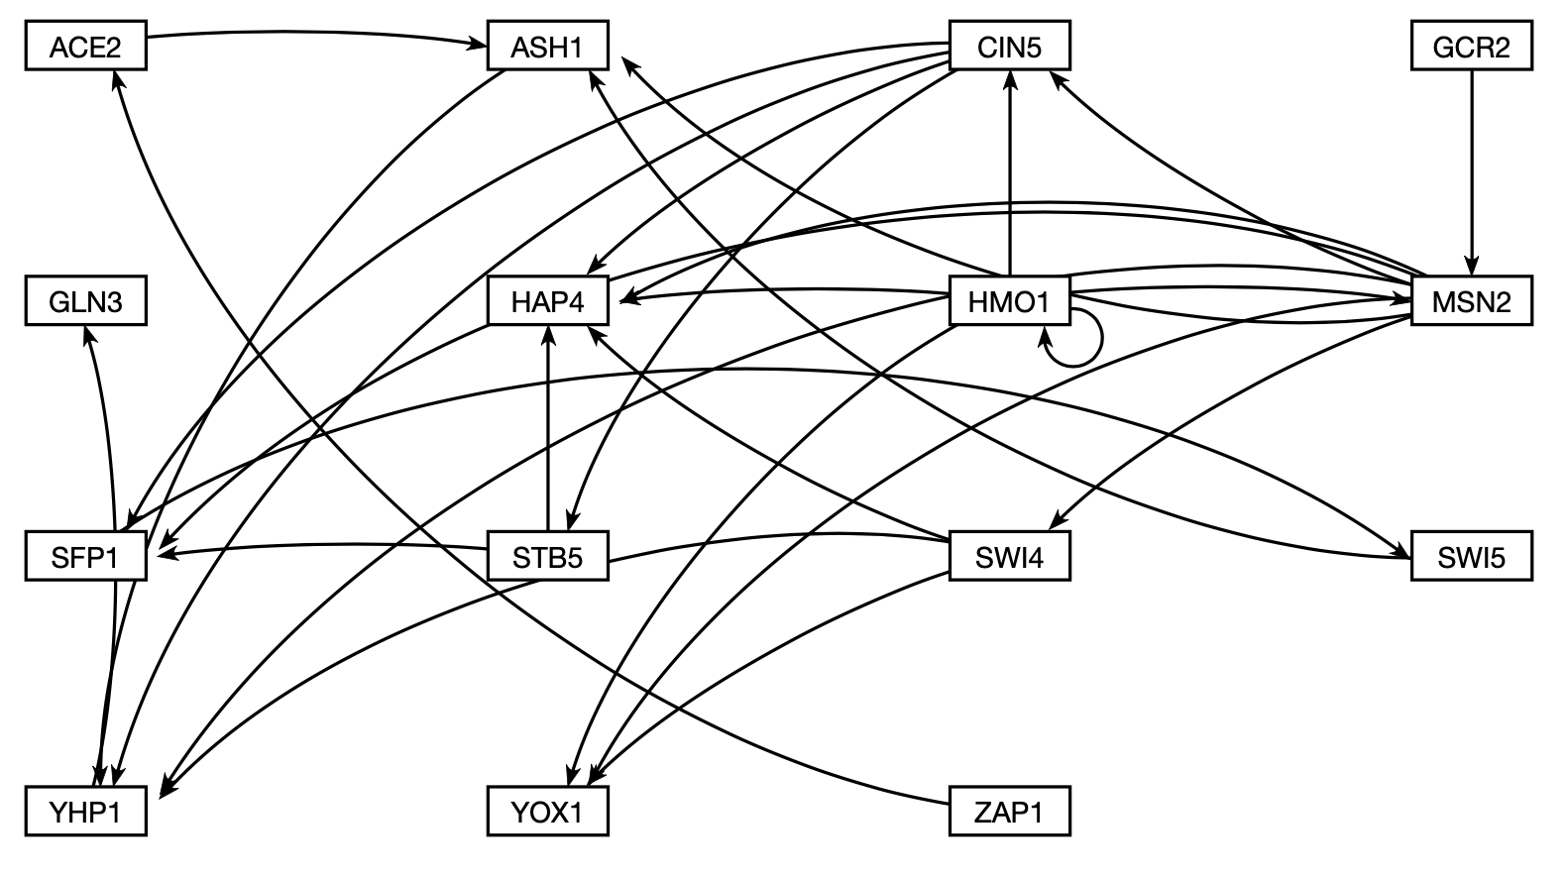
Gene regulatory network (GRN) – a set of transcription factors that regulate the level of expression of a set of target genes, which can include other transcription factors
Node = Transcription Factor
Edge = Regulatory relationship

Slide 10
Outline
Gene regulatory networks (GRNs) are a set of transcription factors that regulate the level of expression of a set of target genes.
GRNs can be used to model the cold shock response in yeast.
A candidate GRN was modeled using differential equations.
Systematic edge deletions were performed in order to assess the importance of each edge in the network.
MSN2, CIN5, and HMO1 are important for regulating the response to cold shock in yeast.

Slide 11
GRNmap uses differential equations to model the expression of each gene in the network
Differential equations model the change in expression as production – degradation for each gene.
One equation per gene – 15 equations
P is the mRNA production rate.
d is the mRNA degradation rate.
w is the weight term, determining the level of influence of a transcription factor on a target.
b is the threshold expression for each gene.
(Dahlquist et al., 2015)
Notes:
We want to know the indirect effects of the transcription factors, and we are going to do that my modeling.

Slide 12
P, b, and w parameters estimated from the microarray data using penalized least square approach
58 total parameters are estimated.
E is the overall error of the model simulation vs. the real data.
The minLSE is the minimum theoretical error achievable given the noise in the data.
LSE:minLSE, then, is a measure of the goodness of fit that can be compared between the models.
(Dahlquist et al., 2015)

Slide 13
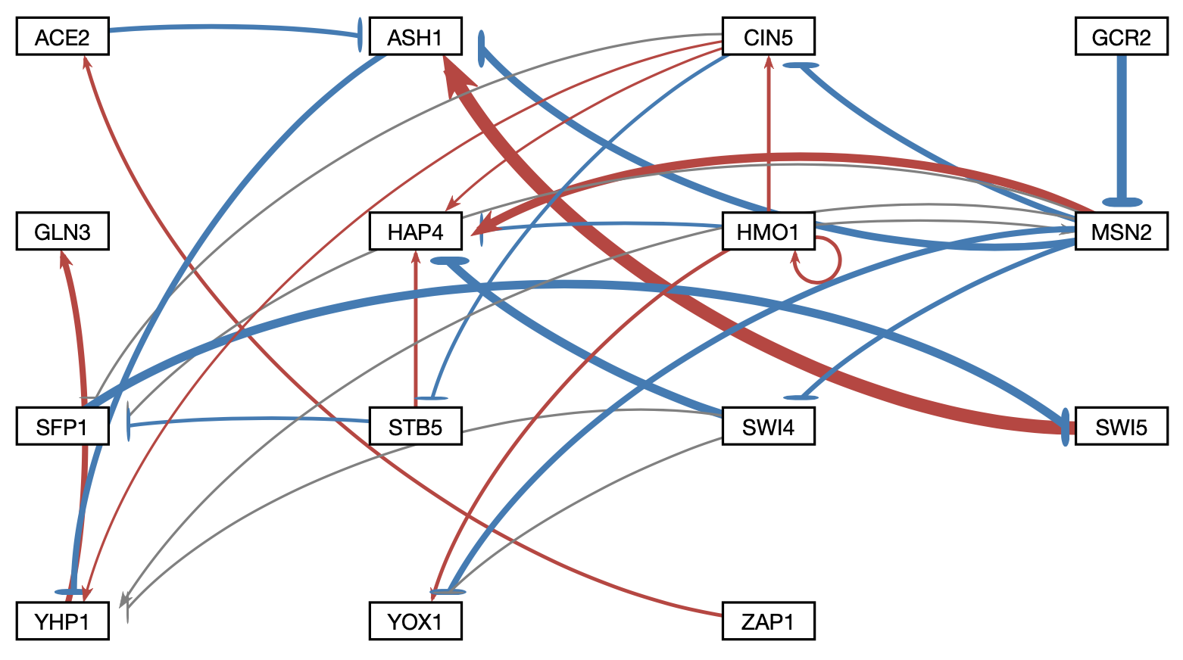
Modeling of the intact network shows a balance of activation and repression
= Activation
= Repression
= low w value
LSE:minLSE = 1.41

Slide 14
Outline
Gene regulatory networks (GRNs) are a set of transcription factors that regulate the level of expression of a set of target genes.
GRNs can be used to model the cold shock response in yeast.
A candidate GRN was modeled using differential equations.
Systematic edge deletions were performed in order to assess the importance of each edge in the network.
MSN2, CIN5, and HMO1 are important for regulating the response to cold shock in yeast.

Slide 15
Which relationships are important?
Each edge was deleted one at a time.
We then re-estimated the parameters using the model.
The model will get better, get worse, or stay the same.
LSE:minLSE

Slide 16
LSE:minLSE ratio compared for 29 networks
Notes:
The LSE:minLSE ratio describes how well the GRN was modeled by GRNmap and allows for the comparison of the intact network to each of the edge deletion networks.
A lower LSE:minLSE ratio (a ratio closer to 1) means that the GRN that resulted from the edge deletion is a better fit to the experimental data.
The deletions of HMO1→CIN5 (C) and ZAP1→ACE2 (D) both improved the fit of the model. The deletion of ZAP1→ACE2 resulted in the largest drop in LSE:minLSE ratio, therefore it is likely not a crucial edge in the network.
The deletions of SWI5→ASH1 (E) and GCR2→MSN2 (F) both result in a larger LSE:minLSE than the intact network, which suggest that those edges are important to the network.

Slide 17
LSE:minLSE ratio compared for 29 networks
Notes:
The LSE:minLSE ratio describes how well the GRN was modeled by GRNmap and allows for the comparison of the intact network to each of the edge deletion networks.
A lower LSE:minLSE ratio (a ratio closer to 1) means that the GRN that resulted from the edge deletion is a better fit to the experimental data.
The deletions of HMO1→CIN5 (C) and ZAP1→ACE2 (D) both improved the fit of the model. The deletion of ZAP1→ACE2 resulted in the largest drop in LSE:minLSE ratio, therefore it is likely not a crucial edge in the network.
The deletions of SWI5→ASH1 (E) and GCR2→MSN2 (F) both result in a larger LSE:minLSE than the intact network, which suggest that those edges are important to the network.

Slide 18
LSE:minLSE ratio compared for 29 networks
Notes:
The LSE:minLSE ratio describes how well the GRN was modeled by GRNmap and allows for the comparison of the intact network to each of the edge deletion networks.
A lower LSE:minLSE ratio (a ratio closer to 1) means that the GRN that resulted from the edge deletion is a better fit to the experimental data.
The deletions of HMO1→CIN5 (C) and ZAP1→ACE2 (D) both improved the fit of the model. The deletion of ZAP1→ACE2 resulted in the largest drop in LSE:minLSE ratio, therefore it is likely not a crucial edge in the network.
The deletions of SWI5→ASH1 (E) and GCR2→MSN2 (F) both result in a larger LSE:minLSE than the intact network, which suggest that those edges are important to the network.

Slide 19
LSE:minLSE ratio compared for 29 networks
Better
Notes:
The LSE:minLSE ratio describes how well the GRN was modeled by GRNmap and allows for the comparison of the intact network to each of the edge deletion networks.
A lower LSE:minLSE ratio (a ratio closer to 1) means that the GRN that resulted from the edge deletion is a better fit to the experimental data.
The deletions of HMO1→CIN5 (C) and ZAP1→ACE2 (D) both improved the fit of the model. The deletion of ZAP1→ACE2 resulted in the largest drop in LSE:minLSE ratio, therefore it is likely not a crucial edge in the network.
The deletions of SWI5→ASH1 (E) and GCR2→MSN2 (F) both result in a larger LSE:minLSE than the intact network, which suggest that those edges are important to the network.

Slide 20
LSE:minLSE ratio compared for 29 networks
Better
Notes:
The LSE:minLSE ratio describes how well the GRN was modeled by GRNmap and allows for the comparison of the intact network to each of the edge deletion networks.
A lower LSE:minLSE ratio (a ratio closer to 1) means that the GRN that resulted from the edge deletion is a better fit to the experimental data.
The deletions of HMO1→CIN5 (C) and ZAP1→ACE2 (D) both improved the fit of the model. The deletion of ZAP1→ACE2 resulted in the largest drop in LSE:minLSE ratio, therefore it is likely not a crucial edge in the network.
The deletions of SWI5→ASH1 (E) and GCR2→MSN2 (F) both result in a larger LSE:minLSE than the intact network, which suggest that those edges are important to the network.

Slide 21
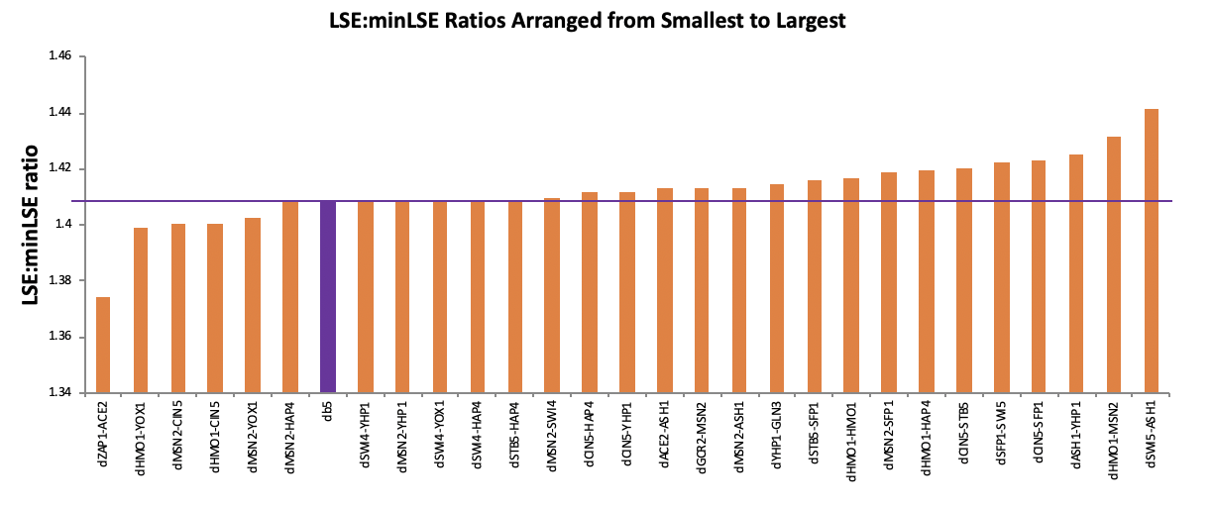
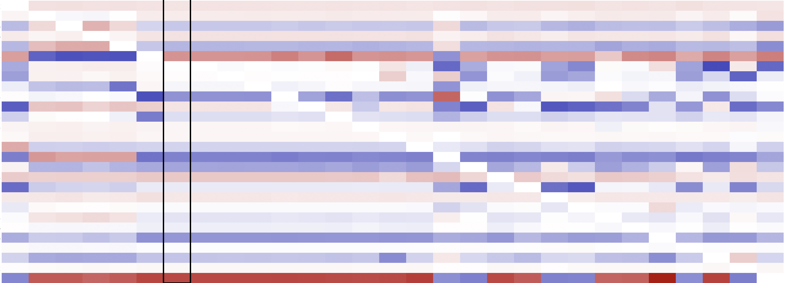
A heatmap of the weight parameters reveals 5 major groupings
1
2
3
4
5

Slide 22
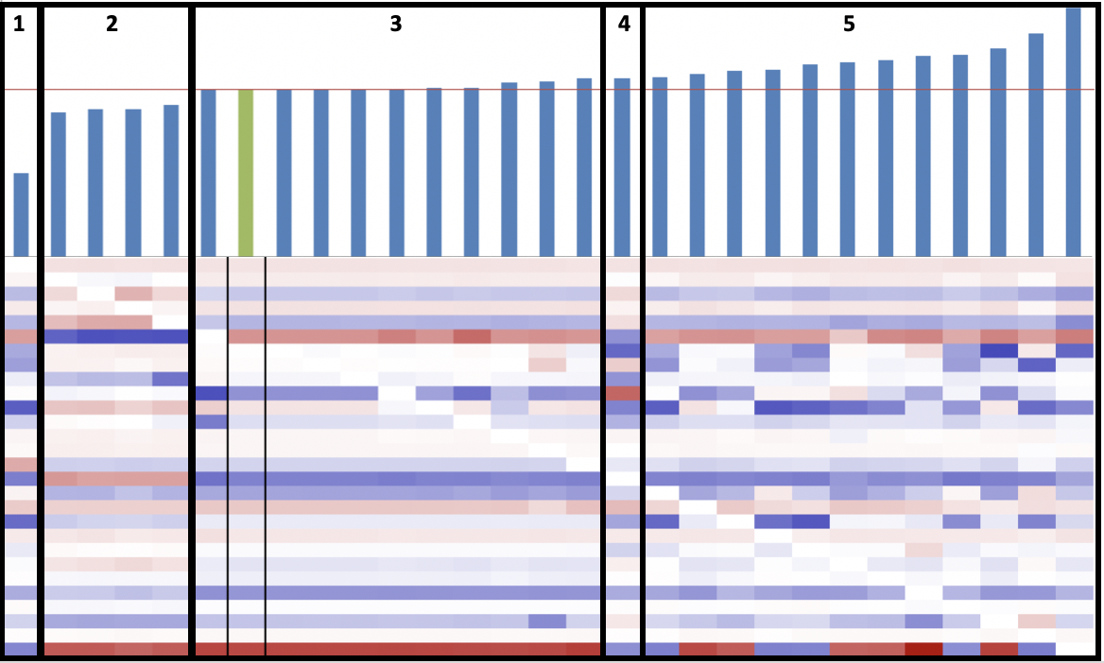
Five representative edge deletion-networks selected for further analysis
1) Edge ZAP1→ACE2 deleted
2) Edge HMO1→CIN5 deleted
3) Edge MSN2→YHP1 deleted
4) Edge GCR2→MSN2 deleted
5) Edge SWI5→ASH1 deleted
Notes:
dZAP1→ACE2 = lowest LSE:minLSE ratio
dHMO1→CIN5 = part of a group with similar LSE:minLSE ratio/edge weight changes
dMSN2→YHP1 = no LSE:minLSE ratio change
dGCR2→MSN2 = larger LSE:minLSE, lots of downstream regulatory changes that stand out
dSWI5→ASH1 = highest LSE:minLSE ratio

Slide 23
Changes in production rates (p) compensate for edge deletions
Notes:
The deletions that caused a change in LSE:minLSE ratio were also associated with production rate changes of certain genes. dMSN2→YHP1 did not result in a change in LSE:minLSE, and therefore there are no production rate changes. Large spikes in production rate are associated with ACE2, CIN5, STB5. SWI4, and YHP1.
The intact network production rate values are normalized as 0
Edge deletions that caused LSE:minLSE changes were also associated with production rate changes
The deletion of MSN2→YHP1 did not change the LSE:minLSE, thus there are no production rate changes
Production rate changes are typically large

Slide 24
Outline
Gene regulatory networks (GRNs) are a set of transcription factors that regulate the level of expression of a set of target genes.
GRNs can be used to model the cold shock response in yeast.
A candidate GRN was modeled using differential equations.
Systematic edge deletions were performed in order to assess the importance of each edge in the network.
MSN2, CIN5, and HMO1 are important for regulating the response to cold shock in yeast.

Slide 25
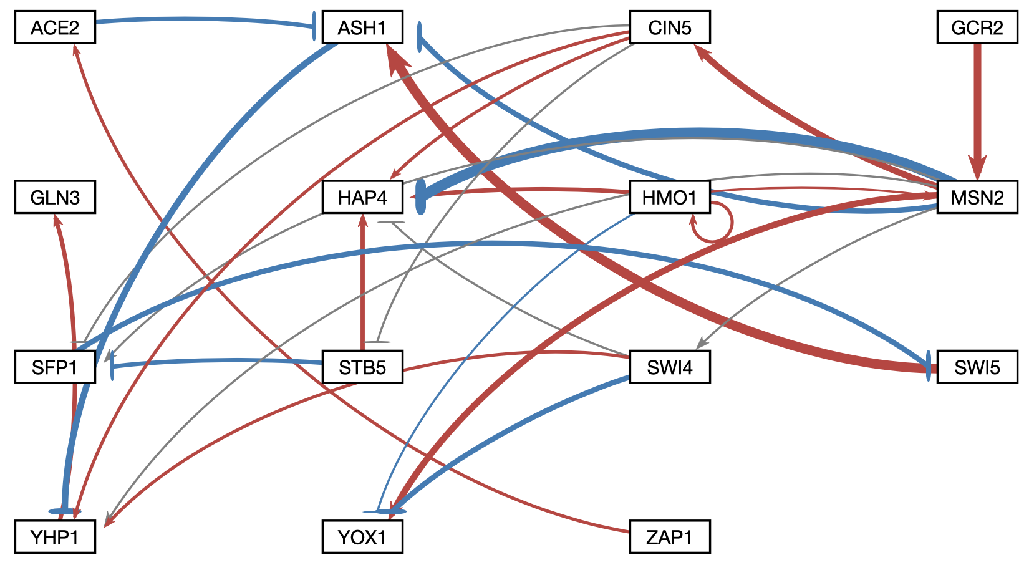
HMO1, CIN5, and MSN2 are central hubs in the network
Intact Network
Group 2: Edge HMO1→CIN5 deleted
*
*
*
*
*
*
*
*
*
*
*
*
*
*
LSE:minLSE = 1.41
LSE:minLSE = 1.40
Notes:
I am summarizing a lot of data, but visually what we arw looking at is that CIN5, MSN2, and HMO1 seem to be critical hubs

Slide 26
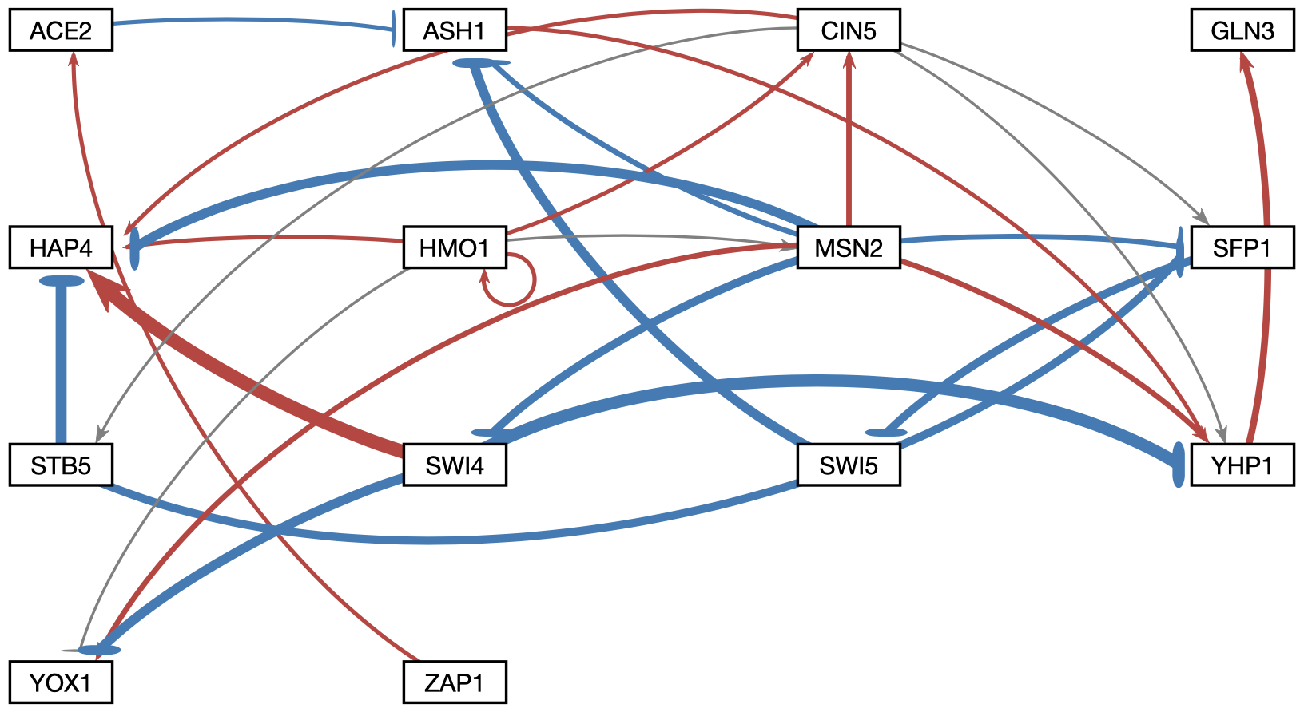
HMO1, CIN5, and MSN2 are central hubs in the network
Intact Network
Group 4: Edge GCR2→MSN2 deleted
*
*
*
*
*
*
*
*
*
*
*
*
*
*
*
*
*
*
LSE:minLSE = 1.41
LSE:minLSE = 1.413
Notes:
I am summarizing a lot of data, but visually what we arw looking at is that CIN5, MSN2, and HMO1 seem to be critical hubs

Slide 27
Conclusion
Gene regulatory networks (GRNs) are a set of transcription factors that regulate the level of expression of a set of target genes.
GRNs were used to model the cold shock response in yeast.
A candidate GRN was modeled using differential equations.
28 systematic edge deletions were performed in order to assess the importance of each edge in the network.
Deletion networks clustered into 5 groups based on their weights.
An analysis of the changes in parameters showed that certain edges are important.
MSN2, CIN5, and HMO1 are important for regulating the response to cold shock in yeast.

Slide 28
Acknowledgments
Microarray data collected by: Cybele Arsan, Wesley Citti, Kevin Entzminger, Andrew Herman, Monica Hong, Heather King, Lauren Kubeck, Stephanie Kuelbs, Elizabeth Liu, Matthew Mejia, Kevin McGee, Kenny Rodriguez, Olivia Sakhon, Alondra Vega, and Kevin Wyllie.
GRNmap alumni: Justin Kyle T. Torres, Brandon J. Klein, and Margaret J. O’Neil
GRNsight team: Mihir Samdarshi, John L. Lopez, and Alexia M. Filler
Dr. Kam Dahlquist
Dr. Ben Fitzpatrick

