Slide 1

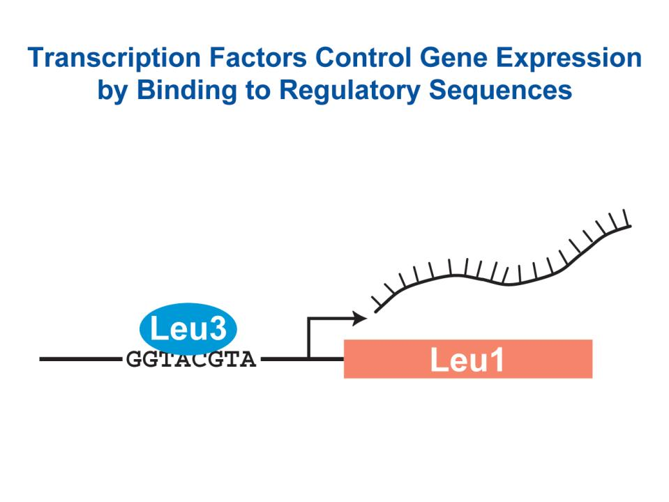
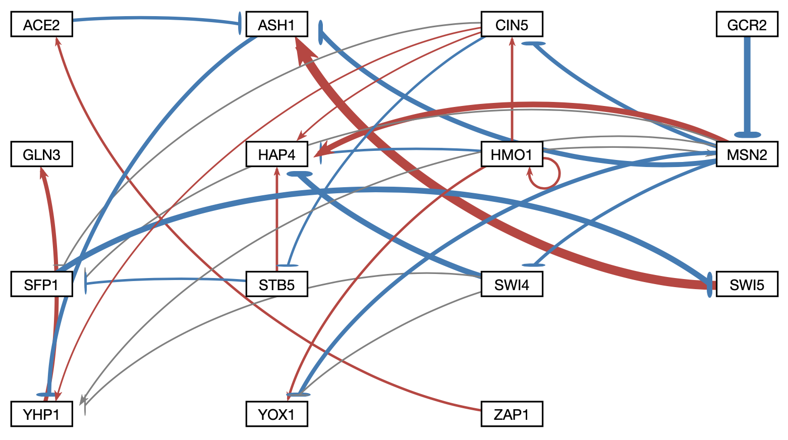
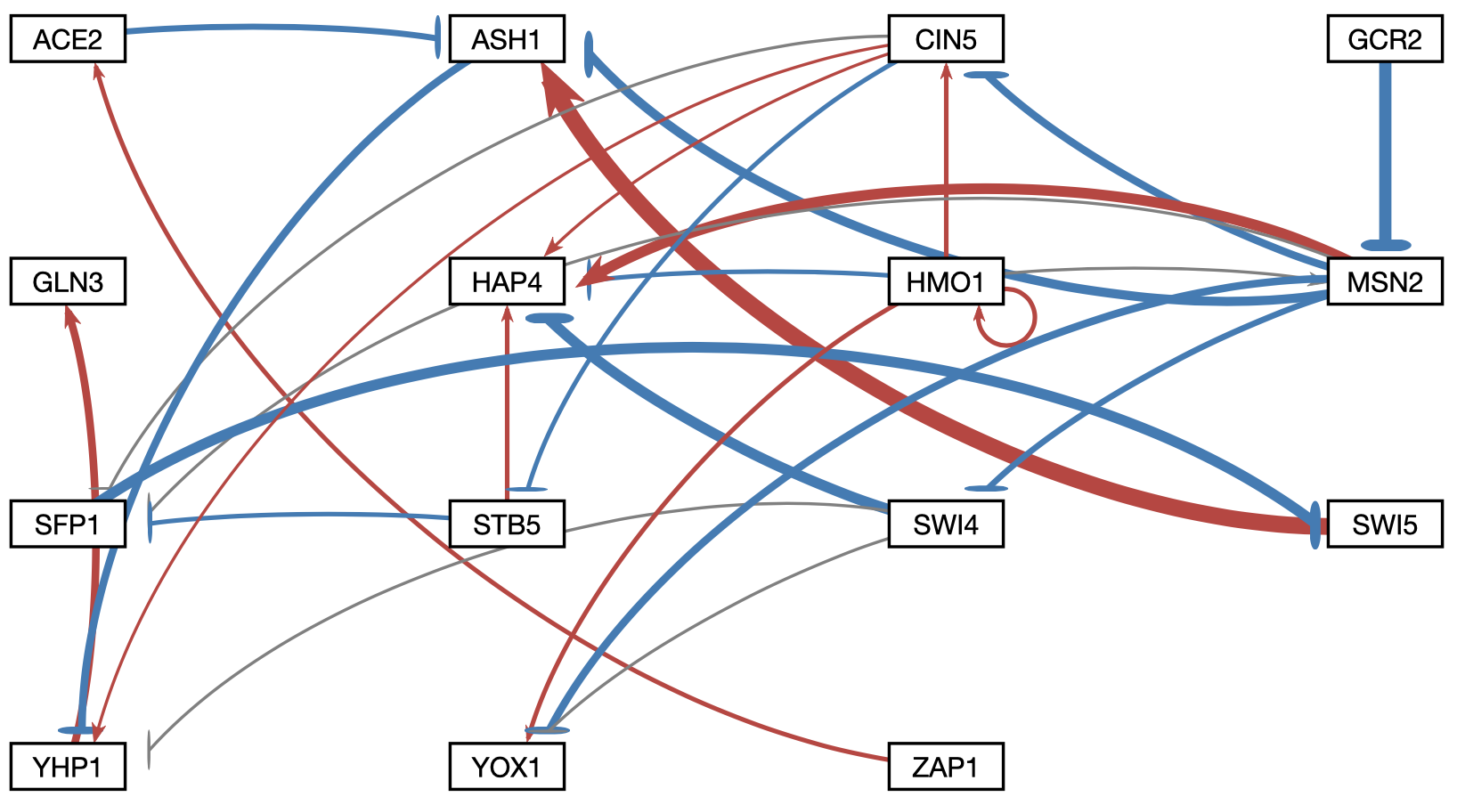
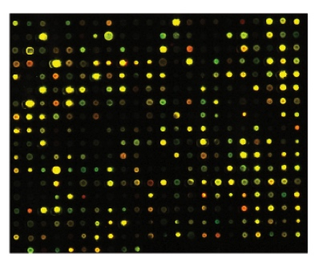
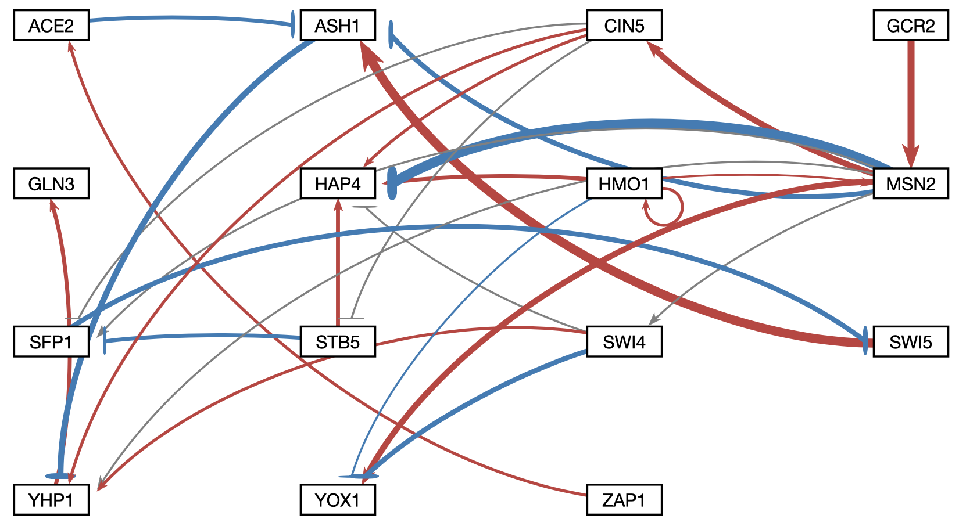
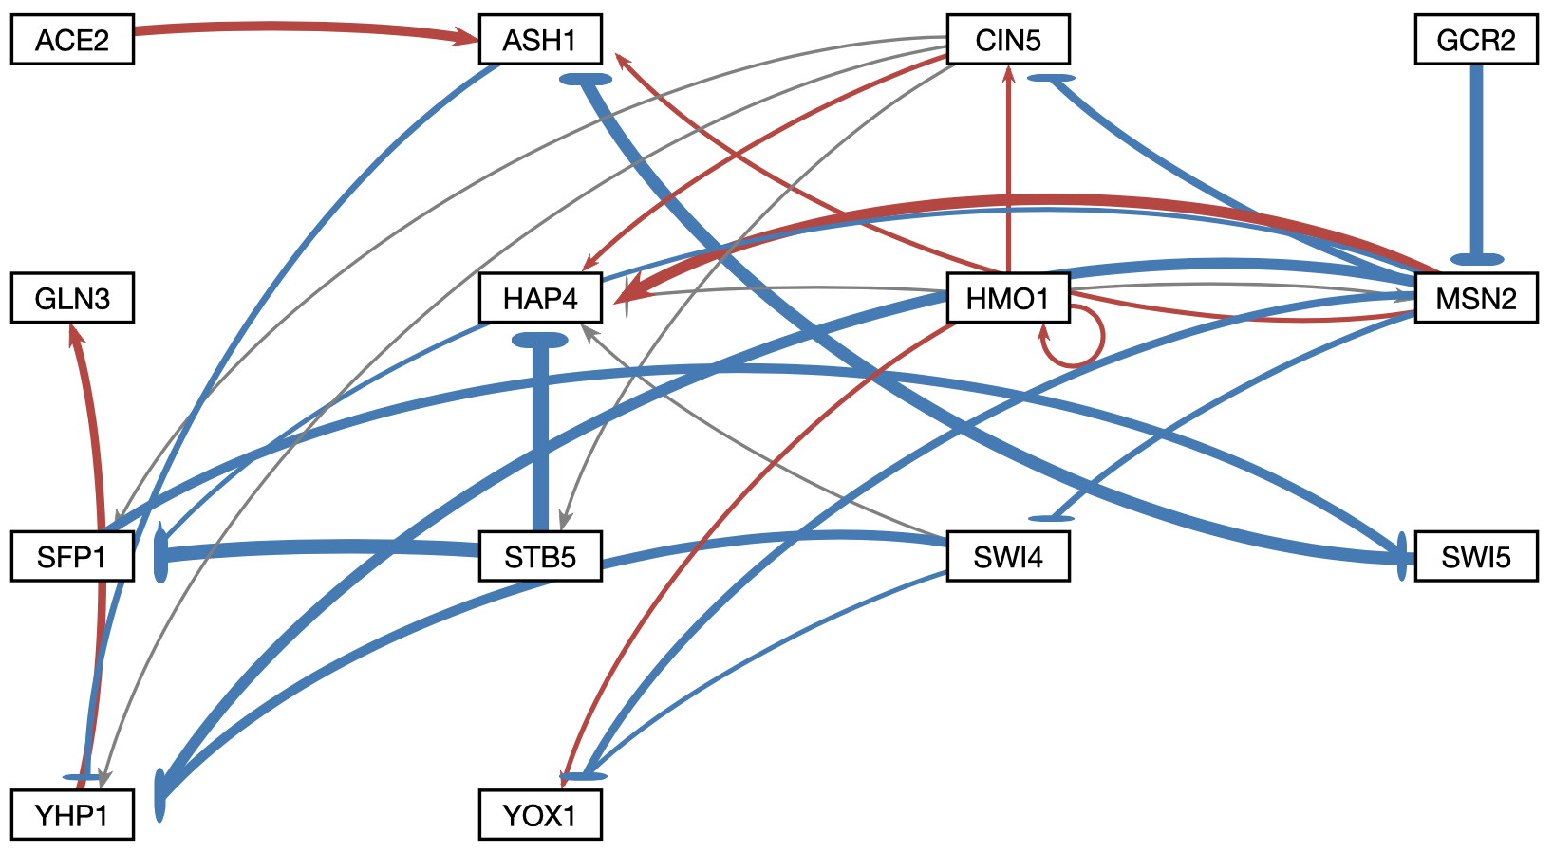
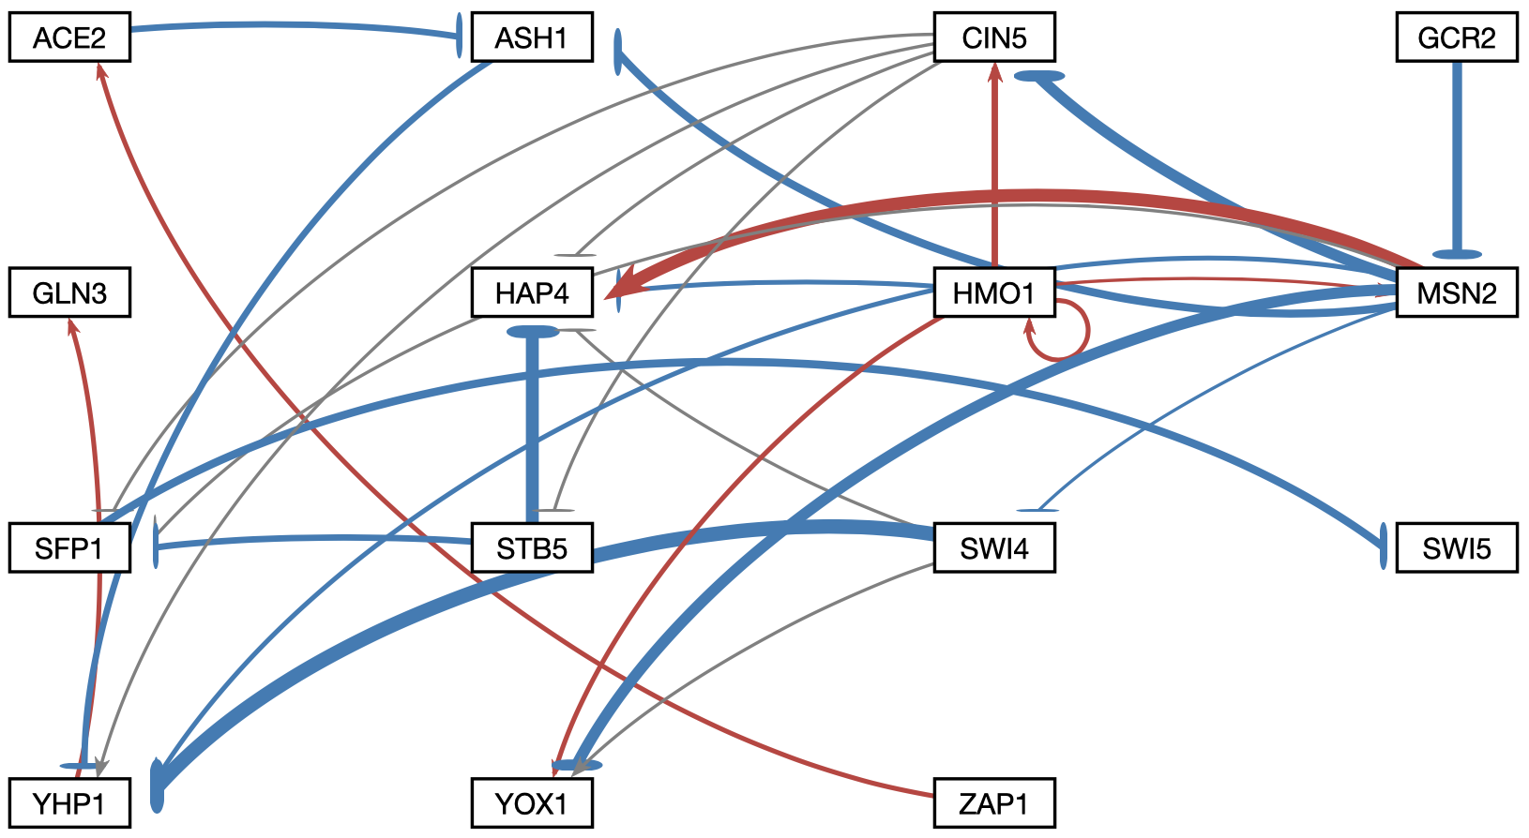
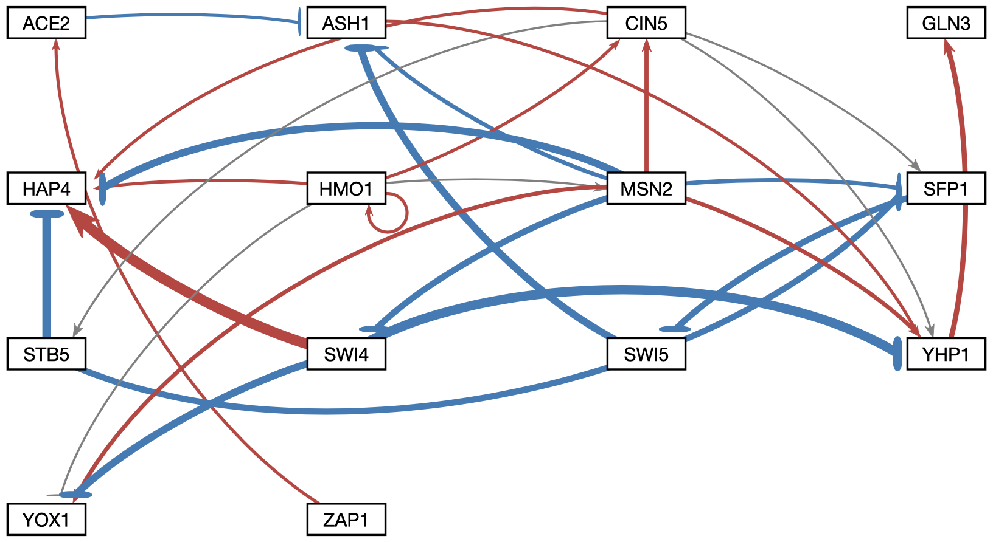
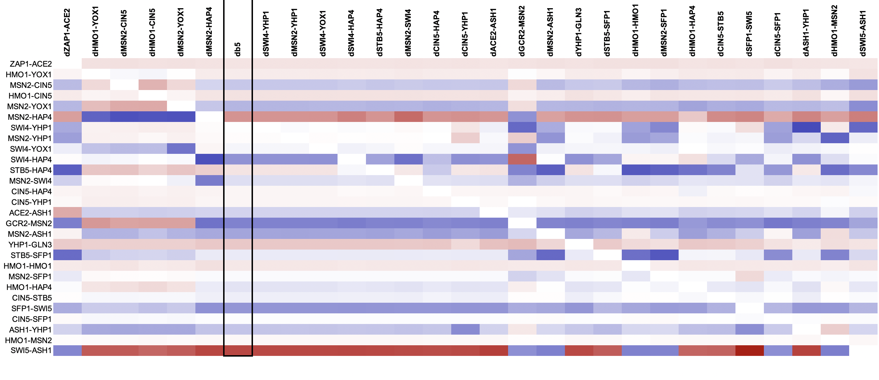
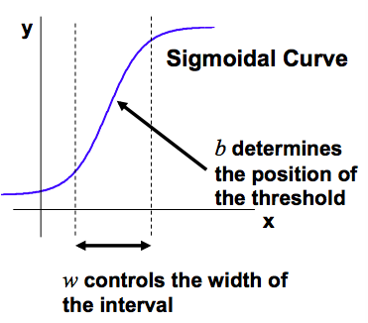
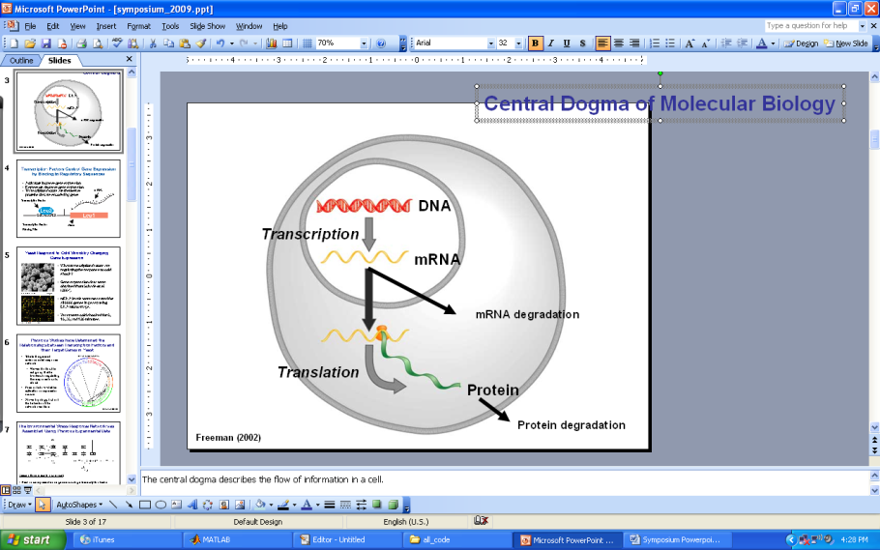
Modeling of Gene Regulatory Network Dynamics Predicts which Regulatory Relationships
are Important for Controlling the Cold Shock Response in Saccharomyces cerevisiae
Lauren M. Kelly¹, Margaret J. O’Neil¹, Ben G. Fitzpatrick², and Kam D. Dahlquist¹
¹Department of Biology, ²Department of Mathematics
Loyola Marymount University, 1 LMU Drive, Los Angeles, CA 90045 USA
Transcription factors control gene expression by binding
to regulatory DNA sequences upstream of genes
28 deletion networks were generated from the intact network
Certain edge deletions caused changes in the LSE:minLSE ratio
Activators increase gene expression.
Repressors decrease gene expression.
Transcription factors are themselves proteins that are encoded by genes.
A gene regulatory network (GRN) consists of a set of transcription factors that regulate the level of expression of a set of target genes, which can include other transcription factors.
The dynamics of a GRN is how the expression of genes in the network change over time.
A. Intact network 15 nodes, 28 edges
B. MSN2→YHP1 edge deletion network
15 nodes, 27 edges
Yeast respond to the environmental stress of cold shock
by changing gene expression
Little is known about which transcription factors regulate this response.
The Dahlquist Lab studies the global transcriptional response to cold shock using DNA microarrays, which measure the level of mRNA expression for all 6000 yeast genes.
We have collected expression data from the wild type strain and five transcription factor deletion strains (Δcin5, Δgln3, Δhmo1, Δzap1, Δhap4 ) before cold shock at 30°C and after 15, 30, and 60 minutes of cold shock at 13°C.
We use mathematical modeling to determine the relative influence of each transcription factor in the GRN that controls the cold shock response.
C. HMO1→CIN5 edge deletion network
15 nodes, 27 edges
D. ZAP1→ACE2 edge deletion network
14 nodes, 27 edges
*
*
*
*
The LSE:minLSE ratio describes how well the GRN was modeled by GRNmap and allows for the comparison of the intact network to each of the edge deletion networks.
A lower LSE:minLSE ratio (a ratio closer to 1) means that the GRN that resulted from the edge deletion is a better fit to the experimental data.
The deletions of HMO1→CIN5 (C) and ZAP1→ACE2 (D) both improved the fit of the model. The deletion of ZAP1→ACE2 resulted in the largest drop in LSE:minLSE ratio, therefore it is likely not a crucial edge in the network.
The deletions of SWI5→ASH1 (E) and GCR2→MSN2 (F) both result in a larger LSE:minLSE than the intact network, which suggest that those edges are important to the network.
*
*
*
*
*
*
Microarray at 60 minutes after cold shock
*
*
*
Certain edge deletions cause changes in production rates and MSE:minMSE Ratio
Microarray data from the Dahlquist Lab was used to derive a family of related GRNs from the YEASTRACT database
E. SWI5→ASH1 edge deletion network
15 nodes, 27 edges
F. GCR2→MSN2 edge deletion network
14 nodes, 27 edges
DNA microarray data for each of the six strains was analyzed to show which genes exhibited significant changes in expression during cold shock. The criteria for significance was a corrected Benjamini & Hochberg ANOVA p value < 0.05.
The genes with significant expression changes were submitted to the YEASTRACT database, which returned a list of transcription factors that could regulate those targets.
Transcription factors for which we had deletion strain microarray data were added to the list of the most significant regulators for each strain to generate six GRNs.
Transcription factors and edges were removed from each GRN in a stepwise fashion in order of least to most significant until the network was pared down to have fewer than 15 genes.
This study focuses one network (db5) with 15 genes and 28 edges, which was input into the Dahlquist Lab’s GRNmap program to model the dynamics of expression for each gene in the network.
*
*
*
*
Strain | Wild type | ∆cin5 | ∆gln3 | ∆hap4 | ∆zap1
Number and % of Genes with p < 0.05 | 1936 (31%) | 1683 (28%) | 1683 (28%) | 1794 (29%) | 1859 (30%)
*
*
*
*
*
*
*
*
MSE:minMSE ratios were compared across Networks A-F using the expression data from each S. cerevisiae strain.
A smaller MSE:minMSE ratio indicates that there is less error and that a particular gene is estimated well.
Deleting MSN2-YHP1, while it does not alter production rates, causes a decrease in MSE:minMSE for HMO1 in the ∆ HMO1 strain.
In the ∆ GLN3 strain, YOX1 has an extremely high MSE:minMSE ratio, indicating that is is not modeled well.
Network A, the intact network, was the starting point.
Edges were deleted one by one to generate 28 edge deletion networks.
The networks generated from each edge deletion were compared to the intact network in order to determine which edges were important to the network.
We found that certain edge deletions resulted in downstream changes in regulation, indicated by the asterisks above. Certain edges changed from activation to repression, and vice versa.
LSE:minLSE ratio, MSE:minMSE ratio, and production rates were also altered as a result of deletions.
Production rates for deletion networks B-F were compared by normalizing each value to the intact network.
dZAP1-ACE2 (lowest LSE:minLSE) and dSWI5-ASH1 (highest LSE:minLSE) both cause certain production rates to spike.
These changes suggest that the networks could compensate for these edge deletions by altering production rates.
Dynamical systems modeling was used to estimate weight parameters for each regulatory relationship
Deletions of individual edges cause downstream regulatory changes
to other edges in the network
Conclusions and Future Directions
The model, called GRNmap (Gene Regulatory Network modeling and parameter estimation) was implemented in MATLAB (Dahlquist et al. 2015).
The MATLAB code and executable are available under an open source license at https://github.com/kdahlquist/GRNmap/.
In total, 29 networks were examined. These were comprised of the intact network and the 28 networks generated from each individual edge deletion.
Upon examination, five of the networks were selected for further analysis: Networks B (dMSN2→YHP1), C (dHMO1→CIN5), D (dZAP1→ACE2), E (dSWI5→ASH1), and F (dGCR2→MSN2). These networks were selected based on their LSE:minLSE ratios and the downstream regulatory changes to other edges in the network.
Networks C and D had smaller LSE:minLSE ratios, and networks E and F had larger LSE:minLSE ratios. Both sets of networks caused a variety of downstream regulatory changes.
The edge deletions that resulted in a higher LSE:minLSE ratio suggest that those particular edges are important to to the network, while the edge deletions that resulted in a lower LSE:minLSE ratio are likely not needed in the network.
The deletions of GCR→MSN2 and SWI5→ASH1 increased both the LSE:minLSE ratios and the production rates of certain genes.
The edge weights with high variability also correspond to the LSE:minLSE ratios. Deletion networks C, D, E, and F all have various edge weights that changed as a result of the deletion and resulted in lower (C and D) and higher (E and F) LSE:minLSE ratio. Deletion network B did not have any edge weight variability and the LSE:minLSE ratio did not change.
The changes in production rates as a result of the edge deletions was also assessed. The networks associated with changes in LSE:minLSE caused changes in the production rates of various genes, while network B did not cause any changes. This indicates that changes in the production rates compensate for the edge changes that affect how well the GRN is modeled.
Changes in MSE:minMSE were assessed based on the gene expression data of all six strains. Network B (dMSN2-YHP1) included a decrease in MSE:minMSE for HMO1 in the ∆ HMO1 strain, indicating that HMO1 is modeled better than in the intact network (Network A)
Overall, the systematic deletions of each of the 28 edges in the intact network revealed that ZAP1→ACE2 is most likely not important to the network and can be removed. The edges that cause changes in gene production rates and increase the LSE:minLSE ratio when they are deleted are likely important to the network. The edges that cause variability in other edges and decrease the LSE:minLSE ratio when they are deleted are likely not important to the network.
Each gene in the network has a differential equation that models the change in expression over time as production – degradation.
Degradation rates for each gene were taken from mRNA half life data from Neymotin et al. (2014).
We use a sigmoidal production function where:
P_{i} is mRNA production rate for gene i
d_{i} is the mRNA degradation rate for gene i
w is the weight term, determining the level of activation or repression of j on i
b is a threshold of expression for each gene
Positive weights to the edges represent activation, negative weights to edges represent repression.
The magnitude of the weight parameter represents the strength of the regulatory relationship.
The production rate (P_{i} ), weight (w ), and threshold (b) values were estimated from DNA microarray data using a penalized least squares approach.
(Freeman, 2002)
Acknowledgments
We would like to thank the GRNmap coding team, Justin Kyle T. Torres and John L. Lopez. We thank Mihir Samdarshi, Yeon-soo (Jen) Shin, and Eileen J. Choe for their work on the GRNsight visualization software. Microarray data were collected by Cybele Arsan, Wesley Citti, Kevin Entzminger, Andrew Herman, Monica Hong, Heather King, Lauren Kubeck, Stephanie Kuelbs, Elizabeth Liu, Matthew Mejia, Kevin McGee, Kenny Rodriguez, Olivia Sakhon, Alondra Vega, and Kevin Wyllie. Further, we would like to thank Brandon J. Klein for his contributions to the GRNmap data analysis team. This work is partially supported by NSF award 0921038 (K.D.D., B.G.F.) and a Kadner-Pitts Research Grant (K.D.D.).
*
*
*
*
*
*
D
C
A
B
F
E
References
E represents the Least Squares Error (LSE) and is the difference between the microarray data (experimental) values and simulated values derived from solving the differentical equation with the estimated parameters.
The LSE can be compared to the minimum theoretical LSE (minLSE) achievable given the experimental data to compare the goodness of fit of different network models.
LSE:minLSE Ratio
Dahlquist, K. D., Dionisio, J. D. N., Fitzpatrick, B. G., Anguiano, N. A., Varshneya, A., Southwick, B. J., & Samdarshi, M. (2016). GRNsight: a web application and service for visualizing models of small-to medium-scale gene regulatory networks. PeerJ Computer Science, 2, e85. doi: 10.7717/peerj-cs.85
Dahlquist, K., Fitzpatrick, B., Camacho, E., Entzminger, S., & Wanner, N. (2015). Parameter Estimation for Gene Regulatory Networks from Microarray Data: Cold Shock Response in Saccharomyces cerevisiae. Bulletin of Mathematical Biology, 77(8), 1457-1492. doi: 10.1007/s11538-015-0092-6.
Freeman, S. (2002). Biological science (First ed.). Prentice Hall.
Neymotin, B., Athanasiadou, R., & Gresham, D. (2014). Determination of in vivo RNA kinetics using RATE-seq. RNA, 20(10), 1645-1652. doi: 10.1261/rna.045104.114
This heat map visualizes the changes in regulation that occurred as a result of the edge deletions.
The LSE:minLSE ratios of these deletion networks increase from left to right.
The edge deletions that cause many changes in regulation seem to be clustered around higher and lower LSE:minLSE ratios (Networks C-F). There are little to no regulatory changes in deletion networks that have an LSE:minLSE very similar to the intact network (Network B).
The changes in regulation on both ends of the LSE:minLSE spectrum involve central genes, such as HMO1, CIN5, and MSN2. These genes are likely involved in long regulatory chains.
Network C is part of a group of networks that experience the same downstream regulatory changes and have an LSE:minLSE lower than the intact network.
Notes:
Overall:
Colored networks
Intact network, and other networks to be referred to throughout the paper
the
Top area:
Make then all GRNmap colored networks.
Put all networks I want to refer to in this area, refer to them throughout poster
Heat map:
Steal title from above intact network
Explain what colors mean
Switch places with LSE
The networks in which (edges) were deleted show a lot of changes across the networks. This could be because they are both involved in long regulatory chains
Conclusions:
Examined 29 networks
Upon examination, overall 5 of the networks had better LSE:minLSE, such and such had worse. How do we explain this
Looked at changes in production rates. This particular network, change in production rates compensated for edge deletion
Significant difference in production rate allows it to have similar LSE ratio as intact network
Differences in optimized rates result in different LSE
Edge weights with high variability corressponds to LSE:minLSE
Grand conclusion: nuke ZAP1-ACE2, these 5 edges are important, these 5 edges are not important

