Slide 1
Visuals of Weighted Graphs from the Edge Deletion Experiment
Lauren Kelly
Data Analysis Meeting
April 6, 2018

Slide 2
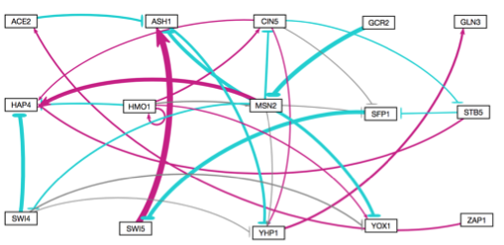
Intact Network

Slide 3
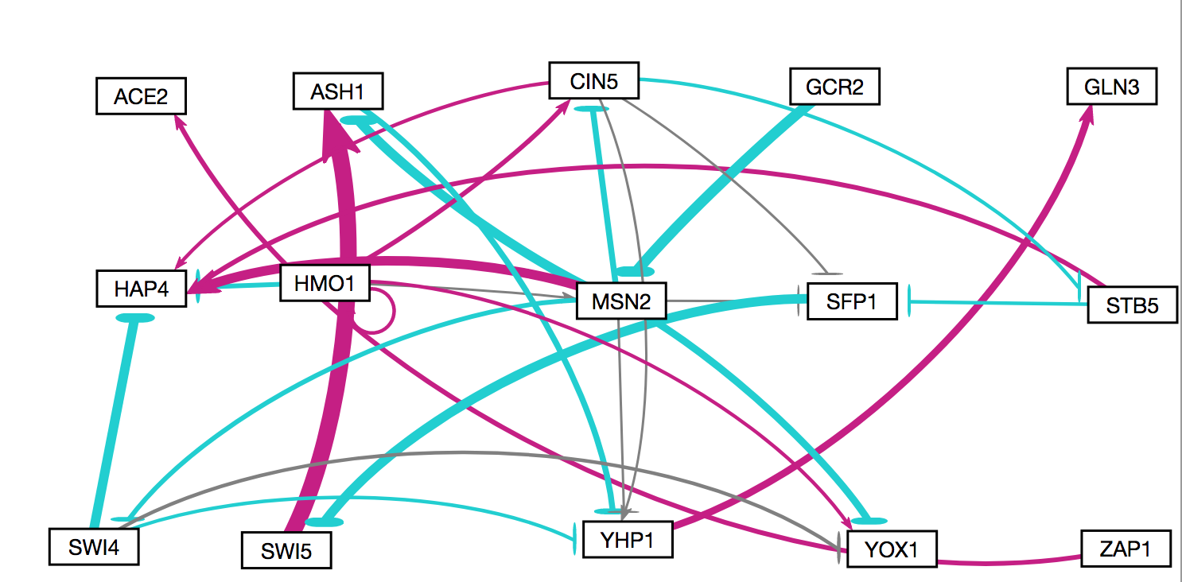
ACE2 → ASH1 Deletion Network

Slide 4
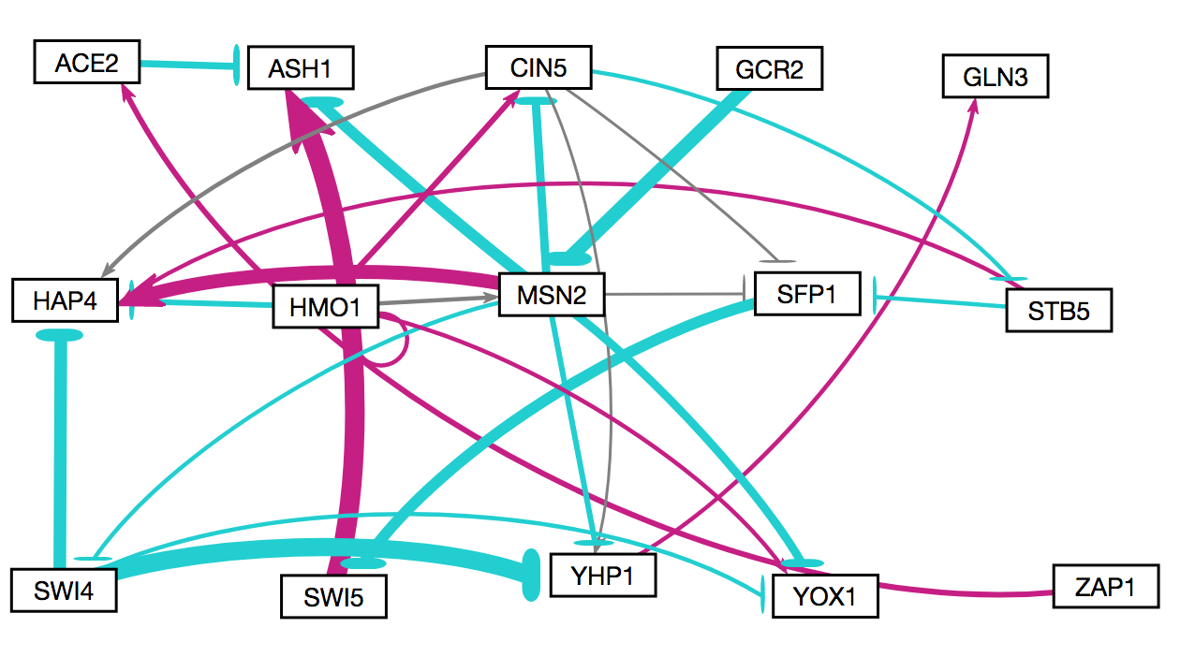
ASH1 → YHP1 Deletion Network

Slide 5
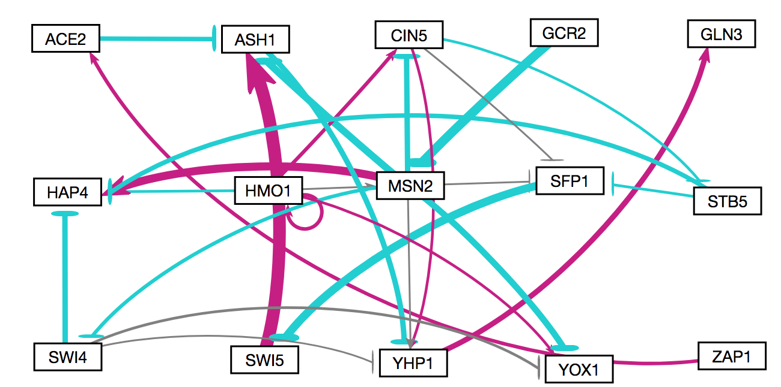
CIN5→ HAP4 Deletion Network

Slide 6
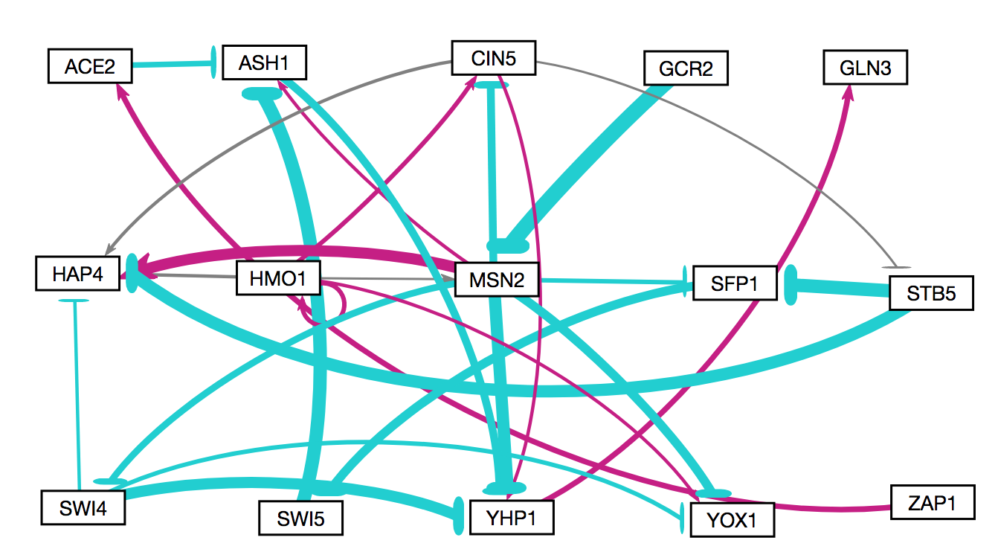
CIN5 → SFP1 Deletion Network

Slide 7
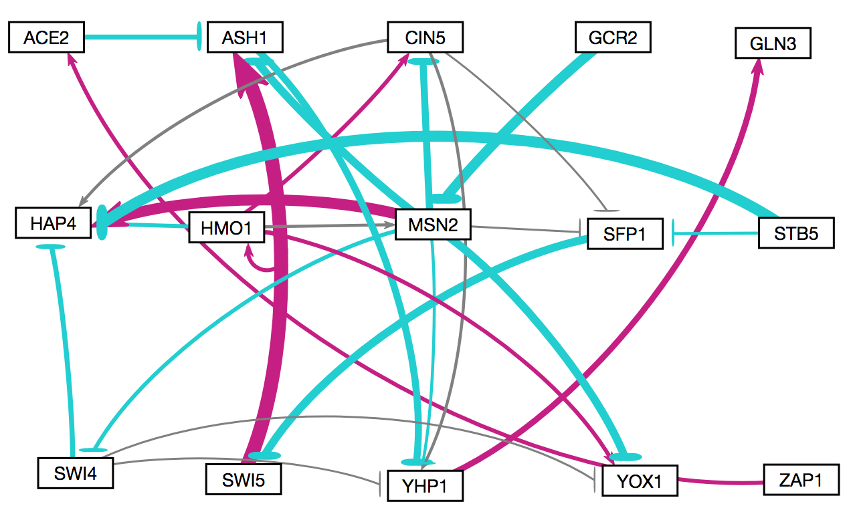
CIN5 → STB5 Deletion Network

Slide 8
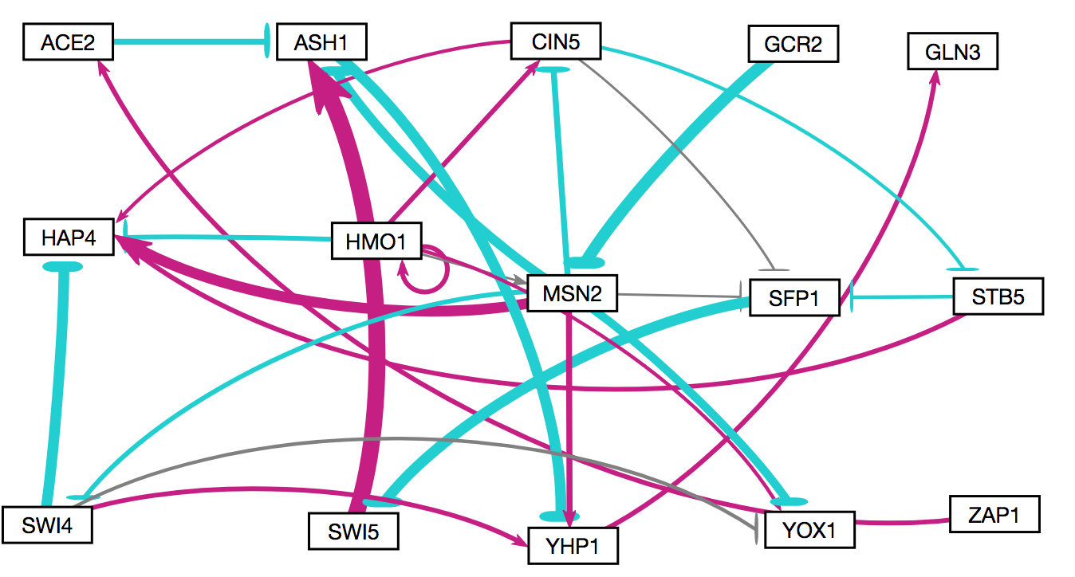
CIN5 → YHP1 Deletion Network

Slide 9
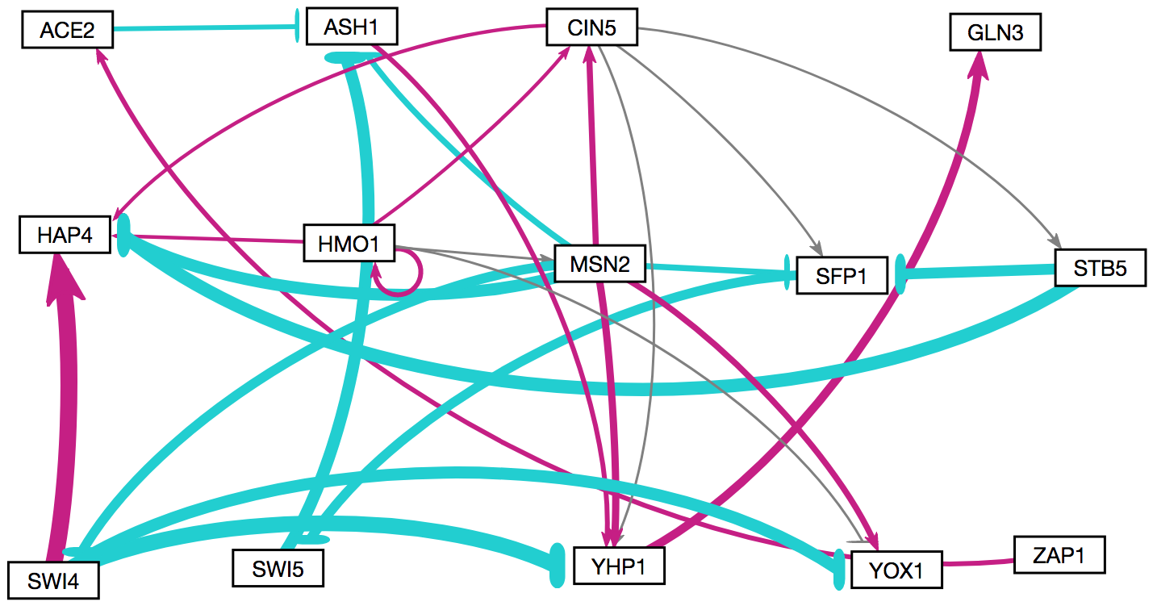
GCR2 → MSN2 Deletion Network

Slide 10
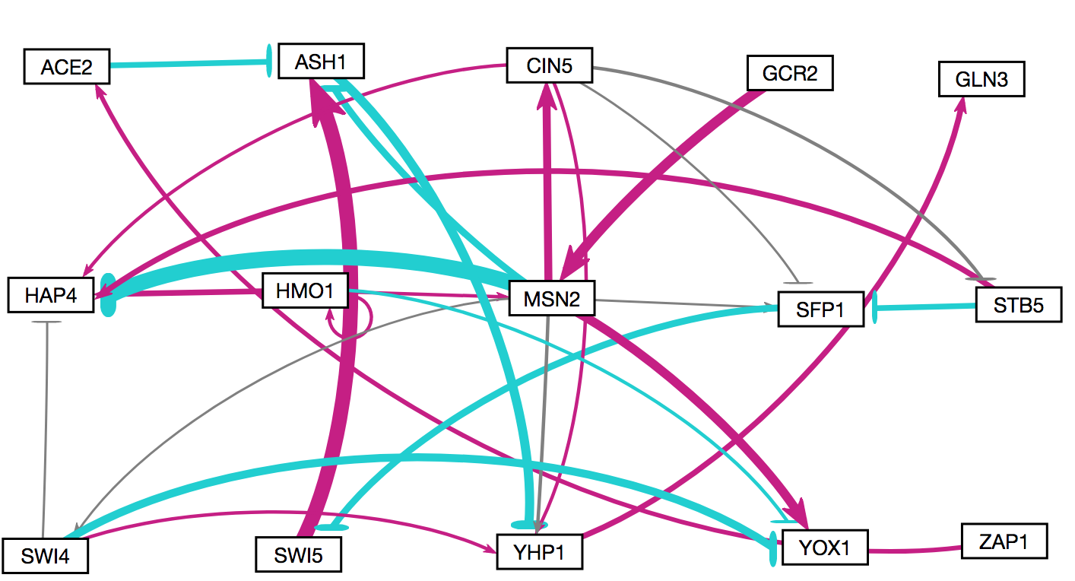
HMO1→ CIN5 Deletion Network

Slide 11
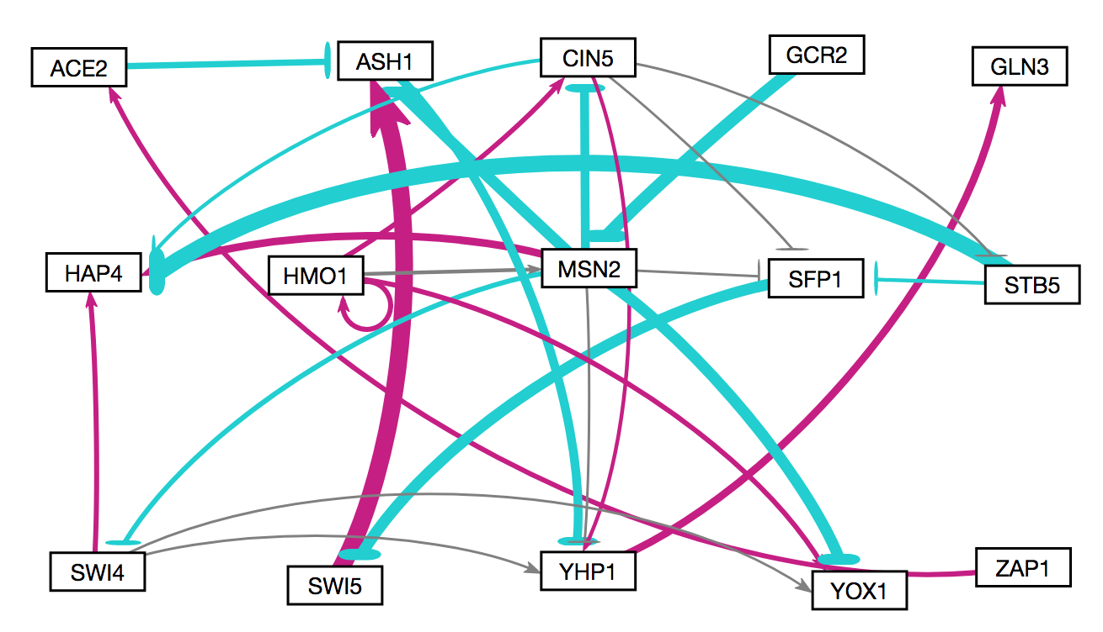
HMO1→ HAP4 Deletion Network

Slide 12
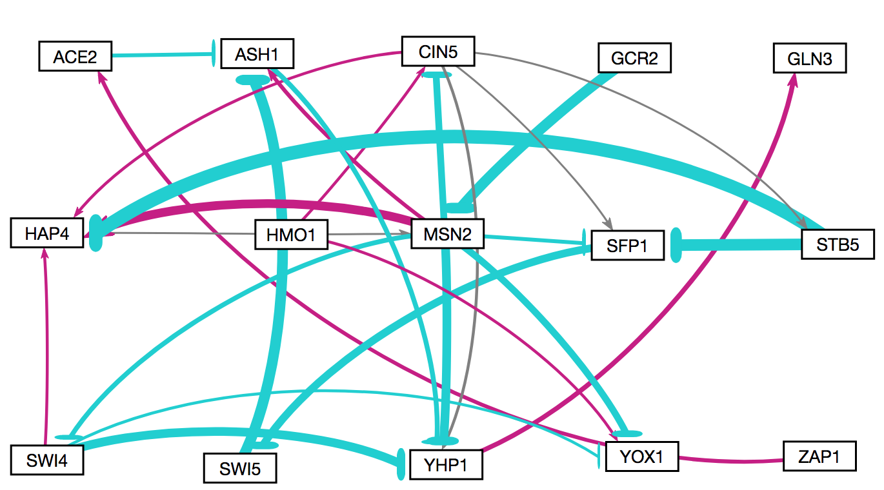
HMO1→ HMO1 Deletion Network

Slide 13
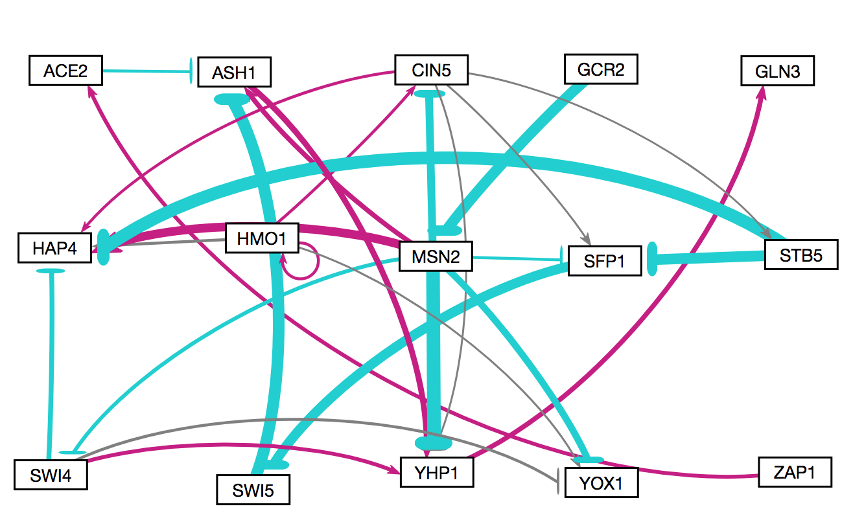
HMO1→ MSN2 Deletion Network

Slide 14
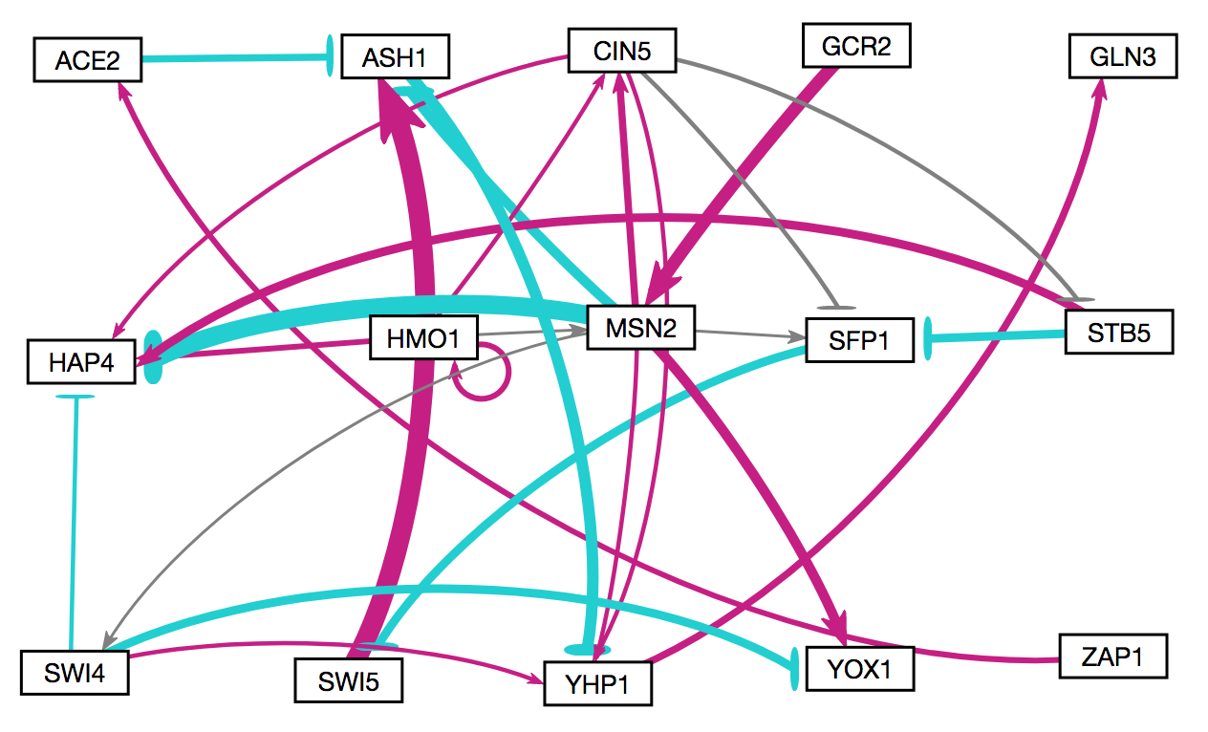
HMO1→ YOX1 Deletion Network

Slide 15
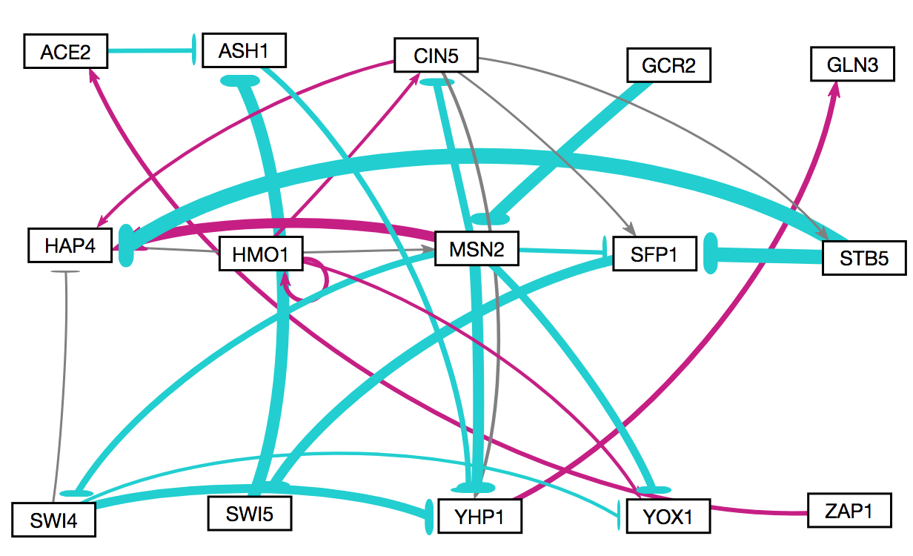
MSN2→ ASH1 Deletion Network

Slide 16
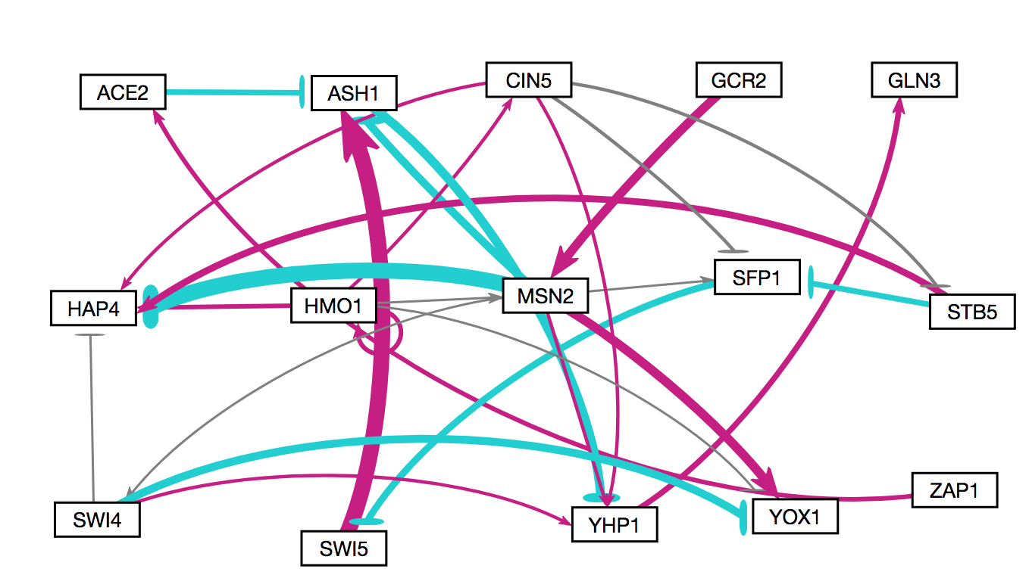
MSN2→ CIN5 Deletion Network

