Slide 1

Deposit Prediction Web App
Özge Sena Karabıyık: 64303375180
Korhan Deniz Akın: 30277304006
Kerem Irmak: 32813381526

Slide 2


Introduction
Predicts bank customers will subscribe to a term deposit or not.
Dataset consists of 20 attributes, including target variable, and 4119 instances.
This project involves data cleaning, data preprocessing, feature selection, model selection, hyperparameter tuning, evaluation and deployment.

Slide 3
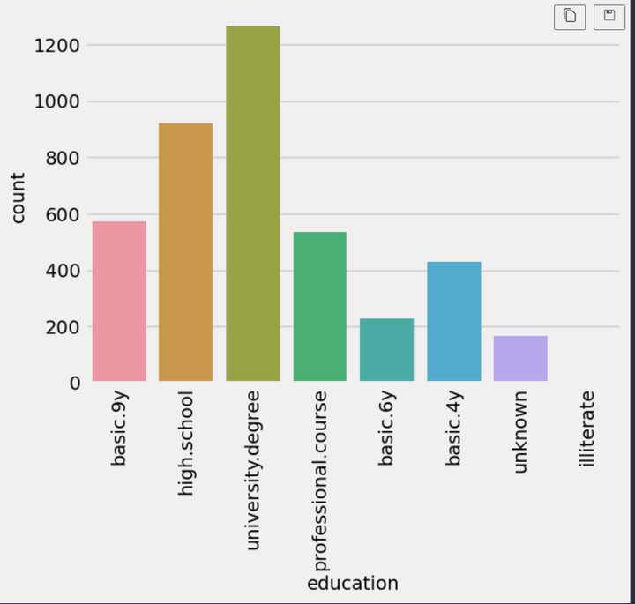
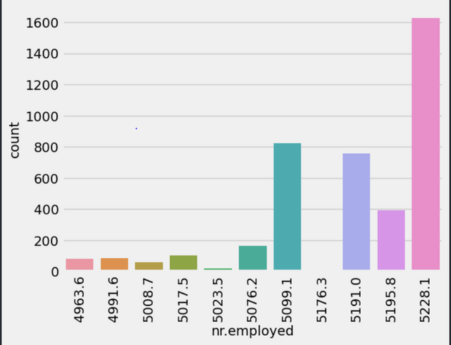
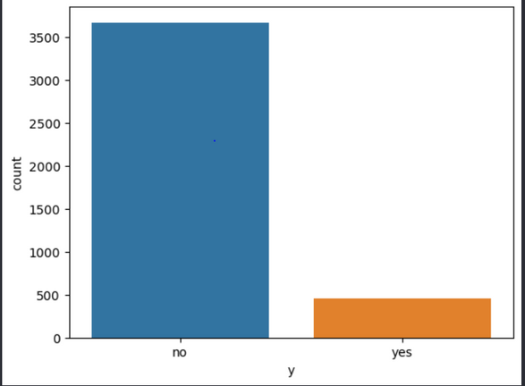
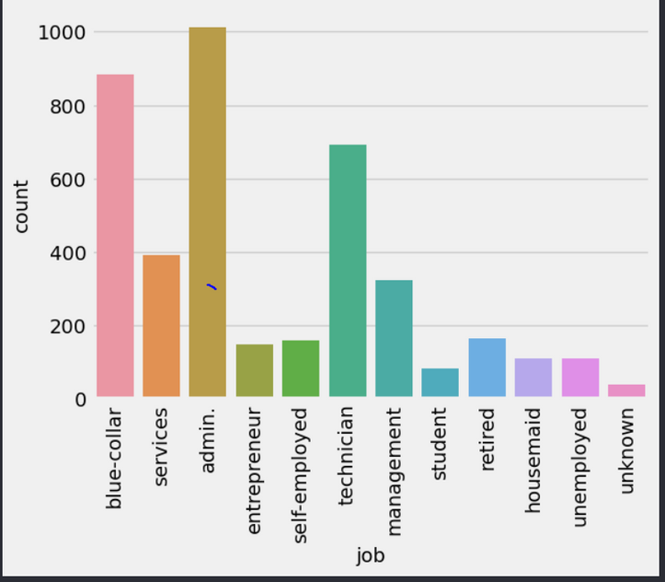
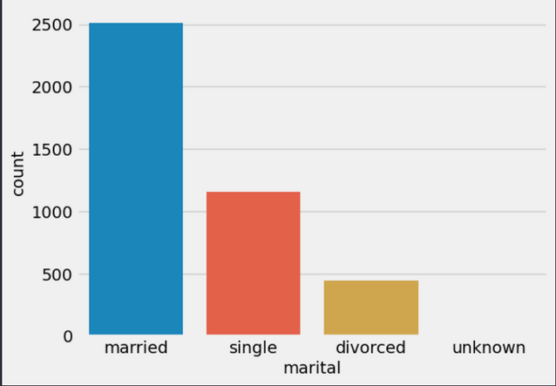
VISUALIZATION
Visualization helps us have a better and more intuitive grasp on how the data behaves, and how they interact with each other. It can help us understand if there are any missing values or inconsistencies

Slide 4

Preprocessing
DATA CLEANING, DATA ENCODING AND SCALING
Encoding | Scaling | Used Pipeline to apply
Ordinal encoding for variables with ordered categories, one-hot encoding for variables without an order. | Standard scaling and min-max scaling for numerical variables are used | These methods are implemented with the pipeline.

Slide 5

Feature Selection
Manually doing so was not the best option.
Scikit Learn’s SelectFromModel algorithm.
Additionally, regularization has been applied to some of our experimented models.
Model Selection
3 different models Scikit Learn’s SelectFromModel algorithm.
After finding the best model, hyperparameter tuning applied.

Slide 6

Evaluation
After finding the best model, hyperparameter tuning applied.
Accuracy: 0.9085760517799353,
Precision: 0.6125,
F1 Score: 0.46445497630331756
Confusion Matrix:
[[1074 31]
[ 82 49]].

Slide 7
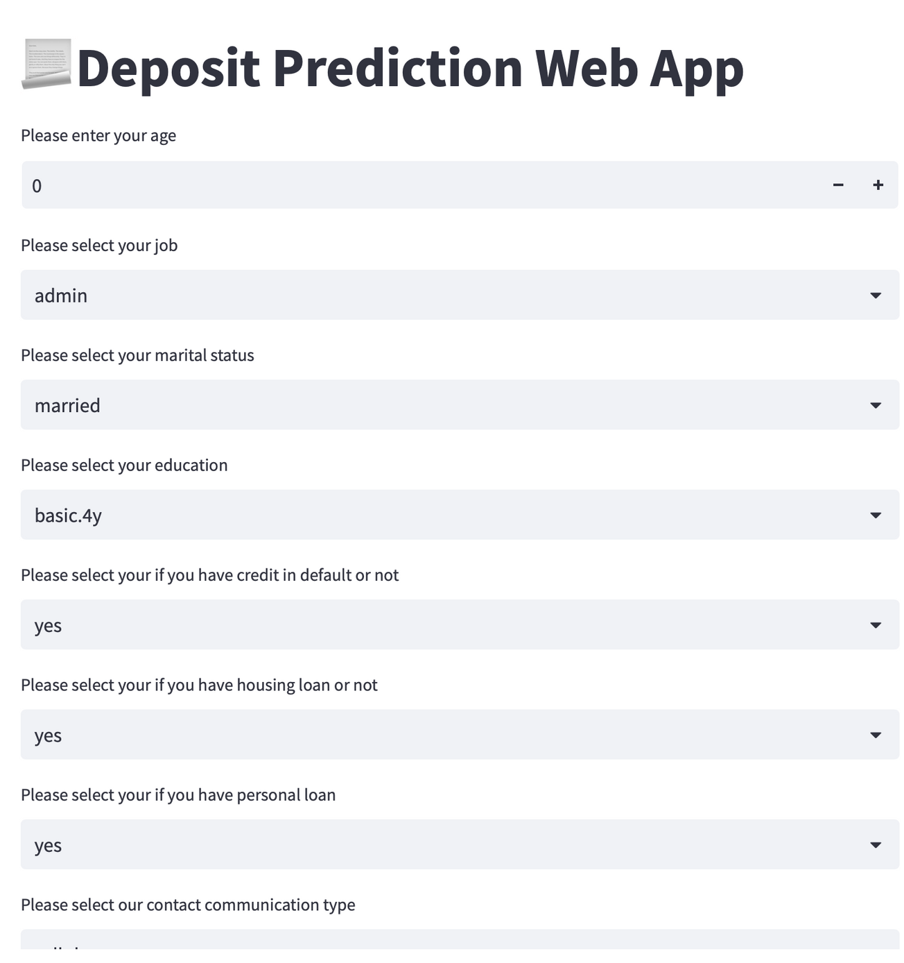
Conclusion
In this project, we developed a web application that predicts, whether a given person subscribes to a term deposit or not, with the help of machine learning

