Slide 1

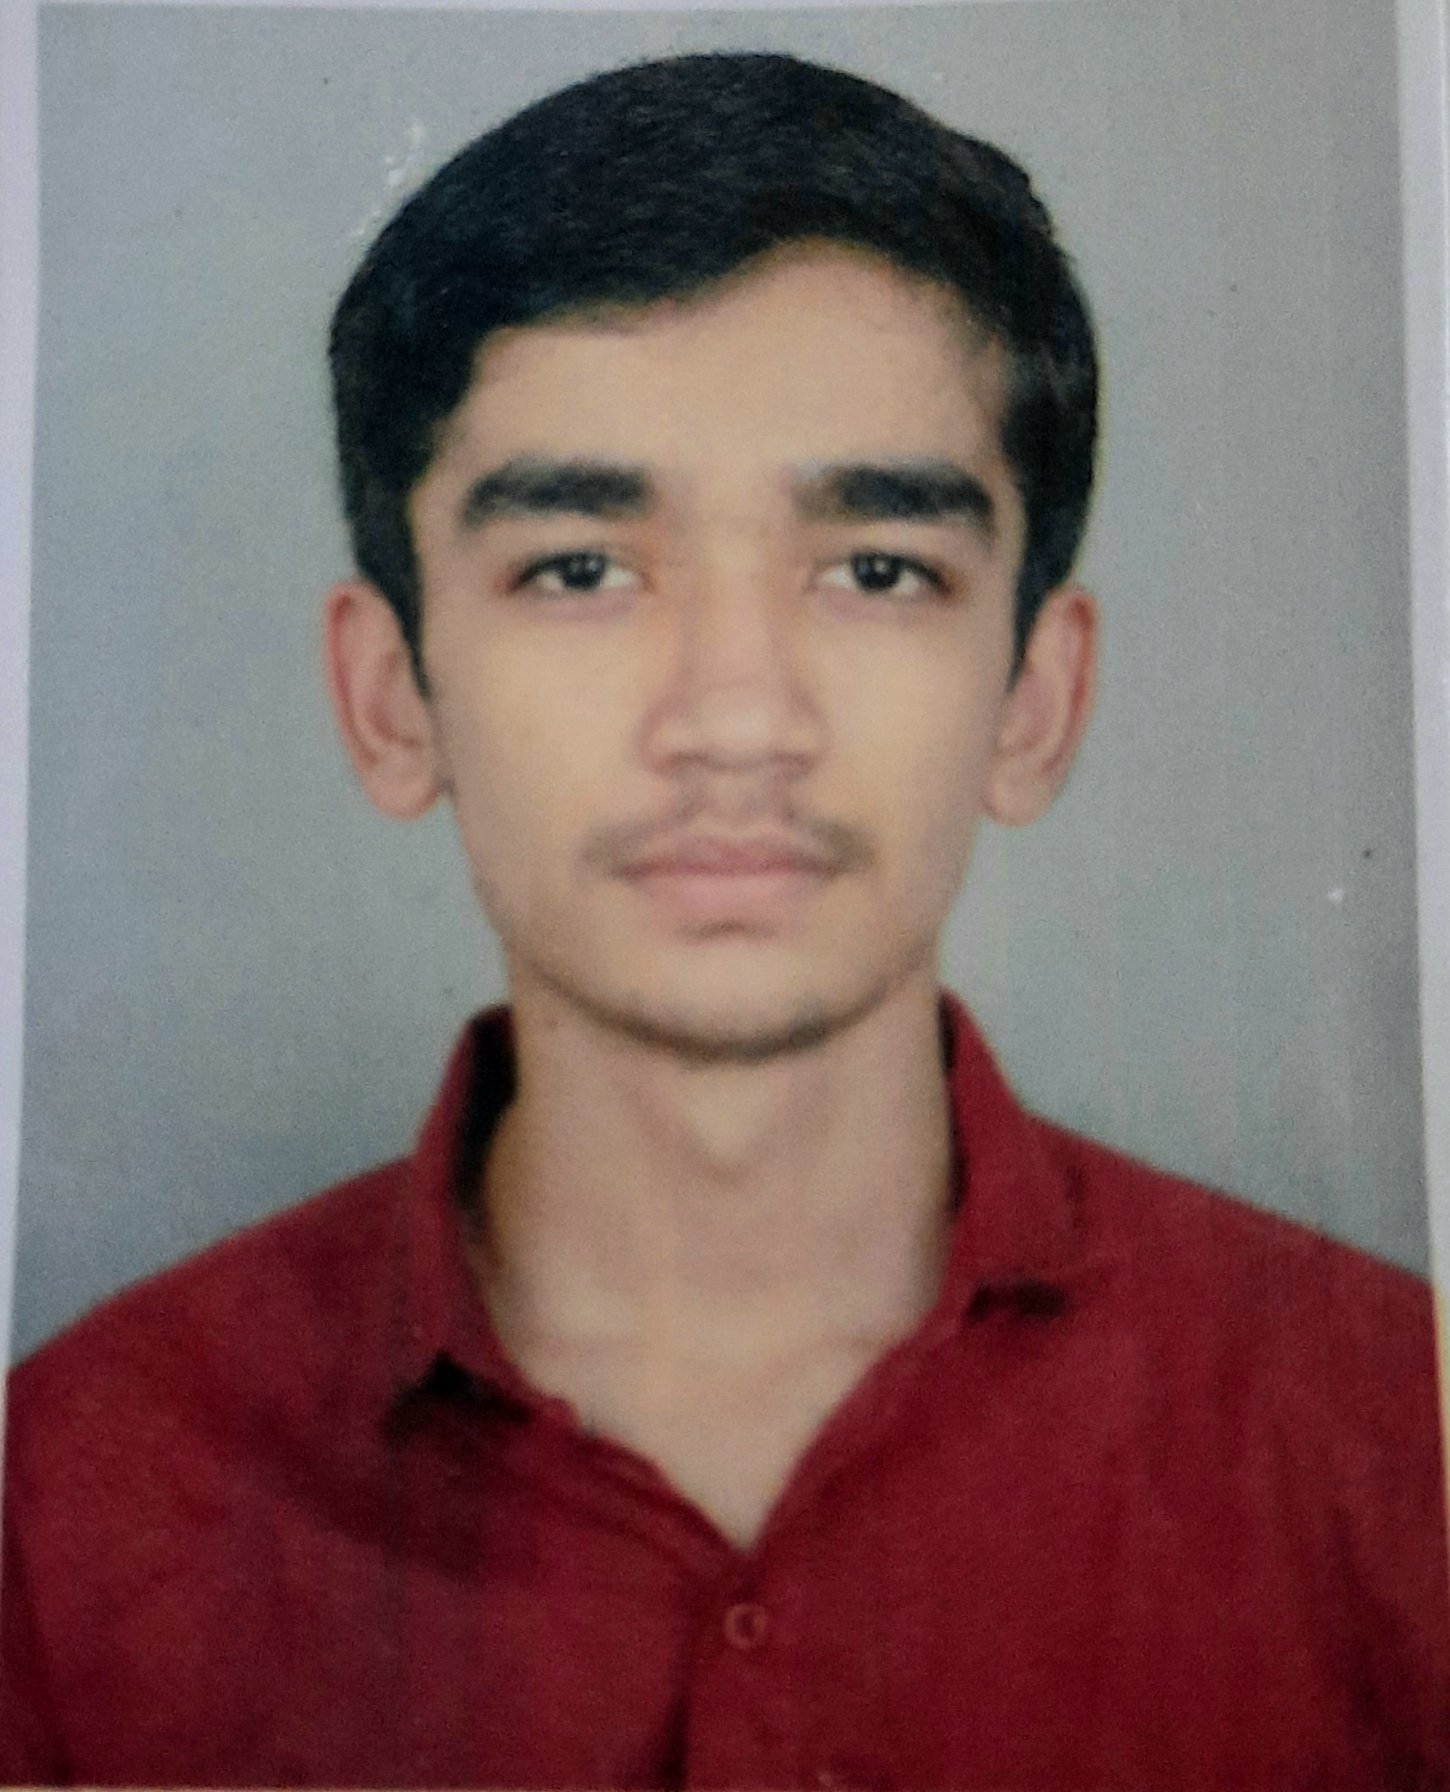
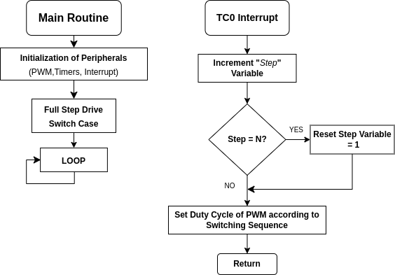
ARM Cortex-M7 Microcontroller based Stepper Motor Controller
SRTD-RTCG-MISA
Name: Daksh Kakadia
Designation: Research Intern
Institution: V.V.P. Engineering College (GTU)
Guide: SRI. MOHAMMAD WARIS
Contact e-mail: waris@sac.isro.gov.in
PHOTO
MAJOR OBJECTIVES:
Understanding and Initializing peripherals of Microcontroller in Software environment using Microchip’s MPLAB IDE, XC32 and Harmony v3 Framework/Configurator.
Integration of ARM Cortex-M7 Microcontroller and Microsemi Motor driver.
Implement Full Stepping and Half Stepping of Stepper motor.
01 Aug 2023 to
31 Oct 2023
METHODOLOGY FLOW CHART:
Full Stepping : N = 4
Half Stepping : N = 8
RESULTS/MAJOR FINDINGS:
1)Full Stepping
2)Half Stepping
CONCLUSION:
This project has provided valuable insights into stepper motor control through full-stepping and half-stepping methods with an ARM microcontroller. Compared with the full step drive, the motor’s step angle resolution is doubled, and the motor runs more smoothly and quietly.

