Slide 1
User level threading
  Student: Damaskinakis Kostas
Trying some ideas from the paper:
“User-level Threading: Have Your Cake and Eat It Too”

Slide 2
Ideas Of The Paper
Thread-per-session runtime implementation:
Non-preemptive execution context (user-level threads)
M:N Thread per session server with event polling
Scheduling mechanisms for user_threads pool
User-level I/O blocking management

Slide 3
What Was Actually Implemented
1) A server with M pthreads each holding its owning an epoll queue
2) A server with M pthreads each owning an epoll queue and a queue of u_threads one per connection (or session)

Slide 4
Implementation Difference
Pthread server:
Main loop accepts connections and distributes work
Each worker polls its queue and handles the requests
“Uthread” server
Main loop accepts connections and distributes work
Each worker polls its queue and creates a uthread for each connection
Requests are then server by context switching to uthreads

Slide 5
Benchmarks
Servers were tested using wrk benchmark with:
4 threads
1000 client connections per thread
15 seconds duration
To test the servers under:
IO heavy workload
Not so IO heavy workload

Slide 6
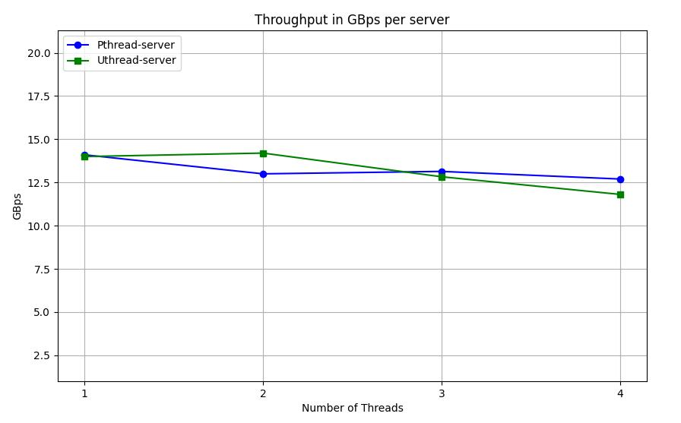
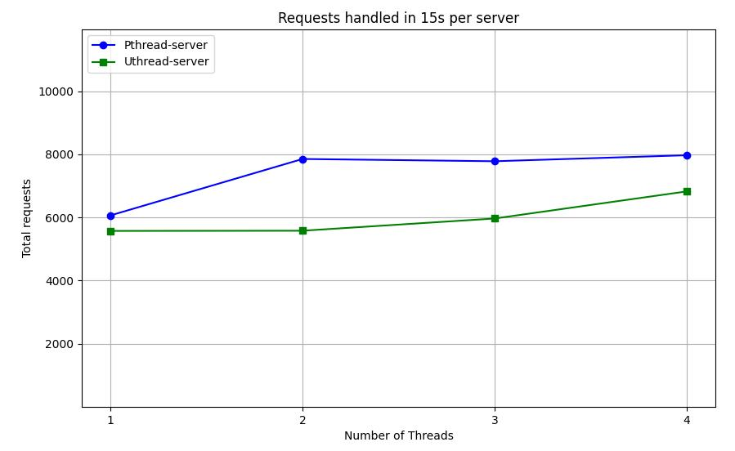
IO Heavy Benchmark

Slide 7
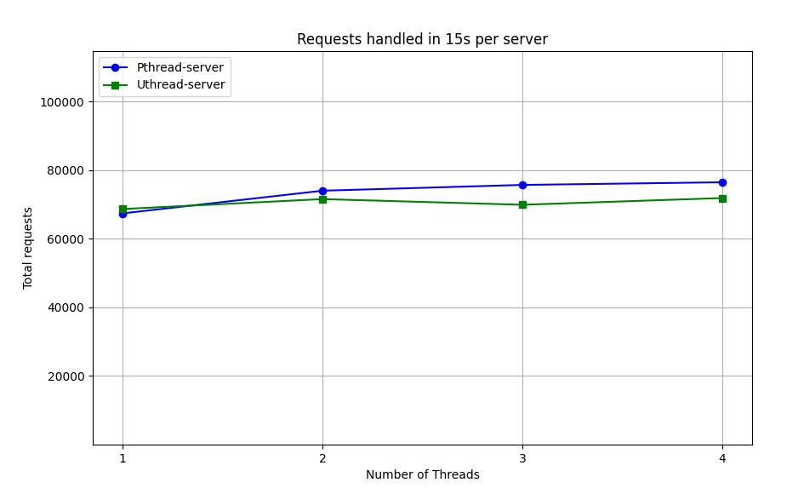
Non IO Heavy Benchmark

Slide 8
End
Thanks for your time

