Slide 1
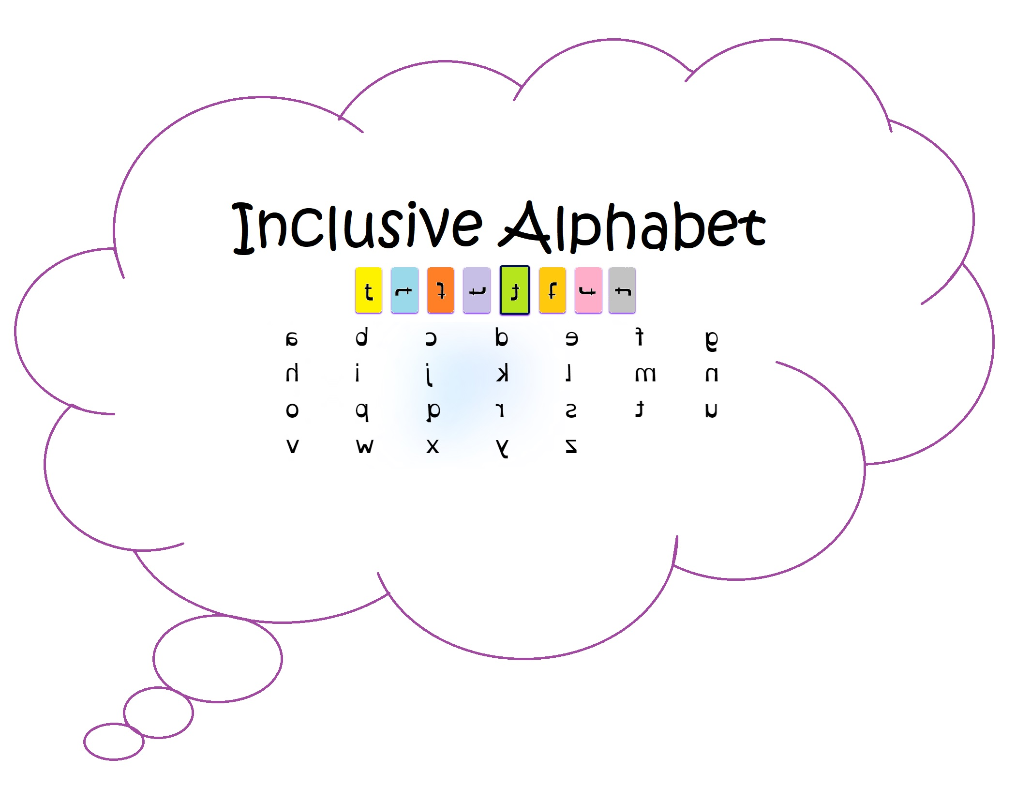
Inclusive Alphabet Team Karen Petersen Donald Mains Annelise Blanchard Scott Hansford
Notes:
Karen

Slide 2
Project Objectives
Dyslexic people see ANS differently than most people. Our team project is to provide a way for people with dyslexia to create their own "language" and be able to translate it to and from the English language that is seen by people without dyslexia. The intent is to build one or more dyslexic database tables of font sets and words that can be used in the future to help dyslexic users read and write in English on their own terms, thereby including them as the individuals they are by accepting how they see characters.
The project will provide a website that allows a user to create a personalized font set of English ANS as each user sees them, hence creating one or more new dyslexic “languages”.
The user will create their own unique font dataset of each ANS by selecting from pre-set ANS options provided.
Notes:
Karen

Slide 3
Project Objectives continued …
Next Steps … Continue working on the website functionality throughout the summer
A voice prompt will prompt the user to select an image for the ANS character displayed to help the user understand what is being requested of them, in case they can’t easily read the visual prompts.
Once a user font set is created, it can be set as the default font set to be used when reading and writing .
The user will be able to turn on/off an option to view the generally accepted view of an English ANS set under their font set so they can see the differences or similarities.
Add, modify, delete, read files in the user’s default font set
The user will be able to create a dictionary/encyclopedia of words in their unique font set, with a definition and image.
Add, update and delete options will be provided for the font set and the dictionary database tables.
Display a user keyboard on a touch screen device
Dyslexic related educational links
Statistics on web site usage
User Blog
Allow the user to create their own font set by creating their own characters (versus using the options provided)
Note: ANS = Alpha-Numeric/Special character set
Notes:
Karen

Slide 4
Individual Objectives
Annelise
Gain a more in depth knowledge of specifically Node.js, React, and the overall language of JavaScript.
Become more comfortable with the process of producing a single project with contributions from a team of multiple people.
Produce a full website with functionality in the front and back end.
Donald
· Gain a more in-depth knowledge of Node.js, React, JavaScript including asynch functions, router paths and VSCode extensions · Integrating AWS services into a project with RDS and Amplify · Increased fluency with Github as a project management tool and means of sharing code among multiple team members · Produce a full website with functionality in the front and back end.
Karen
Create technological functionality that may provide a positive impact and provide a method of inclusiveness/adaptation/acceptance as they are, to a group of people where there is none today.
Learn more about how hardware, operating system, and applications work together/correlate with each other by understanding how what is typed into a keyboard key ends up on a screen or in a file, and how it is used by the operating system and an application.
Improve my software development skills by effectively utilizing current software development tools.
Improve team building skills
Notes:
Annelise
Donald
Karen

Slide 5
What Changed?
UI Design
Individual ANS Images to Font Set
EC2/S3 to Amplify?
Number of Team Members
Scaled down initial version of the website - many features changed to stretch goals that will be worked on over summer quarter
Notes:
Annelise

Slide 6
Growth
New and Improved Skills
Creating SVG files / Font sets
Adobe Illustrator
AWS: Amplify
MySQL and AWS RDS
Lambda
API Gateway
React
Typescript
Javascript
Interpersonal / client skill Development
Team Stand Ups / Working as a team
Working with Special Needs teacher
Notes:
Annelise

Slide 7
IMPACT
Result
Website in progress
Future Impact
New tool to help dyslexic people to more easily learn to read and write English on their own terms, hopefully reducing their stress and frustration.
This can then be used in their daily lives by providing a way to read and write in a font set that displays the characters as their eyes interpret each character, hopefully making it easier for them to learn, and read and write in English. As an example, a student given an assignment, they could download the file, translate to their fontset, open and view the assignment in a font set that they can read, as well as the typical human fontset.
Helping teachers to see and understand how each individual dyslexic person sees each ANS character, learning to accept those differences hopefully gaining more patience when teaching dyslexic people.
Potential for future use in foreign languages for dyslexic people
Job/Job Search Impact
Having a completed project that may have a (significantly) positive impact on society to demonstrate to potential employers
Notes:
Annelise

Slide 8
Demo
Continuing slides are backup for online demo issues…
Notes:
Donald
Re-address objectives, growth, and impact during demo

Slide 9
Most Currently developed UI …

Slide 10
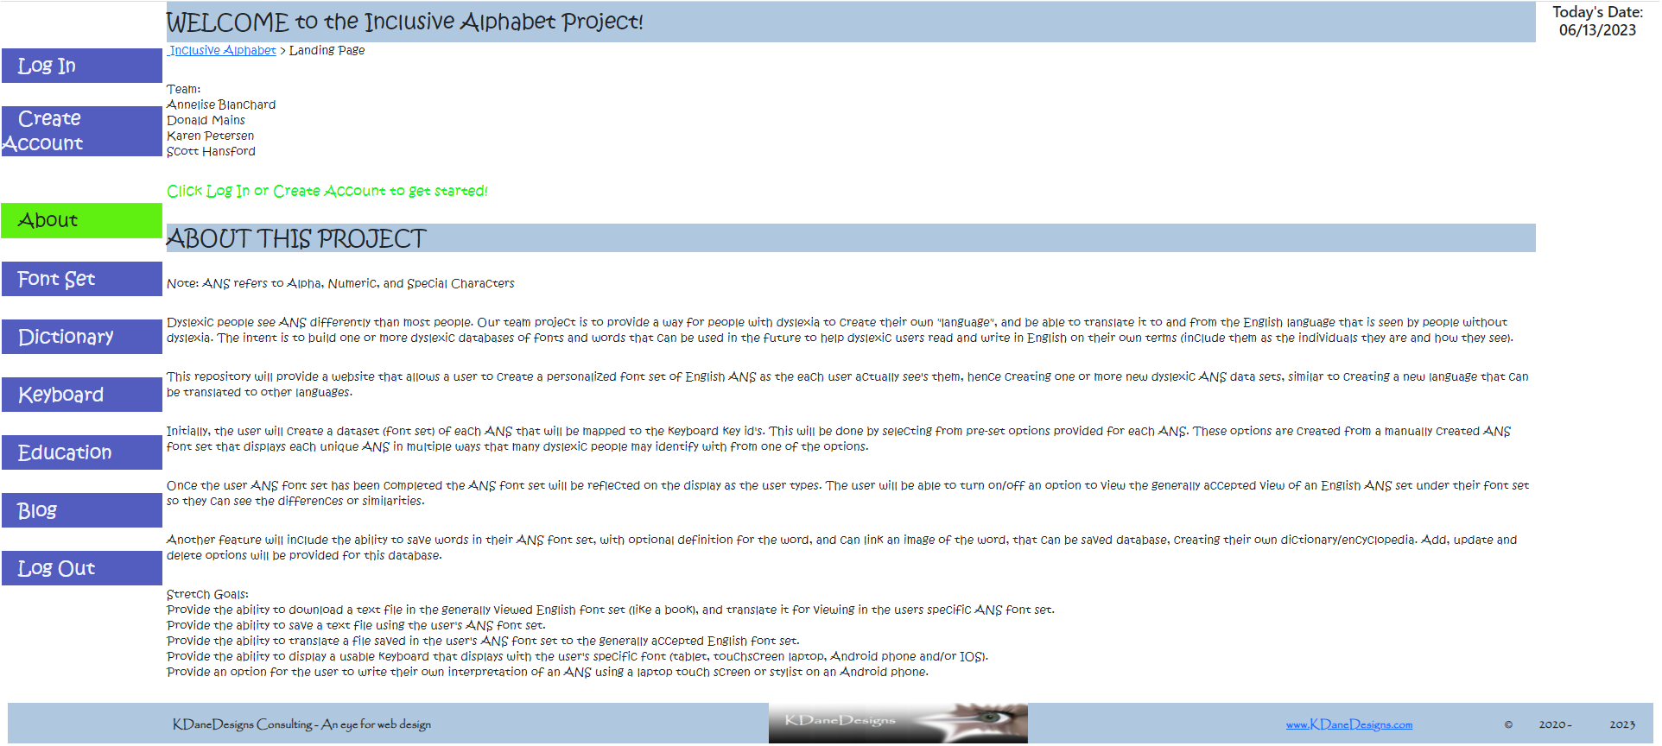
Home Page

Slide 11
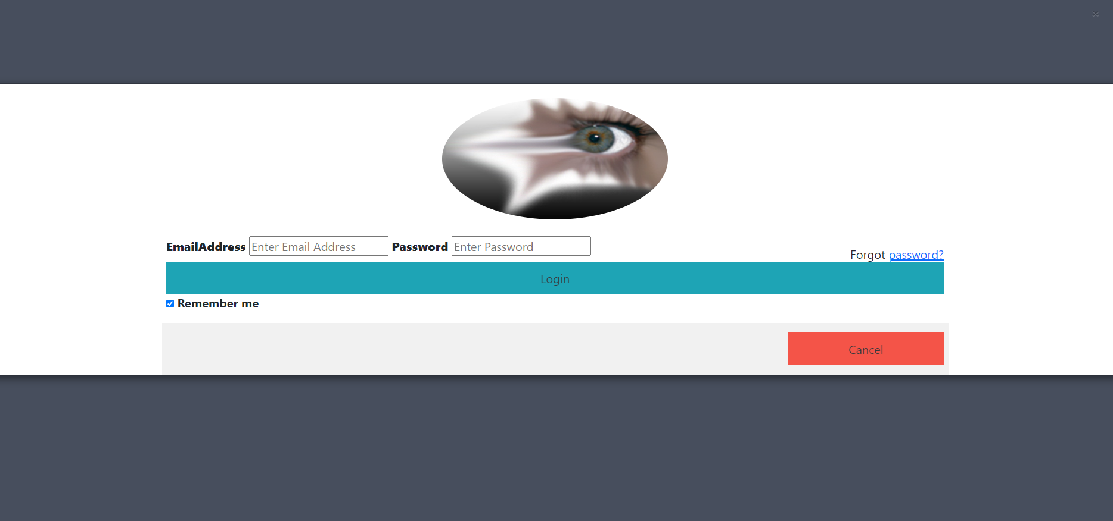
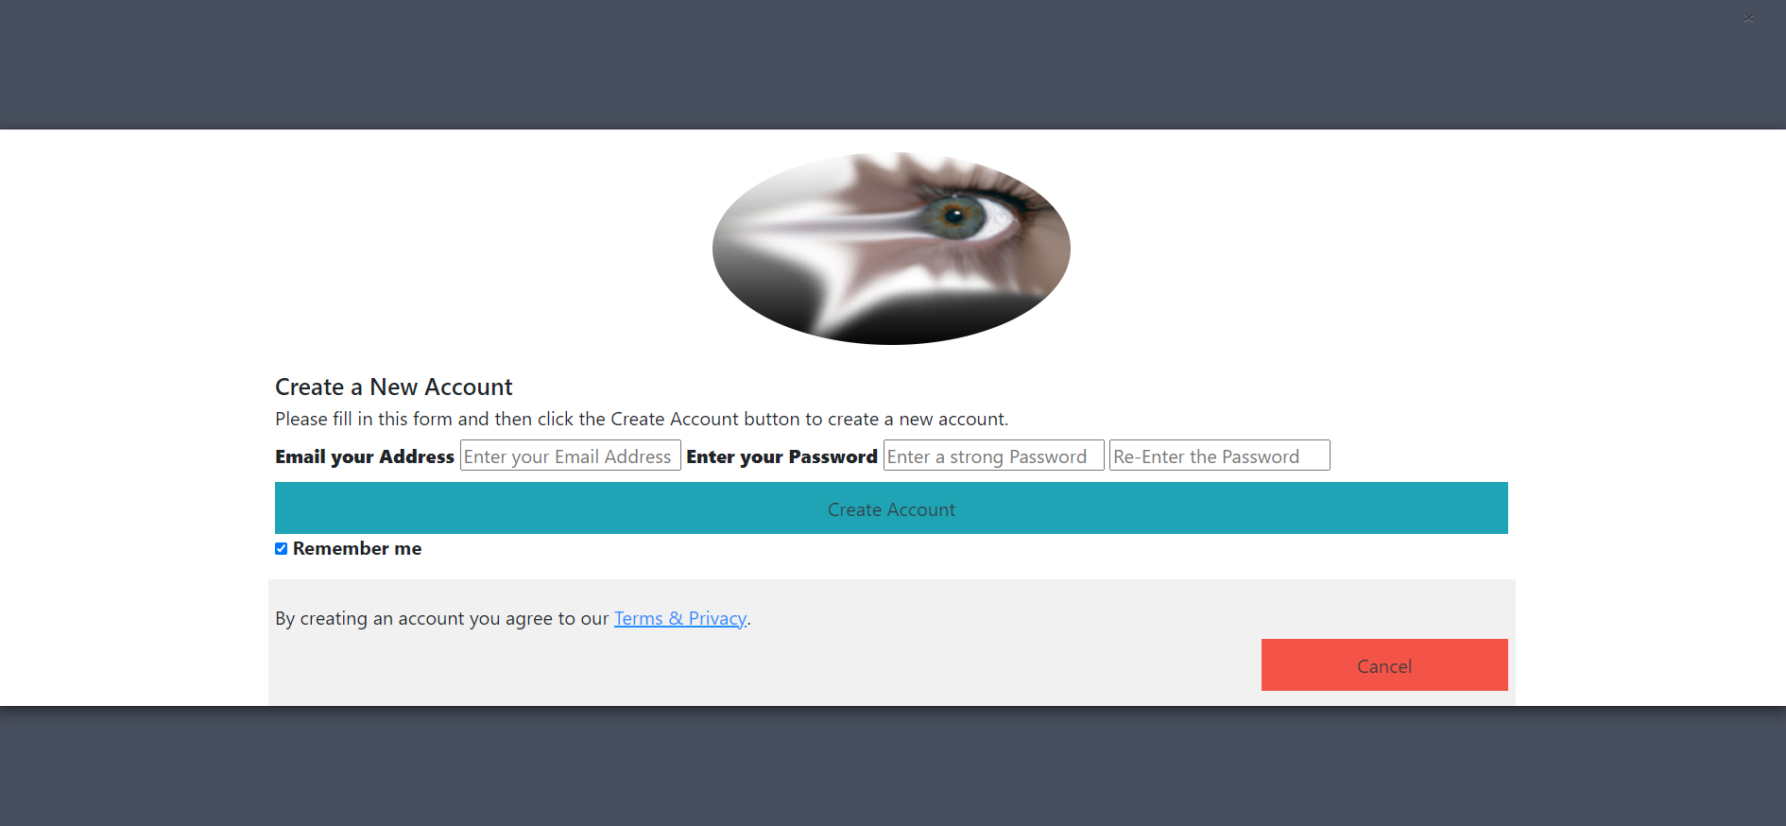
Log In
Create Account

Slide 12
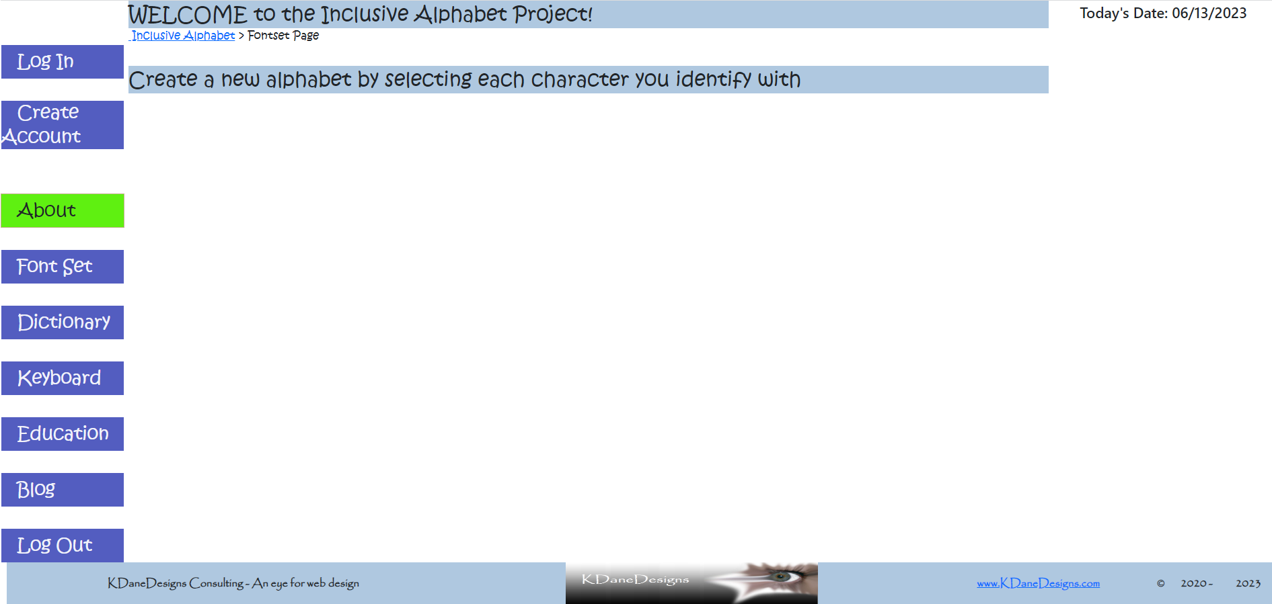
Fontset Creation

Slide 13
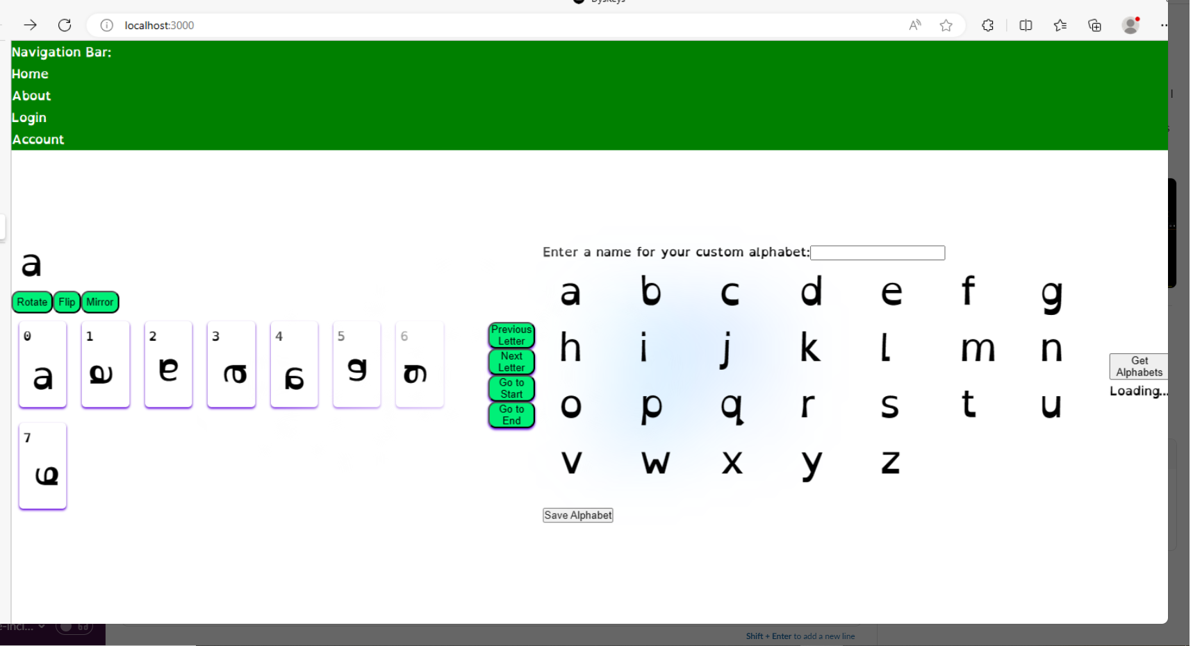
Fontset Creation Functionality

Slide 14

Dictionary

Slide 15
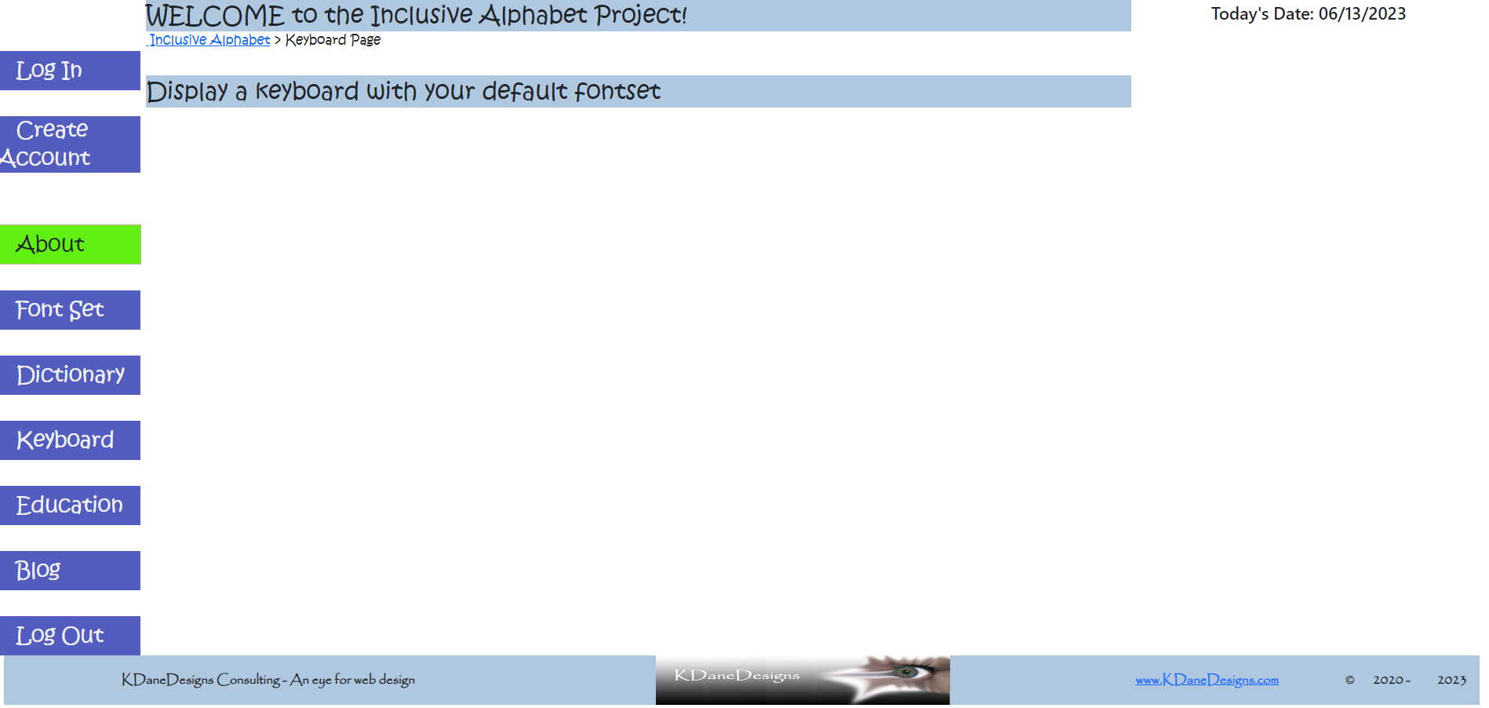
Keyboard

Slide 16
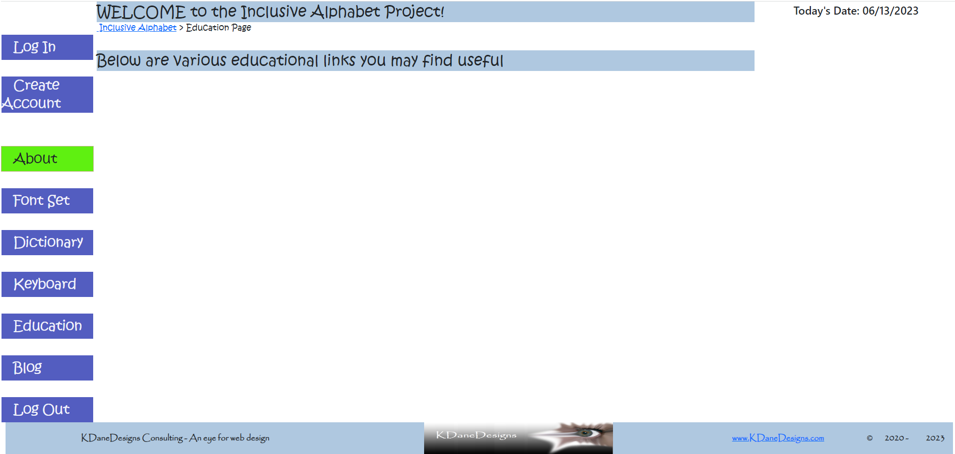
Education

Slide 17
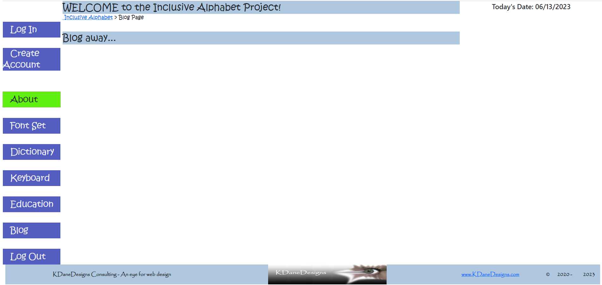
Blog

Slide 18
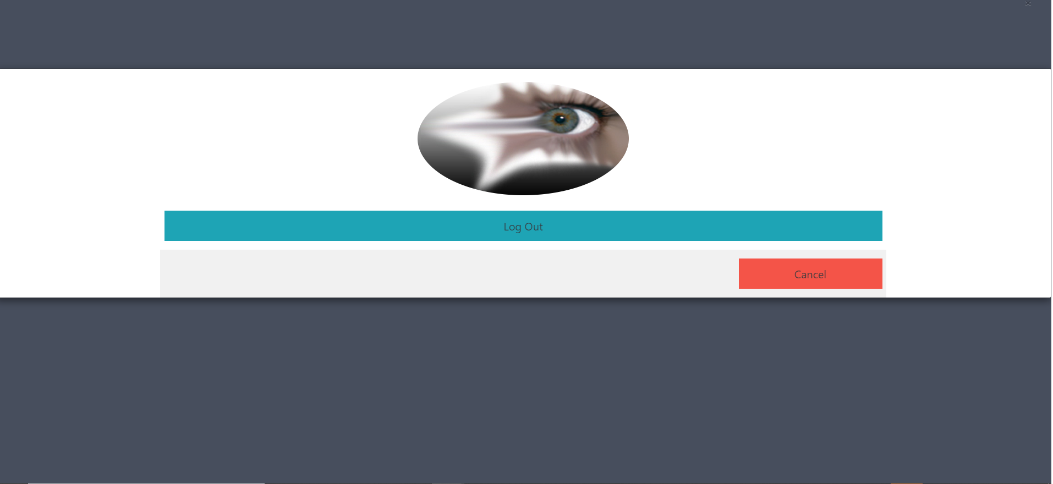
Log Out

Slide 19
Original UI Flow ……

Slide 20
Login or Create Account

Slide 21
Login or Create Account

Slide 22
Home Page

Slide 23
Menu Options

Slide 24
Fontset - Create
When the lower case a is selected, change the color of it to a bright color and put a shape around it.
When the Save lower case a button is selected, save the lower case a to the database table(s), linking the user login id, lower case a, and the image selected and it’s rotation value, the version number of the font set (if there is more than one font set for the user, use the next version number), and then the next character is automatically displayed for creating.
Once two or more characters are created, a back button displays on the bottom of the screen.
Error Handling – If the user doesn’t save the character before selecting next, back, or a new character from the drop down menus, AND the character option has been selected, a pop up displays asking if the user wants to save the character. If yes, the character is saved to the existing font set version, a message displays for 5 seconds that the character was successfully saved, and the next character is displayed for selection. If the user selects back, the previous character screen displays with their selection. If the user has not selected an option, the next button is greyed out until a character selection is made.

Slide 25
Font Set - Modify
When modify font set is selected from the menu, the user’s font set is retrieved from the database, and the user’s font is displayed starting with lower case a’s, with the option that the user had selected being highlighted. The user may then change the selection and resave the image. When Save is clicked, a message displays saying the character was successfully saved displays for 10 seconds
Next and Back buttons are displayed as appropriate (at first character, only next button, at last character, only back button, at all other characters, next and back buttons are displayed.)
Drop down menus are displayed for allowing the user to select the exact character to modify so the user doesn’t have to scroll through every character case. Drop downs are categorized by lower case letter, upper case letter, number, or special character.
Images displayed in drop down menu are the images of the font set that the user created (their dyslexic font set).
Error Handling – If the user doesn’t save the character before selecting next, back, or a new character from the drop down menus, AND the character option has been changed, a pop up displays asking if the user wants to save the character. If yes, the character is saved to the existing font set version, replacing the previous character saved, and a message displays for 5 seconds that the character was successfully saved.

Slide 26
Font Set - Delete
When Delete menu option is selected, a drop down box is displayed asking the user to select a font set to delete. No default font set is selected. Once a font set is selected, a pop up box displays asking the user to confirm deletion of their font set. If yes, the entire font set version is deleted for the user, the font set version name is removed from the drop down box, and a message displays for 5 seconds that the font set was deleted successfully.
Error Handling – if there is no font set to delete, a message displays saying there are no font sets to delete.

Slide 27
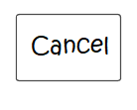
Font Set – Default
When the English and Dyslexic Font sets are selected and saved, these are the font sets used to display Dyslexic and English font sets on the screen, and the Dyslexic font set is mapped to the keyboard keys.
Error Handling – if there is no Dyslexic font set to select, a message displays saying that there are no Dyslexic font sets created for this user, and to create a font set.
If they don’t select a default for either option, a message displays saying please select a default font set value for the missing value. The user may save or cancel setting default font sets.

Slide 28
File - Create
The user can select to just view what they’re typing in their own font set, or View Only a typical English font set as well to compare their font set with an established English font set. When the file is saved, it is saved in the user’s dyslexic font set.
If the View English and Dyslexic Fonts box is checked, when scrolling from either box, the scrolling should be in sync with each box.
Error Handling – if there is no Dyslexic font set to select, a message displays saying that there are not any Dyslexic font sets created for this user, and to create a font set.
Error Handling - If no default English font set has been saved for the user, the default English Font Set is Kristen ITC.

Slide 29
File - Modify
Provide a drop down of the user’s files. If no files, user can just start typing and create a file. Once user selects a file the dropdown closes, exposing the filename created, and the user can scroll through and modify the file, and then save. If the View English and Dyslexic Fonts box is checked, when scrolling from either box, the scrolling should be in sync with each box.
Error Handling – if the user selects a different file name to modify, a pop up displays asking the user if they want to save the changes to existing file. If no, no changes are saved, if yes, changes are saved, and the new file selected is displayed. If they have the view English and Dyslexic fonts checked, both font sets are displayed, else just the Dyslexic font set is displayed.
Stretch goals – add capability of undoing changes before saving. Add capability to save as a new file name.

Slide 30
File - Delete
User selects a file to delete from the drop down list. User must confirm delete or cancel. If deleted, the file is deleted from the database and the drop down list, and a message displays confirming deletion was successful (if it was actually successful) for 5 seconds .

Slide 31
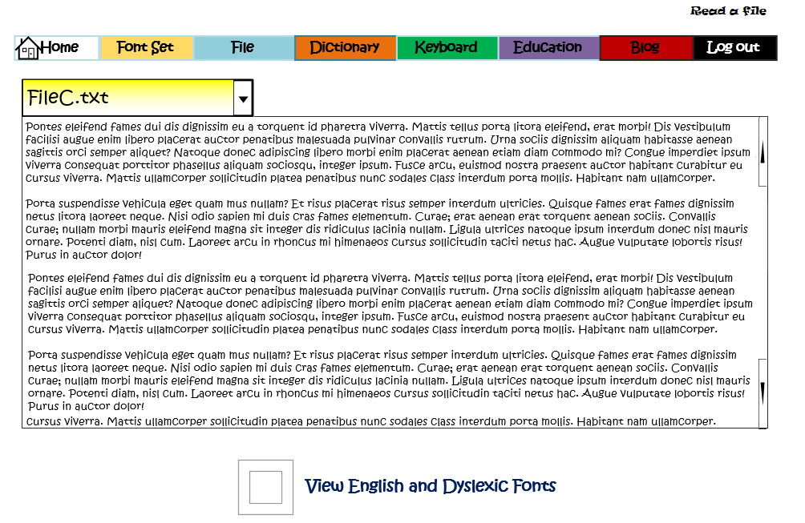
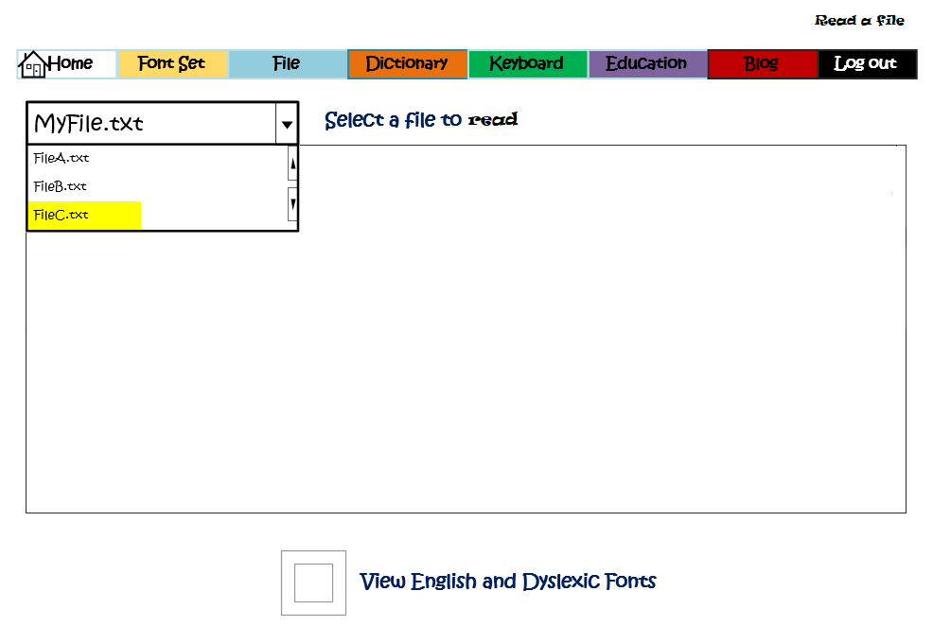
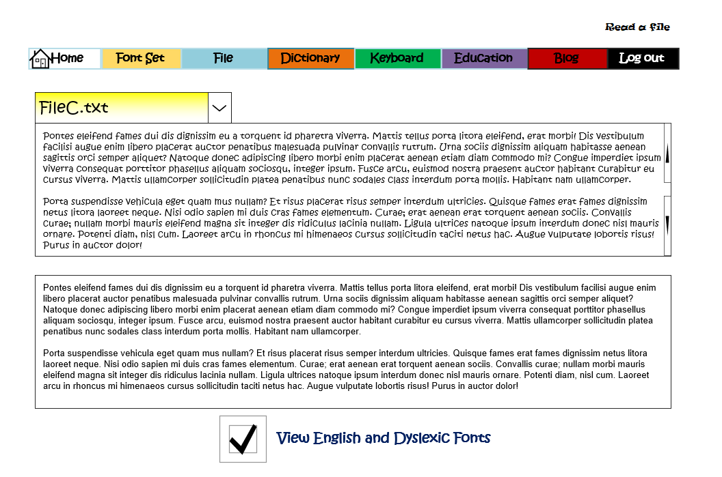
File - Read
User selects a file to read from the file menu on their laptop/PC/tablet, or from dragging and dropping a file into the file window (like in Canvas when you’re adding a file to be uploaded for homework).
They select open file, and the file opens using the user’s default dyslexic font set. There is an option to view the file in the default typical English font set an addition to the user’s dyslexic font set. If selected, the file text is displayed in both font sets.
The file can be saved in the user’s font set, or in the typical English font set, or both. When saving the file, it should save to the user’s local drive or personal cloud space (not the database) – Can we use the local OS file manager to save files? If yes, start with Windows, then Apple, then Linux.
An option to email the file is available (using default size limitation).
Error Handling:

Slide 32
Dictionary – Add Word Modify Word Delete Word
User types in a word to add to the dictionary. User may add an image that depicts the word. User must confirm addition or cancel. If added, the word (and image) are added to the database, and a message displays confirming addition was successful (if it was actually successful) for 5 seconds.
Error Handling – if the word already exists in the database, a message displays saying the word already exists, and do they want to update the word. If yes, any new content for the word, ( word, description, image) is updated for the word. If no, the existing word and it’s associated data are not updated. A confirmation message displays confirming update or no update successful for 5 seconds.
The user may search for an existing word, and modify the word, description and/or image.
Error Handling - If the word spelling is changed, a prompt displays asking if the user wants to add a new word or continue modifying the existing word. If add, add the word and confirm addition, if modify, modify the word and confirm the modification.
The user may search for an existing word, and delete the word and any associated image. Confirm the deletion of the word.
Keyboard – Display
User may display a keyboard on their touchscreen that displays their default font set.
Education - Links
Web page that contains a list of educational links related to Dyslexia.
Statistics
A list of statistics about the number of users, the number of font sets, the amount of times each font set has been utilized, the number of dictionary items, the number of times a dictionary item has been accessed.
Blog
A blog page for users to ask questions and submit comments.

Slide 33

Questions?
Notes:
TODO: Replace the artwork, if desired.

