Slide 1

Project Brief: Modern Web Application
A comprehensive overview of our latest digital product initiative

Slide 2

Project Overview
Core Objectives
Develop responsive, user-centric web platform
Integrate cutting-edge technologies
Ensure seamless cross-device experience
Deliver scalable, maintainable codebase

Slide 3

Technical Architecture
Frontend Framework
Backend Infrastructure
Responsive Design
React-based architecture with modern hooks and component patterns
Robust API integration with cloud-native solutions
Mobile-first approach ensuring optimal performance across devices

Slide 4

Design Principles
01
User-Centric Approach
Every design decision prioritises end-user experience and accessibility
02
Visual Consistency
Unified design system with reusable components and patterns
03
Performance Optimisation
Lightning-fast load times and smooth interactions throughout
04
Accessibility Standards
WCAG 2.1 compliant ensuring inclusive digital experiences

Slide 5

Development Timeline
1
Phase 1: Discovery
Requirements gathering, user research, technical feasibility assessment
2
Phase 2: Design
Wireframing, prototyping, design system creation, user testing
3
Phase 3: Development
Frontend implementation, backend integration, quality assurance
4
Phase 4: Launch
Final testing, deployment, monitoring, post-launch optimisation

Slide 6
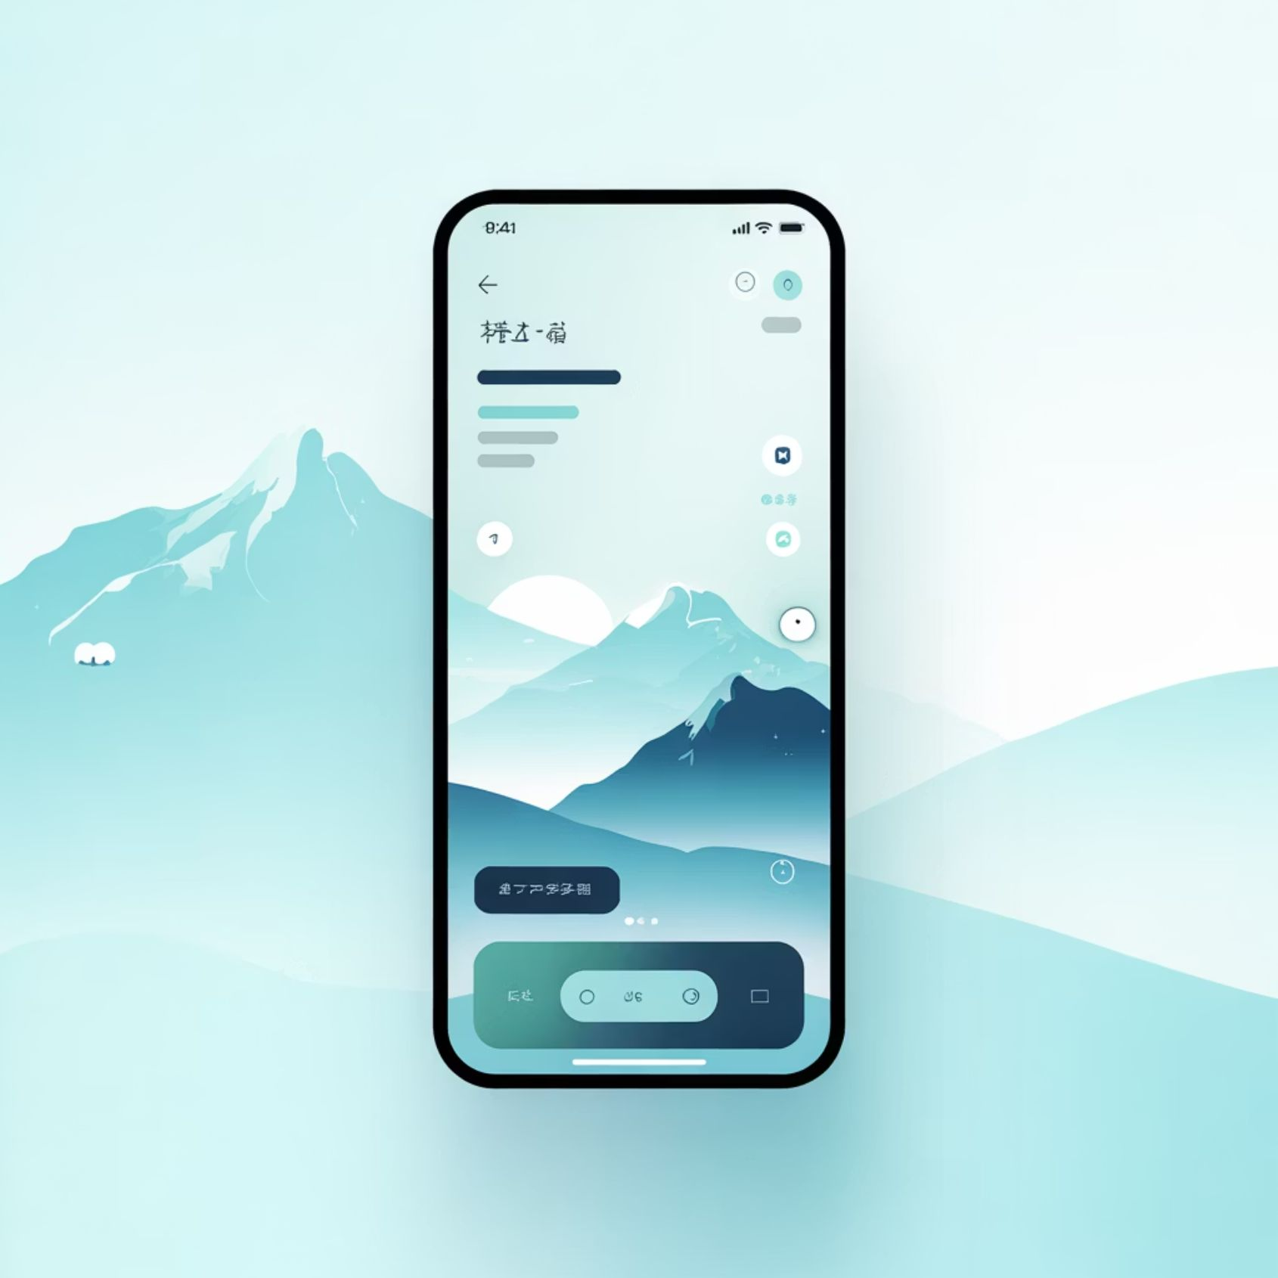
Key Features
1
Intuitive Navigation
Clear information architecture with logical user flows
2
Real-Time Updates
Dynamic content synchronisation across all touchpoints
3
Secure Authentication
Multi-factor authentication ensuring data protection

Slide 7
Technology Stack
JavaScript/TypeScript
Cloud Infrastructure
Type-safe development ensuring robust code quality and maintainability
Scalable hosting with automated deployment pipelines and monitoring
RESTful APIs
Security Protocols
Efficient data exchange with comprehensive documentation standards
Industry-standard encryption and compliance with data protection regulations

Slide 8

Success Metrics
95%
2s
99.9%
User Satisfaction
Load Time
Uptime
Target approval rating from initial user testing groups
Maximum page load time for optimal user experience
Guaranteed system availability and reliability standards

Slide 9

Team Collaboration
Cross-Functional Excellence
Designers
Crafting intuitive, visually compelling interfaces
Developers
Building robust, scalable technical solutions
Product Managers
Aligning vision with user needs and business goals
QA Specialists
Ensuring quality through rigorous testing protocols

Slide 10




Next Steps
Review & Feedback
Stakeholder alignment on project scope and deliverables
Kickoff Meeting
Finalise team roles, timelines, and communication protocols
Begin Development
Commence sprint planning and initial implementation phase
Let's build something extraordinary together

