Slide 1










Katherine Hurtado-da Silva | IST 652
Scripting for Data Analysis- Final Project
How are political affinities
influencing news reporting via
Twitter?

Slide 2









Data Description
According to AllSides Media Bias Chart, Fox News, BBC, and CNN are considered far-right, centrist, and far-left news outlets, respectively. Therefore, their twitter accounts were selected to compare news topics covered and their sentiment patterns.
The following steps were taken to gather the data needed for the analysis:
A query in the Snscrape code was used on each news outlet's twitter account to pull for the last 1,500 tweets and number of likes, between 2022-04-01 and 2022-06-05.
Tweets were changed to lower-case letters, lemmatized, and stripped of punctuation, hashtags, mentions, special characters, and stop words.
Research Questions
How did the reported topics for each news outlet differ?
How did negative, positive, and neutral tweets vary according to each news outlet?
What do the "like" counts for tweets indicate about each news outlet's audience?

Slide 3








Methodology
K-means Clustering was used to identify each news outlet's topic coverage, where Elbow & Silhouette plots determined optimal number of clusters
Sentiment Analysis Labels
Sentiment Analysis via TextBlob (polarity and subjectivity scores) was used to see how negative, positive, and neutral comments varied according to each news outlet.
if sentiment score >= 0.05 : sentiment label was 'Positive' if sentiment score <= -0.05: sentiment label was 'Negative' if -0.05 <sentiment score<0.05: sentiment label was 'Neutral' if subjectivity score >= 0.6 : subjectivity label was 'Highly Subjective' if subjectivity score <= 0.4 : subjectivity label was 'Objective' if 0.4 < subjectivity score <0.6: subjectivity label was 'Subjective'
Box plots of tweet likes, grouped by sentiment/subjectivity, were used to see how like counts vary.

Slide 4


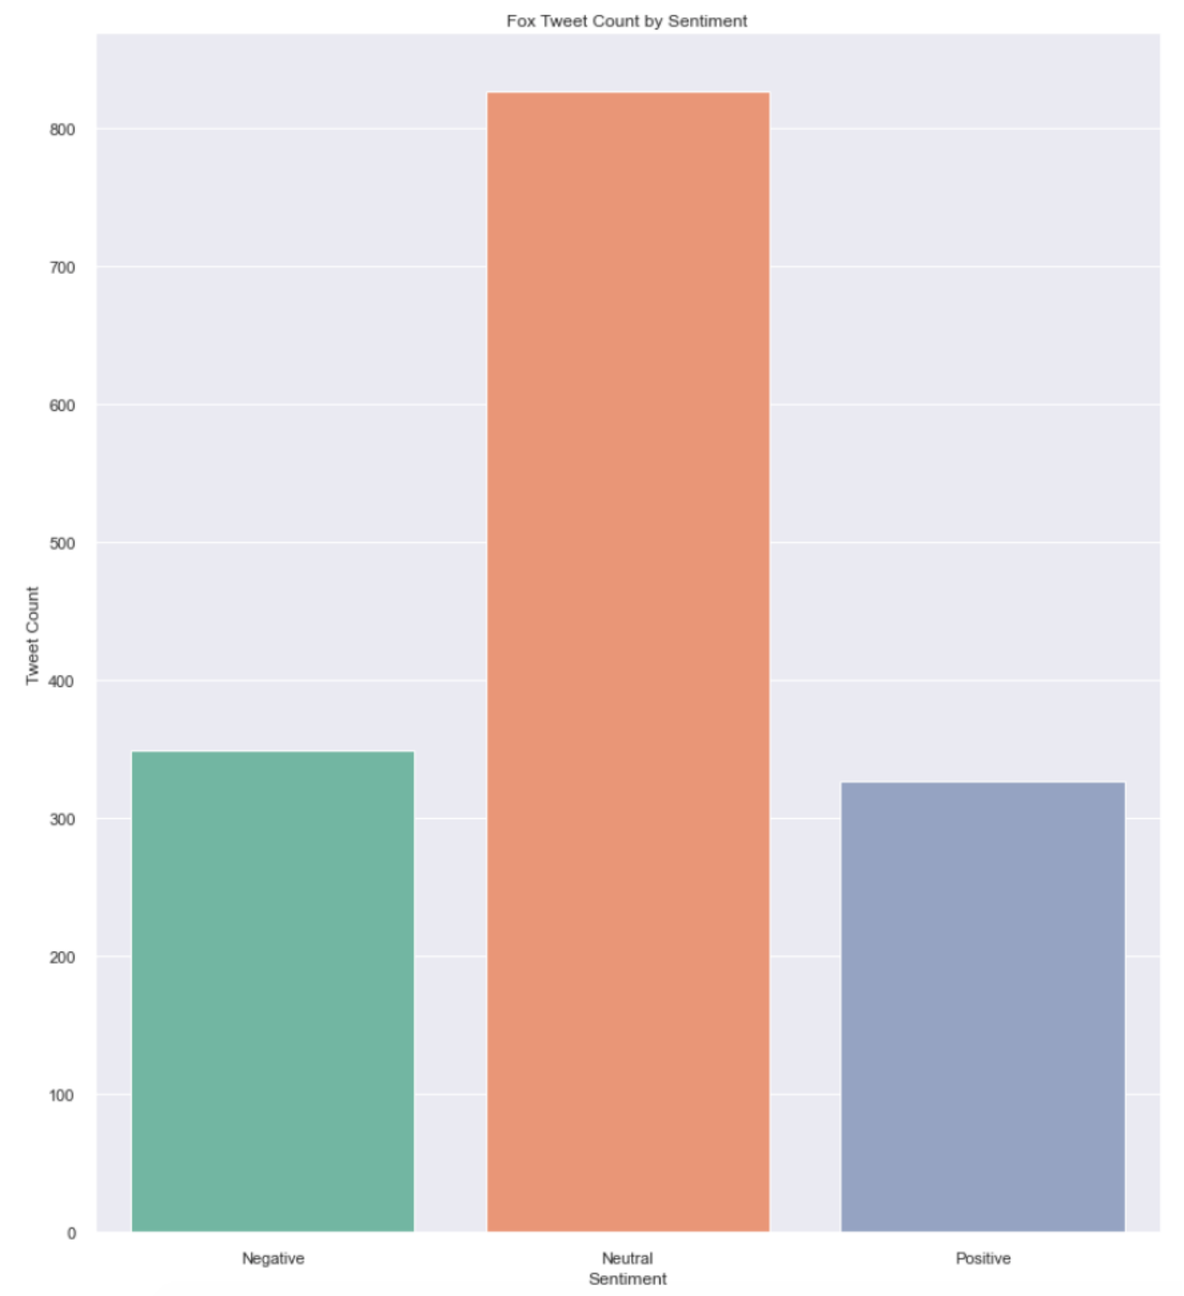
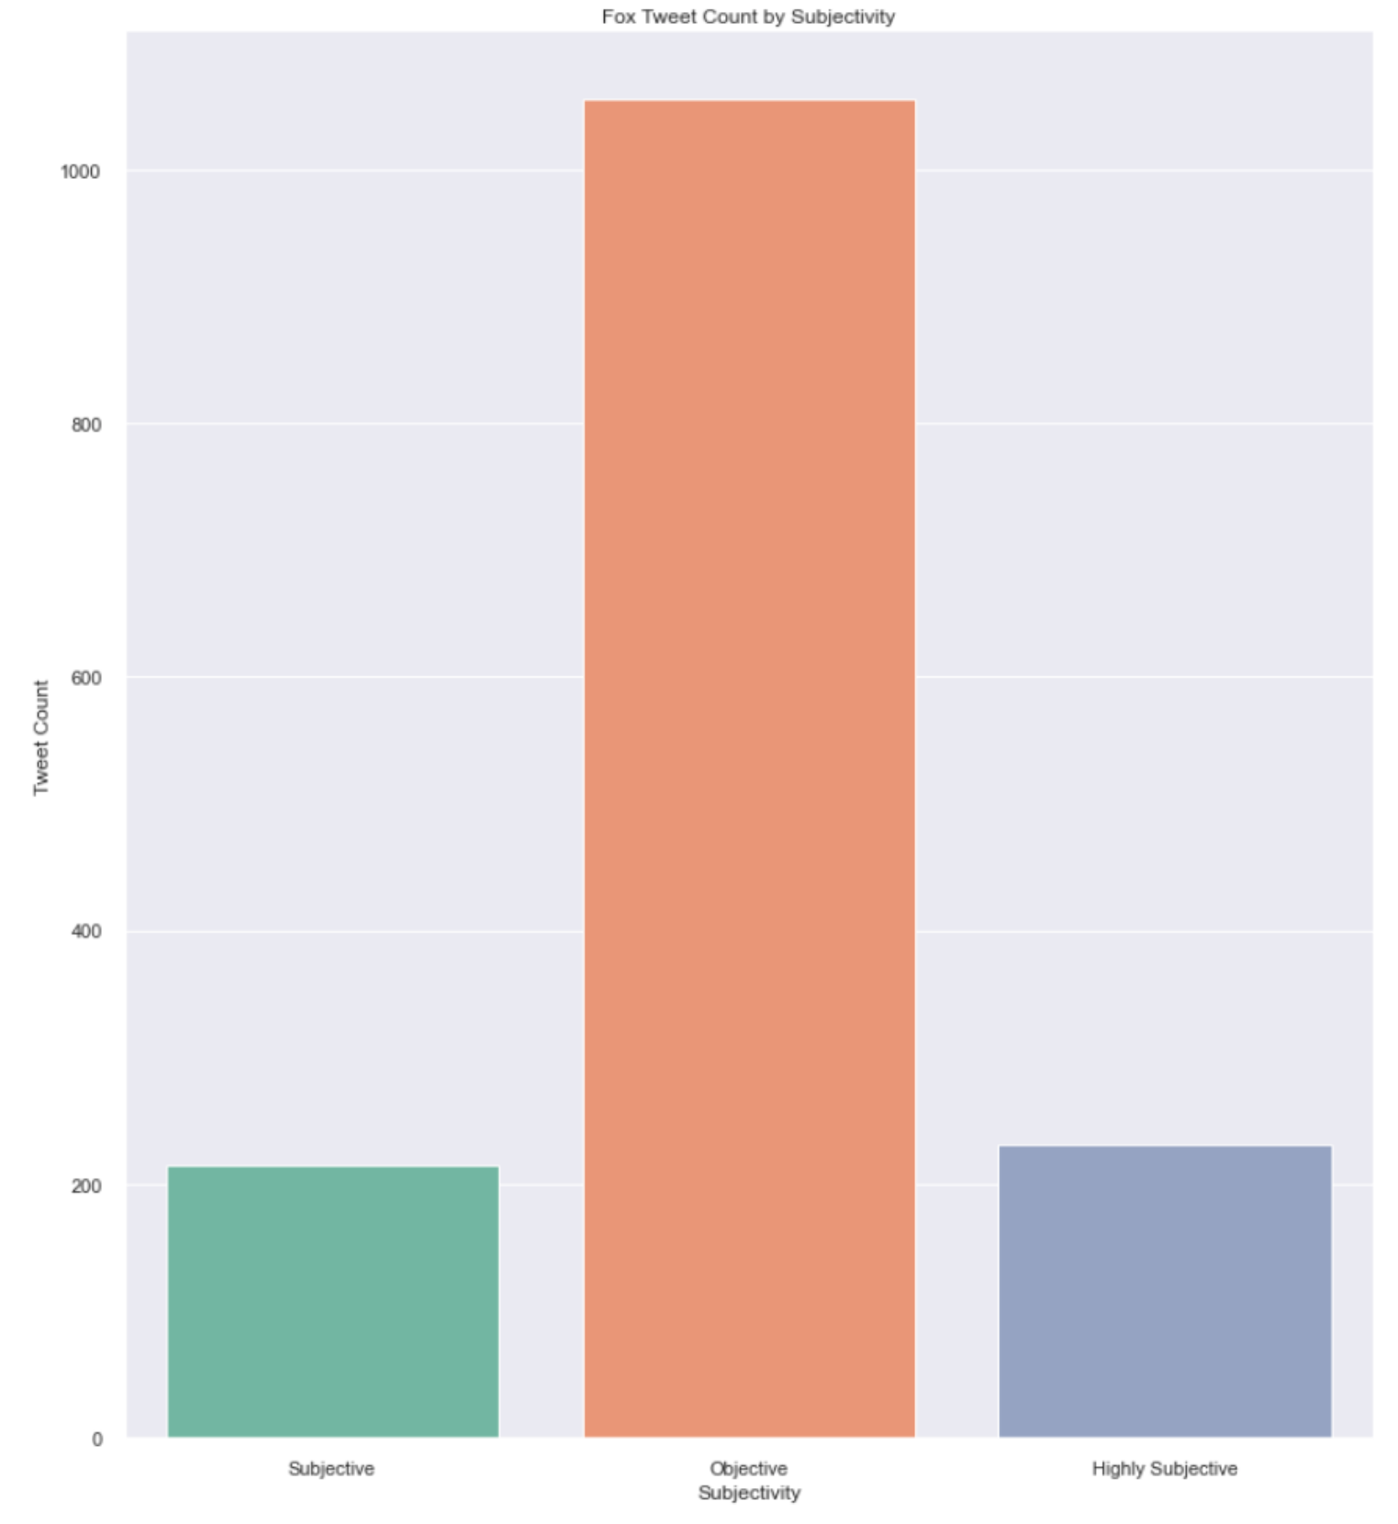
How did negative, positive, and neutral tweets vary according to each news outlet?
FOX TWEETS:
Fox Polarity Results:
~21% positive
~23% negative
~55% neutral
FOX Subjectivity Results:
~70% objective
~14% subjective
~16% highly subjective

Slide 5

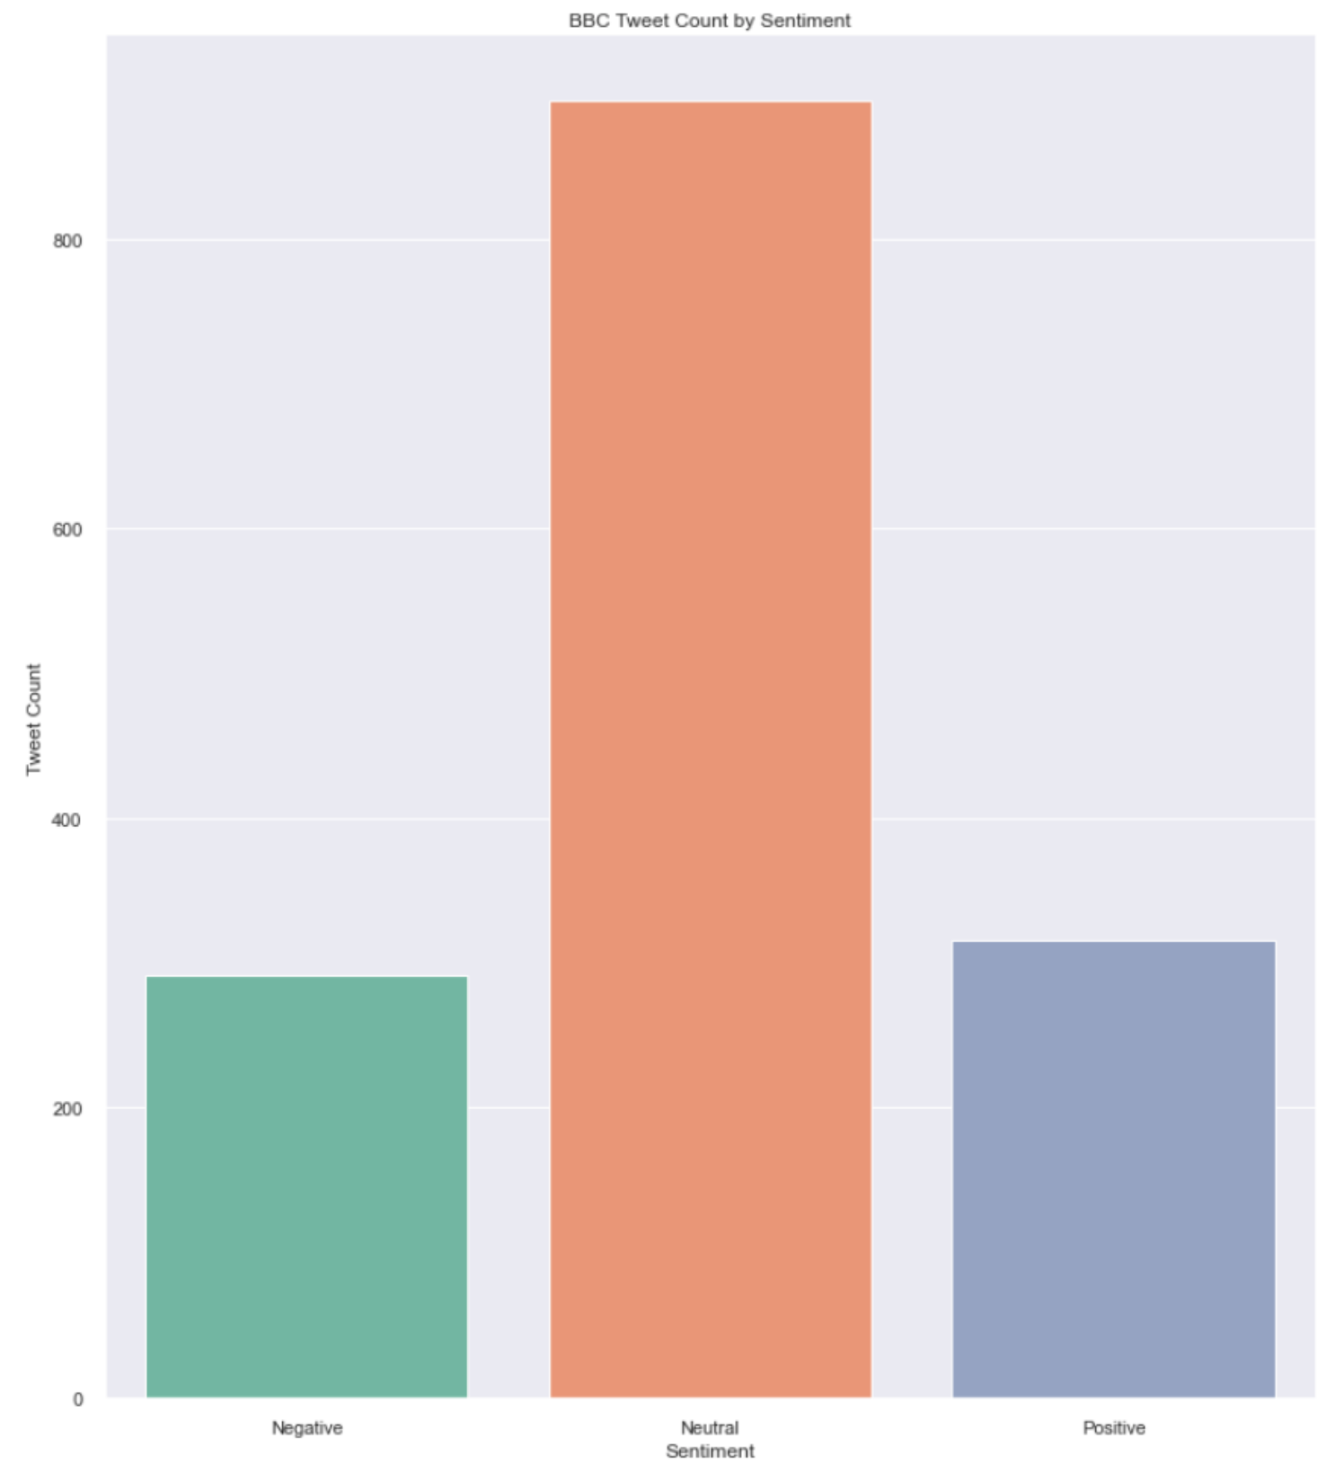
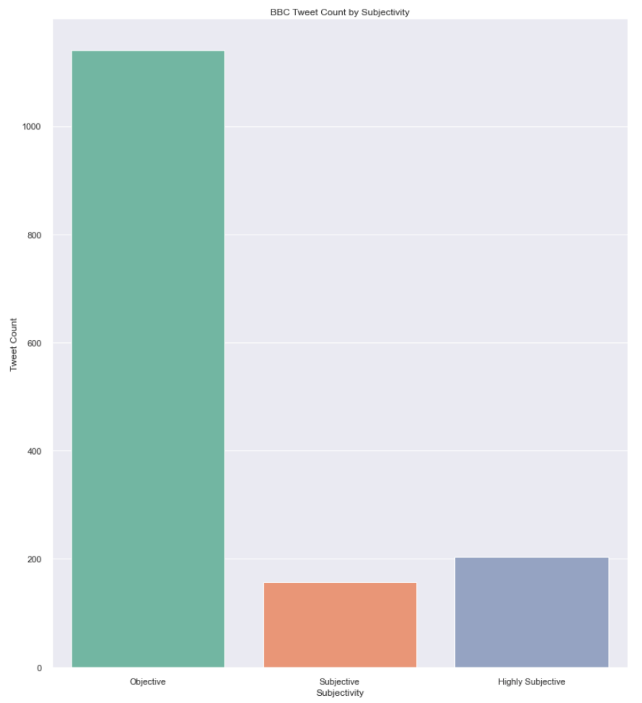
How did negative, positive, and neutral tweets vary according to each news outlet?
BBC TWEETS:
BBC Polarity
Results:
~21% positive
~19% negative
~60% neutral
BBC Subjectivity Results:
~77% objective
~10% subjective
~13% highly subjective

Slide 6

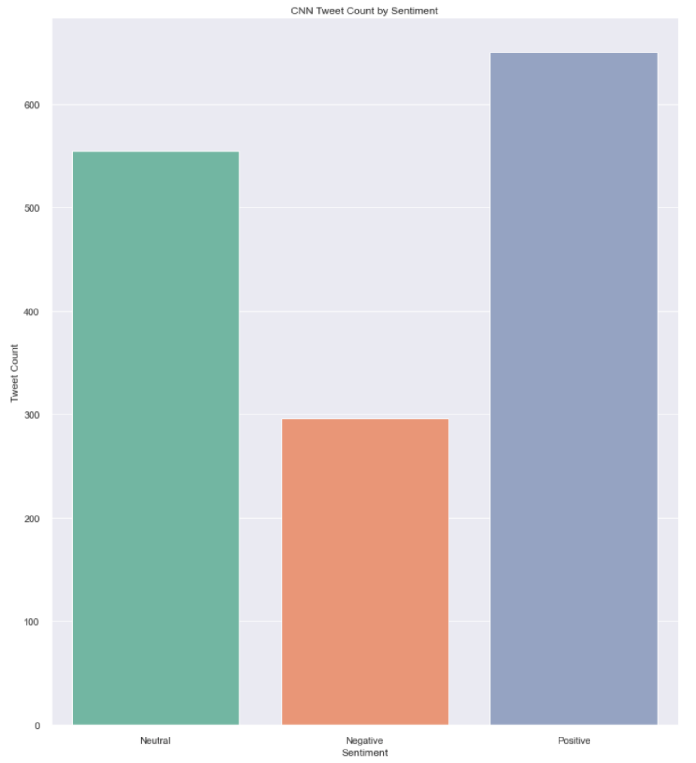
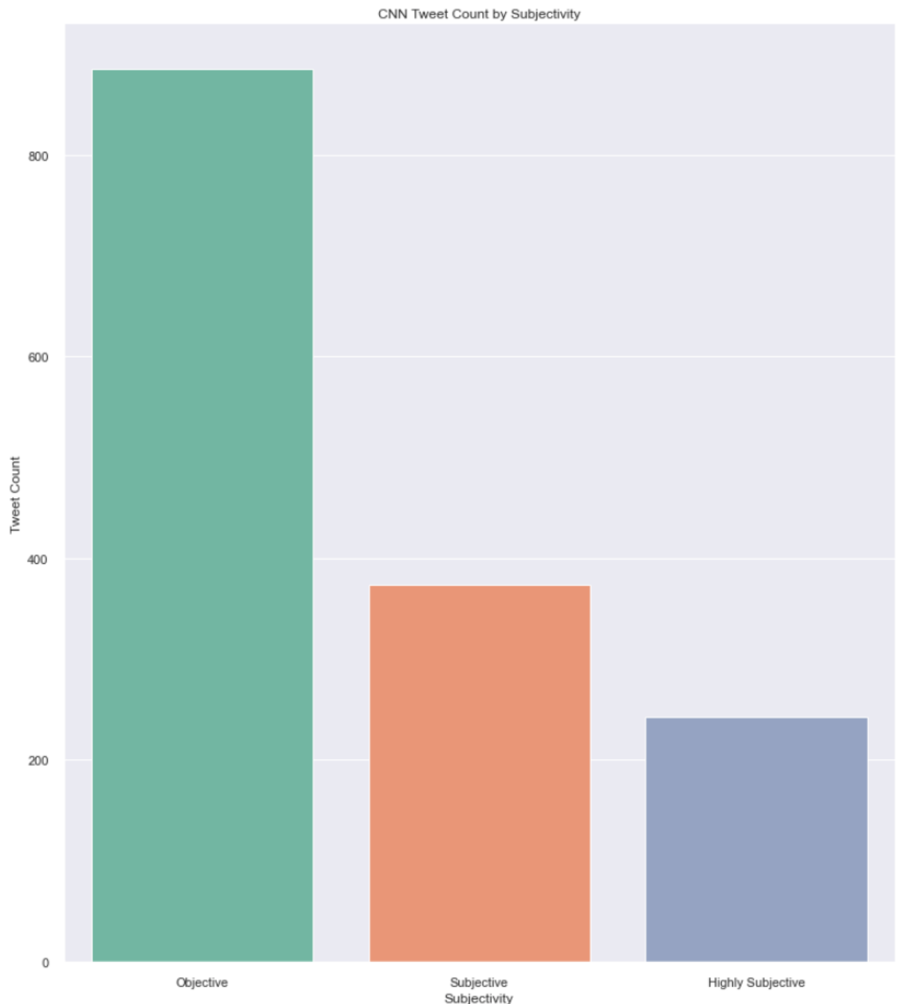
How did negative, positive, and neutral tweets vary according to each news outlet?
CNN TWEETS:
CNN Polarity
Results:
~43% positive
~37% negative
~20% neutral
CNN Subjectivity Results:
~60% objective
~25% subjective
~15% highly subjective

Slide 7









Analysis
Sentiment results on the data collected for Fox, BBC, and CNN indicate that BBC, the 'centrist' news outlet, has the highest percent of objective and neutral tweets. The findings also indicate the 'far-left' outlet, CNN, has highest rates of subjective, positive, and negative tweets. Compared to 'centrist' stats with BBC, the 'far-right' FOX tweets do not vary in objectiveness or sentiment significantly.
BBC tweets had the highest percent of tweets labeled as 'neutral'. FOX tweets came in second with 55%. Both news outlets had more than twice as many neutral tweets as CNN.
BBC tweets had the highest percent of tweets labeled as 'objective. Fox tweets had 70%, while CNN had 60%.
CNN's subjective tweets, collectively amounts to 75% more than those of BBC and about 30% more than FOX.
Conclusion
CNN, which is associated with a 'far-left' political affinity, appears to report the most subjective and non-neutral news via Twitter. BBC, as expected, is the most neutral and objective news source.

Slide 8








Next Steps
Use a query in the Snscrape code that collects tweets during specific and non-continuous 24 hour intervals to vary
Assess score ranges selected for polarity and subjectivity labels
Look into what makes Fox News 'far-right'
Further understanding of optimized number of clusters.
Grouping tweets by matching it to dictionaries of terms associated with specific topics like gun violence, elections, economics, etc., followed by sentiment analysis of each topic to compare how it is reported on.

Slide 9

Katherine Hurtado-da Silva | IST 652
Scripting for Data Analysis- Final Project
Resources
https://www.analyticsvidhya.com/blog/2021/01/sentiment-analysis-vader-or-textblob/ https://medium.com/swlh/tweets-classification-and-clustering-in-python-b107be1ba7c7 https://vitalflux.com/elbow-method-silhouette-score-which-better/

