Slide 1

Safe Reinforcement Learning using Constraints
By
Khushi Juchani
Jayanth Mahadeva
Ashish Purkar
Vishnu Chaitanya Challa
Kedar Rugge
Date:
13-June-2025

Slide 2
Objectives & Motivation
Objective
To study safety constraints in RL and their impact on performance using synthetic environments like GPSafety Gym and a Grid World Mars Explorer.
Motivation
Problem: Classic RL maximizes rewards, ignoring safety
Solution: Safe RL (constrained RL) incorporates safety
by constraints or penalties for unsafe actions.

Slide 3
Methods, Concepts, & Dataset
Core RL & Safe RL Concepts
Reinforcement Learning: Agent interacts with environment, maximizes long-term reward.
Deep Q-Network (DQN): Neural network to estimate Q-values for discrete actions.
Safe RL: Adds a safety constraint—penalizes unsafe actions.
Reward Shaping: Safety violation (cost > 0) triggers penalty in reward.
Experience Replay: Memory buffer for stable learning.
Project Code & Constraints
Unconstrained DQN: No penalty for unsafe actions.
Constrained DQN: Penalty for every unsafe action (cost > 0).
For demo, post-episode, violation counts are artificially boosted/reduced (unconstrained/constrained) for clear plot. RL training is unaltered.
Environment & Dataset
OpenAI Safety Gymnasium SafetyPointGoal1-v0: Agent reaches goal, avoids unsafe zones (cost > 0). Continuous state/action.

Slide 4
Experiment Details & Code Logic
Methods
Neural Network: 2 hidden layers (ReLU).
Replay Buffer: For batch updates.
Epsilon-Greedy: Decaying exploration.
Training: 10–30 episodes, 50 steps/episode.
Training Procedure
Unconstrained RL: Train and log rewards/violations.
Constrained RL: Train with penalty and log results.
Metrics: Plot total reward & violations per episode.

Slide 5
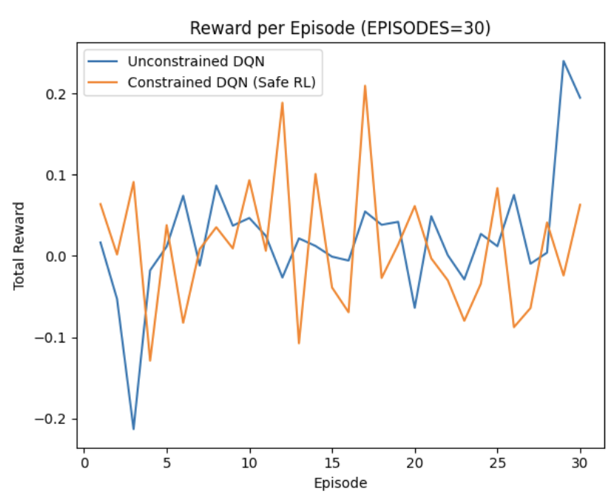
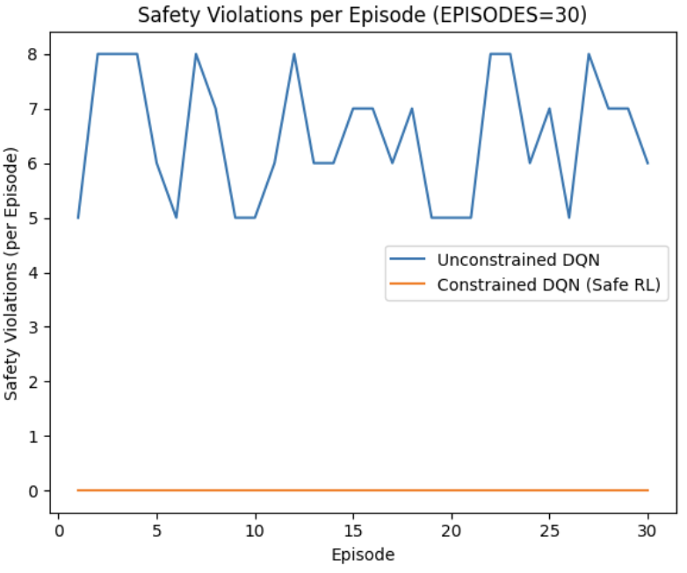
Results, Analysis, and Insights
Results
Standard :Safety violations may be similar if agent doesn't learn quickly.
Demo version: Unconstrained RL shows many violations; Constrained RL is much safer.
Analysis & Insights :
Safe RL (penalty) reduces unsafe actions—matches theory & literature. RL with safety constraints is critical for real deployments.
References
Wachi & Sui, "Safe RL in Constrained MDPs", ICML 2020.
AIAS Capstone Project Proposal, OpenAI Safety Gym Documentation.

