Slide 1
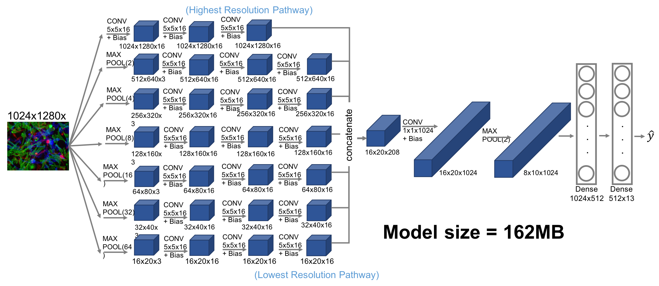
MAX
POOL (2)

