Slide 1
Module 7:Memory interfacing and Address Decoding
By Omoruyi O. and Olatimehin O.P.

Slide 2
Topic
Memory, Types and Notes
Memory Interfacing
Address Decoding.
I/O Interfacing: Memory mapped I/O, Isolated I/O, bus timing, I/O instructions.

Slide 3
Memory
With regards to Semi-conductor memories, they are devices and circuits that can store data or program.
Memories for data are stored in Volatile units called Random Access memory (RAM).
Memories for program are stored in persistent units called Read-only Memory (ROM).

Slide 4
Memory notes
A memory device can be viewed as a single-column table:
  Table index (row number) refers to the address of the memory.
  Table entries refer to the memory contents or data.
  Each table entry is referred to as a memory location or as a word.
Both the memory address and the memory contents are binary numbers, expressed in most cases in Hex format.
The size of a memory device is specified as the number of memory locations times the width or word size (in bits).
For example, A memory with 16 locations and a word size of 8 bits can store 16 x 8 = 128 bits of data.

Slide 5
Memory notes
Pertaining microprocessors, memory devices or memory chips are often connected with three types of lines : Address, Data, and Control.
Address Lines: The input lines that select a memory location within the memory device. Decoders are used inside the memory chip to select a specific location. The number of address pins on a memory chip specifies the number of memory locations.
If a memory chip has 13 address pins (A0 to A12), then it has: 2¹³ = 2³ X 2¹⁰ = 8K locations.

Slide 6
Data Lines
Data Connections: All memory devices have a set of data output pins (for ROM devices), or input/output pins (for RAM devices).
  Most RAM chips have common bi-directional I/O connections.
  Most memory devices have 1, 8 or 16 data lines.
6

Slide 7
Control Connection
Enable Connections:
  All memory devices have at least one Chip Select (CS) or Chip Enable (CE) input, used to select or enable the memory device.
    If a device is not selected or enabled then no data can be read from or written into it.
    The CS or CE input is usually controlled by the microprocessor through the higher address lines via an address decoding circuit.
Control Connections:
  RAM chips have two control input signals that specify the type of memory operation: the Read (RD) and the Write (WR) signals.
    Some RAM chips have a common Read/ Write (R/W) signal.
  ROM chips can perform only memory read operations, thus there is no need for a Write (WR) signal.
    In most real ROM devices the Read signal is called the Output Enable (OE) signal.

Slide 8
Memory Interfacing
8086 has a 20-bit address bus, and hence, it can address 2²⁰ or 1,048,576 addresses. In each location, a byte is stored. When a word is stored in the memory, it is stored in two consecutive locations. Strictly speaking, both memory read and memory write operations require more than one memory cycle. The basic operation of reading/writing a byte from/to a memory location/port is called a machine cycle. A machine cycle is made up of many states.
If we want the 8086 to complete a memory read and memory write operations to be completed with one machine cycle, the memory is to be organized in the form of two banks. Each bank will have 524,288 bytes each.

Slide 9
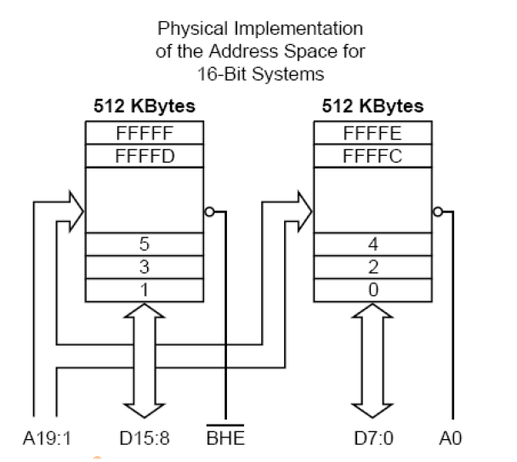
Diagram of Data bus model

Slide 10
Memory interfacing (continued)
One memory bank contains all the even addressed locations like 00000, 00002 and 00004. The data lines of this bank are connected to the lower eight data lines, D0 through D7 of the 8086. The other memory bank has all the odd addressed locations like 00001, 00003 and 00005. The data lines of this bank are connected to the upper eight data lines, D8 through D15 of the 8086. Address line A0 is used as part of the enabling for memory in the lower bank.
Address lines A1 through A19 are used to select the desired memory device in the bank to address the desired byte in the service. These address lines from A1 through A19 are also used to access a particular location in the upper bank. An additional signal called Bus High Enable (BHE –Active Low) is used to enable the upper memory bank. An external latch, strobed by ALE, grabs the BHE (Active Low) signal that holds it stable for the rest of the machine cycle.

Slide 11
Table showing bus cycles and memory access

Slide 12
Bus cycle explained
A bus cycle defines the basic operation that a microprocessor performs to communicate with external devices. Examples of bus cycles are memory read, memory write, input/output read and input/output write.

Slide 13
Data transfer

Slide 14
Data Transfer

Slide 15
Data transfer (16 bit or word transfer)

Slide 16
16 bit Data bus odd word transfer

Slide 17
Memory read
A memory read operation is carried out in the following steps:
  The processor loads on the Address bus the address of the memory location to be read (Step 1).
    Some of the address lines select the memory devices that owns the memory location to be read (Step 1a), while the rest point to the required memory location within the memory device.
  The processor activates the Read (RD) signal (Step 2).
    The selected memory device loads on the data bus the content of the memory location specified by the address bus (Step 3).
  The processor reads the data from the data bus, and resets the RD signal (Step 4).

Slide 18
Memory write
A memory write operation is carried out in the following steps:
  The processor loads on the Address bus the address of the memory location (Step 1).
    Some of the address lines select the memory devices that owns the memory location to be written (Step 1a), while the rest point to the required memory location within the memory device.
  The processor loads on the data bus the data to be written (Step 2).
  The processor activates the Write (WR) signal (Step 3).
    The data at the data bus is stored in the memory location specified by the address bus (Step 4).

Slide 19
The process of accessing memory involves these steps:
1. Address Generation: The CPU generates the address of the memory location it wants to access.
2. Address Transmission: The address is sent over the address bus to the memory.
3. Memory Selection: The memory chip with the matching address is selected.
4. Data Transfer: The selected memory chip either reads data from its location or writes data to it.
5. Data Transmission: The data is transferred over the data bus to or from the CPU.

Slide 20
Address Decoding
Address Decoding: This is the process of selecting a specific memory location. The computer uses address decoding to locate specific memory locations.
The physical address space, or memory map, of a microprocessor refers to the range of addresses of memory location that can accessed by the microprocessor. The size of the address space depends on the number of address lines of the microprocessor.
At least two memory devices are required in a microprocessor system: one for the ROM and one for the RAM. In an 8086 the high addresses in the memory map should always be occupied by a ROM, while the low addresses in the memory map should always be occupied by a RAM. Address decoding is required in order to enable the connection of more than one memory devices on the microprocessor. Each device will occupy a unique area in the memory map.
A memory system is not fully decoded if some of the address lines are not used by the address decoding circuit or memory. In this case a memory device will occupy more than one sections in the memory map. This is referred as memory mirroring or memory imaging.

Slide 21
Simplified memory map of 8086-DATS

Slide 22
I/O Interfacing
Some microprocessors use the same address space for both memory and input/output devices. In this arrangement all instructions that are capable of accessing the memory locations can also access the input/output devices. This can be called Memory-mapped I/O. I.e. Memory-Mapped I/O is a way to treat I/O devices (like keyboards, mice, and printers) as if they were part of the computer's memory.
However, 8086 microprocessor permits the establishment of two separate address spaces for memory and input/output devices. Having separate address space for the input/output devices is called direct I/O or Isolated I/O.

Slide 23
Bus timing
The three buses of the 8086 and 8088—address, data, and control—function exactly the same way as any other microprocessor. If data are written to the memory, the microprocessor outputs the memory address on the address bus, outputs the data to be written into memory on the data bus, and issues a write (WR) to memory and IO/M= 0 for the 8088 and M/IO= 1 for the 8086. If data are read from the memory, the microprocessor outputs the memory address on the address bus, issues a read memory signal (RD), and accepts the data via the data bus.
Bus Timing: This refers to the timing signals that control the flow of data on the bus.

Slide 24
Bus Timing Continues
The 8086/8088 microprocessors use the memory and I/O in periods called bus cycles. Each bus cycle equals four system-clocking periods (T states). Newer microprocessors divide the bus cycle into as few as two clocking periods. If the clock is operated at 5 MHz (the basic operating frequency for these two microprocessors), one 8086/8088 bus cycle is complete in 800 ns. This means that the microprocessor reads or writes data between itself and memory or I/O at a maximum rate of 1.25 million times a second. (Because of the internal queue, the 8086/8088 can execute 2.5 million instructions per second [MIPS] in bursts.)
Newer versions of microprocessors operate at much higher transfer rates due to higher clock frequencies.

Slide 25
I/O instructions
The instruction set contains one type of instruction that transfers information to an I/O device (OUT) and another to read information from an I/O device (IN). Instructions (INS and OUTS, found on all versions except the (8086/8088) are also provided to transfer strings of data between the memory and an I/O device.
Instructions that transfer data between an I/O device and the microprocessor’s accumulator
(AL, AX, or EAX) are called IN and OUT. The I/O address is stored in register DX as a 16-bit I/O address or in the byte (p8) immediately following the opcode as an 8-bit I/O address. Intel calls the 8-bit form (p8) a fixed address because it is stored with the instruction, usually in a ROM.
The 16-bit I/O address in DX is called a variable address because it is stored in a DX, and then used to address the I/O device. Other instructions that use DX to address I/O are the INS and OUTS instructions. I/O ports are 8 bits in width, so whenever a 16-bit port is accessed, two consecutive 8-bit ports are addressed. A 32-bit I/O port is four 8-bit ports.
I/O Instructions: These are special instructions that the computer uses to communicate with I/O devices.

Slide 26
Address size expansion
More than one memory devices can be used to expand the number of memory locations on the system.
To expand the word size do the following:
  Determine the number of memory chips required, by dividing the required memory size with the size of the memory devices to be used.
  Connect the data lines of each memory chip in parallel on the data lines of the processor.
  Connect the address lines of each memory chip in parallel with the low address lines of the processor.
  Connect the CS lines of each memory device with the high address lines of the processor through an address decoding circuit..
  Connect together all WR and all RD lines of each memory device.

Slide 27
Address Size Expansion: (32X4 RAM module using 8X4 RAM chips)
27

Slide 28
Design an 8KX8 RAM module using 2KX8 RAM chips. The module should be connected on an 8-bit processor with a 16-bit address bus, and occupy the address range starting from the address A000. Show the circuit and the memory map.
Number of memory devices needed = 8K/2K = 4
Decoder needed = 2X4
Number of address lines on each 2KX8 memory chip = 11
2^{m} = 2K = 2¹ x 2¹⁰ = 2¹¹ ⇒ (A0..A10)
Decoder needed = 2X4
⇒ 2 address lines are needed for the decoder. ⇒ (A11..A12)
Number of address lines needed for the address selection circuit
= 16 - 11 - 2 = 3 ⇒ (A13, A14 A15)
28

Slide 29
Explanation
Problem Analysis
Let me break down the requirements:
Target Module: 8K×8 RAM (8192 locations × 8 bits)
Available Chips: 2K×8 RAM (2048 locations × 8 bits each)
Processor: 8-bit data bus, 16-bit address bus
Starting Address: A000H
Task: Design the circuit and show the memory map
Step 1: Determine Number of Chips Required
Calculation:
Total memory needed = 8K×8 = 8192 bytes
Each chip capacity = 2K×8 = 2048 bytes
Number of chips required = 8192 ÷ 2048 = 4 chips
Since we need more capacity (8K) and each chip provides 2K, we need to connect 4 chips to achieve the required 8K×8 configuration.

Slide 30
Explanation
Step 2: Address Line Analysis
Address Requirements for 2K×8 RAM Chip
Each 2K×8 chip needs to address 2048 locations.
2048 = 2^11
Therefore, each chip requires 11 address lines (A0-A10)
Address Range Calculation
With a 16-bit address bus, we have address lines A0-A15.
Starting address: A000H = 1010 0000 0000 0000 (binary)
Total memory size: 8K = 8192 bytes = 2000H bytes
Address range: A000H to A000H + 1FFFH = A000H to BFFFH
Which means
A000H (starting) = 1010 0000 0000 0000
BFFFH (ending) = 1011 1111 1111 1111
Address Line Distribution
For 16-bit address bus (A15-A0)
Address Lines | Purpose
A0-A10 (11 bits) | Address lines for each 2K×8 chip (2048 locations)
A11-A12 (2 bits) | Chip select lines (to select 1 of 4 chips)
A13-A15 (3 bits) | Used for address decoding to enable the module
30

Slide 31
Step 3: Address Decoding Logic
Module Enable Logic
For the address range A000H-BFFFH:
A15 A14 A13 = 101 (binary) for addresses A000H-BFFFH
We need to decode these three bits to generate a module enable signal.
Decoding equation:
Module Enable = A15 · A̅14 · A13 (A15 AND NOT A14 AND A13)
Chip Select Logic
A11 and A12 are used to select one of the four 2K×8 chips:
We can use a 2-to-4 decoder (like 74139 or 74155) to generate the four chip select signals.

Slide 32
Step 4: Circuit Design
Circuit Components
Four 2K×8 RAM chips (e.g., 6116 or similar)
One 2-to-4 decoder (74139)
One 3-input NAND gate (74LS10) or discrete logic gates
Address and data bus connections
Summary
This design successfully creates an 8K×8 RAM module using four 2K×8 RAM chips. The module occupies the address range A000H to BFFFH in a system with a 16-bit address bus

Slide 33
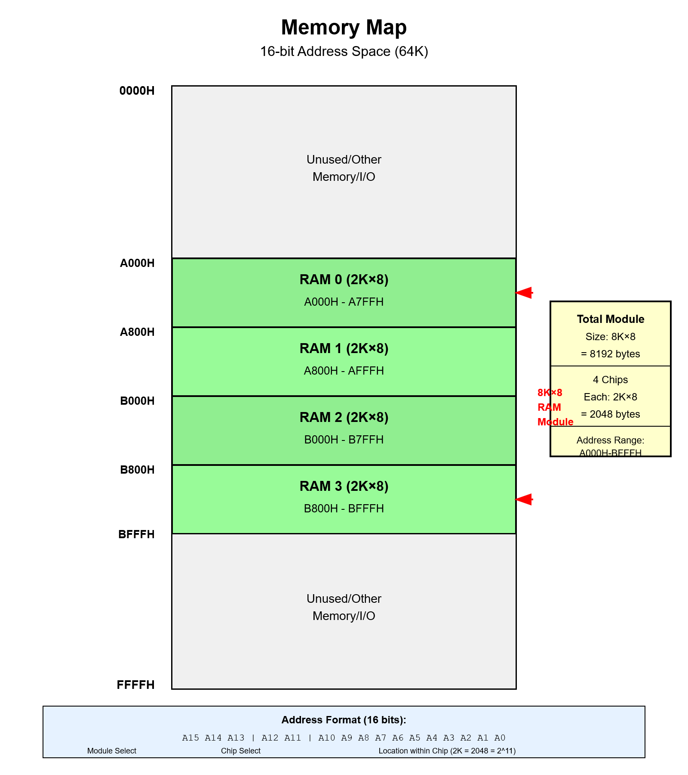

Slide 35
Classwork
1. Design a 16K×8 RAM module using 4K×8 RAM chips. The module should be connected to an 8-bit processor with a 16-bit address bus, and occupy the address range starting from the address 8000H. Show the circuit and the memory map
2. Design a 32K×8 RAM module using 8K×8 RAM chips. The module should be connected to an 8-bit processor with a 16-bit address bus, and occupy the address range starting from the address C000H. Show the circuit and the memory map.

