Slide 1
Docker
Lunch && Learn 09/25/2019

Slide 2

What is Docker?
Open Platform
Written in GO
for creating Application templates
Images
for sharing Application templates
Registries
for running isolated Applications
Containers

Slide 3
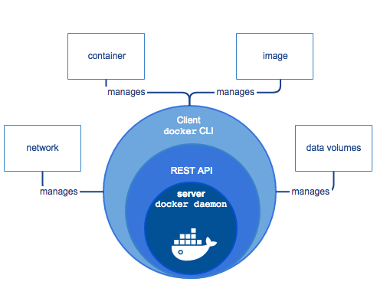
How from 30000ft?
Docker Daemon
The magic sauce
Docker Client
Interface to the Docker Daemon
Docker Objects
Images, Containers, Networks, Volumes, …
Docker Registries
Public / Private Images

Slide 4
The Magic Sauce
Automates and Abstracts:
Namespaces (link)
Used to isolate container access
Control Groups (link)
Authenicate / Control resources available to container
Capabilities (link)
Fine grained superuser permissions

Slide 5
Basics
Dockerfile
Image
Container
Docker Client
Make it go!

Slide 6
Dockerfile
Text Document
Instructions to assemble an image
Automates Command Line

Slide 7
Image
Read-only Docker container template
Created from a Dockerfile
Made of Layers
One Layer per Dockerfile Instruction
UnionFS: many filesystems transparently overlaid
Cached: Only downstream layers are rebuilt

Slide 8
Container
Runnable Instance of an Image
Create
Start
Stop
Move
Delete
Attach Network
Attach Storage ( local filesystems! )
Create New Images off current state!

Slide 9
Docker Client
Most Frequent
build: create an image from Dockerfile
pull: pulls an image from a repository
run: creates container from image
exec: runs a command in a container
ps: list running containers
Less Frequent
attach: attaches to a running container
export: export containers filesystem as a tar archive

Slide 10
Make It Go!
kdavison/DockerExamples
/01
Python dockerfile walkthrough
Docker Build
Docker Run
Docker images
Docker history
Docker attach

Slide 11
Make It Go!
kdavison/DockerExamples
/02
SHELL vs EXEC Forms
RUN, ENTRYPOINT, CMD
Special Third CMD form
ENTRYPOINT vs COMMAND
Similar but not the same
Command line inputs

Slide 12
Intermediate Docker
Be aware of Caching!
MultiStage Builds
NonRoot User
Ports and Volumes
Container Access
What Image Base to Use?

Slide 13
Be aware of Caching
RUN apt update && apt install curl → RUN apt update && apt install curl wget
RUN apt update RUN apt install curl → RUN apt install curl wget

Slide 14
Multistage Builds
kdavison/DockerExamples
/03
Method to Optimize Dockerfiles
Each FROM statement begins a new build stage
Selectively Copy Artifacts from one stage to another

Slide 15
NonRoot User
kdavison/DockerExamples
/04
Most (nearly all) of the docker security vulnerabilities involve privileged user
Very Easy to Use
Doesn’t Affect Application (most of the time)

Slide 16
Access Container
running state of container
need something simple to spin/wait while you poke around
docker exec -it <container id> /bin/sh
ENTRYPOINT [“/bin/sh”, “-c” ,“while [ 1 ]; sleep 1; done”]
docker run -it –entrypoint “/bin/sh” <image>

Slide 17
What Base Image to Use?
Alpine
Smallest!
Uses musl not glibc
Fewer Available Libraries
Use whatever results in least work
Most “popular” images have several variants

Slide 18
Docker-Compose
Abstract docker commands
Very convenient for more complex command sets

