Slide 1
Docker
Lunch && Learn
09/25/2019

Slide 2

What is Docker?
Open Platform
  Written in GO
  for creating Application templates
    Images
  for sharing Application templates
    Registries
  for running isolated Applications
    Containers

Slide 3
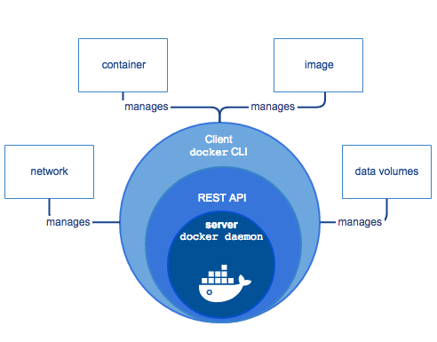
How from 30000ft?
Docker Daemon
  The magic sauce
Docker Client
  Interface to the Docker Daemon
Docker Objects
  Images, Containers, Networks, Volumes, …
Docker Registries
  Public / Private Images

Slide 4
The Magic Sauce
Automates and Abstracts:
Namespaces (link)
  Used to isolate container access
Control Groups (link)
  Authenicate / Control resources available to container
Capabilities (link)
  Fine grained superuser permissions

Slide 5
Basics
Dockerfile
Image
Container
Docker Client
Make it go!

Slide 6
Dockerfile
Text Document
Instructions to assemble an image
Automates Command Line

Slide 7
Image
Read-only Docker container template
Created from a Dockerfile
Made of Layers
  One Layer per Dockerfile Instruction
  UnionFS: many filesystems transparently overlaid
  Cached: Only downstream layers are rebuilt

Slide 8
Container
Runnable Instance of an Image
  Create
  Start
  Stop
  Move
  Delete
  Attach Network
  Attach Storage ( local filesystems! )
  Create New Images off current state!

Slide 9
Docker Client
Most Frequent
  build: create an image from Dockerfile
  pull: pulls an image from a repository
  run: creates container from image
  exec: runs a command in a container
Less Frequent
  attach: attaches to a running container
  commit: create new image from existing container
  export: export containers filesystem as a tar archive

Slide 10
Make It Go!
kdavison/DockerExamples
/01
  Python dockerfile walkthrough
  Docker Build
  Docker Run
  Docker images
  Docker history
  Docker attach

Slide 11
Make It Go!
kdavison/DockerExamples
/02
  SHELL vs EXEC Forms
    RUN, ENTRYPOINT, CMD
    Special Third CMD form
  ENTRYPOINT vs COMMAND
    Similar but not the same
    Command line inputs

Slide 12
Intermediate Docker
Be aware of Caching!
MultiStage Builds
NonRoot User
Inspect Image
What Image Base to Use?

Slide 13
Be aware of Caching
RUN apt update && apt install curl
→
RUN apt update && apt install curl wget
RUN apt update
RUN apt install curl → RUN apt install curl wget

Slide 14
Multistage Builds
kdavison/DockerExamples
/03
  Method to Optimize Dockerfiles
  Each FROM statement begins a new build stage
  Selectively Copy Artifacts from one stage to another

Slide 15
NonRoot User
kdavison/DockerExamples
/04
  Most (nearly all) of the docker security vulnerabilities involve privileged user
  Very Easy to Use
  Doesn’t Affect Application (most of the time)

Slide 16
Inspect Image
Somtimes you need to inspect running state of container
Need something simple to spin/wait while you poke around
ENTRYPOINT [“/bin/sh”, “-c” ,“while [ 1 ]; sleep 1; done”]
  docker exec -it <container id> /bin/sh
docker run -it –entrypoint “/bin/sh” <image>

Slide 17
What Base Image to Use?
Alpine
  Smallest!
  Uses musl not glibc
  Fewer Available Libraries
Use whatever results in least work
Most “popular” docker images have alpine implementations

Slide 18
Docker-Compose
Abstract docker commands
Very convenient for more complex command sets

