Slide 1


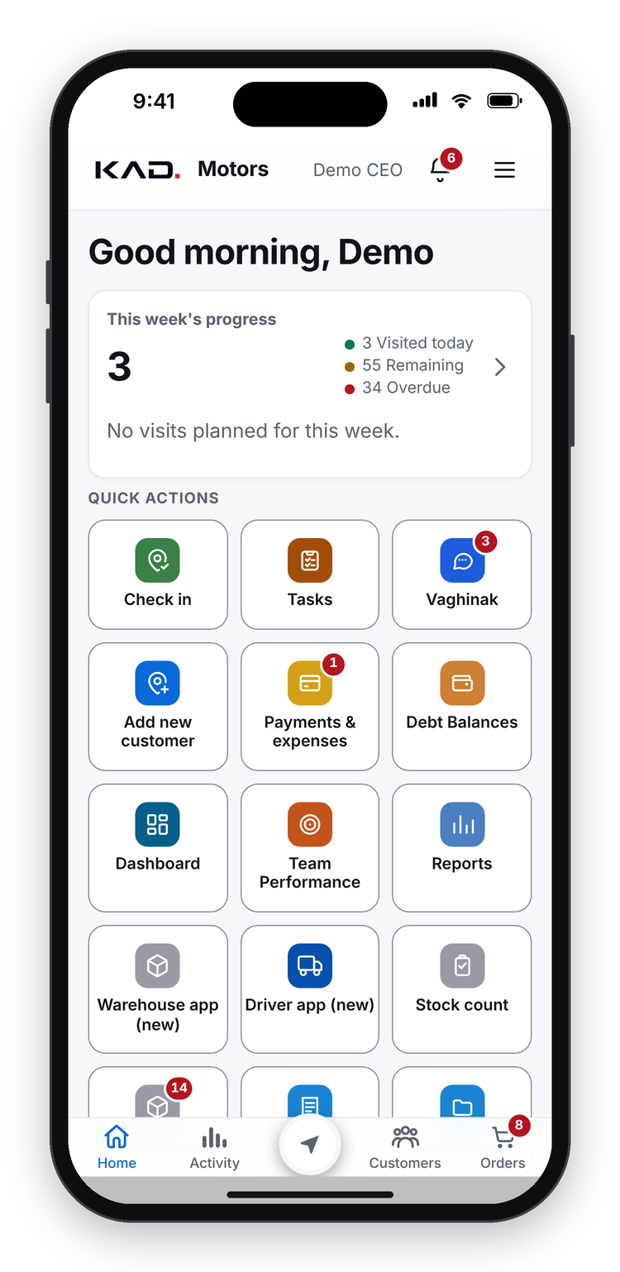
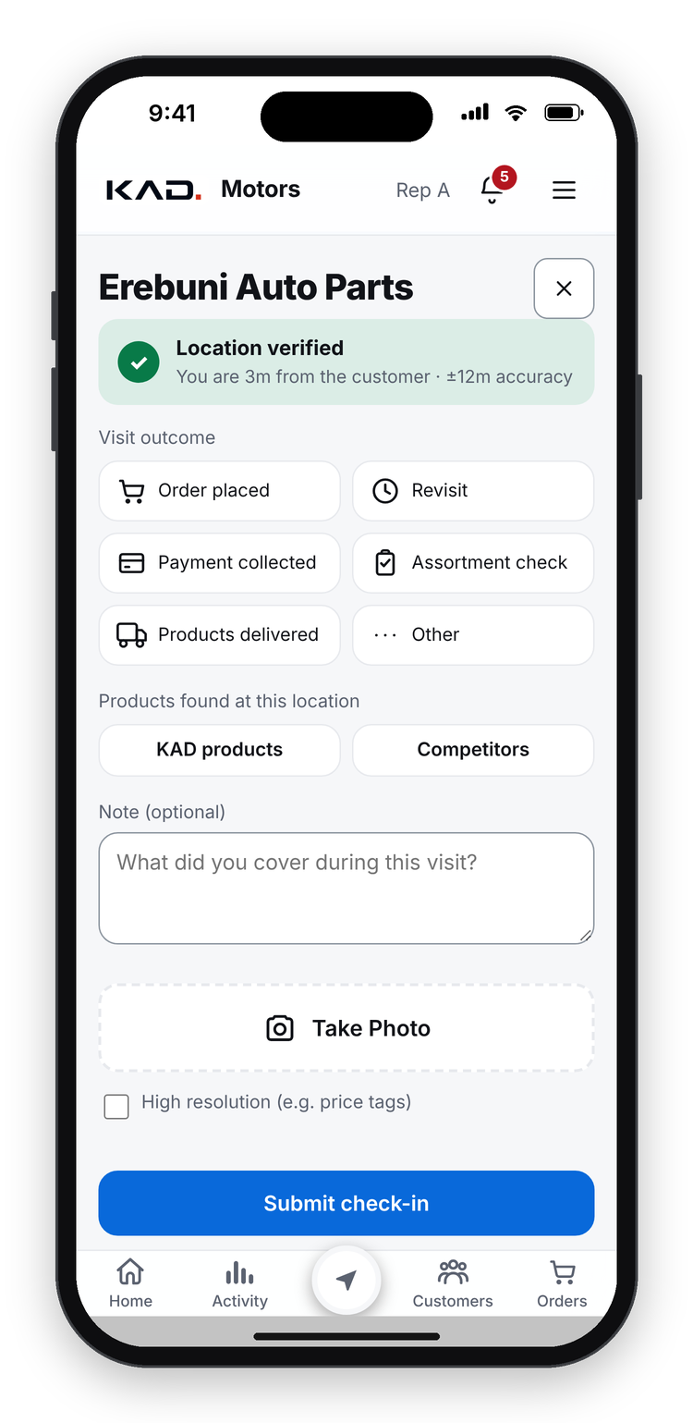
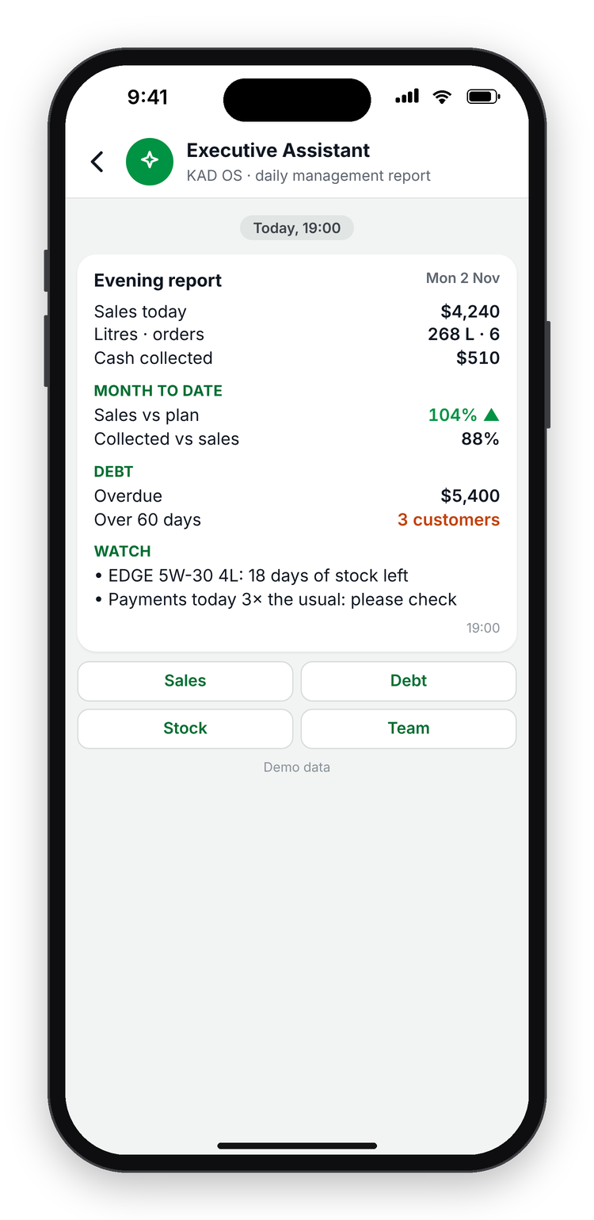
KAD OS
powered by Castrol
The operating system for a modern Castrol distributor.
For Castrol sales & marketing teams · KAD Motors, Armenia · November 2026
Demo data
Notes:
[0:00 - 1:45] KEY MESSAGE: one app runs a whole Castrol distributor, and shows the brand what happens in the field.
Good morning, and thank you for having us. I am from KAD Motors, the Castrol distributor in Armenia.
Let me start with a question. (Pause.) Raise your hand if you have ever asked a distributor: in which shops is our product on the shelf today? (Wait.) And how long did you wait for the answer?
Today I want to show you KAD OS, the app our own team built to run the distributor: every visit, every order, every payment and every delivery. And I will show it through your eyes, as sales and marketing people: what it tells the brand about the field. Everything you see is the real app, with demo data. We keep ten minutes for your questions at the end.

Slide 2











THE BLIND SPOT
11 everyday problems, and how KAD OS answers each one
Was the field really visited?
What is on the shelf?
Where is fake product sold?
GPS check-in with a photo; refused beyond 300 m
A Castrol shelf check at every visit
Fake product flagged, field by field
Which competitors are in the shop?
Which shops don't buy Castrol?
Orders by phone, or on paper
Competitor brands recorded at every visit
Potential customers with level, reason and expected litres
In the app: fixed prices, automatic discounts and offers; a bigger discount goes to the manager
Reports that take days
Problems found too late
Tasks lost in calls and chats
Live dashboard, plus daily, weekly and monthly reports to the sales head, CEO or anyone
An AI agent checks everything, one by one, and finds the problems
Tasks in the app: the manager reviews each visit and sets tasks; the AI agent creates and follows them too
"How much does this shop owe?"
Do our offers reach the shop?
11 questions.
One app.
Debt visible in the app: no call to accounting before collecting cash
Next: offers on the customer's own dashboard
KAD OS
The operating system for a modern Castrol distributor
2
powered by Castrol
Notes:
[1:45 - 5:15] KEY MESSAGE: eleven everyday problems, and one app that answers all of them. Everything else today is detail.
Here are eleven problems that every distributor and every brand team knows. On the left of each card the problem in red, under it our answer in green.
(Top row.) Was the field really visited? Today a visit report says yes, but nobody can prove it. In KAD OS a visit is a GPS check-in with a photo, refused beyond 300 metres. What is on the shelf? The rep checks the Castrol shelf at every visit. Where is fake product sold? Fake product is flagged, field by field.
(Second row.) Which competitors are in the shop? The rep ticks the brands he sees, at every visit. Which shops do not buy Castrol yet? They are in the app as potential customers, with the reason, a level and the litres we expect. Orders by phone, or on paper with a pen? Now the order is in the app, with fixed prices, the discounts and offers applied automatically; and if the rep needs a bigger discount, the request goes straight to the manager.
(Third row.) Reports that take days? There is a live dashboard, plus daily, weekly and monthly reports, to the sales head, the CEO or anyone who needs them. Problems found too late? An AI agent checks everything, one by one, and finds them. Tasks lost in calls and chats? Tasks live in the app: the manager reviews each visit, sees everything the rep wrote and added, and sets a task for any customer; the AI agent creates and follows tasks too.
(Last row.) How much does this customer owe? The rep sees the debt in the app; no more calls to accounting or finance before collecting cash. And do our offers reach the shop? That is our next step, the customer app.
Eleven questions, one app. Now let me show you how it works.

Slide 3
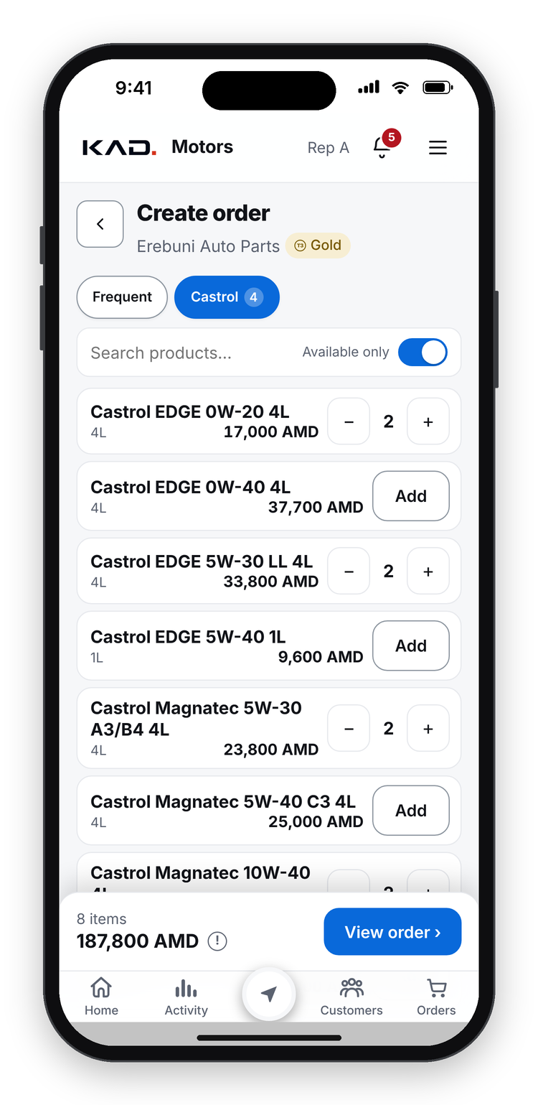
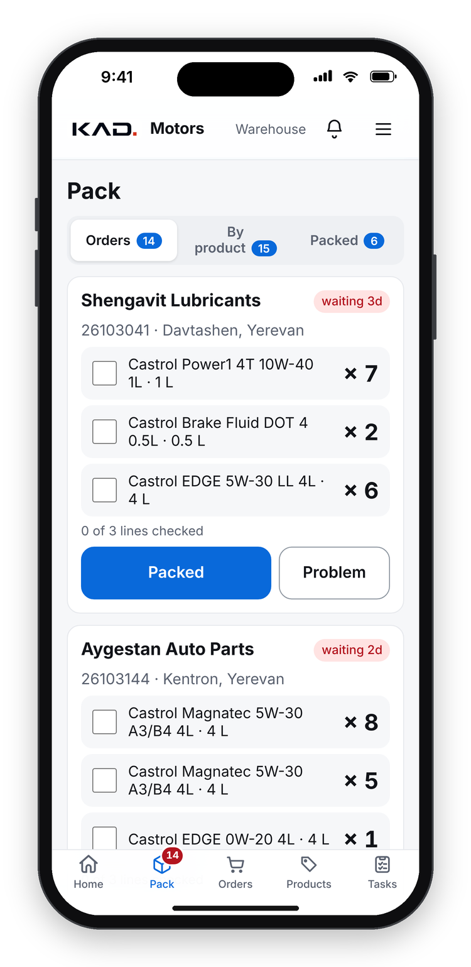
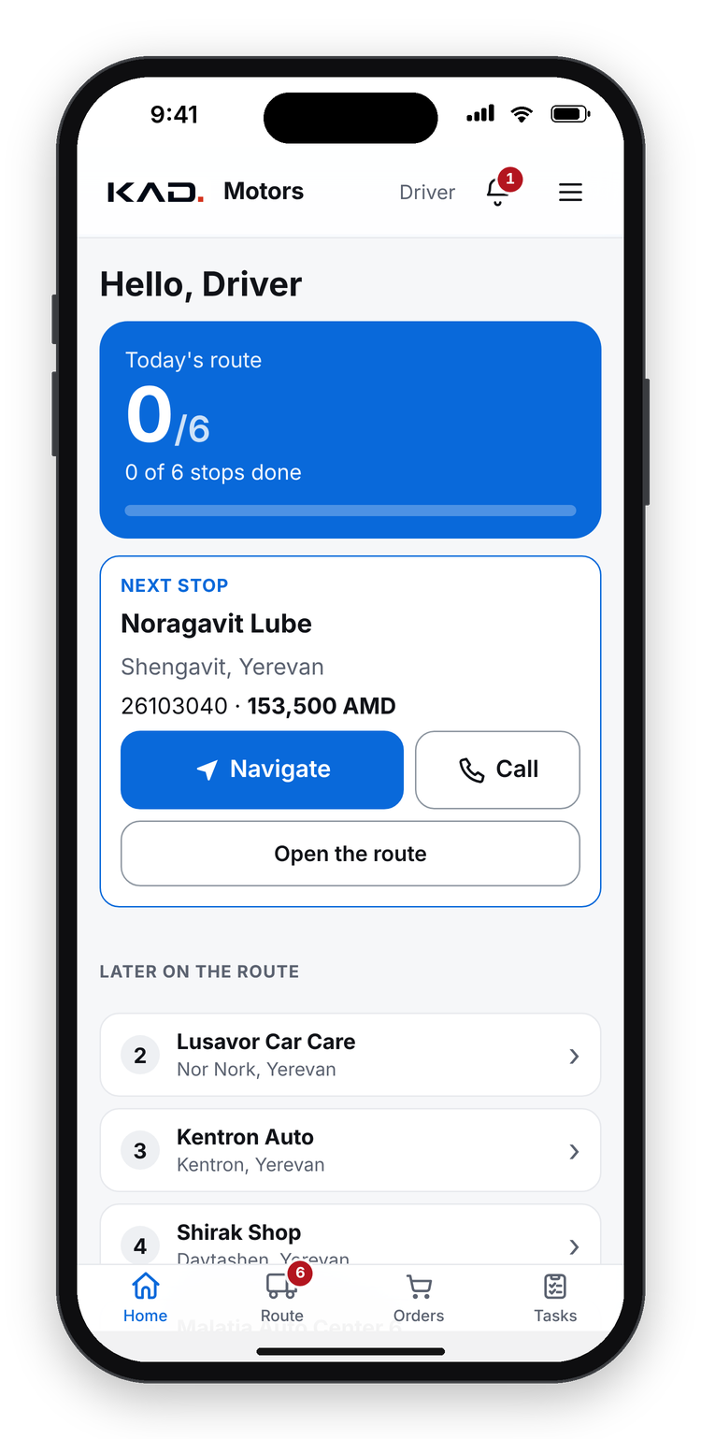
A DAY IN KAD OS
The entire process from A to Z, in one flow
09:40
09:52
11:30
15:10
19:00
Rep checks in
Takes the order
Warehouse packs
Driver delivers
Reporting
GPS + photo at the customer
Right prices, usual basket
Tick lines, press Packed
Next stop, customer signs
Sales, cash, debt, risks
KAD OS
The operating system for a modern Castrol distributor
3
powered by Castrol
Notes:
[5:15 - 7:30] KEY MESSAGE: everyone works in the same app, so one order flows from the shelf to the evening report without paper or calls.
KAD OS is one app for everyone in the distributor: sales reps, the sales director, the warehouse, the driver, the accountant and management. It opens from a link on the phones they already have, with no app store, and it works without signal.
Here is one day, from A to Z, with demo data. At 09:40 the rep checks in at a shop, with GPS and a photo, and records the shelf. At 09:52 he takes the order from the customer's usual basket, at the right price list. Before noon the warehouse picks it, ticking each line, and presses Packed. In the afternoon the driver follows the optimised route, and the customer signs on the phone. At 19:00 management gets the evening report: sales, cash, debt and risks.
No paper, no phone calls, and nobody types anything twice. Because everyone works in one system, the data about each customer is complete: the visit, the shelf, the order, the payment and the delivery are connected. Let us go through it, starting with the visit.

Slide 4
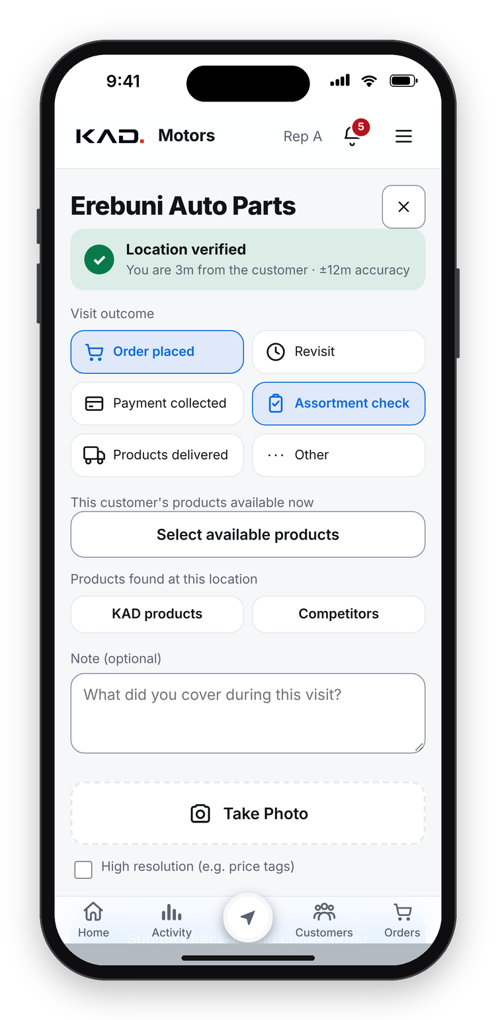
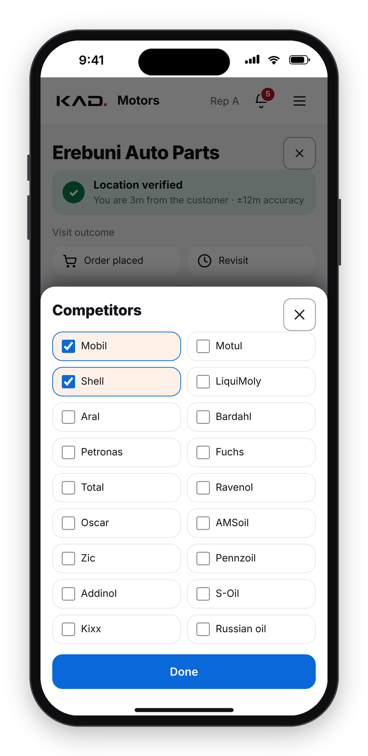
1/5 · EVERY VISIT IS REAL
CHECK-IN
A visit in under a minute, with the shelf on record
1
Open the customer, tap Check In
The phone finds the GPS position at once
2
Location verified
Accepted only within 300 m; the distance and accuracy are saved
3
Choose what happened
Order, payment, assortment check, delivery, revisit
4
Record the shelf
Castrol available, full range or fake; competitors seen
5
Note and photo
High resolution for price tags
6
Submit, even offline
Location verified
Visit outcome
Competitors
With an order, the order screen opens next
Why it matters for Castrol: every visit brings back shelf, fake-product and competitor data, field by field.
KAD OS
The operating system for a modern Castrol distributor
4
powered by Castrol
Notes:
[7:30 - 10:00] KEY MESSAGE: a visit only counts when the rep is really there, and every visit brings back shelf data.
Chapter one: every visit is real. (Point to the progress bar top right: five chapters.)
The rep opens the customer and taps Check In. The phone finds the GPS position at once. The check-in is accepted only within 300 metres, and the real distance and the GPS accuracy are saved with it. So a visit report from the office or from the car is not possible.
Then he chooses what happened: an order, a payment, an assortment check, a delivery or a revisit. (Middle phone.)
Then comes the part that matters most for you: the shelf. Is Castrol available, is the full range there, is there fake product? And he ticks the competitor brands he sees. (Right phone: the competitor list.)
A short note and a photo, in high resolution for price tags, and he submits, even without signal. If he took an order, the order screen opens next. The whole visit takes less than a minute, and that is why reps really do it at every visit.
For a team lead the point is this: you no longer manage the team by asking where they were. You can see it, and you spend your time on what they found.

Slide 5
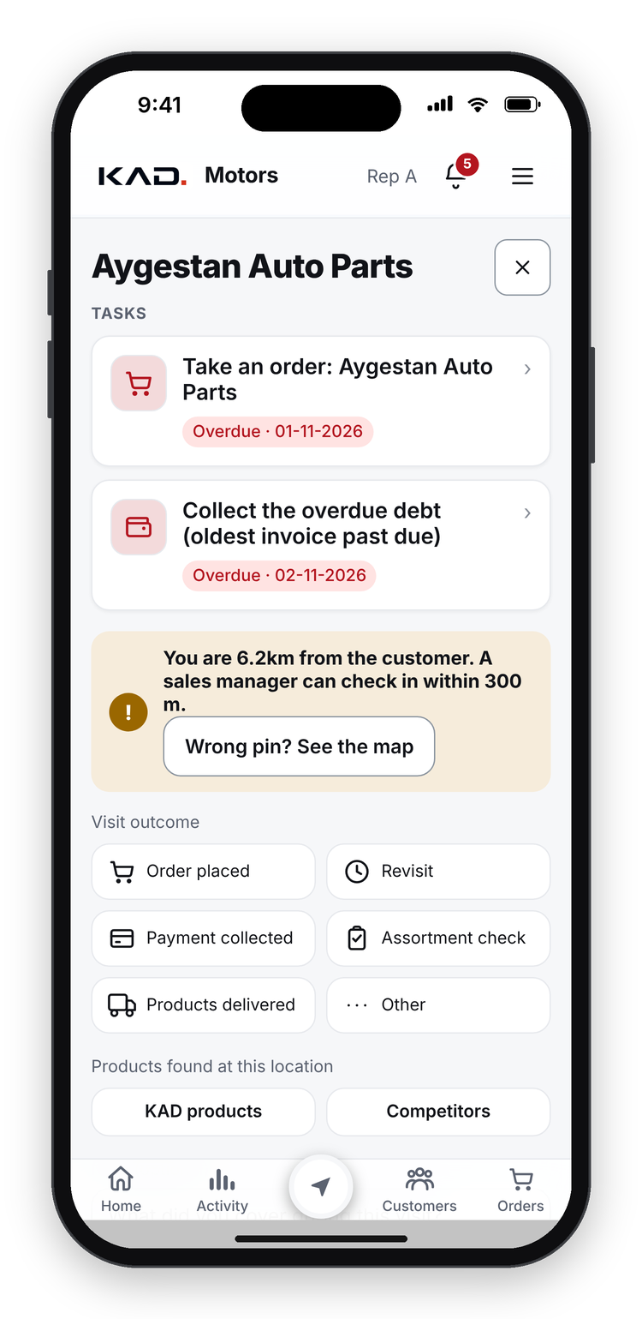
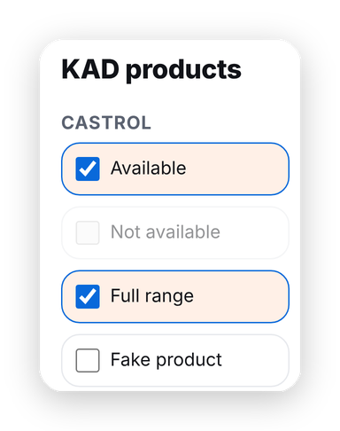
1/5 · EVERY VISIT IS REAL
CHECK-IN
Visits that cannot be faked
1
Too far? Refused
6 km away, the app blocks the check-in and offers "Wrong pin? See the map"
2
Wrong pins are found
Repeated GPS evidence shows customers whose map pin is wrong
3
Visit length
The start and end of each visit are recorded
4
Castrol shelf check
Available, full range or fake product, field by field
5
Management sees it
Visit history per customer and per rep, with time and place
Too far: refused
Shelf check
Why it matters for Castrol: the visit reports you receive are proven, not written from the office.
KAD OS
The operating system for a modern Castrol distributor
5
powered by Castrol
Notes:
[10:00 - 12:00] KEY MESSAGE: proven visits and field-level shelf data the brand never had.
Two details make the data trustworthy.
On the left the rep is 6 kilometres from the customer: the app blocks the check-in. If the pin on the map is wrong, it offers to check the map, and repeated GPS evidence from real visits shows management which customers have a wrong pin, so it gets fixed. The start and the end of each visit are recorded too, so we know how long the rep stayed.
On the right is the Castrol shelf check: available, full range, fake product, field by field.
This is something the brand never had: not an audit of 50 shops once a year, but every customer at every visit, with the date, the place and the rep. Management sees all of it in the visit history. That is chapter one: every visit is real.

Slide 6
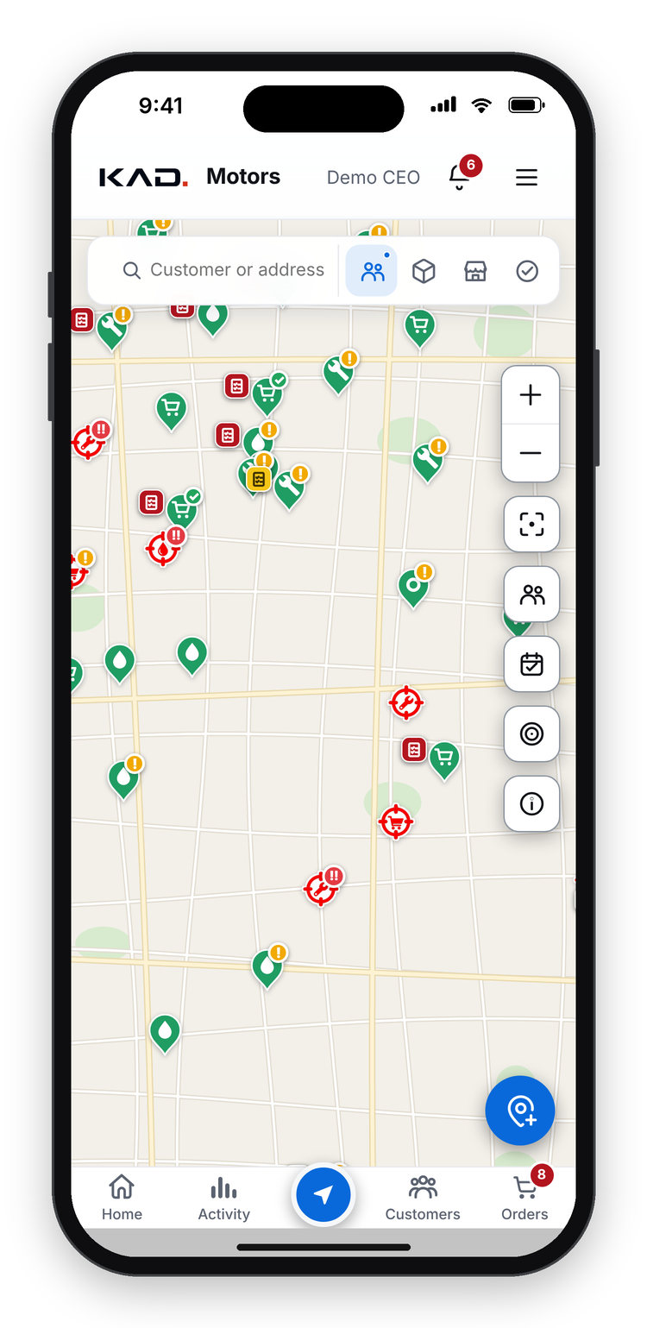
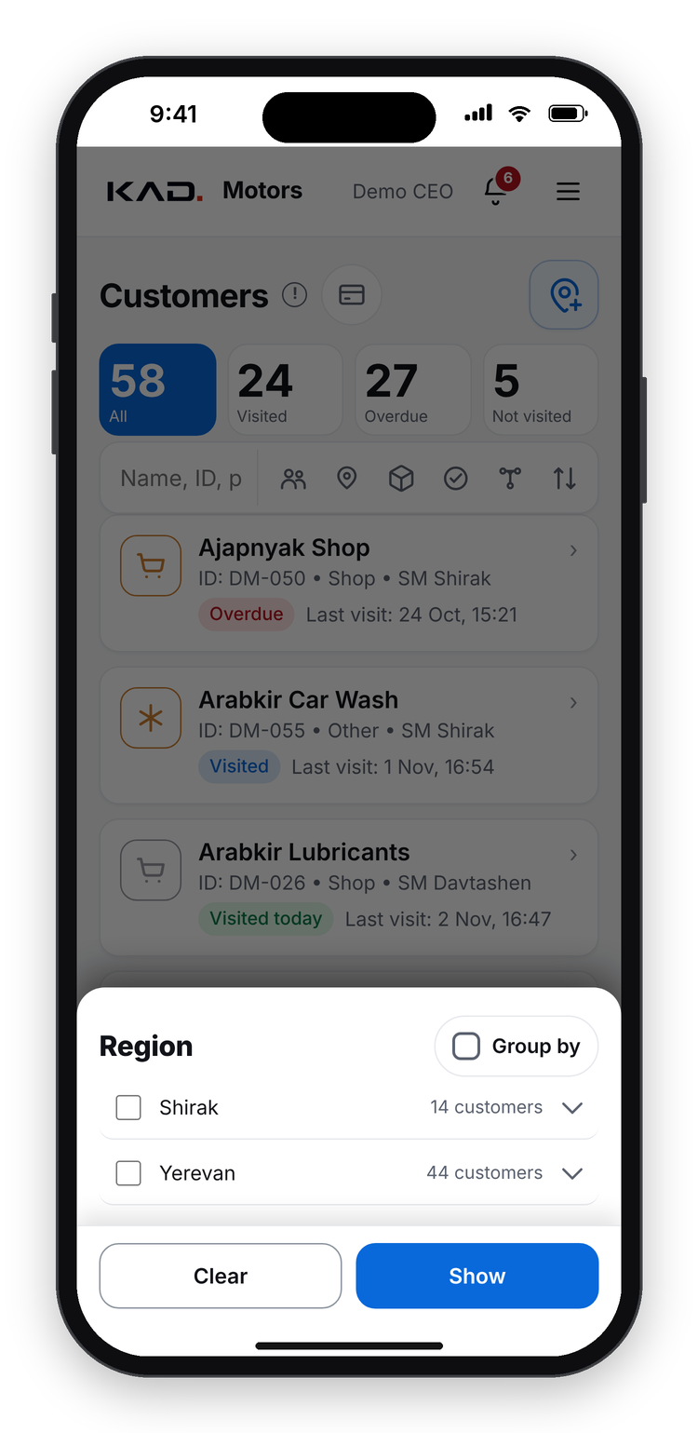
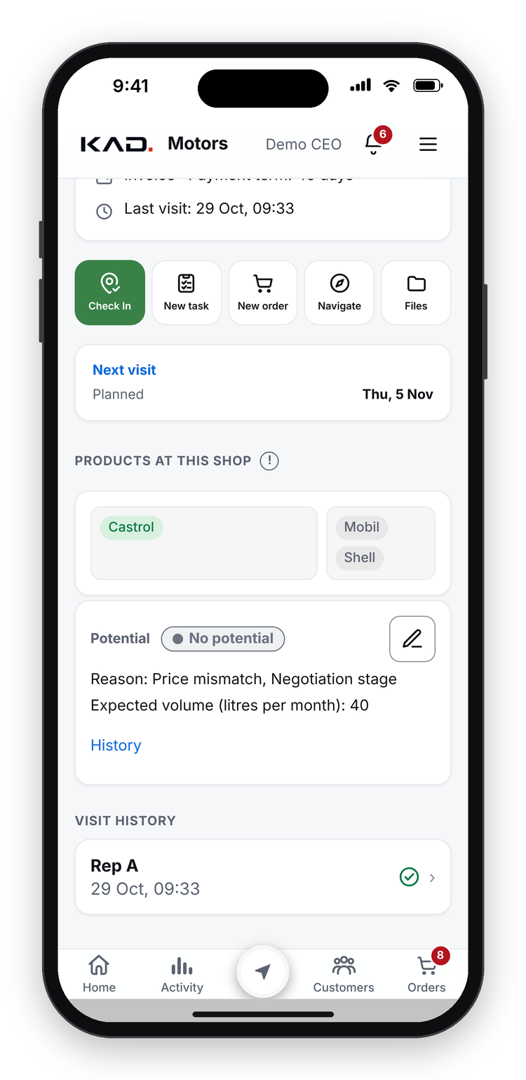
2/5 · THE BRAND SEES EVERY FIELD
CUSTOMERS & FILTERS
Every customer on one map, found in seconds
1
Every customer on the map
Pins show type and visit status; one tap shows debt, last order, last visit
2
Potential customers too
Shops that do not buy yet, with level, reason and expected litres
3
New customer from the map
Added where the rep stands; region and rep filled in
4
Filters for everything
Channel, rep, region, district, visit status
5
Filter by the shelf
For example: shops with fake product, or without Castrol
Map
Region filter
Potential customer
Why it matters for Castrol: a target list for any campaign in one minute: region, shelf, potential.
KAD OS
The operating system for a modern Castrol distributor
6
powered by Castrol
Notes:
[12:00 - 14:00] KEY MESSAGE: every customer, including the ones that do not buy yet, on one map, and any target list in a minute.
Chapter two, the most important one for this room: the brand sees every field.
Every customer is on the map. A pin shows the type and the visit status, and one tap shows the debt, the last order and the last visit. And not only the shops that buy from us: also the potential customers, with a level, the reason they do not buy yet, for example a price mismatch or a contract with a competitor, and the litres a month we expect. (Right phone.)
When a rep finds a new shop, he adds it straight from the map where he stands; the region and the rep are filled in automatically.
And the filters: channel, rep, region and district, visit status, and, most useful for you, the shelf. All shops with fake product. All shops without Castrol. (Middle phone: regions open into districts.)
So when a campaign needs a target list, it takes one minute, not two weeks.

Slide 7
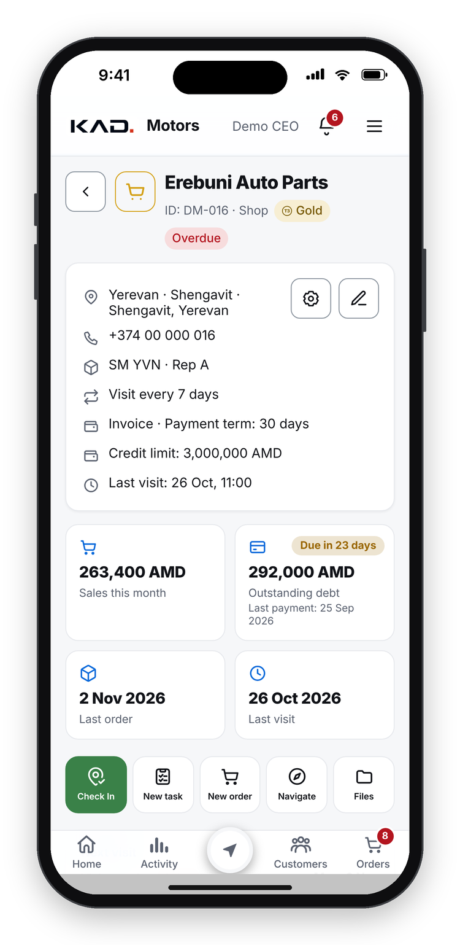
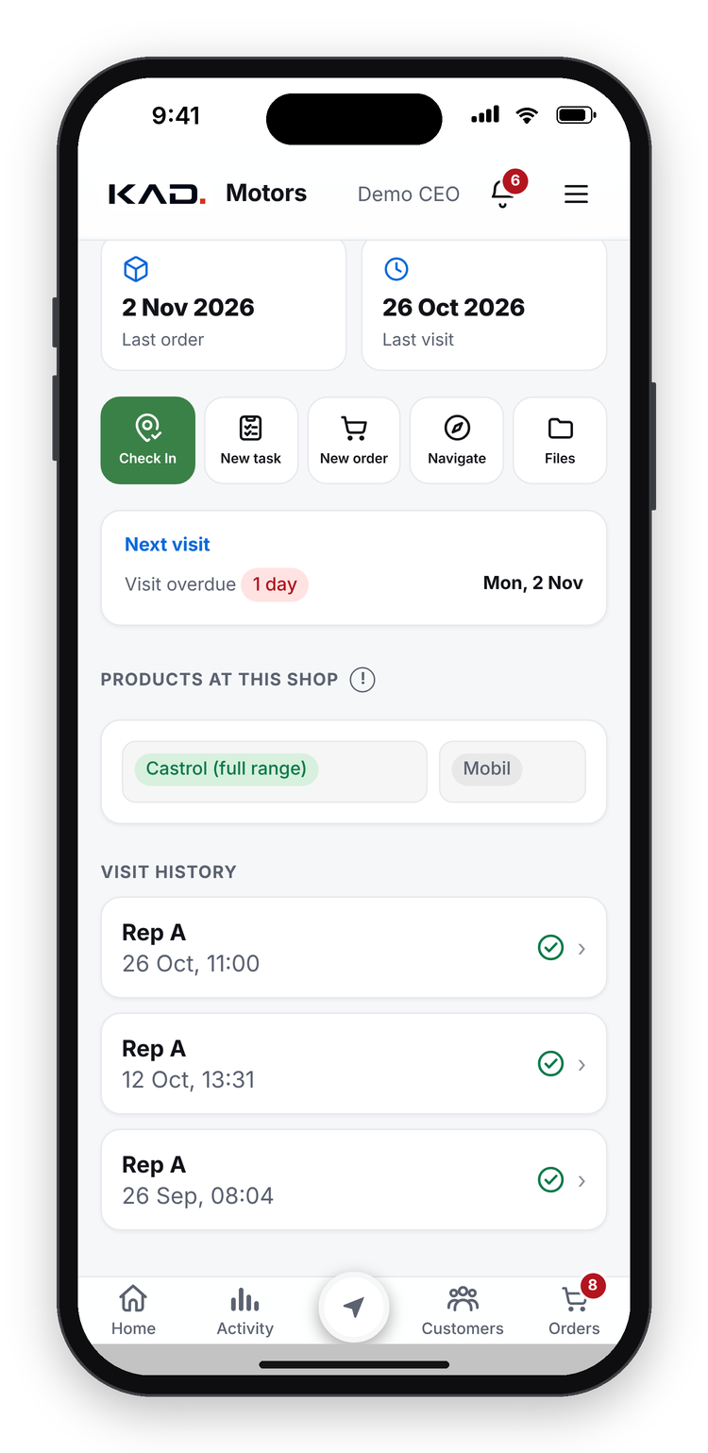
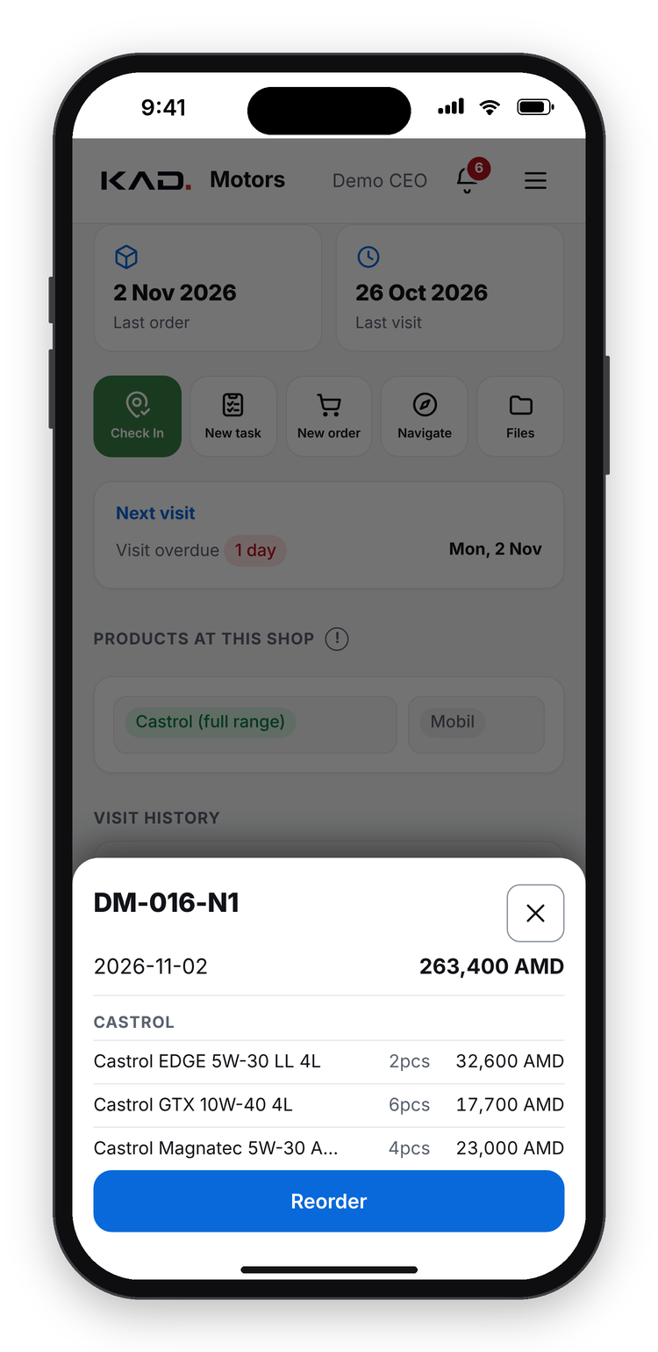
2/5 · THE BRAND SEES EVERY FIELD
CUSTOMER CARD
The whole story of one customer, on one screen
1
Profile
Address, phone, channel, rep, visit frequency, payment term, credit limit
2
Money at a glance
Sales this month, debt with its due date, last payment
3
Dates that matter
Last order, last visit, next planned visit
4
Products at this shop
Castrol on the shelf, full range, competitors seen
5
One tap to the detail
Last order with every line and Reorder; visit history; new task
Top of the card
Scrolled down
Last order
Why it matters for Castrol: the rep walks in knowing the customer: what they buy, what is on the shelf, what they owe.
KAD OS
The operating system for a modern Castrol distributor
7
powered by Castrol
Notes:
[14:00 - 16:00] KEY MESSAGE: before a rep walks in, he knows the whole story of the customer in ten seconds.
The customer card puts everything about one customer on one screen.
At the top the profile: address, phone, channel, rep, how often to visit, the payment term and the credit limit. Then the money at a glance: sales this month, the debt with its due date, and the last payment. The dates that matter: last order, last visit, next planned visit.
Lower down, the products at this shop from the latest shelf check: Castrol on the shelf, the full range, the competitors seen. Then the visit history, and one-tap actions: check in, new task, new order, navigate.
And every tile opens its detail. Tap Last order (right phone) and the whole order opens, with every line and a Reorder button.
Before a rep walks in, he knows what they buy, what is on their shelf and what they owe.

Slide 8
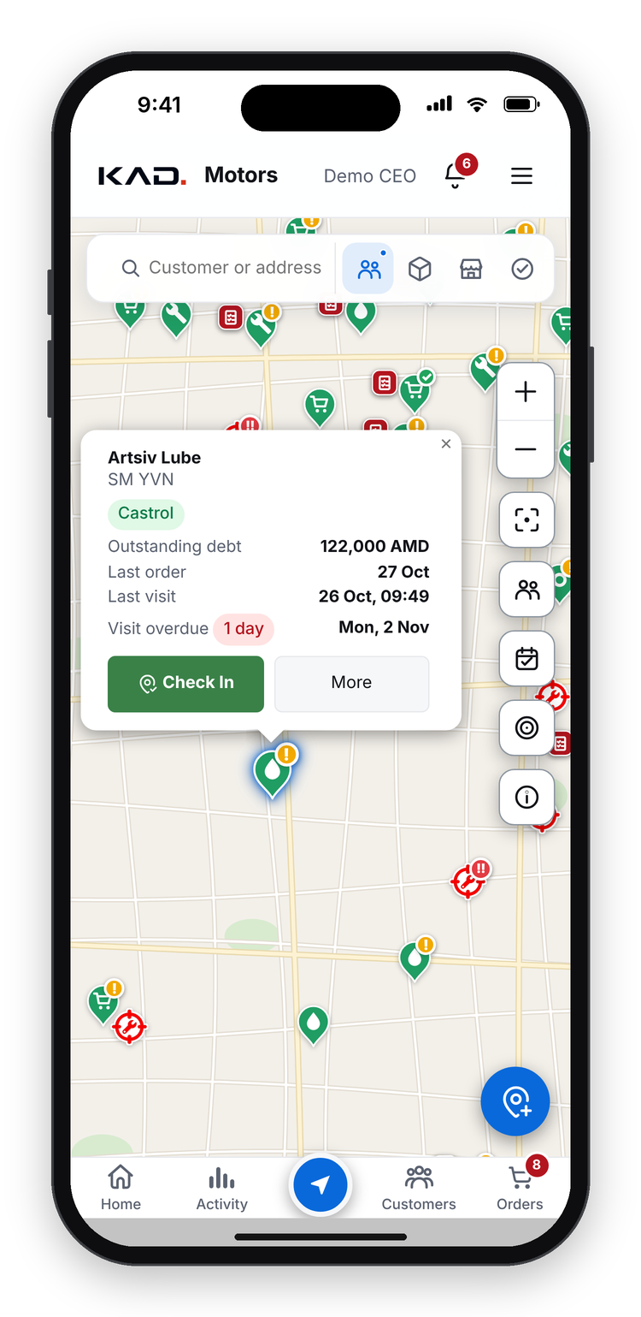
2/5 · THE BRAND SEES EVERY FIELD
FIELD INTELLIGENCE
What the field data gives Castrol sales & marketing
1
Distribution gaps
Shops without Castrol on the shelf, by region and district
2
Fake product hotspots
Every field where fake product was seen, with the visit date and photo
3
Competitor presence
Which brands each shop carries, recorded at every visit
4
Customers to win next
Potential customers with level, reason and expected litres a month
5
Order rhythm
Each customer's usual basket and how often it orders; a gap becomes a task
6
Campaign follow-up
Map pin
Competitors on the shelf
Shelf checks before and after a campaign, field by field
Why it matters for Castrol: you stop asking the distributor for a report and start working from live field data.
KAD OS
The operating system for a modern Castrol distributor
8
powered by Castrol
Notes:
[16:00 - 18:30] KEY MESSAGE: the same field data answers the questions sales and marketing teams ask every month.
So what does all this give Castrol's sales and marketing teams? Six things.
One, distribution gaps: the shops without Castrol on the shelf, by region and district. That is your list for a distribution drive.
Two, fake product hotspots: every field where fake product was seen, with the visit date and the photo. Evidence for action, not a rumour.
Three, competitor presence: which brands each shop carries, recorded at every visit, not once a year.
Four, the customers to win next: potential customers with their level, the reason, and the litres we expect.
Five, order rhythm: each customer's usual basket and how often it orders. When a customer stops ordering, it becomes a task, as you will see in chapter four.
And six, campaign follow-up: the shelf before and after a campaign, field by field.
Think back to my first question: in which shops is our product on the shelf? With KAD OS the answer takes a minute, and a month later the shelf checks show which shops now carry it. That is the difference between hoping and knowing.

Slide 9
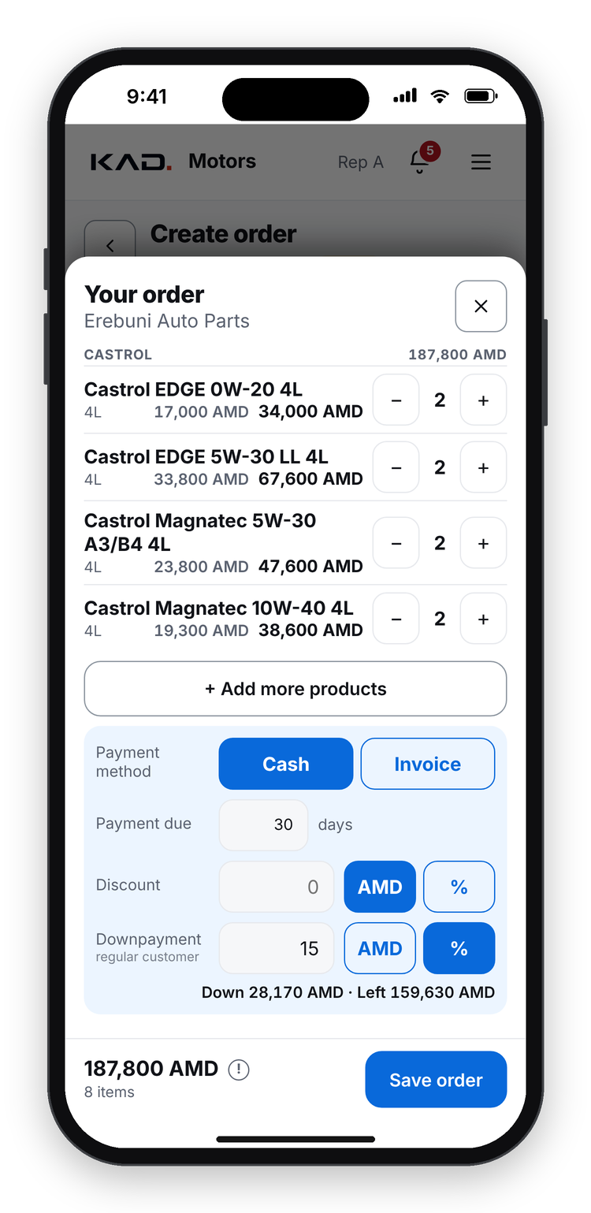
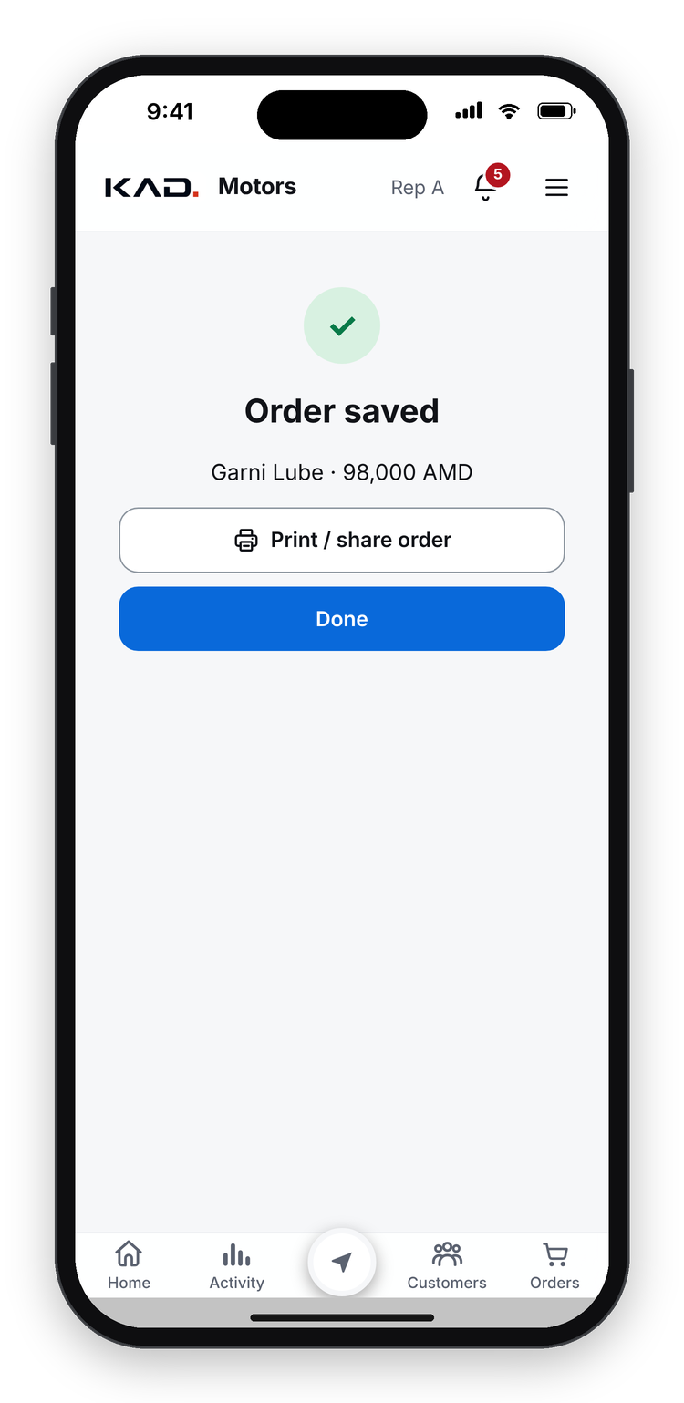
3/5 · ORDERS AND MONEY
ORDERS
Orders in a few taps, at the right price
1
Start the way you want
New order, the usual basket, or repeat a past order
2
Pick products
Frequent products first; brand chips, search, stock shown
3
Prices and offers applied
Customer-level prices; discounts up to 3% automatic
4
Bigger discount? Ask in the app
The request goes straight to the manager to approve
5
Live status
Submitted, confirmed, packed, delivered; everyone sees it
6
Print, sign, photo
Pick products
Review
Saved: print
The order form is ready at once; the signed copy is uploaded
Why it matters for Castrol: the agreed price list and the offers are really applied in the field.
KAD OS
The operating system for a modern Castrol distributor
9
powered by Castrol
Notes:
[18:30 - 20:45] KEY MESSAGE: no more orders by phone or paper; prices, offers and discount rules are applied automatically.
Chapter three: orders and money.
Before, orders came by phone, or on paper with a pen, and the price depended on who wrote it. Now the order is in the app.
The rep starts a new order, the customer's usual basket, or a repeat of a past order. The products this customer buys often come first, with brand chips, search and the stock shown.
The prices for this customer's level and the offers are applied automatically, and a discount up to 3 percent too. If the rep needs more, he sends the request in the app and it goes straight to the manager to approve. A price below our cost can only be approved by the CEO.
After saving, everyone sees the status live: submitted, confirmed, packed, delivered. And the order form is ready at once: the rep prints it, the customer signs, and the rep uploads a photo of the signed copy.
For the brand it means one thing: the agreed price list and the offers are really applied in the field.

Slide 10
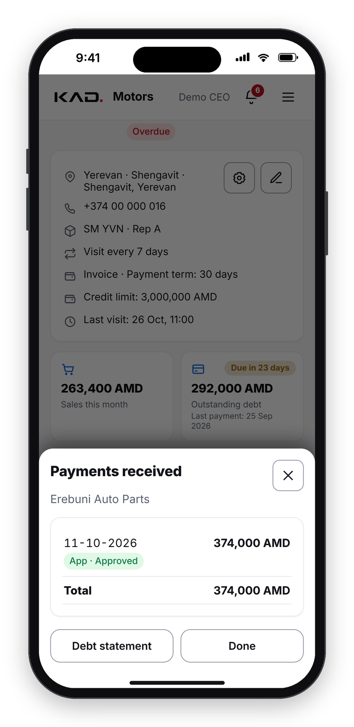
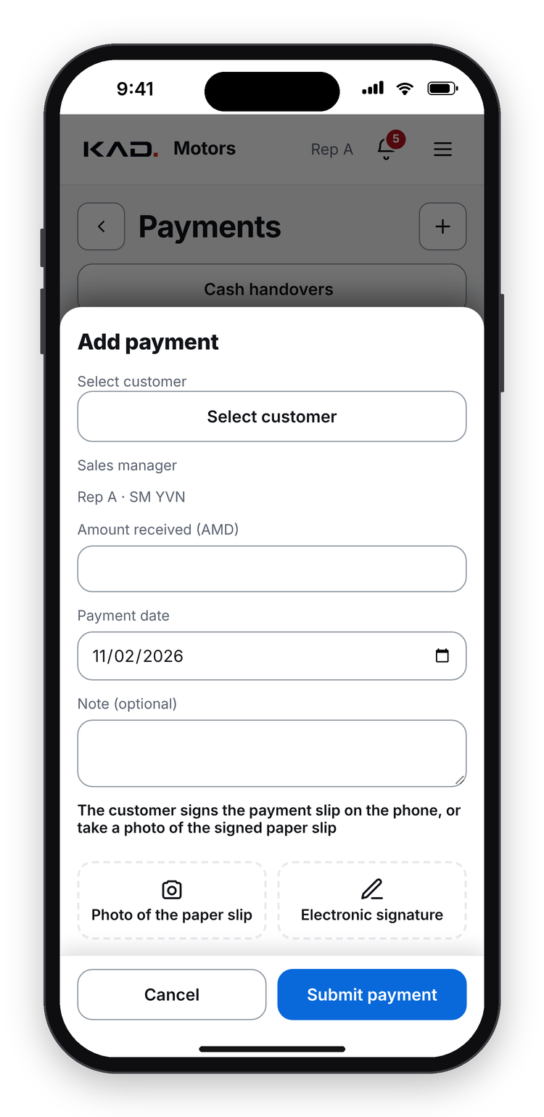
3/5 · ORDERS AND MONEY
DEBT & CASH
Debt in the app: no call to accounting
1
Debt visible to the rep
Per customer and per invoice, with due dates; red when overdue
2
No call to finance
The rep sees the amount to collect before the visit
3
Collection task
Overdue debt becomes a task for the next visit
4
Promise date
A broken promise goes to the sales director
5
Payment at the visit
Recorded on the phone, followed until it reaches the accountant
6
Credit limit
Payments received
Record a payment
Over the limit, the order waits for approval
Why it matters for Castrol: healthy credit keeps the distributor buying, and reps spend their time selling.
KAD OS
The operating system for a modern Castrol distributor
10
powered by Castrol
Notes:
[20:45 - 22:30] KEY MESSAGE: the rep sees the debt himself, so cash collection no longer waits for accounting.
Debt and cash. Before, a rep who wanted to collect money first called accounting or finance: how much does this customer owe? Now he sees it in the app, per customer and per invoice, with the due dates. Overdue invoices are red.
An overdue invoice automatically becomes a collection task for the rep's next visit. The rep records the date the customer promises to pay; if the promise is broken, the sales director is told.
Payments are recorded on the phone during the visit (right phone) and followed until the cash reaches the accountant. And an order over the customer's credit limit waits for approval.
For you this matters because a distributor with healthy credit keeps buying Castrol, and reps who do not wait for accounting spend their time selling.

Slide 11
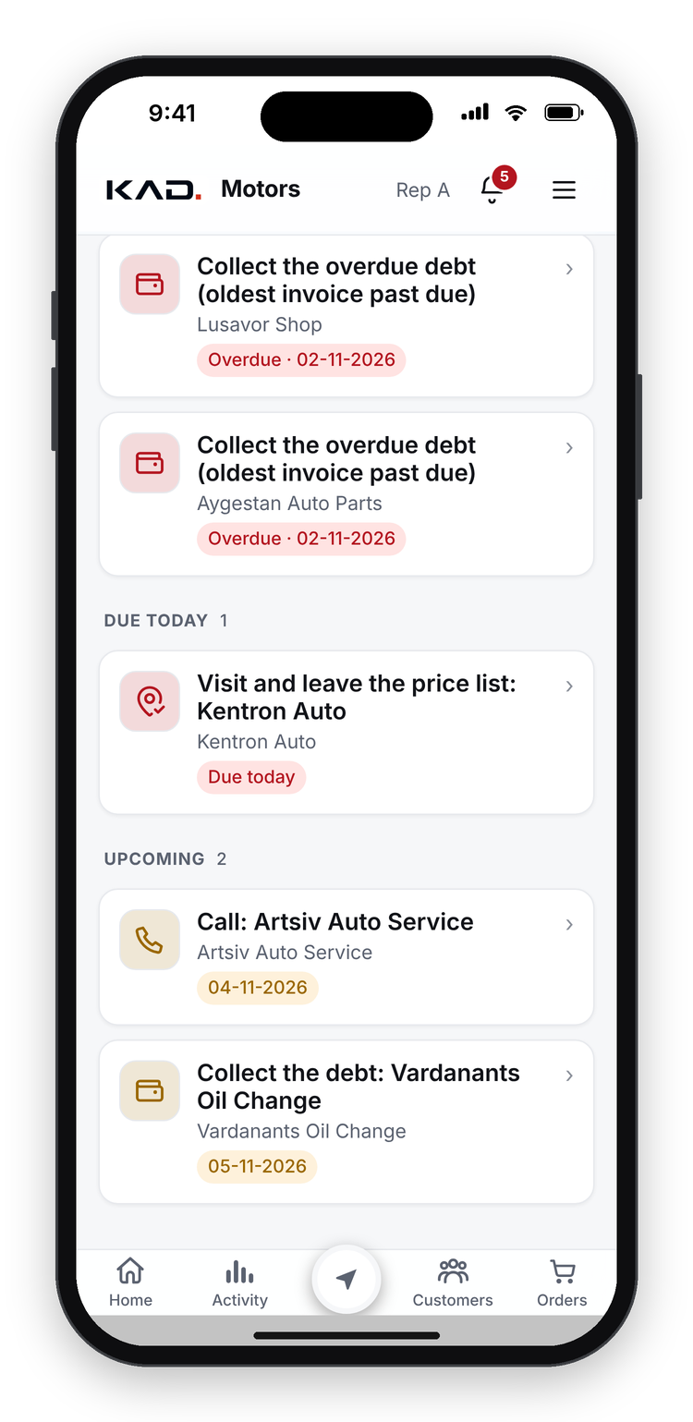
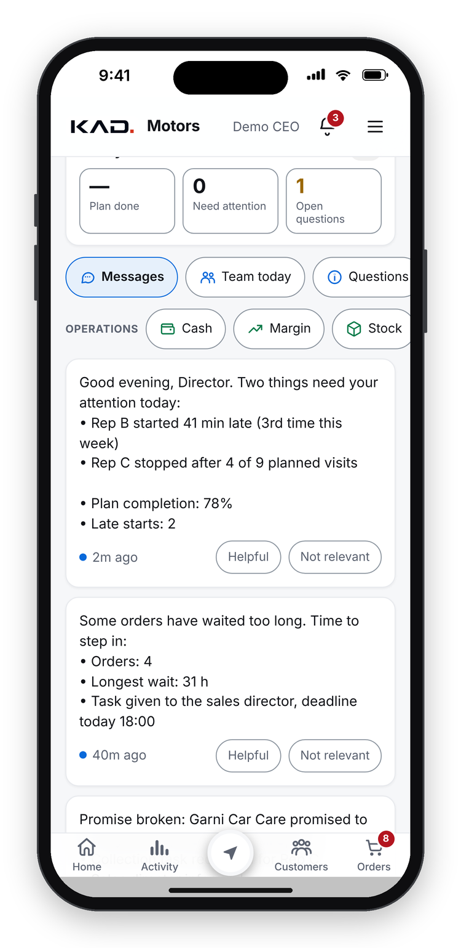
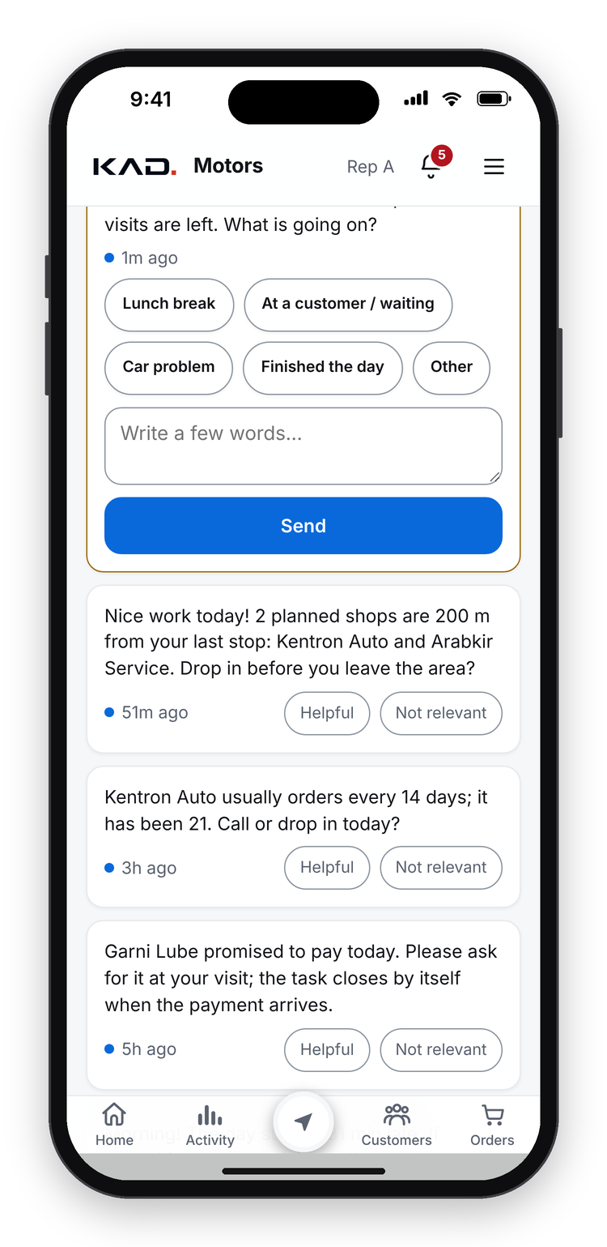
4/5 · AI AND REPORTS
TASKS & AI AGENT
Tasks in the app, created by managers and by AI
1
Manager reviews the visit
Sees everything the rep wrote, ticked and photographed
2
Sets a task in one tap
For any customer, any rep, with a deadline
3
The AI agent checks everything
Every visit, order and payment, one by one, every day
4
It creates and follows tasks
Right person, deadline; closes by itself when done
5
Management hears what slips
Formal with management, friendly with reps
Tasks
AI agent: management
AI agent: rep
Why it matters for Castrol: every problem found in the field becomes a task, and every task is followed to the end.
KAD OS
The operating system for a modern Castrol distributor
11
powered by Castrol
Notes:
[22:30 - 24:45] KEY MESSAGE: every problem found in the field becomes a task, created by a manager or by the AI agent, and followed to the end.
Chapter four: AI and reports.
First, tasks. After each visit the manager can open it and see everything the rep wrote, ticked and photographed. Based on that he sets a task in one tap, for any customer and any rep, with a deadline. (Left phone: the rep's task list.)
Second, the AI agent. In the app we call him Vaghinak. He checks everything, one by one: every visit, every order, every payment, every day. He creates tasks himself, gives them to the right person with a deadline, and closes them when the data shows they are done, for example when the payment arrives.
(Middle phone.) Management gets messages like: "Rep B started 41 minutes late, the third time this week; Rep C stopped after 4 of 9 planned visits." (Right phone.) And the rep gets: "Nice work today. There are two planned shops 200 metres from your last stop. Will you drop in before you leave the area?"
Formal with management, friendly with the reps. Think of him as a team lead who never forgets to follow up.

Slide 12








4/5 · AI AND REPORTS
AI AGENT
How the AI agent decides, assigns and checks
Watches
Notices
Assigns
Checks
Escalates
Orders, payments, visits and check-ins, all day
Something differs from the customer's or rep's usual pattern
A task to the right person, with a deadline
Closes the task by itself when the data shows it is done
Tells management only when it keeps slipping
Customer stopped ordering
Weekly payment missed
Late arrival at the office
Notices: A customer usually orders every 2 weeks. This time no order came.
Does: Task for the rep: go and remind the customer.
Checks: Closes when the next order arrives.
Notices: A customer pays every week. This week there is no payment.
Does: Task for the rep: collect the payment.
Checks: Closes by itself when the rep records the money on the customer card; no double work in Tasks.
Notices: The team starts at the office and checks in there. Arrival is late.
Does: The agent notifies the rep and asks for the reason.
Checks: After the 3rd time, management is notified automatically.
KAD OS
The operating system for a modern Castrol distributor
12
powered by Castrol
Notes:
[24:45 - 27:00] KEY MESSAGE: watch, notice, assign, check, escalate.
How does the agent decide? Five steps. He watches the data all day. He notices when something differs from the usual pattern of a customer or a rep. He assigns a task to the right person, with a deadline. He checks the data to see whether it was done, and closes the task himself. And he tells management only when it keeps slipping.
Three examples. A customer usually orders every two weeks, and this time no order came: the rep gets a task to visit and remind the customer, and it closes when the next order arrives. For the brand, that is a lost order saved.
A customer pays every week, and this week there is no payment: a collection task, which closes by itself when the rep records the money on the customer card.
And the team starts the day at the office: when someone arrives late, the agent asks for the reason, and after the third time management is told.

Slide 13
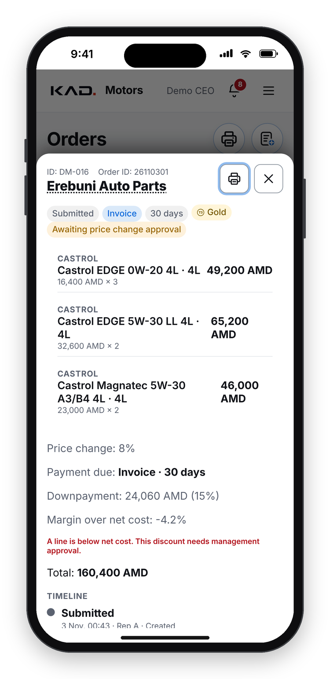




4/5 · AI AND REPORTS
HUMAN APPROVALS
Automation does the work; people approve
Discounts above 3%
Price below our cost
Management approves
Only the CEO approves
Over the credit limit
New orders
Sales director or accountant approves
The sales director confirms
Invoices
Cash and payments
The chief accountant approves and signs
The accountant confirms what was received
Customer data changes by reps
The AI agent itself
Management reviews them
Starts in test mode; management tunes it, then switches it on
Order waiting for approval (demo)
KAD OS
The operating system for a modern Castrol distributor
13
powered by Castrol
Notes:
[27:00 - 28:15] KEY MESSAGE: the system and the AI do the work, but people decide the things that matter.
Because AI can make mistakes, people approve every decision that matters. Discounts above 3 percent: management. A price below our cost: only the CEO. Over the credit limit: the sales director or the accountant. New orders: the sales director. Invoices: the chief accountant approves and signs. Cash: the accountant confirms what arrived. Changes reps make to customer data: management reviews them.
And the AI agent itself started in test mode: management read what it would say and tuned it before switching it on.

Slide 14
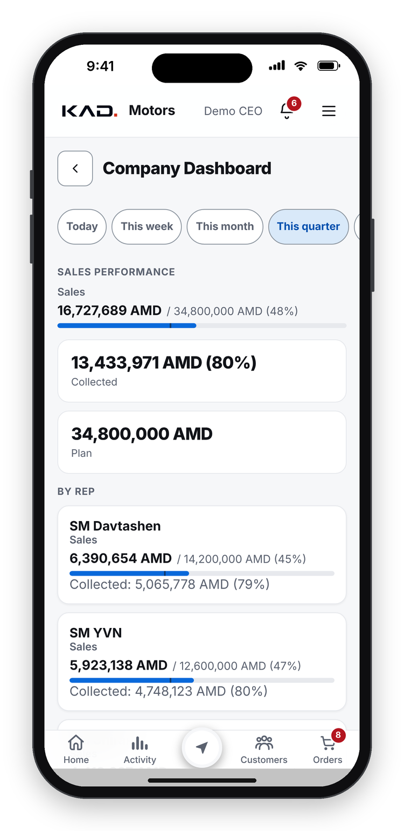
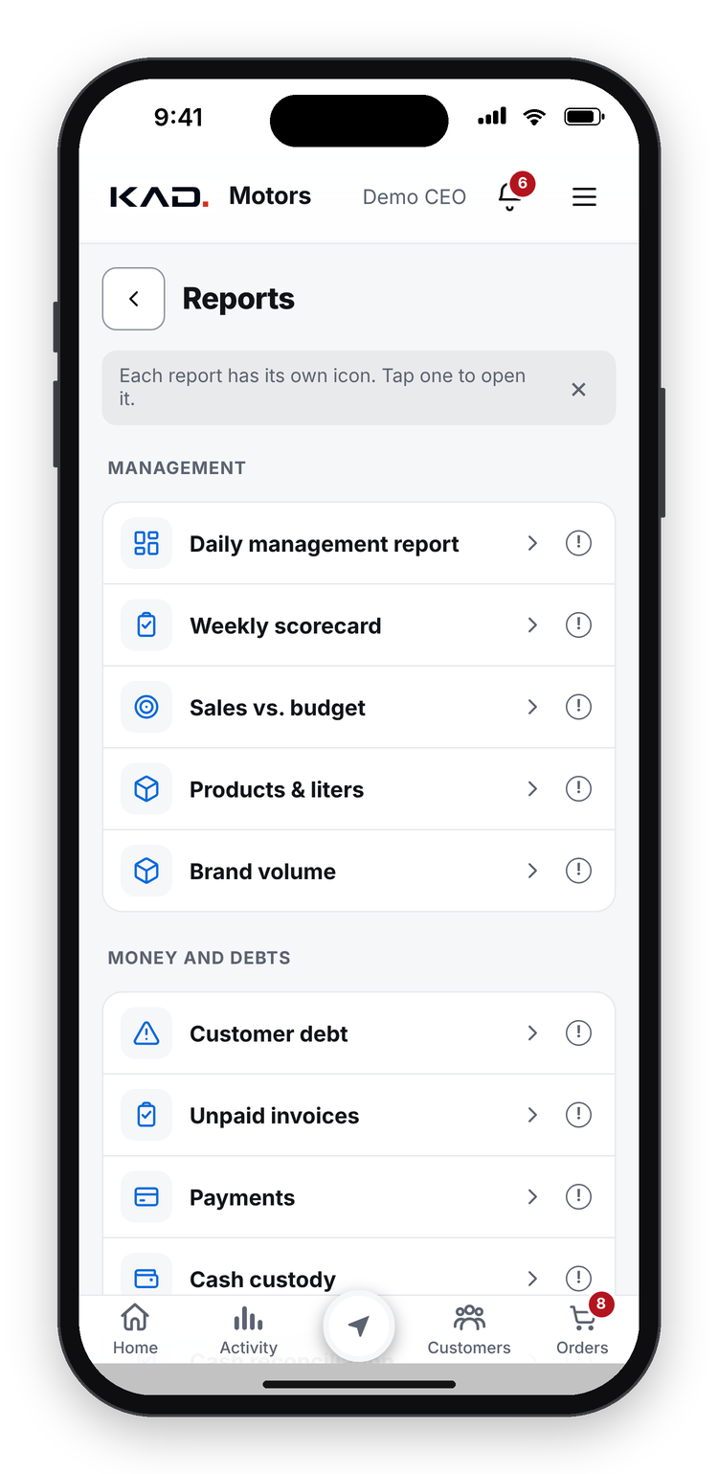
4/5 · AI AND REPORTS
REPORTS
The numbers come to you: live, daily, weekly, monthly
1
Live dashboard
Sales against plan, by rep and by channel
2
Evening report
Sales, volume, cash, debt and stock risks, every day
3
Weekly and monthly
Longer summaries at the end of each period
4
To anyone who needs it
Sales head, CEO, team leads; each sees their own scope
5
Unusual numbers flagged
Anything far from normal is pointed out
Evening report
Dashboard
Reports
Why it matters for Castrol: nobody prepares the report: it is written from the work the team does in the app.
KAD OS
The operating system for a modern Castrol distributor
14
powered by Castrol
Notes:
[28:15 - 30:00] KEY MESSAGE: the numbers come to management by themselves: live, daily, weekly and monthly.
And the reports. Nobody prepares them; they are written from the work the team does in the app.
(Left phone.) Every evening the Executive Assistant sends a short report: sales and volume today and month to date against plan, cash collected and overdue debt, the products about to run out, and any number far from normal. At the end of each week and month it sends a longer summary.
(Middle phone.) The live dashboard: sales against plan, by rep and by channel. (Right phone.) And the full reports: money and debt, sales and litres by product line, the team and the stock.
They go to whoever needs them: the sales head, the CEO, the team leads. Each person sees their own scope: a rep sees only his own customers.

Slide 15
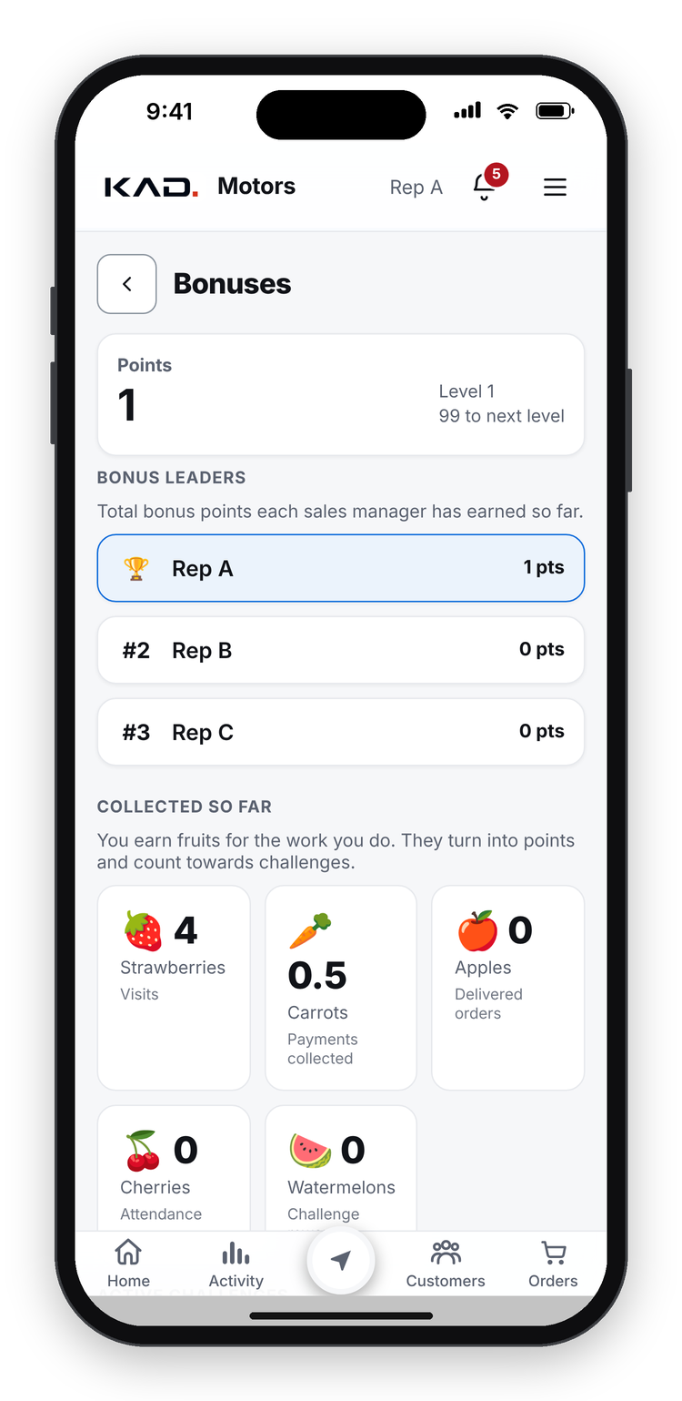
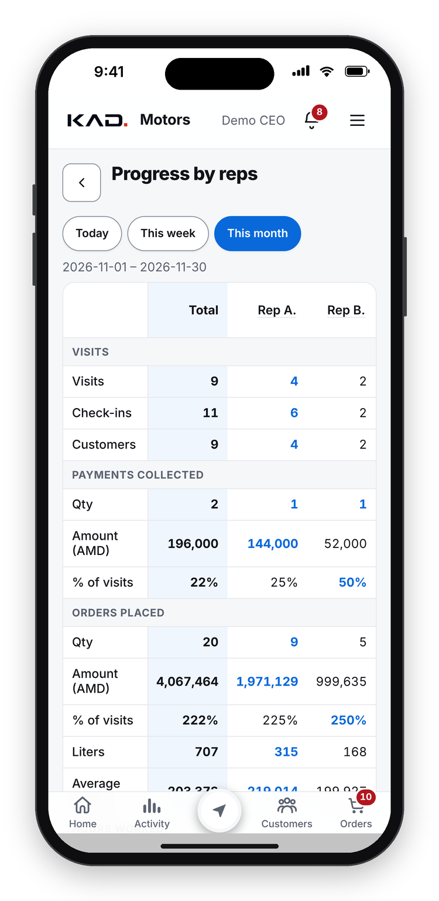
5/5 · ADOPTION AND NEXT
ADOPTION
How we got the whole team to use it
1
The hardest part
New habits: at first not every visit was logged
2
A bonus system
Points for visits, payments, deliveries, attendance and challenges
3
A monthly contest
Most check-ins in the month wins a fixed bonus
4
Visible to everyone
Leaderboard and progress by rep, updated live
5
Still running today
Everything is logged, and the team works more actively
Bonuses and leaderboard
Progress by rep
Why it matters for Castrol: complete field data only comes when the whole team uses the app every day.
KAD OS
The operating system for a modern Castrol distributor
15
powered by Castrol
Notes:
[30:00 - 32:00] KEY MESSAGE: adoption is a people project: make the app save time, make results visible, and reward the habit.
Last chapter, and the question every team lead asks: how do you get a whole team to use it?
Honestly, this was the hardest part. A new app means new habits, and at the start not every visit was logged.
We did two things. A bonus system: reps earn points for visits, collected payments, delivered orders, attendance and small challenges. And a monthly contest: the rep with the most check-ins in the month wins a fixed bonus. The leaderboard and each rep's progress are visible to everyone, live. We still run it today; it pushes the team to log all their work, and the reps simply work more actively.
Three lessons for the team leads here: start with what saves the rep time, like the usual basket and the debt on the card, not with control; make results visible every day; and reward the habit you want until it is normal.

Slide 16
5/5 · ADOPTION AND NEXT
BUILT AND ADOPTED
Live in 3 months, used by the whole team in the 4th month
3 months
4th month
6th month
from first line of code to the first live version
the whole field team working in the app
to the complete system shown today
May → August 2026
September 2026
763 improvements, delivered every week
May 2026
Aug
September
Today
Work starts
First version live
Whole field team in the app
Complete system, weekly updates
KAD OS
The operating system for a modern Castrol distributor
16
powered by Castrol
Notes:
[32:00 - 33:00] KEY MESSAGE: three months to the first live version, the whole team in the fourth.
How long did it take? We started in May 2026. The first version was live three months later, in August. In September, the fourth month, the whole field team was working in the app. And by the sixth month we had the complete system you saw today, improved every week with what the team asked for.

Slide 17


5/5 · ADOPTION AND NEXT
COMING NEXT
Next: KAD OS for our customers
We are opening the app to our customers, so IWS can work with us directly.
Online orders
Offers and discounts
Orders and balance
Notifications
Order any time, at the customer's own prices
Promotions shown on the customer's dashboard
Every order, its status, and the current balance
Automatic, when an order is placed and when a payment arrives, cash or bank
Why it matters: no more manual updates to customers, fewer calls and errors, faster payments, and more frequent Castrol orders.
KAD OS
The operating system for a modern Castrol distributor
17
powered by Castrol
Notes:
[33:00 - 34:30] KEY MESSAGE: next, the customers themselves join KAD OS, and Castrol's offers reach the shop directly.
What comes next answers the last of the eleven questions: do our offers reach the shop?
We are opening KAD OS to our customers, so the workshops can work with us directly. They will order online at any time at their own prices, see offers and discounts on their own dashboard, follow every order and see their balance, and get a notification when an order is placed and when a payment arrives.
Today we still send customers updates by hand; with the customer app that disappears. For Castrol it means a direct channel for promotions to every shop. Imagine launching an offer and seeing in the same week which workshops opened it and ordered.

Slide 18

THREE THINGS TO REMEMBER
1. Every visit is real
KAD OS
GPS-verified check-ins with a shelf check, competitors and a photo.
powered by Castrol
2. The brand sees every field
The operating system for a modern Castrol distributor.
Shelf, fake product, competitors, potential customers and order rhythm.
Thank you. Questions?
3. The team stays on plan
Tasks and an AI agent; the whole team was in the app by month 4.
KAD OS
The operating system for a modern Castrol distributor
18
powered by Castrol
Notes:
[34:30 - 35:00, then questions until 45:00] KEY MESSAGE: repeat the three takeaways slowly, then open the questions.
If you remember three things: one, every visit is real, verified by GPS, with a shelf check. Two, the brand sees every field: shelf, fake product, competitors, potential customers and order rhythm. Three, the team stays on plan, with tasks and an AI agent, and the whole team adopted it within four months.
Thank you. We are happy to take your questions.
(Presenter: repeat each question before answering; keep answers under a minute; backup slides B1 to B7 follow this slide. Stop at 45:00 and offer to continue one to one.)

Slide 19






BACKUP
THE HOME SCREEN
One home screen: every part one tap away
1
Notifications and menu
QUICK ACTIONS
1
Approvals, alerts and settings, top right
Check in
Tasks
start a visit
today's to-dos
2
2
This week's progress
AI agent
Add new customer
Visited today, remaining and overdue customers
messages and questions
from the map
3
Payments & expenses
Debt balances
3
Quick actions
cash and receipts
who owes what
Each tile opens a module (list on the right)
Dashboard
Team performance
sales vs plan
per rep
4
Bottom bar
Reports
Warehouse app
all reports
pack and stock
Home, Activity, Map in the centre, Customers, Orders
4
Driver app
Stock count
routes and delivery
daily counting
KAD OS
The operating system for a modern Castrol distributor
B1
powered by Castrol
Notes:
BACKUP (home screen). The home screen as management sees it: 1, notifications and the menu; 2, this week's progress, visited, remaining and overdue customers; 3, quick actions, each tile opens a module; 4, the bottom bar with Home, Activity, the map in the centre, Customers and Orders. Each role sees its own home: a rep starts with today's tasks, the warehouse with what to pack, the driver with the next stop.

Slide 20
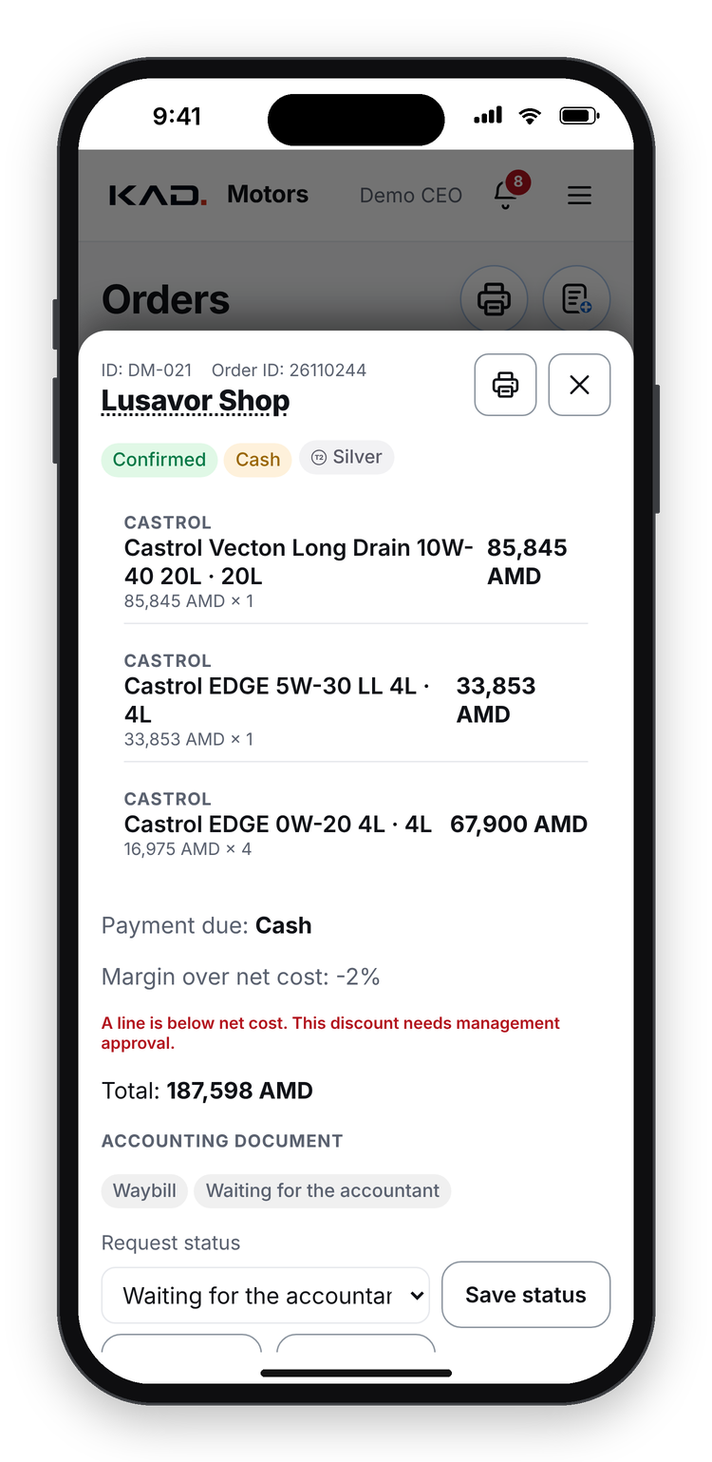
BACKUP
ACCOUNTING & INVOICING
Invoices and delivery documents are created by themselves
1
Rep chooses the payment
Invoice or cash, while making the order
2
Sales director approves
One tap confirms the order
3
Invoice: created automatically
Our invoicing system is connected; the chief accountant only approves and signs
4
Cash: delivery document ready
The driver cannot load goods without it; he gets a notification to download and print
5
Signed copies come back
Customer signs on paper or on the phone; the rep uploads the photo
6
Customer updates
Today we send them by hand; the customer app will show them automatically
Accounting document
Payment: sign or photo
KAD OS
The operating system for a modern Castrol distributor
B2
powered by Castrol
Notes:
BACKUP (accounting and invoicing). The rep chooses invoice or cash while making the order; the sales director approves; for an invoice, the invoice is created through the connected local invoicing system and the chief accountant approves and signs; for cash, the delivery document is created and the driver is notified to download and print it. Signed copies come back as photos. Customer updates are still sent by hand today; the customer app will show them automatically.

Slide 21
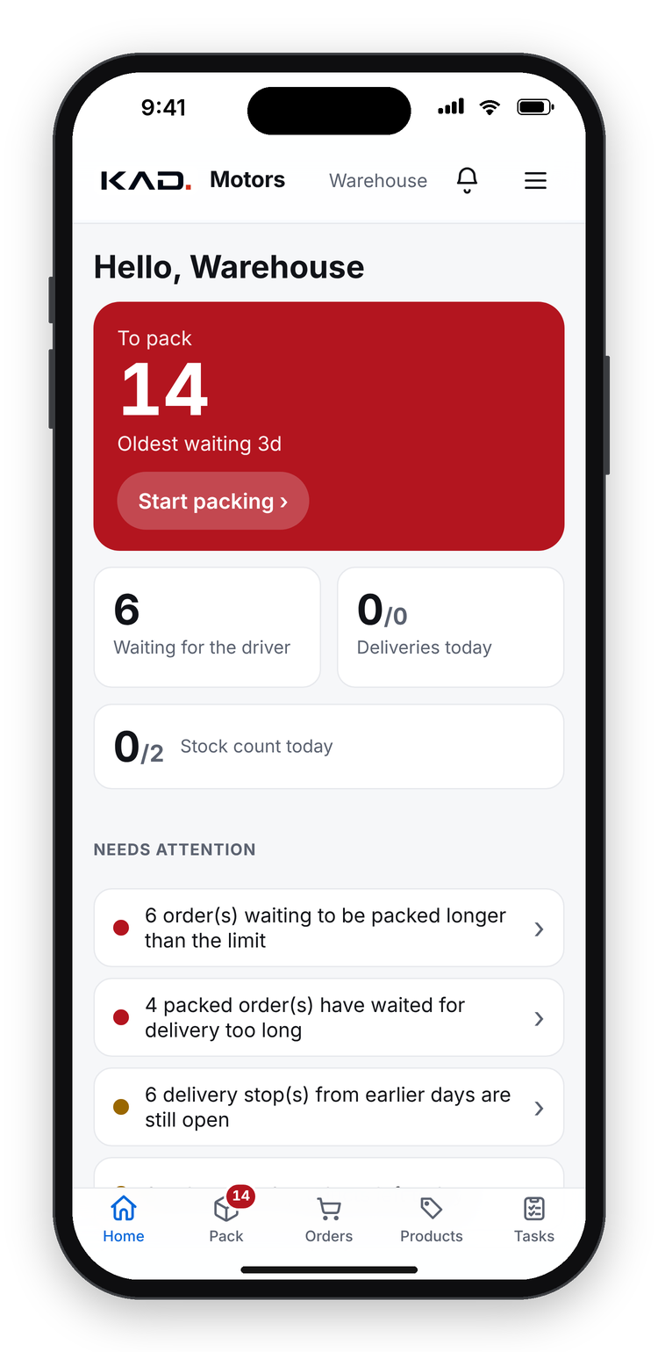
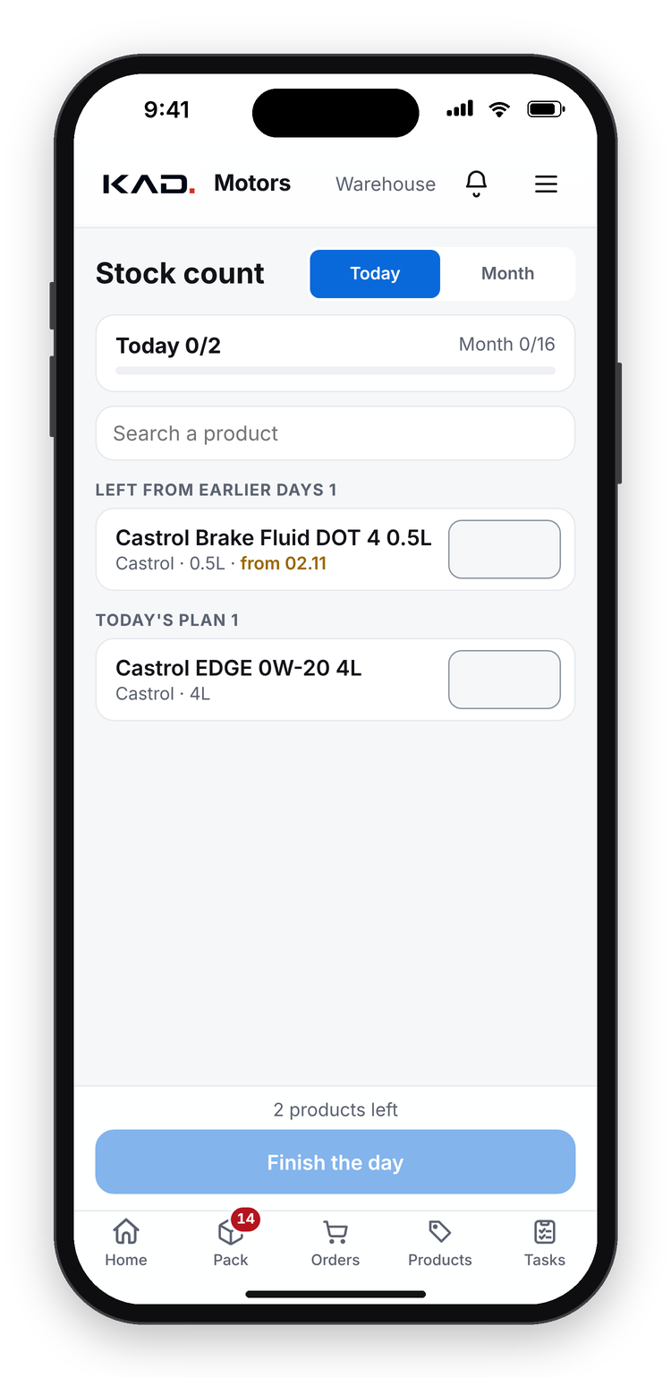
BACKUP
WAREHOUSE
The warehouse packs from the phone
1
What to do now
Home shows orders to pack, the oldest waiting, and what is late
2
Pick and pack
One card per order: tick each line while picking, then Packed
3
By product
One pick list across all orders; short stock in red
4
Problem button
A missing product is reported, not hidden
5
Daily stock count
Every product counted once a month, a few each day, blind
Warehouse home
Pack
Stock count
6
Reorder list
Days of stock left and what to buy
KAD OS
The operating system for a modern Castrol distributor
B3
powered by Castrol
Notes:
BACKUP (warehouse). The warehouse home shows orders to pack, the oldest waiting and what is late. One card per order: tick each line while picking, then Packed. A pick list by product across all orders, with short stock in red, and a Problem button. A daily blind stock count, each product once a month, and a reorder list with days of stock left.

Slide 22
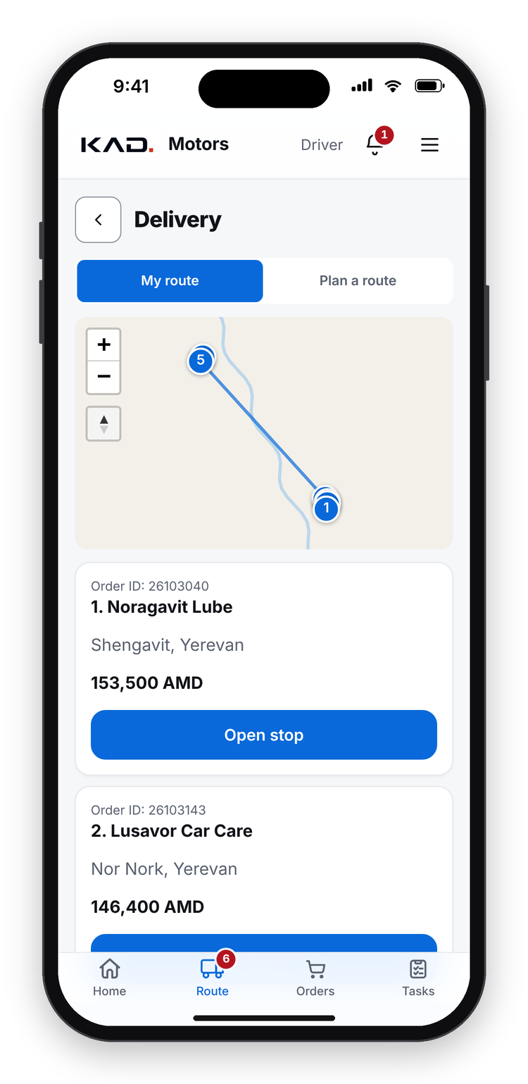
BACKUP
DELIVERY & DRIVER
Deliveries on an optimised route, signed on the phone
1
Route in one tap
Packed orders become a route in the shortest order
2
Next stop first
Navigate and Call buttons; later stops below
3
Arrival detected
When the driver reaches the customer: off, one-tap Delivered, or automatic
4
Customer signs
Signature on the phone; cash collected is recorded
5
Failed delivery
A reason is recorded and the order goes back to the plan
6
Everyone sees it
The order turns Delivered for the rep and the office
Driver home
Route
KAD OS
The operating system for a modern Castrol distributor
B4
powered by Castrol
Notes:
BACKUP (delivery and driver). Packed orders become a route in one tap, in the shortest order. The driver sees the next stop first, with Navigate and Call. Arrival is detected; management chooses whether that does nothing, offers a one-tap Delivered, or marks it delivered automatically. The customer signs on the phone, cash collected is recorded, a failed delivery keeps its reason, and the order turns Delivered for everyone.

Slide 23
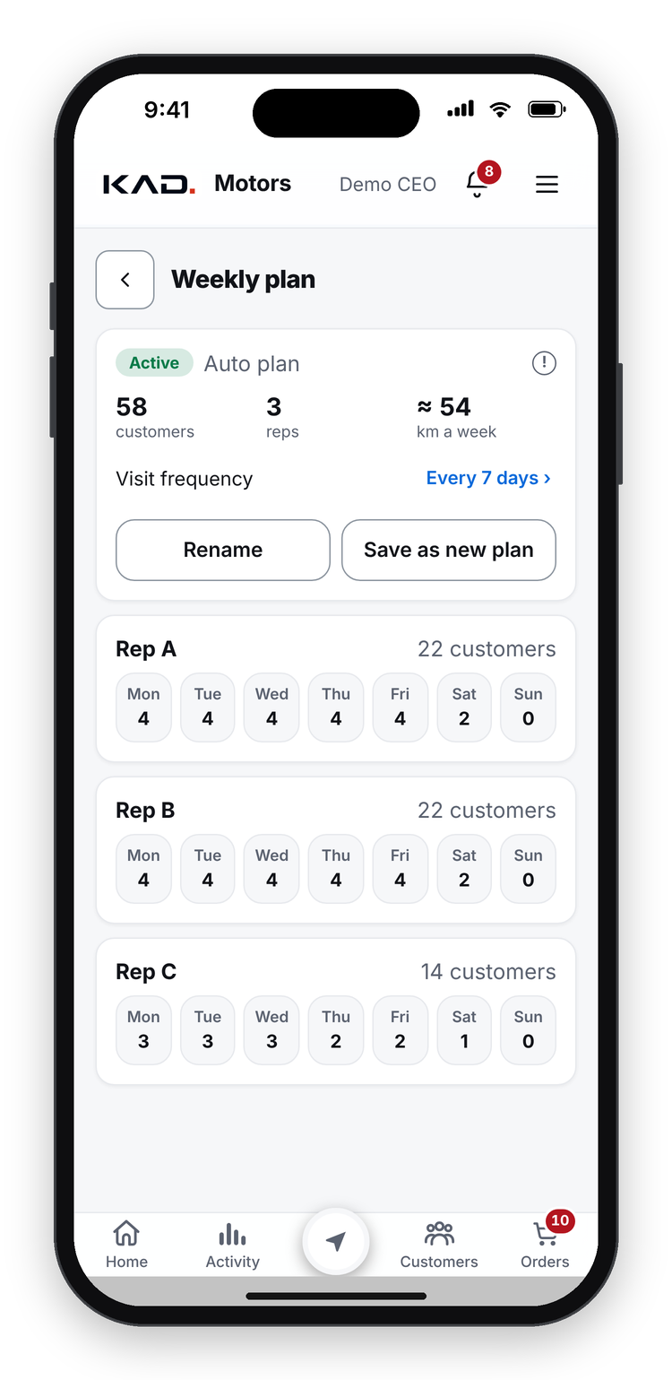
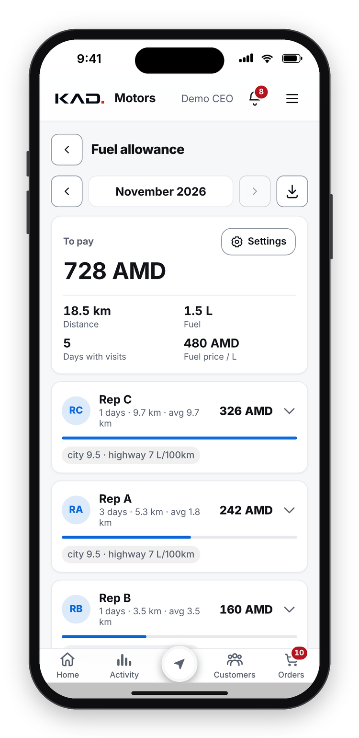
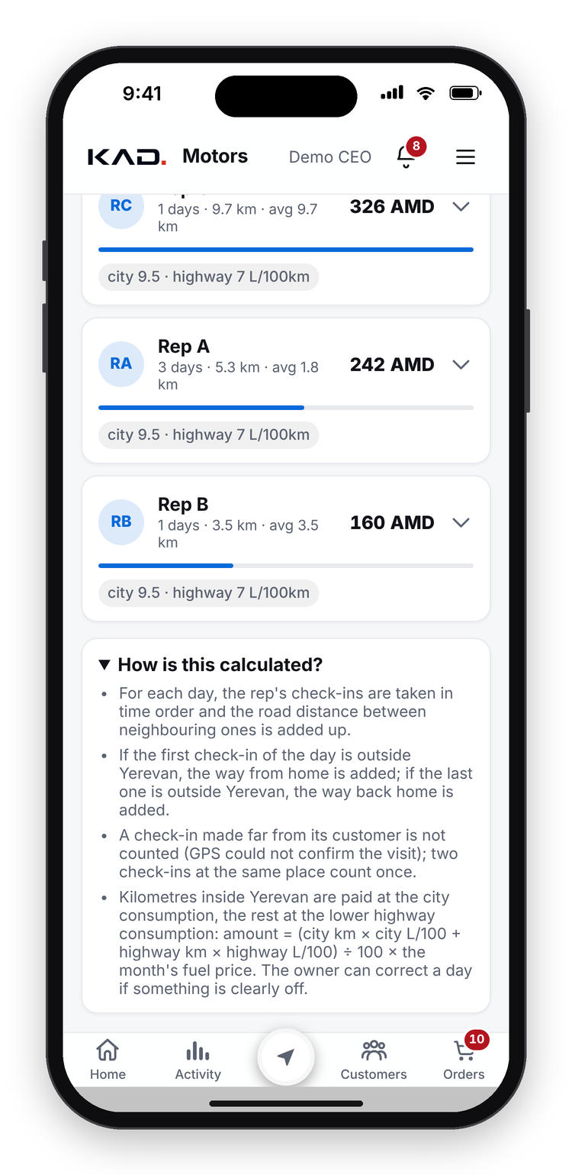
BACKUP
ROUTES & FUEL
Weekly routes for every rep, and a fair fuel allowance
1
Weekly route plan
Built automatically: each rep's customers spread over the week, nearby shops on the same day
2
The real route of the day
The day's check-ins in time order; the road distance between them is added up
3
Only real visits count
A check-in far from its customer is left out; check-ins at one place count once
4
Home legs outside Yerevan
If the day starts or ends outside the city, the way from and back home is added
5
City and highway
Km inside the city at the rep's city consumption, the rest at the lower highway rate
Weekly route plan
Fuel allowance
How it is calculated
6
Amount
Litres x the month's fuel price; unusual days are flagged and management can correct them
KAD OS
The operating system for a modern Castrol distributor
B5
powered by Castrol
Notes:
BACKUP (routes and fuel allowance). Each rep has a weekly route plan, built automatically: the rep's customers spread over the week, nearby shops on the same day. The fuel allowance is calculated from the real day: the check-ins in time order and the road distance between them; a check-in far from its customer is left out; home legs are added outside Yerevan; city and highway kilometres use different consumption; unusual days are flagged and management can correct them.

Slide 24
BACKUP
AI AND AUTOMATION
AI and automatic calculations do the routine work
CALCULATED AUTOMATICALLY
AI analyst: ask your data
Landing cost of every product
True cost at the selling price, for each discount
Management asks a question in plain words and gets an answer with numbers:
Debt age of every invoice
Suggested credit limit per customer
“Which customers bought less EDGE this quarter, and who is their rep?”
Each customer's usual basket and order rhythm
Days of stock left and what to reorder
Optimised delivery route
Customers and staff are hidden behind codes
Read-only, every question logged
Rep working hours and weekly scorecards
Fuel allowance from the real GPS route
KAD OS
The operating system for a modern Castrol distributor
B6
powered by Castrol
Notes:
BACKUP (AI analyst and automatic calculations). Management can ask the AI analyst a question in plain words and get an answer with numbers; customers and staff are hidden behind codes, it is read-only and every question is logged. Calculated automatically: landing cost, true cost at each discount, debt age, suggested credit limit, usual basket and order rhythm, days of stock and reorder list, delivery route, working hours and scorecards, fuel allowance.

Slide 25






BACKUP
BUILT FOR REAL FIELD WORK
Works on any phone, fast, offline and secure
Any phone or PC
Works offline
Fast on cheap phones
Opens from a link; no app store
Visits, orders and counts wait on the phone and send later
Speed is tested on a slow phone
Role-based access
Secure
Data stays with us
Everyone sees only what their role allows
Encrypted connection, protected logins, audit trail
Our data lives in a cloud system
KAD OS
The operating system for a modern Castrol distributor
B7
powered by Castrol
Notes:
BACKUP (built for field work). Any phone or PC from a link, no app store; works offline and sends later; fast on cheap phones (tested on a slow phone); role-based access; encrypted connection, protected logins and an audit trail; our data stays in our own cloud system.

