Slide 1


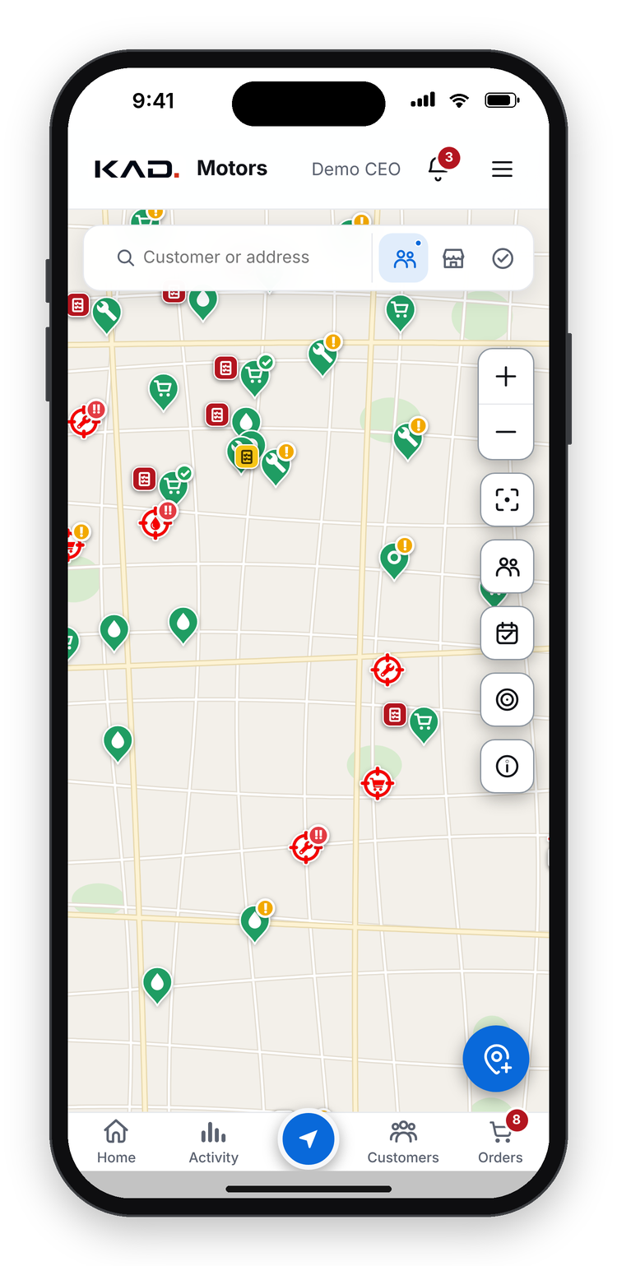
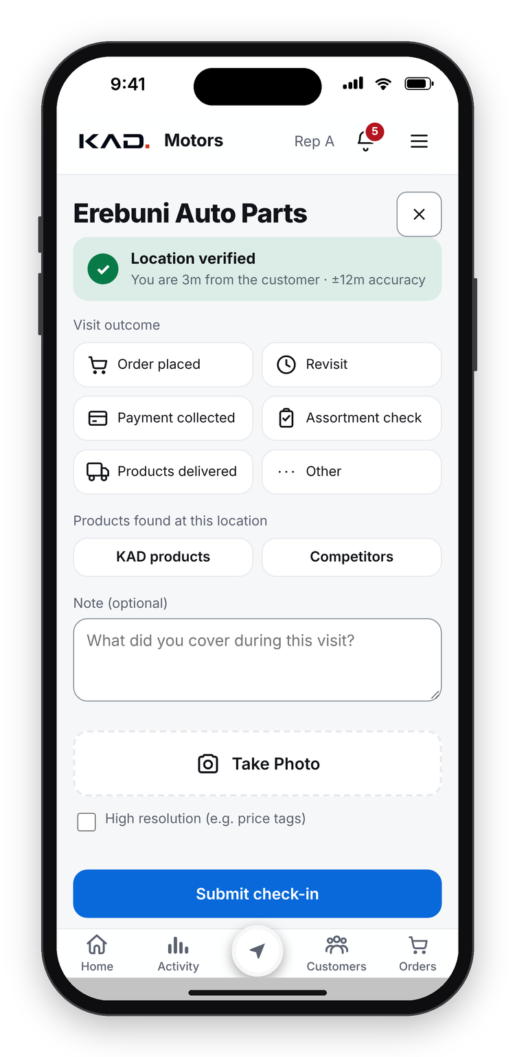
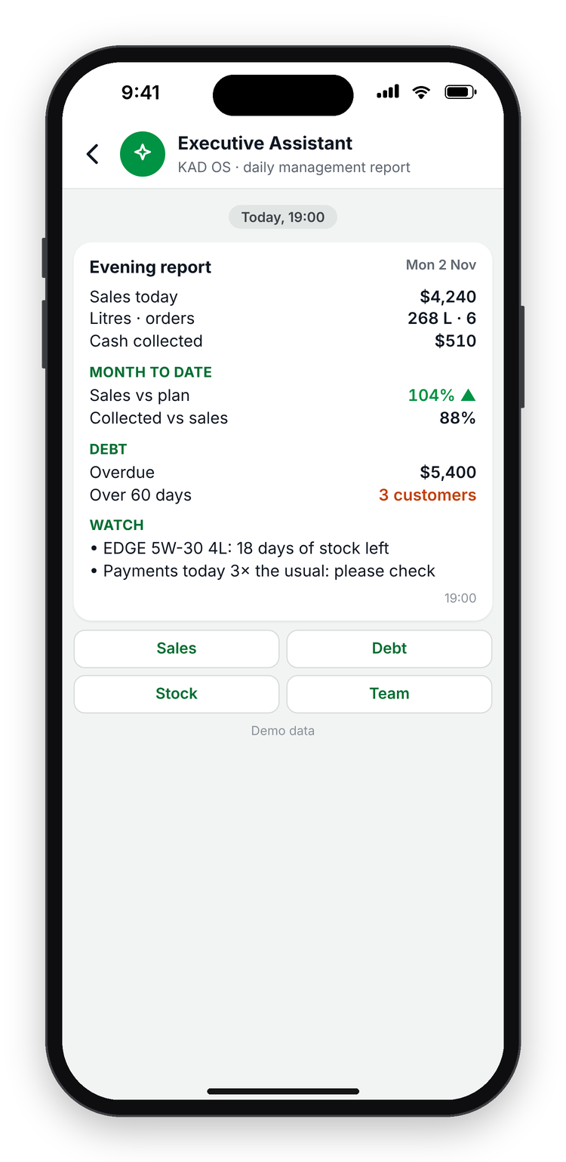
KAD OS
powered by Castrol
The operating system for a modern Castrol distributor.
Introducing the app · KAD Motors, Armenia · November 2026
Demo data
Notes:
Thank you for your time. Today I want to introduce KAD OS, the app our team built to run the daily work of a Castrol distributor. I will show what it is, how it works, every function, and the problems it solves. The screens use demo data.
"Powered by Castrol" is our proposed co-brand; we would use it only with Castrol's approval.

Slide 2






WHAT IS KAD OS?
One app for everyone in a Castrol distributor
Field sales, customers, orders, credit, cash, the team and management reports in one system, with AI that keeps everyone on plan.
Sales reps
Sales director
Warehouse
Accountant
CEO
Visit, check in, take orders and payments
Plans routes, approves prices and credit
Sees confirmed orders to pack and ship
Invoices, payments and cash
Live dashboards and an evening report
Opens from a link on any iPhone, Android phone or PC. No app store. Works without signal.
KAD OS
The operating system for a modern Castrol distributor
2
powered by Castrol
Notes:
KAD OS is one app for everyone in a distributor. Sales reps use it to visit customers, check in, take orders and collect payments. The sales director plans routes and approves prices and credit. The warehouse sees which confirmed orders to pack and ship. The accountant handles invoices, payments and cash. And the CEO sees live dashboards and gets an evening report.
Everyone opens it from a link on the phone or PC they already have. There is no app store and no installation project, and it keeps working without signal.

Slide 3







PROBLEMS IT SOLVES
Six everyday problems, and how KAD OS solves each one
Visits nobody can check
Orders by phone, wrong prices
GPS check-in with a photo at the outlet
Orders in the app at fixed price lists
Overdue debt found too late
No view of the shelf
Debt per invoice and automatic collection tasks
A Castrol shelf check at every visit
Reports that take days
Problems noticed too late
Live dashboards and an evening report
An AI deputy director gives and chases tasks
KAD OS
The operating system for a modern Castrol distributor
3
powered by Castrol
Notes:
These are six everyday problems of a distributor, and the answer KAD OS gives to each.
Visits nobody can check: now every visit is a GPS check-in with a photo. Orders by phone with wrong prices: orders are made in the app at fixed price lists. Overdue debt found too late: debt is tracked per invoice and becomes a collection task automatically. No view of the shelf: reps record a Castrol shelf check at every visit. Reports that take days: dashboards are live and management gets an evening report. Problems noticed too late: an AI deputy director gives tasks to the right person and chases them.

Slide 4


HOW IT WORKS
How KAD OS works, in four simple steps
1. The team works in the app
2. KAD OS checks the rules
3. AI spots problems
4. Management sees it live
Visits, orders and payments are recorded where they happen
Prices, discounts, credit and stock, at once
Gives a task to the right person, with a deadline
Dashboards, reports and an evening summary
One cloud system. Customers, products, orders, money and tasks live in one secure database. The accounting system is connected through the integration API, so nobody types anything twice.
KAD OS
The operating system for a modern Castrol distributor
4
powered by Castrol
Notes:
How does it work? Four simple steps.
One: the team works in the app, so visits, orders and payments are recorded where they happen, at the customer. Two: KAD OS checks the rules at once: prices, discounts, credit and stock. Three: AI spots problems and gives a task to the right person, with a deadline. Four: management sees everything live, in dashboards, reports and an evening summary.
Underneath there is one cloud system: customers, products, orders, money and tasks in one secure database, and the accounting system is connected through an integration API, so nobody types anything twice.

Slide 5
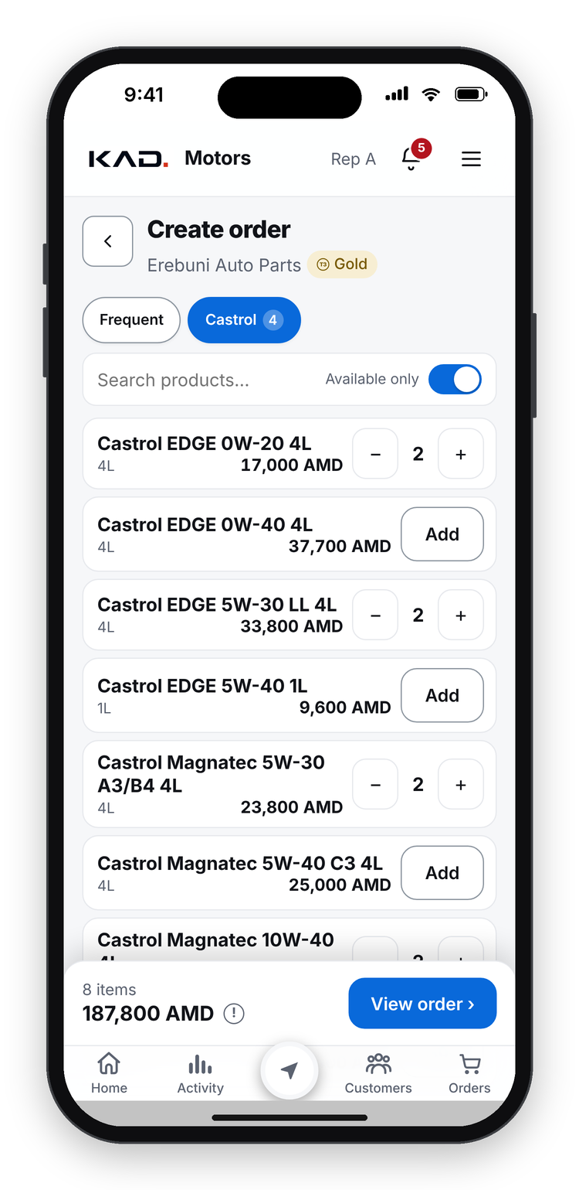
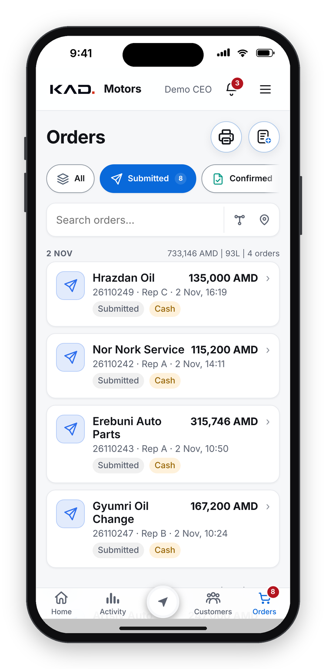
A DAY IN KAD OS
From the shop counter to the CEO's phone, in one flow
09:40
09:52
09:53
19:00
Rep checks in
Takes the order
Manager sees it live
CEO gets the report
GPS + photo at the outlet
Right prices, usual basket
Approves in one tap
Sales, cash, debt, risks
KAD OS
The operating system for a modern Castrol distributor
5
powered by Castrol
Notes:
Here is one day in KAD OS, with demo data. At 09:40 a rep checks in at a shop: the phone confirms the location and the rep adds a photo. At 09:52 the rep takes the order from the customer's usual basket, at the right prices. One minute later the manager sees the order live and approves it in one tap. At 19:00 the CEO gets the evening report: sales, cash, debt and the risks to watch.

Slide 6
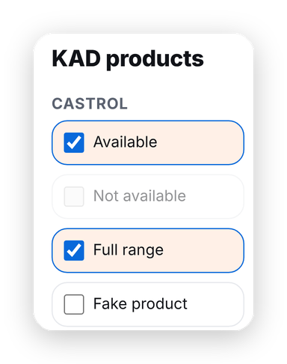





VISITS IN THE FIELD
Every visit is checked and recorded
GPS check-in
Only within 300 m of the outlet (set by management)
Photo proof
A photo and the visit outcome are saved
Shelf check
Castrol on the shelf, full range, fake products, competitors
Open tasks at the visit
The rep sees what to do at this customer
Works without signal
The visit is saved and sent later
Demo data
KAD OS
The operating system for a modern Castrol distributor
6
powered by Castrol
Notes:
Visits in the field are the heart of the app. A rep can check in only near the outlet, within 300 metres by default, a limit management can change. A photo and the visit outcome are saved: order, payment, delivery or assortment check.
At each visit the rep records the shelf: whether Castrol is there, whether the full range is there, and whether there are fake products or competitor brands. The rep also sees the open tasks for this customer. Without signal, the visit is saved on the phone and sent later.

Slide 7
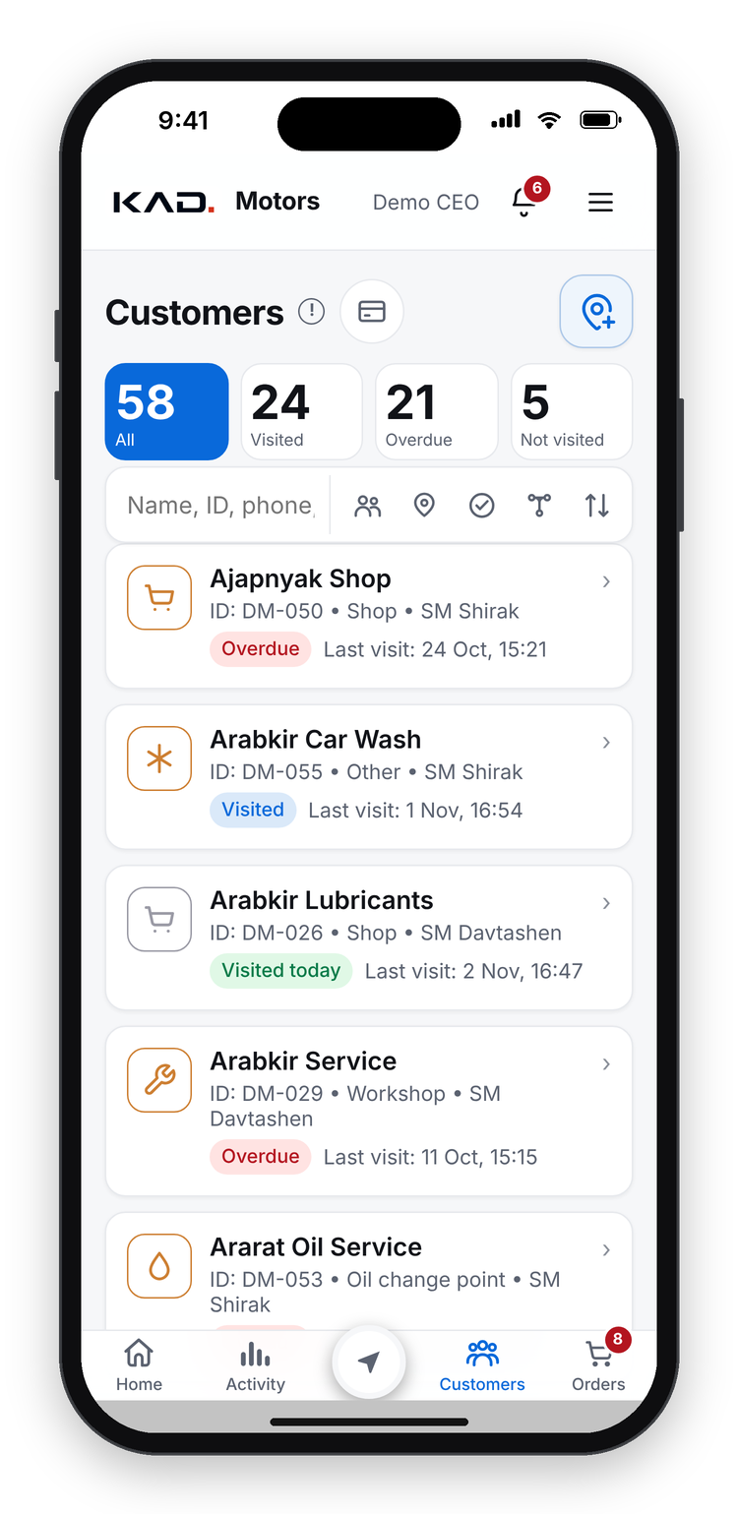




CUSTOMERS & MAP
Every customer, on a map, with everything about them
Customer map
Every outlet, coloured by visit status
Customer card
Contacts, orders, debt, visits, tasks
Visit plans and routes
Weekly routes for every rep, planned automatically
New customers from the map
Add a shop where you stand
Overdue visits
Customers not visited on time are flagged
Demo data
KAD OS
The operating system for a modern Castrol distributor
7
powered by Castrol
Notes:
All customers are on a map, coloured by visit status, and in a searchable list. The customer card shows contacts, orders, debt, visits and open tasks in one place.
Each rep gets weekly visit routes, planned automatically and balanced across the week. A rep can add a new customer directly from the map, where they stand. Customers that were not visited on time are flagged, so nobody is forgotten.

Slide 8




ORDERS
Orders in a few taps, at the right price
Fast ordering
Usual basket, repeat last order, search
Price lists by customer level
Bronze, Silver, Gold; reps never type prices
Discount rules
Over 3% needs approval; below cost, the CEO
Live order status
Draft, submitted, confirmed, packed, delivered
Printable order form
A delivery act for the customer to sign
Demo data
KAD OS
The operating system for a modern Castrol distributor
8
powered by Castrol
Notes:
Ordering takes a few taps: start from the customer's usual basket, repeat the last order, or search. Prices come from price lists by customer level, Bronze, Silver or Gold, and reps never type prices.
Discount rules are built in: up to 3% is automatic, more needs approval, and anything below our cost needs the CEO. Everyone sees the order's status live, from draft to delivered, and the app prints the delivery form the customer signs.

Slide 9
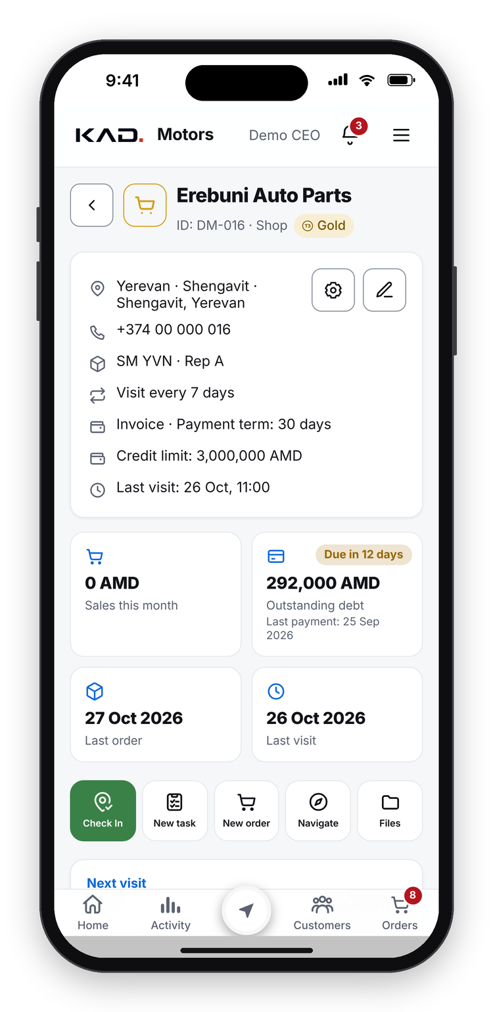
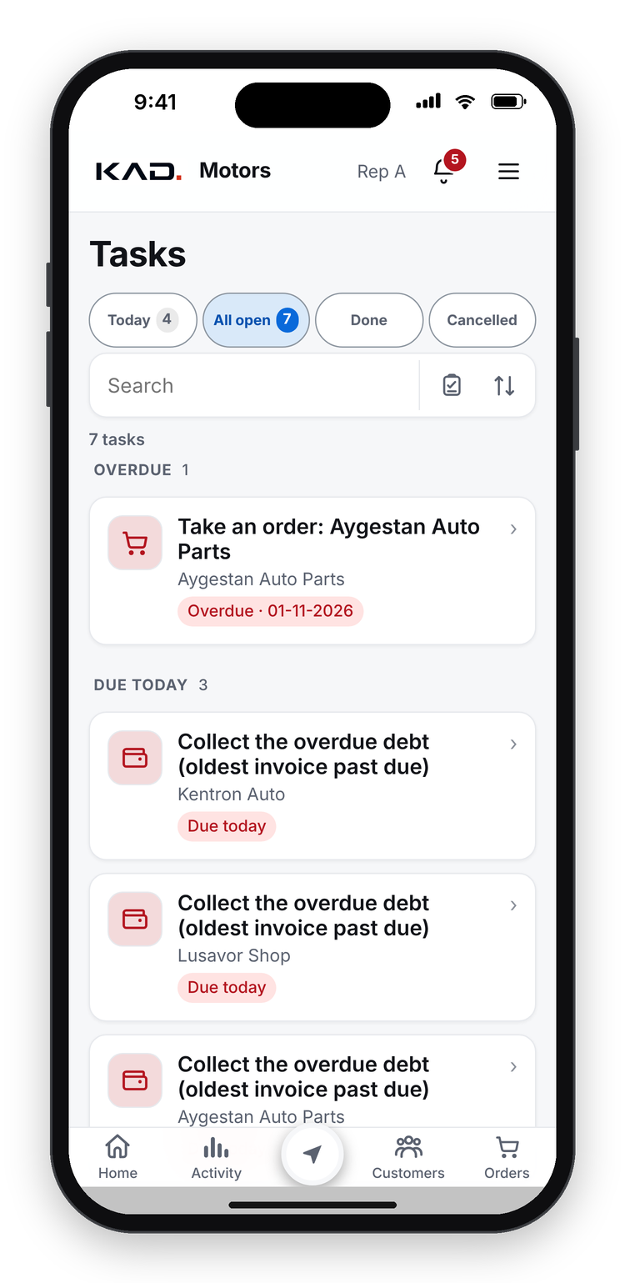



CREDIT, DEBT & CASH
Credit and cash under control, without chasing
Credit limits
Over the limit, the order waits for approval
Debt per invoice
Every unpaid invoice with its due date
Collection tasks
Overdue debt becomes a task with a promise date
Payments at the visit
Recorded and tracked to the accountant
Debt statement
A one-page PDF for the customer
Demo data
KAD OS
The operating system for a modern Castrol distributor
9
powered by Castrol
Notes:
Every customer can have a credit limit; an order over the limit waits for approval. Debt is tracked invoice by invoice, each with its due date.
When an invoice is overdue, the rep automatically gets a collection task, and can record the customer's promise date; a broken promise goes to the sales director. Payments are recorded at the visit and tracked until they reach the accountant, and the app produces a one-page debt statement for the customer.

Slide 10
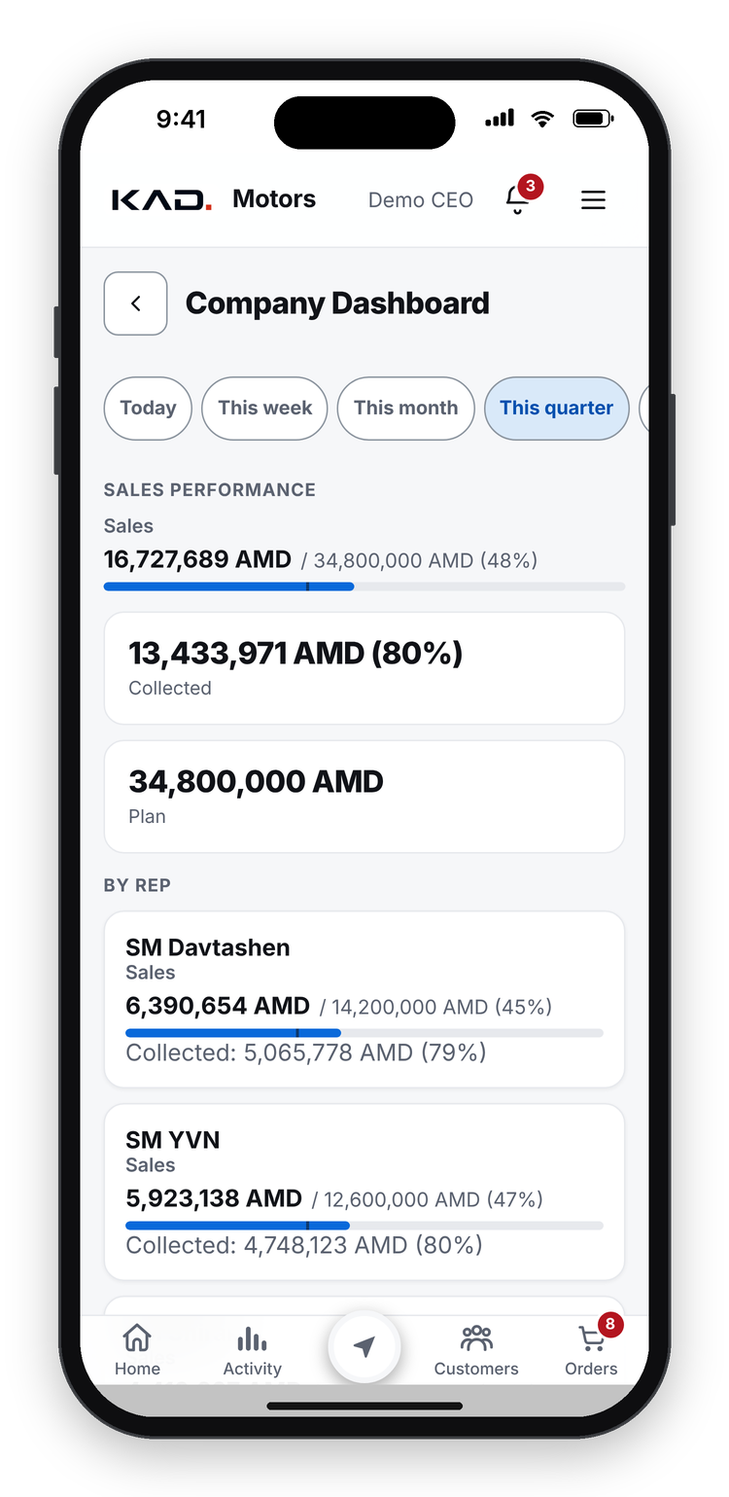
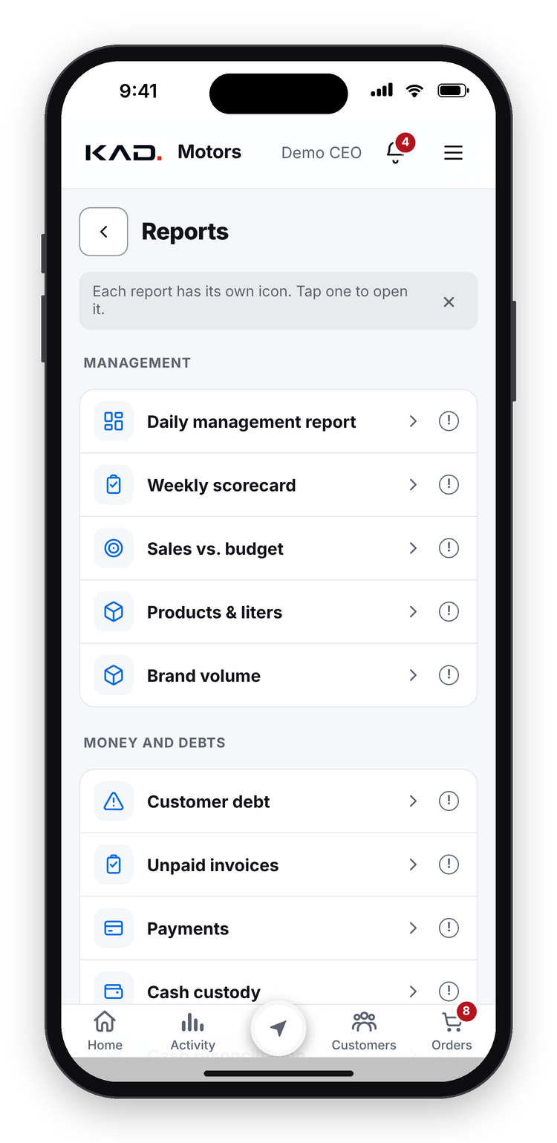


MANAGEMENT
Management sees the business live
Live dashboard
Sales against plan, by rep and channel
Targets and bonuses
Each rep sees plan, progress and points
Team scorecards
Visits, orders and payments per rep, each week
Reports
Money and debt, sales and litres, team, stock
Right data for each role
A rep sees only own customers
Demo data
KAD OS
The operating system for a modern Castrol distributor
10
powered by Castrol
Notes:
Management sees the business live. The dashboard shows sales against plan by rep and by channel. Every rep sees their own targets, progress and bonus points, and management gets a weekly scorecard per rep.
Reports cover money and debt, sales and litres by product line, the team, and stock. And each person sees only what their role needs: a rep sees only their own customers.

Slide 11
EXECUTIVE ASSISTANT
An evening report on the CEO's phone, every day
Sales and volume
Today and month to date, against plan
Cash and debt
Collected today, overdue, oldest debts
Stock risks
Products about to run out
Unusual numbers
Anything far from normal is flagged
Weekly and monthly
Longer summaries at the end of each period
Demo data
KAD OS
The operating system for a modern Castrol distributor
11
powered by Castrol
Notes:
The KAD OS Executive Assistant sends the CEO a report every evening. It covers sales and volume, today and month to date against plan; cash collected and overdue debt; products about to run out; and any number that is far from normal. At the end of each week and month it sends a longer summary.

Slide 12
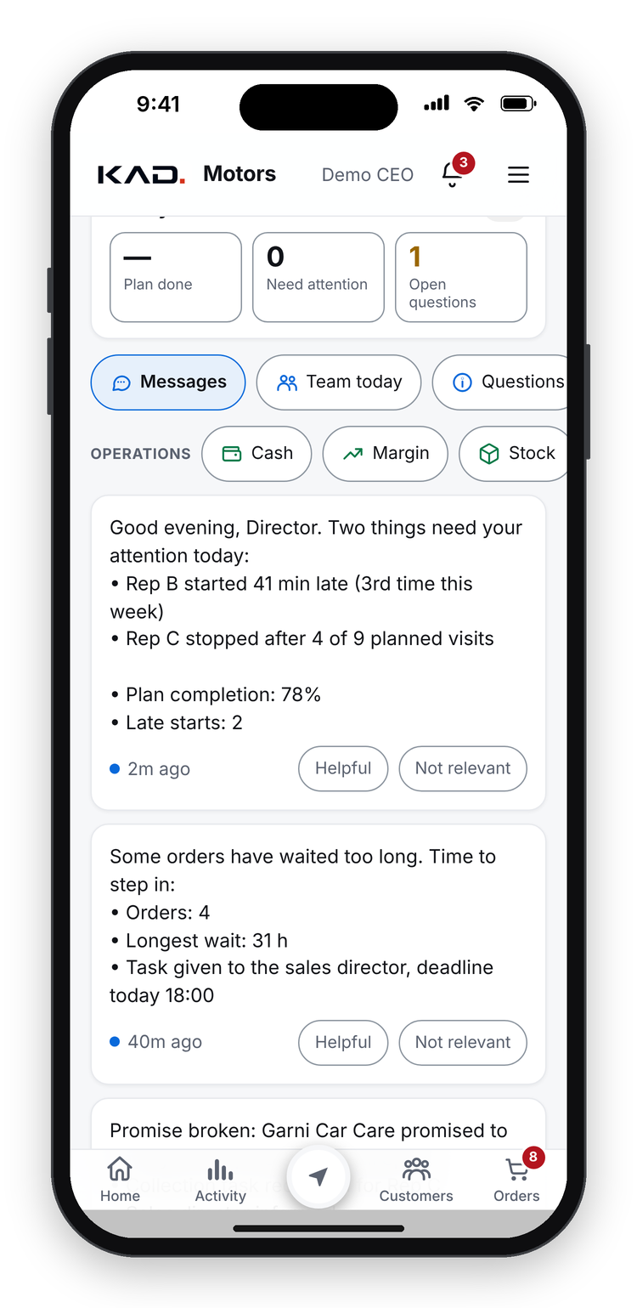
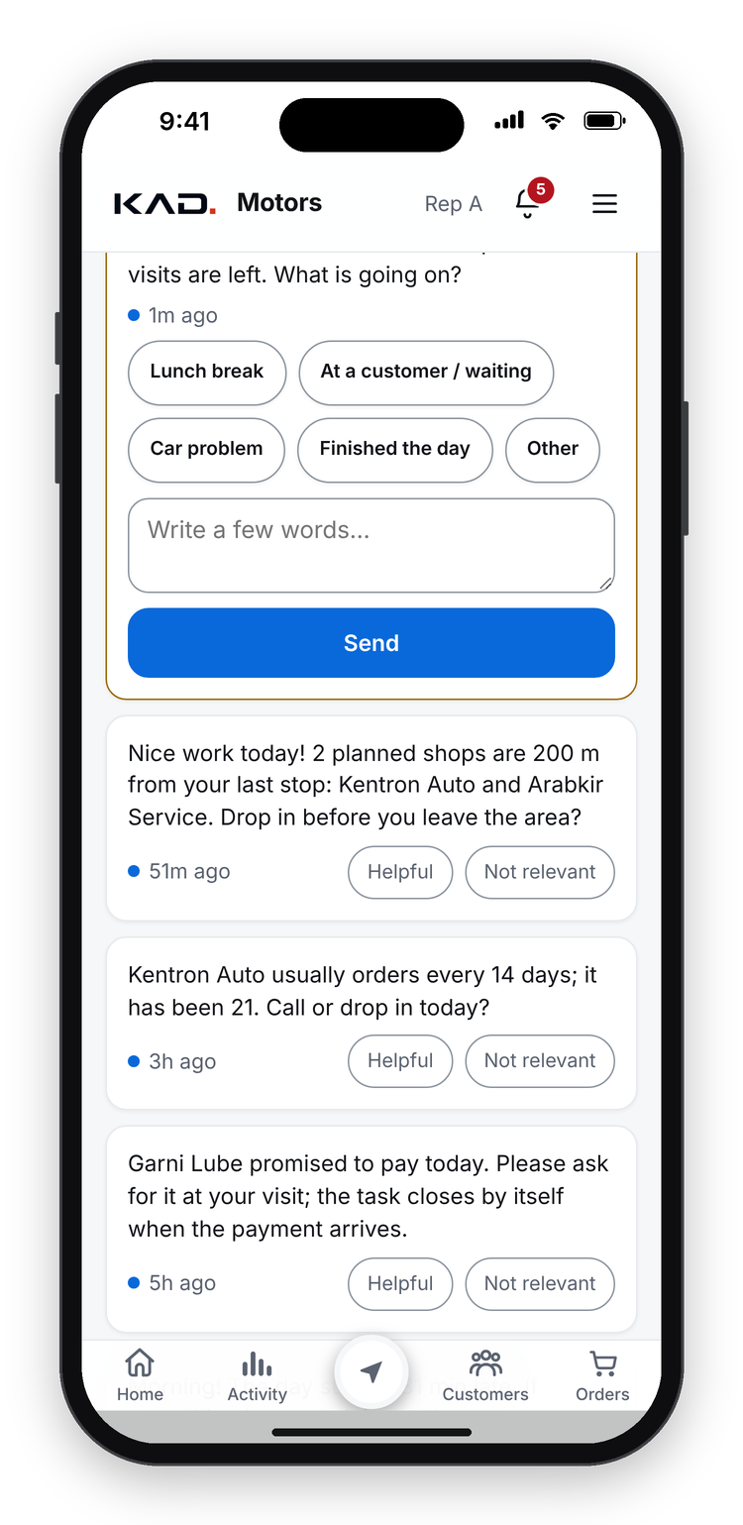


AI DEPUTY DIRECTOR
An AI deputy director keeps everyone on plan
Watches the working day
Late starts, missed visits, long office stays
Keeps visits on route
Reminds reps about planned shops nearby
Chases money
Overdue debt, down payments, broken promises
Gives and closes tasks
Right person, deadline; closes when done
Escalates only what slips
Management hears only what needs them
Demo data
KAD OS
The operating system for a modern Castrol distributor
12
powered by Castrol
Notes:
This is our AI deputy director. He watches the working day: late starts, missed visits and long stays in the office. He reminds reps about planned shops nearby, chases overdue debt, down payments and broken promises, and gives each task to the right person with a deadline. Tasks close themselves when the problem is solved, for example when the payment arrives.
Management only hears about what slips. Some of his questions to reps must be answered before they carry on, as on the right-hand screen. He speaks to each person in their own tone, formal with management and friendly with reps.

Slide 13
AI AND AUTOMATION
AI and automatic calculations do the routine work
CALCULATED AUTOMATICALLY
AI analyst: ask your data
Landing cost of every product
True cost at the selling price, for each discount
Management asks a question in plain words and gets an answer with numbers:
Debt age of every invoice
Suggested credit limit per customer
“Which customers bought less EDGE this quarter, and who is their rep?”
Each customer's usual basket and order rhythm
Days of stock left and what to reorder
Customers and staff are hidden behind codes
Read-only, every question logged
Rep working hours and weekly scorecards
Fuel allowance from the real GPS route
KAD OS
The operating system for a modern Castrol distributor
13
powered by Castrol
Notes:
Beyond the AI deputy director, KAD OS has an AI analyst: management asks a question in plain words, for example which customers bought less EDGE this quarter and who their rep is, and gets an answer with numbers. Customers and staff are hidden behind codes, and every question is logged.
And many calculations happen automatically: the landing cost of every product, the true cost at the selling price for each discount, the age of every invoice, a suggested credit limit for each customer, each customer's usual basket and order rhythm, days of stock left and what to reorder, rep working hours and scorecards, and the fuel allowance from the real GPS route.

Slide 14



BUILT FOR REAL FIELD WORK
Works on any phone, fast, offline and secure
Any phone or PC
Works offline
Fast on cheap phones
Opens from a link; no app store
Visits and orders wait on the phone and send later
Speed is tested on a slow phone
Role-based access
Secure
Data stays with us
Everyone sees only what their role allows
Encrypted connection, protected logins, audit trail
Our data lives in our own cloud system
KAD OS
The operating system for a modern Castrol distributor
14
powered by Castrol
Notes:
KAD OS is built for real field work. It opens from a link on any phone or PC. It works offline: visits and orders wait on the phone and are sent later. It is fast even on cheap phones; we test its speed on a slow phone. Everyone sees only what their role allows. The connection is encrypted, logins are protected, and every key change is kept in an audit trail. And our data stays in our own cloud system.

Slide 15
BUILT AND ADOPTED
Live in 2 days, adopted in the first month
2 days
1st month
10 weeks
from first line of code to the first live version
the whole field team working in the app
to the complete system shown today
22 Aug → 24 Aug 2026
September 2026, the first full month after launch
763 improvements, delivered every week
22 Aug
24 Aug
September
Today
Work starts
First version live
Whole field team in the app
Complete system, weekly updates
KAD OS
The operating system for a modern Castrol distributor
15
powered by Castrol
Notes:
How long did it take? Our team started building on 22 August 2026, and the first version was live two days later, on 24 August. The whole field team was working in the app in September, the first full month after launch. In ten weeks we reached the complete system you have just seen, with 763 improvements, delivered every week based on what the team asked for.
The reason it was adopted so quickly is that our own people designed it: reps, the sales director, warehouse, accounting and management told us exactly what they needed.

Slide 16

COMING NEXT
Next: delivery, warehouse and more AI
LAUNCHING NEXT
LAUNCHING NEXT
LAUNCHING NEXT
Delivery & Driver
Warehouse
AI expert agents
Delivery routes for drivers
Picking and packing in the app
Sales, finance and stock specialists
Arrival detected automatically
Live stock behind every order
Led by the AI deputy director
Customer signs on the phone
Stock counts, even offline
Each finds, assigns and checks
KAD OS
The operating system for a modern Castrol distributor
16
powered by Castrol
Notes:
What comes next. Delivery and Driver: delivery routes for drivers, automatic detection when the driver arrives, and the customer signs on the phone. Warehouse: picking and packing in the app, live stock behind every order, and stock counts even without signal. And more AI: expert agents for sales, finance and stock, led by the AI deputy director. These are not live yet; we build them on the same core, in small weekly steps.

Slide 17
KAD OS
powered by Castrol
The operating system for a modern Castrol distributor.
Thank you. Questions?
KAD OS
The operating system for a modern Castrol distributor
17
powered by Castrol
Notes:
Thank you. To sum up: KAD OS is one app for the whole distributor team; it checks every visit, order, price and payment; an AI deputy director keeps everyone on plan; and management sees everything live. Our team built it in weeks and adopted it in the first month. I am happy to answer questions or show the app live.

