Slide 1
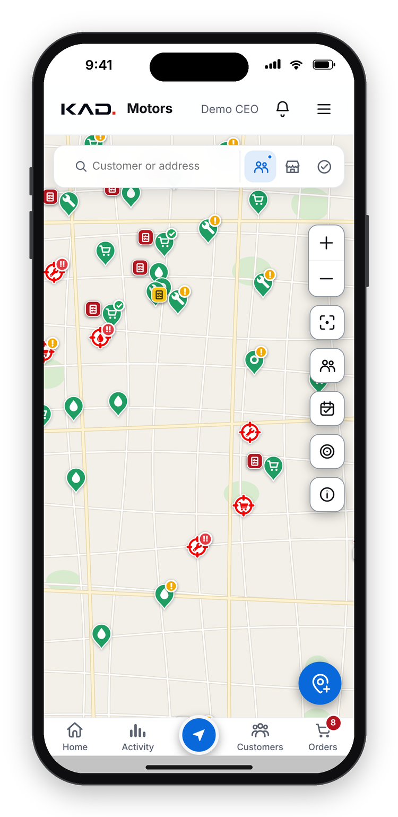
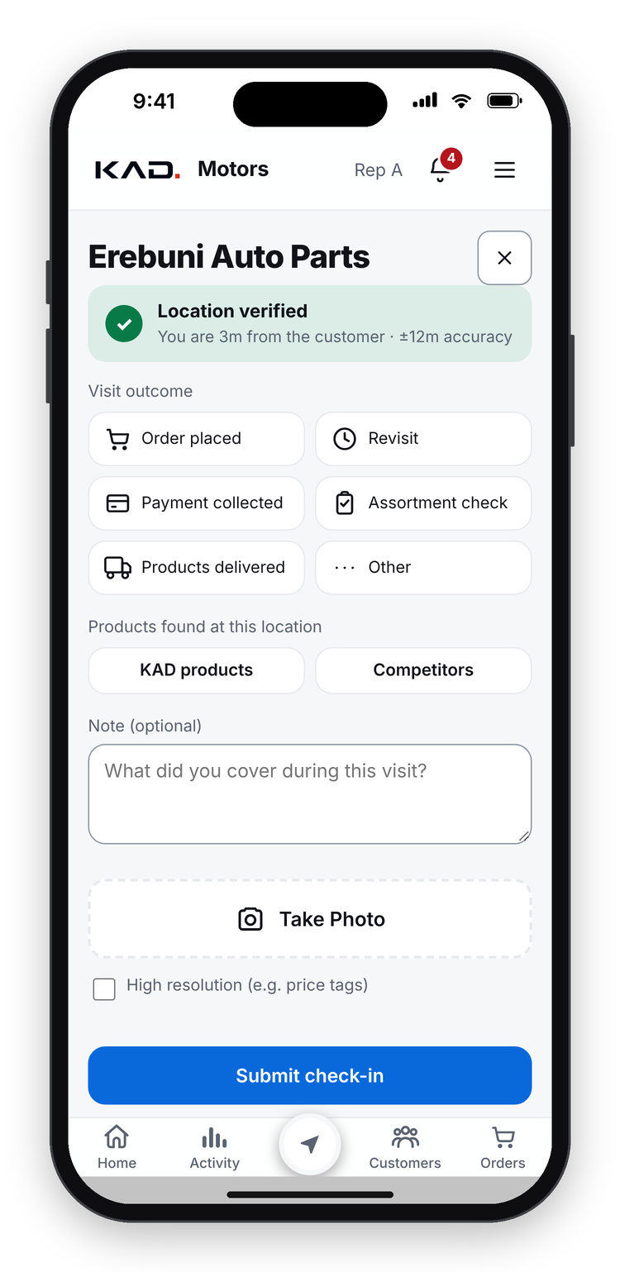
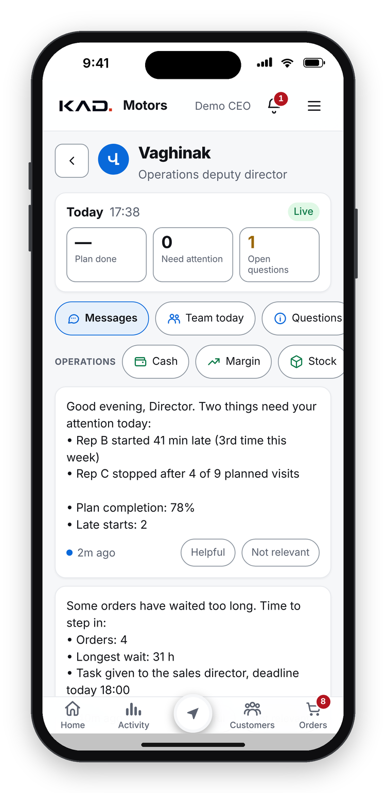

PREPARED FOR CASTROL GLOBAL
KAD Motors: Digital Sales Platform for Castrol Distribution
Field app · AI deputy director · CEO bot
Yerevan, Armenia · October 2026
CASTROL LOGO
place official asset here
Notes:
Thank you for your time. KAD Motors is a Castrol distributor in Armenia. Over the last months our own team built a digital platform that runs the whole commercial side of a distributor: a field app for the team, an AI deputy director who controls the daily work, and a CEO bot for management.
Today I will show the real problems of a distributor, how the platform solves each one, and why we believe it can become a model for other Castrol distributors, with shelf and sell-out visibility for Castrol.
All screens and example values in this deck are made-up demo data. No real customer, staff or company figures are shown.

Slide 2








KAD MOTORS AT A GLANCE
A Castrol distributor with one goal: No. 1 in Armenia
OUR GOAL
No. 1 in Armenia's oil market
Castrol distributor in Armenia
Field, warehouse and finance teams
Customers across Armenia's regions
Volume
Revenue
WHO WE SERVE
Reputation
Technology
Then: take the model beyond Armenia
Workshops & garages
Oil-change points
Auto-parts shops
Fleets & car dealers
Digital Sales Platform for Castrol Distribution
2
Notes:
KAD Motors distributes Castrol lubricants in Armenia. We have field sales reps, a warehouse, delivery, accounting and management, and customers across the regions of Armenia: workshops and garages, oil-change points, auto-parts shops, fleets and car dealers.
Our goal is to become No. 1 in Armenia's oil market: in volume, in revenue, in reputation and in technology. The platform is how we get there, and once the model works here we want to take it further.

Slide 3





BUILT BY A DISTRIBUTOR
Designed by our whole team, not only by developers
Sales reps
Sales director
Warehouse
Accounting
CEO & owner
Visits, orders, cash
Plans, approvals, prices
Stock, packing, delivery
Invoices, debt, cash ledger
Goals, margins, decisions
One platform for the whole distributor. Every module started from a real daily problem in our business.
How we build: the team reports a problem on Monday, the fix is in everyone's phone within days. 750+ improvements since August 2026.
Digital Sales Platform for Castrol Distribution
3
Notes:
This platform was not ordered from an IT agency. It was designed by our own people: sales reps, the sales director, the warehouse and delivery team, accounting, and management, working every day with our developers.
Each role brought its real daily problems: a rep who loses time typing orders twice, an accountant who chases cash, a director who learns about a problem a month too late. Every module started from one of those problems.
That is why the platform covers the needs of a Castrol distributor end to end, and why it keeps improving: problems reported on Monday are usually fixed on everybody's phone within days. More than 750 improvements have shipped since August 2026.

Slide 4





OUR PRINCIPLE
Data is worth nothing until it drives action
1
2
3
4
5
6
Collect
Analyse
Find cause & owner
Task + deadline
Control
Escalate or report
Visits, GPS, photos, orders, payments, ERP
AI and rules spot the problem
Why it happened, who is responsible
The solution goes to that person
Reminders until it is done on time
Not solved in plan? Management knows
Steps 2 to 6 run automatically, led by our AI deputy director, Vaghinak.
Managers stop searching for problems. They receive the problem, its cause, the person responsible and the deadline, and they only step in when the plan slips.
Digital Sales Platform for Castrol Distribution
4
Notes:
This is the most important idea of the platform. Collecting data alone adds no value. Value comes from decisions and actions.
So the platform works as a closed loop. Step one, it collects data: visits with GPS, photos, orders, payments and the daily ERP file. Step two, AI and business rules analyse it and spot problems. Step three, they find the cause and the person responsible. Step four, they give that person a task with a deadline. Step five, they control it: reminders until it is done. Step six, if it is not solved within the plan, they escalate to management or report it.
Steps two to six are run by Vaghinak, our AI deputy director. Managers stop searching for problems; they receive them already analysed, assigned and tracked.

Slide 5










REAL PROBLEMS WE HAD TO SOLVE
Ten daily problems of a distributor, before the platform
Reps start late, skip visits
No proof a visit happened
Overdue debt nobody chases
Orders by phone, wrong prices
Discounts that kill margin
Cash stuck with reps
Stock-outs and dead stock
No view of the shelf, fakes
Late reports, Excel chaos
Customers quietly stop buying
Result: management learns about problems a month late, when the money is already lost.
Digital Sales Platform for Castrol Distribution
5
Notes:
These are ten real problems we lived with, and that every distributor we know lives with.
Reps start late and skip planned visits. Nobody can prove that a visit happened. Overdue debt sits without anyone chasing it. Orders come by phone with wrong prices. Discounts eat the margin. Cash stays with reps for days. Some products run out while others sit as dead stock. Nobody knows what is on the shelf, or how many fakes are sold. Reports arrive late from a messy Excel. And customers quietly stop buying, and we notice months later.
The common result: management learns about a problem when the money is already lost. The next two slides show how the platform solves each one.

Slide 6
PROBLEM → SOLUTION (1/2)
Each problem has an automatic answer and an owner
PROBLEM
WHAT THE PLATFORM DOES
Reps start late, skip visits
Vaghinak logs every arrival and visit, reminds, asks a must-answer question, reports weekly
No proof a visit happened
GPS check-in only within 300 m of the outlet, with photo and visit outcome
Overdue debt nobody chases
Debt aged per invoice; a collection task for the next visit; promise dates; broken promise escalated
Orders by phone, wrong prices
Orders in the app, at central tier prices, from the usual basket, even offline
Discounts that kill margin
Up to 3% automatic; more needs approval; below cost only the CEO
Digital Sales Platform for Castrol Distribution
6
Notes:
Reps start late, skip visits: Vaghinak logs every arrival and visit, reminds, asks a must-answer question, reports weekly.
No proof a visit happened: GPS check-in only within 300 m of the outlet, with photo and visit outcome.
Overdue debt nobody chases: Debt aged per invoice; a collection task for the next visit; promise dates; broken promise escalated.
Orders by phone, wrong prices: Orders in the app, at central tier prices, from the usual basket, even offline.
Discounts that kill margin: Up to 3% automatic; more needs approval; below cost only the CEO.
Every answer has an owner and a deadline, and the platform checks that it was done.

Slide 7
PROBLEM → SOLUTION (2/2)
Each problem has an automatic answer and an owner
PROBLEM
WHAT THE PLATFORM DOES
Cash stuck with reps
Every payment tracked from rep to accountant and matched with the ERP automatically
Stock-outs and dead stock
Days of stock per product, a ready reorder list, dead-stock decisions with owners
No view of the shelf, fakes
Shelf audit at every visit: Castrol presence, full range, fakes, parallel imports, competitors
Late reports, Excel chaos
One daily ERP file: checked, reported by the bot, synced to the app in minutes
Customers quietly stop buying
Each customer's order rhythm is learned; when it breaks, a call-or-visit task
Digital Sales Platform for Castrol Distribution
7
Notes:
Cash stuck with reps: Every payment tracked from rep to accountant and matched with the ERP automatically.
Stock-outs and dead stock: Days of stock per product, a ready reorder list, dead-stock decisions with owners.
No view of the shelf, fakes: Shelf audit at every visit: Castrol presence, full range, fakes, parallel imports, competitors.
Late reports, Excel chaos: One daily ERP file: checked, reported by the bot, synced to the app in minutes.
Customers quietly stop buying: Each customer's order rhythm is learned; when it breaks, a call-or-visit task.
Every answer has an owner and a deadline, and the platform checks that it was done.

Slide 8
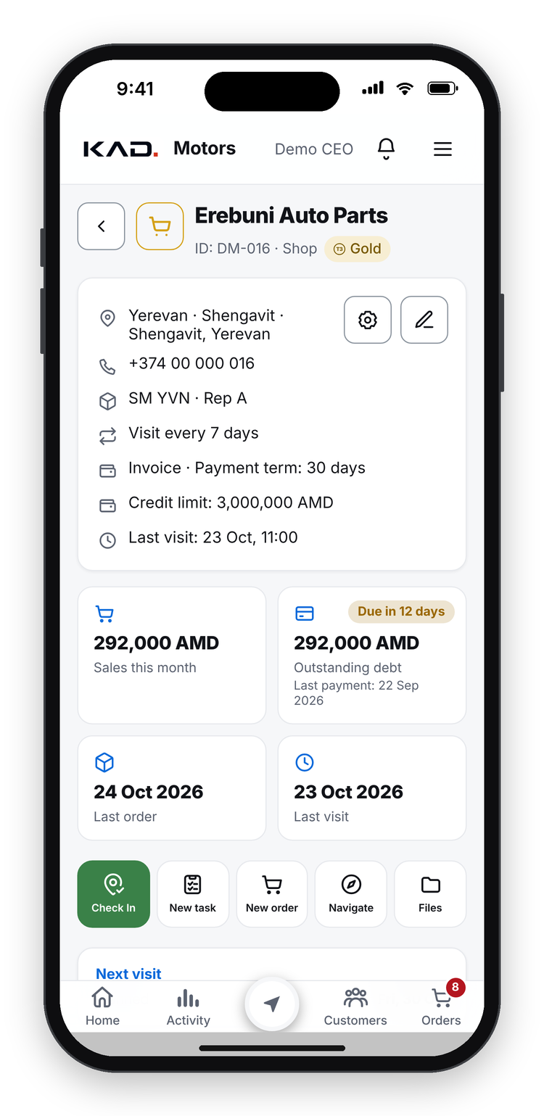
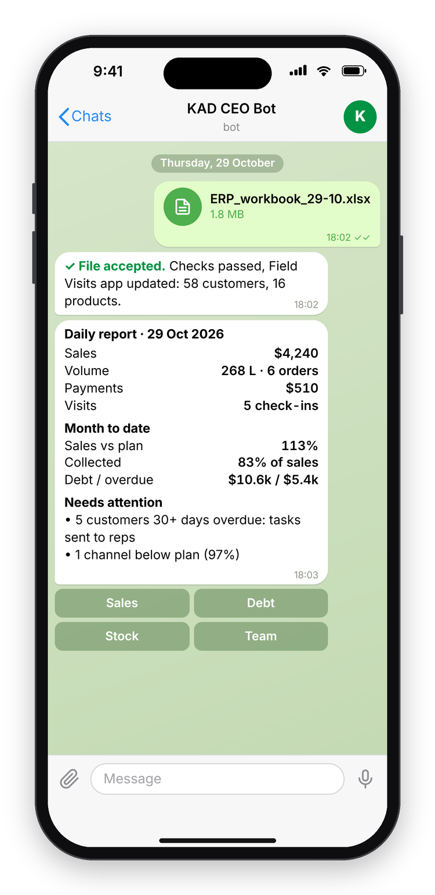




THE PLATFORM
One app from a link, an AI deputy director, and a CEO bot
Field Visits app
Opens from a link on iPhone and Android. No app store. Works offline.
Vaghinak, AI deputy director
Watches the day, assigns tasks, chases deadlines, escalates.
CEO Telegram bot
Checks the daily ERP file and sends management reports.
All fed every day from the same ERP workbook (Excel)
Demo data
Digital Sales Platform for Castrol Distribution
8
Notes:
The platform has three parts.
The Field Visits app: a progressive web app. A rep opens one link on any iPhone or Android phone. No app store, and it works without signal.
Vaghinak, our AI deputy director: he watches the working day, gives tasks, chases deadlines and escalates when something slips.
The CEO bot in Telegram: every day accounting drops the ERP workbook into the bot; it checks the file, builds the management reports and feeds the app.
All screens and example values in this deck are made-up demo data. No real customer, staff or company figures are shown.

Slide 9

HOW IT WORKS
One daily file feeds the whole team
STEP 1
STEP 2
STEP 3
STEP 4
ERP workbook
CEO bot
ERP sync
Field Visits app
Excel, updated daily by accounting
Checks the file, builds the reports
Debt, sales, prices, stock and plans
Reps, managers, warehouse, accounting
Daily reports to management on Telegram
CAPTURED IN THE APP
GPS visits
Photos & shelf audit
Orders
Payments
Matched by ERP ID, never by name. Excel stays the source of truth.
Digital Sales Platform for Castrol Distribution
9
Notes:
The data flow on one page. Accounting keeps the ERP workbook in Excel and uploads it once a day. The CEO bot checks the file and builds the management reports. The same run syncs debt, sales, prices, stock and plans into the app, where every role works.
The app adds what Excel never had: GPS-verified visits, photos and shelf audits, orders and payments captured at the outlet. Customers and products are matched by ERP ID, never by name, and Excel remains the source of truth for debt and sales.

Slide 10
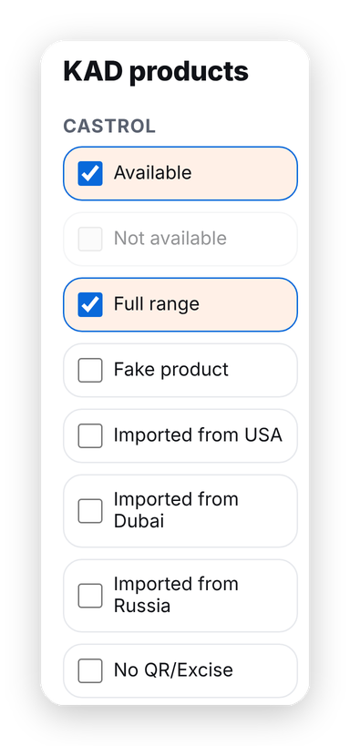
FIELD EXECUTION
Every visit is verified: GPS check-in, photo and shelf audit
GPS check-in + photo
Shelf audit at every visit
Customer map & CRM
Accepted only within 300 m of the outlet.
Castrol available, full range, fake or parallel import.
Every outlet with visit status, debt and plan.
Digital Sales Platform for Castrol Distribution
10
Notes:
A rep can only check in when the phone is near the outlet (300 metres by default, set by management), attaches a photo and records the outcome.
At every visit the rep records the shelf: Castrol available or not, full range, fake product, parallel imports (from the USA, Dubai or Russia) and products without the Armenian QR/excise mark, plus competitor brands. Nobody else in our market collects this.
The map is also the CRM: every outlet with its visit status, debt and next planned visit; an automatic planner builds balanced weekly routes for each rep.
All screens and example values in this deck are made-up demo data. No real customer, staff or company figures are shown.

Slide 11
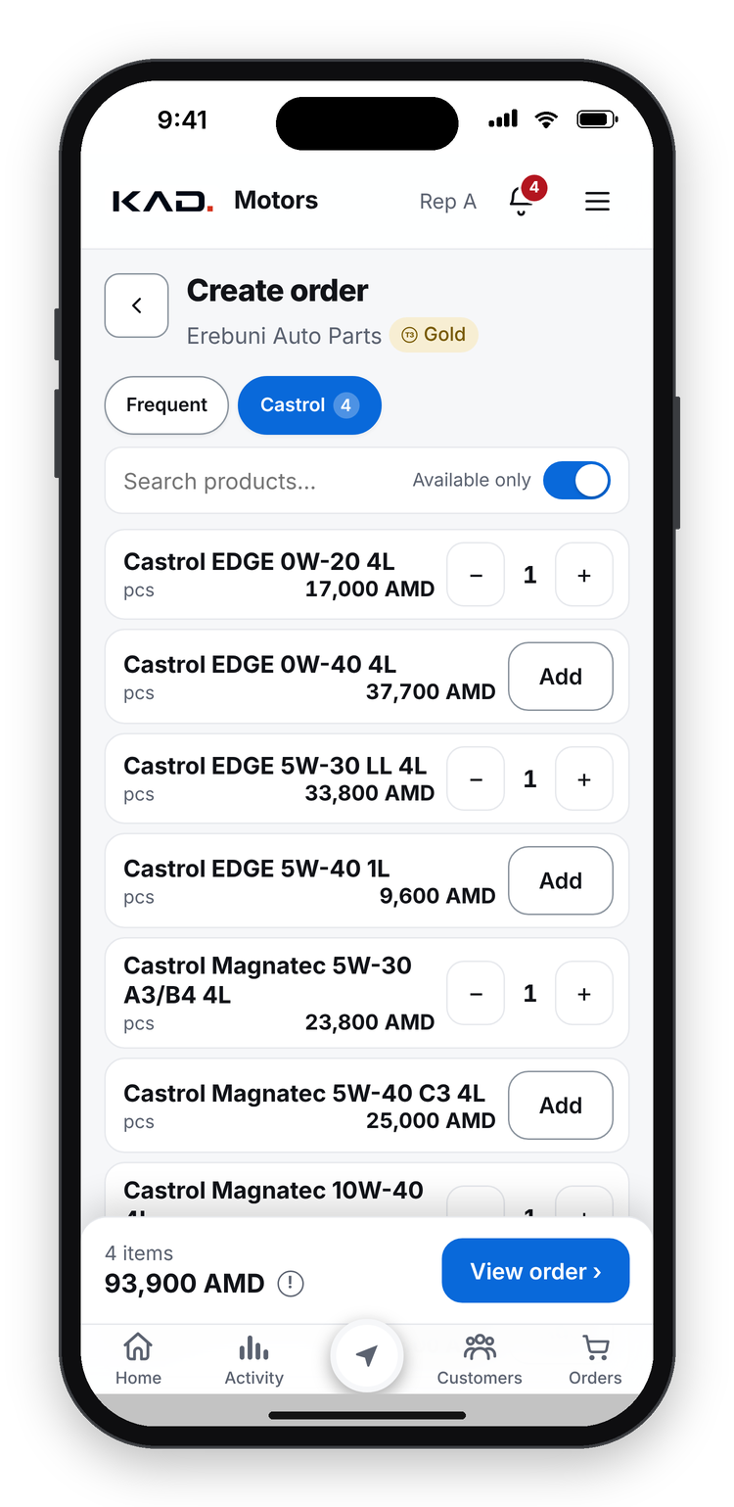
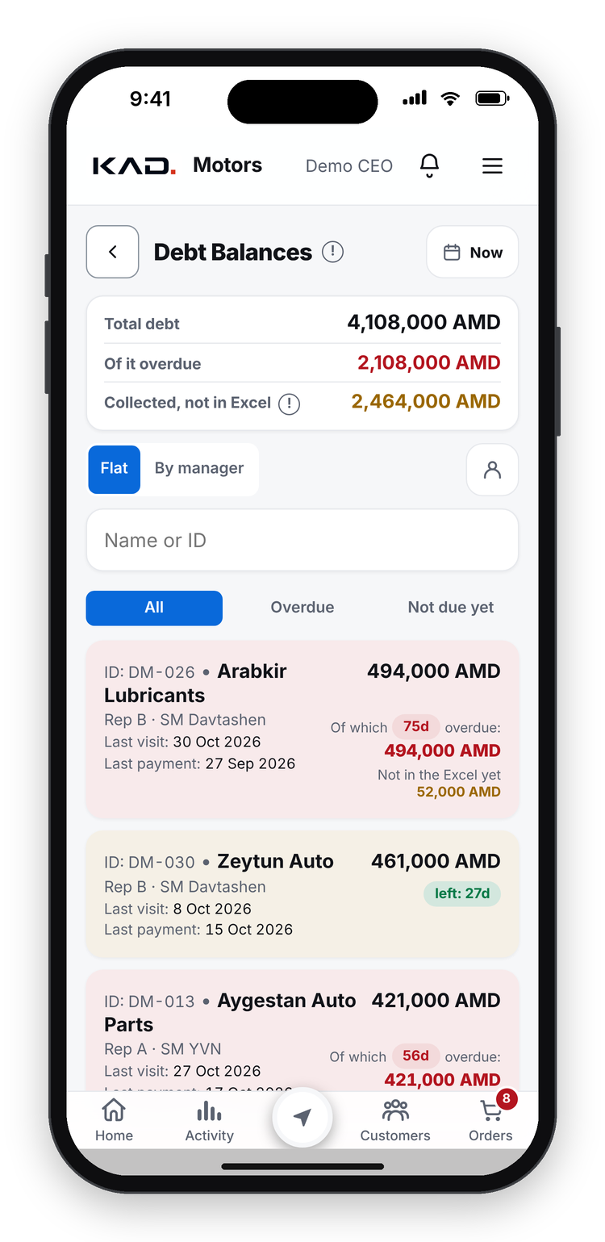



COMMERCIAL CONTROL
Orders, prices, credit and cash in one controlled flow
Orders in a few taps
Usual basket and repeat order, even offline.
Central price lists
Bronze, Silver and Gold tiers; no typed prices.
Discount control
Above 3% needs approval; below cost only the CEO.
Credit and cash
Credit limits, overdue alerts, cash tracked to the accountant.
Targets and bonuses
Rep targets and points for visits, orders and collections.
Digital Sales Platform for Castrol Distribution
11
Notes:
Orders: built in a few taps from the customer's usual basket or a repeat of the last order, even offline. Prices come from central tier price lists; reps never type prices. Discounts up to 3% are automatic; more needs management approval, and a price below our landing cost needs the CEO.
Credit: limits per customer, overdue alerts and collection tasks; every cash payment is tracked from the rep to the accountant. Reps see their own targets and earn points for visits, orders and collections.
All screens and example values in this deck are made-up demo data. No real customer, staff or company figures are shown.

Slide 12
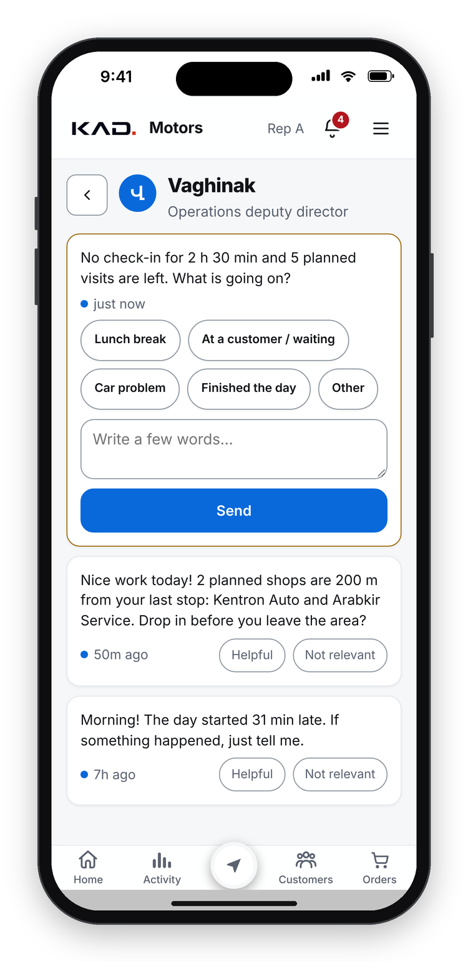




VAGHINAK, AI DEPUTY DIRECTOR
Vaghinak controls the working day of every person
Arrival & lateness
No visit yet
Logs every start; reports the week
Asks why at 60 min; must answer at 2 h
Too long in the office
Stopped mid-day
Reminder, then a must-answer question
Visits left? Asks why, keeps the plan
Skipped nearby shops
Debt collection
Planned shop close by? Sends the rep back
Task per overdue invoice; promise dates
Calls & reorders
Down payments
Customer stopped ordering? Call or visit
Chases unpaid down payments after delivery
Orders waiting
Data & Excel
Too slow? Sales director, then the CEO
Missing data or late ERP file: a task
Left: the brief to management. Right: a rep's must-answer question (demo, translated).
Digital Sales Platform for Castrol Distribution
12
Notes:
Meet Vaghinak, our AI operations deputy director. He lives inside the app, with his own page and a badge on the home screen.
He controls the working day of every person. He logs every arrival and every late start, staying quiet within a 30-minute grace and reporting the week. If a rep has not made a first visit after an hour he asks why; after two hours the question becomes mandatory and blocks the app until answered. He notices a rep sitting in the office with visits planned, or stopping in the middle of the day, or leaving planned shops a few hundred metres behind.
He also owns the money and customer follow-ups: a collection task for every overdue invoice, with promise dates; call-or-visit tasks for customers who stopped ordering; chasing down payments after delivery; orders that wait too long go to the sales director and then to the CEO; and missing data or a late ERP file becomes a task for the right person.
On the left is his evening brief to management; on the right, a mandatory question to a rep. In real life he speaks Armenian; these demo messages are translated.

Slide 13



VAGHINAK CLOSES THE LOOP
From problem to result, without a manager chasing anyone
Detect
Cause & owner
Task + deadline
Control
Escalate
Close
An invoice is 56 days past due
Oldest unpaid invoice; customer of Rep C
Collect at the next visit, due Thursday
Rep records: customer promised to pay by the 27th
Promise broken: task reopened, sales director told
Payment arrives in the ERP: task closes itself
Example with demo data
Speaks to each person in their own tone: formal with management, warm and friendly with reps
Staff rate every message (helpful / not relevant), so he keeps improving
Monday digest: each rep's week, and for management who needs a talk
Starts in test mode; management tunes every threshold before he goes live
Digital Sales Platform for Castrol Distribution
13
Notes:
Here is one loop from start to finish, with demo data.
Vaghinak detects that an invoice is 56 days past due. He finds the cause and the owner: it is the oldest unpaid invoice of a customer assigned to Rep C. He creates a task to collect at the next visit, with a deadline. He controls it: the rep records that the customer promised to pay by the 27th. When the promise is broken, the task is reopened and the sales director is informed automatically. When the payment arrives in the ERP, even by bank transfer, the task closes itself.
No manager had to chase anyone. The same loop runs for lateness, visits, reorders, down payments, waiting orders and data quality.
He speaks to each person in their own tone, formal with management and warm with reps; staff can rate each message; every Monday he sends each rep their week and tells management who needs a talk; and he starts in test mode so management can tune every threshold before he goes live.

Slide 14
AI AND AUTOMATION
AI and automatic calculations replace hours of manual work
CALCULATED AUTOMATICALLY
KAD AI: ask your data
Landing cost per product: freight, customs, excise, VAT, FX
True cost at the selling price, for every discount decision
Management asks in plain language and gets an answer with numbers, in seconds:
Debt ageing per invoice and days past due per customer
Suggested credit limit from each customer's purchases
“Which customers bought less EDGE this quarter than last, and who is their rep?”
Each customer's order rhythm and usual basket
Days of stock and a ready reorder list
Rep hours, visits, conversion and weekly scorecard
Read-only access to the data
Customers and staff anonymised as codes
Monthly cost cap, every question logged
Fuel allowance from the real GPS route
ERP orders and payments matched to app records
FX moves 2%? A price-review task for the owners
Digital Sales Platform for Castrol Distribution
14
Notes:
AI and automation do the work that used to take hours of Excel.
KAD AI lets management ask questions in plain language, for example which customers bought less EDGE this quarter and who their rep is, and get an answer with numbers in seconds. The AI has read-only access; customers and staff are anonymised as codes, so no names leave our server; every question is logged and the monthly cost is capped.
On the right, what the platform calculates automatically: landing cost per product from freight, customs, excise, VAT and the exchange rate; the true cost at the selling price for every discount decision; debt ageing per invoice; suggested credit limits; each customer's order rhythm and usual basket; days of stock and reorder lists; rep hours, visits, conversion and weekly scorecards; fuel allowance from the real GPS route; automatic matching of ERP orders and payments; and a price-review task when the exchange rate moves 2%.

Slide 15
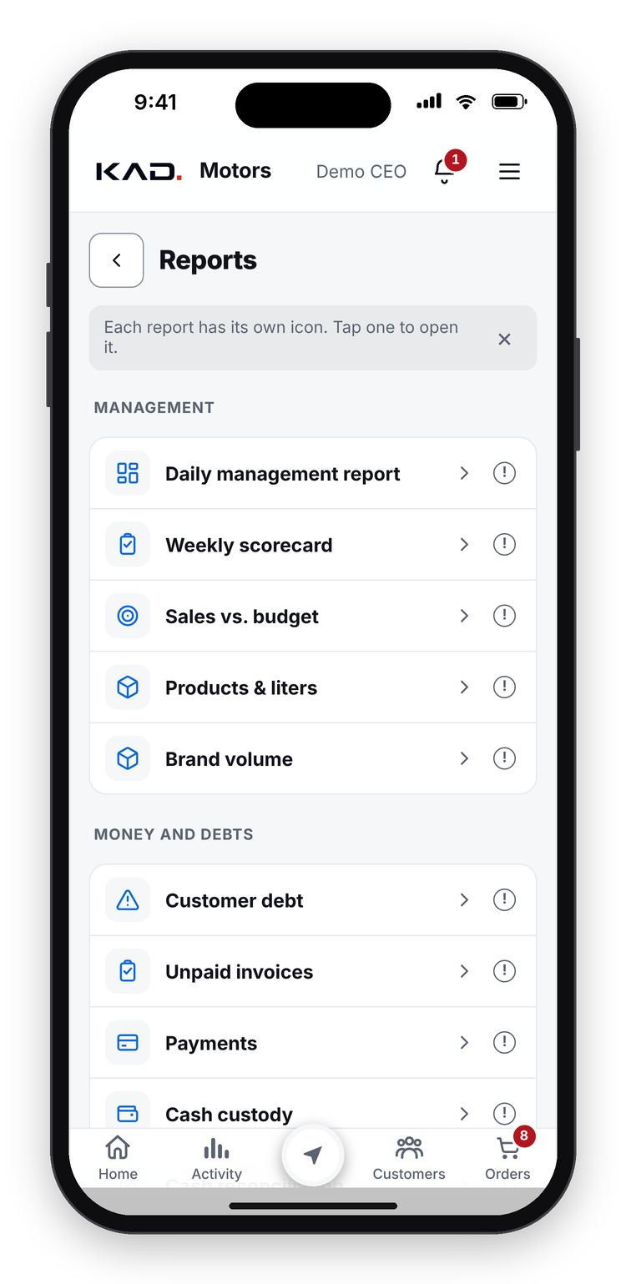
FINANCIAL AND MANAGEMENT REPORTS
Every report a distributor needs, live and on the phone
Money & debt
Sales & margin
Customer debt, as of any date
Unpaid invoices by age
Debt statement PDF for the customer
Payments and cash custody
Bank statement matching
Sales vs plan, by rep and channel
Litres by product line and region
Margin and price realisation
Below-cost sales
Brand volume
Team & field
Operations
Weekly scorecard per rep
Progress by reps, day by day
Visits and shelf presence
New customer pipeline
Fuel allowance
Order flow vs time limits
Delivery speed
Stock days and dead stock
Data quality score
Daily, weekly, monthly bot briefs
Digital Sales Platform for Castrol Distribution
15
Notes:
The platform replaces the monthly Excel report pack with live reports on the phone.
Money and debt: customer debt as of any date, unpaid invoices by age, a one-page debt statement PDF to hand to the customer, payments and cash custody, and bank statement matching.
Sales and margin: sales against plan by rep and channel, litres by product line and region, margin and price realisation, sales below cost, brand volume.
Team and field: the weekly scorecard per rep, progress day by day, visits and shelf presence, the new-customer pipeline and the fuel allowance.
Operations: order flow against time limits, delivery speed, stock days and dead stock, a data-quality score, and the bot's daily, weekly and monthly briefs.
Every report respects roles: a rep sees only their own customers.

Slide 16
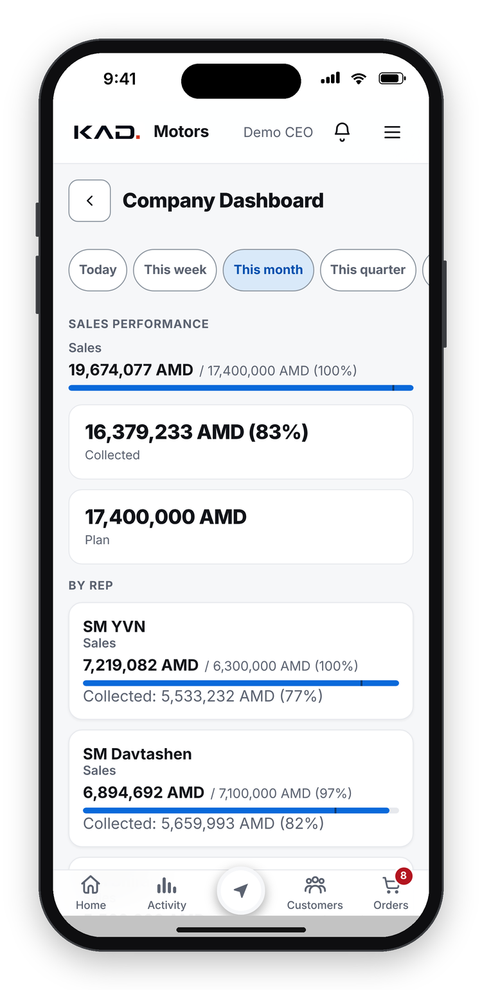
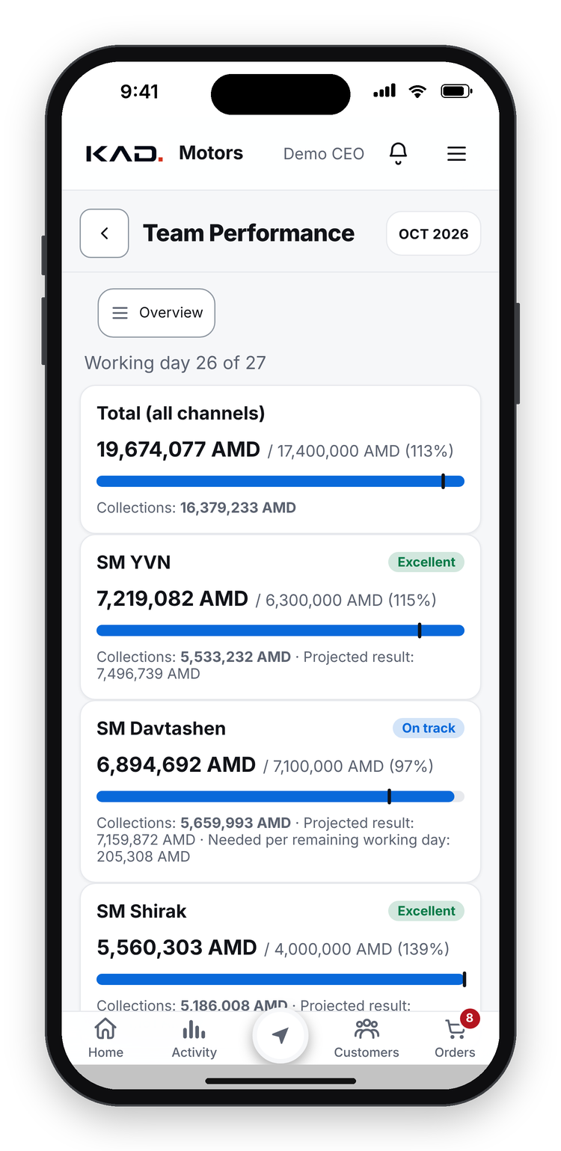


MANAGEMENT VISIBILITY
Management sees every rep, region and KPI, every day
Sales vs plan
Cash collected
Visits & coverage
Litres by product line
Debt ageing
Rep scorecards
CEO bot on Telegram
Daily, weekly and monthly reports as soon as the ERP file arrives.
Digital Sales Platform for Castrol Distribution
16
Notes:
The company dashboard and team performance show sales against plan per channel and per rep, cash collected, and how much each rep still needs per working day. Management follows sales versus plan, cash, visits and coverage, litres by product line, debt ageing and rep scorecards, and the CEO bot sends daily, weekly and monthly summaries as soon as the ERP file arrives.
All screens and example values in this deck are made-up demo data. No real customer, staff or company figures are shown.

Slide 17



WHAT MAKES IT UNIQUE
Twelve things we have not seen in other distributor tools
AI deputy director
Shelf & fake tracking
Price floor
Debt per invoice
Finds problems, assigns, chases, escalates
Fakes, parallel imports, no QR/excise
Below landing cost? Only the CEO approves
Real age of every unpaid invoice
Self-closing tasks
Pin review
Auto route planner
Fuel by real route
Bank payment in the ERP closes the task
GPS evidence finds wrong shop locations
Balanced weekly routes for every rep
Allowance from the GPS route, city vs highway
Order speed measured
Truly offline
Emergency lockdown
KAD OS for customers
Seconds and taps per order, per rep
Visits and orders saved without signal
One switch locks the app on every phone
Free shop ERP that orders from us (pilot)
Digital Sales Platform for Castrol Distribution
17
Notes:
Twelve features we believe are unique.
An AI deputy director who finds problems, assigns them, chases and escalates. Shelf tracking that records fakes, parallel imports and products without the Armenian excise mark. A price floor: nothing sells below landing cost without the CEO. Debt aged per invoice, not per customer. Tasks that close themselves when the payment arrives in the ERP, even by bank transfer. Pin review, which uses GPS evidence to find shops whose location is wrong on the map. An automatic route planner. Fuel allowance calculated from the real GPS route, split between city and highway. The speed of every order measured in seconds and taps. A truly offline app. An emergency lockdown that locks the app on every phone with one switch. And KAD OS, a free shop ERP for our own customers, in pilot, which lets them order from us directly and in time gives sell-out data.

Slide 18
WHAT MANAGEMENT SEES
A month on the platform, at a glance
ILLUSTRATIVE VALUES · NOT COMPANY DATA
108%
91%
1,240
sales vs plan
of sales collected
GPS-verified visits
$52.4k of $48.5k
$47.7k collected
96% of planned visits
64%
$8.9k
19 of 23
outlets with Castrol on the shelf
overdue debt found
tasks closed on time
Stage 1 target: 70%
23 collection tasks created
4 escalated to the sales director
All values are illustrative, in USD, to show what the platform measures. They are not KAD Motors figures.
Digital Sales Platform for Castrol Distribution
18
Notes:
This slide shows what management sees in a typical month. The values are illustrative only, in US dollars; they are not our company figures.
Top row, the classic numbers: sales against plan, cash collected, GPS-verified visits.
Bottom row, what a traditional report never shows: the share of outlets with Castrol on the shelf against the stage 1 target of 70%; the overdue debt the system found and turned into collection tasks; and how many of those tasks were closed on time, with the rest escalated automatically. That is the data-decision-action loop, measured.

Slide 19
THE MARKET PLAN
The platform drives a 3-stage plan to win Armenia's shelves
STAGE 3
Preference
STAGE 2
Customers sell mostly Castrol
Full range
STAGE 1
Complete Castrol product lines on the shelf
Presence
70% of customers carry at least one Castrol product
Measured by: Shelf audit: Castrol available
Measured by: Shelf audit: full range, plus order mix by line
Measured by: Share of each customer's purchases and sell-out
Recorded at every visit (demo)
Digital Sales Platform for Castrol Distribution
19
Notes:
The platform drives our three-stage market plan. Stage 1, presence: 70% of our customers carry at least one Castrol product, measured outlet by outlet with the shelf audit. Stage 2, full range: complete Castrol product lines on the shelf, measured by the full-range tick and the order mix by product line. Stage 3, preference: customers sell mostly Castrol, measured by the share of each customer's purchases and, through KAD OS, their sell-out.
Vaghinak tracks every stage per outlet, rep and region, and turns gaps into tasks.

Slide 20
ROADMAP
Next: delivery, warehouse and a full AI management team
Driver & delivery
Warehouse
AI management team
Optimised delivery routes
Picking and packing in the app
Vaghinak leads expert AI agents
Arrival detected automatically
Live stock behind every order
Sales, finance and stock specialists
Customer signs on the phone
Stock counts, even offline
Each agent finds, assigns, controls
Today: field sales, orders, cash, reports and Vaghinak. Next: a complete operating system for a Castrol distributor.
Digital Sales Platform for Castrol Distribution
20
Notes:
Next steps. Driver and delivery: optimised routes, automatic arrival detection, and the customer signs for the delivery on the phone. Warehouse: picking and packing in the app, live stock behind every order, stock counts even offline. AI management team: Vaghinak becomes the lead of a team of expert AI agents for sales, finance and stock, each of which finds problems, assigns them and controls the result.
Timing to be confirmed; we ship in small weekly releases.

Slide 21

WHY IT MATTERS FOR CASTROL
Ready to scale, with Castrol shelf data built in
WHAT CASTROL GETS
OUR PROPOSAL
CASTROL LOGO
place official asset here
Shelf visibility per outlet: presence and range
A pilot partnership
Sell-out signals by product line and region
1
Monthly Castrol shelf and sell-out dashboard for Armenia
2
Pilot with 1–2 more Castrol distributors
A standard toolkit, opened from a link
3
Joint review of results after 90 days
Data stays with the distributor; Castrol sees aggregates
Next step: a 60-minute session with Castrol Global
Digital Sales Platform for Castrol Distribution
21
Notes:
For Castrol: shelf visibility outlet by outlet; sell-out signals by product line and region, not only sell-in; a standard toolkit that any distributor can start from a link; and a clean data model where operational data stays with the distributor and Castrol receives aggregated dashboards.
Our proposal is a pilot partnership: a monthly Castrol shelf and sell-out dashboard for Armenia, a pilot with one or two more Castrol distributors, and a joint review after 90 days. The next step we ask for is a 60-minute working session with your team.

Slide 22
APPENDIX
Architecture and security
Progressive web app
Works offline
Role-based access
Installs from a link on iPhone, Android and desktop.
Visits and orders wait on the phone and send automatically.
8 roles; every rule is enforced on the server.
PostgreSQL database
Secure by default
Data stays with the distributor
Runs on the distributor's own cloud server.
HTTPS, signed sessions, CSRF protection, rate limits, lockout.
Castrol gets aggregates; AI analysis uses anonymised codes.
Quality: about 1,200 automated tests run on every change; 750+ improvements shipped since August 2026.
Digital Sales Platform for Castrol Distribution
22
Notes:
For digital and IT colleagues: a progressive web app that installs from a link; offline-first, with visits and orders queued on the phone and sent without duplicates; 8 roles with every rule enforced on the server; PostgreSQL on the distributor's own cloud server; HTTPS, signed session cookies, CSRF protection, rate limits and lockout; operational data stays with the distributor and the AI sees anonymised codes only. About 1,200 automated tests run on every change.
All screens and example values in this deck are made-up demo data. No real customer, staff or company figures are shown.

