Slide 1
Code Examples

Slide 2
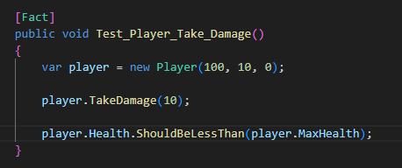



Slide 3



Slide 4
