Slide 1

Domain Analysis
Die |  |  | 2 | played with | Monopoly Game |  |  | played on |  | Board
Count
turn using | 2 | 2..8 |  |  |  |  |  |  |  |  | Defines a location 40
Player |  |  | represents |  |  | Piece | 0..8 |  | is on | Square
 |  |  |  |  |  | Character |  |  |  | Location
takes
Property |  | Utility |  | Jail
SWEN-610
Foundations of Software Engineering
Department of Software Engineering Rochester Institute of Technology

Slide 2
The domain for a software system defines the context in which the software operates.
This is also referred to as the application domain.
Retail sales
Banking
Customer contact management
Checkers playing
The domain model describes the ubiquitous world in which the system's experts and users exist and work on a daily basis.
Domain entities
Domain language
Associations/relationships between entities
2

Slide 3
Domain analysis provides an understanding of the application problem space.
Use the language of the application and
user! It does not define the implementation.
Application Domain
What are the entities and associations within this domain?
Domain Model
What entities and associations are important for this application?
Class Model
What software structure and relationships will provide the implementation of this application?
The domain model influences the naming and structure in the software class model.

Slide 4
The domain model identifies important aspects of the application not the implementation.
Only use vocabulary from the problem statement
For example, a unique identifier needed to store data with no meaning to the user
would not be in a domain model.
Establishes a common understanding of the problem for customer/user and software team

Slide 5
Domain model definition starts with an analysis of the nouns in the domain.
The steps in the noun analysis include
Identify the nouns in the problem statement and language of the domain experts and
users.
Identify any words that might be specializations of other nouns.
Identify any nouns that might be attributes or properties of other nouns.
Identify any other associations between nouns.
5

Slide 6
The domain model is typically drawn using a simplified class diagram notation.
Show the following information
Domain entities
Attributes in domain entities
Associations between domain entities
Use user vocabulary
Attributes do not indicate data type
Associations come from the problem statement
Place label on the association line
Usually completes a phrase between two domain entities: DE₁ association DE₂ (LineItem records-sale-of Product)
Indicate multiplicity, if known
Use inheritance, if appropriate

Slide 7
An association should describe the relationship between two domain entities.
All associations should have an arrow to indicate the direction to read the association.
Use the active voice for the verb when possible.
An association of "has" or "contains" does not describe much about the relationship.
Reverse the direction and rephrase the association
Customer |  | Address
*
is shipping
has location for
1

Slide 8
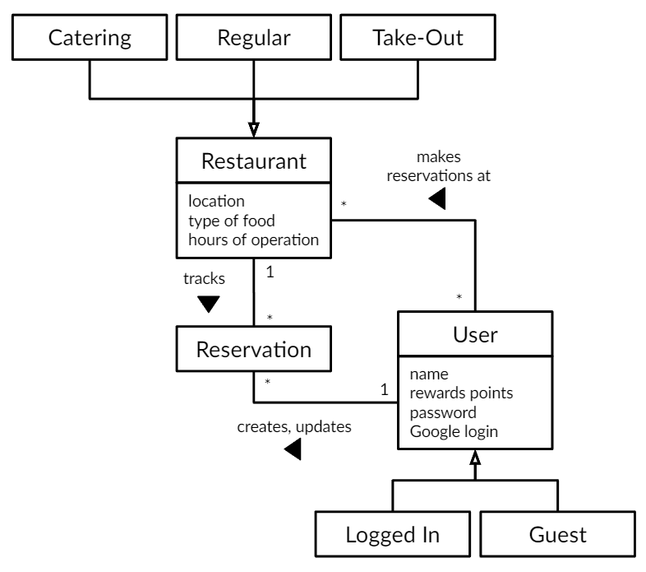
This partial domain model for a restaurant website

Slide 9
Discussion
1. What is the purpose of a Domain Model? How do you think it helps support software development?
2. When might it hurt progress or add unnecessary overhead?
3. How does a domain model help establish a shared vocabulary between developers, domain experts, and customers?
4. What are examples of when a Domain Model is giving too much information
5. Domain models evolve as requirements change—what risks arise if the domain model is not updated?

Slide 10
Domain analysis continues through the project.
The domain model continues to evolve as you learn more about the project.
Working on the project gives you a different understanding of the domain.
New features change your understanding of the domain.
When user stories are refined during backlog refinement more details may come out about the domain.
Keep your domain model up-to-date so that there is always a common understanding between the development team and Product Owners.
9

