Slide 1
SWEN-755: Software Architecture Structures and Views
Recommended reading:
Architectural Blueprints—The “4+1” View Model of Software Architecture
Chapter 18 “Software Architecture In Practice,” 3rd edition
A7E Avionics System: A Case Study In Using Architectural Structures

Slide 2
Topics
Structures and views
Modules
Component and connector
Allocation
Examine some software architecture view examples

Slide 3
Structures and Views
Problem: it is difficult to comprehend and discuss the entire system and all structures at once
Address a specific set of related architectural concerns
Focus on a subset of the architecture elements and relationships
Consider a view as a cohesive collection of architectural elements, selected to illustrate and define one or more structural relationships
Structural relationships to define:
Module (static)
Component-and-Connector (dynamic)
Allocation (physical, development)

Slide 4
Possible Views (Viewpoints)
Functional/logic view
Code/module view
Development/structural view
Concurrency/process/runtime/thread view
Physical/deployment/install view
User action/feedback view
Data view/data model
Which of the views is the architecture?
Which views convey the architecture?
None of them
All of them

Slide 5
Three Broad Groups of Architectural Structures
Address three broad types of architectural decisions
Module structures (static)
How is the system to be structured as a set of functional code units (modules)?
Component-and-connector structures (dynamic)
How is the system to be structured as a set of computational elements that have runtime behavior (components) and interactions (connectors)?
Allocation structures (physical, deployment)
How is the system to relate to the non-software structures in its environment (such as CPUs, file systems, networks, development teams, etc.)?
Notes:
This is a review from a previous lecture.

Slide 6
Some Common, Useful Software Structures (1/3)
Module
Decomposition
Class
Uses
Layered
Static

Slide 7
Some Common, Useful Software Structures (2/3)
Component-and-Connector
Client-Server
Shared
Data
Process
Concurrency
Dynamic

Slide 8
Some Common, Useful Software Structures (3/3)
Allocation
Work Assignment
Implementation
Deployment
Physical Development

Slide 9
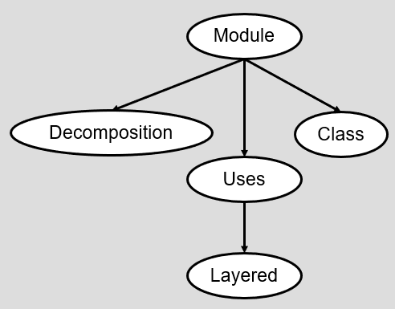
Module Structures
Software Structure | Relations | Useful for
Decomposition | Is a sub-module of; shares secrets with | Resource allocation and project structuring and planning; information hiding, encapsulation; configuration control
Uses | Requires the correct presence of | Engineering subsets; engineering extensions
Layered | Requires the correct presence of; uses the services of; provides abstraction to | Incremental development; implementing systems on top of “virtual machines;” portability
Class | Is an instance of; shares access methods of | In object-oriented design systems, producing rapid, almost-alike implementations from a common template

Slide 10
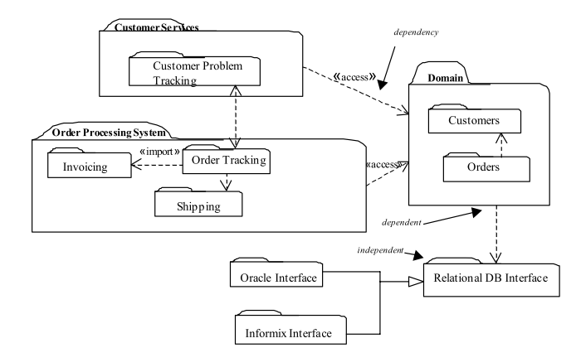
Module View Example
Notes:
Note the layered structure here

Slide 11
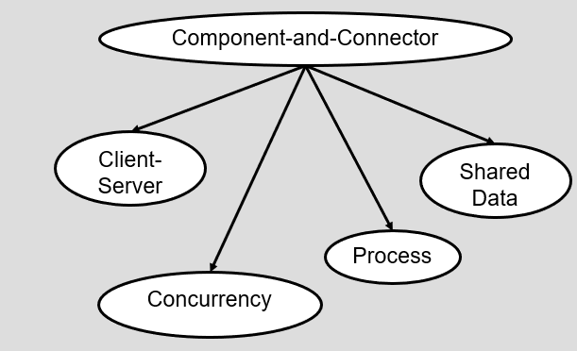
Component-and-Connector Structures
Software Structure | Relations | Useful for
Client-Server | Communicates with; depends on | Distributed operation; separation of concerns; performance analysis; load balancing
Process (Communicating Processes) | Runs concurrently with; may run concurrently with; excludes; precedes; etc. | Scheduling analysis; performance analysis
Concurrency | Runs on the same logical thread | Identifying locations where resource contention exists, where threads may fork, join, be created or be killed
Shared Data (Repository) | Produces data; consumes data | Performance; data integrity; modifiability; persistence

Slide 12
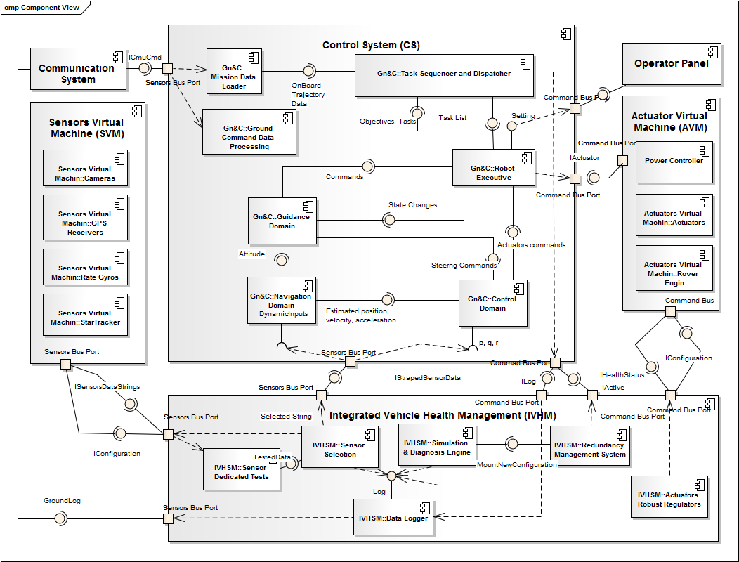
Component-and-Connector

Slide 13
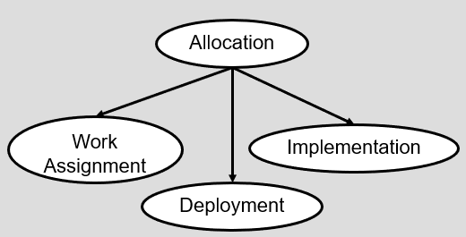
Allocation Structures
Software Structure | Relations | Useful for
Deployment | Allocated to; migrates to | Performance, availability, security analysis
Implementation | Stored in | Configuration control, integration, test activities
Work assignment | Assigned to | Project management, best use of expertise, management of commonality

Slide 14
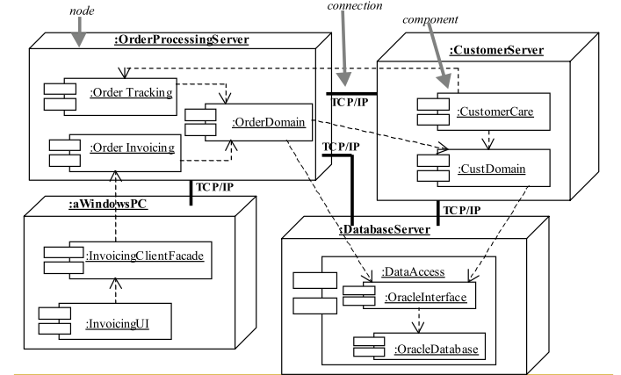
Allocation View – Deployment Example

Slide 15
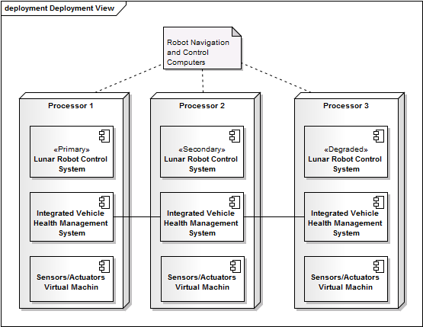
Allocation View – Deployment Example

Slide 16
Relating Structures to Each Other
Each structure provides a different perspective and design handle on a system
Each is valid and useful on its own
The structures are not independent, just the opposite
Elements of one will be related to elements of another
Relationships should be consistent and rational
Example: a code module in a decomposition structure may map to one, part of one, or several run-time components in a component-and-connector structure
Sometimes, one structure dominates (usually decomposition structure)
For some systems, given structures may be irrelevant or trivial, such as a single node, single process application

Slide 17
Sometimes, it may make sense to combine views
A combined view contains elements and relations from two or more views.
Combined views can be very useful as long as you do not try to overload them with too many mappings.
The easiest way to merge views is to create an overlay that combines the information that would otherwise have been in two separate views.
This works well if the coupling between the two views is tight (elements of both views are closely related).

Slide 18
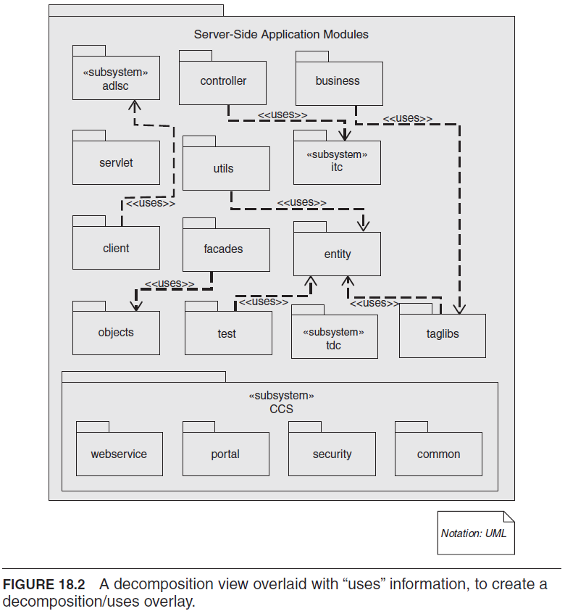

Slide 19
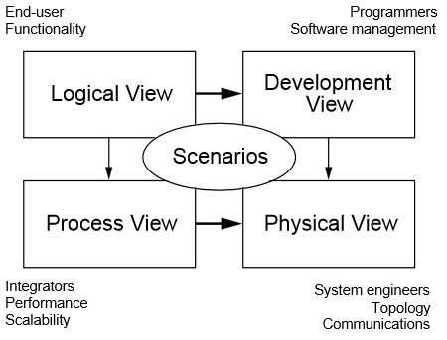
4+1 Views of Software Architecture
Phillipe Kruchten, “Architectural Blueprints—The “4+1” View
Model of Software Architecture,” IEEE Software 12 (6)
Notes:
“The description of an architecture—the decisions made—can be organized around these four views, and then illustrated by a few selected use cases, or scenarios which become a fifth view. The architecture is in fact partially evolved from these scenarios.”

Slide 20
4+1 View Model [P.B. Krutchen, 1995]
Logical view – e.g. object model using object-oriented design method
Process view – captures the concurrency and synchronization aspects
Physical view – describes the mapping of software components to hardware, reflects its distribution aspect
Development view – describes the static organization of the actual software modules (libraries, packages, subsystems)
Use case (scenario) view – the “+1” view that integrates (and illustrates) the others
Notes:
https://arxiv.org/ftp/arxiv/papers/2006/2006.04975.pdf

Slide 21
4+1 Views of Software Architecture
Object model of the design
Static organization of software in its development environment
Use cases
Concurrency and synchronization
Mapping onto hardware, reflects distributed aspect
Phillipe Kruchten, “Architectural Blueprints—The “4+1” View
Model of Software Architecture,” IEEE Software 12 (6)
Notes:
https://arxiv.org/ftp/arxiv/papers/2006/2006.04975.pdf
Logical view – e.g. object model using object-oriented design method
Process view – captures the concurrency and synchronization aspects
Physical view – describes the mapping of software components to hardware, reflects its distribution aspect
Development view – describes the static organization of the actual software modules (libraries, packages, subsystems)
Use case (scenario) view – the “+1” view that integrates (and illustrates) the others

Slide 22
Possible Outline of a Software Architecture Document
Title Page
Change History
Table of Contents
List of Figures
1. Scope
2. References
3. Software Architecture
4. Architectural Goals & Constraints
5. Logical Architecture
6. Process Architecture
7. Development Architecture
8. Physical Architecture
9. Scenarios
10. Size and Performance
11. Quality
Appendices
A. Acronyms and Abbreviations
B. Definitions
C. Design Principles
Phillipe Kruchten, “Architectural Blueprints—The “4+1” View
Model of Software Architecture,” IEEE Software 12 (6)
Notes:
“This “4+1” view model has been used with success on several large projects with or without some local customization and adjustment in terminology [4]. It actually allowed the various stakeholders to find what they want to know about the software architecture. Systems engineers approach it from the Physical view, then the Process view. End-users, customers, data specialists from the Logical view. Project managers, software configuration staff see it from the Development view.”
- brings everyone on the same page

Slide 23
Conclusion
There are many software structures
Each serves as an engineering leverage point into the design process
A software architecture design provides early insight into the system, enables communication among stakeholders, and provides a re-usable asset
Provide views
Selected subset of related structures
To focus stakeholders on concerns of interest
For a case study, see the A7E Avionics System architecture (recommended reading) – an early real-world use of architectural principles (such as information hiding) in a complex software system

Slide 24
Homework 4

