Slide 1
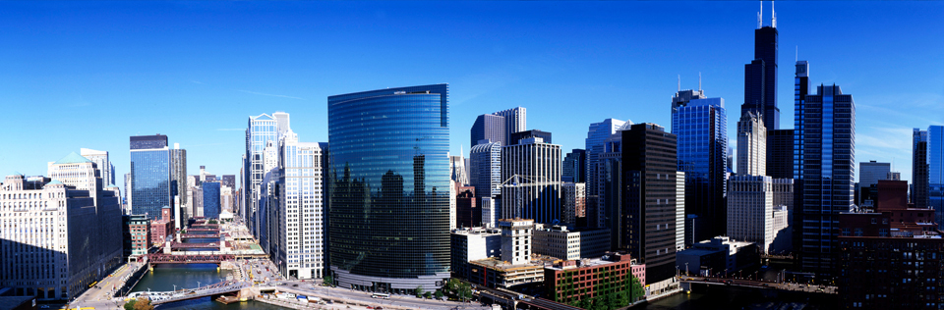
SWEN-755: Software Architecture Viktoria Koscinski
Lecture 2: Introduction to Software Requirements and Architecture (continued)

Slide 2
Is this architecture? Why or why not?
“Components and Connectors”
“Overall structure of the system”
Component X
Component A
Component B
Component C
Notes:
Yes and no

Slide 3
The System “What” not the “How”
What is wrong with this description?
What kind of component?
Task, process, object, program, function, library, processor, …?
What kind of connector?
Calls, invokes, signals, uses, data flow, subclass, runs with, excludes, co-located with, ….?
Meaning of overall structure (ovals and lines)?
Which structure – module, task, uses, logical, physical?
What is the significance of the layout?
To which extent does an element’s behavior influence another element or the acceptability of the system as a whole?
Conclusion – the diagram is not the architecture but a starting point, one view

Slide 4

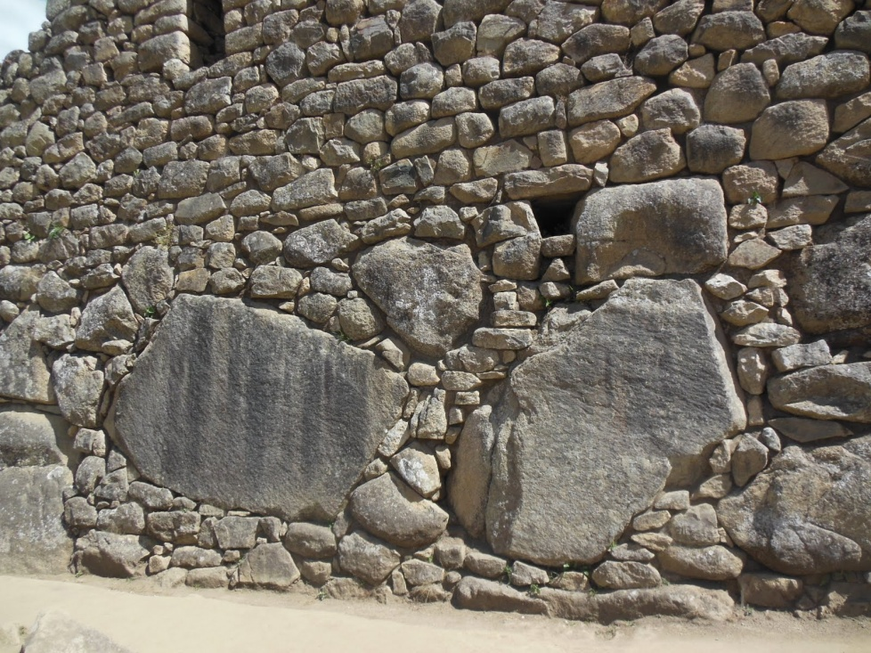
What is architecture?
“The software architecture of a system is the set of structures needed to reason about the system, which comprise software elements, relations among them, and properties of both.”
Structure and Vision
Structures – a set of elements and relationships among them
Structures provide insight – a perspective for reasoning about relevant quality attributes of the software (example: modifiability, performance, availability)
View – a representation of architectural elements (representation of one or more structures) as written and read by system stakeholders
Architects design structures and document their views
Notes:
Does anyone remember what these two images represented?
High level – strategic
Low level – tactical

Slide 5
System and enterprise architecture
Enterprise architecture: concerned with how an enterprise’s systems support the business processes and goals of the enterprise
System architecture: concerned with the total system, including software, hardware, and humans
Enterprise architecture
System architecture
Software architecture

Slide 6
Why is architecture important?
An architecture will inhibit or enable a system’s driving quality attributes.
The decisions made in an architecture allow you to reason about and manage change as the system evolves.
The analysis of an architecture enables early prediction of a system’s qualities.
A documented architecture enhances communication among stakeholders.
The architecture is a carrier of the earliest and hence most fundamental, hardest-to-change design decisions.
An architecture defines a set of constraints on subsequent implementation.
The architecture dictates the structure of an organization, or vice versa.
An architecture can provide the basis for evolutionary prototyping.
An architecture is the key artifact that allows the architect and project manager to reason about cost and schedule.
An architecture can be created as a transferable, reusable model that forms the heart of a product line.
Architecture-based development focuses attention on the assembly of components, rather than simply on their creation.
By restricting design alternatives, architecture channels the creativity of developers, reducing design and system complexity.
An architecture can be the foundation for training a new team member.
Notes:
The authors of “Software Architecture in Practice, 3rd edition” provide 13 reasons.

Slide 7
The System “What” not the “How”
Why is architecture important?
3 most important reasons:
1.
2.
3.
(discussion activity)
Notes:
Come up with what are the 3 most important reasons with your group (5 min).
Ask at least 3-4 groups to say their 3 most important reasons and why.
There is no “wrong” answer.
The most important reasons will vary depending on the system being designed.
For example,
(4) A documented architecture enhances communication among stakeholders. – Will likely be important if you have stakeholders from different areas of expertise working on a project, but less important if you have a project that maybe doesn’t include highly specific SMEs as experts.
(10) An architecture can be created as a transferable, reusable model that forms the heart of a product line. – Will likely be important if you have a large product line where you are planning to build additional software down the road, but less important if you won’t need to reuse any portion of the project.

Slide 8
The System “What” not the “How”
Architectural structures – 3 main types
Module structures: show how a system is to be structured as a set of code or data units (classes, layers, divisions of functionality) that have to be constructed:
What is the primary responsibility assigned to each module?
What other software elements is a module allowed to use?
What are the software dependencies?
Notes:
Now we will pivot a little and talk about the 3 main types of architectural structures.
This is a static structure – it focuses on how the functionality is split up.

Slide 9
The System “What” not the “How”
Architectural structures – 3 main types
Component-and-connector structures: show how a system is to be structured as a set of elements that have runtime behavior (components) and interactions (connectors)
What are major executing components (services, peers, clients, servers, filters, etc.) and how do they interact at runtime?
What are the major shared data stores?
What parts can run in parallel?
Notes:
This is a dynamic structure – it focuses on interactions at runtime.

Slide 10
The System “What” not the “How”
Architectural structures – 3 main types
Allocation structures: show how a system will relate non-software structures in its environment (CPUs, file systems, networks, dev teams, etc.)
What processor does each software element execute on?
What is the assignment of each software element to development teams?

Slide 11
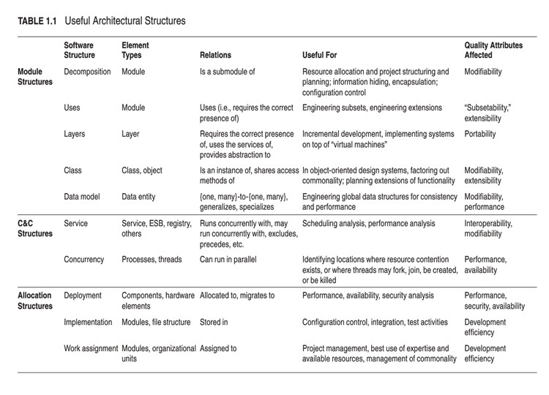
The System “What” not the “How”
Architectural structures – subtypes
Software Architecture In Practice, 3rd edition
Notes:
Table from Software Architecture in Practice, 3rd edition. Please see textbook for a better image.
There’s different types of sub-structures for each of the 3 main ones, which we will go over in more details later in the semester.

Slide 12
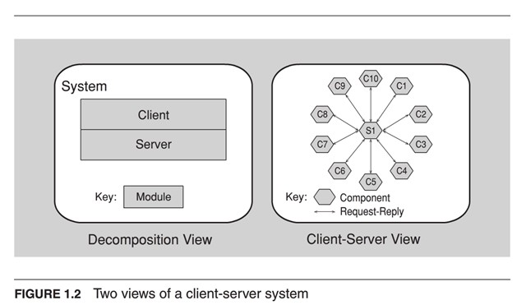
The System “What” not the “How”
Architectural structures – subtypes
Notes:
Which of these is better?
Final activity: draw a view of a system you created, participation

Slide 13
The System “What” not the “How”
Architectural styles/patterns
Compositions of architectural elements that provide packaged strategies for solving some of the problems a system may face
Reoccurring reusable architecture designs
The underlying intuition of decision rationale behind the pattern, or the system model
The kinds of components that are used in developing a system according to the pattern
The connectors, or kinds of interactions, among the components
The control structure or execution discipline
Example: client-server pattern
We will learn more about patterns later on (read Section 1.3 of “Software Architecture in Practice,” 3rd ed. for an overview)
Notes:
Example: client-server pattern
Intuition/decision rationale: communication
Components: clients, servers
Connectors: protocols, messages

Slide 14
What makes a “good” architecture?
Software architecture process guidelines:
Single architect or small group with identified leader
Based on validated business, functional, and non-functional (quality attributes) requirements
Actively reviewed and understood by stakeholders
Well-documented using understandable views
Incremental construction is enabled
Notes:
There is no “best” architecture, but there are plenty of “good” ones.

Slide 15
What makes a “good” architecture?
Product (structural) guidelines:
Well-defined functional modules using information hiding, and separation of concerns
Encapsulates changeable aspects to facilitate change
Enables independent concurrent development by separate teams
Quality attributes achieved using well-known architectural patterns and tactics specific to each attribute
Limited dependencies on a particular technology or commercial product or tool
Account for the runtime environment (quality attributes)
Logical modules assigned to processes and tasks to accommodate needs
Process assignment to processors easily changed
Small set of resource contention areas
Consistency: do the same things in the same way
Notes:
Common theme: planned structure based on good design principles

Slide 16
What makes a “good” architecture?
What is the common theme?
There is a planned structure based on good design principles
Notes:
Common theme: planned structure based on good design principles

Slide 17
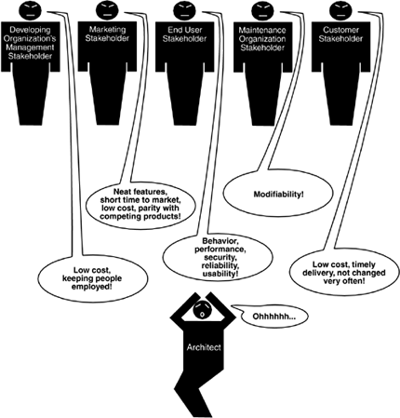
Stakeholders: have a stake in system’s success
Software Architecture In Practice, 3rd edition
Notes:
Stakeholders: customer buying the software product, end users, developers, project manager, maintainers, people who market the system
Architect’s role: mediate conflicts (compromise), fill in the blanks (“make it easy to use,” “make it fast”), communication (it’s a beautiful thing)
If you don’t do it, the person next in line will (developer, project manager, etc.)

Slide 18
The System “What” not the “How”
Benefit of good architecture
Value of reuse
Requirements
Architecture
Design
Code
Cost of defects
Notes:
We want to fix defects earlier, at the design stage, rather than at the implementation stage.
It’s easier to reuse designs than it is to reuse specific pieces of code

Slide 19
The System “What” not the “How”
Software engineering context
Problem Domain
Requirements
Rework
Projects fail if
$Rework > $Value Work
Architecture
Design
Implementation
Test and Deployment
Time
Product or Service

Slide 20
The System “What” not the “How”
Architecture influences
MyCourses, CampusGroups, SIS
What are the contextual influences?
Business – business goals
Technical – quality attributes (performance, availability, usability, testability, safety, interoperability…), tech environment
Project life-cycle – software development process, evaluating the architecture
Professional – architects’ background and experience, communication between architect and stakeholder
Who are the stakeholders?
How do these systems reflect or impact the organizational structure?
(discussion activity)
Notes:
Organizational structure – where does it fall into place?
MC:
Business – students paying for classes are satisfied, instructors use it to communicate with students
Technical – limited downtime, easy-to-use
Stakeholders: RIT (customer), students and instructors (users), developers
Structure: a component used for communication between students and instructors, a place to hand in homework
CG:
Business – students paying for classes are satisfied, RIT is able to keep track of event attendance to see what to spend more/less on
Technical – easy-to-use, performance is quick for scanning qr codes so people can sign into events
Stakeholders: RIT (customer), students (users), developers
Structure: a component used for tracking event attendance
SIS:
Business – students paying and signing up for classes, employees teaching classes getting paid, administration helps schedule things
Technical – availability, security/privacy
Stakeholders: RIT (customer), students and faculty (users), administration (users) developers
Structure: a component used for scheduling classes (big impact on school)

